Slide 1
Facial Paralysis & Reanimation
By:
Dr. Priyank Katwala
Assistant Professor
Department of Plastic Surgery, SBKSMI & RC

Slide 2
Introduction
Injury to facial nerve
Aim of reconstruction
Prognosis

Slide 3
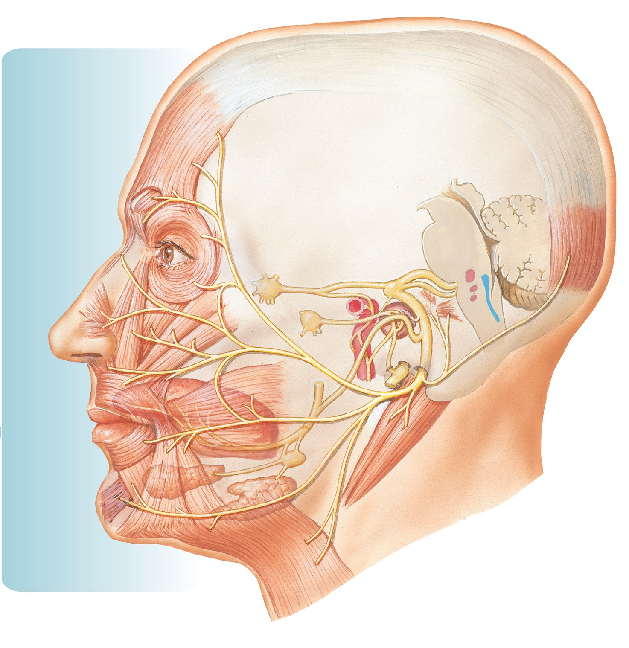
Anatomy

Slide 4
Etiology of facial paralysis
Intracranial
Intratemporal
Extracranial
Idiopathic facial palsy (Bell’s palsy)
Congenital facial paralysis
Developmental facial paralysis

Slide 5
Goals of reconstruction
Facial symmetry
Coordinated animation
Competent ocular and oral sphincters
Preserve residual facial function
Minimal donor motor nerve function loss

Slide 6
Preoperative Examination
Clinical features
Complete cranial nerve
Electroneurography
EMG
NCV
Spiral CECT
MRI

Slide 7
Operative techniques:
Primary repair
Nerve grafting
Cross facial nerve grafting

Slide 8
Nerve transfers
Direct Neurotization
Muscle Transposition– temporalis, masseter
Free functional Muscle Transfer– gracilis

Slide 9
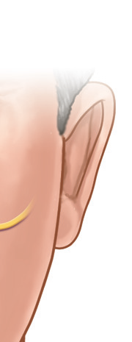
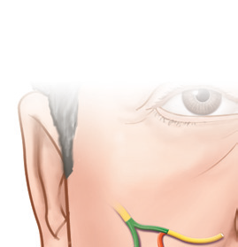
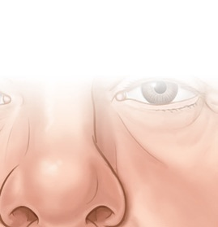
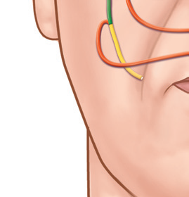
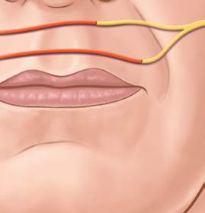
Babysitter principle

Slide 10
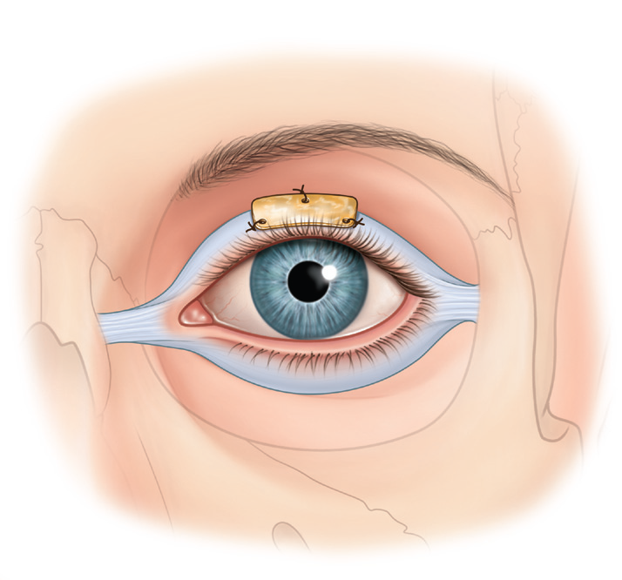
Reanimation of eye
Temporary measures
Primary repair
Muscle transposition
- temporalis
Upper eyelid

Slide 11
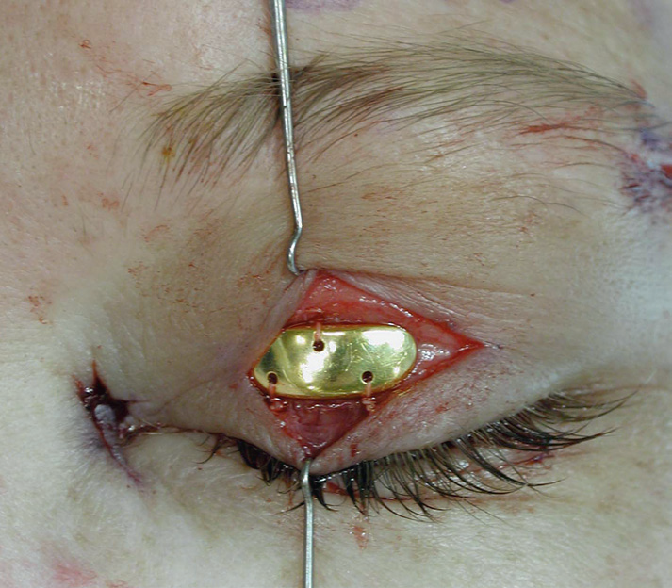
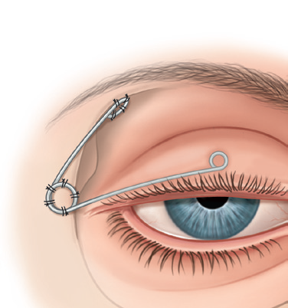

Slide 12
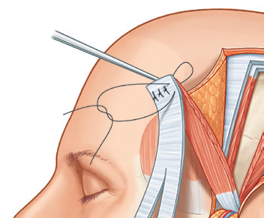
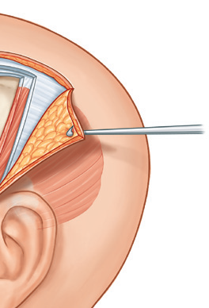
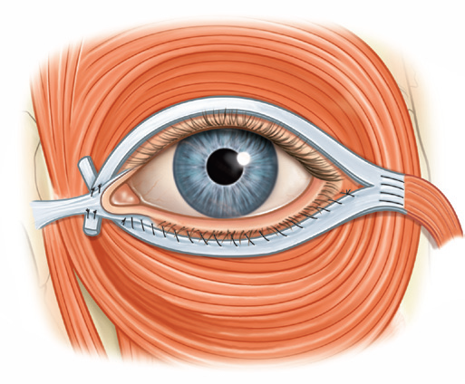
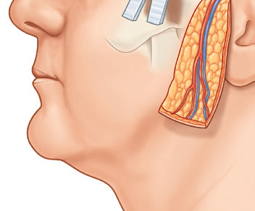
Temporalis muscle transposition

Slide 13
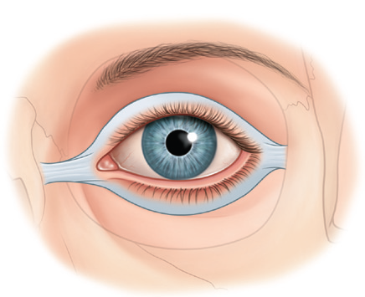
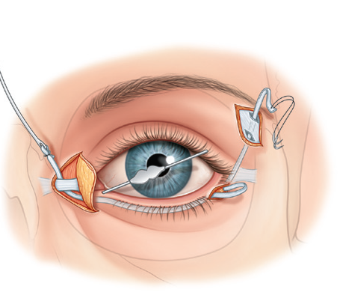
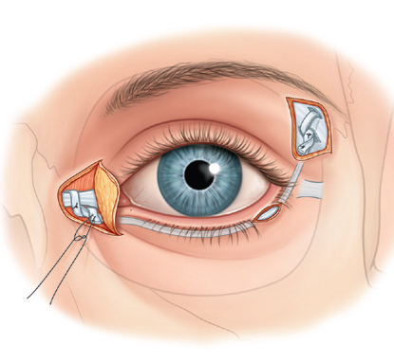
Lower eyelid
Slings– tendon / facial lata
Horizontal lid shortening

Slide 14
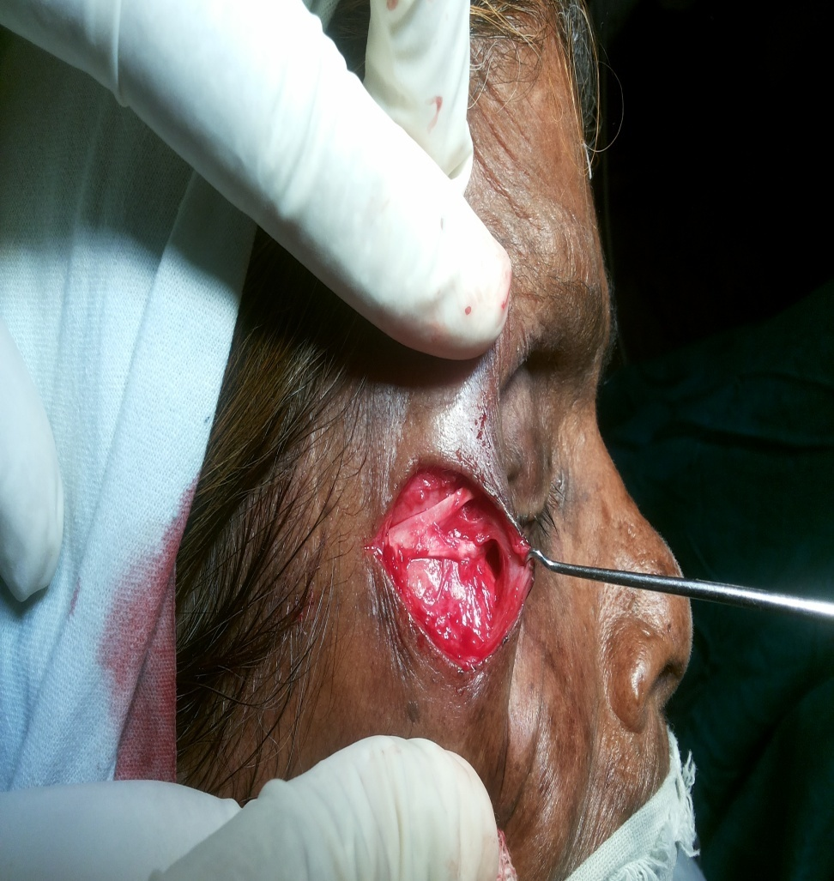
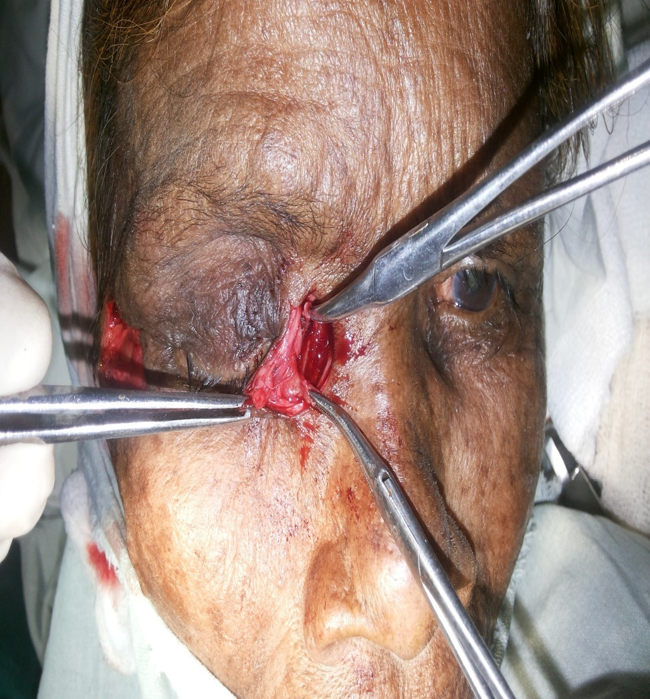

Slide 15
Reanimation of smile
Regional muscle transfers– temporalis, masseter
Free microneurovascular muscle transfer-- gracilis
Single stage free tissue transfer

Slide 16
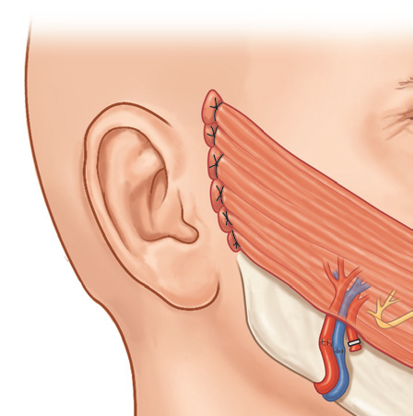
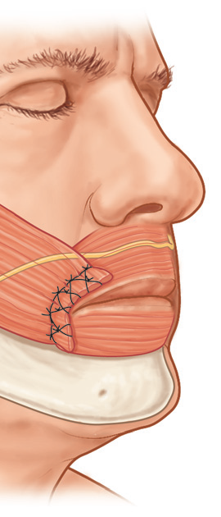
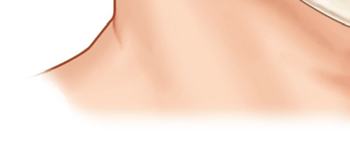
Gracilis muscle transplantation

Slide 17
Reanimation of lower lip depressors
FT wedge resection
Digastric muscle transplantation
Mini hypoglossal nerve transplantation (30-40%)– cervicofacial branch
Selective myectomy (depressor labii inferioris)
of normal side
Platysma transplantation

Slide 18
Static sling procedures
Rejuvenation procedures
Secondary procedures

Slide 19
Thank You

