Slide 1
Forensic Anthropology
- Dr Kalpesh Zanzrukiya

Slide 2
Forensic Anthropology
It’s the application of physical anthropology to the legal process.
Identify skeletal, badly decomposed or unidentified human remains for legal and human reasons.
Started during the 19th century, popular during 1930s because of WWII and the Korean War.

Slide 3
Forensic Anthropologists can often answer many questions:
Are the remains human?
Are the remains a single individual or mixed remains of several individuals?
When did the death occur?
What are the gender, age, and race of the individual?

Slide 4
Forensic Anthropologists can often answer many questions:
What caused the death?
What kind of death was it – a homicide, a suicide, and accident or a natural death, or is the cause still undetermined?
Did the individual have any anatomical peculiarities, signs of disease, or old injuries?

Slide 5
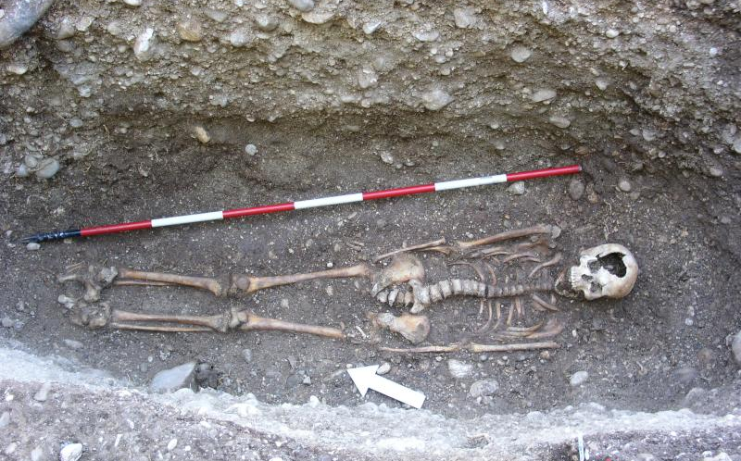
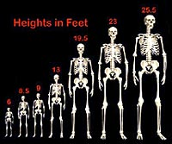
Forensic Anthropologists can often answer many questions:
Can the individual’s height, body weight, and physique be estimated?

Slide 6
Forensic Anthropology
Role of the Forensic Anthropologist:
Recover Human Remains
Identify Human Remains
Determine Time or Cause of Death

Slide 7
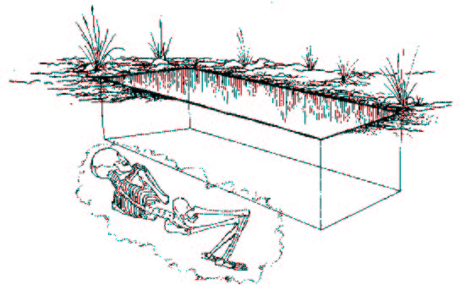
Forensic Anthropology
Recovering Human Remains

Slide 8
Forensic Anthropology > Recovering Remains
Locating Human Remains
Cadaver dogs
Remote sensing methods

Slide 9
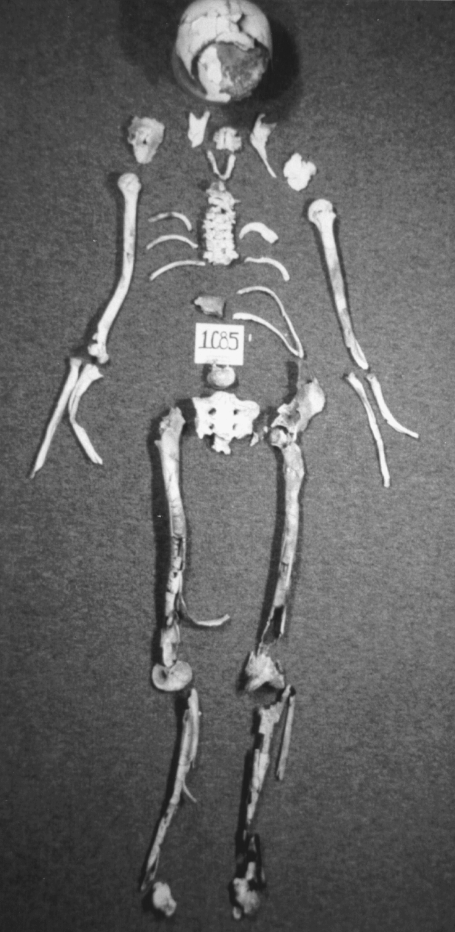
Forensic Anthropology > Recovering Remains
Anthropologists can help:
Find small bones or bone fragments
Recover clothing and trace materials associated with bones
Prevent damage of bones
Map the location of bones and maintain chain of custody

Slide 10
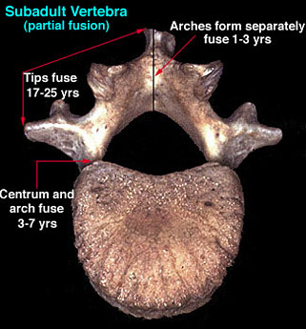
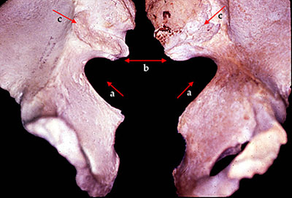
Forensic Anthropology
Identifying the remains
Age - look at bone length and bone fusion
Sex - differences in pelvis, skull, femur
Stature - size of bones
Ancestry - teeth, skull

Slide 11
Forensic Anthropology
Determining Age
A forensic anthropologist can reasonably estimate an individual’s age at the time of death by examining biological changes that took place during that person’s life. The investigator can estimate most accurately when teeth are erupting, bones are growing, and growth plates are forming and uniting. Closure of cranial sutures in the skull is also an age indicator. After 25 to 30 years, age estimation becomes more difficult.

Slide 12
Forensic Anthropology
Determining Sex
Determining the sex is crucial when analyzing unidentified human remains. The os pubis, sacrum, and ilium of the pelvis are bones that have the most obvious differences between men and women, along with the shape of the skull, shape of the mandible, and the size of the occipital protuberance (bump) at the back of the skull to determine male or female traits.

Slide 13
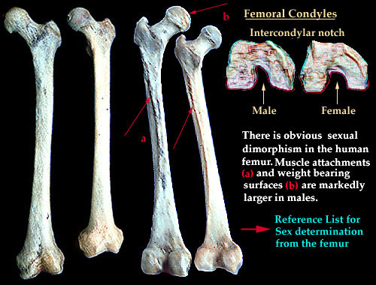
Forensic Anthropology
Determining Sex using the femur

Slide 14
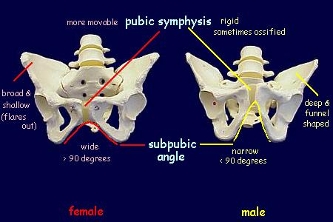
Forensic Anthropology
Determining Sex using the pelvis

Slide 15
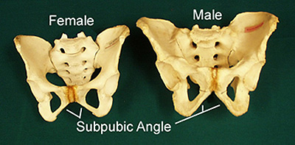
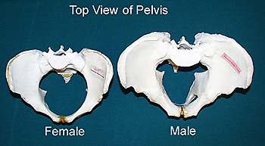
Subpubic angle
  Females – greater than 90°
  Males – less than 90°
Sciatic notch
  Females – more than 68°
  Males – less than 68°
Sacrum is straighter in women than in men.

Slide 16
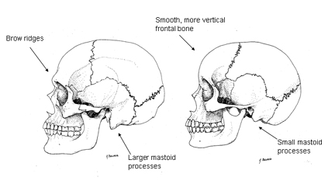
Figure 2 Male (left) and female (right) skulls
Forensic Anthropology
Determining Sex using the skull
Male (left) and female (right) skulls

Slide 17
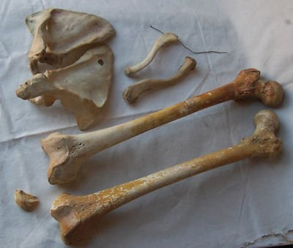
Forensic Anthropology
Determining Stature
Forensic scientists can estimate a person’s stature (height) by examining one or more of the long bones. Men and women have different proportions of long bones to total height.

Slide 18
Forensic Anthropology
Determining Culture - race
Three major anthropological racial groups based on observable skeletal features:
Caucasoid: European, Middle Eastern and East Indian descent
Negroid: African, Aborigine and Melanesian descent
Mongoloids: Asian, Native American and Polynesian descent

Slide 19
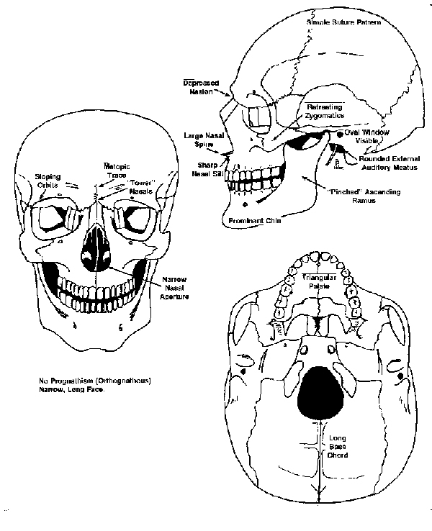
Forensic Anthropology
Caucasoid

Slide 20
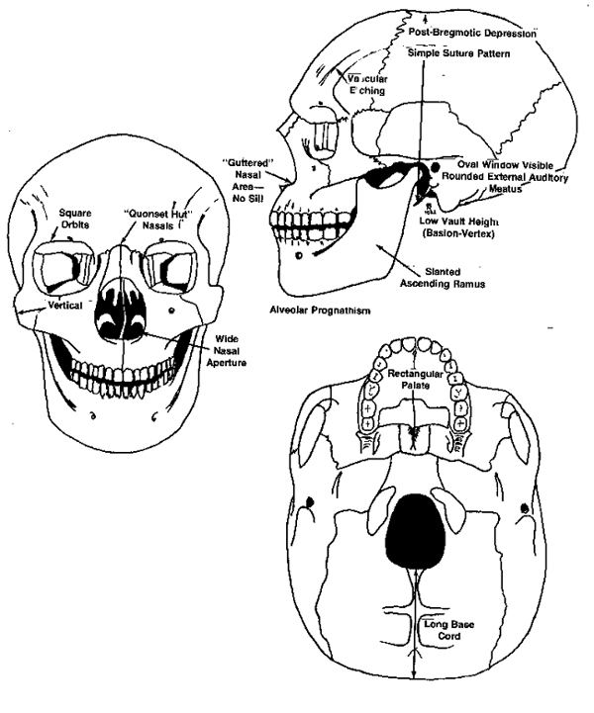
Forensic Anthropology
Negroid

Slide 21
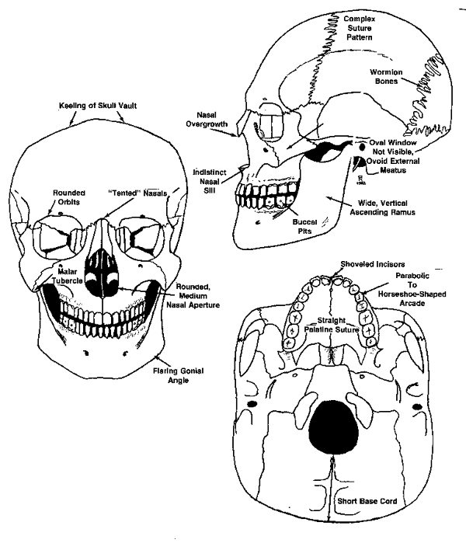
Forensic Anthropology
Mongoloid

Slide 22
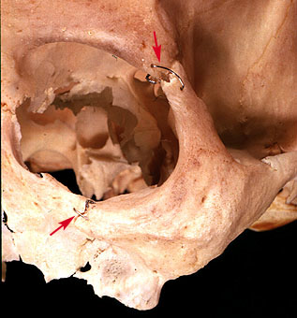
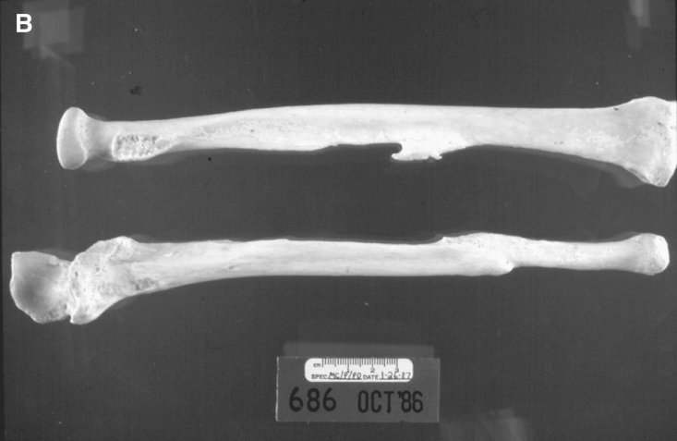
Forensic Anthropology
Identifying the remains
Individuality may be determined:
from surgical procedures
from broken bones

Slide 23
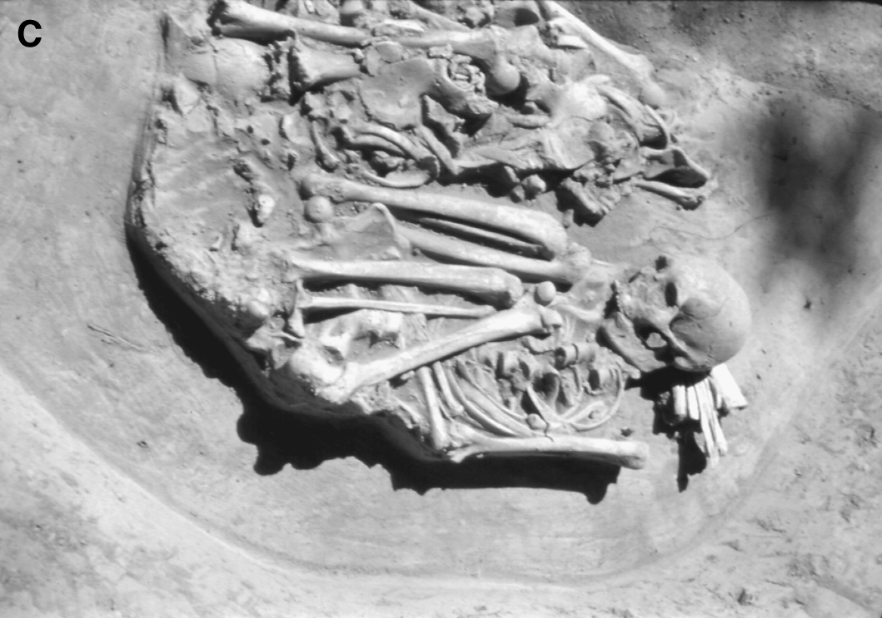
Forensic Anthropology
Determining Time of Death
Anthropologist helpful if soft tissues have decomposed.
If soft tissue is present, identification can be done by the pathologist.

Slide 24
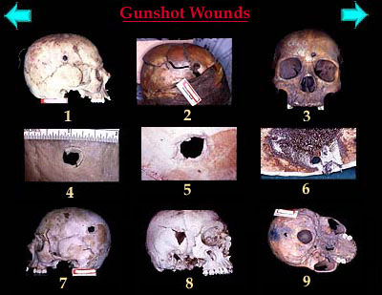
Forensic Anthropology
Determining Cause of Death
Sharp force trauma (bone cut)
Blunt force trauma (broken bone)
Antemortem vs. postmortem breaks

Slide 25
Forensic Anthropology
Final Report Should Include:
Taphonomy (time of death)
Biological profile (age, sex, stature, race)
Individual characteristics
Evidence of possible cause of death

