Slide 1
Liposuction
BY:
Dr. Priyank Katwala (M.Ch.)
Assistant Professor
Department of Plastic Surgery, SBKSMI & RC

Slide 2
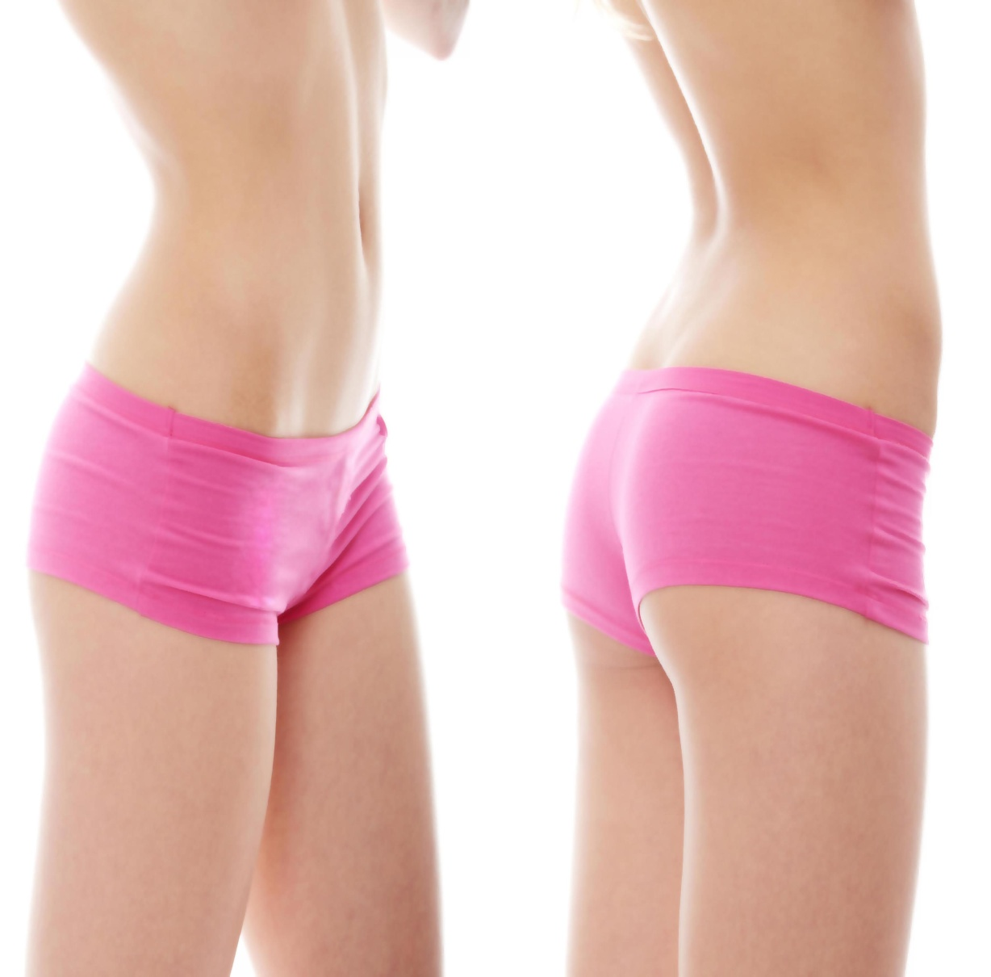
Definition
It is one of the most commonly performed technique in aesthetic plastic surgery.
It is surgical aspiration of fat from subcutaneous plane giving more desirabe body contour.
Introduced by Illouz in 1980

Slide 3
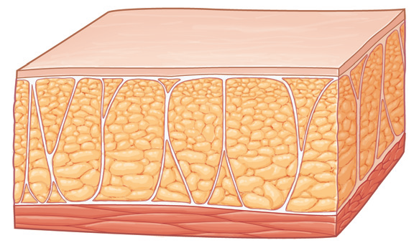
Sugical anatomy of subcutaneous fat
3 layers:
Superficial
Intermediate
Deep

Slide 4
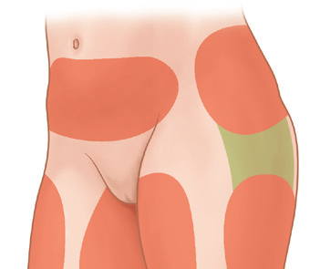
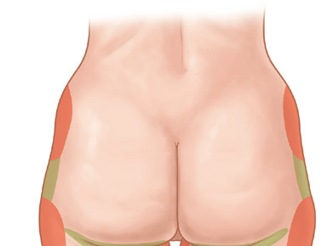
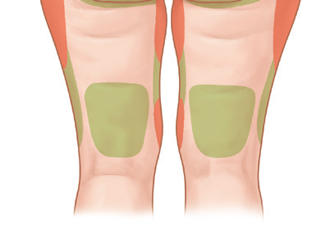
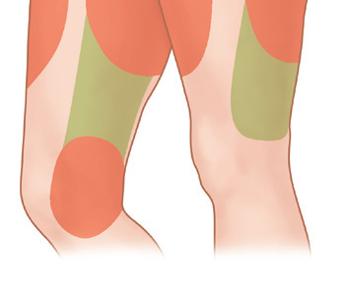
Zones of adherence

Slide 5
Classification of lipodystrophy
Localised
Generalised
Lipodystrophy with skin redundancy
Cellulite

Slide 6
Indications:
Contraindications
Liposuction should not be offered as treatment for obesity.
Liposuction does not treat cellulite.

Slide 7
Initial Evaluation
Physical Examination
Informed consent

Slide 8
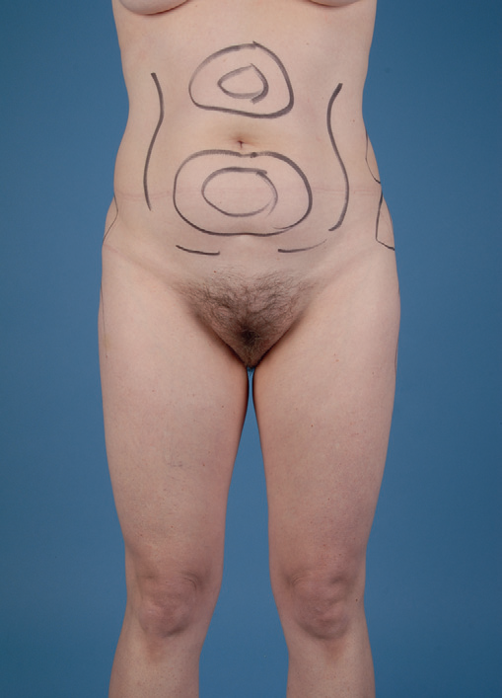
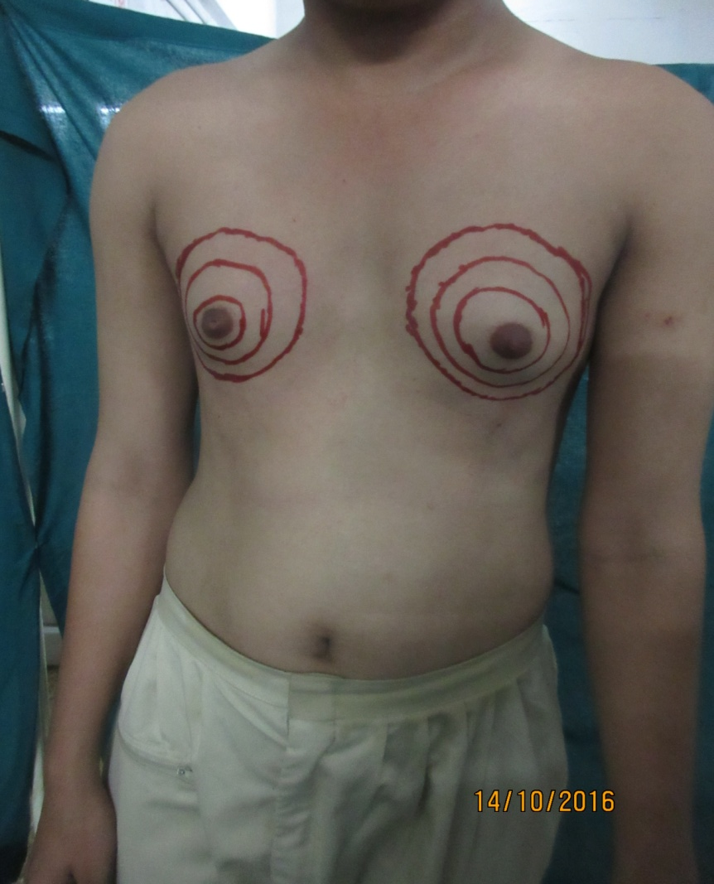
Preoperative marking

Slide 9
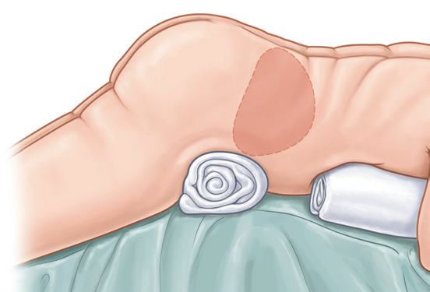
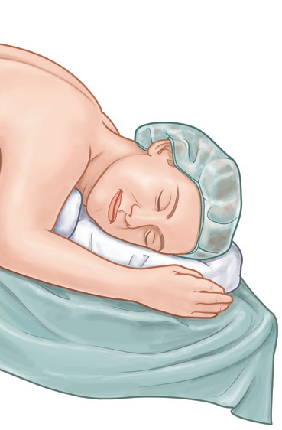
Anaesthesia
Position
  Prone
  Supine
  Lateral decubitus
  Fluid management

Slide 10
Wetting solutions
Dry
Wet
Superwet
Tumescent

Slide 11
Klein’s formula
Normal saline solution 1000 mL
1% lidocaine 50 mL
1 : 1000 epinephrine 1 mL
8.4% sodium bicarbonate 12.5 mL
Hunstad’s formula
Ringer’s lactate solution 1000 mL at 38–40°C
1% lidocaine 50 mL
1 : 1000 epinephrine 1 mL
Fodor’s formula
Ringer’s lactate solution 1000 mL
Aspirates <2000 mL 1 : 500 epinephrine 1 mL
Aspirates 2000–4000 mL 1 : 1000 epinephrine 1 mL
Aspirates >4000 mL 1 : 1500 epinephrine 1 mL
UT Southwestern formula
Ringer’s lactate solution 1000 mL at 21°C
Aspirates <5000 mL 1% lidocaine 30 mL
Aspirates >5000 mL 1% lidocaine 15 mL
1 : 1000 epinephrine 1 mL

Slide 12
Types of liposuction
Suction assisted liposuction (SAL)
Power assisted liposuction (PAL)
Ultrasound assisted liposuction (UAL)
Vaser assisted liposuction (VAL)
Laser assisted liposuction (LAL)
Technique
End Points

Slide 13
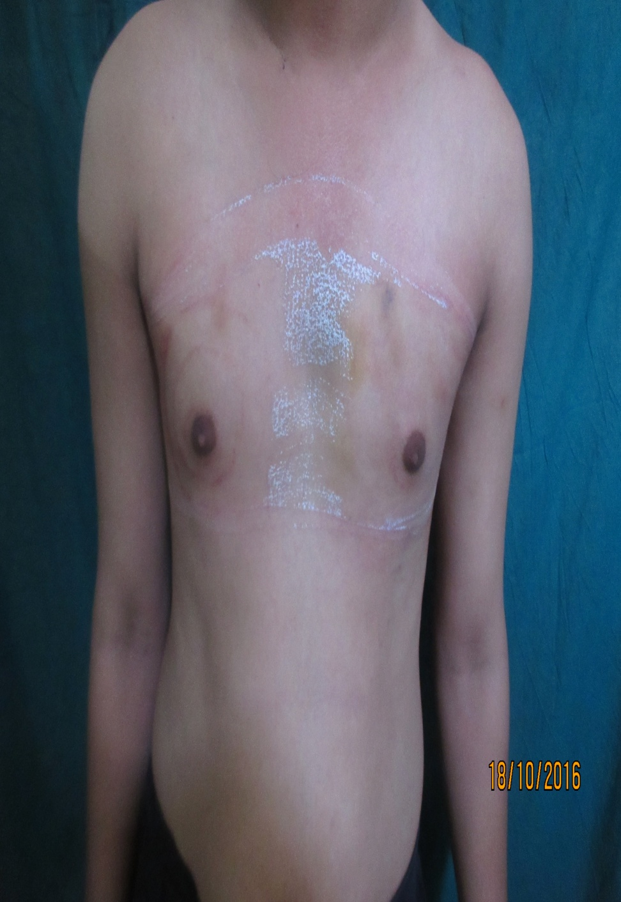

Slide 14
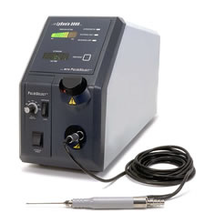
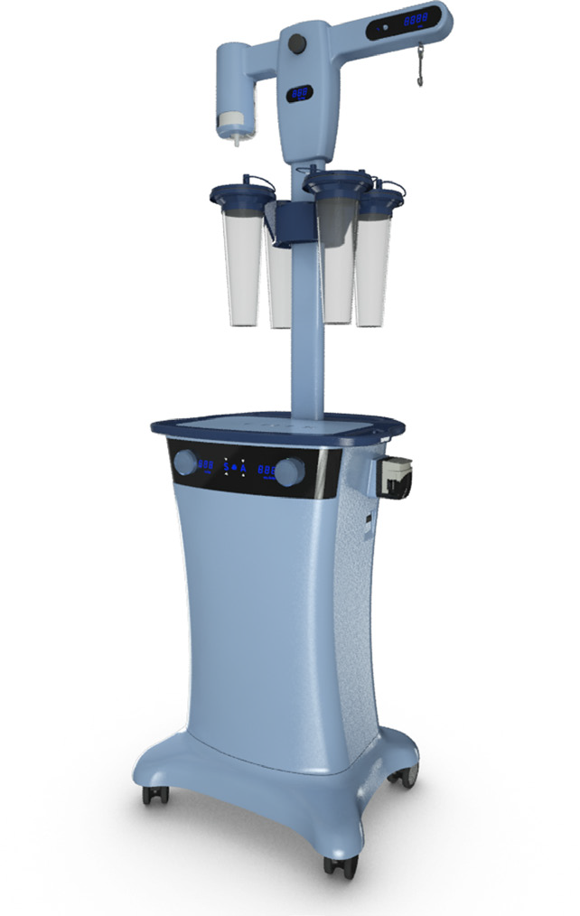

Slide 15
Complications
Perioperative
Postoperative
  Early
  Late

Slide 16
Thank you

