Slide 1
Cerebral Venous Thrombosis
Faculty : Dr. C. Rathore

Slide 2
Scheme
Introduction
Epidemiology
Etiology
Clinical features
Imaging
Prognosis
Management issues
Guidelines

Slide 3
Introduction
0·5% of all stroke
Can occur at any age, including in neonates
Wide spectrum of clinical presentations
Numerous causes
Usually a favorable outcome with a low mortality rate

Slide 4
Introduction
A cause cannot be found in about 15% of cases
Individual outcome difficult to predict
May occasionally worsen despite anticoagulation

Slide 5
Anatomy

Slide 6
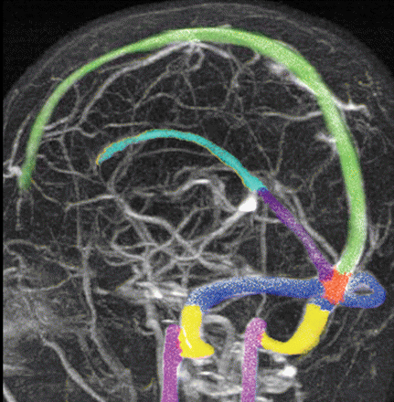

Slide 7
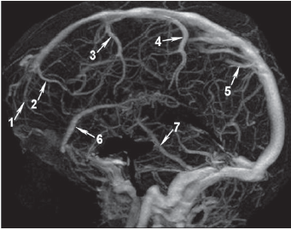
Frontopolar [1]
Anterior frontal [2]
Posterior frontal [3]
Trolard vein [superior anastomotic vein] [4]
Anterior parietal veins [5]
Superficial middle cerebral vein] [6]
Labbe´ vein [7]

Slide 8
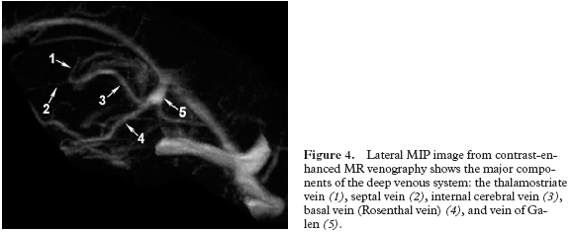

Slide 9
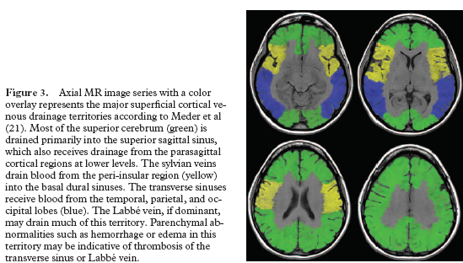

Slide 10
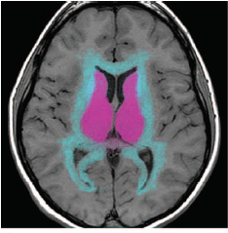
Drainage territory of internal cerebral vein & vein of Galen (pink)
Deep white matter (medullary) venous drainage territory (blue)

Slide 11
Epidemiology
Annual incidence in adults – 0.22/100 000
Frequent in patients between 20 and 40 years of age & in infants and neonates
M:F 1:3
Ferro et al:Practical Neurology,2003

Slide 12
Etiology

Slide 13
Etiology
Predisposing factors and Precipitating factors
Typically multifactorial
ISCVT -- 44% of the pts had >1 predisposing factor
Congenital or genetic thrombophilia -- 22% pts
Prognosis of cerebral vein and dural sinus thrombosis: results of
the International Study on Cerebral Vein and Dural Sinus Thrombosis (ISCVT). Stroke 2004

Slide 14
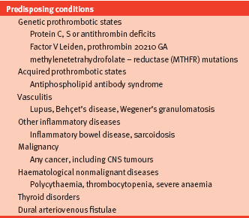

Slide 15
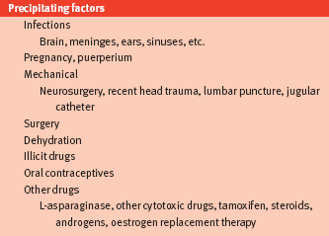

Slide 16
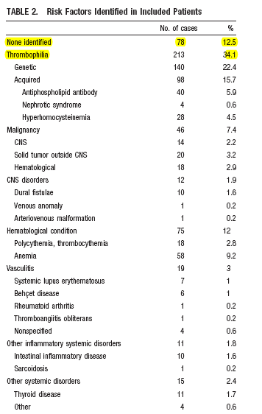
ISCVT :Stroke 2004

Slide 17
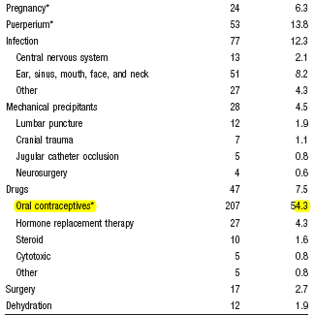
ISCVT :Stroke 2004

Slide 18
Rare causes (case reports)
Thalidomide
Tamoxifen
Erythropoietin
High altitude as reported in the Himalayas
Cushing’s syndrome
Shiatsu massage (an oriental technique of neck massage)

Slide 19
Factor XII C46T gene polymorphism and the risk of CVT
FXII initiates procoagulatory cascade
Reduced FXII plasma levels were found in patients with
  retinal and peripheral venous thrombosis
  in women with recurrent miscarriages.
Increased the risk for CVT
Reuner et al Neurology 2008

Slide 20
Clinical features

Slide 21
CLINICAL FEATURES
Wide spectrum
Headache – commonest – 80%
Earliest symptom in 60%
Papilloedema : variable – 10- 80%
  Associated transient visual obscurations, persistent visual loss
Focal deficits : inaugural in 15%
present in 50%
Motor and sensory deficit usually unilateral; legs greater than upper limb
ISCVT: Stroke 2004

Slide 22
Seizures : inaugural in 15%
present in 40%
focal and generalised occur equally
Increased in those with focal deficits
Altered consciousness: present in 50%
Other signs: cerebellar ataxia, psychiatric disturbances
Classical paraplegia / alternating crural monoplegia in SSS thrombosis very rare.
ISCVT: Stroke 2004

Slide 23
CLINICAL FEATURES
Presentation of CVT
  Acute: less than 48 hrs: 25%
  Sub-acute: 3 – 30 days: 50%
  Chronic > 30 days: 25%

Slide 24
CLINICAL FEATURES
Presenting symptoms are grouped into four major syndromes (Bousser et al. 1997)
Isolated intracranial hypertension
Focal syndrome
Encephalopathy
Cavernous sinus syndrome

Slide 25
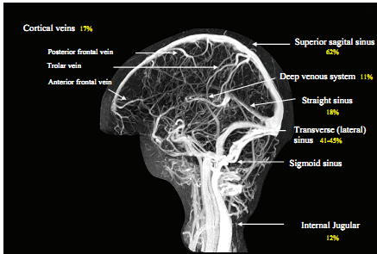
Topographic diagnosis
Multiple sinuses / veins involved – 75%
SSS – most common

Slide 26
CLINICAL FEATURES
Isolated cortical vein occlusion can produce motor or sensory deficits and seizures
Isolated thrombosis of the lateral sinus -- isolated intracranial hypertension

Slide 27
CLINICAL FEATURES
Left transverse sinus occluded -- aphasia
Deep cerebral venous system occluded--coma, mental changes, and bilateral motor deficits

Slide 28
Unusual presentations
Isolated headache/ Thunderclap headache
Transient ischaemic attacks
Attacks of migraine with aura
Isolated psychiatric disturbances
Tinnitus
Isolated or multiple cranial nerve involvement
Subarachnoid haemorrhage.

Slide 29
Headache as the only neurological sign of cerebral venous thrombosis: a series of 17 cases. Cumurciuc et al, JNNP 2005
17 patients among 123 consecutive CVT
Associated with lateral sinus thrombosis
Mechanism of the headache remains unknown
  Stretching of nerve fibres in the walls of the occluded sinus
  Local inflammatory reaction
Up to 25% in some case series

Slide 30
In patients with the clinical features of idiopathic intracranial hypertension, imaging of the cerebral venous system is recommended to exclude CVT
(Class I; Level of Evidence C)
AHA/ ASA 2011 guideline

Slide 31
Diagnosis

Slide 32
CT Brain
Plain CT
Cord sign
Represents thrombosed cortical vein / internal cerebral vein
Rare
Dense triangle sign
Opacification of fresh clot in SSS
Rare
Difficulty to access in the other sinuses, Normally hyperdense in children and in high Hb

Slide 33
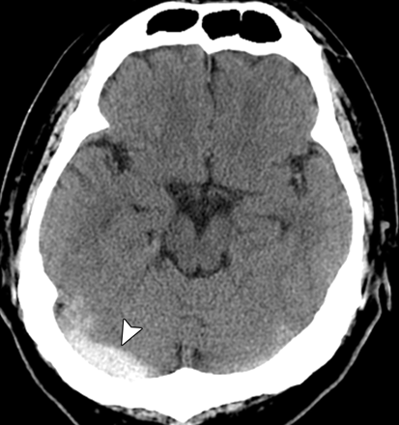

Slide 34
CT Brain
Contrast CT
Empty delta sign
Most frequent sign
Represents opacification of collateral veins in SSS wall with nonfilling clot inside sinus
Absent when posterior third of SSS is not involved
CT done less than 5 days / more than 2 months neg
False positive : early division of SSS.

Slide 35
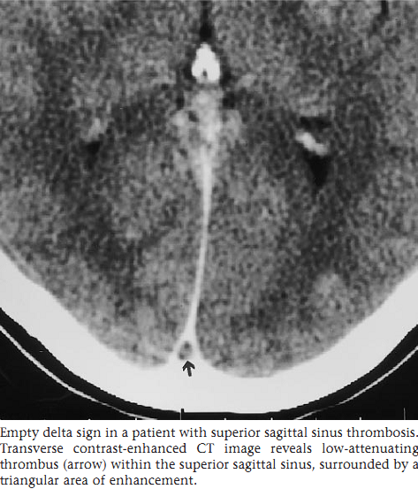

Slide 36
Venous infarct :
  Non arterial distribution
  Unilateral/bilateral
  Single/multiple
  Large subcortical , multifocal hematomas
  Petechial hemorrhages within large hypodensities
  CE may or may not be present
Assoc SAH/SDH.
Non hemorrhagic infarct: almost equally common.

Slide 37
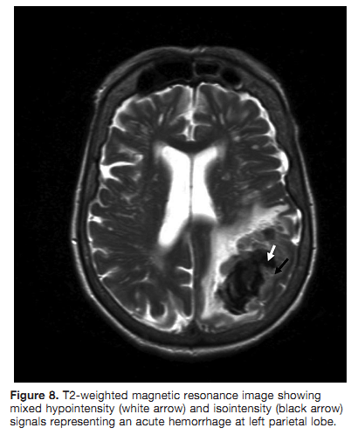

Slide 38
MRI Brain
Stages of thrombus evolution
Day 1-5 T2 : Hypo T1 : Iso
Day 5 -15 T2 : Hyper T1 : Hyper
Day 15 to 3rd month Signal decreased in intensity in both T1 & T2
4th month onwards Some heterogenous signal changes (residual thrombus), Flow voids reestablished

Slide 39
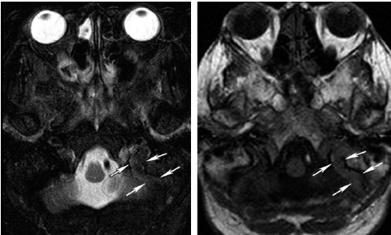
Acute thrombus in left sigmoid sinus (arrows)
T2 hypointense and T1 isointense

Slide 40
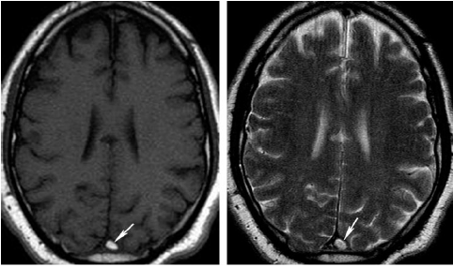
Subacute thrombus—T1,T2 hyper
Subacute thrombus – T1 & T2 HI

Slide 41
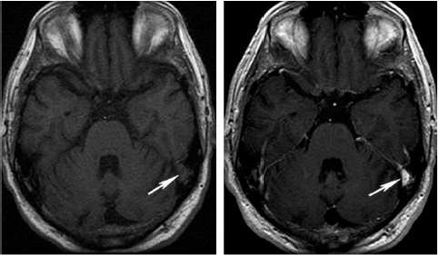
Chronic thrombus—T1 hypo,CE

Slide 42
MRV
MRI Brain -- normal in up to 25% of patients.
Key to diagnosis is--MRV --show the occluded vessel or the intravascular thrombus
TOF: widely used
CE
Phase contrast: operator dependent

Slide 43
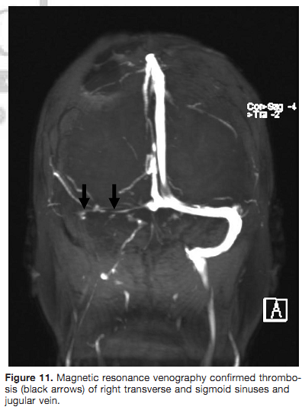

Slide 44
MRV -- does not differentiate between thrombosis and hypoplasia
Typical diagnostic dilemma for lateral sinus
Inv of choice -- conventional angiography (Urban et al 2005)
Recommended in pts with suspected CVT with neg MRV/CTV

Slide 45
CT venogram
Equivalent to MRV
Concerns about radiation exposure
Potential for iodine contrast material allergy
Use of contrast in the setting of poor renal function

Slide 46
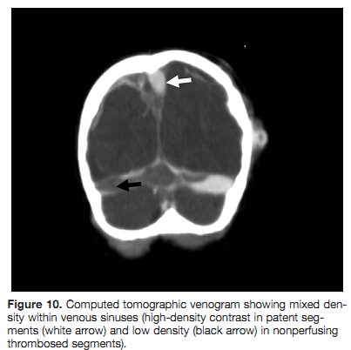
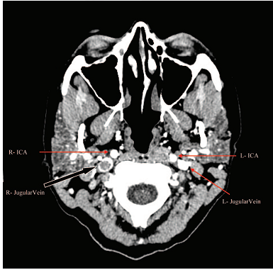

Slide 47
Idbaih et al. MRI of clot in CVT high diagnostic value of SWI . Stroke 2006
Thrombosed cortical veins -- detected with T2*(97%), T1 78%, FLAIR <40%
T2* is useful in isolated cortical venous thrombosis and during the very early days of acute CVT

Slide 48
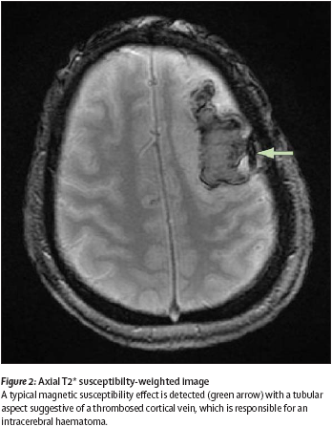

Slide 49
Echoplanar T2 susceptibility-weighted imaging combined with MRV are considered the most sensitive sequences
AHA/ ASA 2011 guidelines

Slide 50
DWI
Hyperintense signal of thrombosed sinus on DWI -- low diagnostic sensitivity--detected in only 10–40%
Parenchymal lesions
1.Heterogeneous signal intensity with normal or
increased ADC corresponding to vasogenic oedema.
2. Decreased ADC suggestive of cytotoxic oedema Forbes et al AJNR 2001

Slide 51
D-dimer
D-dimer concentrations are increased
A negative D-dimer assay may make the diagnosis of CVT very unlikely
Tardy et al :Am J Med 2002
Kosinski :Stroke 2004

Slide 52
D-dimer
This holds true in patients who present with neurologic signs (D-dimers are normal in only 4% of cases)
Not in those who present with isolated headache
Series of 73 patients with CVT of < 30 days:
26% of those who presented with isolated headache had normal D-dimer concentrations.
Crassard et al :Stroke 2005

Slide 53
Prothrombotic W/U
Factor V Leiden mutation
Prothrombin G20210A mutation
Deficiencies of protein C, S, or antithrombin
  difficult to interpret during treatment with warfarin
Hyperhomocysteinemia
Elevated factor VIII
APLA
  2 or more occasions at least 12 weeks apart

Slide 54
Treatment

Slide 55
Treatment of CVT with anticoagulants has been controversial.
Anticoagulants -- prevent new venous infarcts, neurologic deterioration, and pulmonary embolism
But may also promote haemorrhages.
There have been two randomised controlled trials to date, one using unfractionated and the other low molecular weight heparin

Slide 56
Heparin treatment in sinus venous thrombosis.
Einhäupl et al, Lancet 1991
Randomised, blinded (patient and observer), placebo-controlled study
20 patients (10 heparin, 10 placebo)
Clinical course of 2 groups started to differ in favor of the heparin group after 3 days of treatment (p < 0.05) and the difference remained significant (p < 0.01) after 8 days of treatment.

Slide 57
After 3 months,
  8 of the heparin-treated patients had a complete clinical recovery and 2 had slight residual neurological deficits.
  Placebo -- only 1 patient had a complete recovery, 6 patients had neurological deficits, and 3 patients died (p less than 0.01).

Slide 58
Retrospective study on the relation between heparin treatment and ICH in CVT patients
102 patients
27 of these patients were treated with dose-adjusted, IV heparin after the ICH.
4 / 27 died (mortality 15%)
14 /27 patients completely recovered.
13 patients that did not receive heparin after ICH,
  9 died (mortality 69%)
  3 patients completely recovered.
Heparin treatment in sinus venous thrombosis. Einhäupl et al, Lancet 1991

Slide 59
Heparin treatment in sinus venous thrombosis.
Einhäupl et al, Lancet 1991
Conclusion : anticoagulation with dose-adjusted intravenous heparin is an effective treatment in patients with CVT and that ICH is not a contraindication to heparin treatment in these patients.

Slide 60
Randomized, placebo-controlled trial of anticoagulant treatment with LMWH for cerebral sinus thrombosis. de Bruijn et al, Stroke 1999
Double-blind, placebo-controlled multicenter trial
Subcutaneous nadroparin (180 anti-factor Xa units/kg per 24 hours) Vs placebo
Followed by 3 months of oral anticoagulants for patients allocated to nadroparin (open part)
60 patients

Slide 61
After 3 wks
  6 of 30 patients (20%) in the nadroparin group
  7 of 29 patients (24%) in the placebo group
had poor outcome
After 12 wks
  4 of 30 patients (13%) in the nadroparin group
  6 of 29 (21%) in the placebo group
had poor outcome
No new symptomatic cerebral hemorrhages.
1 patient in the nadroparin group had a major GI hemorrhage
1 patient in the placebo group died from clinically suspected pulmonary embolism.

Slide 62
UFH vs LMWH: Cochrane review
Meta-analysis of 22 studies
Lower risk with LMWH
  major hemorrhage (1.2% versus 2.1%)
  thrombotic complications (3.6% versus 5.4%)
  death (4.5% versus 6.0%)

Slide 63
Other Rx
Direct Fibrinolytic therapy - if
  clinical deterioration continues despite anticoagulation
  patient has elevated ICP that evolves despite other rx
  ICH in 17%, Clinical worsening in 5%
Mechanical thrombectomy
  usually used in conjunction with local fibrinolytic rx

Slide 64
Decompressive craniectomy
Among 13 patients with severe CVT who underwent decompressive craniectomy, 11 (84.6%) achieved a favorable outcome (mRS score ≤3)
Indications for decompressive craniectomy
  deterioration of level of consciousness with venous infarction/ bleeding with mass effect and midline shift
Necessitates perioperative withholding of anticoagulation
Coutinho JM et al. Decompressive hemicraniectomy in cerebral sinus thrombosis: consecutive case series and review of the literature. Stroke. 2009;40:2233–2235.

Slide 65
EFNS guideline
Small subgroup of patients who deteriorate especially in the presence of large intracerebral haemorrhages, decompressive craniectomy might be an alternative treatment option

Slide 66
Raised intracranial pressure Rx
Raising the head off the bed
Treatment with glycerol or mannitol
Sedation
Hyperventilation
No indication for steroids having a benefit, even in patients with parenchymal lesions.
Bousse et al,Lancet neurology 2007

Slide 67
IIH like presentation
No RCTs
LP and CSF removal
Acetazolamide
Monitor VA/ VF
Lumbo-peritoneal shunt, Optic N sheath fenestration
Steroids not useful

Slide 68
Infection
  Antibiotics
  Surgical drainage

Slide 69
AEDs
Patients who present with seizures should receive antiepileptic drugs because they are at risk of recurrence.
Risk of occurrence of seizures in patients without seizures on admission is very low, except for patients with parenchymal lesions on admission.
Ferro et al 2003

Slide 70
EFNS guideline -AED
Prophylactic antiepileptic therapy may be an therapeutic option in patients with FND and focal parenchymal lesions on admission CT/MRI.
The optimal duration of treatment for patients with seizures is unclear.

Slide 71
AHA/ ASA 2011 guideline - oral AC
Provoked CVT (associated with a transient risk factor): OAC for 3 to 6 months, with a target INR of 2.0 to 3.0
Unprovoked CVT: OAC for 6 to 12 months
Indefinite OAC for
  recurrent CVT
  VTE after CVT
  first CVT with severe thrombophilia
    homozygous prothrombin G20210A
    homozygous factor V Leiden
    deficiencies of protein C, protein S, or antithrombin
    combined thrombophilia defects
    antiphospholipid syndrome

Slide 72
Prognosis

Slide 73
Francesco et al, Natural history of cerebral vein thrombosis: a systematic review, Blood 2006
1980-2005
19 studies
1488 patients
Overall mortality rate at the end of follow-up was 9.4%
At 12 or more months
  972 (88.3% ; range, 54.2%-97.1%) had a complete or partial recovery
  107 (9.7%; range, 0%-45.8%) had a poor outcome.

Slide 74
5.6% of patients died during the acute phase-- due to cerebral herniation
9.4% of patients had died at the end of the follow-up period -- due to underlying conditions such as cancer
Most surviving patients recovered completely or had only mild functional or cognitive deficit

Slide 75
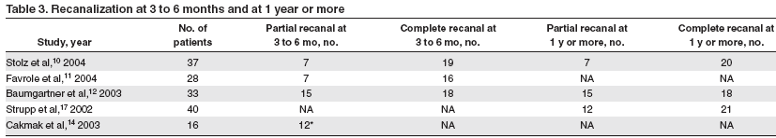
Recanalization

Slide 76
No difference in the rate of recanalization at 3 months and at one year of follow-up
Recanalization occurs only within the first months following CVT and not thereafter, irrespective of anticoagulation.
No correlation between recanalization and clinical outcome
Strupp et al 2002,Stolz et al 2004

Slide 77
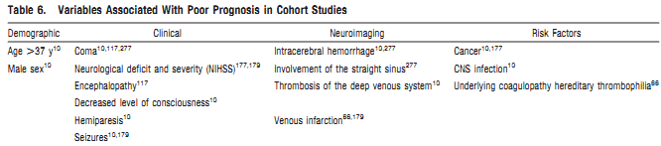
Prognostic factors

Slide 78
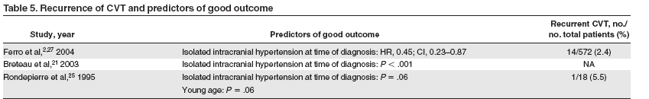
Francesco et al, Blood 2006

Slide 79
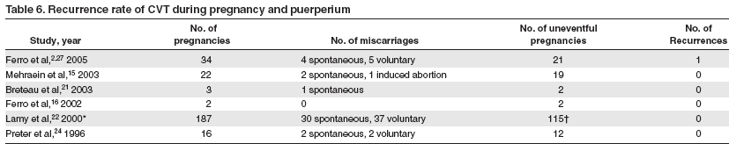

Slide 80
Special situations

Slide 81
CVT in pregnancy
For acute rx LMWH preferred over UFH
Continue LMWH throughout pregnancy
Continue LMWH/ OAC till 6 weeks postpartum
AHA/ ASA 2011 guidelines

Slide 82
Risk of future pregnancies in women with CVT
CVT and even pregnancy related or puerperium-related CVT are not a contraindication for future pregnancies.
Prophylaxis with LMWH during future pregnancies and the postpartum period is probably recommended
AHA/ ASA 2011 guidelines

Slide 83
Neonatal CVT
Maternal gestational risk factors
-- pre-eclampsia
-- diabetes
75% of neonates have acute illness at the time of diagnosis, mostly dehydration, cardiac defects, sepsis, or meningitis

Slide 84
Neonatal CVT
Most common presenting symptoms are seizures 2/3 and respiratory distress or apnoea 1/3
Other symptoms include poor feeding, weight loss, acidosis, hypotonia, and lethargy
As in adults, the superior sagittal sinus and lateral sinuses are the most typically involved
Straight sinus and deep venous system are more commonly involved (about one-third of cases)

Slide 85
Infarct on neuroimaging in 40–60% of cases with a very common haemorrhagic component and an intraventricular haemorrhage in 20% of cases.
79% of children were left with some degree of impairment, 41% with seizures

Slide 86
Neonatal CVT
Symptomatic rx important
  rehydration
  antibiotics for suspected sepsis
  antiepileptic drugs
  cardiac surgery for some cardiac malformations.
Treatment with LMWH or UFH may be considered
AHA/ ASA 2011 guidelines

Slide 87
CVT in elderly
ISCVT -- 8·2% of the pts were 65 years or older.
Less frequent isolated intracranial hypertension
More frequent depressed consciousness and mental status changes
Carcinoma was more frequent as a cause.
Prognosis was worse with 49% of patients dead or dependent at the end of follow-up.
Because of increased risk of further thrombotic events -- anticoagulation for more than 6 months

Slide 88
Recommendations

Slide 89
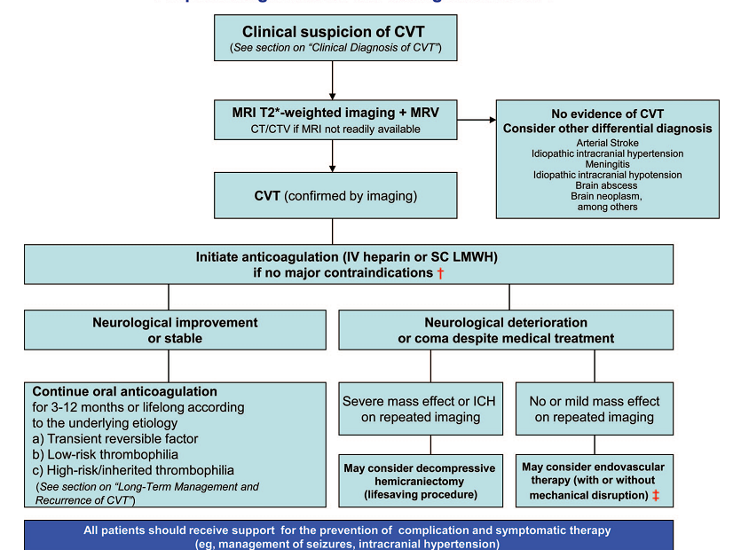

Slide 90
HEPARIN
Loading dose: 80 U/kg IV bolus f/b
infusion 18 U/kg/h IV
aPTT checked q6h & adjust dose as follows
<1.2 times control: 80 U/kg bolus with increase 4 U/kg/h
1.2-1.5 times : 40 U/kg bolus with increase of 2 U/kg/h
1.5-2.3 times control: No change in infusion rate
2.3-3 times control: Decrease rate by 2 U/kg/h
>3 times control: Hold infusion for 1 h and decrease rate by 3 U/kg/h

Slide 91
SCTIMST data
Jan 2004 to Jan 2011
40 patients
Age range was 13 to 62 years (mean 37 years)
Headache (81%), seizures (79%), papilloedema(63%), focal motor deficits (35%), and altered sensorium (6%)
Hyperhomocystinemia (23%), systemic and central nervous system infection (18%), dehydration (13%), oral contraceptive pill use (3%), postpartum state (2%), genetic thrombophilia (2%)

Slide 92
SCTIMST data
All patients received therapeutic anticoagulation
81% patients responded well
No death was recorded
Focal motor deficits and hemorrhagic infarctions were independent predictors of unfavorable outcome

Slide 93
Thank you

Slide 94
References
Cerebral venous thrombosis: an update, Bousse et al, Lancet Neurol 2007; 6: 162–70
Natural history of cerebral vein thrombosis: a systematic review, Francesco Dentali, Blood 2006,vol 108,no 4
Prognosis of Cerebral Vein and Dural Sinus Thrombosis Results of the International Study on Cerebral Vein and Dural Sinus Thrombosis (ISCVT) Ferro et al,Stroke 2004
Diagnosis and Management of Cerebral Venous Thrombosis, Saposnik et al. Stroke. 2011

Slide 95
Endovascular Thrombectomy and Thrombolysis for SevereCerebral Sinus Thrombosis-A Prospective Study Jan Stam et al: Stroke 2008
Randomized, placebo-controlled trial of anticoagulant treatment with LMWH for cerebral sinus thrombosis. de Bruijn et al, Stroke 1999
Keller et al: Decompressive craniectomy in severe cerebral venous and dural sinus thrombosis. Acta Neurochir Suppl. 2005

Slide 96
Most common symptom in patient with CVT is
Seizure
Headache
Motor weakness
Ataxia

Slide 97
Most common venous sinus to be thrombosed in CVT is
A. Superior sagittal sinus.
B. Inferior sagittal sinus.
C. Labbé’s vein.
D. Internal cerebral vein

Slide 98
MRI of a young woman shows swelling and
T2 prolongation of the bilateral thalami and basal
ganglia, consistent with infarction. Which of the
following venous structures is probably thrombosed?
A. Superior sagittal sinus.
B. Inferior sagittal sinus.
C. Labbé’s vein.
D. Internal cerebral vein

Slide 99
Which of the following conditions in a patient with single episode of CVT is an indication for indefinite OAC?
APLA syndrome
Hyperhomocystinemia
Heterozygous Factor V mutation
Heterozygous Prothrombin 20210 mutation

