Slide 1
Status Epilepticus
Definition & Pathophysiology
Dr. C. Rathore

Slide 2

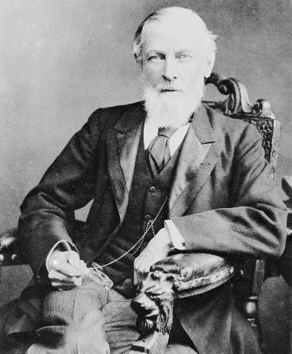
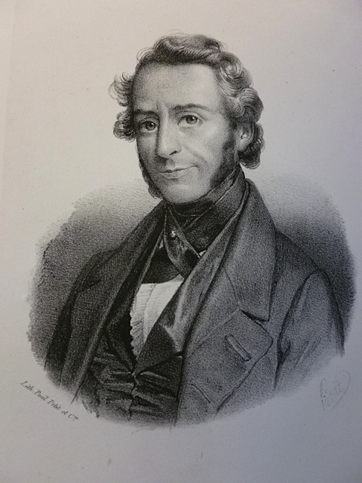
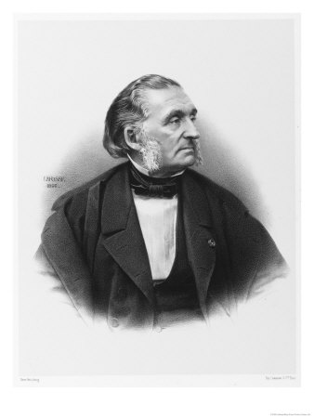
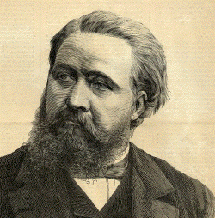
Brief History of Status Epilepticus
Status Epilepticus
Sakiku Cuneiform
600-700 BC
Gowers
In
Queensquare
1860s
Louis Calmeil
1824
Etat de Mal
Trosseau
Bazire’s translation
1868-70
Desir Magloir Bourneville
1869
Neligan A, Shorvon D S.Epilepsia, 50(Suppl. 3):56–68, 2009

Slide 3
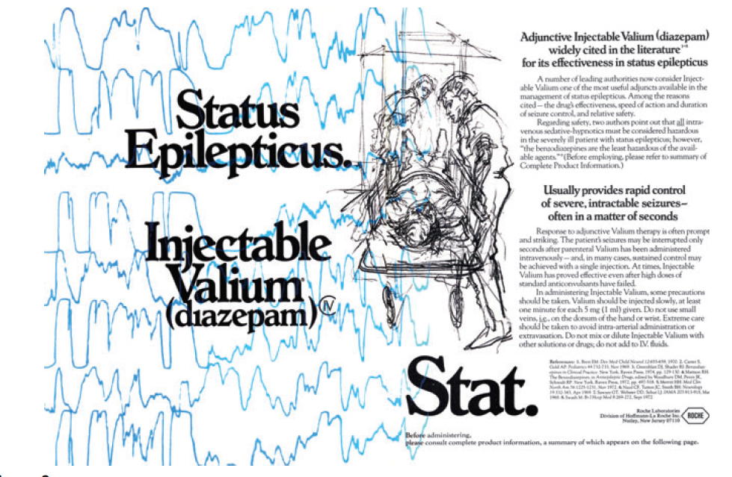
Brief History of Status Epilepticus
The treatment of status between 1909 and 1958:The period of bromide, barbiturate, sedatives,and anesthetics
The treatment of status epilepticus after 1958: Phenytoin and the benzodiazepines
Neligan A, Shorvon D S.Epilepsia, 50(Suppl. 3):56–68, 2009

Slide 4

Evolution of Definition of
Status Epilepticus

Slide 5
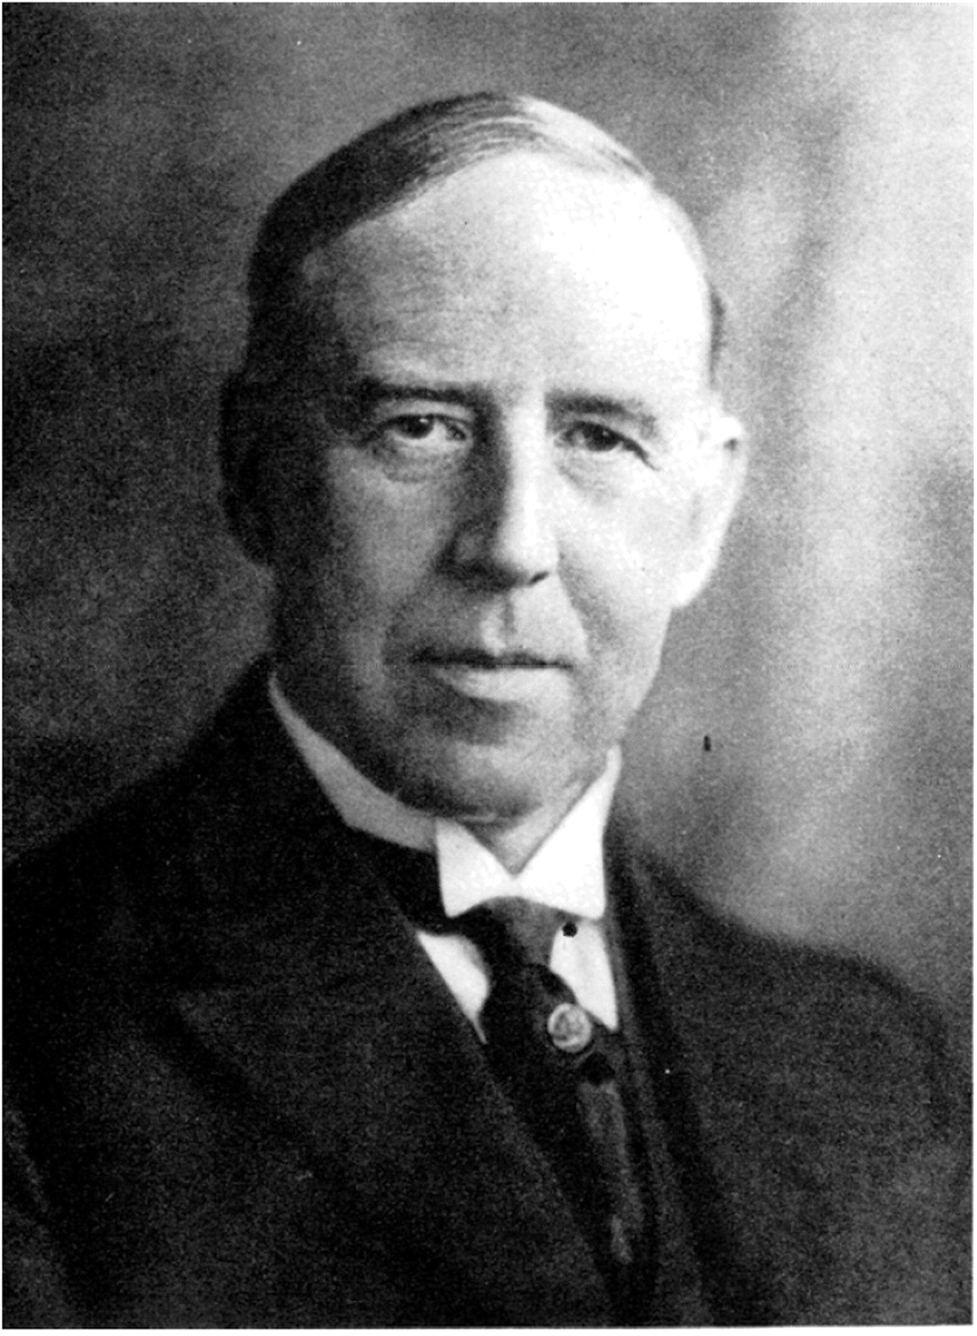
1904, Clark and Prout
A state in which seizures occur so frequently that ‘‘the coma and exhaustion are continuous between the seizures”.
1940, Sir Kinnear Wilson
Severest form of seizures in which “the post-convulsive sleep of one attack is cut short by development of the next”

Slide 6
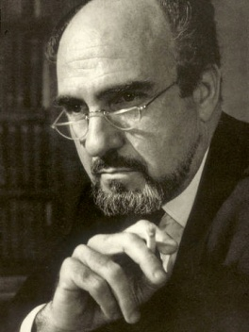
Marseilles in 1962
(Xth Marseilles Colloquium)
Landmark meeting in Marseilles in 1962
Gastaut
There are as many types of SE as there are types of epileptic seizures.
A term used whenever a seizure persists for a sufficient length of time or is repeated frequently enough to produce a fixed or enduring epileptic condition.
Retained in 1970 meeting as well
Gastaut H. A propos d. une classification symptomatologique desetats de mal epileptiques. In: Gastaut H, Roger J, Lob H, editors. Les etats de mal epileptiques. Paris: Masson; 1967. p. 1-8.

Slide 7
ILAE
1981
???
mts
30
20
10
5
American Epilepsy
Working Group
1991
30 minutes
Bleck et al
1991
20 minutes
VA Cooperative trial on Rx of SE
1998
10 minutes
Proposed operational
Definition
1999
>_5 minutes

Slide 8
ILAE 1981
A seizure that persists for a sufficient length of time or is repeated frequently enough that recovery between attacks does not occur.
Just a clinical definition
Emphasizes the importance of prolonged nature and potential for brain damage
Fails to provide operational details such as the precise duration of seizure or number of seizures

Slide 9
1993
American Epilepsy Working Group
Operational Definition
Seizure lasting more than 30 min or occurrence of two or more seizures without recovery of consciousness in between.
Working Group on Status Epilepticus. Treatment of convulsive status epilepticus: recommendations of the Epilepsy Foundation of America’s Working Group on Status Epilepticus. JAMA 1993;270:854-9.

Slide 10
Why 30 minutes ?
Any seizure that persists for more than 30 min is accompanied by serious metabolic decompensation and permanent neuronal damage

Slide 11
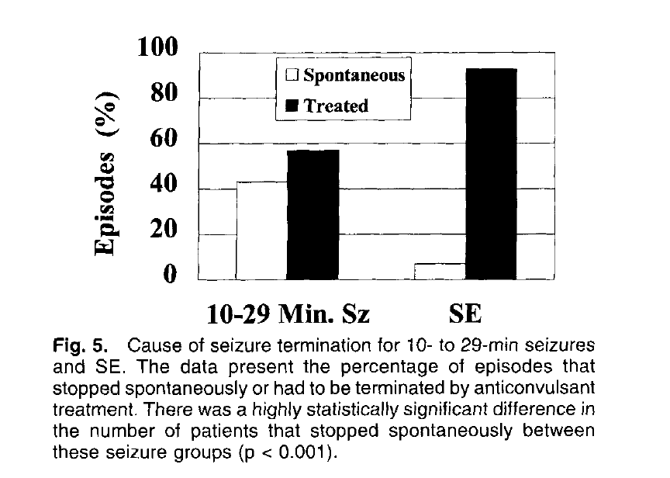
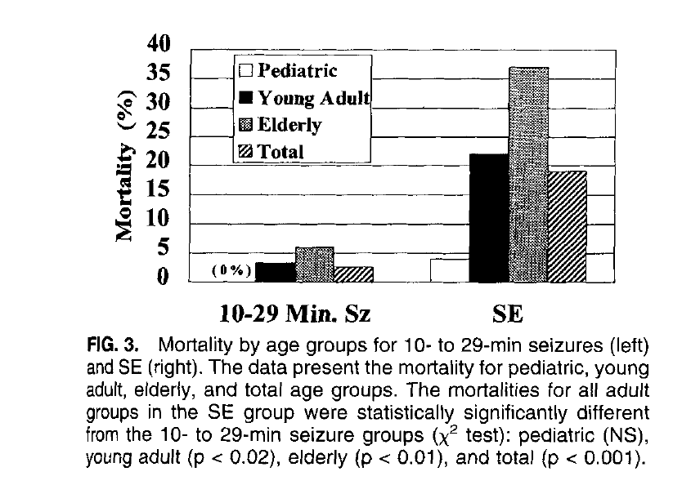
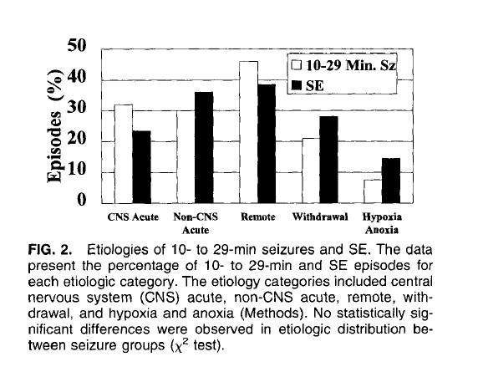
Richmond study
40% of the seizures lasting from 10–29 min stopped spontaneously without treatment
Overall mortality was 2.6% versus 19% for status epilepticus lasting over 30 min (p<0·001).
Delorenzo RJ, Garnett LK, Towne AR, et al. Comparison of status epilepticus with prolonged seizure episodes lasting from 10 to 29 minutes. Epilepsia 1999; 40: 164–69.
Notes:
228 cases of SE in 2 years
Retrospective chart review
81 patients of prolonged seizure activity
Prolonged seizures (1 0- to 29-min seizure episodes) were defined as continuous seizure activity or intermittent seizure activity from which the patient did not regain consciousness, lasting 10-29 min.

Slide 12
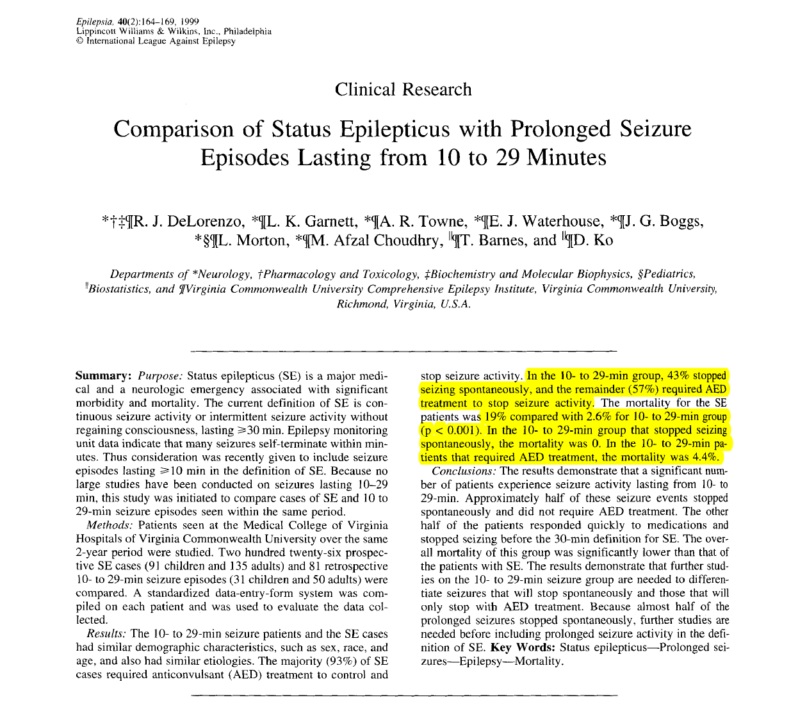

Slide 13
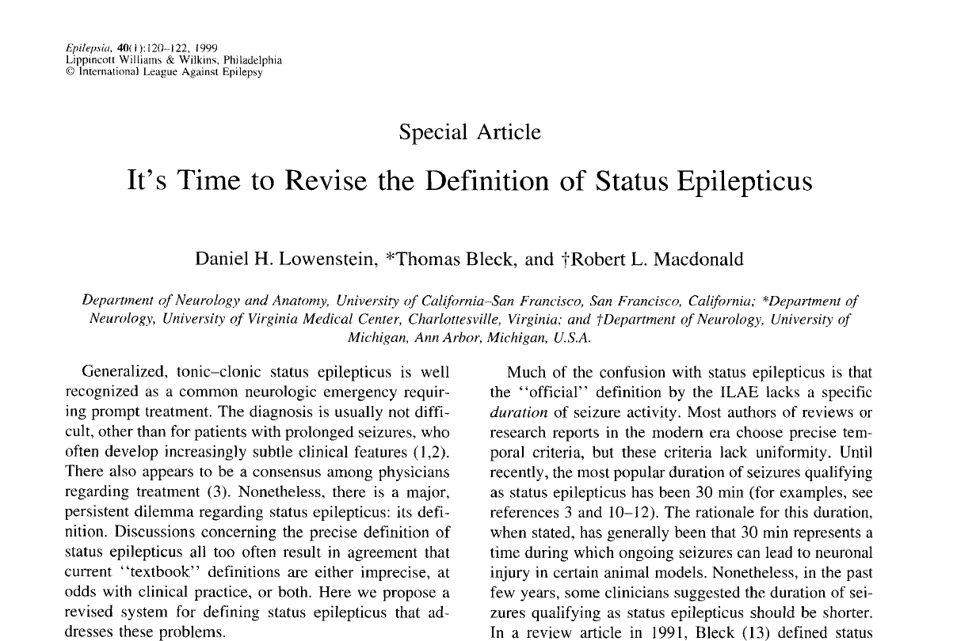

Slide 14
Revised definition proposed in 1999
Generalized convulsive SE
Generalized, convulsive status epilepticus in adults and older children (>5 years old) refers to a 5 min of continuous seizures or two or more discrete seizures between which there is incomplete recovery of consciousness.

Slide 15

Why not 30 minutes ??
Baboon Experiments
Seizures lasting >82 min in un-anesthesized baboons could cause irreversible brain injury
Five animals in status epilepticus for 50-120 min had no obvious brain injury.
Neuronal injury in humans is complex and influenced by various factors besides duration of seizure activity.
Meldrum B, Brierley J. Prolonged epileptic seizures in primates: ischemic cell change and its relation to ictal physiological events. Arch Neurol 1973;28:10-7.

Slide 16
The typical, generalized tonic-clonic seizure (GTCS) in adults appears to last >5 min relatively rarely.
Gastaut and Broughton*
  18,000 clinical cases and 100,000 eegs
  tonic phase lasted 1-20 s
  clonic phase lasted -30 s
  postictal tonic contraction lasted a few secs to 4 min.
* Gastaut H, Broughton R. Epileptic seizures: clinical and elecrrographic features, diagnosis and treatment. Springfield, IL: Charles Thomas, 1972:25-90.

Slide 17
Theodore et al
120 GTCS in 47 patients
GTCS divided into onset of generalization, pretonic-clonic , tonic , tremulousness, and clonic.
27% patients – all phases
  Mean duration of GTCSs was 62 s,
  Range of 16-108 s.
Theodore W, Porter R, Albert P, et al. The secondarily generalized
tonic-clonic seizure: a videotape analysis. Neurology 1994;44: 1403-7.

Slide 18
Why not 30 minutes ??
It is unreasonable to wait 30 or even 15 min before initiating therapy.
Persistent seizures of any duration are potentially at greater risk for cardio-respiratory problem

Slide 19
Early or ‘impending’ Status epilepticus
5 – 30 minutes
Continuous or intermittent seizures lasting more than 5 min, without full recovery of consciousness between seizures.
5 minutes is 18–20 standard deviations away from the norm of a single seizure
Pharmacosensitive initiation phase of experimental status epilepticus
Chen, Wasterlein. Lancet Neurol 2006; 5: 246–56

Slide 20
Established status epilepticus
Should we go back to 30 minutes ??
Clinical or electrographic seizures lasting more than 30 min without full recovery of consciousness between seizures.

Slide 21
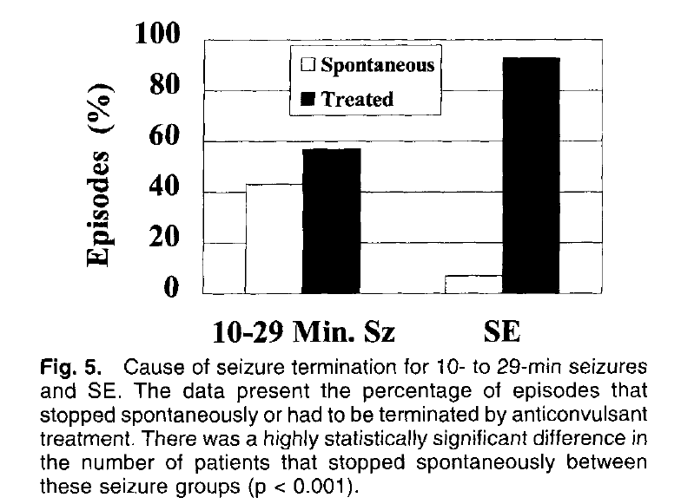
Bringing meaning to 30 minutes cut off for SE
- Seizure to Enduring epileptic condition

Slide 22
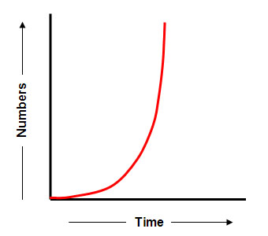
Richmond data and the exponential curve
100%
63%
Percentage of patients with transformation to SE
50%
30 mts
Delorenzo RJ, Garnett LK, Towne AR, et al. Comparison of status epilepticus with prolonged seizure episodes lasting from 10 to 29 minutes. Epilepsia 1999; 40: 164–69.
Notes:
By assuming that the transition from seizures to status epilepticus can be modelled by a single exponential curve, the time constant of this
transformation is defined by the time point when 63% of patients have completed the transformation

Slide 23
Subtle status epilepticus
Treiman
Both the motor and electroencephalographic expression of seizures become less florid, yet the prognostic and therapeutic implications of that stage are still those of convulsive status epilepticus.

Slide 24
Status epilepticus
I. Epilepsia partialis continua (EPC)
    A. As occurs with Rasmussen syndrome
    B. As occurs with focal lesions
    C. As a component of inborn errors of metabolism
II. Supplementary motor area (SMA) status epilepticus
III. Aura continua
IV. Dyscognitive focal (psychomotor, complex partial) status epilepticus
    A. Mesial temporal
    B. Neocortical
V. Tonic-clonic status epilepticus
VI. Absence status epilepticus
    A. Typical and atypical absence status epilepticus
    B. Myoclonic absence status epilepticus
VII. Myoclonic status epilepticus
VIII. Tonic status epilepticus
IX. Subtle status epilepticus
Report of the ILAE Classification Core Group 2006,

Slide 25
Pathophysiology

Slide 26
Self-sustaining status epilepticus
Awake, free-running animal experiments
  seizures rapidly become self-sustaining and continue long after the withdrawal of the epileptogenic stimulus, whether chemical or electrical.
Initiation Phase
Maintanence Phase
Seizures that last more than a half hour become very hard to control

Slide 27
Initiation phase
  Triggering stimuli evoke discrete seizures that tend to abate as soon as the stimulus is removed
Maintenance phase
  In the subsequent maintenance phase discrete seizures coalesce together into a continuum, with triggering stimuli no longer required to sustain a train of seizures.

Slide 28
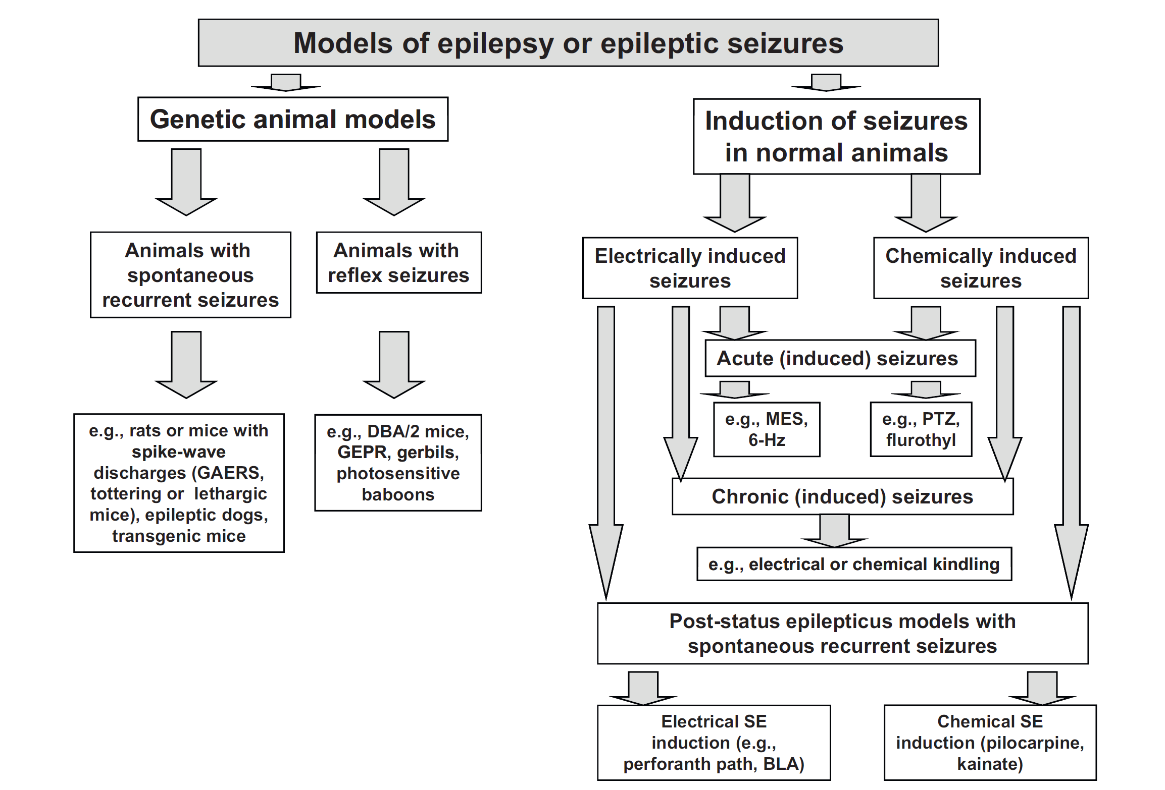
Lo¨ scher W. Animal models of epilepsy and epileptic seizures. In: Eadie MJ, Vajda F, editors. Antiepileptic drugs. Handbook of experimental pharmacology. Berlin: Springer; 1999. p. 19–62.

Slide 29
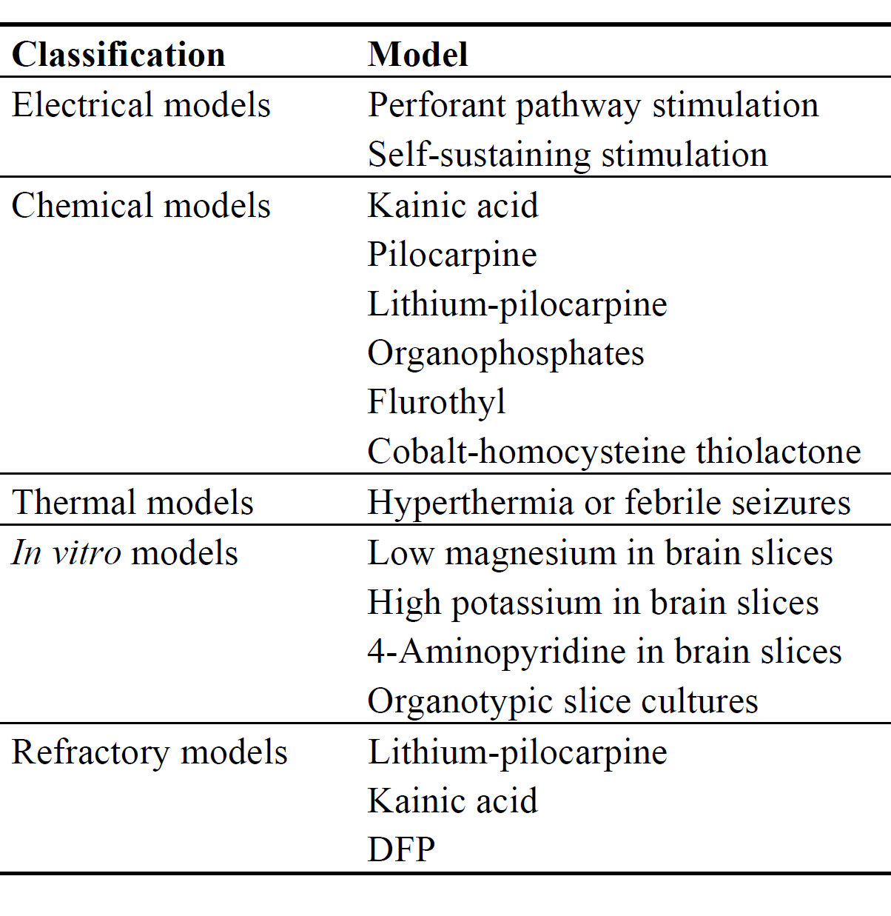
Animal Models of SE

Slide 30
Pathophysiology of self-sustaining status epilepticus
Milliseconds
  Ionic channels open and close, neurotransmitters and modulators are released, and receptor desensitisation, in its many forms, takes place.
Seconds to Minutes
  Receptor trafficking causes some key adaptations.
Minutes to hours
  Plastic changes in neuropeptide modulators
  Often maladaptive
Lancet Neurol 2006; 5: 246–56.

Slide 31
Days to weeks
  Long-term changes in gene expression
  Seizure-induced neuronal death, and of the resulting neuronal reorganisation
Lancet Neurol 2006; 5: 246–56.

Slide 32
Progressive development of pharmaco-resisitance
BZDs lose potency early (decrease by 20X in 30 mts)
Phenytoin later
NMDA antagonists effective till later
    Self sustainind SE stopped only by drugs that affect glutamatergic tranmission, directly or indirectly.

Slide 33
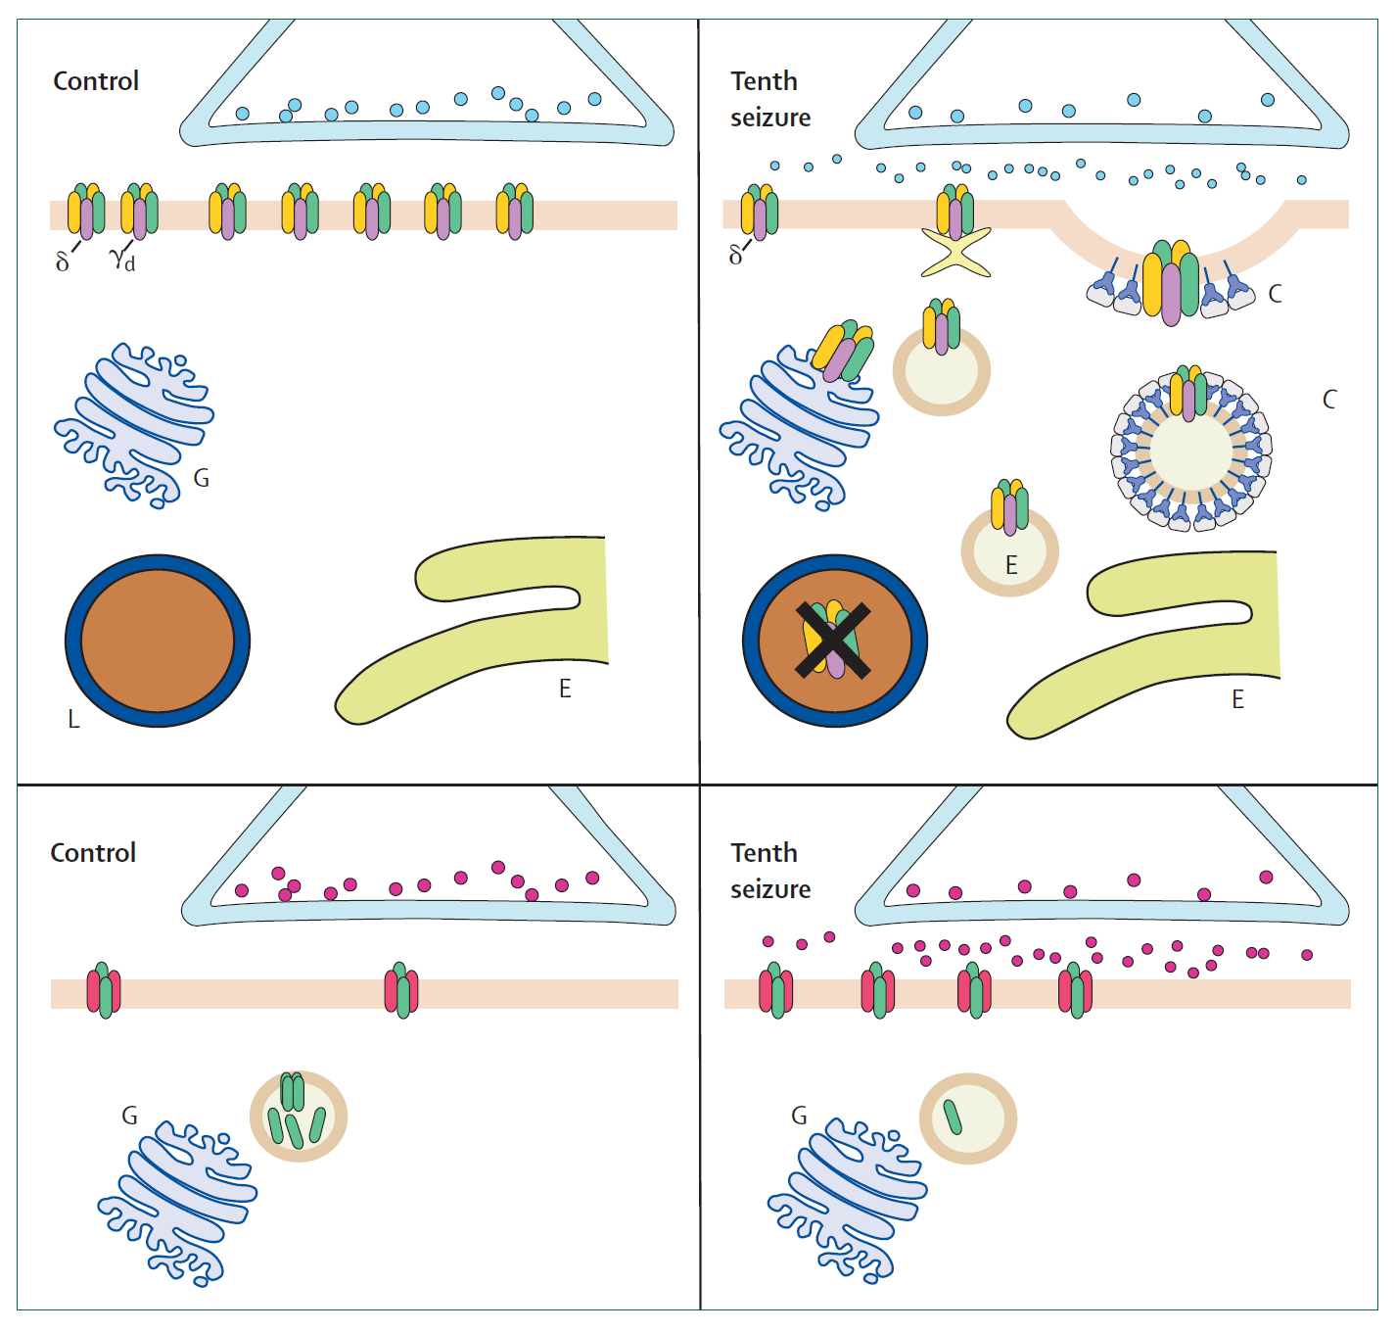
GABA A
NMDA
Notes:
Top: after repeated seizures, the synaptic membrane of GABAA receptors forms clathrin-coated pits, which
internalise as clathrin-coated vesicles (C), inactivating the receptors because they are no longer within reach of the
neurotransmitter. These vesicles develop into endosomes (E), which can deliver the receptors to lysosomes (L)
where they are destroyed, or to the Golgi apparatus (G) from where they are recycled to the membrane. Bottom: by
contrast, in NMDA synapses, subunits are mobilised to the synaptic membrane and assemble into additional
receptors. As a result of this trafficking, the number of functional NMDA receptors per synapse increases whereas
the number of functional GABAA receptors decreases.59

Slide 34
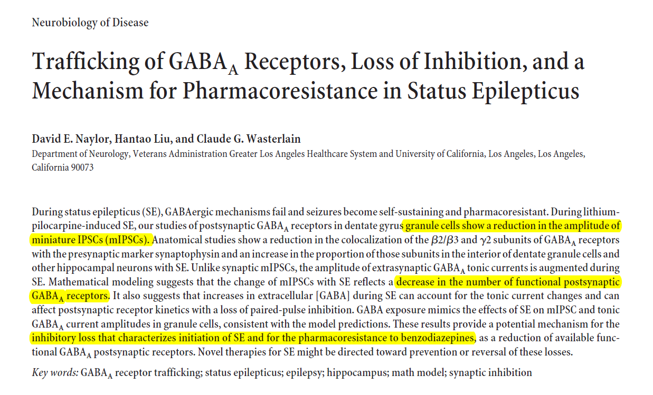

Slide 35
Transition from isolated seizures to status epilepticus
The number of GABA A receptors per dentate granule cell synapse is 18 (SD 4), compared with 36 (SD 11) per synapse in controls
Decrease in the number of subunits present on the synaptic membrane and an increase in the interior of the cell
AMPA and NMDA receptor subunits move to the synaptic membrane where they form additional excitatory receptors

Slide 36
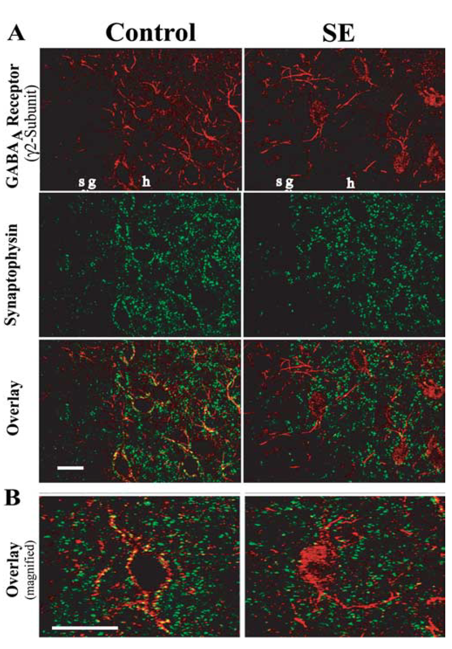


Slide 37
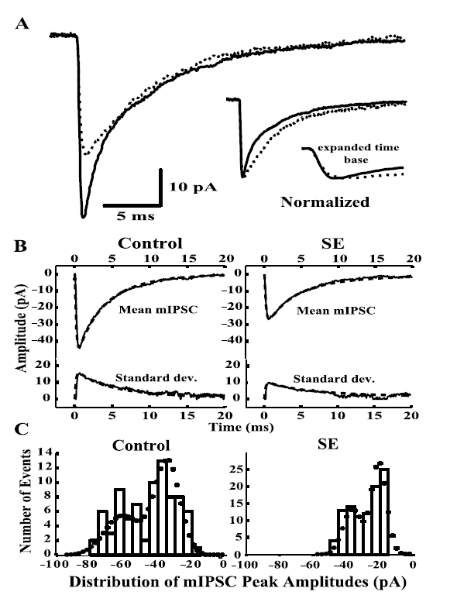
mIPSC - Miniature Inhibitory
post synaptic currents
Notes:
mIPSCs from dentate gyrus granule cells of SE and controls. A, mIPSC mean traces
from a typical granule cell from a control (solid line) and an SE animal (dotted line) demonstrating
smaller amplitude and prolonged decay in the latter. B, Optimized computer model fits
(dashed line) to mean and SD traces of mIPSCs (solid) from a typical control and an SE cell (see
Table 1 for model values). C, Histogram for peak amplitudes of individual mIPSC events recorded
from a control (left) and an SE (right) granule cell with the superimposed predicted distribution
(filled circles) from model fits of B.

Slide 38
After 1 h of SE,we estimate that dentate granule cells have a 50% decrease in the number of physiologically active GABA-A receptors per granule cell synapse.
The reduction of GABA-A synaptic receptors may characterize the key transition in which the potent intrinsic mechanisms that usually stop seizures fail and SE becomes self-sustaining

Slide 39
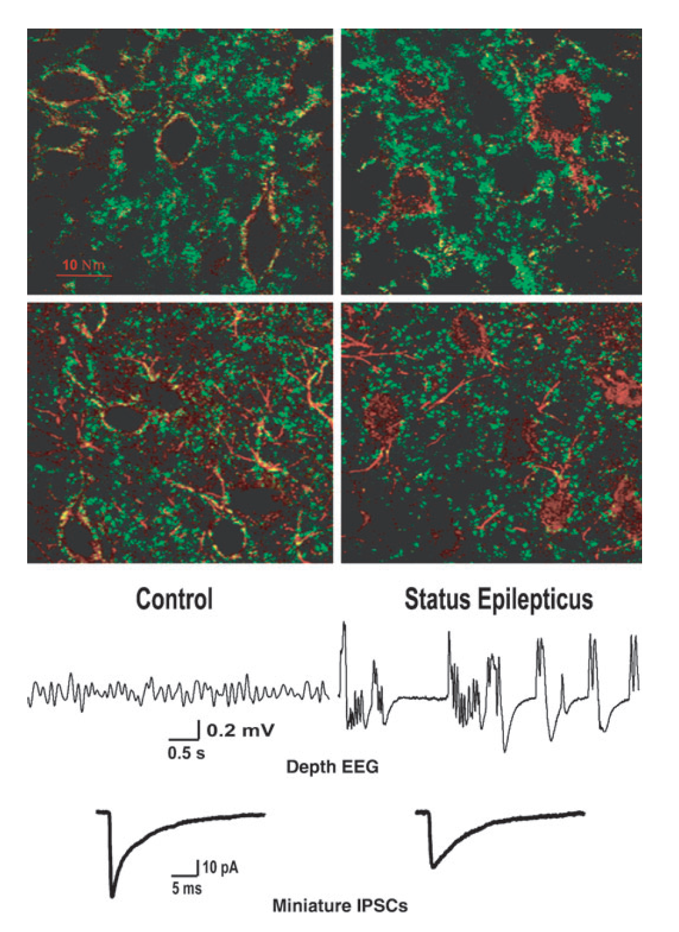
Notes:
Intracellular distribution of GABAA subunits in hippocampal neurons from SE and control rats. Top row: Double-label
immunocytochemistry in dentate and CA3c of control and SE animals using antibodies to GABAA b2/b3 subunits (red) and
synaptophysin (green). Note the co-localization (yellow) of receptor subunits with presynaptic sites in controls (left) and greater
internalization of receptor subunits during SE (right). Second row: Similar confocal image of granule cells using antibodies to
GABAA c2 subunits (red) and synaptophysin (green). Internalization is seen in soma and proximal dendrites of animal in SE. Third
row: EEGs recorded from dorsal hippocampus 1 h after PPS or sham stimulation. Fourth row: mIPSC mean traces from a typical
granule cell from a control and an SE animal, demonstrating smaller amplitude and prolonged decay in the latter [modified from
Naylor et al. (75)]

Slide 40
Anticonvulsant potency of benzodiazepines can decrease by 20 times within 30 min of self-sustaining status epilepticus.
Why is Diazepam / BZD potency affected ?
Why not pentobarbital ?
Status epilepticus alters specific properties of GABARs rather than causing a generalized dysfunction of the receptor.
Kapur J, Macdonald RL. Rapid seizure-induced reduction of benzodiazepine and Zn2+ sensitivity of hippocampal dentate granule cell GABAA receptors.
J Neurosci 1997; 17: 7532–40.

Slide 41
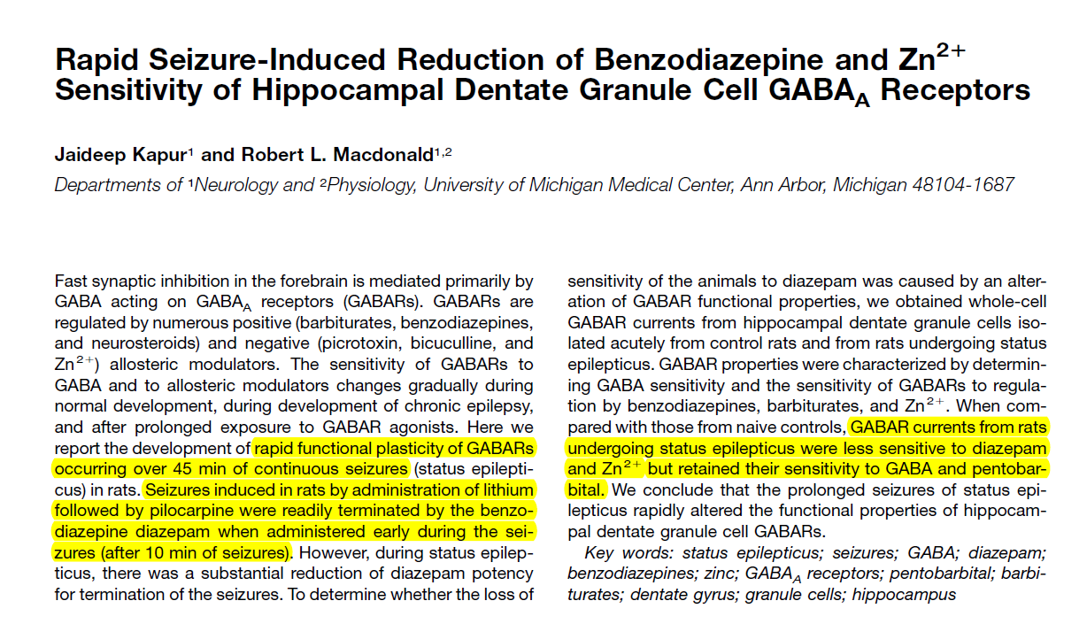
Functional plasticity alterations

Slide 42
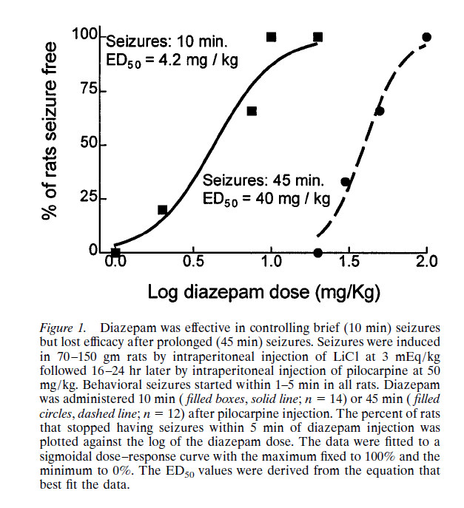

Slide 43
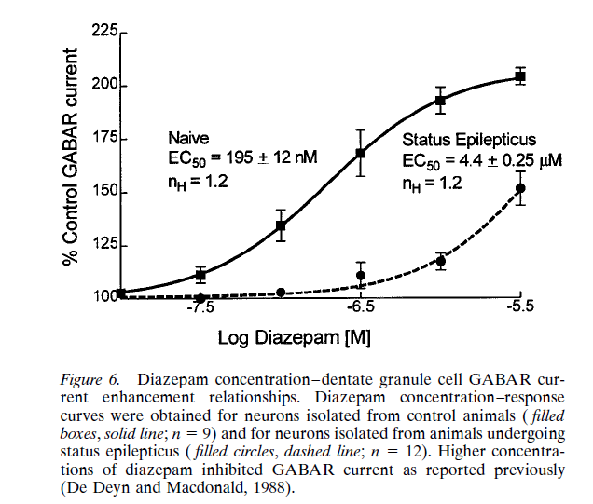

Slide 44
Glutamate
AMPA and NMDA receptor subunits move to the synaptic membrane where they form additional excitatory receptors
NR1 subunits of NMDA receptors move from subsynaptic sites to the synaptic surface, and physiological investigations show an increase in functional NMDA receptors per dentate granule cell synapse from 5·2(SD 1·2) receptors per synapse in controls to 7·8 (SD 1·2) after 1 h of status epilepticus.

Slide 45
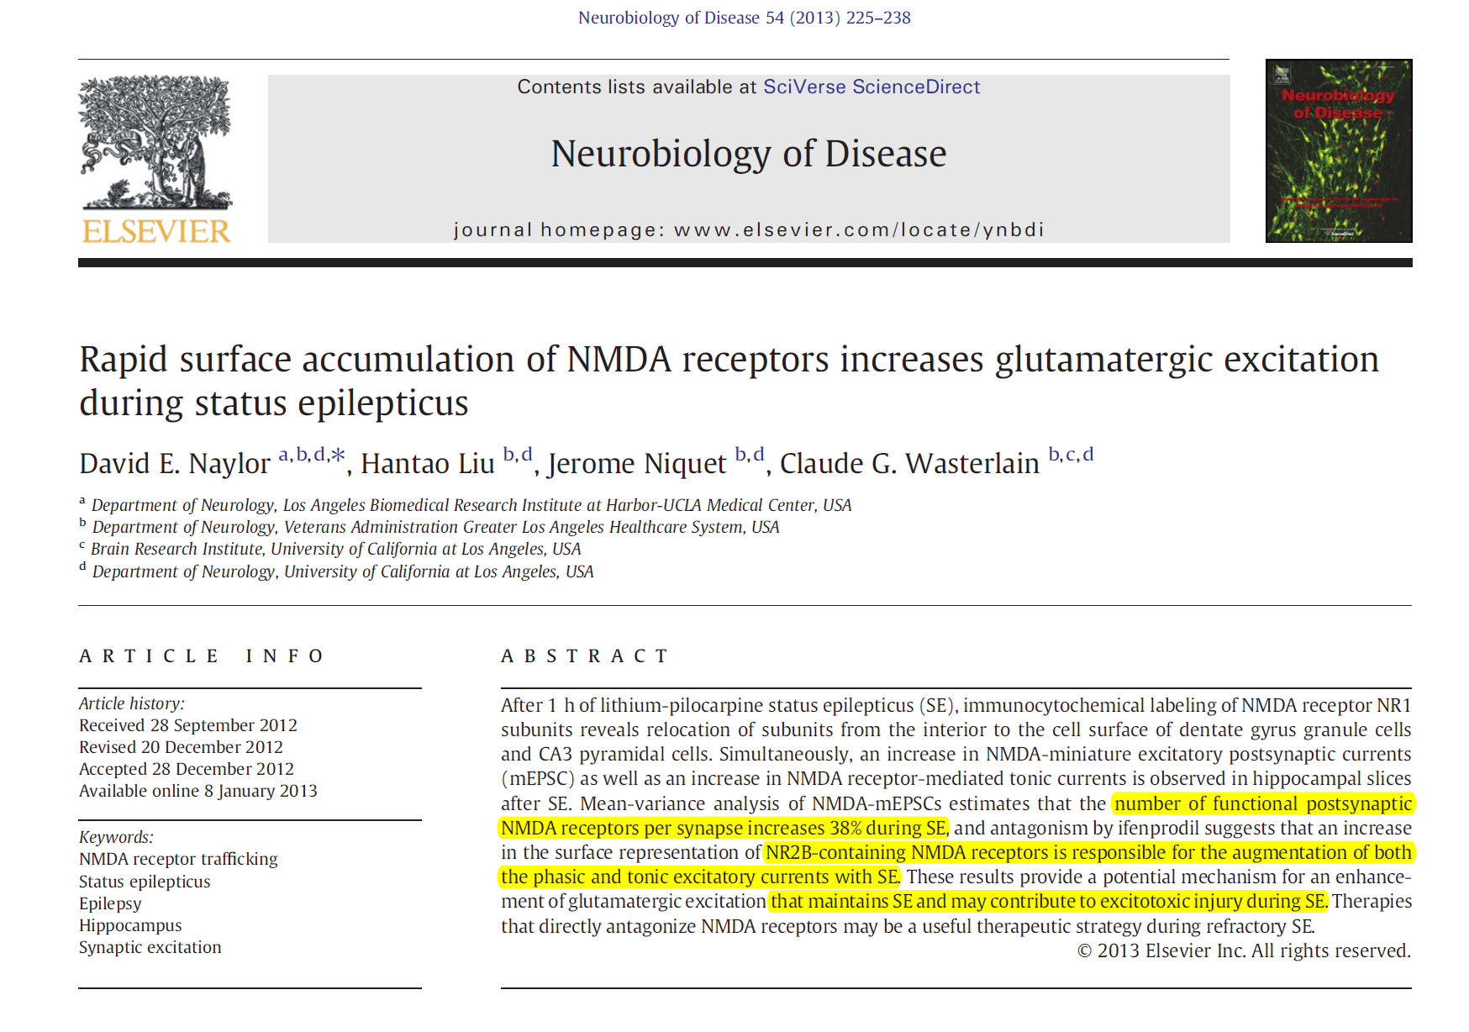

Slide 46
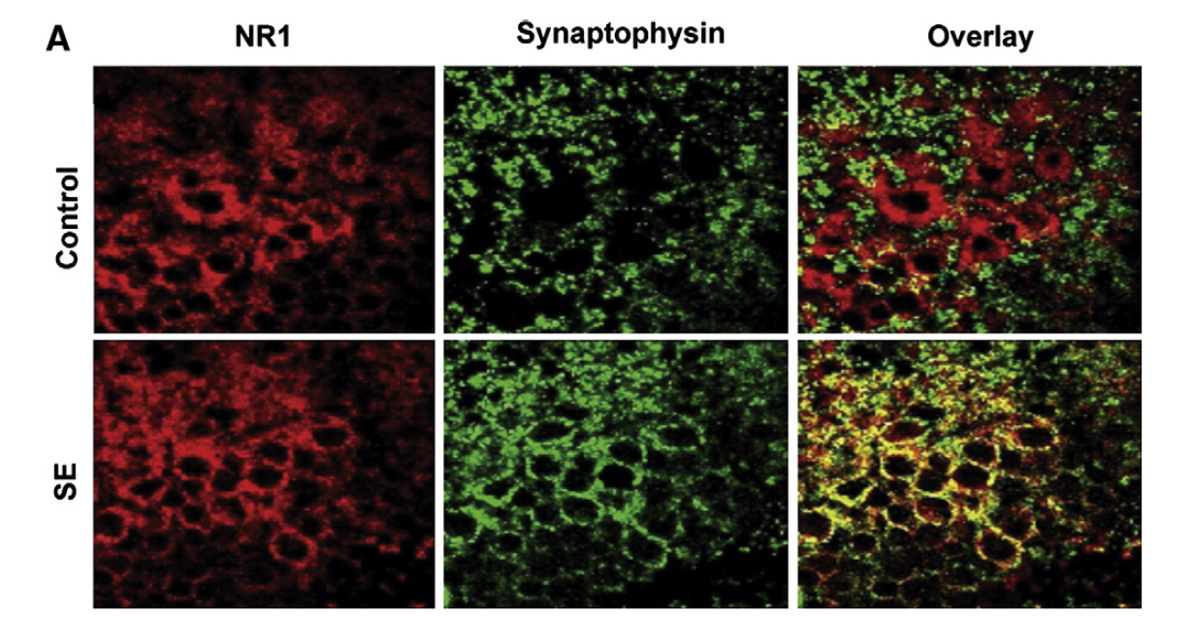

Slide 47
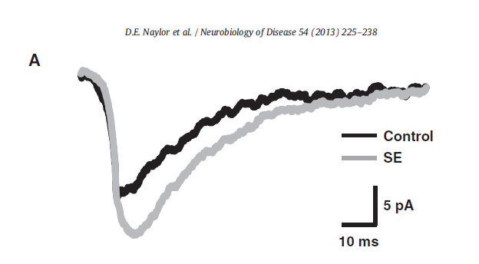
Glutamate excess
Excitatory + Neurotoxicity
mEPSC - Miniature Excitatory
post synaptic currents
NMDA-mEPSC mean traces from a typical granule cell from a control (black) and a SE animal (gray), demonstrating larger amplitude and area-under-the curve (AUC) in the latter

Slide 48
Maladaptive changes in neuropeptide expression in self-sustaining status epilepticus
Depletion of predominantly inhibitory peptides
Dynorphin,
Galanin,
Somatostatin,
Neuropeptide Y
Expression of the proconvulsants
Tachykinins
Substance P
Neurokinin B

Slide 49
Seizure-induced neuronal injury and death
Widespread neuronal death
    Necrosis
    Mitochondrial dysfunction
    Apoptosis
Autopsy studies (DeGieurgio et al)
    Decreased neuronal density in hippocampi (CA1 & CA3)
NSE – high levels in serum of patients with SE
Anecdotal evidence for brain atrophy on neuroimagiing

Slide 50
The degree of neuronal injury is closely related to the duration of seizures, underscoring the importance of rapid control of SE.
Even without attendant hypoxia, acidosis, hyperthermia, or hypoglycemia, ongoing seizures in primates and rats can cause neuronal death. (Meldrum & Brierly 1972).
Neuronal death is probably caused by the release of excitatory neurotransmitters.

Slide 51
A predictable hierarchy of nervous vulnerability is seen: somatostatin-containing hilar interneurons > CA3 neurons > CA1 neurons > dentate granule cells > GABA- or GAD-containing neurons
(Ben-An, 1985; Sloviter, 1987; Babb et al., 1989).

Slide 52
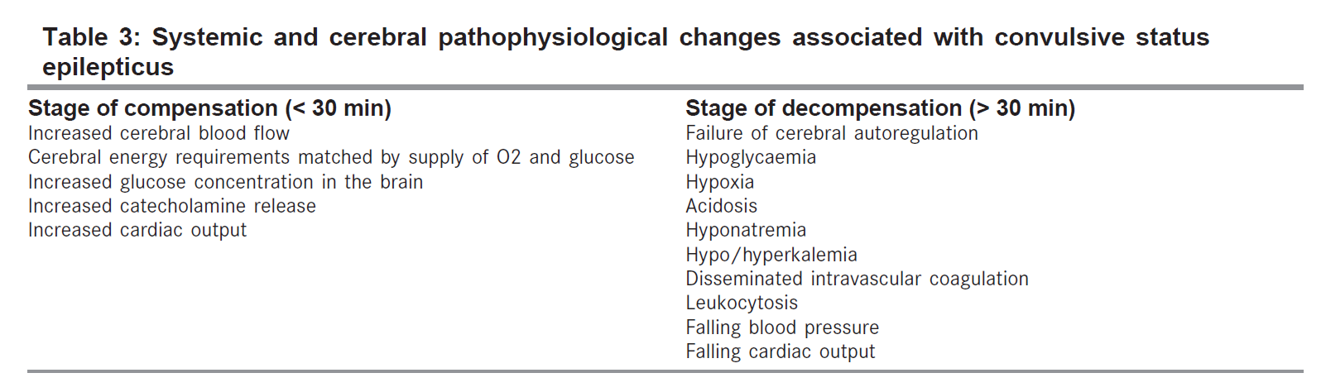

Slide 53
Epileptogenesis induced by SE
Animal Studies
loss of GABAergic interneurons
Sprouting of excitatory connections
Risk of unprovoked seizure after SE – 3.34 X (41%) compared to single seizures (13%)
Risk of developing a febrile seizure is much higher after status epilepticus than after simple febrile convulsions
Ann Neurol 1998 Dec;44(6):908-12

Slide 54
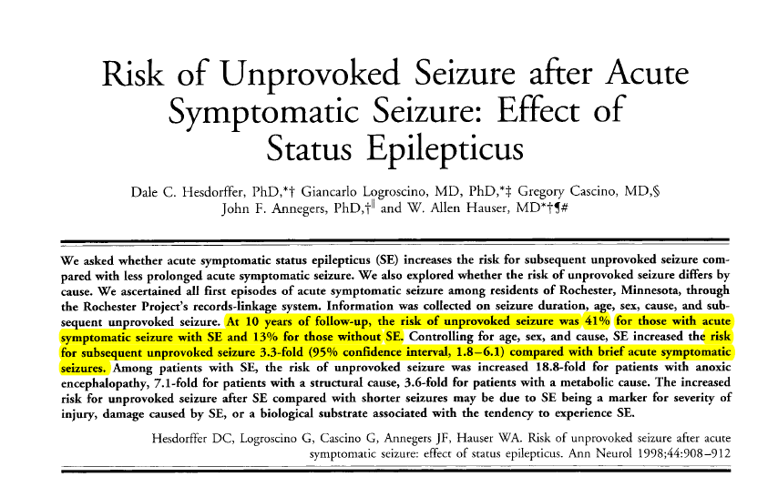

Slide 55
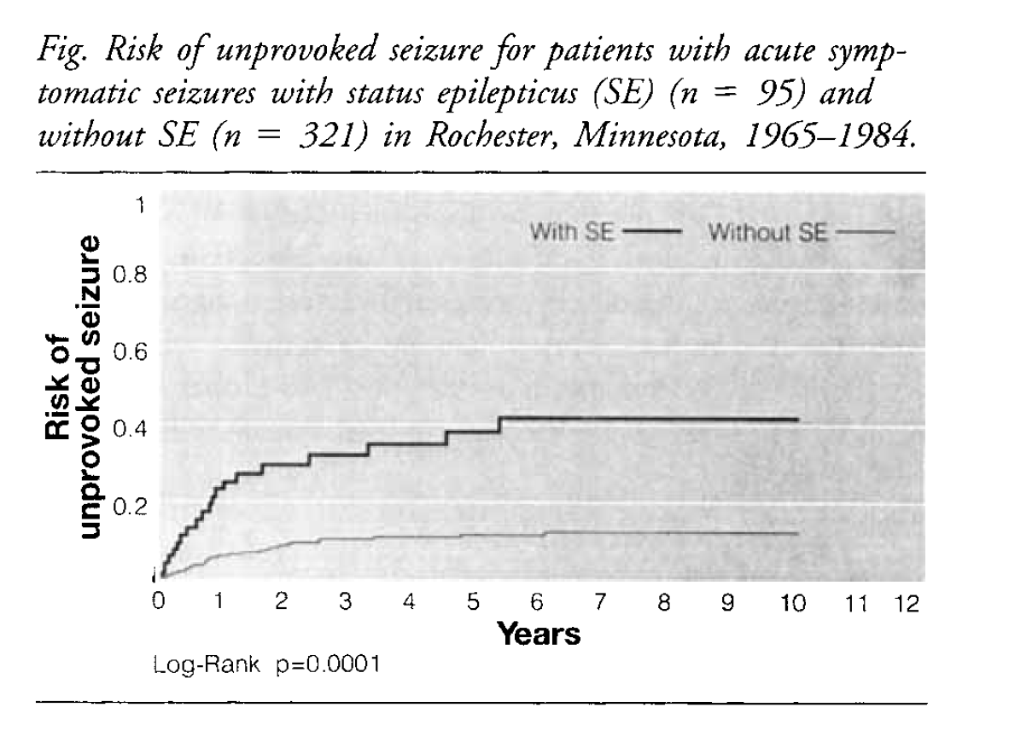

Slide 56
Thank You

