Slide 1
A diagnostic and therapeutic scheme for a solitary cysticercus granuloma
Faculty : Dr. Sanjay Prakash

Slide 2
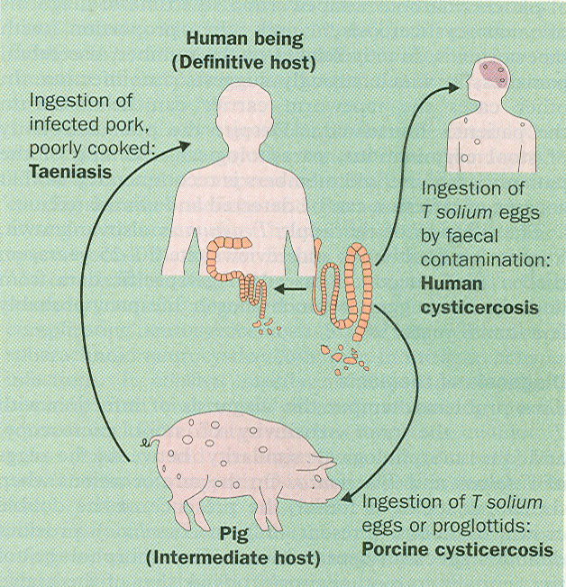

Slide 3
Introduction
Widely prevalent in low- and middle income countries of the world like India, China, sub-Saharan Africa, and Central and South America.
Emerging importance in many high-income countries (e.g., US) due to migration.

Slide 4
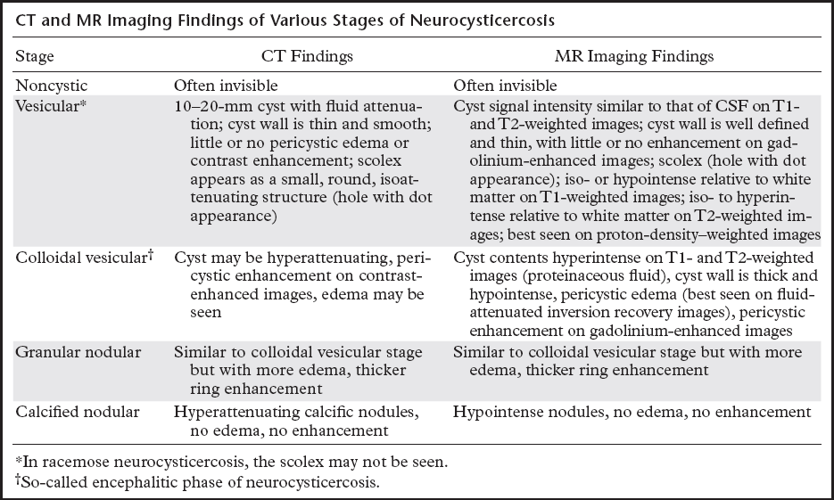

Slide 5
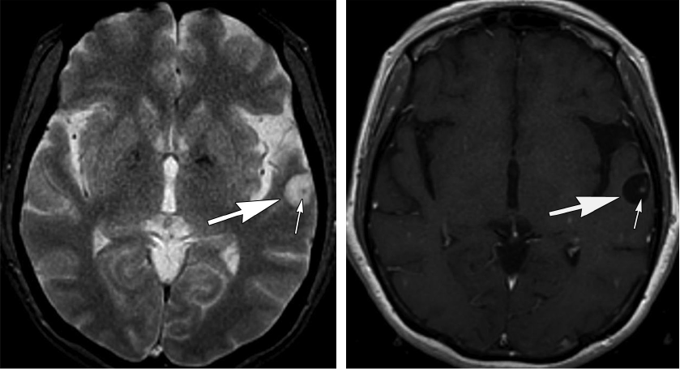
Vesicular stage

Slide 6
Clinical neurological forms
Multiple parenchymatous cysticerci
Solitary cysticercus granuloma (SCG)
Disseminated systemic cysticercosis
Meningoencephalitic form
Intraventricular cysticercosis
Spinal cysticercosis
Ocular cysticercosis

Slide 7
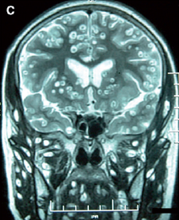
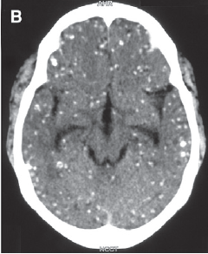
Disseminated NCC

Slide 8
Solitary cysticercus granuloma (SCG)
single, degenerating parenchymal cysticercus cyst.
Widely reported from India.
Author | NCC | SCG | % | City
Singhal, 1995 | 406 | 360 | 88.6 | Mumbai
Mukherjee, 1996 | 113 | _ | 45 | Kolkata
Rajshekhar, 2000 | 459 | 279 | 61.1 | Vellore

Slide 9
SCG is the m/c form of NCC in India.
As opposed to other forms of NCC, SCG is more freq in higher income groups.

Slide 10
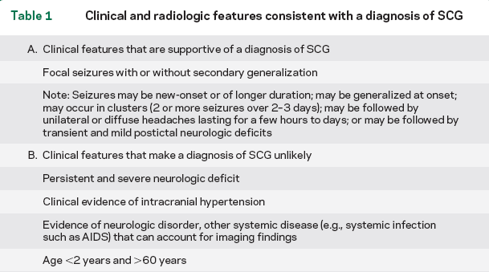
Definition of SCG

Slide 11
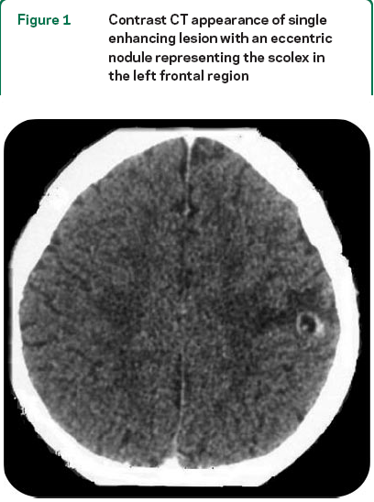
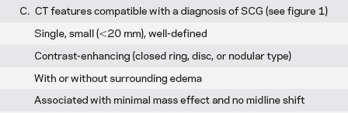

Slide 12
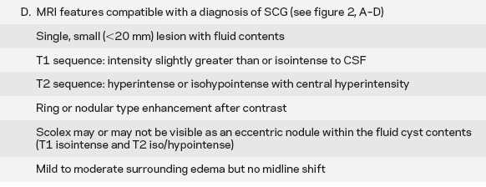

Slide 13
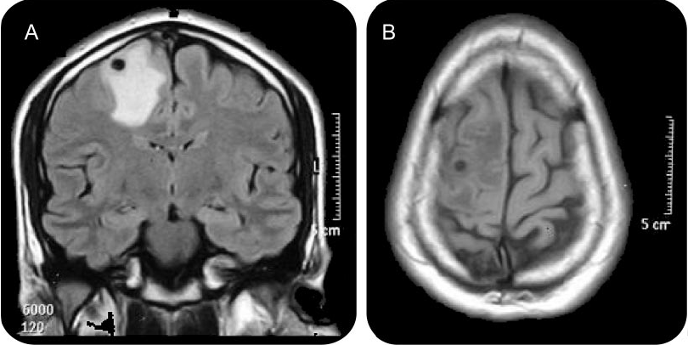

Slide 14
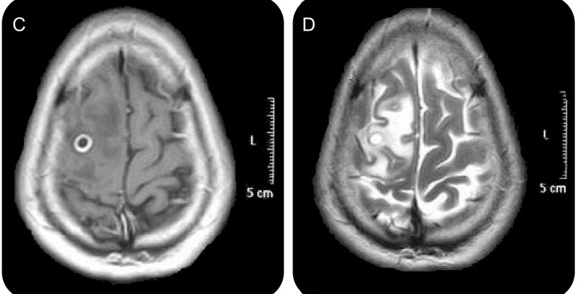

Slide 15
Unanswered issues in SCG
Benefits of anti-helminthic Rx?
Use of steroids, alone or in combination with antihelminthic Rx?
Optimal duration of AED therapy?

Slide 16
METHODS
18 experts with published research experience in NCC were invited to the meeting.
Following issues were discussed
role of imaging and serology in the diagnosis of SCG.
benefit of antihelminthic Rx ± steroids on seizure outcome and radiologic resolution in SCG.

Slide 17
the optimal choice of and duration of AED treatment.
the appropriate timing and modality for follow-up imaging.

Slide 18
Medline and Cochrane Central Register were searched with search terms “solitary cysticercus granuloma” or “single lesion” and “neurocysticercosis.”
Level of evidence & strength of recommendations were graded according to standard criteria.

Slide 19
Results
Natural history of SCG.
Can be studied under 2 aspects:
radiologic resolution
seizure outcome.

Slide 20
Radiologic resolution.
only those studies that included pts soon after their 1st seizure were analyzed.
natural history of SCG takes one of the following paths:
1) the lesion could completely resolve or
2) the lesion could resolve by leaving a punctuate calcific residue.

Slide 21
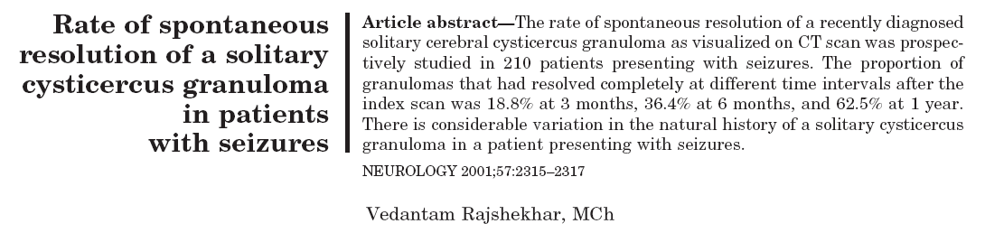
Study

Slide 22
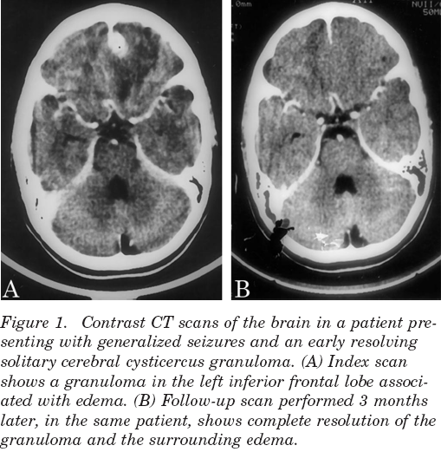

Slide 23
Seizure outcome
Dichotomized into
1) those seizures that recurred while the granuloma was actively degenerating
2) those that recurred following resolution of the granuloma.
The natural history of seizure outcome was determined from data of control arms of the several RCTs (no intervention other than AEDs) in SCG.

Slide 24
Seizure recurrence in actively degenerating granuloma was 13%–48% (while on AEDs for 6–15 months).
Garg et al., J Infect 2006, Mall et al., Epilepsia 2003, Prakash et al., Seizure 2006.
On the other hand, in a prospective, observational study (n=185)with a mean f/u period 66 months, incidence of seizure recurrence following resolution of the granuloma was 15%. Rajshekhar et al., Neurology 2004.

Slide 25
Statement
The majority of SCGs resolve by 1 year.
The natural history of SCG may take one of the following paths:
1) the lesion may completely resolve or
2) the lesion may calcify.
The risk of seizure recurrence is high as long as the granuloma is visible on imaging as an enhancing lesion (level of evidence: Class IV)
Seizure outcome improves following resolution of SCG (level of evidence: Class IV).

Slide 26
Investigative workup of SCG
Imaging. The initial imaging may be contrast CT / MRI.
Two head-to-head comparison studies of CT vs MRI are available; however, these studies were performed on highly selected populations and the MRI techniques used were suboptimal.
de Souza et al., J Neurol Sci 2009; Rajshekhar et al., Neuroradiology 1996

Slide 27
In these studies, MRI was not found to be superior to CT (level of evidence: Class II).
Recommendation. Once CT shows a single enhancing lesion consistent with a diagnosis of SCG, further evaluation with MRI may not be required (strength of recommendation: C).

Slide 28
Immunologic tests
Currently enzyme-linked immunoelectrotransfer blot (EITB) assay is the standard serologic diagnostic evaluation (100% sensitive and 99% specific in multiple NCC).
However, in hospital-based series of SCG, the yield of EITB was lower, i.e., 20%– 80% (level of evidence: III).
Singh G et al., JAPI 1999, Rajshekhar V et al., JNNP 1991.

Slide 29
No published studies of EITB in CSF in cases of SCG are available.
A practical limitation is that EITB is not widely available in many parts of the world where cysticercosis is endemic.

Slide 30
Recommendation.
Where available, the EITB may be performed on serum in order to establish exposure to T solium in individuals with SCG (strength of recommendation: C).

Slide 31
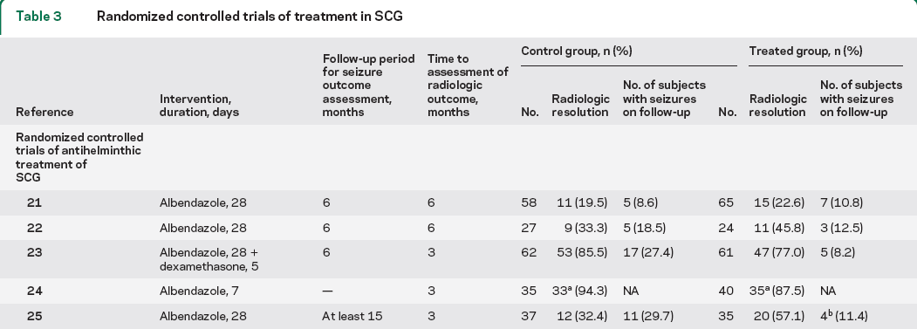
Antihelminthic Rx of SCG:
Overview of RCTs and meta-analysis.
de Souza et al., 2009
Gogia et al., 2003
Kalra et al., 2003
Padma et al., 1994
Baranwal et al., 1998

Slide 32
Meta-Analysis: Cysticidal Drugs for Neurocysticercosis:
Albendazole and Praziquantel
Oscar et al., Ann Intern Med, 2006
Aim- to study the effect of cysticidal drugs on imaging and clinical outcomes of pts with NCC (1-2 lesions).
11 trials included.
Trials on enhancing lesions showed a lesion resolution favoring the use of cysticidal drugs (69% vs. 55%; P < 0.006).

Slide 33
Risk for seizure recurrence was lower after cysticidal treatment. (14% vs. 37%; P < 0.001).
One trial reported 67% reduction in the rate of generalized seizures with Rx (P < 0.006). Garcia et al., NEJM 2004.

Slide 34
Dose, duration, and side effects
All trials used albendazole in dose of 15 mg/kg/daily in 2–3 divided doses.
However, the duration of treatment was quite variable (1–4 weeks).

Slide 35
Albendazole was well tolerated in most studies, however, adverse eff like headache, vomiting & recurrence of seizures were reported in 35%.
Rajshekhar V., Acta Neurol Scand 1998

Slide 36
Statement
A possible beneficial effect of albendazole in form of improved resolution rates of the granuloma and better seizure control (level of evidence: Class II).
However, the size of these effects appears to be modest.

Slide 37
Recommendation
In the absence of large well organized RCTs a short course (1–2 weeks) of albendazole (±corticosteroids) may be prescribed soon after presentation, i.e., the 1st seizure (strength of recommendation: A).

Slide 38
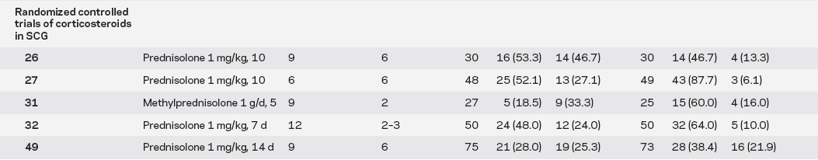
Role of corticosteroids
Garg et al., 2006
Mall et al., 2003
Prakash et al., 2006
Kishore et al., 2007
Singla M., 2009

Slide 39
Statement and recommendation
In the absence of large RCTs definite recommendations regarding the use of corticosteroids alone in the management of SCG cannot be made (strength of recommendation: C).

Slide 40
Recent study
Short-course of prednisolone in solitary cysticercus granuloma: A randomized, double-blind, placebo-controlled trial.
Singla et al., Epilepsia Jul 2011.
Study methods- 148 pts, new-onset sz (<15 days duration) with SCG.
Prednisolone (40-60mg/d for 2weeks) or placebo in add to standard AED.
CT at 3 mo & MRI at 6 mo.

Slide 41
Results- no difference in seizure recurrence during follow-up in treatment (n=16, 21.9%) and control (n=19, 25.33%) groups (p =0.7).
However, generalized seizures occurred in a significantly lesser proportion in the treatment group (p=0.015).
No significant differences in the proportion of subjects with complete resolution on rpt CT/MRI.

Slide 42
Duration of AED therapy
3 open-labeled trials compared short duration (6 months) vs longer duration (12–24 months) in individuals with SCG and seizures.
No benefit of the longer-duration AED administration in individuals in whom the SCG had resolved.
However, Increased risk of seizures with early withdrawal of AEDs in whom the granuloma resolved leaving behind a calcific residue.
Verma et al., Acta Neurol Scand 2006; Thussu et al., Neurol India 2002; Gupta et al., Neurol India 2002.

Slide 43
Recommendations
It is appropriate to continue AEDs till the granuloma is actively degenerating (i.e., appears as an enhancing lesion on imaging), (strength of recommendation C).
The long-term seizure outcome in pts with SCG is generally good (level of evidence: Class III).

Slide 44
In case of resolution with calcification, longer duration of AED should be considered (strength of recommendation: B). But “how long” is unclear.

Slide 45
Choice of AEDs
Single, small, open label trial (clobazam vs phenytoin). No other comparison studies of AEDs.
Kaushal et al., Neurol India 2006.
Both DPH & CBZ ↑ the metabolism of praziquantel and albendazole.
No reported experience with newer AEDs in the treatment of seizures associated with SCG.

Slide 46
Recommendation
Any AED might be used for much of the treatment period in SCG.
A newer, non-enzyme-inducing AED might be considered for the time the antihelminthic treatment is administered (strength of recommendation: C).

Slide 47
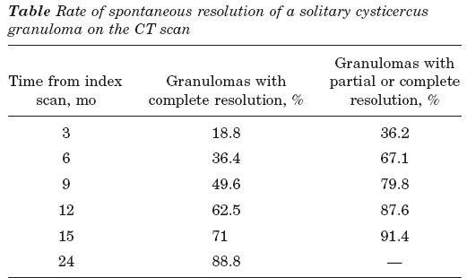
Appropriate timing and modality of follow-up imaging
No head to head comparison studies of CT vs MRI for f/u purpose in SCG available.

Slide 48
An observational f/u study based on MTR MRI demonstrated resolution with perilesional gliosis in a 20% of pts with SCG.
Pradhan S et al., Ann Neurol 2000.
Occurrence of perilesional gliosis correlated with seizure recurrence in the follow-up period.

Slide 49
Recommendation
Follow-up imaging (either CECT / MRI) can be undertaken at 6 months. (strength of recommendation: C).
However, earlier CT (at 3 months) to be considered to identify those lesions that enlarge, suggesting an alternative etiology (e.g., neoplasm, tuberculoma, or fungal granuloma) (strength of recommendation: C).

Slide 50
DISCUSSION
A logical first step in formulating the diagnostic and therapeutic scheme is to accurately define SCG.
In essence, the SCG represents a degenerating single cerebral cysticercus cyst.
A scolex might or might not be identified upon imaging.

Slide 51
Hence, the observation of a single, ring- or disc-enhancing lesion on CT is highly suggestive of a SCG, provided the size criterion of < 20 mm is strictly met (level of evidence: Class IV).
Lesions > 20 mm or conglomerate ring lesions does not denote SCG (level of evidence: Class IV).

Slide 52
From a pathologic standpoint,
the lesions might represent either the colloidal or granular-nodular stage in the cycle of cysticerci as a clearcut differentiation between the 2 stages is not possible upon imaging.

Slide 53
Investigative workup of SCG: Imaging
MRI has few advantages like-
better characterizes the pathologic stage (colloidal vs granular-nodular stage),
identifies an eccentric nodule(or scolex),
may reveal granulomas at sites that are obscured by bone artifacts (e.g., temporal location).
Despite this, it rarely provides additional information that may impact Rx of SCG.

Slide 54
In addition, there are limitations to performing MRI in resource-poor countries including the lack of widespread availability and the cost.
Hence, the expert group accepts CECT as the initial imaging provided all criteria are met.

Slide 55
Caveat- In many resource-poor countries, the available CT scanners might be of the older generation and characterization of SCG on these scanners might be suboptimal.

Slide 56
Antihelminthic treatment of SCG.
Based on the results of meta-analysis, albendazole provides modest benefit in the form of improved rates of radiologic resolution and a reduction in the incidence of seizure recurrence.
However, max f/u period was < 1 year.

Slide 57
Subgroup effects and covariates
It is possible that the effect of antihelminthic treatment on resolution of SCG may vary among different subgroups.
Eg. of subgroups include -
colloidal vs granular-nodular stage,
presence or absence of scolex on MRI,
disc vs ring pattern of enhancement on CT.

Slide 58
None of the studies have analyzed subgroup effects on the outcome parameters.
The effect of timing of therapeutic intervention in relation to duration of symptoms on outcome has not been studied.

Slide 59
It is a matter of debate whether antihelminthic Rx should be instituted upon initial presentation following the first seizure or only if follow-up imaging shows persistence of granuloma.

Slide 60
Role of corticosteroids
Problem with the available trials is that they do not provide information on the timing of recurrent seizures in relation to the administration of steroids.
Thus, it is not clear whether the benefit of steroid is owing to their anti-inflammatory action or due to a more sustained effect by altering the natural history of the granuloma.

Slide 61
Antiepileptic drug therapy
Carbamazepine and phenytoin are the most frequently used AEDs. Relatively cheap and easily available in resourse poor countries.

Slide 62
Appropriate timing and modality of follow-up imaging
It is conventional practice to perform follow-up imaging at 6 mo.
Argument in favor of CT is that it is superior to MRI in detecting calcific residues. However, modern MRI techniques (e.g., T2 GRE imaging) are sufficiently sensitive for detecting minor calcifications.

Slide 63
Hence, the choice of follow-up imaging may be based on availability and cost considerations.

Slide 64
Limitations of studies
Only few studies blinded the evaluators to outcome measures.
Small numbers of subjects.
Outcome measures and study designs relating to the assessment of seizure recurrence following therapeutic intervention have varied quite considerably between the various trials.
Small period of follow up.

Slide 65
Future recommendations
The role of initial and follow-up investigations (CT/MRI) needs to be determined in a larger controlled study.
A carefully planned, RCT is desirable in order to define the role of various classes of therapeutic agents alone or in combination in individuals with SCG.

Slide 66
The trial should incorporate QOL measures and cost-benefit analyses esp in the economic conditions of the geographic regions in which SCG are commonly found.

Slide 67
Algorithm
Solitary enhancing lesion on imaging (satisfying criteria as described earlier)
Endemic location
Alternative etiology worked up & less likely
SCG
Albendazole (15mg/kg/d BD x 2 weeks) +
Steroid x 7-14 days
+
AED (monotherapy preferable)
Follow up CT/MRI at 6 months.
Surgical excision & further w/u if size ↑
Ct AED if calcified
If resolved, taper & stop AED if sz free in previous 3 mo

Slide 68
Thank you

Slide 69
Classification of levels of evidence for or against therapeutic interventions
Table e-1: Classification of levels of evidence for or against therapeutic interventions.
Level Criteria
Class I
Randomized, controlled trial with masked or objective outcome assessment in a representative population. Relevant baseline characteristics are presented and are substantially equivalent or there is appropriate statistical adjustment for the difference. It should have (a) concealed allocation, (b) well-defined primary outcome measure and (c) well-defined inclusion and exclusion criteria.
Class II
Randomized controlled trial lacking one of the criteria in a-c above or a prospective matched cohort study with masked and objective outcome assessment.
Class III
All other controlled trials (e.g., historical controls); outcome is independently assessed or derived by objective outcome measurement.
Class IV
Studies not meeting any of the above class of criteria including consensus or expert opinion.

Slide 70
Strength of recommendations for treatment approach or use of a diagnostic test
Table e-3: Strength of recommendations for treatment approach or use of a diagnostic test (35).
Rating strength Definition Criteria
A
Established as effective, ineffective or harmful for the given condition in the specified population
Requires at least one class 1 or two consistent class 2 studies
B
Probably effective (or useful), ineffective (not useful) or harmful for the given condition in the specified population
Requires one convincing class 2 or three consistent class 3 studies
C
Possibly effective (or useful), ineffective (not useful) or harmful for the given condition in the specified population
Requires at least two consistent class 2 studies
U
Data inadequate or conflicting; utility of treatment / test or lack of utility of treatment /test unproven

