Slide 1
DNR ORDERS IN STROKE
Faculty : Dr. Sanjay Prakash

Slide 2
Introduction
Resuscitation has the ability to reverse premature death.
It can also prolong terminal illness, increase the family's anxiety
and have serious economical consequences

Slide 3
Do-not-resuscitate (DNR) orders represent patient or family
preferences for limitations in cardiopulmonary resuscitation
DNR orders are not intended to limit other aspects of
medical care

Slide 4
DNR orders represent various factors
Advanced directives (living wills)
Preadmission function
Illness severity
Perceived futility of resuscitation
Patient or family beliefs and values
community and hospital practices.

Slide 5
The advance directives (ADs) are “oral or written statement in
which people declare their treatment preferences in the event
that they lose decision making capacity.
They include withholding or withdrawing interventions .One of the most discussed ADs is the DNR order

Slide 6
futility of resuscitation
A treatment is considered futile when the likelihood of the
treatment achieving its physiological objective is less than 1%.
Alternatively the treatment would have been a failure
in the last 100 time it was tried in a similar patient.

Slide 7
The response to CPR varies depending on the primary condition and the outcome is worst in patient with sepsis and acute stroke

Slide 8
In all the court cases of medical futility of the
procedure including CPR versus patients or
bystanders decision to continue such treatment , the
court favoured the decisions of the family.

Slide 9
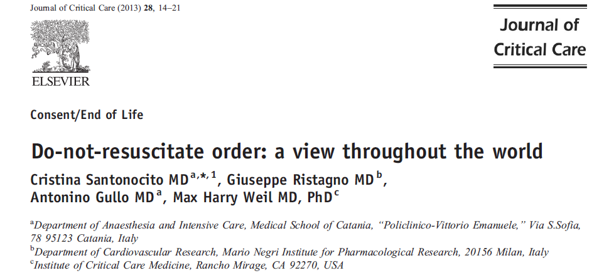

Slide 10
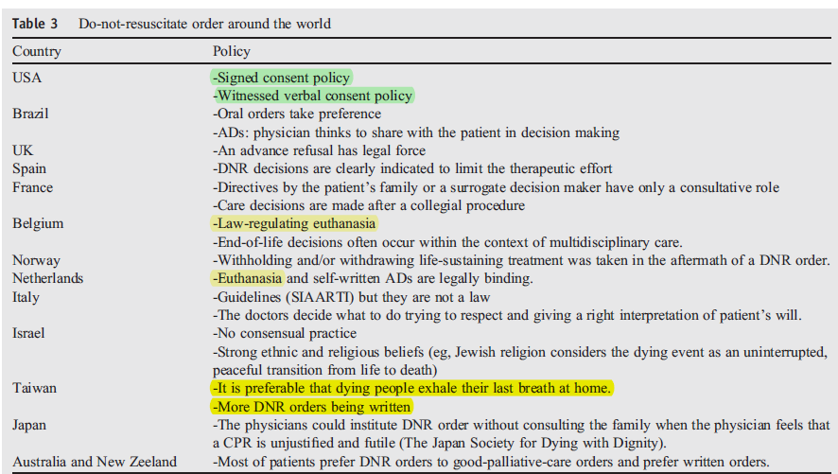

Slide 11
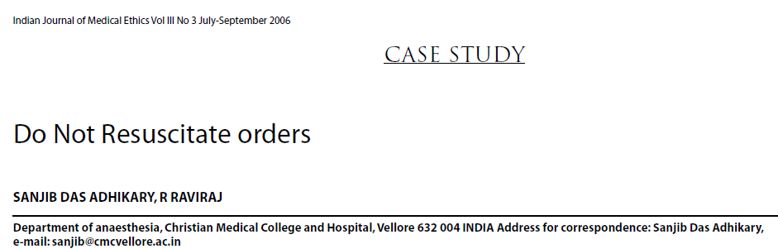

Slide 12
DNR in INDIA
The Do Not Resuscitate (DNR) order is still not
documented legal practice in India.
It is a verbal communication between the clinician
and the patient’s relative or caregiver.
The autonomy of the patient also remains a weak
concept.
Even the right to live a dignified life or die a dignified
death has not been extensively discussed.

Slide 13
The law is silent or ambiguous on most issues related
to end-of-life care. The financial status of the patient
appears to be the deciding factor.
In most cases health-care expenses are entirely borne
either by the patient or by the patient’s relative

Slide 14
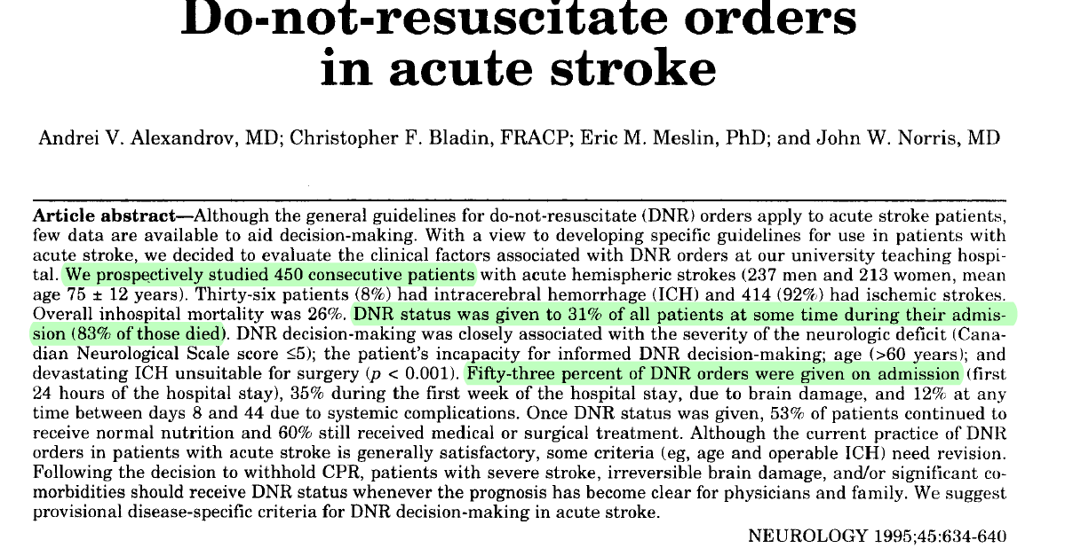

Slide 15
DNR and End of life support in stroke
ICH
Malignant MCA infarction
Basilar artery occlusion

Slide 16
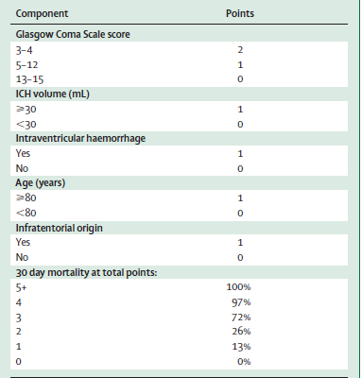
ICH Score

Slide 17
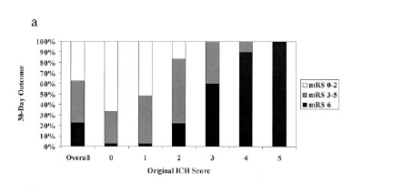

Slide 18
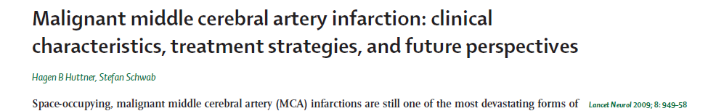
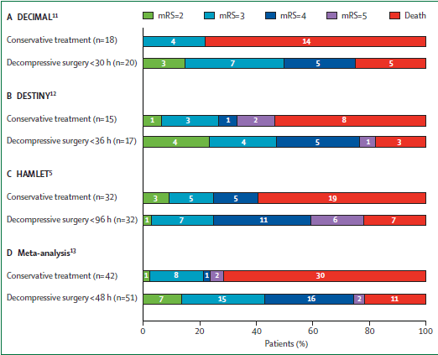

Slide 19
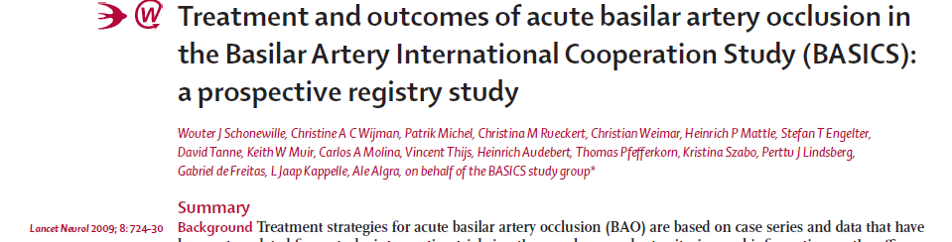
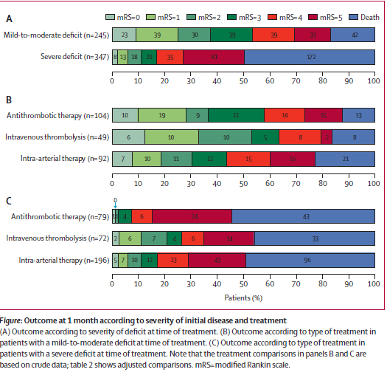
Coma,Locked in state, Tetraplegia
Is considered severe

Slide 20
Several studies have shown that mortality in stroke
patients with DNR orders is much higher than can be
explained by the presence of preexisting comorbidities
illness severity

Slide 21
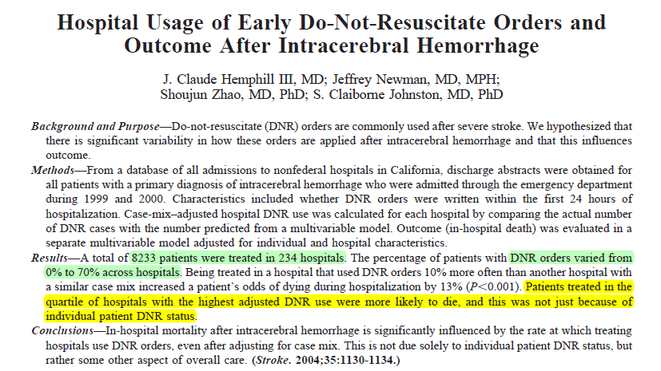

Slide 22
One hypothesis is that DNR patients are treated differently
receiving less aggressive treatment and poorer quality of care.

Slide 23
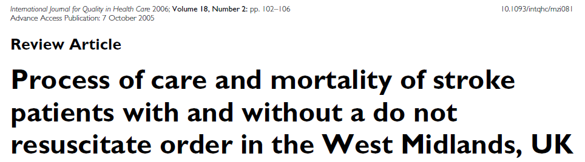
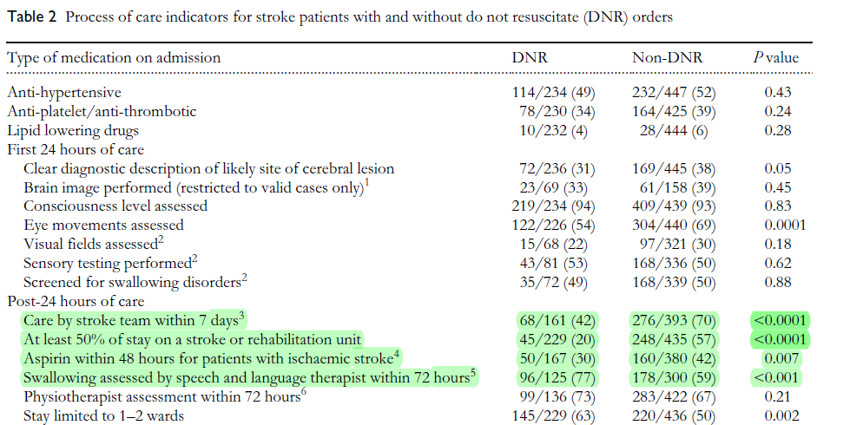

Slide 24
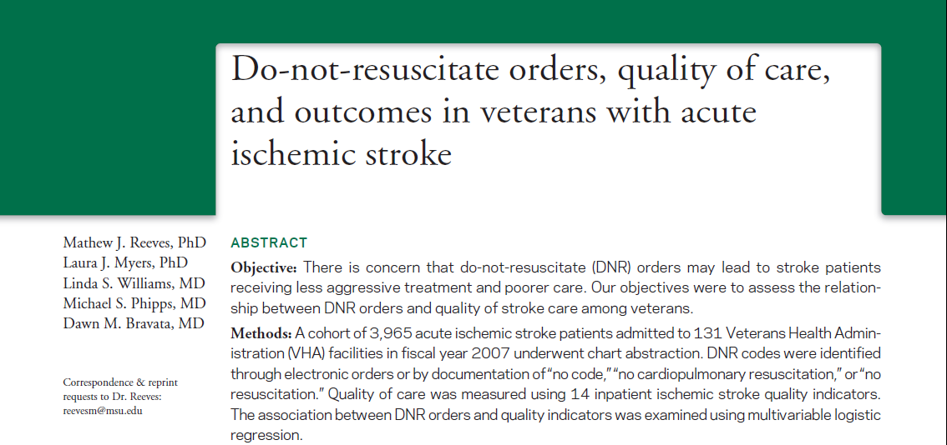

Slide 25
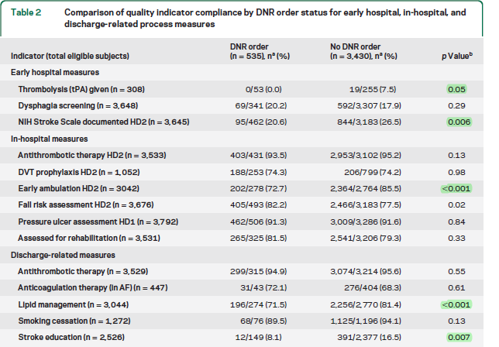

Slide 26
An analysis of over 13,000 stroke patients from 30 area
hospitals in Cleveland found that DNR orders were
significantly less common in teaching hospitals and in
those with religious affiliations

Slide 27
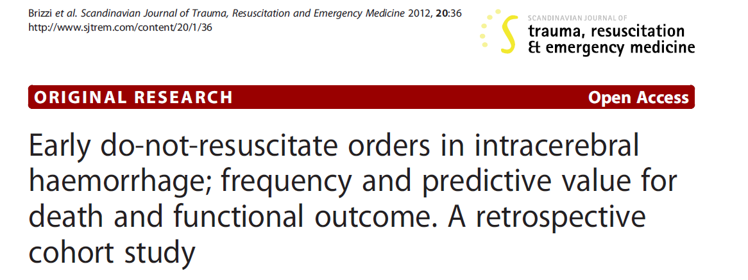

Slide 28
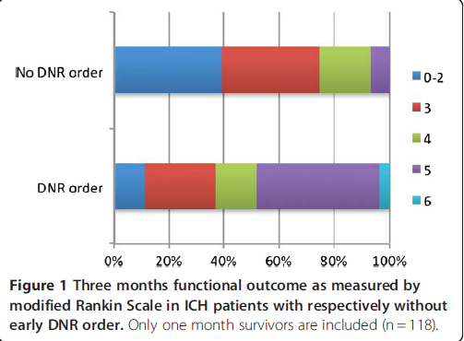
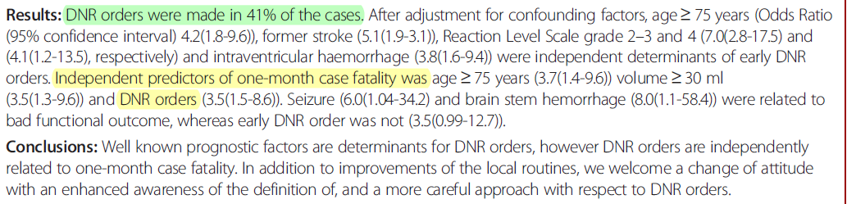

Slide 29
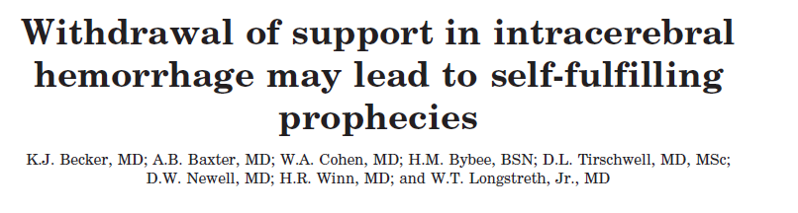
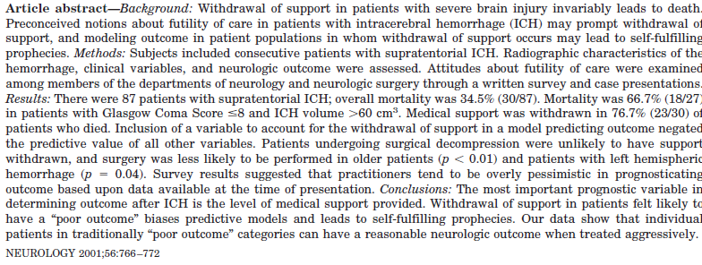

Slide 30
The most important variables for prognostication
of ICH are the hematoma volume and the initial
Glasgow Coma Score (GCS).
Most studies report a 30-day mortality 90% in patients with ICH
Volume 60 to 65 cm3 and GCS <8.
The risk of death increases with the presence of intraventricular
Hemorrhage, Hydrocephalus,active bleeding, the degree of
midline shift etc

Slide 31
The decision to withdraw medical support and life
sustaining therapies is often made when patients with
devastating neurologic injuries are expected to have a
“poor outcome.”
The decision is usually made by a spouse or first
degree relative,as very few patients have written
advanced directives

Slide 32
What constitutes a “poor outcome,” or an outcome in which continued aggressive therapy would be considered “futile,”
is difficult to adequately define.
The definition of futility is most complicated and controversial when applied to the patient with brain-injury

Slide 33
In a study probing issues surrounding withdrawal of
support in the neurologic intensive care unit
(including but not limited to patients with ICH), 17%
of surrogate decision makers felt that the timing of
the first decision to withdraw life support was
premature
Mayer SA et al. Withdrawal of life support in the neurological intensive care unit. Neurology 1999;52:1602–1609.

Slide 34
In the survey by the study group, most physicians appeared to
rely upon the volume of ICH and the GCS In their decision making process.
Withdrawal of support in intracerebral hemorrhage may lead to self-fulfilling prophecies
K.J. Becker et al NEUROLOGY 2001;56:766–772

Slide 35
The patient outcome data, however, suggest that
these criteria may be overly pessimistic in predicting
outcome.
This fact is underscored by the number of patients with
ICH volume > 60 cm3 and GCS score < 8 who not only
survived their hospitalization, but achieved functional
independence

Slide 36
What constitutes an acceptable quality of life can
only be determined by the individual whose life is
being examined.
The clinicians surveyed in this study felt that if a
Patient could possibly recover to a mRS score of 4,
aggressive therapy was warranted.

Slide 37
Several studies, however, show that many individuals
consider major stroke to be an outcome worse
than death
Solomon NA et al. Patient preferences for stroke outcomes. Stroke 1994;25:1721–1725

Slide 38
Despite poor outcome in patients requiring Intubation and mechanical ventilation for stroke, most families that opted for aggressive therapy stated that they would opt for aggressive therapy if the situation presented itself again
Grotta J et al. Elective intubation forneurologic deterioration after stroke. Neurology
1995;45:640–644.

Slide 39

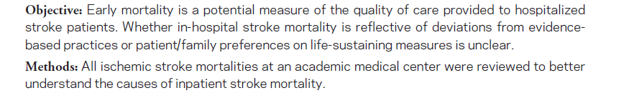

Slide 40
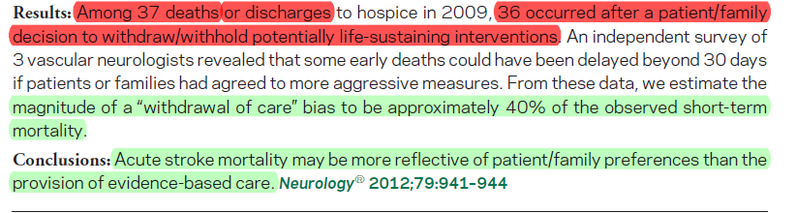

Slide 41
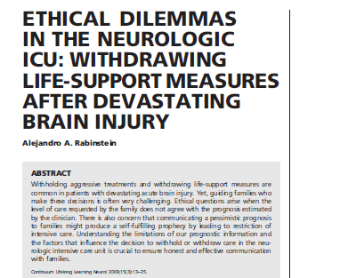

Slide 42
Requesting withdrawal or withholding of life-support
treatments is a right of patients, based in the ethical
Principle of autonomy.
When patients lose decision-making capacity, their
autonomy is not lost. Instead their autonomy is
expressed by a surrogate decision maker.

Slide 43
Withdrawal of life support is the most common
immediate cause of death in the NICU
Diringer et al, 2001, Zurasky et al, 2005.

Slide 44
Providing a prognosis is a fundamental role of
neurologists attending critically ill neurologic patients

Slide 45
When a poor prognosis leads to limitations in the
level of care or withdrawal of life support, it may
Create a self-fulfilling prophecy

Slide 46
UNCERTAINTIES OF PROGNOSIS
Only the combination of coma, loss of all
pontomesencephalic reflexes and absent response to
pain is uniformly predictive of death in these patients
Absolutely no hope? Some ambiguity of futility of care in
devastating acute stroke Rabinstein et al crit care med 2002

Slide 47
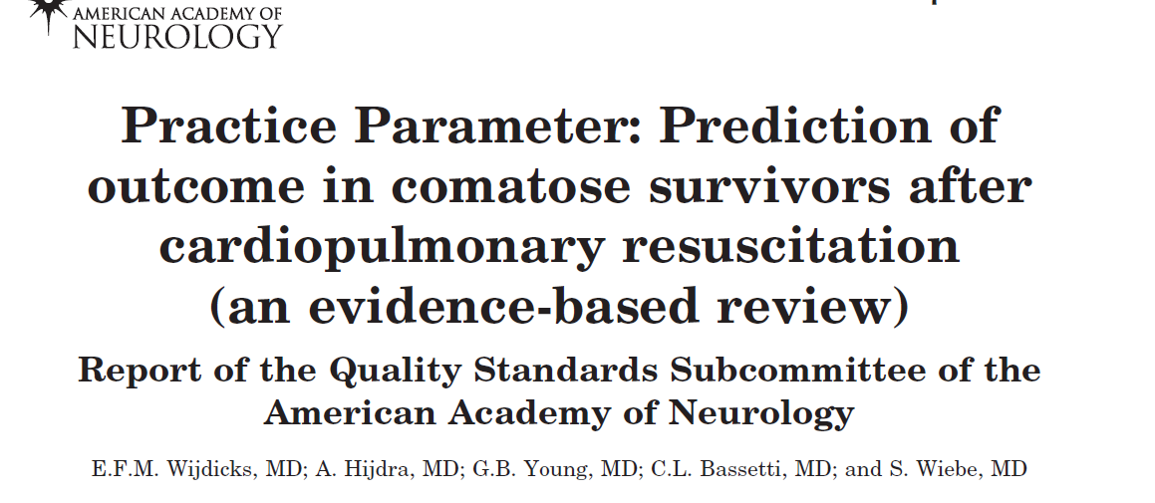

Slide 48
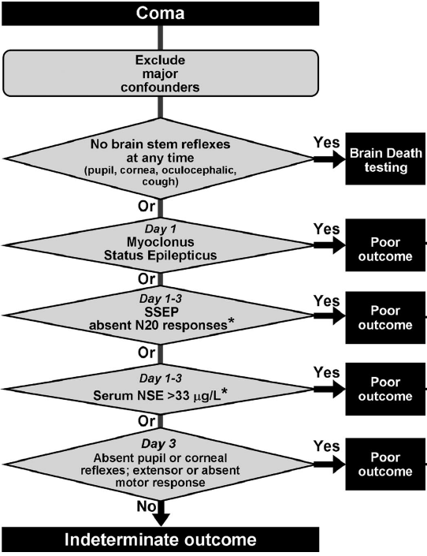

Slide 49

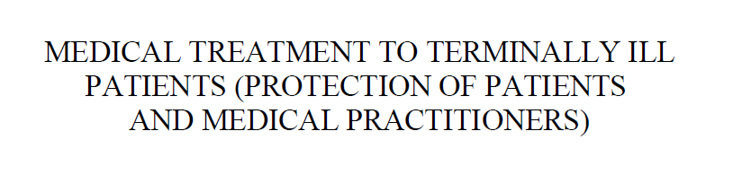
5 major recommendations

Slide 50
A The physician has a duty to disclose to the capable
patient or family, the patient’s poor prognosis with honesty
and clarity when further aggressive support appears non
beneficial
B Physician has to accept patient’s autonomy in making an
informed choice of therapy

Slide 51
C Pending consensus decisions or in the event of conflicts
between the physician’s recommendations and the family’s
wishes, all existing supportive interventions should be
continued
D The discussions leading up to the decision to withhold
life-sustaining therapies should be clearly documented in
the case records. Such documentation should
mention the persons who participated in the decisionmaking
process and the treatments withheld or withdrawn

Slide 52
E If the capable patient or family consistently desires
that life support be withdrawn, in situations in which the
physician considers aggressive treatment non-beneficial,the
treating team is ethically bound to consider withdrawal within
the limits of existing laws

Slide 53
CONCLUSIONS
It is the duty of neurologists to guide families in the
process of deciding the level of care to be provided to
a patient with severe acute neurologic disease.
Premature restrictions of care should be discouraged,
as seemingly desperate cases may improve with
aggressive treatments.

Slide 54
When conveying the prognosis, physicians should rely
on their best estimate based on available published
evidence and personal experience

Slide 55
Prognostic uncertainties must be acknowledged, and
the possibility of producing a self-fulfilling prophecy
should be kept in mind

Slide 56
It is crucial to establish open and honest communication with the family, appreciate cultural differences and respect the family’s values and wishes.

Slide 57
The physician should always avoid being Judgmental or confrontational, even if the decision of the family is strongly contrary to his or her professional advice.
Failing to do so will close the channel of communication and result in otherwise preventable disputes.

Slide 58
After open and comprehensive discussions, the family exercises the right to request withdrawal of life support, the team should be supportive and fulfill their wishes.
Preserving the quality of life and the dignity of death are the physician’s irrevocable responsibilities.

Slide 59
Thank you

