Slide 1
Therapies for Dopaminergic Induced Dyskinesias in Parkinson Disease
Faculty : Dr. Sanjay Prakash

Slide 2
Introduction
L-dopa (LD) is the most effective drug in the symptomatic Rx of PD.
However, the emergence of motor fluctuations and dyskinesias on long term use limits its usefulness.

Slide 3
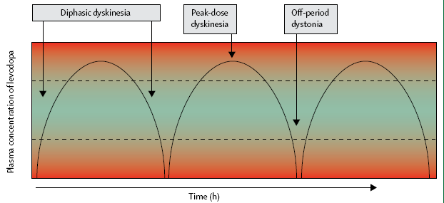
Clinical classification of L-dopa induced dyskinesias (LIDs)

Slide 4
Basic sequence
Peak dose dyskinesias-
Parkinsonism– improvement– dyskinesia–improvement–Parkinsonism (I-D-I)
Diphasic dyskinesias-
Parkinsonism– dyskinesia–improvement– dyskinesia– Parkinsonism (D-I-D)

Slide 5
Clinical phenomenology
Jankovic., Mov dis 2005, Fabbrini et al., Mov dis 2007
Peak dose dyskinesias-
stereotypic, choreic or ballistic movements
involving the head, trunk, and limbs, and occasionally, the respiratory muscles
painless
upper > lower limbs

Slide 6
Diphasic dyskinesias-
dystonic
sometimes painful
lower > upper limbs
OFF period dystonia-
painful dystonia of foot on more affected side. Usually in early morning.

Slide 7
Prevalence with duration of Rx

Slide 8
Risk factors ass with dyskinesias
earlier age at onset, Clin Neuropharmacol 2000
longer duration of disease,
longer duration of L-dopa treatment,
L-dopa dose, ELLDOPA trial Arch Neurol 1999; Mov dis 2002
female sex,
genetic factors (DRD2Taq1A polymorphism). Wang et al., Neurology 2001

Slide 9
Dyskinesias and Quality of Life
Except early stages (i.e., 1st 2 years of Rx), pts with severe dyskinesias had poor QL. Pechevis et al., Eur J Neurol 2005
Peak dose dyskinesias were better accepted by the patients than other forms of dyskinesias. Chapuis et al., Mov dis 2005

Slide 10
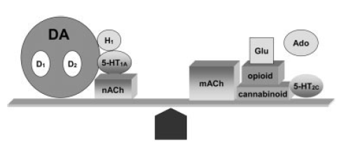
Mechanism
overactivity of the direct striatal output pathway.
Glutamatergic &
Non-glutamatergic influences

Slide 11
Mechanism
chronic pulsatile stimulation of dopamine receptors with L-dopa.
changes in postsynaptic signaling kinases in direct pathway neurons result in increased sensitivity to D1 agonists.
changes in synaptic plasticity and loss of depotentiation.
abnormal levels of phosphorylated DARPP-32, a signaling protein.

Slide 12
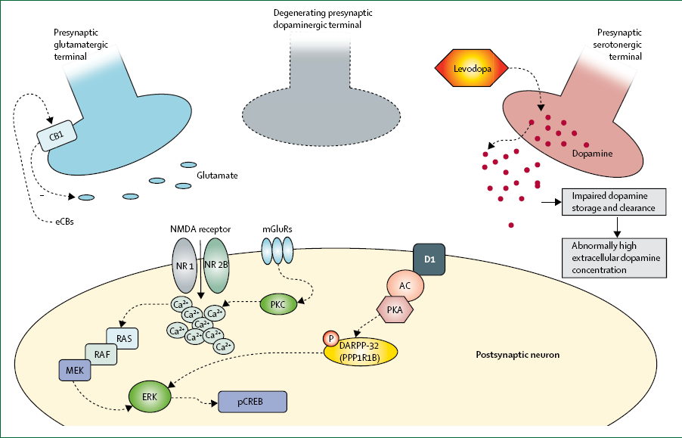

Slide 13
Rating scales
Desired characteristics-
define clinical phenomenology,
assess anatomical distribution,
rate severity of movements,
determine their impact on ADL,
short and easy to use.
None of the available scales fulfill all criteria.

Slide 14

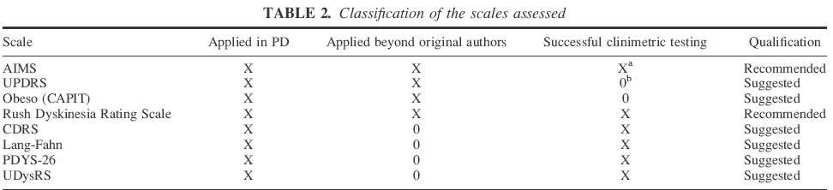
Mov dis 2010

Slide 15
Rx of dyskinesias
Delaying the onset of dyskinesias.
Treatment of established dyskinesias.

Slide 16
Questions to be answered in a PP
Does the therapy have a long lasting effect?
Is the improvement clinically meaningful?
Does the clinical benefits outweigh its side effects?

Slide 17
Delaying the onset of dyskinesias
Rationale behind using dopa agonists (DAs) as initial therapy in PD.
longer t1/2 of DAs ensure more continuous stimulation compared to pulsatile stimulation of dopa receptors seen with L-dopa.
greater potential for D2- than D1-receptor binding seen with DAs than L-dopa.

Slide 18
Pramipexole vs L-dopa as initial therapy
4 RCTs of Parkinson study group have addressed this issue.
A randomized controlled trial comparing pramipexole with levodopa in early Parkinson's disease: design and methods of the CALM-PD Study.
Clinical Neuropharmacol, 2000.
301 eligible pts were randomized to (i) active pramipexole and placebo levodopa or (ii) placebo pramipexole and active levodopa.

Slide 19
After 24 months, pramipexole-treated patients were receiving a mean daily dose of 2.78 mg pramipexole plus 264mg L-dopa, compared with 509 mg L-dopa for those receiving only this agent.
Pts in the pramipexole group had a significantly lower incidence of dyskinesias (9.9% vs 30.7%, p < 0.001).
After a mean 6-year follow-up, >90% of patients ended up receiving L-dopa therapy regardless of their initial treatment assignment.
No diff in the incidence of disabling or painful dyskinesias bet 2 groups.

Slide 20
The mean improvement in the total UPDRS score from baseline to 48 months was greater in the L-dopa group than in the pramipexole group.
Both options resulted in similar quality of life.
Side eff (like somnolence, edema) were more in Pramipexole group.

Slide 21
Conclusion-
L-dopa and pramipexole both appear to be reasonable options as initial dopaminergic therapy for PD, but they are associated with different efficacy and adverse-effect profiles.

Slide 22
Ropinirole vs L-dopa
3 RCTs are available.
Risk of developing dyskinesias after initial monotherapy with ropinirole was less than with L-dopa & delayed the onset of dys by ~ 3 yrs (on subsequent L-dopa addition).
Rascol et al., NEJM 2000; Hauser et al., Mov dis 2007; Watts et al., Mov dis 2010
Many of these pts eventually needed supplemental L-dopa.
Neuropsychiatric complications were more in Ropinirole group.

Slide 23
Conclusion-
Though Ropinirole delays the onset of dys in PD, the long term follow up of such pts does not differ from those on L-dopa from beginning of Rx.

Slide 24
Treatment of established dyskinesias- Antidyskinetic Drugs
NMDA receptor antagonists-
Amantadine
Safinamide
5HT1A agonists-
Sarizotan
5HT2A antagonists-
Clozapine
Adenosine A2A receptor antagonists-
Istradefylline
Preladenant

Slide 25
Nicotinic receptor agonists-
Nicotine
Antiepileptic drug-
Levetiracetam
Cannabinoid CB1 receptor agonists-
Nabilone
Partial agonists at D2, D3 receptors-
Pardoprunox

Slide 26
Amantadine
NMDA receptor antagonist
Evaluated in 1 class II & 2 class IV studies
Reduced the severity of LIDs (up to 60%), without impacting the beneficial effects of L-dopa on motor function.
However, only a small number of pts (n=53 in 3 studies)were evaluated & there was an inadequate or no washout period between treatments.
Metman et al., Neurology 1998; Luginger et al., Mov dis 2000; Snow et al., Clin Neuropharmacol 2000.

Slide 27
Recent study has claimed its long term antidyskinetic effect. Wolf et al., Mov dis 2010
Commonly used at doses of 200 to 300 mg/day.
Side effects like confusion, worsening of hallucinations, edema & livedo reticularis are infrequent.

Slide 28
Conclusion-
Amantadine is effective in alleviating LIDs. Level C recommendation in AAN PP 2006.
Currently the only drug recommended for the treatment of LIDs.
Pahwa et al., Practice Parameter: Treatment of Parkinson disease with motor fluctuations and dyskinesia (an evidence-based review) : Report of the Quality Standards Subcommittee of the American Academy of Neurology, 2006.

Slide 29
Clozapine
Receptor affinity- D4 & 5HT-2A antagonist
Single Class III study available.
Pts (n=50) reported 2-hour ↓ in duration of LIDs without ↑ in the duration of off-periods.
5 pts developed SEs (incl 3 with reversible eosinophilia).
Durif et al., Neurology 2004.

Slide 30
Conclusion-
Clz may be effective in Rx of LIDs (Level U recommendation in AAN PP 2006), moreover SEs limit its utility as a chronic antidyskinetic therapy.

Slide 31
Continuous Delivery Methods
Rationale for use-
Chronic pulsatile stimulation of DA receptors is associated with the induction of LIDs.
In animal studies (MPTP-induced parkinsonism), cabergoline, a D2 agonist with a relatively long t1/2,added to oral L-dopa/benserazide (100/25mg) for 1 month, produced significantly lower dyskinesia scores than when L-dopa was given alone (p < 0.01).
Belanger et al., Mov dis 2003.

Slide 32
Subcutaneous Lisuride
Single RCT available.
40 pts were randomized to receive either sc lisuride (n=20) or to continue on oral L-dopa (n=20).
All pts in L-dopa group and 18/20 pts in lisuride group completed all visits over 4-year period.
Lisuride Rx pts improved their baseline dyskinesia scores (measured by AIMS) by 49%, whereas scores worsened by 59% (p < 0.0001) in the L-dopa group.
Fabrizio et al., Brain 2002.

Slide 33
No deterioration of motor fn (as measured by UPDRS) was noted in lisuride group.
Most commonly encountered adverse events in the lisuride group were mild skin nodules (11 patients).

Slide 34
Conclusion-
Continuous Lisuride infusion can be beneficial in advanced PD with dyskinesias.

Slide 35
Subcutaneous Apomorphine
Receptor sensitivity- D2, D3 & D4 and to a lesser extent with D1 receptors.
Mode of use- acute intermittent Rx of hypomobility esp in advanced PD (US)/ continuous subcutaneous infusion (Europe & Canada).

Slide 36
Role in dyskinesias-
1 Class I & 5 open label studies.
Summary of studies-
mean maximum ↓ of dyskinesia per patient ranged from 31-64%
Colzi et al., JNNP 1998
pts were able to ↓ their daily L-dopa intake by 55% & upto 33% were able to completely discontinue oral L-dopa.
Katzenschlager et al., Mov dis 2005

Slide 37
Most common adverse events-
Panniculitis (skin nodules), skin inflammation that was overcome by rotation of injection site & cognitive or psychiatric disturbances.

Slide 38
Conclusion-
Apomorphine sc can be an alternative to pts who experience severe motor complications that are unresponsive to oral Rx & have an adequate home monitoring/ support system (Level C recommendation in AAN PP 2006).

Slide 39
Intraintestinal L-Dopa
Solubility is a limiting factor for continuous IV infusions of L-dopa.
An alternate strategy is direct intraintestinal infusion of L-dopa–carbidopa using a suspension of micronized L-dopa in a methylcellulose gel (Duodopa) and a portable infusion pump.

Slide 40

N=91
Mean age -72.7 years.
Average disease duration- 17 years.
Patients were at advanced stage: 91% had gait disorders, 65% had visual hallucinations, and 50% were demented.
Follow up- 18 ± 8.4 months.
David et al., Mov dis 2009

Slide 41
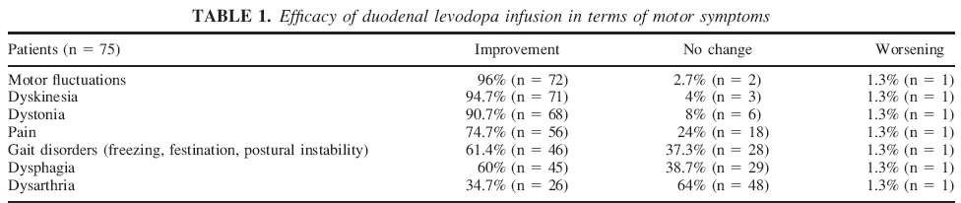
Adverse events- 2 had psychosis, technical issues were limiting factors.
Conclusion: Duodopa is an effective last-line therapy for motor complications in PD esp those having CIs for apomorphine or neurosurgical Rx. Hence, technical improvements and earlier introduction should be considered.

Slide 42
Other Compounds in Early-Stage
Development
Fipamezole (α2-Adrenergic Receptor antagonist)-
In 1 previous study, it ↓ the severity of LIDs by 23% and 31% at 60mg and 90mg, resp, without affecting antiparkinsonian response. Lewitt et al., Mov dis 2009
Results of a recent phase 2B trial is awaited.
Presynaptic adr
Postsynaptic GABAergic
Direct pathway neuron
LIDs

Slide 43
Preladenant (Adenosine A2A receptor antagonist)
A single RCT incl 253 pts with mean f/u of 12 wks showed increase in awake time spent in the on-state of 1.4 h/day (5 mg) and1.3 h/day (10 mg) respectively compared to 0.2 h/day in the placebo group, without overall worsening of dyskinesias. Hauser et al., Lancet neurol 2011.

Slide 44
Nicotine
Early epidemiologic studies suggest nicotine as a neuroprotective therapy.
Nicotinic activation (α4b2 and α6b2 subtypes on dopaminergic terminals) has been found to trigger DA release.

Slide 45
A study in MPTP lesioned primates, in which nicotine was administered for several weeks prior to L-dopa administration (5mg/kg twice daily), resulted in a 50% ↓ in dyskinesias without impacting the effect of L-dopa on parkinsonian deficits.
Wonnacott S., Trends Neurosci1997

Slide 46
Levetiracetam
An AED that binds to synaptic vesicle protein, SV2A.
3 open label studies.
Most promising data comes from a study of 9 pts experiencing LIDs for at ~25% of waking hours. Zesiewicz et al., Mov dis 2005
After Rx with LVT (mean, 625mg) for 60 days, pts experienced ~ 42% ↑ in on-time without dyskinesia.
Dose-related CNS depressant effects were reported frequently.

Slide 47
Pardoprunox
Receptor affinity- partial agonist at D2/D3 and a full agonist at 5HT1 recp.
In 2 studies, a significant ↑ in on-time without troublesome dyskinesias was observed after 2 weeks, 5 weeks and 7 weeks.
Additionally, a low incidence of dyskinesias was reported spontaneously as an adverse event (3.9%).
Hauser et al., Eur Neurol 2009; Bronzova et al., Mov dis 2010

Slide 48
Safinamide
MOA- MAO type B inhibitor and ↓ overactivity of glutamatergic signaling by inhibiting glutamate release.
Low-dose safinamide provided additional on-time (0.5–0.7 hours) compared to placebo without increasing troublesome dyskinesias in patients with advanced PD.
Meshram et al., Mov Dis 2010

Slide 49
Transcranial Magnetic Stimulation
The effect of rTMS on various aspects of motor fn in PD is evaluated in 2 meta-analyses.
Fregni et al., JNNP 2005; Elahi et al., Mov Dis 2009.
The effect size (on motor component of UPDRS) was 0.62 & 0.58 respectively.
However, in the 2nd review, high freq TMS was more effective than low freq.

Slide 50
Putative MOA- TMS effects are primarily directed at surface cortical regions. Since the dopaminergic deficiency in PD is localised to the subcortical basal ganglia, the beneficial effects of rTMS on PD are somewhat indirect.
rTMS induces network changes that affect basal ganglia function.
rTMS to cortical sites compensates for abnormal changes in cortical function associated with PD.
The effect of rTMS to modulate LIDs is assessed in 2 small studies, which showed improvement.
Brusa et al., Clin Neurophysiol 2006; Shukla et al., Neurology 2007

Slide 51
In study by Shukla et al., published in Neurology 2007; 6 pts with PD included.
Inclusion criteria were1) stable medication dose for 4 weeks, 2) LID > 25% of waking hours.
900 stimuli (15 minutes) at 1 Hz and 90% of resting motor threshold for FDI muscle was delivered at the same time for 10 consecutive days.
Both peak and mean dyskinesia scores were significantly lower for day 15 compared to day 0.

Slide 52
Conclusion:
Larger studies are needed.
Method (eg, stimulation pattern electrode placement, pulse frequency) needs optimization.

Slide 53
Stereotactic surgery- Pallidotomy
> 20 open label studies and few RCTs demonstrated that u/l pallidotomy ↓ LID on the side contralateral to the lesion.
U/l pallidotomy can ↓ dyskinesia severity by 75% in the contralateral limbs and a mean ↑ of 2.8 hours in daily ON time without dyskinesias.
Verhagen et al., Mov dis 2005; Vitek et al., Ann neurol 2003.

Slide 54
Conclusion-
U/l pallidotomy is considered Likely Efficacious and Clinically Useful for the treatment of LID (Level C acc to MDS review recommendations).
Goetz et al., Mov dis 2005
B/l procedure is ass with severe permanent SEs, hence not recommended.

Slide 55
DBS
B/L STN DBS is the preferred procedure for advanced PD pts having disabling LID
Multiple uncontrolled & few RCTs report dyskinesia reduction by ~70%.
Deuschl et al., NEJM 2006
Clinical improvement incl reduction of dyskinesias, may last up to 5 years.
Krack et al., NEJM 2003
Common SEs include ICH (4%), Infection (1.5%) & device malfunction.

Slide 56
B/l globus pallidus (GPi) stimulation has been explored as a Rx for LID in several open studies with an overall improvement of dyskinesias severity by 41 to 87%.
Deep-Brain Stimulation for Parkinson Disease Study Group. NEJM 2001.

Slide 57
Conclusion-
b/l DBS of STN is possibly effective in reducing dyskinesias (Level C recommendation in AAN PP 2006).
Though several reports show a favourable trend, there is insufficient data to recommend b/l GPi DBS for dys Rx (Level U recommendation in AAN PP 2006).
Also DBS may be preferable over surgery in view of its potential reversibility.

Slide 58
Effect of STN stimulation on dyskinesias- SCT experience
Asha Kishore et al., Mov dis 2010
45 pts who ↓went b/l STN stimulation for PD at SCT from 1999 to 2004 participated in the study.
All subjects were assessed in open-label conditions using UPDRS I–IV 1 week before surgery (baseline) and at yearly intervals for 5 years with ‘‘drug off’’ and ‘‘drug on’’ assessments.

Slide 59
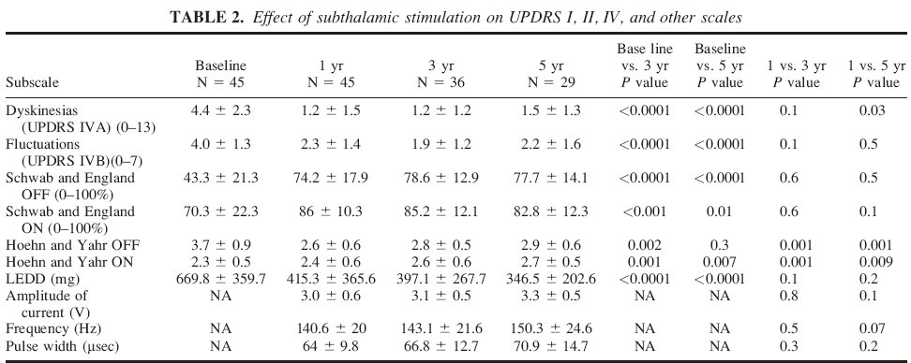
Scores for dyskinesias (UPDRS IV A) improved from baseline by 72% and motor fluctuations (UPDRS IV B) by 52% at 3 yrs and by 66% & 45% resp, at 5 yrs.

Slide 60
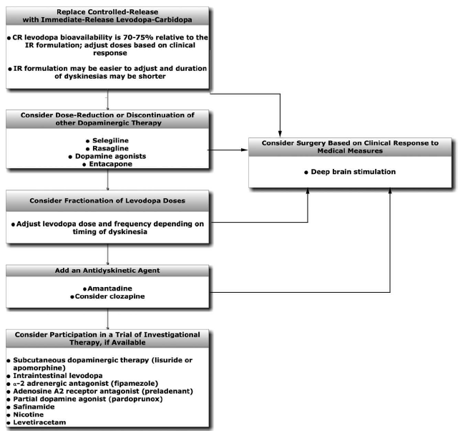
Algorithm for Rx of LIDs esp peak dose

Slide 61
Algorithm for Rx of off period dystonia
Bed time L-dopa CR/ DA
Chew/ crush L-dopa tab, take with carbonated beverage
Add baclofen/ anticholinergic
Botulinum toxin injection

Slide 62
Algorithm for Rx of diphasic dyskinesias
Smooth out response oscillations by adding DA/ COMT inh/ ↑ freq of administration
Subcutaneous apomorphine
DBS
Intraintestinal L-dopa

Slide 63
Thank u

