Slide 1
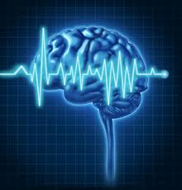
Physiological basis of eeg
Faculty : Dr. Kaushik Rana

Slide 2
SCHEME
Physiological basis of scalp potentials
Physiological basis of biological rhythms
Basis of spikes and other transients
Breach rhythm

Slide 3
    EEG is a graphic representation of the difference in voltage between two different scalp locations plotted over time
    The scalp EEG signal generated by cerebral neurons is modified by
    electrical conductive properties of the tissues between the electrical source and the recording electrode on the scalp
    conductive properties of the electrode
    the orientation of the cortical generator to the recording electrode

Slide 4
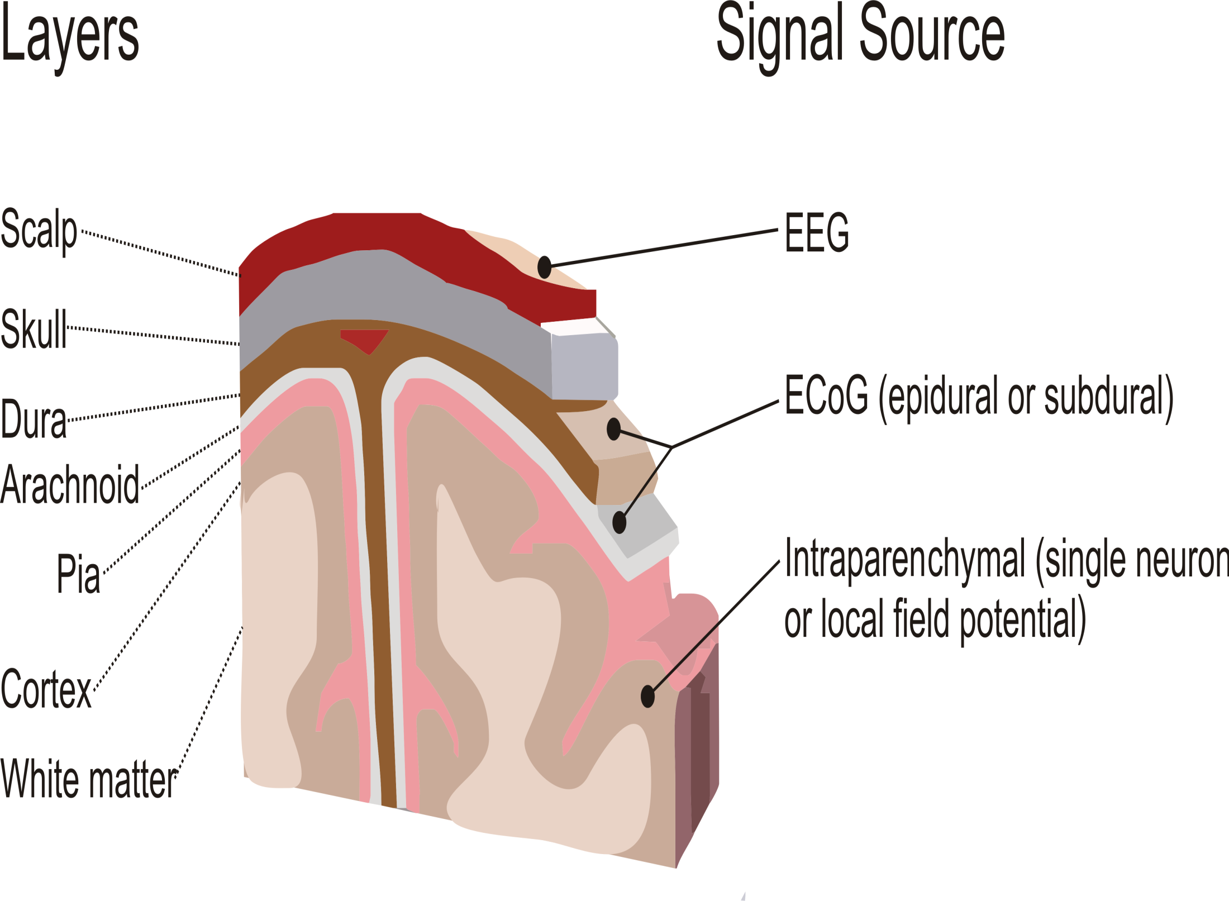

Slide 5
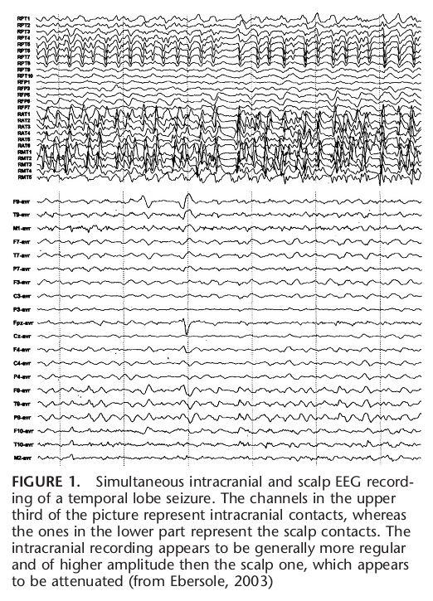

Slide 6
Sources of extracellular current
1. Fast (Na+) action potentials
2. Synaptic activity
3. Calcium spikes
4. Intrinsic spike afterhyperpolarizations
5. Neuron-glia communication

Slide 7
SYNAPTIC SOURCES OF EEG
Most significant source of EEG potentials
Each synapse acts like a battery driving current in a small loop
Both EPSPs and IPSPs contribute to the synaptic activity recorded as EEG
Summation of extracellular currents is slow enough to be able to generate EEG potentials

Slide 8
SOURCE OF EEG
An electrode placed at the scalp cannot detect electrical changes in a single neuron because:
1) the potentials are small in magnitude
2) there is considerable distance from the cell to the scalp surface

Slide 9
However, two cortical properties permit to record the brain’s electrical potential
First, pyramidal cells have the same relative orientation and polarity
Second, many cells are synchronously activated

Slide 10
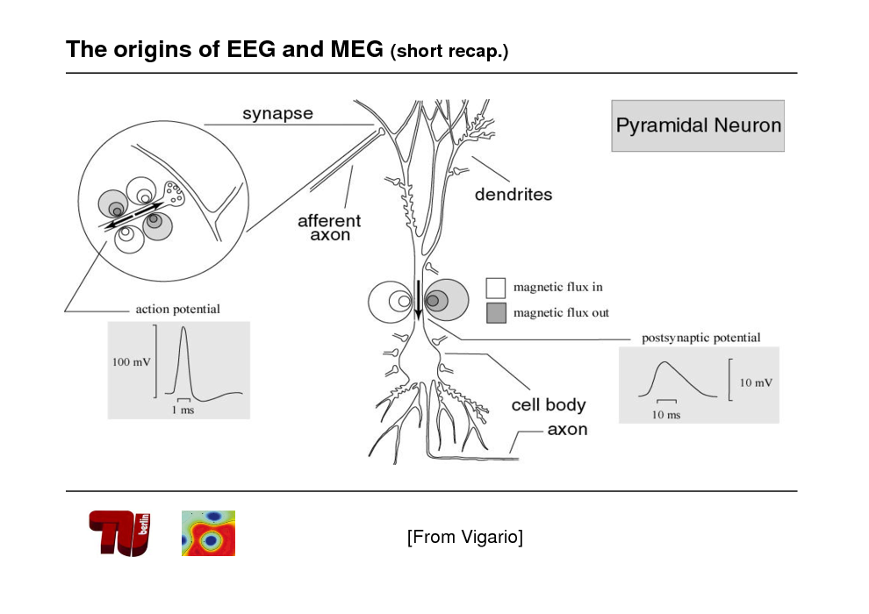

Slide 11
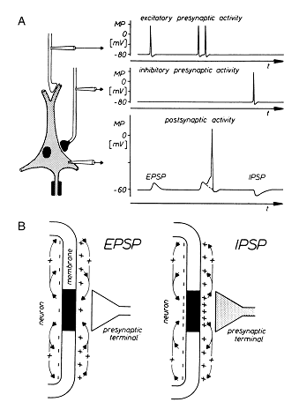

Slide 12
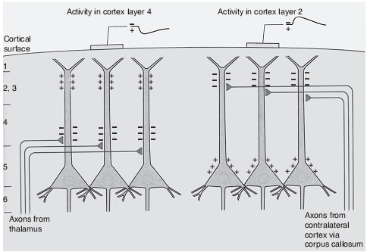

Slide 13
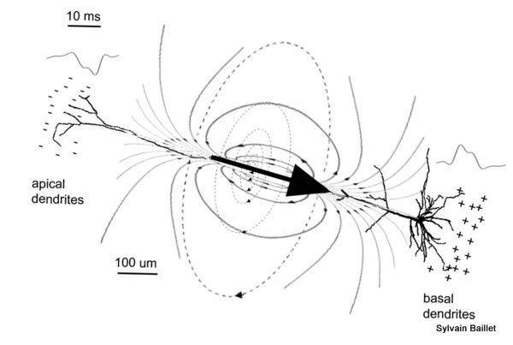

Slide 14
CORTICAL GENERATORS OF EEG
Combined synchronous electrical activity of approx 108 neurons in a cortical area of minimum 6 sq.cm to create visible EEG
The area of cortex required for the generation of interictal spikes may be as large as 20 sq.cm generally that found at gyral surfaces.
The cortex that faces the cortical sulci generally does not contribute to the EEG potentials because the cortical dipoles generated in this location cancel each other.

Slide 15
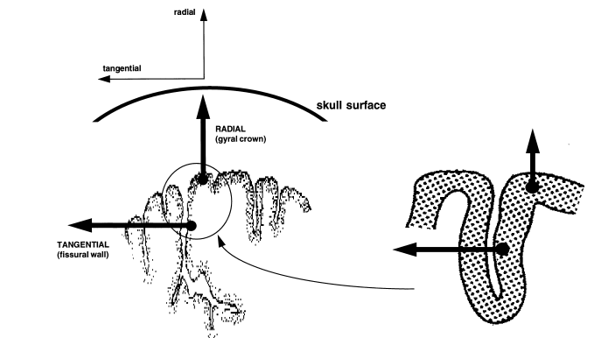
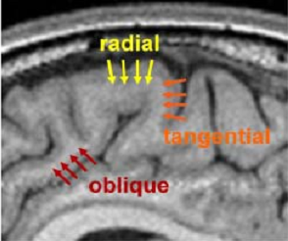

Slide 16
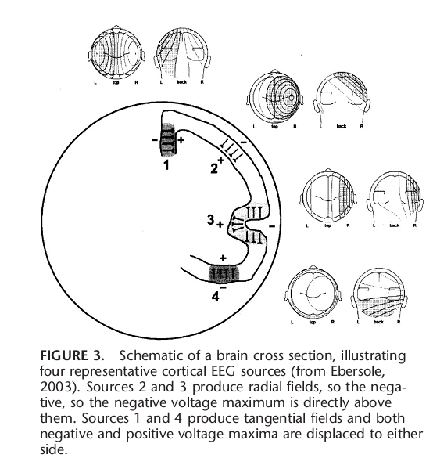

Slide 17
INTRINSIC NEURONAL SOURCES
Calcium-mediated action potentials (calcium spikes) are voltage generated and occur synchronously with dendritic EPSPs
They can contribute to the creation of the dendritic field sinks, especially during epileptiform activity

Slide 18
INTRINSIC SPIKE AFTERHYPERPOLARIZATION
Intrinsic spike after hyperpolarization (AHP) following dendritic Ca spikes results in suppression of fast spikes and hyperpolarization of the membrane caused by activation of the Ca –mediated K+ conductance. These AHPs are comparable in amplitude and duration to the synaptic events and may contribute to extracellularly recorded EEG potentials

Slide 19
GLIA
An augmentation of the extracellular potassium concentration (potassium activity) causes depolarization of glial cells
Neuronal activity is associated with outflow of potassium ion and hence to glial cell depolarization

Slide 20
NEURON–GLIA INTERACTIONS
The astrocytes are connected by gap junctions that allow spread of current and diffusion of molecular transport
This coupling allows spreading Ca 2+ waves triggering calcium influx into the neurons. Postictally increased K+ levels produce propagating waves across the astrocytes manifested by slowly spreading sustained potentials
Astrocytes release more K+, depolarizing the neurons and blocking the after discharge with resulting postictal depression

Slide 21
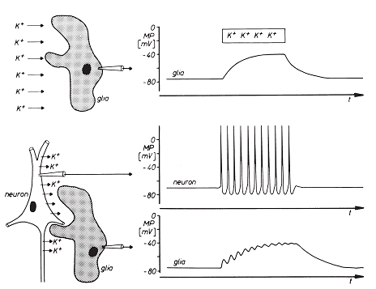

Slide 22
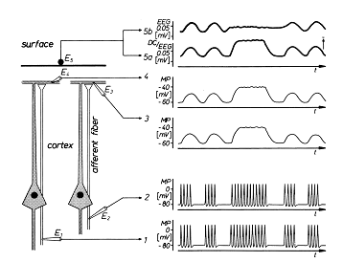

Slide 23
ALPHA BAND
During relaxed wakefulness, brain exhibits pronounced rhythmic electrical activity in the α frequency band (8–13 Hz)
3 main components:
the classic occipital α rhythm
the Rolandic µ rhythm
third rhythm

Slide 24
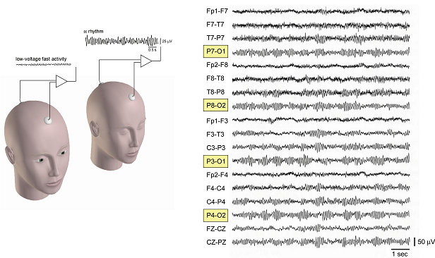

Slide 25
ALPHA RHYTHMS
2 key cellular thalamic mechanisms
Rhythmic burst firing, termed high threshold (HT) bursting which occurs in a specialized subset of thalamocortical (TC) neurons
Interconnection of this subset via gap junctions (GJs)

Slide 26
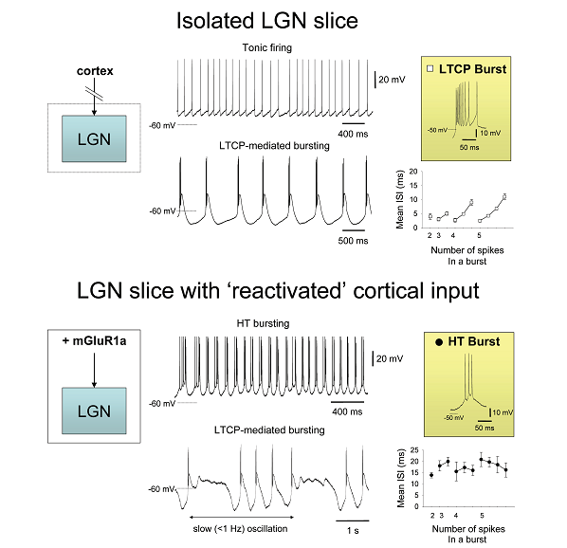

Slide 27
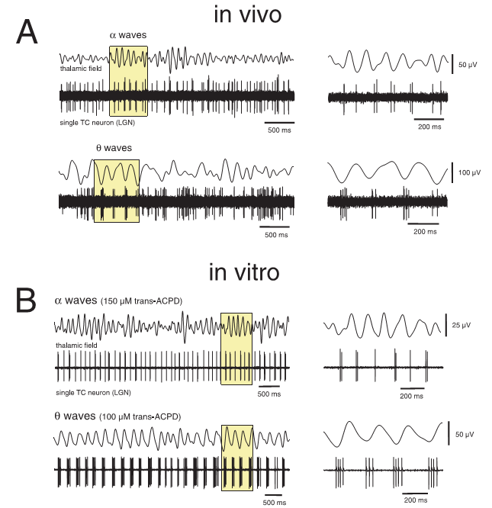

Slide 28
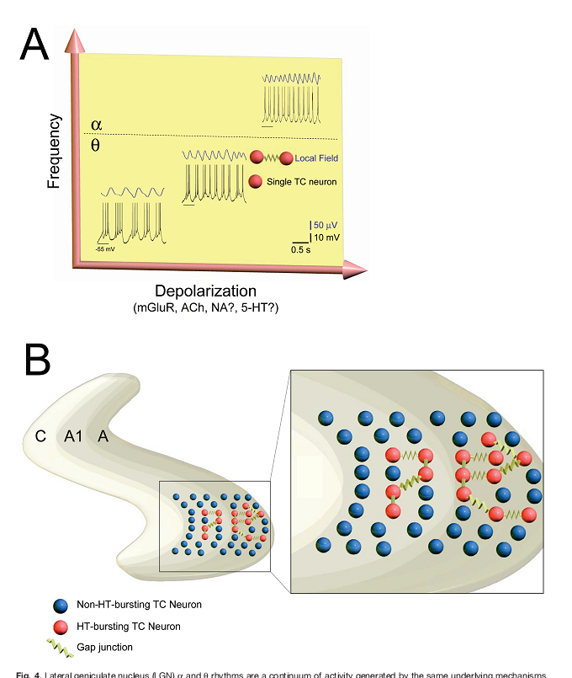

Slide 29
At the thalamic level, α and θ waves form a continuum of activity that is determined by the same intrinsic neuronal behavior

Slide 30
BETA – GAMMA RHYTHMS
Primarily generated in the cortex itself
Visual cortex , somatomotor cortex, olfactory cortex
The simplest form of gamma rhythm can be seen in networks of interneurons - Interneuron Gamma ( ING )

Slide 31
DELTA RHYTHMS
Frequency band 0- 4 Hz
There are two cellular sources of delta activities: thalamus and the cortex.

Slide 32
Delta wave generation is based on the summation of long-lasting AHPs of layer V pyramidal neurons
During sleep, pyramidal cells of the neocortex often fire bursts in response to rhythmic thalamic volleys and these bursts, in turn, can trigger Ca²⁺-mediated K⁺-conductance changes

Slide 33
The long-lasting nature of AHP favors the summation of outward somatic currents of individual pyramidal cells resulting in a local positive field in deep layers
Such extracellularly summated currents were hypothesized to form the basis of slow delta EEG waves recorded during sleep

Slide 34
The reason why delta waves occur only during slow wave sleep is because subcortical neurotransmitters, such as basal forebrain and brainstem cholinergic neurons, locus coeruleus cells, neurons of the raphe nuclei and hypothalamic histaminergic neurons neurotransmitters are released mostly in the awake brain and the common property of these neurons is to reduce the calcium-mediated potassium conductance
These actions of subcortical neurotransmitters at the cellular level therefore result in the blockade of delta waves.

Slide 35
SUBCORTICAL SYNCHRONIZATION OF EEG
The dorsal thalamus is considered as the chief subcortical EEG rhythm generator synchronizing populations of neocortical neurons as voltage generators
In normal conditions both thalamic nuclei and cortical regions interact to produce the synchrony of cortical postsynaptic potentials (PSPs) during wakefulness and sleep

Slide 36
Facultative pacemaker theory
The facultative pace-maker theory assumes that thalamocortical relay neurons send fibers to the cortex as well as give off branches that turn back and end on thalamic inhibitory interneurons (biofeed-back servomechanism).

Slide 37
Nucleus reticularis hypothesis
Nucleus reticularis hypothesis attributes the pacemaker properties to the nucleus reticularis thalami, whose cells release the inhibitory neurotransmitter GABA in rhythmic bursts of depolarizations directed to the neurons of the dorsal thalamus and rostral brainstem

Slide 38
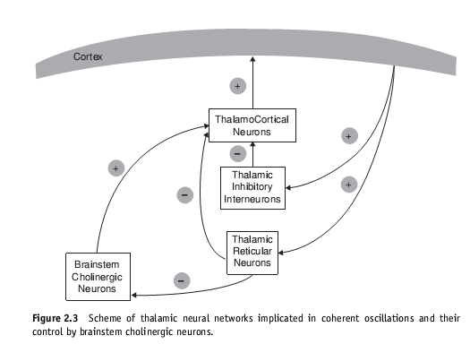

Slide 39
SUBCORTICAL EEG DESYNCHRONIZATION
Desynchronization of the EEG is the interruption of its rhythmical activity
It occurs with activation of ascending cholinergic projections of the basal forebrain and brainstem and projections from the raphe nuclei and locus ceruleus

Slide 40
Rhythmical activity is interrupted by both direct effects on cortical neurons and indirectly on thalamic neurons
At the cellular level, desynchronization is accompanied by a transition from a burst firing pattern to more continuous or single spike pattern

Slide 41
Seizure initiation is characterized by two concurrent events:
1) high frequency bursts of action potentials, and
2) hypersynchronization of a neuronal population
The synchronized bursts from a sufficient number of neurons result in a so called spike discharge on the EEG

Slide 42
PAROXYSMAL DEPOLARISING SHIFT
Cellular substrate of epilepsy
It begins with a calcium mediated depolarization, followed by opening of voltage-gated sodium channels and relatively synchronized action potentials, seen as a “spike” at the surface

Slide 43
As positive charge moves into the cell, a negativity is recorded at the surface. Inhibitory inputs to the axon hillock follow the spike. This results in an influx of negative charge at the axon and an outflux of negativity at surface. This is seen as a slow surface negativity, i.e. “slow-wave

Slide 44
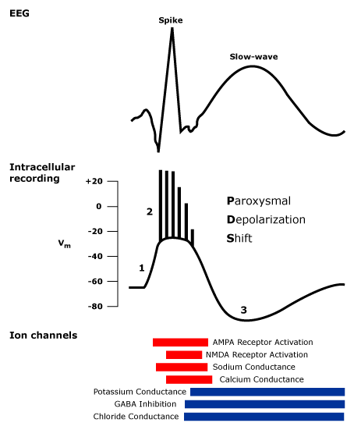

Slide 45
Seizure propagation- the process by which a partial seizure spreads within the brain, occurs when there is sufficient activation to recruit surrounding neurons
This leads to a loss of surround inhibition and spread of seizure activity into contiguous areas via local cortical connections, and to more distant areas via long association pathways such as the corpus callosum.

Slide 46
Repetitive discharges lead to
1) an increase in extracellular K⁺, which blunts the extent of hyperpolarizing outward K⁺ currents, tending to depolarize neighboring neurons
2) accumulation of Ca⁺⁺ in presynaptic terminals, leading to enhanced neurotransmitter release
3) depolarization-induced activation of the NMDA receptor, which causes more Ca⁺⁺ influx and neuronal activation

Slide 47
High frequency oscillations
(HFOs)
Represent short-term neuronal synchronization
HFOs can be divided into ripples (80-250 Hz) and fast ripples (250-500 Hz)
Ripples can be recorded from normal hippocampus
Fast ripples are typically associated with epileptic brain and though to represent local abnormally synchronous action potentials

Slide 48
Neuronal (Intrinsic) Factors Modifying Neuronal Excitability
Ion channel type, number, and distribution
Post-translational modification of channels (phosphorylation, etc)
Activation of second-messenger systems that affect channel function (e.g. G proteins)
Modulation of gene expression of ion channels

Slide 49
Synaptic Factors Modifying Neuronal Excitability
Alterations in expression of transmitter gated ionotropic channels
Post-translational changes in neurotransmitter channels
Remodeling of synapse location or configuration (deafferentation, sprouting)
Changes in gap-junction synaptic function

Slide 50
Non-synaptic (Extrinsic) Factors Modifying Neuronal Excitability
⬧ Changes in extracellular ion concentration
Changes in extracellular space
⬧ Modulation of transmitter metabolism or uptake by glial cells

Slide 51
Mechanisms of Generating Hyperexcitable Networks
Excitatory axonal “sprouting”
Loss of inhibitory neurons
Loss of excitatory neurons “driving” inhibitory neurons
Change in neuronal firing properties (channelopathies)

Slide 52
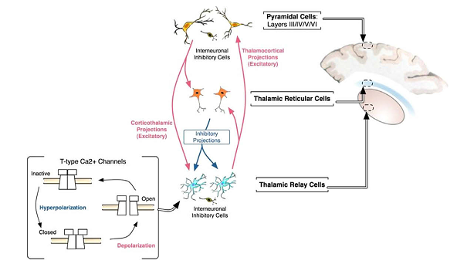
GENERALISED EPILEPSY

Slide 54
The thalamic relay neurons can activate the cortical pyramidal neurons either in a tonic mode, which occurs during wakefulness and rapid-eye-movement (REM) sleep, or in a burst mode, which occurs during non-REM sleep
The burst mode is made possible by T-type calcium channels, which allow for low-threshold depolarizations on which bursts of action potentials (mediated by voltage-gated sodium channels) are superimposed.

Slide 55
The mode of thalamocortical activation — tonic or burst — is controlled largely by input from the thalamic reticular neurons, which hyperpolarize the relay neurons, allowing them to fire in bursts
The reticular neurons can themselves be inhibited through recurrent collaterals from neighboring reticular neurons.Both cortical pyramidal neurons and thalamic relay neurons project to the reticular neurons to complete the circuitry.

Slide 56
In normal non-REM sleep, thalamic relay neurons in the burst mode activate the cortex in a rhythmic, bilaterally synchronous way, creating visible EEG patterns, such as sleep spindles
This “sleep state” of the thalamocortical circuit is in contrast to the normal “awake state,” in which the thalamic relay neurons are firing in the tonic mode and thalamocortical projections are transferring sensory information to the cortex in a nonrhythmic manner
In absence epilepsy, the abnormal circuit causes rhythmic activation of the cortex (typical of normal non-REM sleep) during wakefulness, which results in the characteristic EEG discharges and clinical manifestations of an absence

Slide 57
Enhanced burst firing in thalamic networks may be important for the transition from sleep spindles to spike-and-wave seizures
This increased burst firing may be mediated by increased IPSP durations in thalamocortical cells and by increased EPSPs in Nrt cells, leading in both cases to enhanced calcium spikes.

Slide 58
In summary, GABA A receptors have the potential to make the oscillation frequency∼10/s, roughly in the range of the spindle-wave discharge
However, if GABA B receptors are also strongly activated, the oscillation frequency will be∼3–4 Hz

Slide 59
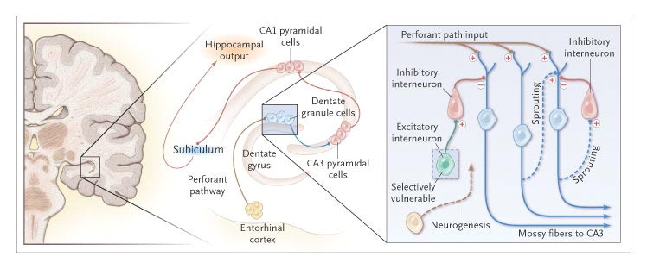

Slide 61
REFERENCES
Neurophysiologic Basis of EEG .Piotr Olejniczak .J Clin Neurophysiol 2006;23: 186–189
Basic physiology of the EEG .Neurology Asia 2011; 16 (Supplement 1) : 23 – 25
Niedermeyer's Electroencephalography: Basic Principles, Clinical Applications, and Related Fields. 6th Edition . 2010

Slide 62
REFERENCES
Thalamic Mechanisms of EEG Alpha Rhythms and Their Pathological Implications – Neuroscientist 2005 11: 357
Epilepsy . Chang BS Lowenstein DH N Engl J Med 2003; 349:1257-1266

Slide 63
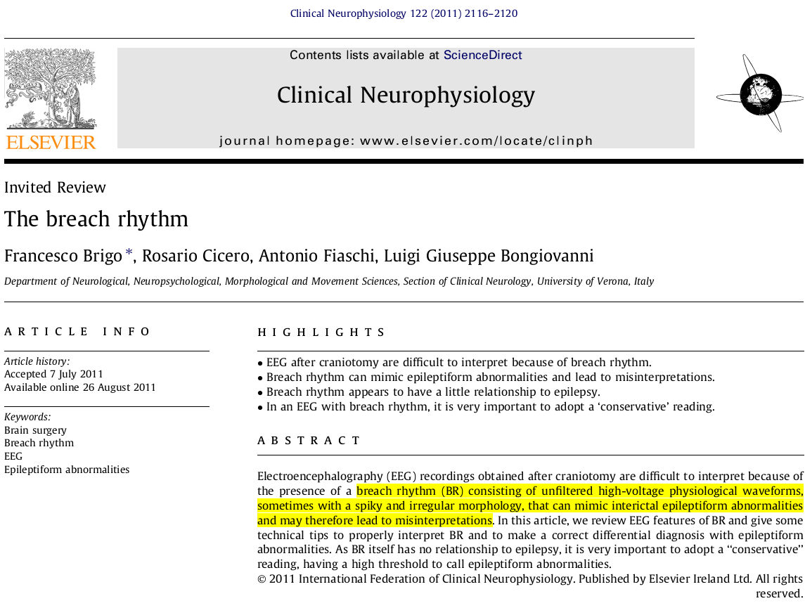

Slide 64
BREACH RHYTHM
Breach rhythm or breach effect is defined as a focal increase in the amplitude activity
of alpha, beta and mu rhythms which tends to develop over or near the area of a bony skull defect, such as after craniotomy or cranial surgery (Cobb et al, 1979)
Bone acts as a filter attenuating higher frequencies

Slide 65
Absence of bone therefore results in a significant increase in current from cortex to scalp, so that BR represents unfiltered brain activity through a skull defect
It is an expected physiologic consequence of a skull defect

Slide 66
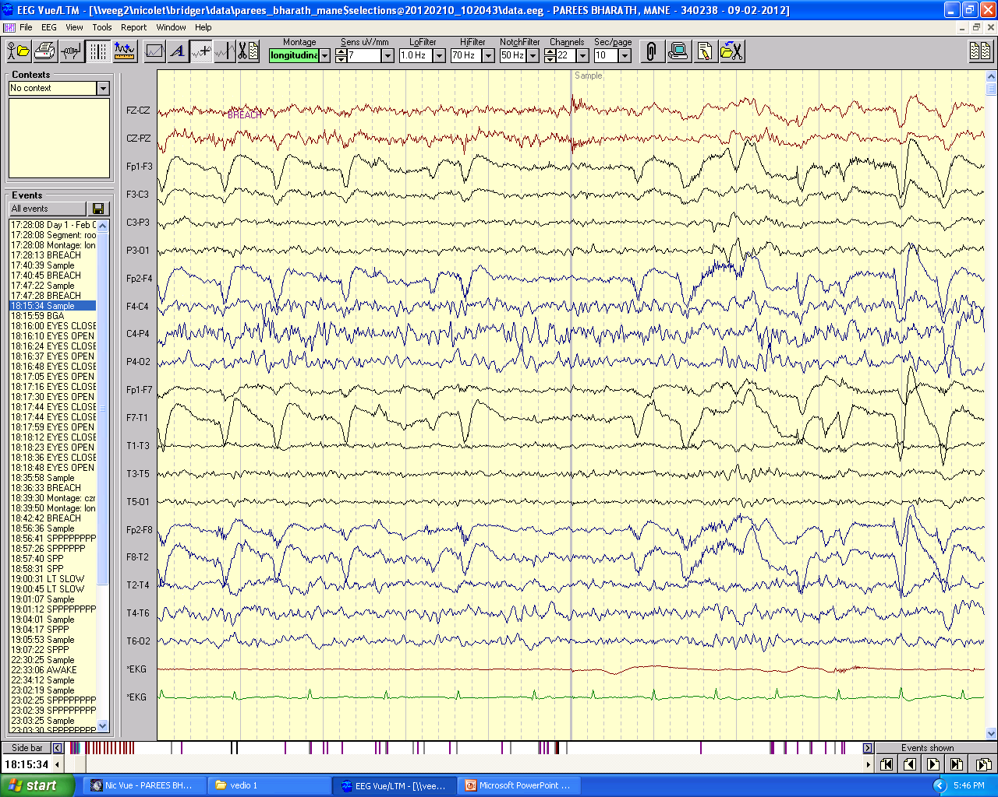
Asymmetry-increased right(Breech)

Slide 67
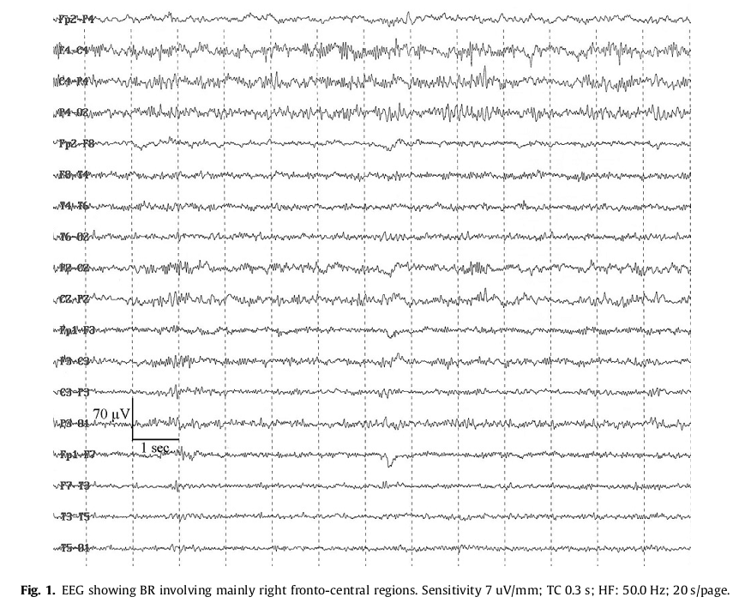

Slide 68
(1) In pure BR there are no after-going slow waves
(2)In pure BR there is no spread of ‘‘suspicious activity’’ to other areas
(3) Sleep recordings - BR may attenuate in amplitude or disappear. Sleep has great impact on activation of interictal epileptiform abnormalities
(4) The reactivity of BR, when present, is therefore indicative of a normal pattern, such as that of an enhanced underlying mu rhythm; however, the lack of reactivity does not rule out the presence of a normal pattern (such as ‘‘third rhythm’’ of temporal lobe)

Slide 69
(5) EEG filters should be used carefully: reducing too much high frequency filters’ values to attenuate the BR, may filter out the higher frequencies of BR, so that what is left could actually resemble spikes /sharp-waves
(6) In case of excessively high amplitude, reducing sensitivity may be useful to better analyse EEG features of BR, so that sometimes epileptiform abnormalities may be more easily legible

Slide 70
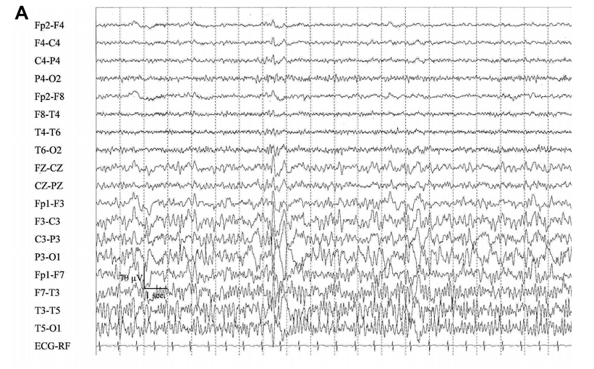

Slide 71
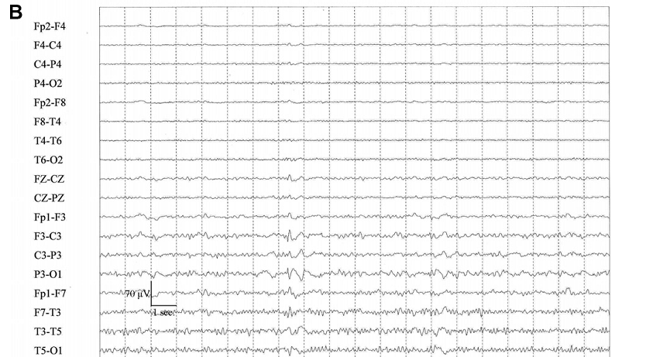

Slide 72
(7) Progression of a lesion (e.g., tumour) beneath the skull defect or burr hole should be suspected if serial EEG recordings show attenuation of pre-existing high amplitude and/or the presence of focal slow waves.

Slide 73
THANK YOU

