Slide 1
SIADH, CSW, DI
DR BHAGWATI SALGOTRA

Slide 2
DEFINITIONS
SIADH :-AKA Schwartz-Bartter syndrome..There is release of ADH hormone in absence of physiological (osmotic)stimuli resulting in hyponatremia with hypervolemia or euvolemia with inappropriately high urine osmolality.
Should be distinguished from cerebral salt wasting

Slide 3
CEREBRAL SALT WASTING: Renal loss of sodium as a result of intracranial disease resulting in hyponatremia and a decrease in extracellular fluid volume .
DIABETES INSIPIDUS: This is due to insufficient ADH resulting in high output of dilute urine, high serum sodium with normal or high serum osmolality

Slide 4
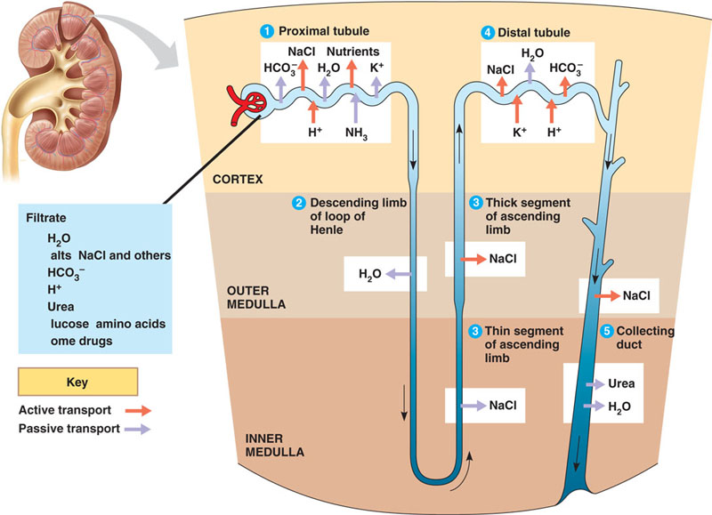

Slide 5
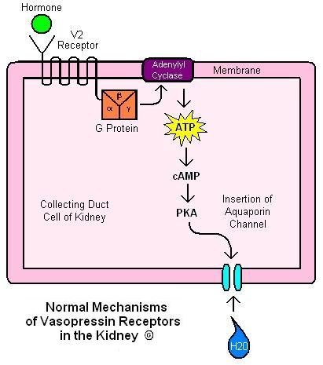
ADH-ANTIDIURETIC HORMONE

Slide 6
PLASMA AND URINE OSMOLALITY
Osmolality is the number of osmoles of solute in a kilogram of solvent. (mOsmol/kg).
osmolarity is the number of osmoles of solute in a litre of solution.(mOsmol/L)
Osmolality and osmolarity are units of measurement.

Slide 7
Plasma Osmolality:
= 2 x Na + glucose + BUN
18 2.8
Normal = 2 (140) + 5 + 5 = 290 (275-290 mM)
Urine Osmolality:
    Normal: 400-500 mM
        Maximal dilution 50-100 mM (U_{SG} 1.002-1.003)
        Maximal concentration 900-1200 mM (U_{SG} 1.030-1.040)

Slide 8
URINE SPECIFIC GRAVITY
Urine Specific gravity is the ratio of density of urine compared to the density of fresh water at 4°C (39° F). At this temperature the density of water is at its greatest value and equal 1 g/mL. Since specific gravity is a ratio, so it has no units.
Normal:- 1.003 to 1.010

Slide 9
    Normal Plasma osm is 0.8-1.0% heavier than water so P_{SG} = 1.008-1.010
Each ↑ in U_{OSM} 30-35 mM ↑ U_{SG} by 0.1% (0.001)
Therefore, U_{SG} of 1.010 ~ U_{OSM} 300-350 mM
Larger MW substances (glucose, radiocontrast,) if present will falsely elevate U_{SG}
Nothing falsely lowers U_{SG}

Slide 10
NORMAL SODIUM LEVELS
Normal sodium level =135 to 145 mmol/L
Hyponatremia= less than 135
hypernatremia= more than 145

Slide 11
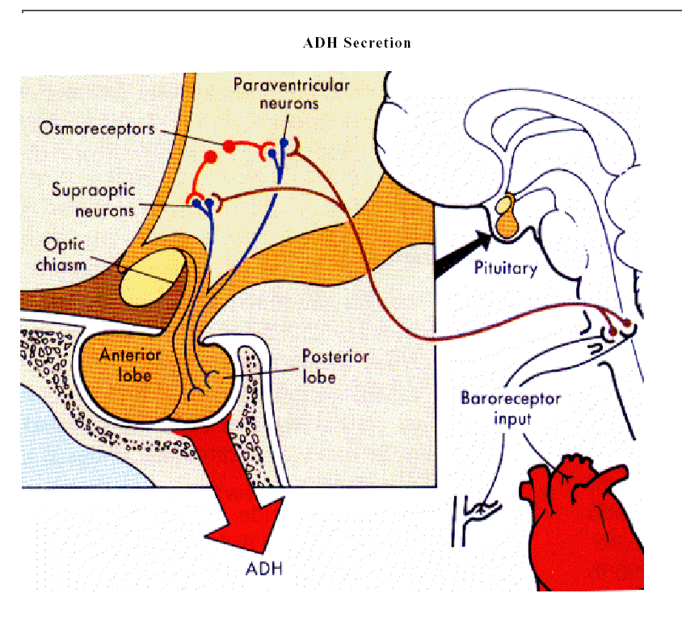

Slide 12
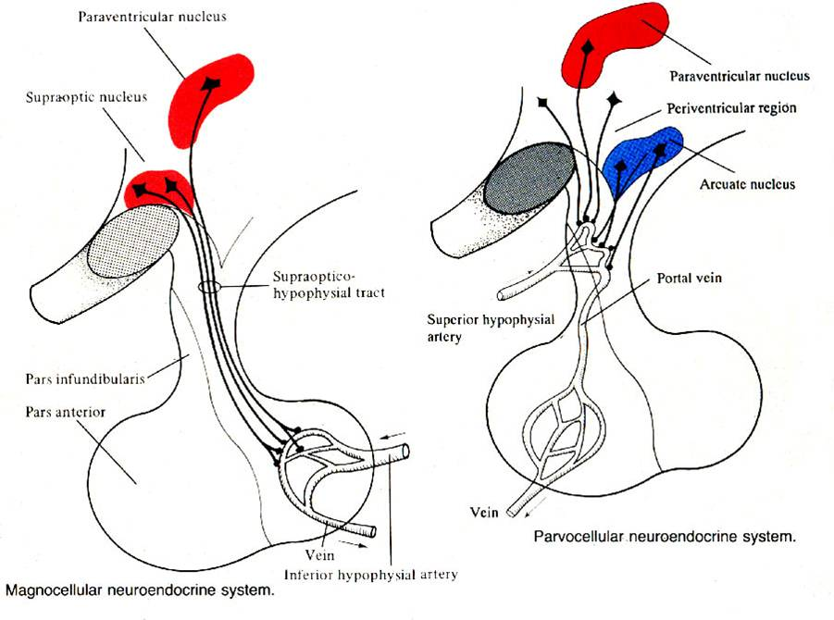

Slide 13
SIADH
Etiologies of SIADH
CNS Disorders-Head trauma
increased ICP
brain tumors
S.A.H
cavernous sinus thrombosis
multiple sclerosis
Guillain-Barre syndrome
delirium tremens
CNS infections- encephalitis
meningitis T.B and Bacterial
Brain Abscess
AIDS

Slide 14
Drug induced- phenothiazines
tricyclic antidepressants
Monoamine oxidase inhibitor
Serotonin reuptake inhibitor
chlorpropamide
vincristine
Carbamazepine
vasopressin
Neoplasms
Endocrine disturbance
Metabolic causes

Slide 15
SIADH
Diagnosis
↓ serum Na
Low serum osmolality
High urine sodium > 20 mEq/L
High ratio of urine : serum osmolality
Normal renal function,adrenal function
No hypothyroidism
Treatment
Fluid Restriction
Salt suppliment
Lasix 20 mg po od-bid: Loop direct diminishes medullary gradient
Demeclocycline 300-600 mg bid (can be nephrotoxic)
Conivaptan:antagonist of V1a and V2 receptor
Lithium (induces NDI)

Slide 16
Water load test
Patient is given 20ml/kg free water or up to 1500 ml of fluid.
In absence of any adrenal or renal insufficiancy patient should void
65% of fluid load in 4 hour
Or 80% of fluid load in 5 hours
Failure to do this indicates SIADH

Slide 17
Cerebral Salt Wasting
Renal loss of sodium due to Cerebral disease (particularly SAH)
Produces hyponatremia and decreases ECF volume
Mimics SIADH with hyponatremia except primary defect is salt wasting not water retention.
Exact mechanism not known,probable Circulating factor which impairs renal tubular function are.
    Atrial natriuretic peptide?
    Brain natriuretic peptide?
Lab tests are similar to SIADH

Slide 18
MANAGEMENT OF CSW
Goal is to volume replacement and positive salt balance
Hydrate the patient with 0.9% normal saline
3% N.S
Fludracortisone 0.2mg i.v qid.
Rapid correction of hyponatremia sould be avoided.

Slide 19
SIADH v.s. Cerebral Salt Wasting
 | SIADH | CSW
Serum Na | ↓ | ↓
ECFv | NormaL | ↓
U_{Na} | ↑ | ↑↑
U_{OSM} | ↑ | ↑
Urine volume | N or ↓ | ↑
CVP | N or raised | ↓
Serum osmolality | reduced | N or ↑

Slide 20
DIABETES INSIPIDUS
Due to low level of ADH
High output of dilute urine(< 200 mOsmol/L, and SG < 1.003)
High serum sodium
Normal or high serum osmolality
Craving for water
Pt may suffer dehydration if not managed

Slide 21
Diabetes Insipidus
Central (CDI)
Idiopathic(autosomal dominant)
  autoimmune
Neurosurgery, head trauma
Cerebral hypoperfusion
Tumor
  Craniopharyngioma, pituitary adenoma, suprasellar meningioma, pineal gland, metastasis
Brain death:hypothalamic production ceases
Central herniation;
Infiltration
  NeuroSarcoidosis, Histiocytosis X
Nephrogenic (NDI)
X-linked recessive
Hypokalemia
Hypercalcemia
Renal disease: after ATN, postobstructive uropathy, RAS, renal transplant, amyloid, Sickle cell anemia
Sjogren’s Syndrome
Drugs:
  Lithium, 20% of chronic users
  Demeclocycline, amphotericin, colchicine

Slide 22
DIAGNOSIS
Urine osmolality :< 200mOsmo/L
Urine specific gravity: <1.003
Inability to concentrate urine to >300mosmol/L in presence of dehydration
High volume dilute urine output: >250ml/h
Normal of high sodium levels
Normal adrenal function.

Slide 23
Water Deprivation Test
NPO for 8 hours
Check urine output and urine osmolality per hour
Normal respose: urine output decreases and urine osmolality rises to 600-850mosmol/L
If patient fails to give normal response then:
give endogenous ADH i.e Pitressin 5U SQ
Check urine osmolality 30 and 60 minute later
Compare highest urine osmolality after Pitressin to osmolality before giving Pitressin

Slide 24
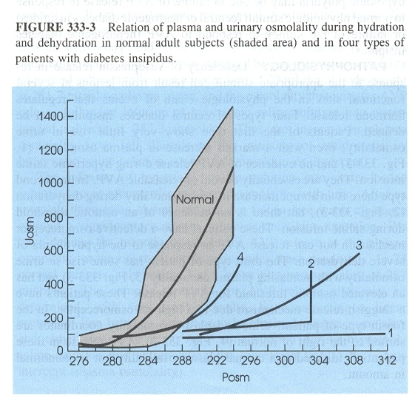
5% increase in urine osmolality-normal
6-67% increase – partial deficience of ADH
67% increase - sever deficience of ADH

Slide 25
Management of Diabetes Insipidus
Conscious Ambulatory patient with Intact thirst & access to water
    Mild symptoms: First instruct to drink only when thirsty
    Sever cases….. high-normal serum sodium (142-145 mEq/L)
    Sever Polydipsia (crave cold fluids)
    Polyuria, Nocturia → sleep disturbance
    then treatment is pharmacological
Conscious ambulatory patient with Impaired thirst or access to water:
    Monitor urine output and daily weight.
    Treantment is taking free water and pharmacological
    Check labs weekly

Slide 26
Non-ambulatory comatous or stuporous patients
Monitor urine output , urine specific gravity,serum electrolyes and serum osmolality
Give i.v fluids
Pharmacological treatment
Pitressin-5U SQ 4-6/q
Vasopressine drip-0.2U/min and then titrate
Desmopressin inj.-2 to 4 mcg daily in divided doses and titrate

Slide 27
Case: Pt presents with Severe hyponatremia delirium in emergency
IV fluid therapy is administered, and serum sodium is normal by the next day.
The patient's mental status improves, and he or she is more alert, but this is followed by neurologic deterioration 48-72 hours later.
Key features of the neurologic exam include confusion, horizontal gaze paralysis, pseudobulbar palsy and spastic quadriplegia.

Slide 28
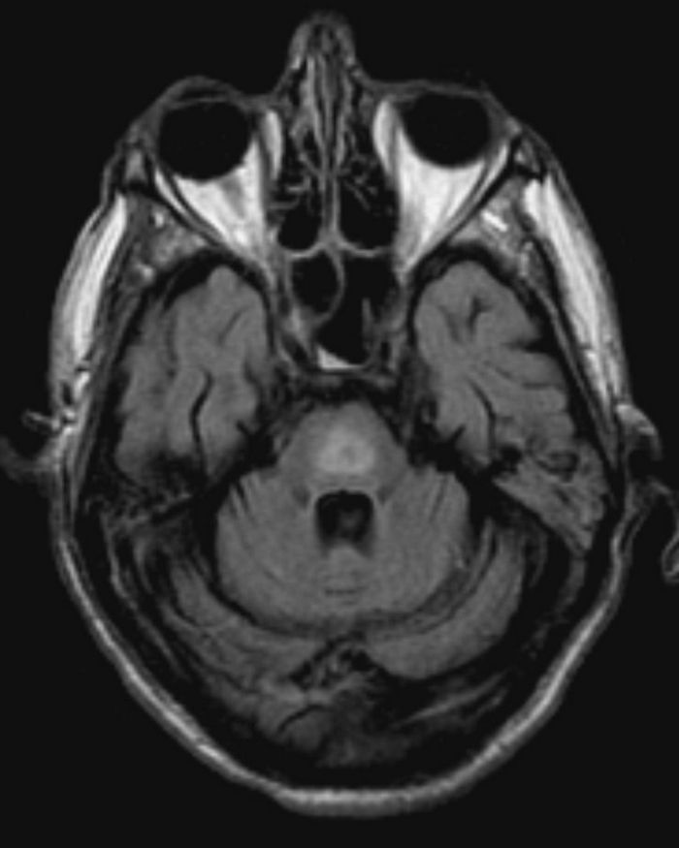
Central pontine myelinolysis

Slide 29
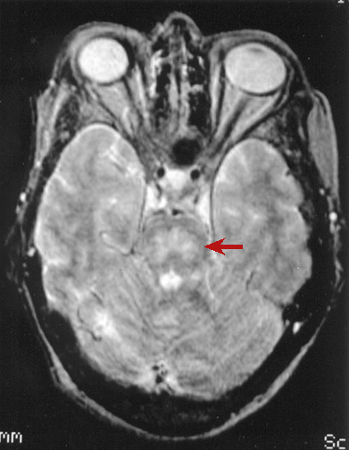

Slide 30
Central pontine myelinolysis is frequently symmetric, noninflammatory demyelination within the central basis pontis.
In at least 10% of patients with central pontine myelinolysis, demyelination also occurs in extrapontine regions, including the mid brain, thalamus, basal nuclei, and cerebellum. The exact mechanism that strips the myelin sheath is unknown.

Slide 31
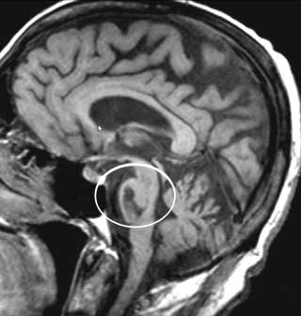

Slide 32
Hyponatremia
Serum OSM
Low
Normal
High
Marked hyperlipidemia
(lipemia, TG >35mM)
Hyperproteinemia
(Multiple myeloma)
Hyperglycemia
Mannitol
Hypotonic
Hyponatremia
*Note: all have ↑ADH
SIADH: inappropriate
Rest: appropriate
ECFv *
Low
High
Normal
CHF
Cirrhosis
Nephrosis
Hypothyroidism
AI
SIADH
Water Intoxication
1° Polydipsia
TURP post-op
Renal loss (U_{Na} > 20)
  Diuretics
    Thiazide
    K-sparing
  ACE-I
  Cerebral salt wasting
Extra-renal loss (U_{Na} <10)
  Bleeding
  Burns
  GI (N/V, diarrhea)
  Pancreatitis

Slide 33
Hyponatremia
Hypovolemia- salt and water suppliment
Hypervolemia:-salt and water restriction
- loop diuretics
Normovolemia:-water restriction

Slide 34
Change in serum Sodium
= Infusate Na /L - serum level
TBW + 1
0.9% NaCL = 154 mEq/L Na
3.0% NaCL = 513 mEq/L Na

Slide 35
Hypernatremia
Hypernatremia is most commonly due to water deficit and not due to sodium overload
Water Deficit= plasma Na – 140 x TBW
140

Slide 36
Thank you

