Slide 1
INFANTICIDE
Dr Lavlesh Kumar
Professor & Head
Forensic Medicine
SBKS MI & RC, SVDU

Slide 2
Learning objectives
Definitions
Live born, Dead born & Still born
Features of Dead born
Acts of commission and Omission in infant deaths
Battered baby death syndrome
Sudden infant death syndrome
Munchausen syndrome by proxy

Slide 3
Infanticide
Unlawful killing of an infant
Sec 302 IPC
No difference b/w Homicide & Infanticide
Presumption of Law : Live/Dead
Birth:
Indian Law Vs English Law
Commonly committed by widows , unmarried girls

Slide 4
Why to conduct Autopsy on Infants
To determine :
Still born or dead born
Whether viability attained or not
The degree of maturity
If live born; length of survival
The Cause of death
Act of commission and Omission leads to death

Slide 5
Still birth, dead born, maceration
Still born: born after 28th week of gestation, live in utero, do not exhibit any sign of live after completely born
Dead Born: dead in utero : Rigor , maceration
Maceration : Aseptic Autolysis
Features: Earliest sign: detachment of bronchial linings with degeneration of nuclear structure
Earliest X Ray feature: Gas shadow in the aorta

Slide 6
Viability of infant
210 days of IUL/ 180 days
Features of Viable child
End of seven month: 35 cms, 1-1.5 kg, eyelids open, nails reach up to tip of finger, meconium in entire large intestine, testes at external inguinal canal, placenta 35-400 g , center of ossification in talus

Slide 7
Full term fetus
50 cms, 2.5-4 kg, thick scalp hair, lanugo hair only on shoulders, testes in scrotum, nail projects beyond the tip of finger, meconium in rectum, umbilicus midway between pubis and xhiphoid process, centre of ossification in lower end of femur and sometimes in cuboid and upper end of tibia. Placenta 22 cms in diameter, 1.5 cm thick, 1 kg weight, umbilical cord 1 cm thick, 50 cm long

Slide 8
Rule of Haase
Rough method to calculate the age of fetus.
Length is measured in cms from crown to heel
First 5 months of pregnancy, square root of length gives age of foetus in lunar months
Eg. 25 cms is 5 month old
After 5 month, length is divided by 5, gives age in lunar month
E.g. 40 cms is 8 months old

Slide 9
Signs of live birth
Chest
Diaphragm: 3rd-4th rib ..... 6th-7th rib
Lungs
Unrespired : Lies close to spine, margins sharp, solid, firm, reddish brown color, wt 30-40 gm; 1/70 th of the body weight, sp gravity: 1040 -1050
Respired : fill the chest cavity, margins rounded, pink color, wt- 60- 80 gms (double) (Fodere’s test); 1/35th of body weight (Ploucquet’s test) and sp gravity 940 (Hydrostatic test)

Slide 10
Hydrostatic test
Based on the principle that specific gravity of the lungs before respiration is 1040-1050 and it becomes 940 after respiration because of the increase in volume and areation
Procedure:
Fallacies of the test:
Expanded lungs may sink from: a. Disease (Pnumonia, acute oedema, congenital syphilis b. Atelectasis
Putrefaction,; Artificial inflation
Test is unnecessary when:
1. Child is born before 180 of gestation,2. Monster 3. Macerated, 4.umbilicus helaled and separated, 5.milk in stomach

Slide 11
MCQ 1
Still birth is foetal death, occurring after
A. 20 weeks
B. 24 weeks
C. 28 weeks
D.32 weeks

Slide 12
MCQ 2
The process of aseptic autolysis is known as
A. Mummification
B. Maceration
C. Adipocere
Putrefaction

Slide 13
MCQ 3
The test in which weight of lung is considered to know the live birth is
A. Hass test
B. Fodre’s test
C. Hydrostatic test
D.Breslaus test

Slide 14
MCQ 4
To confirm a case of infanticide, the following should be proved from autopsy examination
A. Viability nof the examination
B. Unnatural cause of death
C. Length of survival after live birth
D. All of the above

Slide 15
MCQ 5
Meconium consists of
A. Urine and blood
B. Saliva
C. Bile and mucus
D. Blood and mucus

Slide 16
Infant death
causes
Natural
Accidental
Criminal
Unnatural
postnatal
perinatal
Acts of commission
Acts of ommission

Slide 17
Natural causes
Prematurity
ABO & Rh incompatibility
Pre-eclamptic toxemia
Congenital malformations
Neonatal infection
Intrapartum asphyxia
Birth trauma

Slide 18
Criminal causes
Acts of commission
1. Strangulation
2.Poisoning
3.Smothering
4.Head injury
5.Concealed puncture wounds
6.Twisting the neck
7.Burning
8. Drowning

Slide 19
Acts of Omission
Intentional failure on the part of the mother to extend care to the new born leading to his death
1. Provide proper assistance during labour
2.Clear the respiratory passage
3.Tie the cord after it is cut
4.Protect the child from exposure to heat
5.Supply the child proper food

Slide 20
Sec 317 IPC
It deals with abandoning by the father or mother of the child under age of 12 years with imprisonment up to 7 years with/without fine

Slide 21
Battered Baby Syndrome
A child who has received repetitive injuries as a result of non-accidental violence produced bya parent or a guardian.
Age: below 3 years
Status of the child: Usually illegitimate
Position in family: eldest or the youngest
Marital status: unmarried couple
Age of Parents: Young parent usually
Socio-economic: Low
Long standing emotional problem
Act of disobedience by the child
Soiling of napkins or bedclothes

Slide 22
Features arising suspicion of abuse
Parents give vague history- not consistent
Often- tendency of child to bruise easily
Seek medical care very late
Injuries of different ages
Later, parents admit assaulted the child but very mildly

Slide 23
Injuries
Surface injuries
CNS: by throwing, dropping the child, Vigorously shaking the child (Shaken Baby Syndrome; Whiplash injury)
Eyes: retinal haemorrhage
Visceral injuries: Internal organs tear
Burns
Skeletal injuries : Rib fracture : String of beads

Slide 24
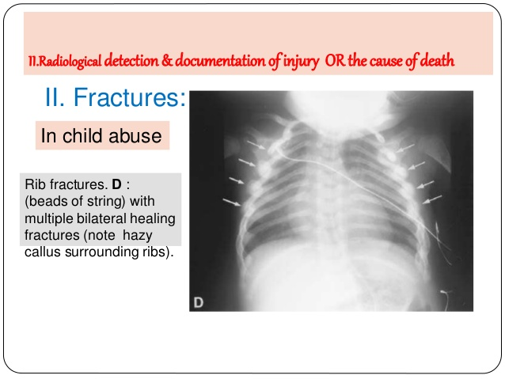
Beads of string

Slide 25
Diagnosis
Nature of injuries
Delay in seeking medical treatment
Recurrent injuries
Radiological manifestations

Slide 26
Sudden infant death syndrome
Sudden and unexpected death of seemingly healthy infant whose death remains unexplained even after complete autopsy.
It is an autopsy diagnosis and not a clinical
Features:
  Incidence: 0.2-0.4%
  World wide distribution
  Age: between 2 wks to 2 years (peak age 204 months)

Slide 27
Sex: M:F 3:2
Socio economic: Low and middle class family, poor housing condition, large family
Time of Death: Early morning pr some times after first feed in the morning
Season: mostly Rainy and winter season
Twining: more among twins
Addiction: smoking (pre and post natal) and drug abuse by pregnant women increases risk.

Slide 28
Causes:
Prolonged sleep apnoea
Respiratory infection
Hypersensitivity of the respiratory tract
Overlaying
MLI:
  Natural death
  Some infanticide causes may be presented as cot death cases

Slide 29
Munchausen Syndrome by proxy
A form of abuse in which parent or guardian fabricates or produces symptoms of an illness in a child in order to gain sympathy or attention for themselves.
The parents frequently have abnormal or borderline personality disorder
Diagnosis may require high level of suspicion

Slide 30
Features
Child brought with vague complaints
  Vomiting- Ipecac syrup
  Bleeding: exogenous blood, anticoagulants
  Fever: injecting contaminants in iv line
  Seizures: suffocation
  The parents or guardians derives some non-economic benefits at the expense of the victim.

Slide 31
MCQ 1
Abandoning a child is a crime under section
A. 302 IPC
B. 304 IPC
C. 317 IPC
D. 318 IPC

Slide 32
MCQ 2
Battered baby syndrome is also called as
A. Sudden infant death syndrome
B. Non accidental injury of childhood
C. Indecent assault
D. All of the above

Slide 33
MCQ 3
Violent shaking of child will produce
A. Subdural haematoma
B. Fracture of the skull
C. Fracture of the long bones
D. Rupture of the spleen

Slide 34
MCQ 4
Concealment of birth is a crime under
A. 302 IPC
B. 304 IPC
C. 318 IPC
D. 317 IPC

Slide 35
MCQ 5
In a newly born child who has breathed, the highest point of diaphragm is at the level of
A. 4th &n 5th rib
B. 6th & 7th rib
C. 8th & 9th rib
D. 10th rib

