Slide 1
REVIEW OF IDEAS ON ATOMIC AND NUCLEAR PHYSICS
ALPHA DECAY, BETA DECAY, GAMMA EMMISION, X-ray

Slide 2
NATURE OF OUR SURROUNDINGS
All things can be classified as matter or energy.
Matter is anything that occupies space, and has mass.
All matter is composed of fundamental building blocks called atoms.

Slide 3
MATTER AND ENERGY
Matter is anything that occupies space.
The fundamental, complex building blocks of matter are atoms and molecules.
Energy: the ability to do work.

Slide 4
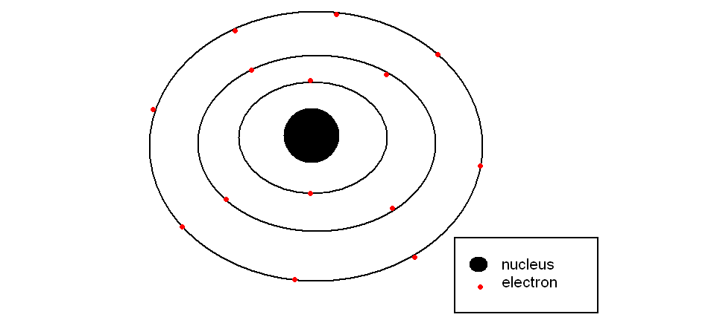
ATOM

Slide 5
COMPOSITION AND STRUCTURE
An atom is the smallest unit of an element.
Atoms combine to form molecules.
Atoms cannot be broken down without losing its identity.

Slide 6
RUTHERFORD’S MODEL
Ruther ford presented that atoms contains positively charged core, or nucleus, surrounded by negatively charged electrons.
This model come to be known as nuclear atom.

Slide 7
NEILS BOHR MODEL
Neils bohr presented a model later on known as bohr atom.
There is a set of stable electron orbits or shells.
Electrons exists without losing its energy.
Electrons revolve around the nucleus in the orbit.

Slide 8
centripetal force: The force that keeps the electron in orbit.
centrifugal force : the force created by the electron which maintains their distance from the nucleus while travelling in a circular path.

Slide 9
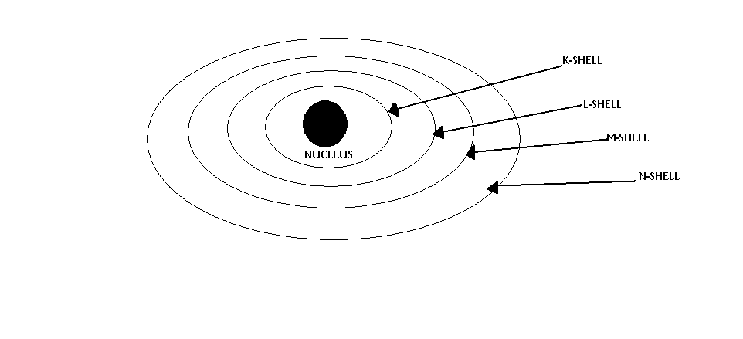
ELECTRON BINDING ENERGIES AND ENERGY LEVELS

Slide 10
Electrons occupy the innermost shell of an atom in the most stable configuration.
eg: carbon[C₆]
2 electrons in K shell.
Rest electrons in L shell.

Slide 11
BINDING ENERGY
The energy required to completely remove an electron from a shell in an atom.
Innermost shell has high binding energy.
It decreases as the number of sub shell increases.
A very high energy is required to move an electron from an inner most shell.

Slide 12
NUCLEUS
COMPOSITION:
The atomic nucleus is composed of protons and neutrons . Collectively known as nucleons.
Nucleons are much more massive than electrons.

Slide 13
TERMINOLOGY AND NOTATION
An atomic nucleus is characterized by the number of neutrons and protons.
It contains:
atomic number[Z]: no. of protons
mass number[A]: no. of nucleons
N- neutron number: the difference A-Z.

Slide 14
Isotopes: nuclides that having the same atomic number.
Eg: ¹²⁵I,¹²⁷I,¹³¹I are isotopes of element iodine.
Isobars: nuclides with same mass number.
Eg: ¹³¹I, ¹³¹Xe, ¹³¹Cs

Slide 15
RADIATION
There are 3 different kinds of radiation emitted by radionuclide
They are alpha particles, beta particles, and gamma rays.
Alpha particle : they are simply helium nuclei consisting of two protons and 2 neutrons.
Represented by ₂⁴He
They strongly ionize the atoms of matter through which they pass.

Slide 16
BETA PARTICLE
They are often called beta rays.
Consists of high speed electrons.
Represented by ₋₁⁰e.
More penetrating power than alpha particle.

Slide 17
GAMMA RAYS
They are electromagnetic waves of high energy.
They are physically identically with x-rays.
They originate from atomic nuclei, where as x-rays are produced from nuclei.

Slide 18
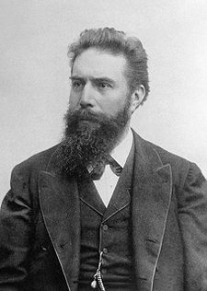
Sir Wilhelm Conrad Roentgen
The German physicist discovered X-ray in 1895.
Roentgen received first Nobel prize in physics in 1901.

Slide 19
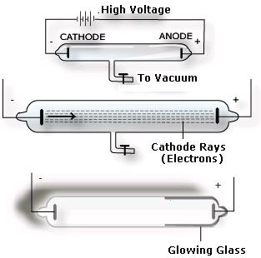
He concluded that the rays were not charged particles. As their nature was not known he called them x-rays.

Slide 20
PROPERTIES OF X-RAYS
X-rays are electromagnetic radiation.
Highly penetrating, invisible rays.
Travel in straight line.
Travel at same velocity as light -3 ×10 8 m/sec
X-rays affect the photographic film and form latent image.
Electrically neutral.
Produce scattered radiation.

Slide 21
X-rays produce ionization and excitation in the substances through which they pass.
X-rays produce biological effects in living organisms. The cells can be either damaged or killed due to x-ray exposure.
Heterogeneous or poly energetic.
Produce luminescence .

Slide 22
X-RAY PRODUCTION
X-rays are produced when fast moving electrons are stopped by target material.
The moving electron possesses kinetic energy
When the electron is suddenly stopped , its kinetic energy converted into heat and x-rays.
The interaction of electron with the target is the basis for x-ray production

Slide 23
ELECTRON INTERACTION WITH THE TARGET
When the electron arrives at the target, it interacts in four ways.
Excitation in an outer shell
Ionization in an outer shell
Ionization in an inner shell
Interaction with nuclear field

Slide 24
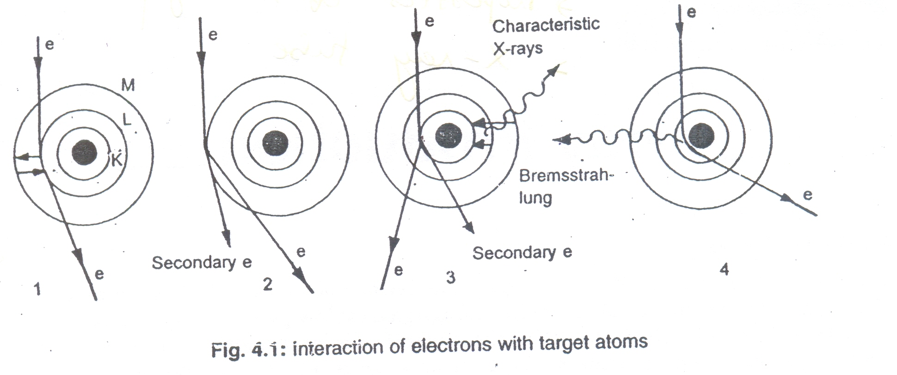

Slide 25
SPECTRA OF X-RAYS
An x-ray beam will have a wide range of x-ray energies; this is called an x-ray spectrum.
There are two types of x-ray spectrum
Continuous spectrum
It consists of x-ray photon of all energies up to the maximum in a continuous fashion. This is also known as white radiation
b) Characteristic spectrum
It consists of x-ray photons of few energies. This is also called as line spectrum.

Slide 26
QUALITY AND INTENSITY OF X-RAYS
QUALITY:
The Quality of an x-ray beam refers to its ability to penetrate matter.
If the X-ray beam consists of same energy(homogeneous)photons ,then the Quality can be described by the photon energy . But the X-ray beam consists of many photon energies(heterogeneous);hence its Quality cannot be described by photon energy.
X-ray beam Quality is specified by Half-value layer.

Slide 27
HALF-VALUE LAYER
The amount of absorbing material required to attenuate a beam of radiation to half its original level.
HVL also called as Half-value thickness.
The half-value layer is always stated together with the value of applied voltage and filtration.
Aluminium and copper are the materials commonly used to specify HVL.

Slide 28
INTENSITY:
The term Intensity refers the Quantity of radiation.
The Intensity of radiation beam is the number of photons in the beam multiplied by the energy of each photon.
Intensity measured in roentgens per minute(R/min).
Quantity refers to the number of photons comprising the beam.

Slide 29
THE FACTORS INFLUENCING QUALITY AND INTENSITY
The x-ray production efficiency, quality, quantity and intensity are influenced by several factors namely -
Applied voltage
Tube current
Target material
Generator waveform
Exposure time
Beam filtration
Distance.

Slide 30
The Applied voltage: the value of applied voltage affects both the quality and intensity of X-rays.
As the applied voltage increases , the effective photon energy also increases.
The maximum photon energy is proportional to the peak value of applied voltage.
The intensity also increases with the increase of applied voltage.

Slide 31
Tube current: The number of X-rays produced depends on the number of electrons that strike the target
The number of electrons depends on the tube current(mA) used.
The tube current affects only the intensity but not the quality of X-rays.
As the tube current increases the intensity also increases.
The intensity proportional to the average tube current.

Slide 32
Atomic number of the target material: The atomic number of the target material affects the intensity of the X-rays.
The intensity increases with the increase of atomic number.
The atomic number of the target material determines the quality of characteristic X-rays.

Slide 33
The generator waveform: The generator waveform affects the quality of emitted X-ray spectrum because of the average potential difference across the tube.
Exposure Time: Exposure time determines the length of X-ray production.
The total quantity of x-rays is directly proportional to the product of tube current and exposure time(mAs).

Slide 34
Beam filtration: filters are thin sheet of material(Al,Cu) which offer high attenuation for low energy photons.
Filters alter both the quality and quantity of X-rays by selectively removing the low energy photons in the spectrum.
A filtered beam consists higher photon energies.

Slide 35
Inverse square law: The beam intensity decreases with distance from the target because of divergence of the X-ray beam.
The nonlinear fall-off in intensity with distance is called the inverse square law.
I₁ /I ₂ = (d₂ /d ₁)²

Slide 36
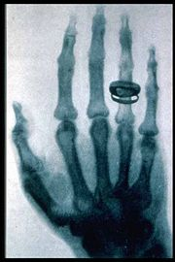
THANK YOU

