Slide 1
RADIOGRAPHIC POSITIONING OF CHEST

Slide 2

ANATOMY OF CHEST
Chest is the region of the body between the neck &abdomen.
It is mostly protected & supported by ribcage,spine and shoulder girdle.

Slide 3
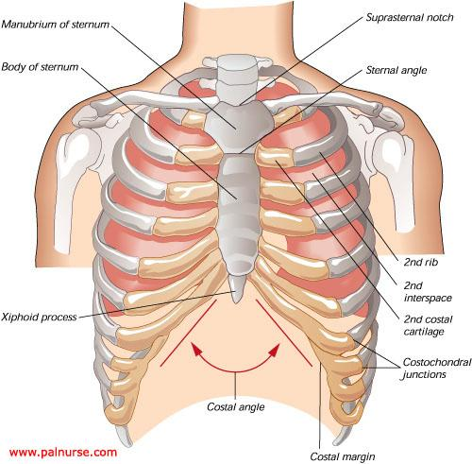

Slide 4
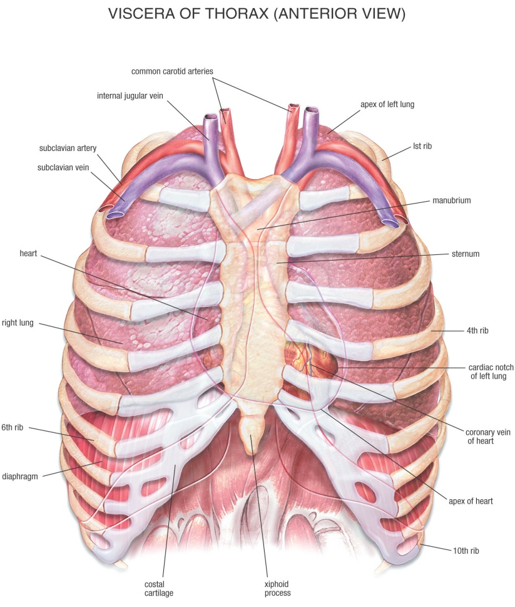

Slide 5
CHEST
AP VIEW
PA VIEW
LATERAL VIEW
LEFT AND RIGHT OLIQUE VIEW
APICOGRAM
LORDOTIC VIEW

Slide 6
Positioning landmarks
Vertebral prominence( c7)
Jugular notch( T2-T3)
Sternal angle(T4-T5)
Xiphoid process(T9-T10)

Slide 7
POSTERO-ANTERIOR VIEW | ANTERO-POSTERIOR VIEW
Patient in standing/sitting position | Patient in supine position
No overlapping of scapulae on lung fields | Scapulae overlap lung fields
Clavicle is not foreshortened | Clavicle is foreshortened
Ribs course obliquely | Ribs assume a horizontal course
No Cardiac magnification | Cardiac magnification
Fundic air bubble seen | Fundic air bubble not seen

Slide 8
Preparation
Pregnant women should inform their doctor and Technologist as the radiations may affect the fetus. If needed, precautions can be taken to lower the radiation exposure to the fetus.
Patient may have to remove your jewellery and any metal objects which might interfere with the image.
Depending on the area to be imaged, Patient need to wear a hospital gown at the time of the scan.

Slide 9
PA PROJECTION
INDICATION:
    Pleural effusions
    Tuberculosis
    Pneumothorax
    Atelectasis (partial collapse or incomplete inflation of the lung)
    Signs of infections

Slide 10
PATIENT POSITIONING
Patient should be in erect position facing the cassette.
Raise the chin and rest over the upper border of cassette.
Rest the patients hand against his hips with the palms turned outward to rotate the scapulae away from the lung field.
Centre the Mid-sagittal-plane to
the mid line of the grid

Slide 11
TECHNICAL FACTORS USED FOR PA CHEST
Casette:14 X17(crosswise/lengthwise)
Moving or stationary grid
Kvp:60-70
mAs:8-10
Minimum SID is 180cms/6 feet.

Slide 12

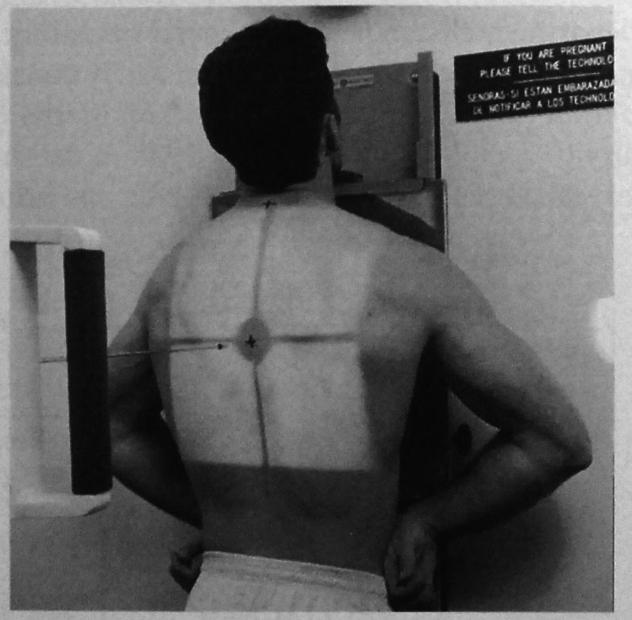

Slide 13
CENTRAL RAY
Central Ray perpendicular to the Image Receptor
Centered to Mid-Saggital-Plane at the level of T4 vertebrae
50 caudal angulation

Slide 14
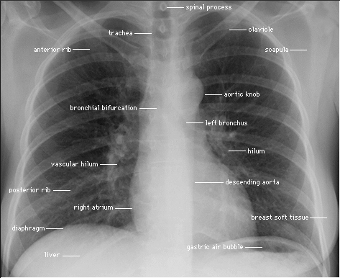

Slide 15
STRUCTURES SEEN
Both lungs from apices to costophrenic angles
Air filled trachea.
Hilium region markings.
Heart .
Great vessels.
Bony thorax

Slide 16
EVALUATION CRITERIA
Anterior ribs from 1-9 from both sides should be seen above the diaphragm.
Ribs should be visualized clearly through the lungs and demonstrate sufficient contrast

Slide 17
AP-ANTERIOR POSTERIOR
INDICATION
to see mainly the ribs
and for stricture patients
TECHNICAL FACTORS USED FOR AP CHEST
Casette:14X17
Kvp:60-70
mAs:8-10
Minimum SID is 100cms.

Slide 18
POSITIONING
ERECT
SEMI-ERECT
SUPINE
Mid-sagittal-plane(MSP) is brought right angle to the cassette.
Shoulders are bought downward and forward, with the backs of the hand below the hips
Cassette is carefully placed under the patients chest.
MSP is adjusted right angle to the middle cassette.
Arms are rotated laterally ,head is supported on a pillow with the chin slightly raised
MSP is adjusted right angle to the midline of the cassette
Patient is supported in a semi recumbent position , facing the x ray tube.

Slide 19
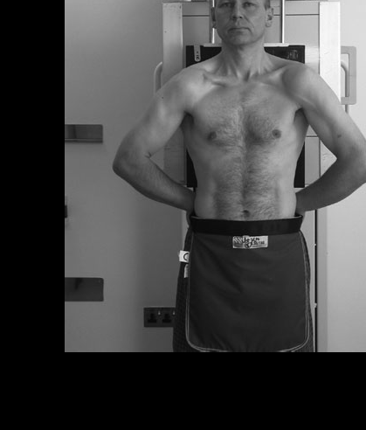
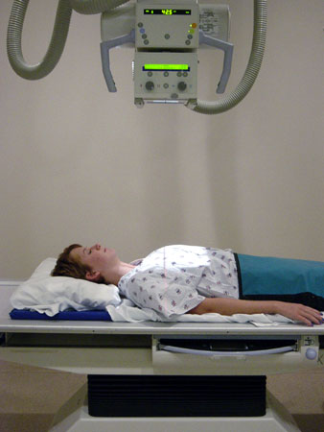

Slide 20
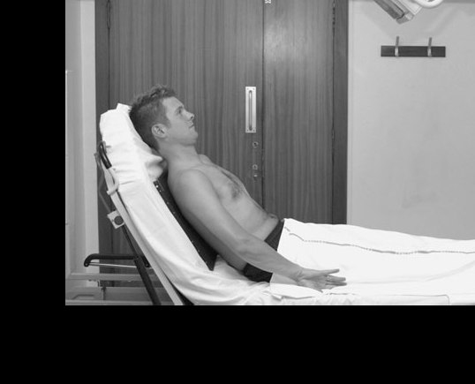

Slide 21
CENTERING
ERECT
Horizontal ray is right angled to the cassette and towards the sternal notch
SEMI ERECT
CR is directed right angle to the cassette and towards the sternal notch.
SUPINE
CR is directed right angle to the cassette and towards the sternal notch.

Slide 22
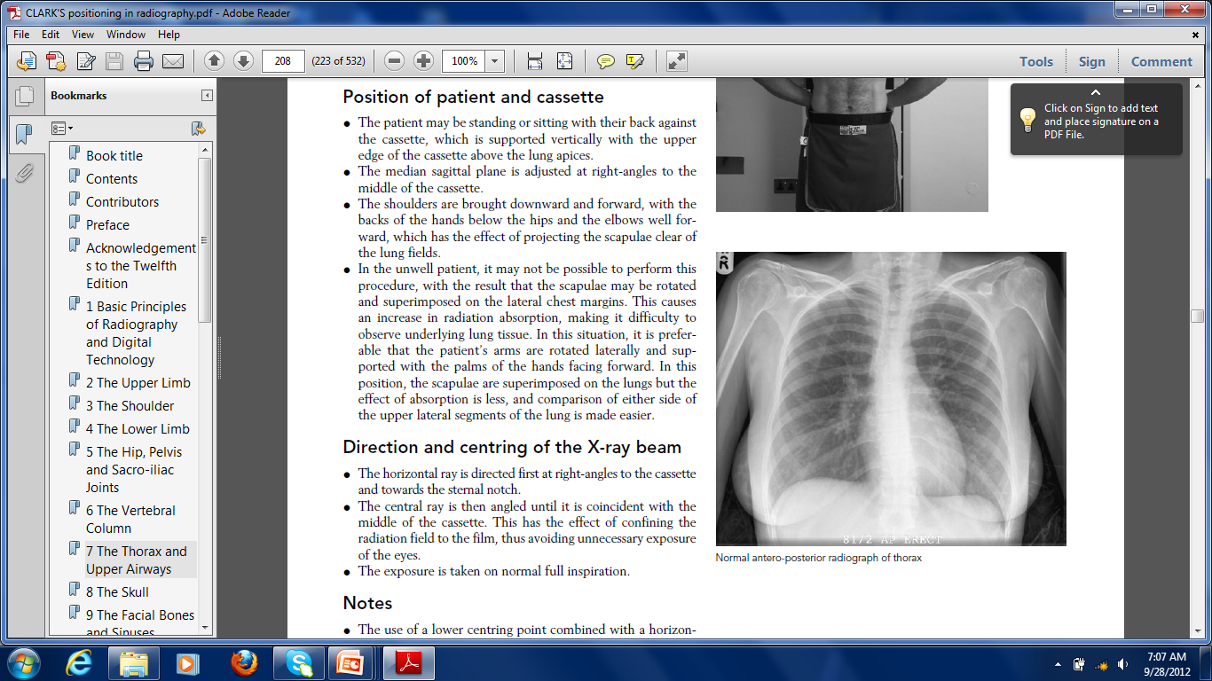
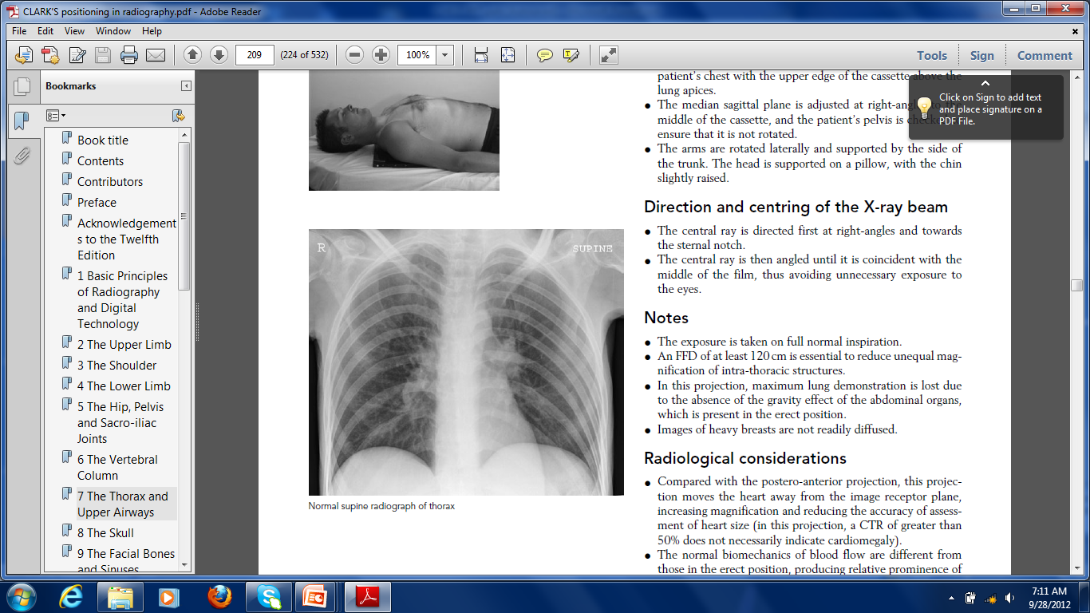
ERECT
SUPINE

Slide 23
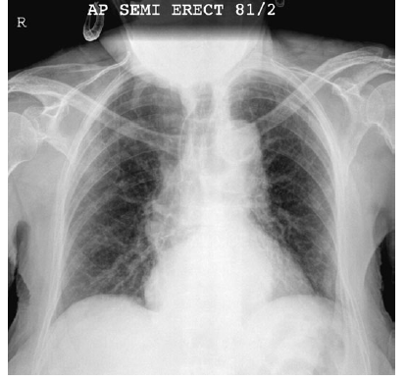
SEMI ERECT

Slide 24
STRUCTURES SEEN
Posterior rib shown above and below the diaphragm
EVALUATION CRITERIA:
Ribs should be above diaphragm.
Posterior ribs 8-10 from both sides should be seen above diaphragm.

Slide 25
CHEST LATERAL VIEW
PATIENT POSITIONING:
Patient is turned to the area of examination in contact with film.
Mid-sagittal-plane is parallel to the film.
The arms are folded over the head .
Mid –auxiliary line midline of the film and include apices and lower lobe to the level of first lumbar vertebra.

Slide 26
TECHNICAL FACTORS USED FOR CHEST
LATERAL:
Casette:14 X17
Kvp:60-70
mAs:25-30
Minimum SID is 100cms.

Slide 27
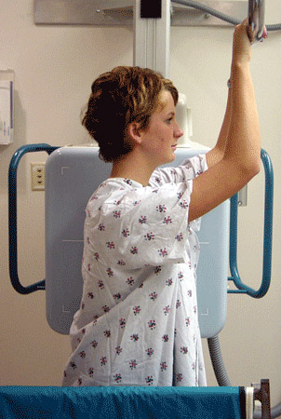
Direction and centering of the film
Direct the central ray right angle to the middle of the film in mid auxiliary line.

Slide 28
STRUCTURES SEEN
Left lateral and Right lateral projections are mainly taken to demonstrate the heart, aorta and pulmonary lesions.
The lateral positions are employed extensively to demonstrate the interlobar fissures,to differenciate the lobes, and to localize pulmonary lesions.

Slide 29
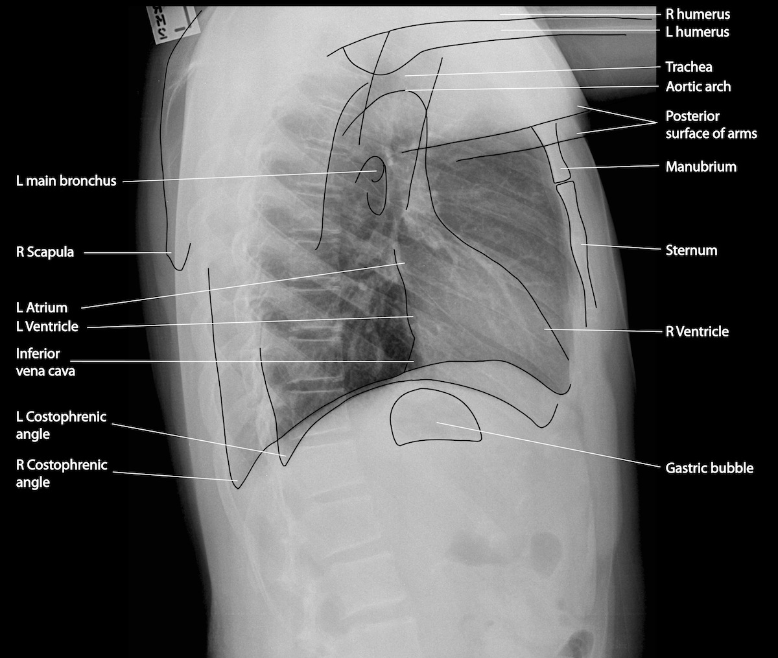

Slide 30
Evaluation criteria
The ribs posterior to the vertebral column should be superimposed.
There should be no shadow of arm or its soft tissue overlapping upper lungs field.
The long axis of the lungs should be vertical without forward backward leaning.
The sternum should be in lateral and not rotated.

Slide 31
Cont….
Costophrenic angles and the apices of the lungs must be included.
The exposure should penetrate the lungs and heart.
The heart and diaphragm should have sharp outline.

Slide 32
OBLIQUE PROJECTIONS
ANTERIOR OBLIQUE PROJECTIONS
Right anterior oblique
Left anterior oblique
POSTERIOR OBLIQUE PROJECTIONS
Right posterior oblique
Left posterior oblique

Slide 33
TECHNICAL FACTORS
Casette:14 X17(crosswise/lengthwise)
Moving or stationary grid
Kvp:60-70
mAs:8-10
Minimum SID is 180cms/6 feet.

Slide 34
ANTERIOR OBLIQUE PROJECTION
POSITIONING OF PATIENT
Patient should be in erect position.
For Right Anterior Oblique(RAO)- Right side of patient body should be contact with the Image Receptor.
For Left Anterior Oblique (LAO)-Left side of patient body should be contact with the Image Receptor.
Patient body should be rotate at the angle of 45 degree.
CENTERING: Central Ray is directed perpendicular to the level of t4-t6 vertebrae.

Slide 35
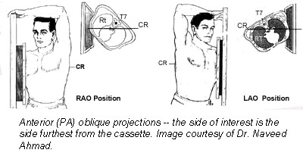

Slide 36
STRUCTURES SEEN
Both lunges from the apices to the Costophrenic angles.
Air filled trachea.
Great vessels and heart shadows are well visualized.
EVALUATION CRITERIA:
Both lungs should be included
The exposure should clearly visualize the lung field

Slide 37
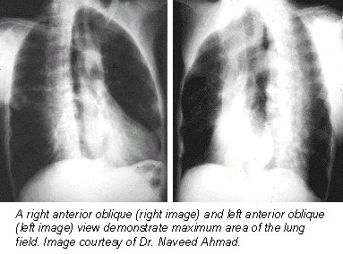

Slide 38
POSTERIOR OBLIQUE PROJECTION
POSITIONING OF PATIENT
Right-Posterior-Oblique(RPO):Patient should be in erect position, rotated 45 degree with right posterior shoulder against Image-Receptor.
Left-Posterior-Oblique(LPO): Patient should be in erect position, rotated 45 degree with Left posterior shoulder against Image-Receptor.
CENTERING: Central Ray is perpendicular to the level of t4-t6 vertebrae

Slide 39
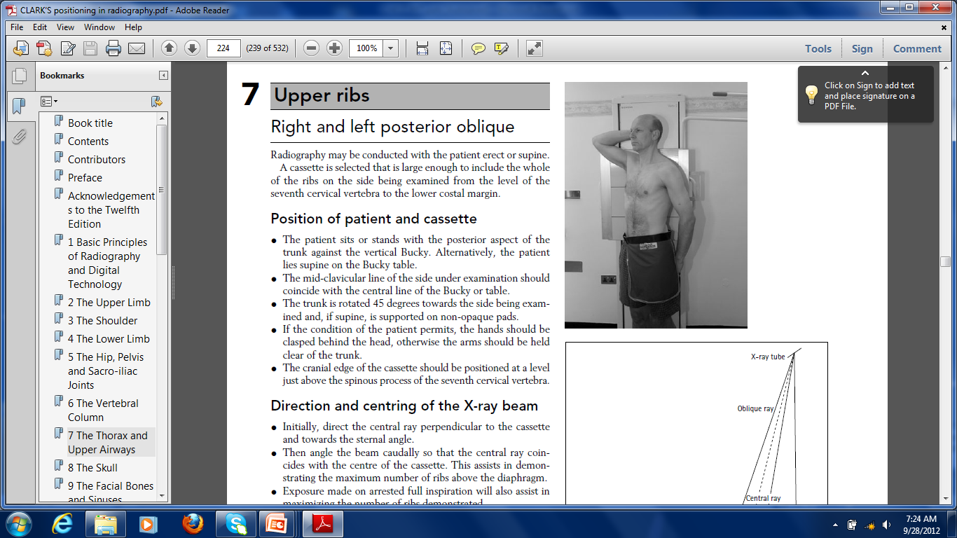

Slide 40
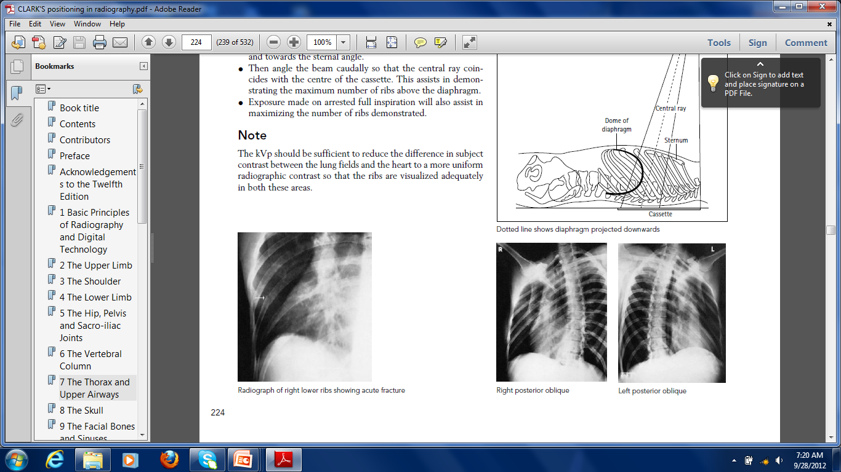

Slide 41
STRUCTURES SEEN
Auxiliary portion of the ribs are projected free of self-superimposition
EVALUATION CRITERIA:
Auxiliary portion of the rib should be demonstrated free of superimposition
Ribs should be clearly demonstrated through the lungs or abdomen according to the region examined.

Slide 42
RADIATION PROTECTION
Repeat exposures : avoid repeat exposures
Collimation : it not only helps to avoid scatter radiation but also helps to improve image quality
Gonadal shielding

Slide 43
APICOGRAM
Indication :
-Radiographic Visualisation of apex, superior mediastinum and thoracic outlet.
-Enhances visualisation of minor fissure in suspected right middle lobe atelectasis

Slide 44
LORDOTIC PROJECTION
Positioning of the patient
Patient should be standing with feet approximately 30cm away from the image receptor, with back arched until upper back, shoulders and head are against the image receptor.
Shoulders and elbows are rolled anteriorly
Angle formed between the mid-coronal body plane and image receptor should be approximately 45 degrees

Slide 45
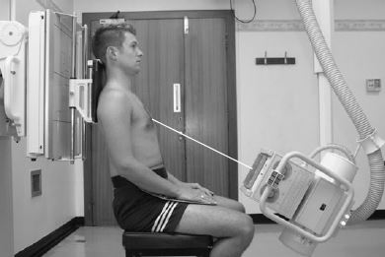

Slide 46
Technical factors
Centring of X-ray beam
  Mid-sagittal plane, halfway between the manubrium and the Xiphoid process
collimation
  superiorly 5 cm above the shoulder joint to allow proper visualization of the upper airways
  inferior to the inferior border of the 12th rib
  lateral to the level of the acromioclavicular joints
  Cassette size- 10X12
Exposure : 60-70 Kvp, 8-10 mAs
SID: 180 cm
Grid: yes (this may be departmentally dependent)

