Slide 1
X-ray room design and shielding
In the planning of any medical X-ray facility main priority is to ensure that persons in the vicinity of the facility are not exposed to levels of radiations which surpass the current regulatory exposure limits.
Appropriate steps must be taken to ensure adequate shielding is present to meet the requirements
Follows the guidelines of AERB

Slide 2
Radiology Department Infrastructure
This must include :
  Electrical power
  Heating, ventilation and air conditioning (HVAC)
  Floor space and floor loading
  Links to other critical areas e.g., emergency

Slide 3
ROOM LAYOUT FOR AN X-RAY INSTALLATION
Location :
Shall be located as far away as feasible from areas of high occupancy places/departments.
In case the installation is located in a residential complex, it shall be ensured that:-
Walls of the x-ray rooms on which primary x-ray beam falls are not less than 35 cm thick brick or equivalent.
Walls of the x-ray room on which scattered x-ray fall are not less than 23 cm thick brick
There is a shielding equivalent to at least 23 cm thick brick or 1.7 mm lead in front of the door(s) and windows of the
X-ray room.

Slide 4
Layout:
The room housing an x-ray unit shall have an appropriate area to facilitate easy movement of staff, patient positioning.
Appropriate structural shielding shall be provided for walls, doors, ceiling and floor of the room housing the X-ray.
Appropriate shielding shall also be provided for the dark room to ensure that the undeveloped X-ray films are not exposed to more than 10μGy per week

Slide 5
Room Size:
The room housing an X-ray unit shall be not less than 18 m square for general purpose radiography and conventional fluoroscopy.
The size of room housing the gantry of the CT unit shall not be less than 25 m square.
Also, not more than one unit of any type shall be installed in the same room, and any single dimension should not be less than 4 m.

Slide 6
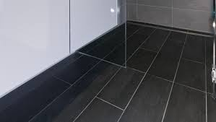
Floor design
Maximum Radiation received by the floor
Usually located in the ground floor, so much shielding not required
It is required if a basement unit is present
Usually use tiles- easily cleaned

Slide 7
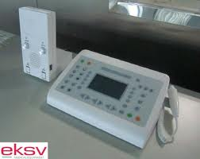
Control Panel:
The control panel of diagnostic X-ray equipment operating at 125 kVp or above shall be installed in a separate with direct viewing and oral communication facilities.
In case of X-ray equipment operating up to 125 kVp, the control panel can be located in the X-ray room.
The distance between control panel and X-ray unit/chest stand shall be not less than 3 m for general purpose fixed X-ray equipment.

Slide 8
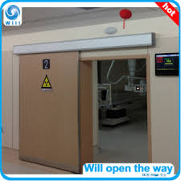
Warning Light and Placard:
Red light shall be provided outside the X-ray room and kept “ON” when the unit is in use.
An appropriate warning placard as indicated in Appendix-II shall also be posted outside the X-ray room.

Slide 9
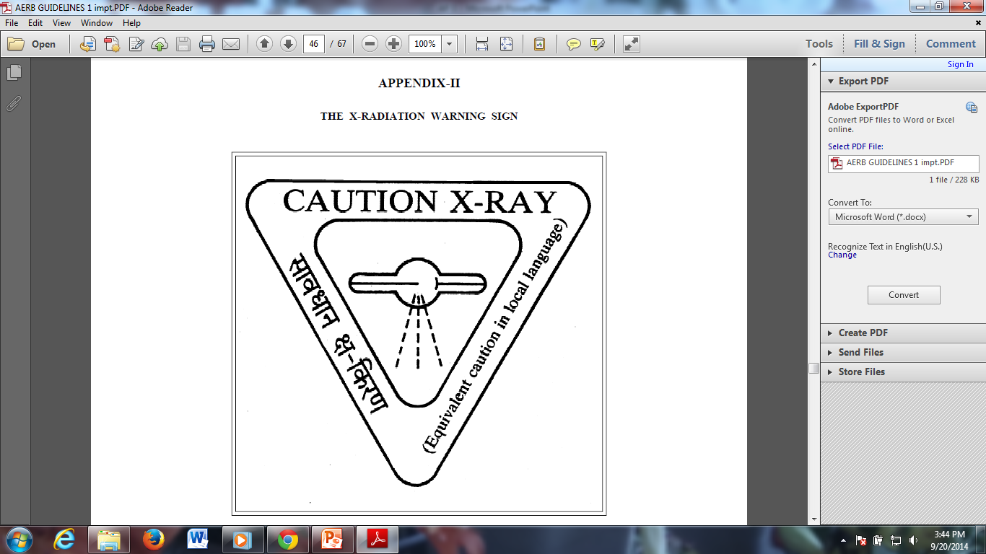

Slide 10
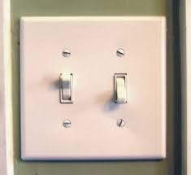
SWITCHES
MAIN SWITCH- near the entrance
At a reachable height- high tension switch
Exposure switch –control panel
Other switches– light and fan all will be placed together near entrance
Emergency switch- control panel and near machine

Slide 11
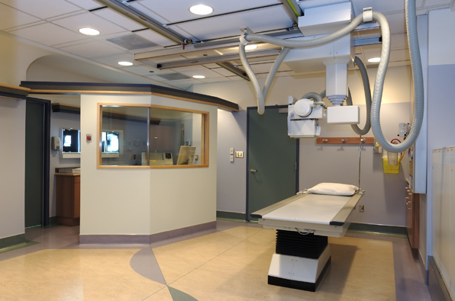
Openings and Ventilation:
Unshielded openings in an X-ray room for ventilation or natural light shall be located above a height of 2 m from the finished floor level outside the X-ray room.

Slide 12
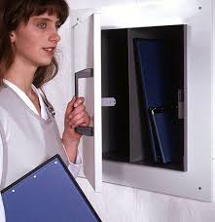
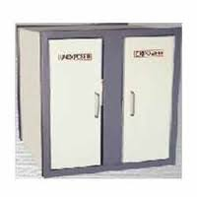
In presence of Dark Room
Adjacent to the x ray room
Walls should be lead lined
Warning light near the door
Pass boxes / hatches :
1.5mm lead equivalent shielding-in the x ray room side

Slide 13
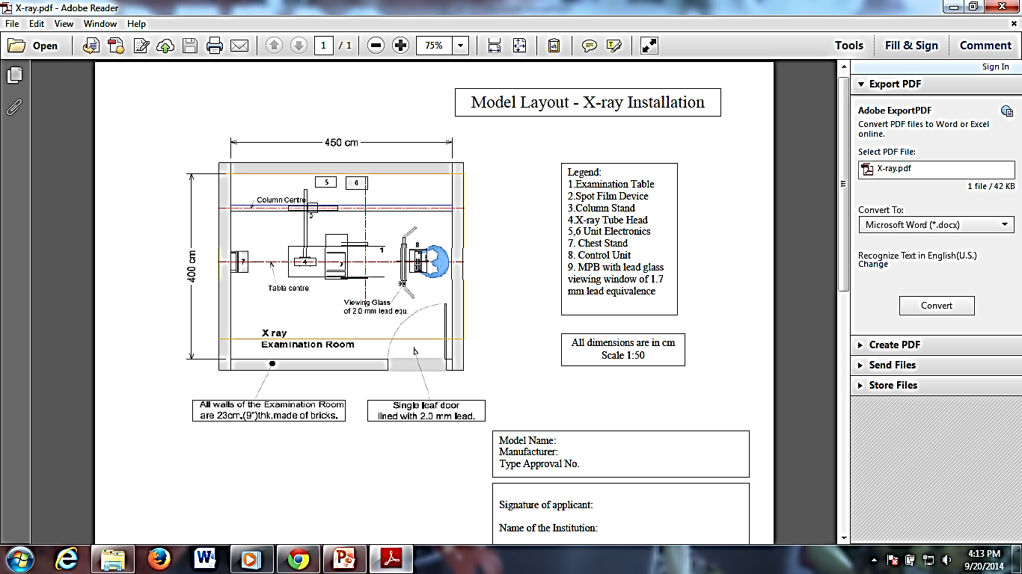

Slide 14
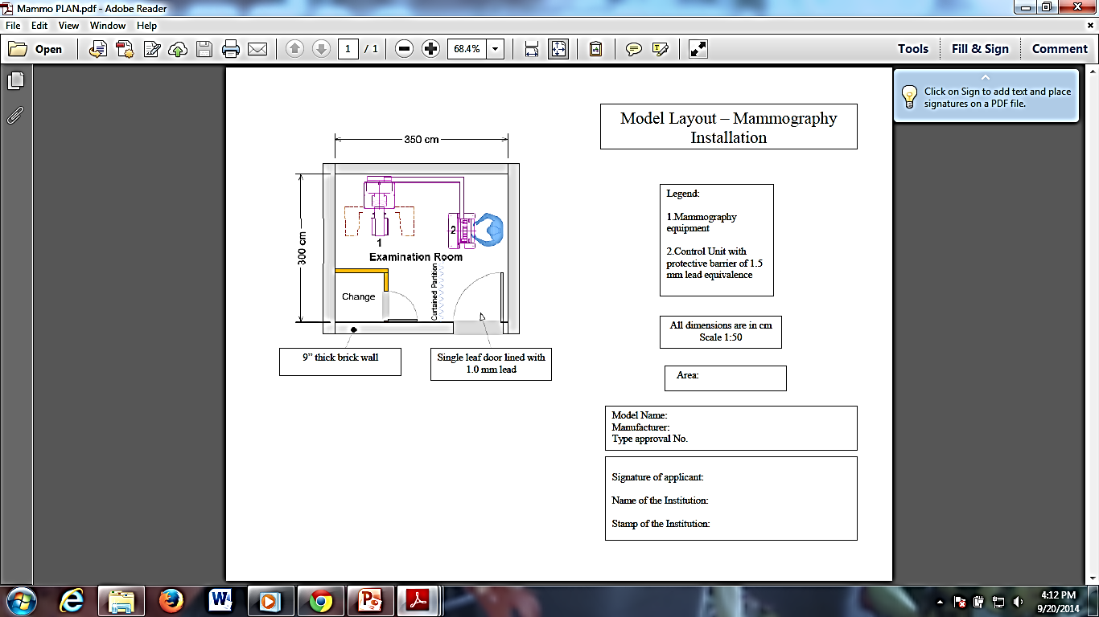

Slide 15
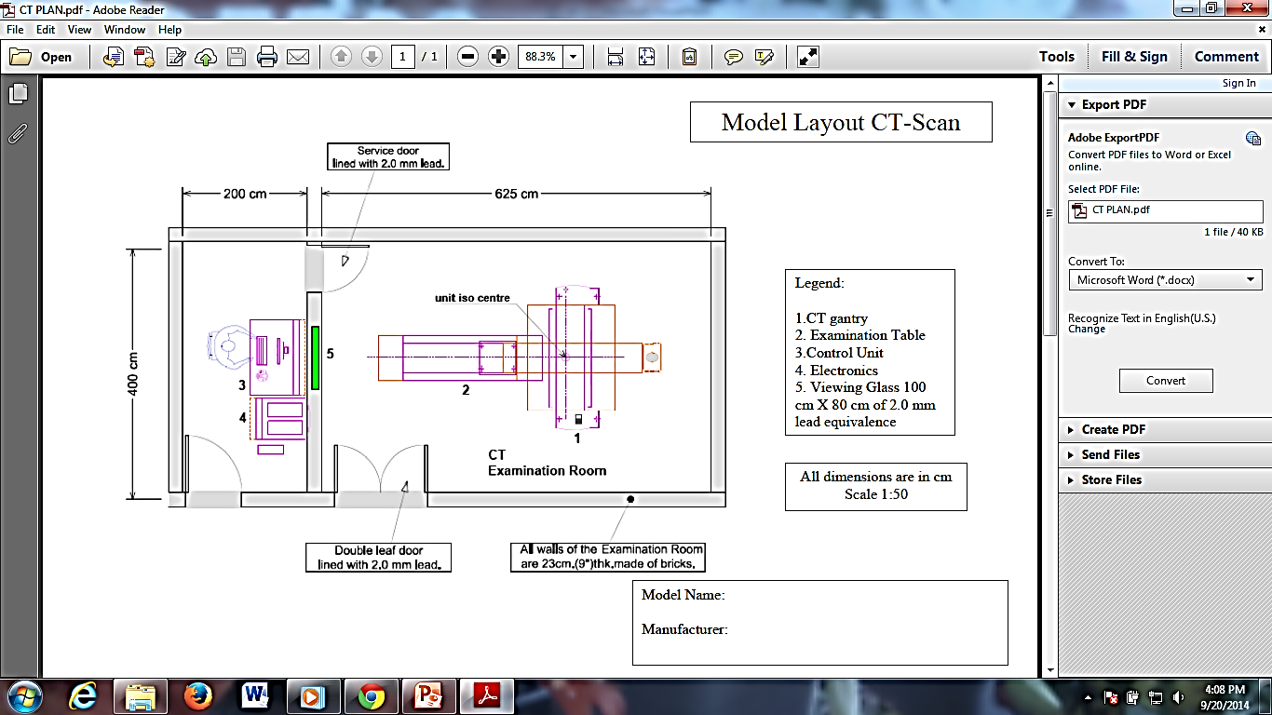

Slide 16
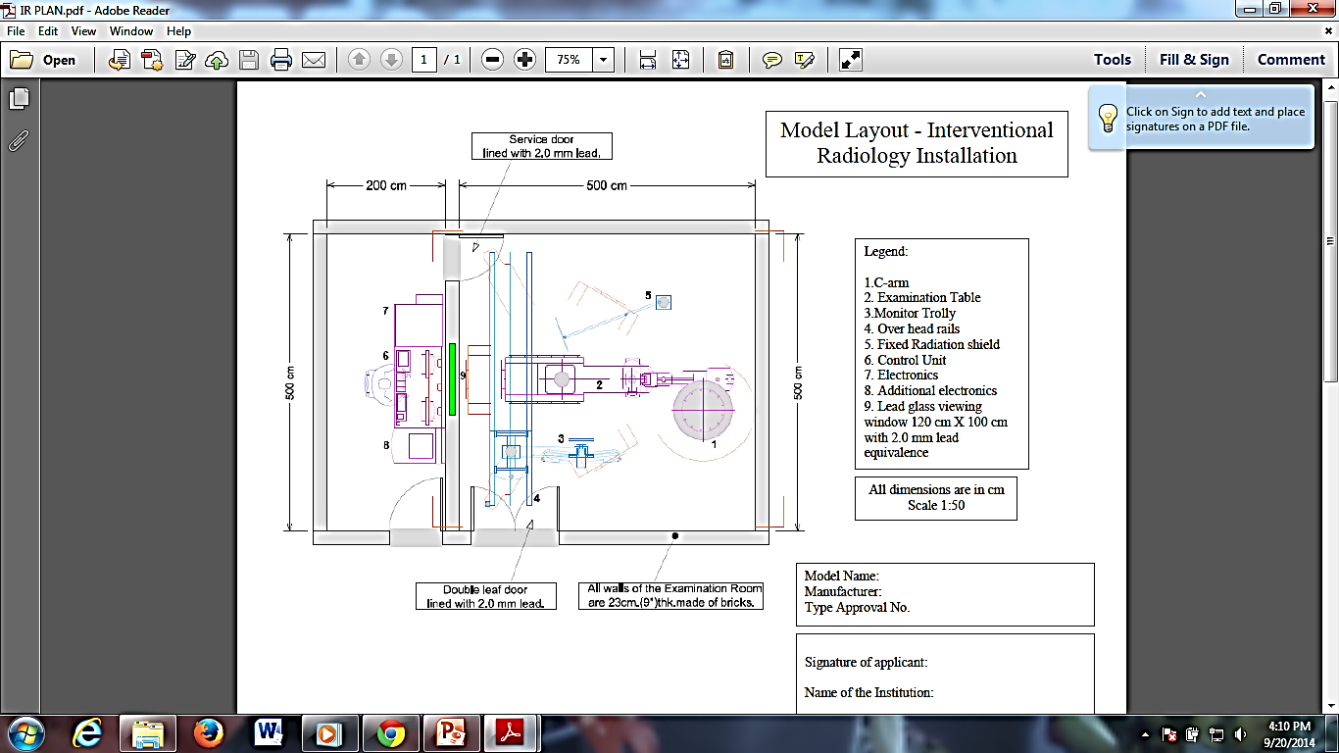

Slide 17
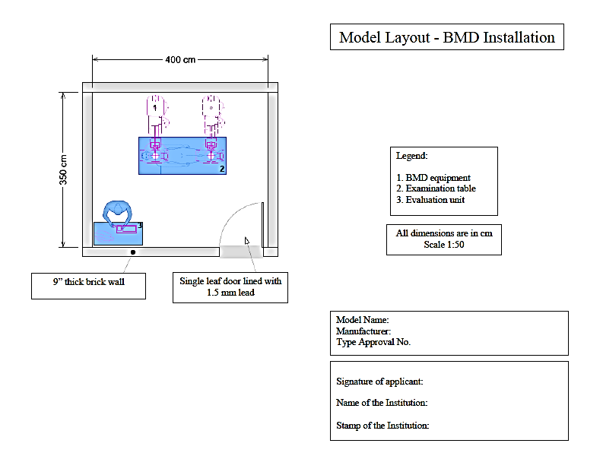

Slide 18
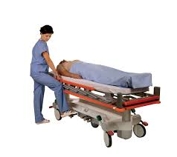
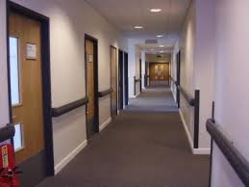

Parts of the department
Entrance- Kept Minimum
Patient Corridor-wide Enough For Wheel-chair Or Trolleys
Controlled Area
X ray Rooms
Patient Changing Area
Patient Waiting Area
Restrooms

Slide 19
Radiology Room Features
X-ray tube(s) and table
Chest stand
Change room(s)
Operator’s console
Darkroom and film storage
Surrounding areas (use, occupancy)
Shielding

Slide 20
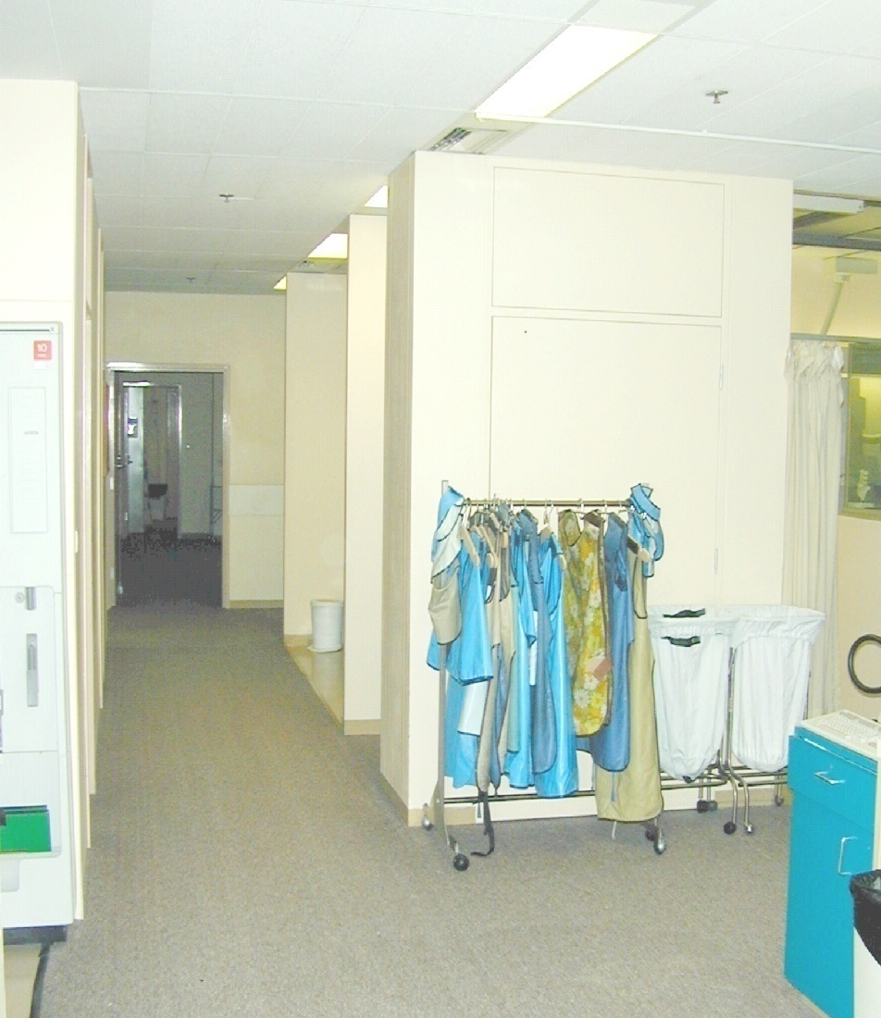
Radiology Work Area
Note :
Rack for lead gowns,
and easy access to
all work rooms for staff

Slide 21
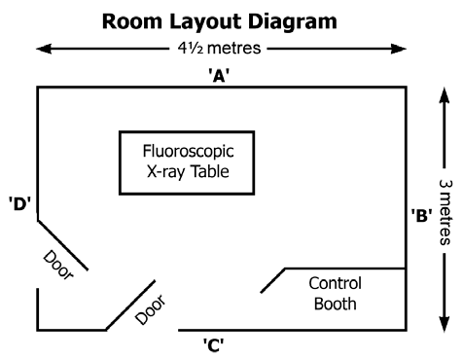
FLUROSCOPY ROOM

Slide 22
The current x-ray workload in the room does not exceed 50 fluoroscopic (radioscopic) procedures [average fluoroscopy (radioscopy) time is 5 minutes per patient] per week.
The x-ray unit is normally operated in the range 70-100 kVp, and occasionally at up to 125 kVp.
The room containing the unit has dimensions of at least 3m x 4.5m.
Unexposed x-ray film is stored in a film bin, lined with at least 0.8mm lead.

Slide 23
Shielding is required to provide protection outside the room
(a) For workers to meet the Action Level of 1mSv/year, as specified in the Occupational Health and Safety Regulation.
(b) For members of the public to not exceed the recommended public dose limit of 1 mSv/year.

Slide 24
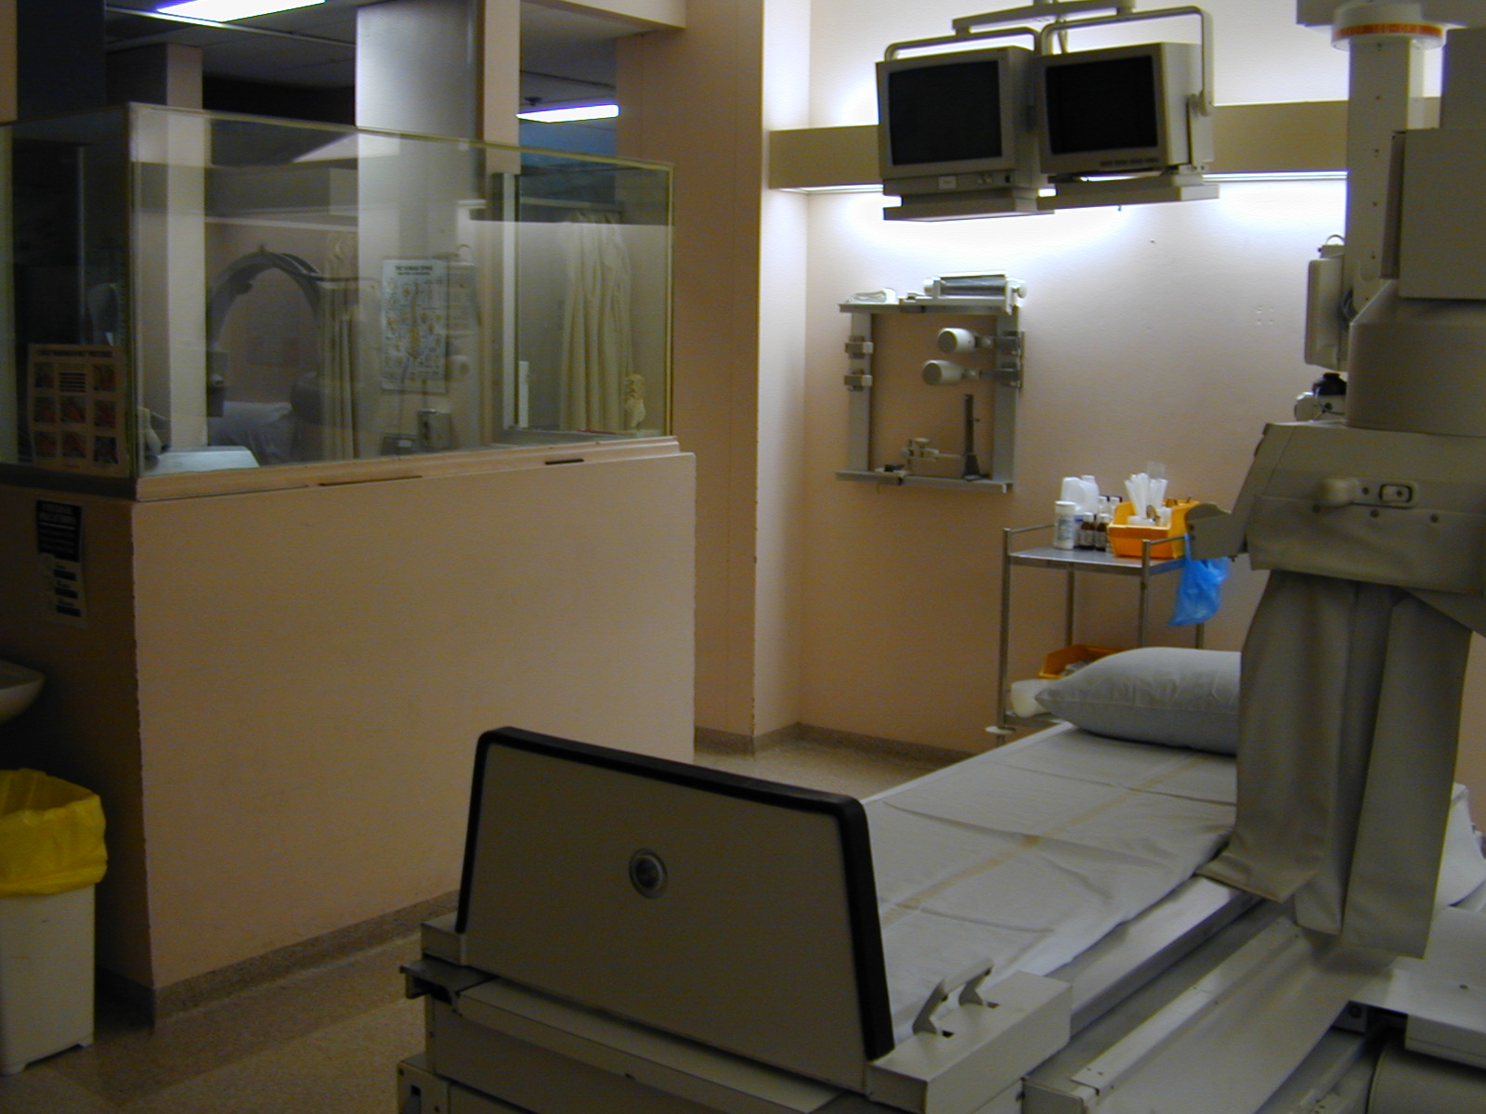
Fluoroscopy Room

Slide 25
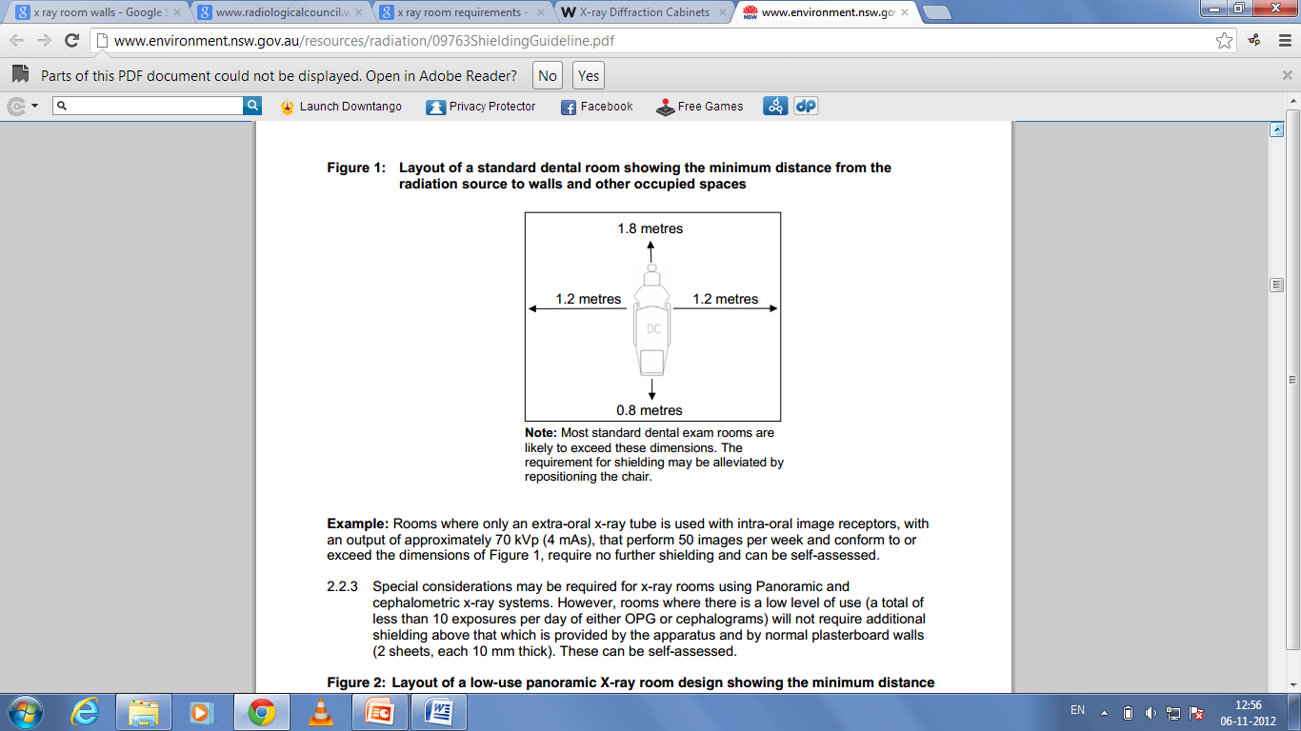
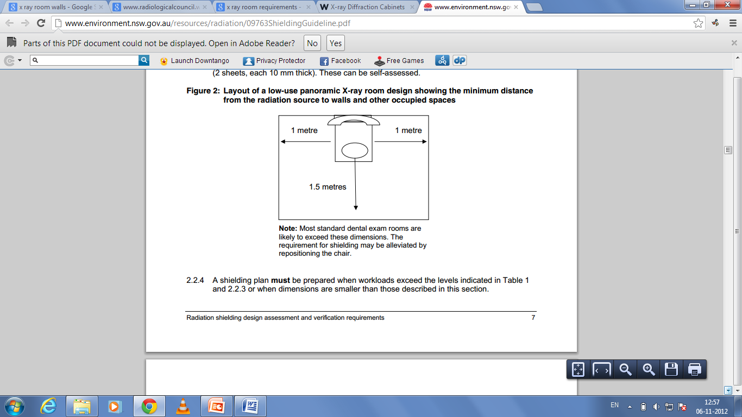
DENTAL LAYOUT
23cm thick brick walls/35cm in case of residency premises
1.7 mm Lead lined doors
Mobile protective barrier with lead glass viewing window of 1.7 mm Pb equivalent
One dimension- not less than 3m
Total area: 13m2

Slide 26
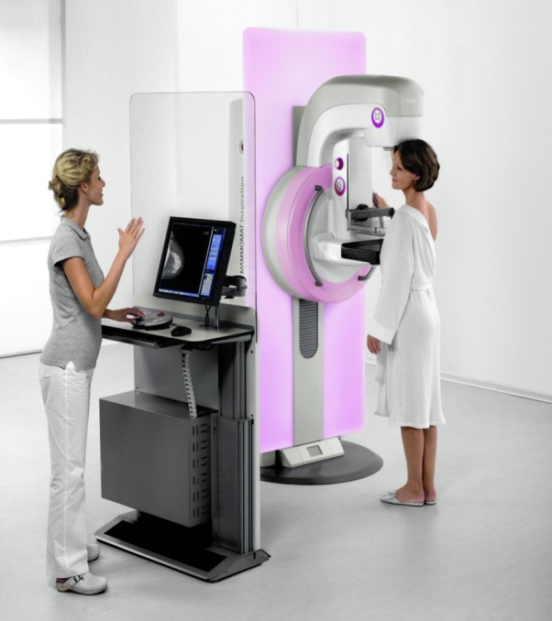
Mammography
23cm thick brick walls
1.7 mm Lead lined doors
Mobile protective barrier with lead glass viewing window of 1.7 mm Pb equivalent
One dimension- not less than 3m
Total area: 10m2

Slide 27
Shielding
Appropriate structural shielding shall be provided for
  Walls
  Doors
  ceiling
  and floor
Doses received by workers and the public shall not exceed the respective annual effective doses
Appropriate shielding shall also be provided for the dark room (undeveloped X-ray films- not be exposed more than 10 mGy per week.)

Slide 28
To protect:
  the patients (when not being examined)
  the X Ray department staff
  visitors and the public
  persons working adjacent to or near the X Ray facility

Slide 29
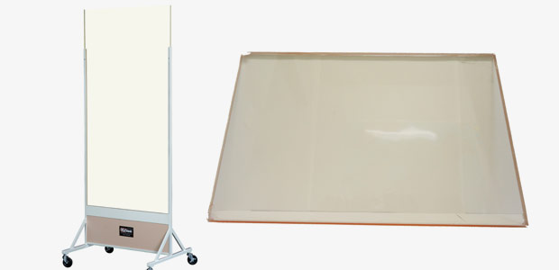
Materials used for shielding
  Lead sheet brick
  gypsum
  concrete block
  leaded glass or acrylic- 30x30 cm

Slide 30
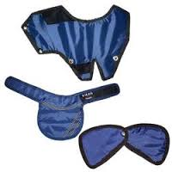
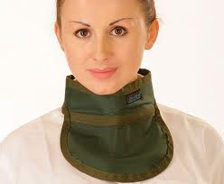
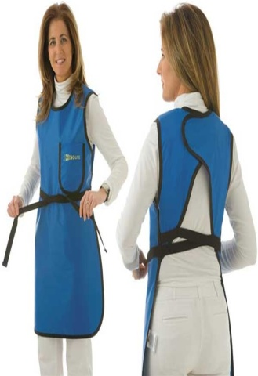
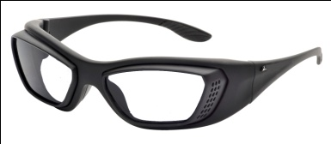

Shielding from secondary radiation:
Mainly used for scattering radiation
collimation shutters of x-ray tube 0.5-0.35mm
Protective drape: at least 0.25 mm Pb.
Protective apron:0.5mmPb
Lead shield:0.5mm Pb
Lead protective gloves.
Always wear a film badge or TLD monitor.
Lead Glasse : .75mmPb

Slide 31

REGULATORY CONTROLS
Design Certification
Type Approval / No Objection Certificate
Approval of Layout
Registration of X-ray Equipment
Commissioning of X-ray Equipment
Inspection of X-ray Installations
Decommissioning of X-ray Installations
Certification of RSO
Certification of Service Engineers
Penalties
Notes:
Any person who contravenes the provisions of the Radiation Protection
Rules, 1971, elaborated in this Code, or any other terms or conditions
of the license/registration/certification granted to him/her by the
competent authority, is punishable under sections 24, 25 and 26 of the
Atomic Energy Act, 1962. The punishment may include fine, imprisonment,
or both, depending on the severity of the offence.

Slide 32
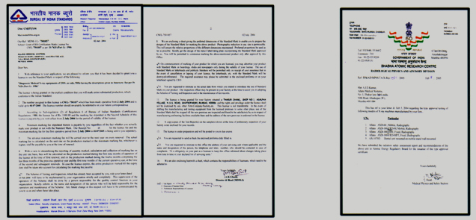
AERB APPROVAL CERTIFICATION FOR RADIOLOGY MACHINERY

Slide 33
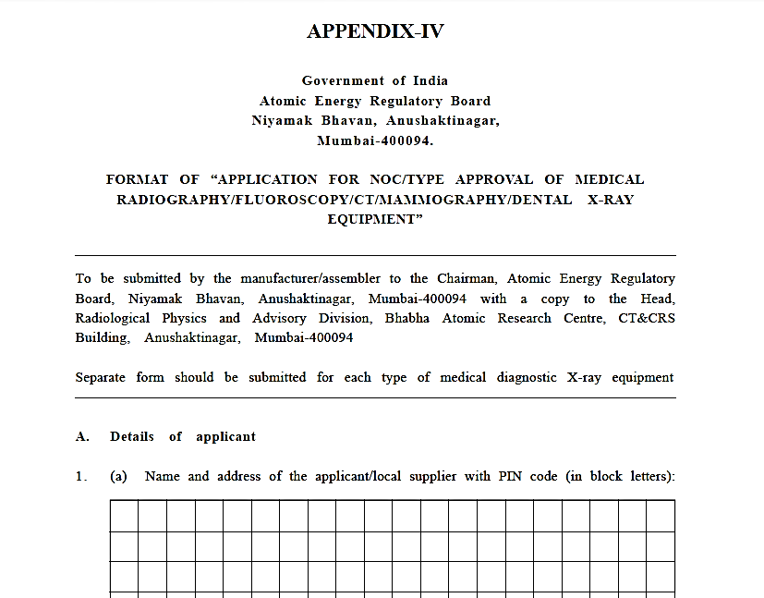

Slide 34
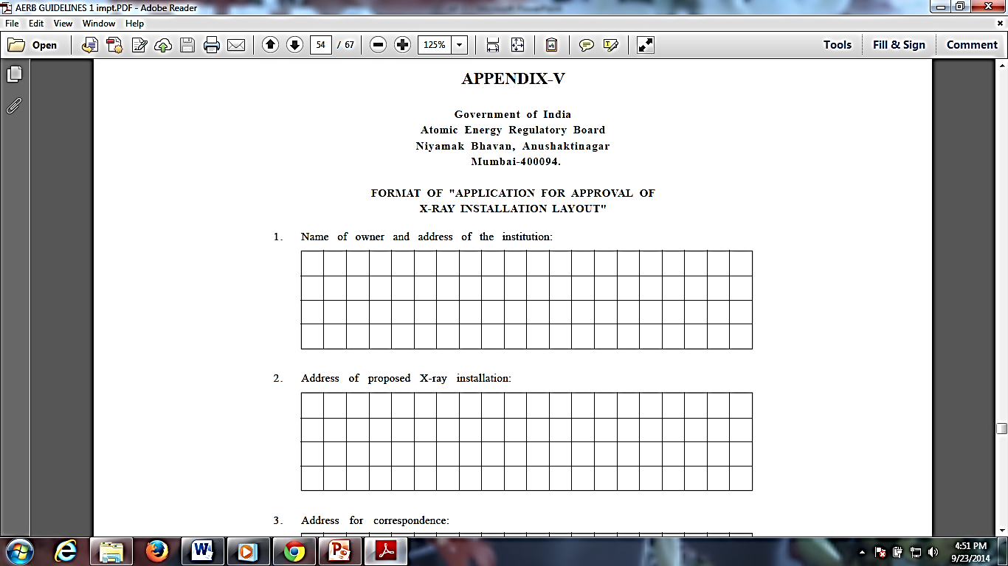

Slide 35
Thank you

