Slide 1
Image characteristics
Definition of Reflected, Transmitted and Emitted light images

Slide 2
Image
Real image
Imaginary image

Slide 3
Characteristics of image
Noise
Contrast
Sharpness
Resolution

Slide 4
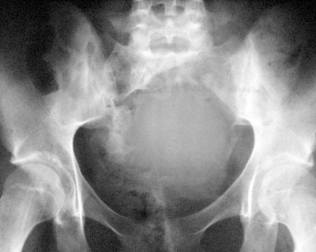
Noise
Noise mean any signal that does not convey useful information of the subject.

Slide 5
Contrast
The brightness ratio of the lightest to the darkest part of an image or difference in density or luminance

Slide 6
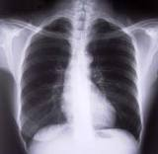
High contrast; means harsh, with lots of dense blacks and brilliant white

Slide 7
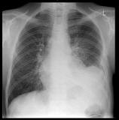
Low contrast; dull, lacking in any true black white

Slide 8
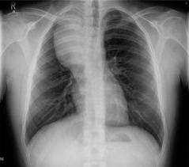
Optimum contrast; midway between the low and high contrast which is enable to manipulate freely and repeatedly after exposure.

Slide 9
Sharpness
Different in density or luminance between two adjacent areas of an image and convey that how suddenly change at boundary between two adjacent parts

Slide 10
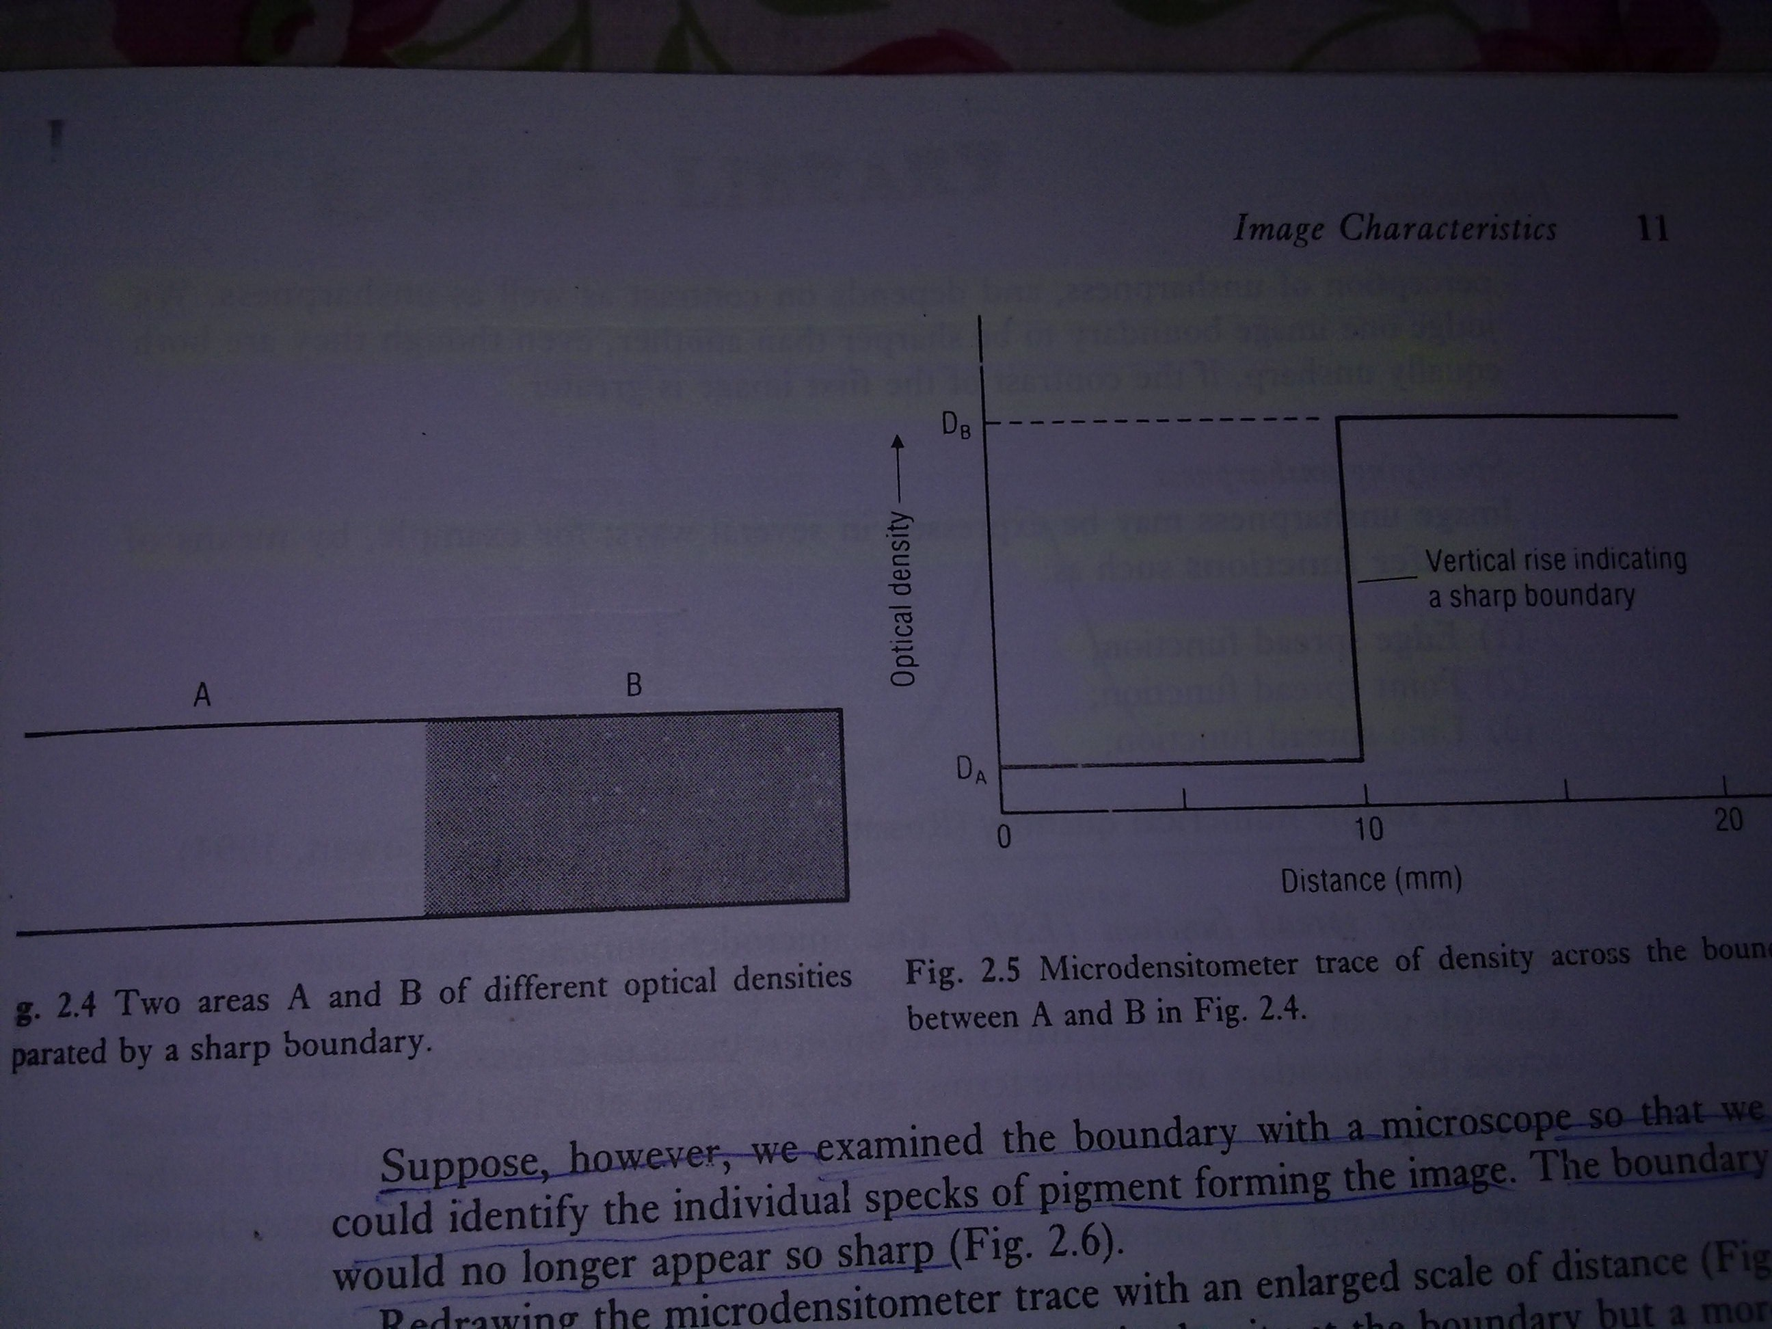

Slide 11
unsharpness
Quantitive measure of the loss of edge detail which is due geometrical properties of the object.
Image unsharpness may be express in several ways-:
Edge spread function;
Point spread function;
Line spread function;

Slide 12
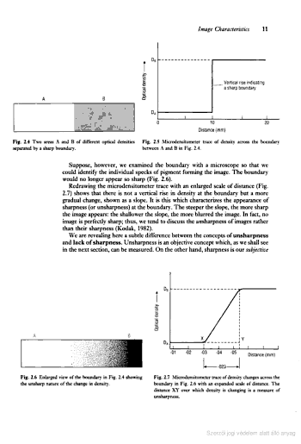

Slide 13
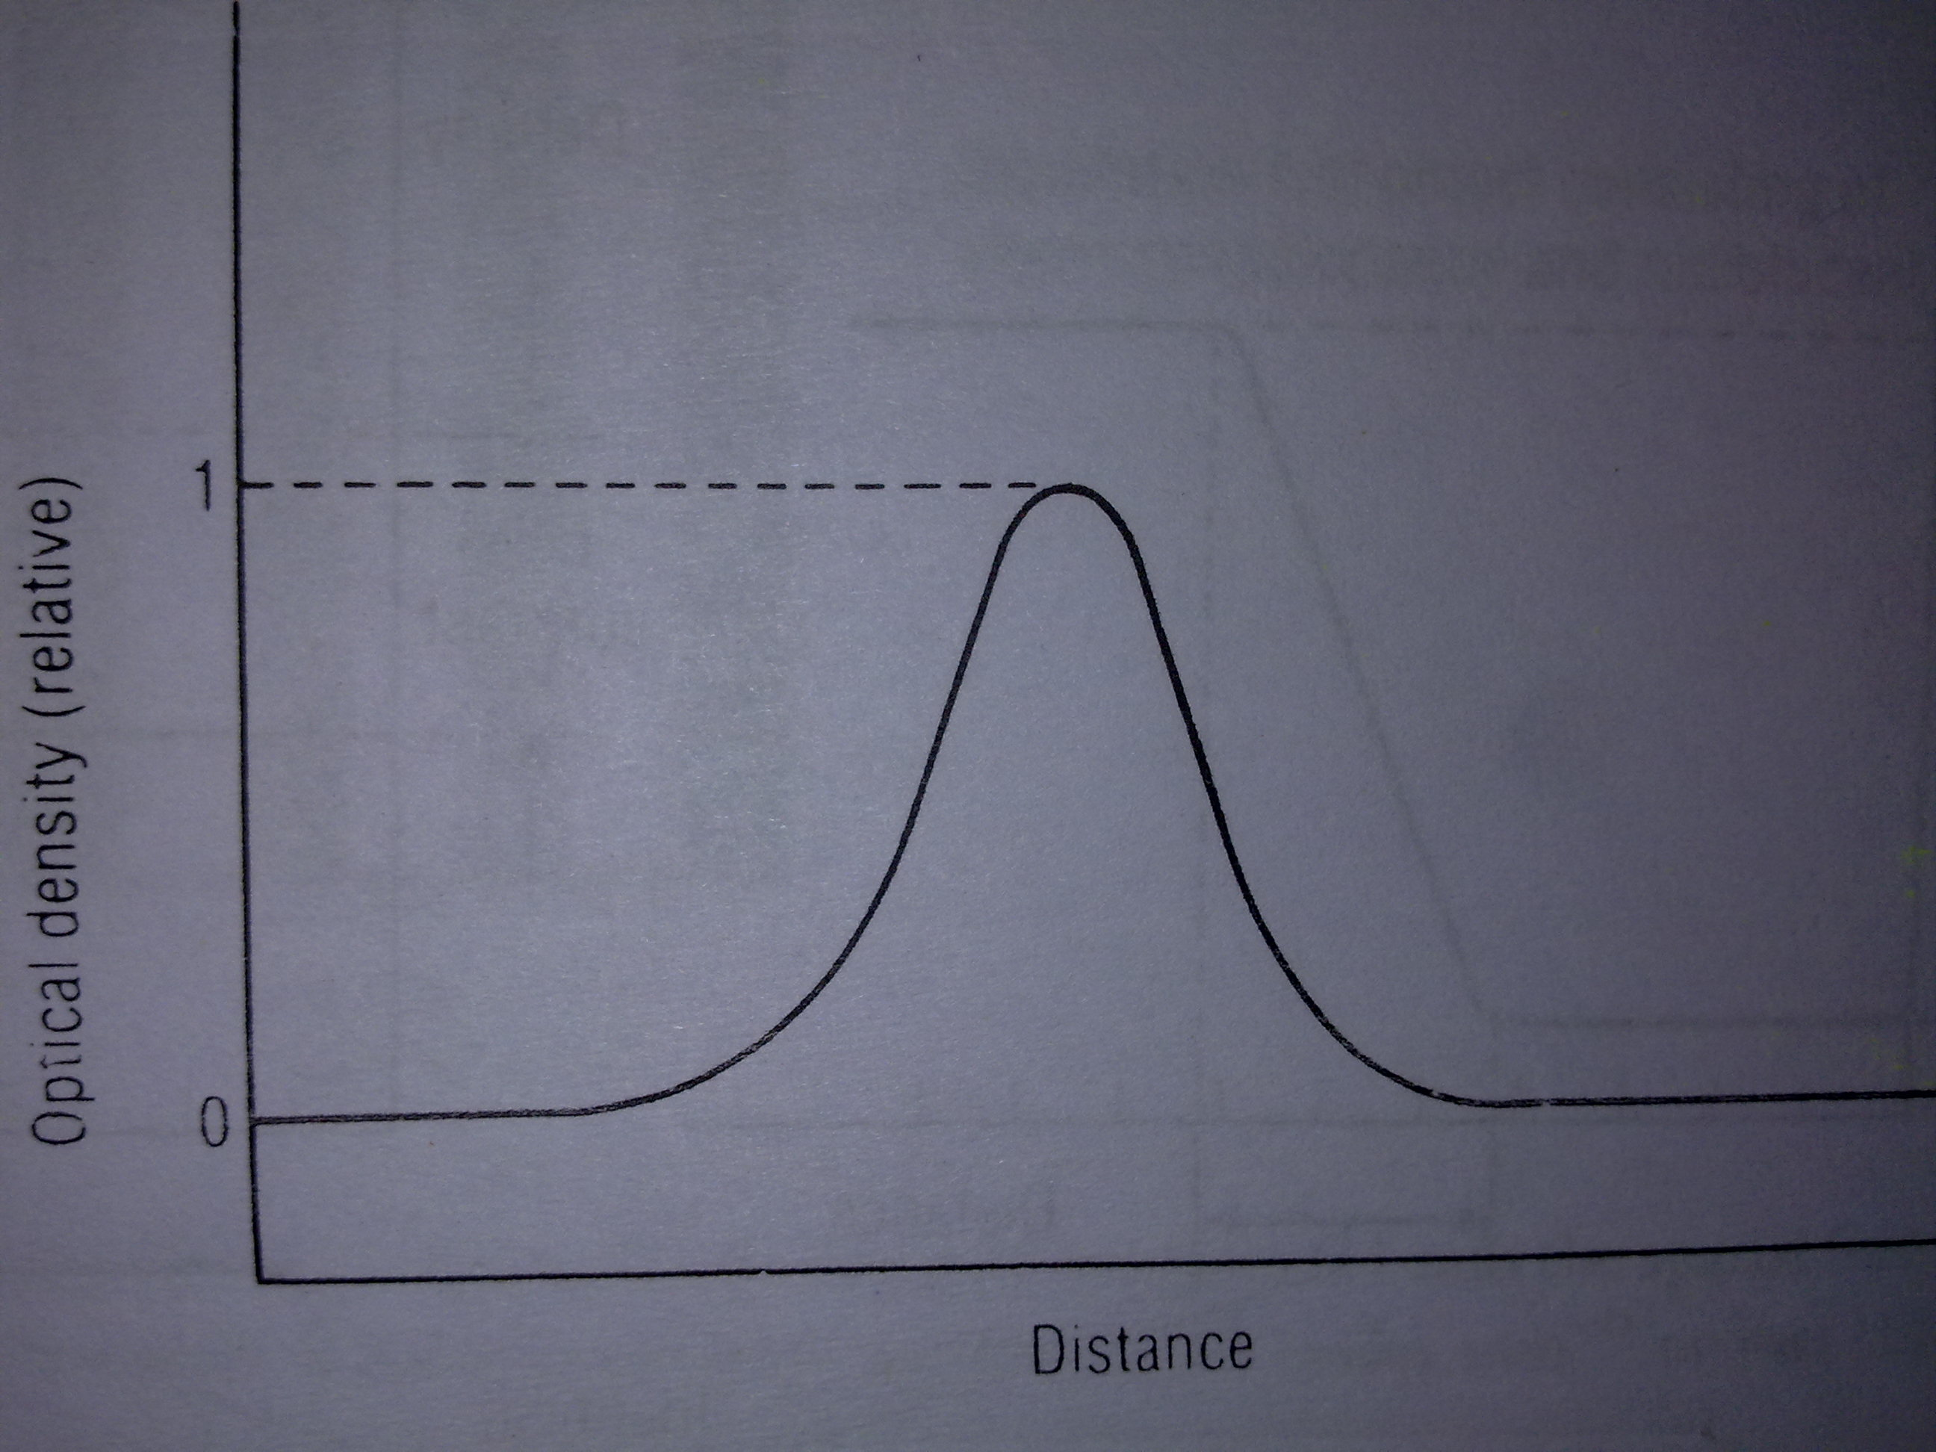

Slide 14
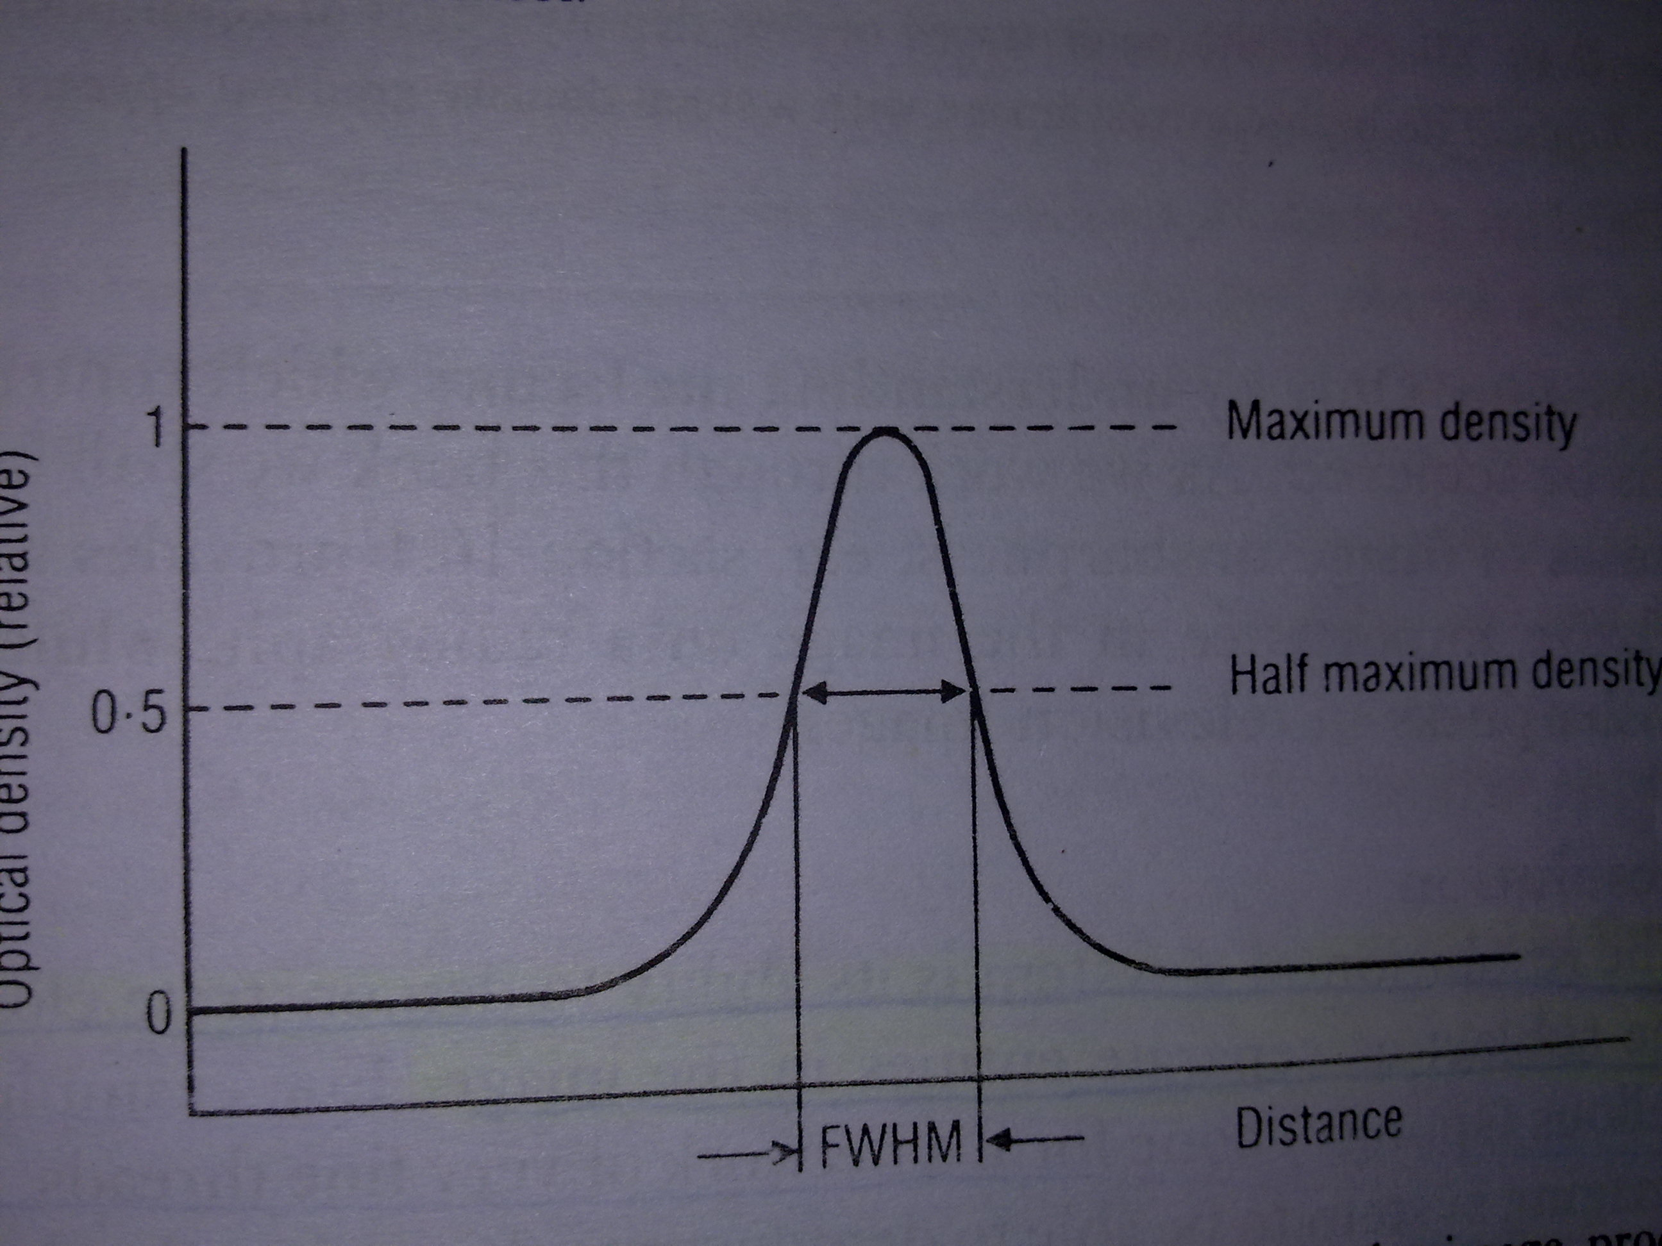

Slide 15
Resolution
The act, process, or capability of distinguishing between two separate but adjacent parts, objects, or sources of light or between two nearly equal wavelengths.

Slide 16
Modulation transfer function(MTF)
It is the test of resolution of an image system
It assessing modulation of structure into the density or lamination in the image.
So magnitude of modulation in an image and object are compared.
As spatial frequency increases, MTF decreases.

Slide 17
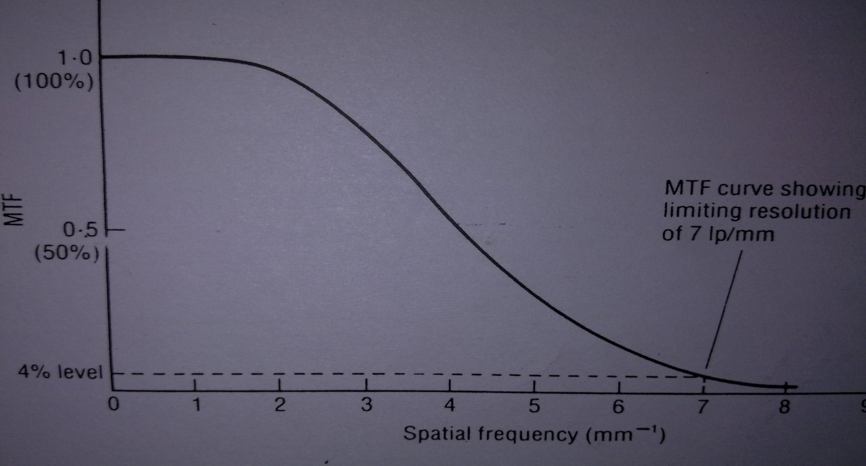
Graph curve between MTF and spatial frequency

Slide 18
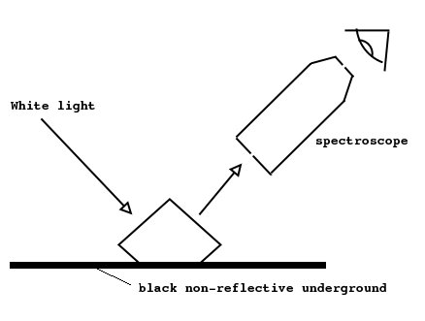
Reflected light
Reflected light is any light that has been bounced off of an object before we see it. Moonlight is actually sunlight that has been bounced off the surface of the moon.

Slide 19
Viewing of reflected light from a surfaces;
The surfaces contains pigments which reflect varying amounts of light incident upon them. Any text and illustration of the book are all viewed by reflected light and the absorbent pigment used is ink. In radiography are also viewed by reflected light.
Light falling on dark pigment is mostly absorbed and little reflected or white pigment is mostly reflected, little absorbed.

Slide 20
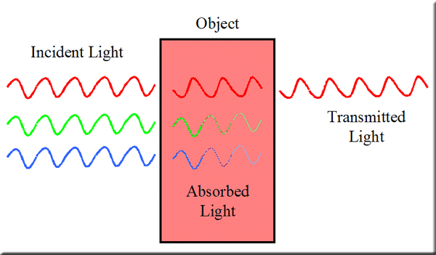
Transmitted light that has been transmitted through a transparent medium.

Slide 21
Viewing by light transmitted through a samitransparent layer;
The layer contain pigment which transmit varying amounts or colors of the light incident upon them. The image on a conventional radiograph is viewed by transmitted light. In this case light-absorbing pigment is metallic silver.
Light falling on pigment free transmitted area is mostly transmitted but less is in pigment.

Slide 22
Emitted light
Emitted light is a light from the sun, it's light from anything that makes the light itself. There are many different ways to make emitted light.

Slide 23
Viewing by light emitted from a fluorescent layer;
Fluorescent layer
HIB
High intensity emission of light
where radiation intensity is high
LIB
Low emitted light intensity
where radiation intensity is low

Slide 24
Cont...
Exposure to x-rays or to an electron beam stimulates the fluorescent material to emit varying amounts of light. The fluoroscopic screen image and the image on the television screen are produced in this way.
Its depend on intensity beam,
High intensity, high emission or low emitted light in low intensity.
Means, viewing of image by reflected and transmitted light requires an external source but not in fluorescent image.

Slide 25
Thank you

