Slide 1


Cerebrospinal Fluid
PRESENTATION BY:
Ms. Pooja Shashikant Chavan (2019-20)
F Y Microbiology for B. Sc Cardiac/Perfusion
Radio Imaging/Medical Laboratory Technology
CSF

Slide 2
What is CSF ?
Cerebrospinal fluid is an ultra filtrate of plasma,functioning as a hydraulic shock absorber. CSF is found in the ventricles of the brain and also in the subarachnoid space around brain and spinal cord.

Slide 3
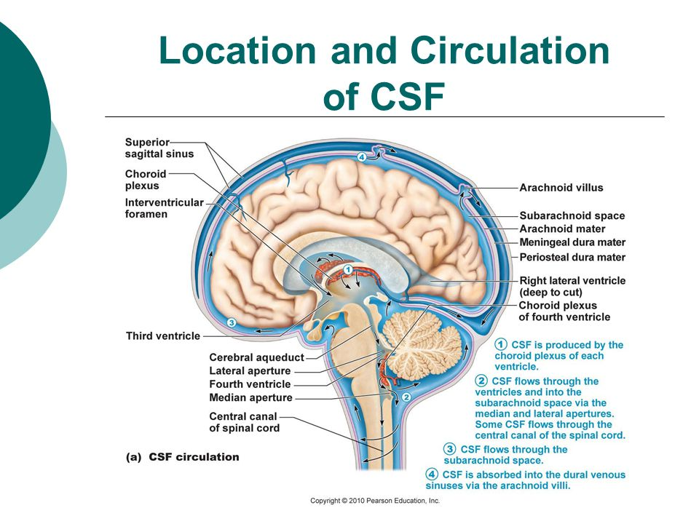

Slide 4
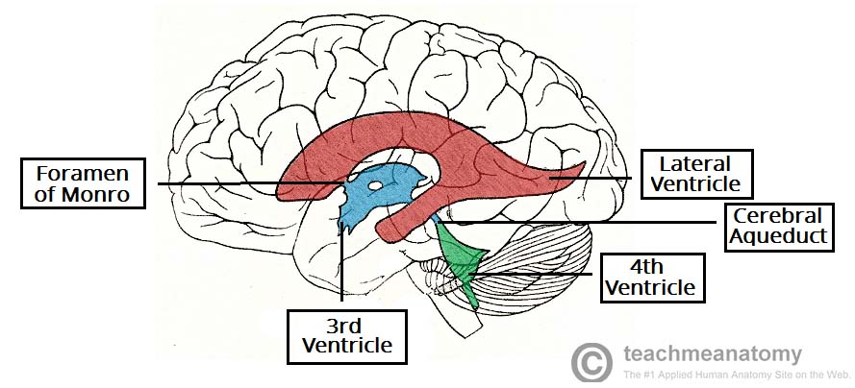
Formation
In choroid plexus (50-70%)
Ependymal surfaces of ventricles
Perivascular spaces

Slide 5


Function
Protects CNS from injuries

Slide 6

Cushion from surrounding bone structure
Provides mechanical buoyancy
SO COMFY...!!!

Slide 7

Provides nutrients
Removes waste products by returning them to blood

Slide 8
Characteristics
Clear
Colourless
pH 7.3

Slide 9
Composition
Glucose (50-85 mg/dl)
Electrolyte
Protein (15-45 mg/dl)
No. Of cells (0-3 lymphocytes)
Amino acids
And other small molecules found in plasma

Slide 10
Volume of CSF
Adults
120-150 ml
Neonates
10-60 mm H2O

Slide 11
Applications
Because of its easy access, it has diagnostic and therapeutic applications
Diagnostic: CSF analysis for detection of pathological conditions
Therapeutic: central neuraxial block

Slide 12
Clinical Significance
Meningitis and encephalitis, which may be viral, bacterial, fungal or parasitic infection.
Metastatic tumor; like leukemia and CNS tumors that shed cells into CSF
Syphilis; an STD, bacterial disease
Bleeding (hemorrhaging) in brain and spinal cord
Multiple sclerosis, degenerative nerve disease that results in loss of myelin coating of nerve fiber of brain and spinal cord

Slide 13
Routine Examination
Includes observation of color, clarity and test for glucose protein, lactate and RBC count, WBC count, gram staining, bacterial culture.
For example: an abnormally high to protein is seen in a patient suspected of having demyelinating disease like sclerosis

Slide 14
Gross Examination
Same as routine examination but also indicate the presence of bilirubin,hemoglobin,red blood cells,or increased protein.

Slide 15
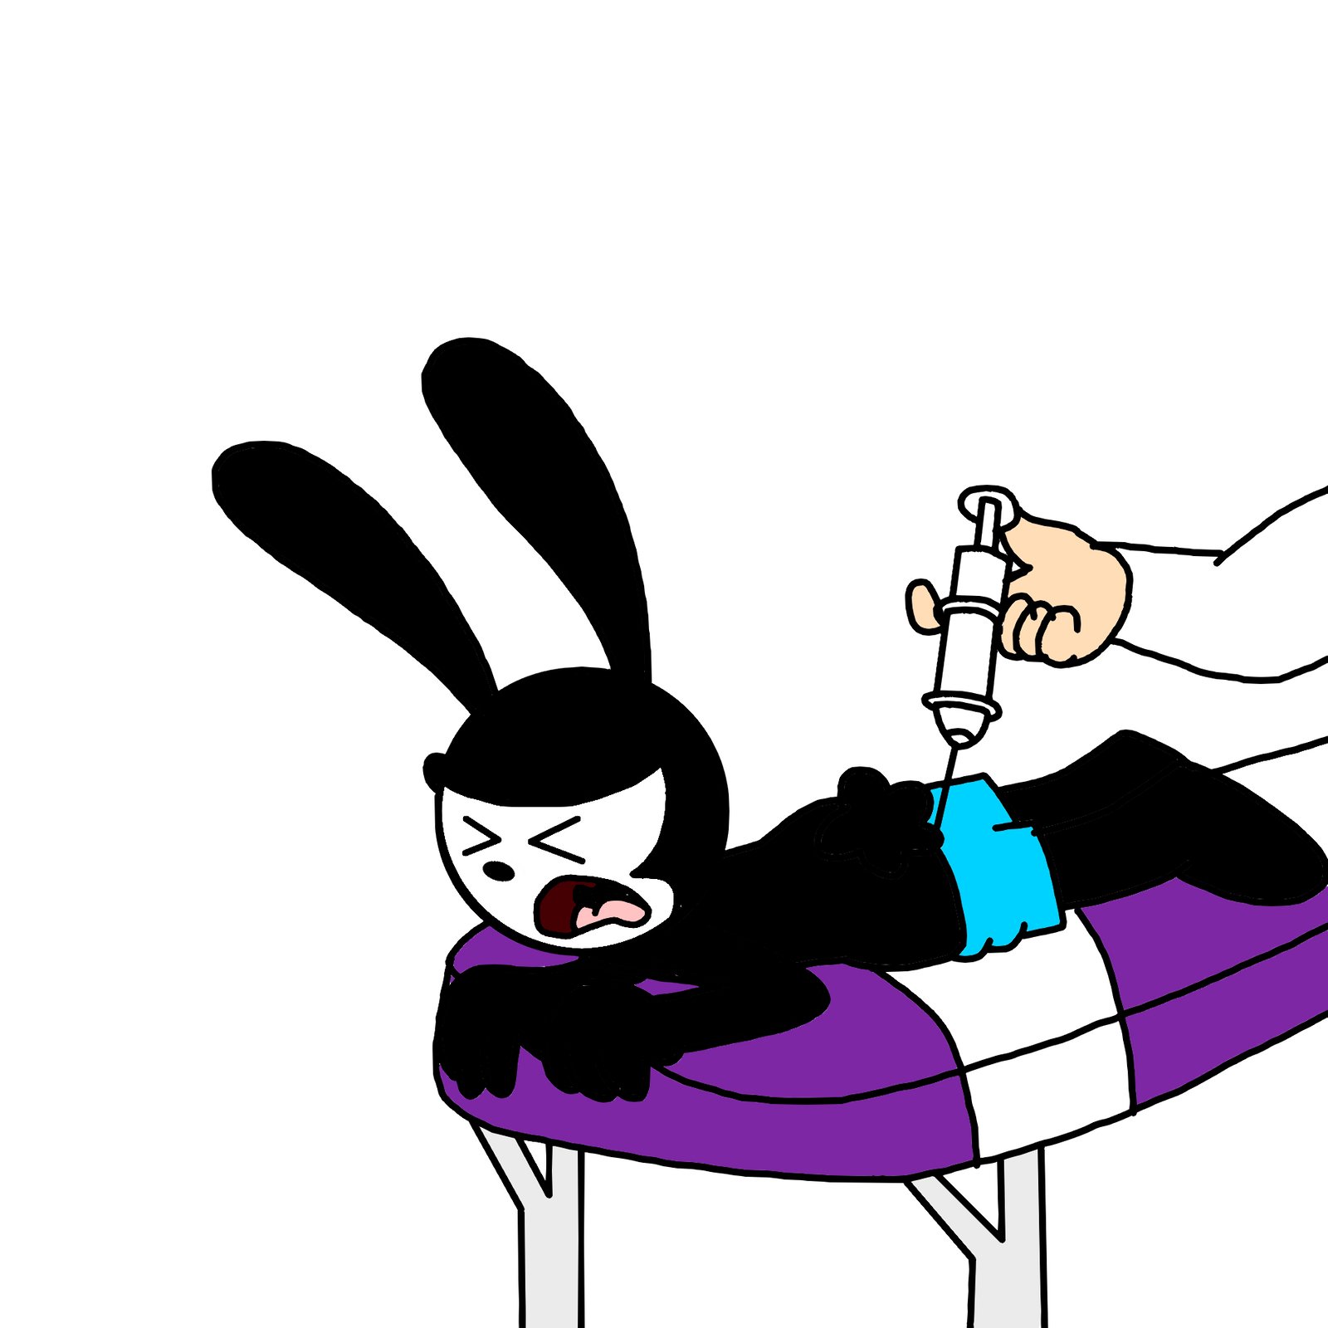
Collection of Specimen

Slide 16
There are different ways to get a sample of CSF.
Lumbar puncture (spinal tap)is the most common method.
To have the test:-
  You will lie on your side with your knees pulled up towards the chest, and chin tucked downward. Sometimes the best is done sitting up, but bent forward.
  After the back is cleaned,the health care provider will inject a local numbing medicine(anesthetic) into the lower spine.
  A spine needle will be inserted.

Slide 17
  An opening pressure is something taken.An abnormal pressure can suggest an infection or other problem.
  Once the needle is in positoin,the CSF pressure is measured and a sample of 1 to 10 milliliters (mL) of CSF is collected in 4 vials.
  The needle is removed,the area is cleaned,and a bandage is placed over the needle site. You may be asked to remain lying down fir a short time after tahe test.

Slide 18
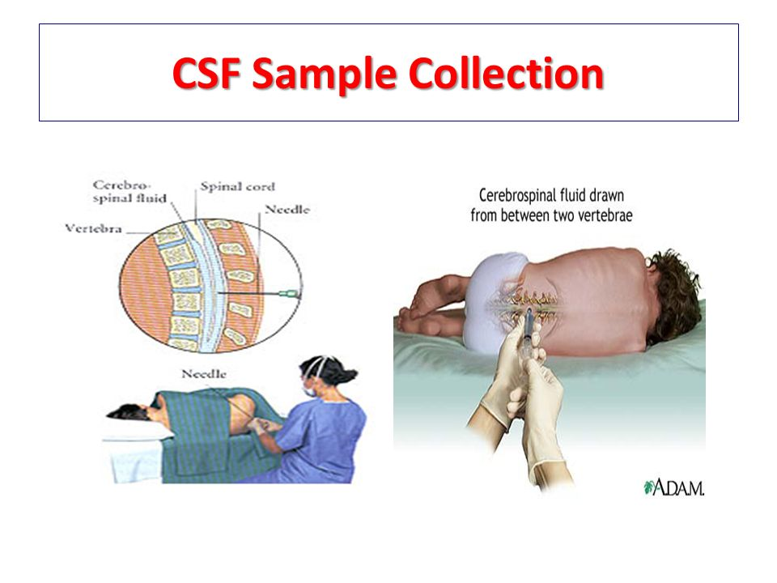

Slide 19

Transportation of specimens

Slide 20
Approximately 5-10ml of CSF should collected in two sterile tubes by lumbar or ventricular puncture performed by a physician.
Thorough disinfection of skin is mandatory.
Part of the CSF specimen will be used for cytological and chemical examination,and the remainder for the microbiological examination.
The specimen should be delivered to the laboratory at once, and processed immediately, since cells disintegrate rapidly.
Any delay may produce a cell count that does not reflect the clinical situation of the patient.

Slide 21

Processing of Specimen

Slide 22
The spinal fluid collected in sterile collection tubes is first used for an all India ink preparation without centrifugation.
If yeast-like organisms are seen, part of the specimen is taken for culture of Cryptococcus
Remaining centrifuged (3000rpm, 15mins), sediment used for study of a stained smear (Romanowsky’s stain, Gram’s stain and acid fast stain) and for culture of infectious agent
Acute bacterial meningitis- CSF turbid with higher total protein count and lower sugar; microscopic exams reveal increased white cell count.
Purulent mengitis caused by bacteria- large clot may form and can be used for smear preparation

Slide 23
Gram staining is done by routine procedure with gram reaction reported immediately
Presence of gram negative diplococci in nutrophils suggests Neisseria meningitides
Presence of gram positive diplococci suggests Streptococcus pneumoniae
Presence of gram negative cocco-bacilli suggests a possible Haemophilus influenzae infection
CSF specimen subjected to acid-fast staining for the possible diagnosis of Myobacterium tuberculosis ; but laboratory culture is necessary for confirmation

Slide 24
CSF specimens are routinely inoculated on blood agar, chocolate agar, MacConkey’s agar and thioglycollate broth.
All culture media are kept under aerobic conditions except chocolate agar which is kept under in a candle jar.
If there is no growth continue to inoculate for 48 hours.
Blood agar medium serves as a general purpose medium; growth of S. pneumoniae can be recognised on primary plate.
MacConkey plate will alow gram negative rods to grow , and further biochemical reactions will be able to identify them
Growth in thioglycollate broth, with the presence of gram negative rods, suggest the possibilities of bacteroides infection. If there is no growth, observe the thioglycollate broth for 7 days.

Slide 25
Summary
What is CSF Formation Function Characteristics Composition Volume Applicatipon Clinical significance | Routine examination Gross examination Collection of CSF specimens Transport of CSF specimens Processing of CSF specimens

Slide 26


