Slide 1
Streptococcus pneumoniae

Slide 2
CONTENT:-
Introduction
Morphology
Culture
Bio-Chemical Test
Pathogenicity
Laboratory Diagnosis
Treatment

Slide 3
INTRODUCTION
Streptococcus pneumoniae, or
Pneeumococcus, is a gram positive,
alpha-hemolytic(a greenish discoloration and partial hemolysis of the red blood cells immediately surrounding colonies of some streptococci on blood agar plates ) or beta-hemolytic,
facultative anaerobic member of the
genus Streptococcus. They are usually
found in pairs and do not form spores
and are non motile.
Class: Bacilli
Scientific Name: Streptococcus pneumoniae
Family: Streptococcaceae

Slide 4
MORHOLOGY
Streptococcus pneumoniae are the gram positive, lancet shape bacteria with one end broad or rounded and other end pointed.
They usually occurs in pairs (diplococcus) as well as they can also occurs in short chain (Streptococcus).
They are similar than 1 micrometre in diameter.
They are non-spore forming and non-motile in nature.

Slide 5
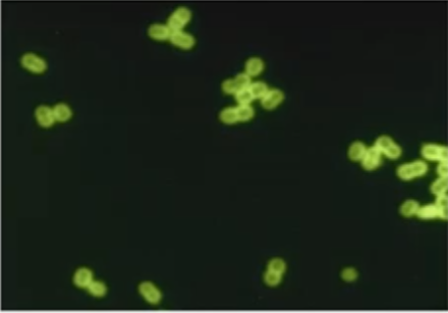
CULTURE
Various types of culture are prepared for the study of the given bacteria.
Blood Agar
PEA Culture
Streptococcus pneumoniae

Slide 6
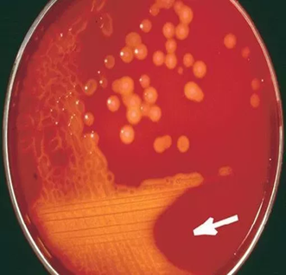
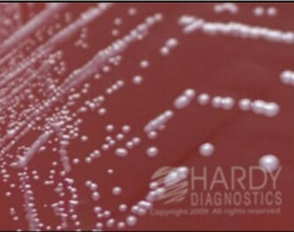
SR. NO. | CULTURE | DETAILS | IMAGES
1. | Blood Agar | After overnight Incubation, small colonies with Circular shape, semi-transparent, Are seen.
2. | PEA (Phynyl Ethyl Alcohol agar)Culture | Anaerobic PEA should appear opaque, and dark red in colour.

Slide 7
Bio-Chemical Test
SR. NO. | TEST NAME | INTERPRETATION
1. | Bile Esculin | Positive
2. | Mannitol | Positive
3. | Optochin | Positive

Slide 8
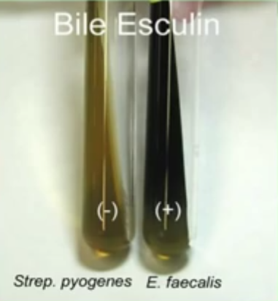
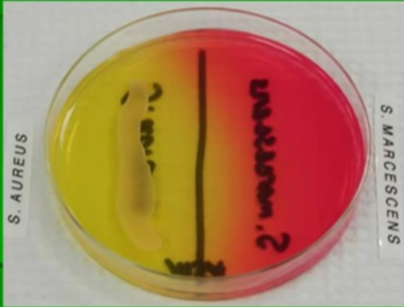
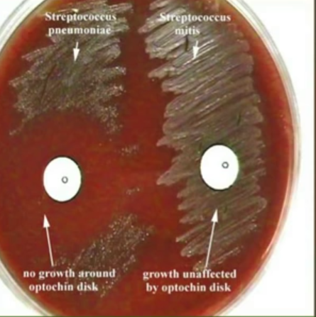
Bile Esculin
Mannitol
Optochin

Slide 9
PATHOGENICITY
Intra peritoneal inoculation in mice and rabbit can cause a fatal infection and death can occur in 1 to 3 days.
Pneumococcus can localize in human nasopharynx and can infect middle ear and respiratory tract.
Generally, infection is endogenous but highly virulent strains can also cause exogenous infections.
Pneumococci are a cause of pneumonia and bronchopneumonia.
Pneumococci are associated with chronic bronchitis.

Slide 10
LABORATORY DIAGANOSIS
The sputum sample is collected from the patient.
The sputum sample is homogenized and gram staining procedure is carried out.
After homogenization, it is inoculated on blood agar for
37 ºc for 24 hours.
In case of infants serum coated laryngeal swaps are used.
Gram-Stained CSF is used for presumptive diagnosis of meningitis and gram-positive diplococci are observed.

Slide 11
TREATMENT
Antibiotic used for treatment are penicillin and amoxicillin.
If the strains are resistant to other antibiotics like erythromycin and tetracycline are used.
In serious infections, vancomycin and cephalosporin drugs are of choice.

Slide 12
THANK YOU

