Slide 1
SPINAL POISONS
DR SUNIL DOSHI

Slide 2
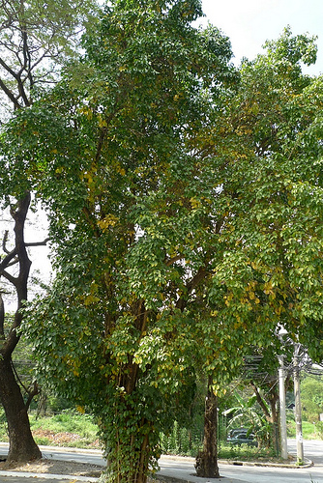
STRYCHNOS NUX VOMICA
Strychnine (kuchila)
powerful alkaloid obtained
from seeds of
strychnos nux vomica.
It is an evergreen tree native
to south east asia and
several parts of india
Medium sized tree
Leaves size 5cm x 8cm

Slide 3
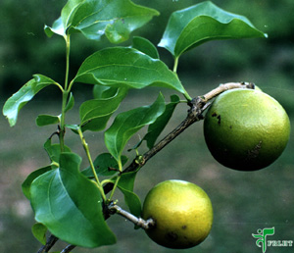
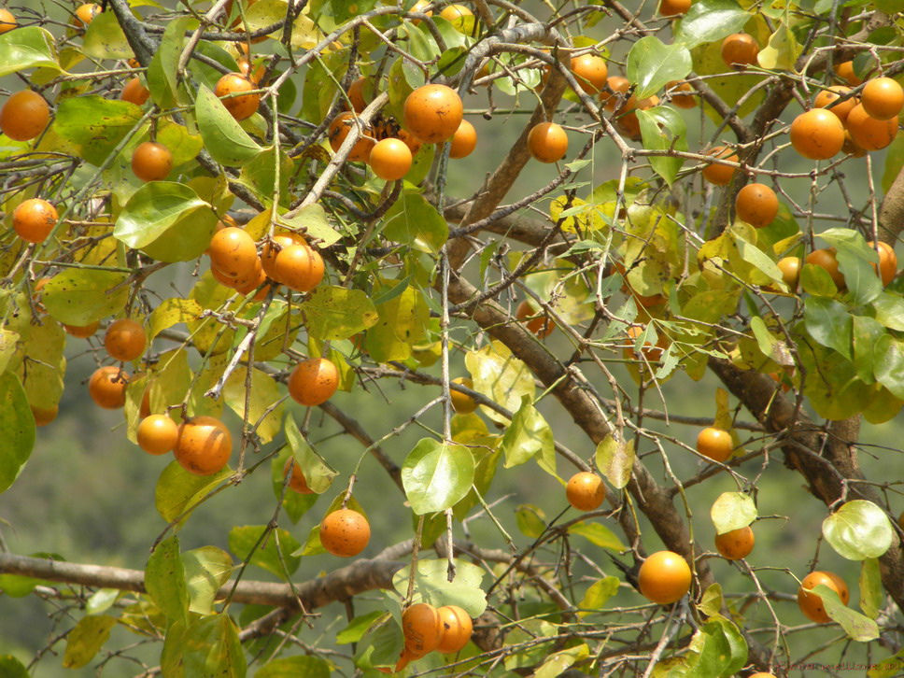
Fruit of strychnos

Slide 4
Fruit of strychnos
Fruits are round , hard, slightly rough, glossy orange in appearance
Each fruit has 3 to 5 seeds
Seeds of ripe fruit are poisonous.
Powerful alkaloids present in seeds
Strychnine : 10 times more potent than brucine.
Brucine
Loganine (glucoside)

Slide 5
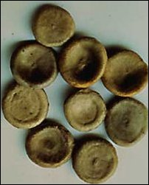
Seeds

Slide 6
Seeds
flat, circular discs or concavo-convex
Greyish brown in colour
Appx. 6 mm in thickness
Shining surface and covered with radiating
silky fibers
Very hard and tough
Odourless but extremely bitter to taste.

Slide 7
Absorption and excretion
Crushed seeds are well absorbed at all mucus members
Taken up by liver and muscles
Released in circulation or destroyed
Release of it fropm liver and muscle produces convultions on 2nd or 3rd day.
Oxidized in liver, excreted by kidney slowly
May be found in cadavers for years

Slide 8
Mode of action
Competitive antagonism of inhibitory neurotransmitter glycine at post synaptic spinal cord neurone. (Anterior horn cells)
Results in widespread ‘release’ exitation
Stimulates cerebral cortex.

Slide 9
Onset of action
Uncrushed seeds have no poisonous effects, passed entire in g.i.t.
Crushed seeds taken , effect after an hour
If alkaloid is taken , symptoms within 5 to 10 mins

Slide 10
Clinical feature
Bitter taste in mouth
Sence of uneasiness
Feeling of suffocation, fear
Difficulty in swallowing
Increased rigidity of muscles, muscle twitches
Covulsions (clonic followed by tonic) due to direct effect of alkaloid on reflex centre of spinal cord, affecting all muscles at same time.
Face is cyanosed, giving anxious look, promonent eye ball, dilated pupils.

Slide 11
Risus sardonicus
Contraction of facial and jaw muscles in which corners of mouth are drawn back. Mouth is covered with froth.

Slide 12
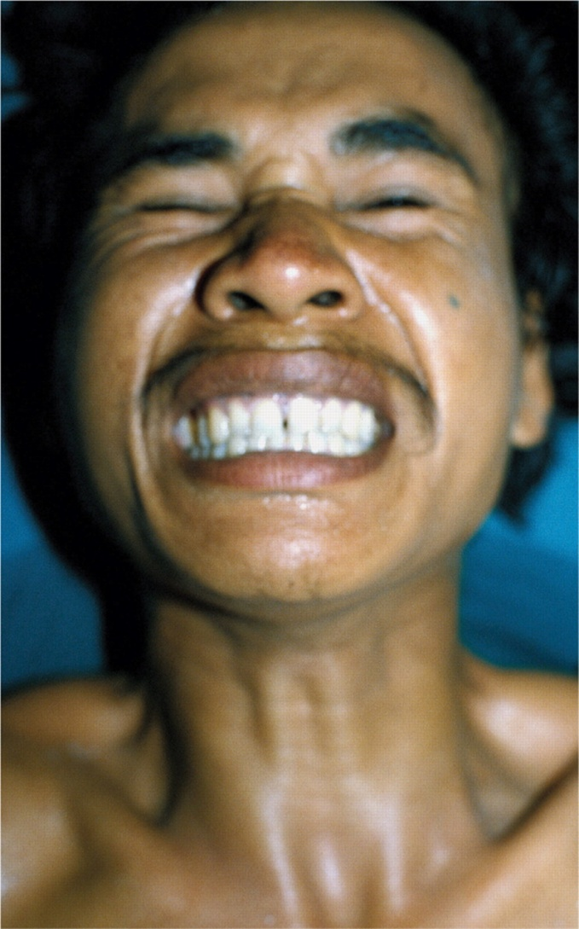
Risus sardonicuis

Slide 13
Clinical features
Convulsions more marked in anti gravity muscles.
Opisthotonus : body is typically arched in hyperexrtension. Supported by heels and head only. Legs adducted and extended, arms flexed over chest ,hands are tightly clenched, head is bent backwards and whole body is assuming a bow like form.
Emprosthotonus : due to spasm of the abdominal muscles forward bending of the body
Pluerosthotonus : sideway bending of the body

Slide 14
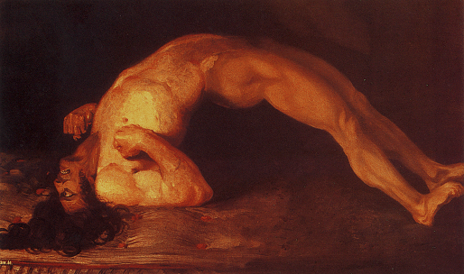
Opisthotonus

Slide 15
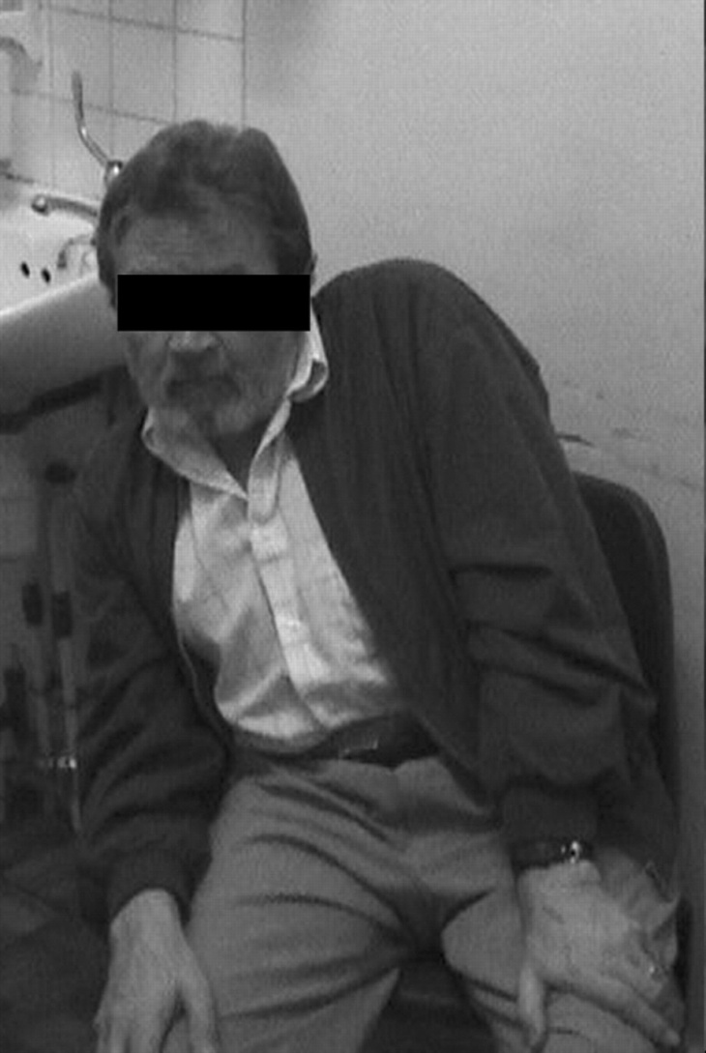
Pleurosthotonus

Slide 16
Consciousness is not lost and mind remains clear till death. So suffering is very severe as patient is aware of impending death.
In between convulsions muscles are completely relaxed.
On even slightested impulse, another convulsion starts. In fatal cases they succeed one another. Death usually ocurs after four to five convulsions.
In non fatal cases interval between convulsions is longer and spasm is less, untill entirely stop. Recovery takes place in one to two days.
Duration of convulsion : half to two minutes

Slide 17
Difference b/w strychnine piosoning and Tetanus
Trait | Strychnine poisoning | Tetanus
History | No h/o injury | h/o injury
Onset | Sudden | gradual
Convulsion | All muscles are affected at same time | Usually starts from lower jaw. Not affected at same time
Muscle condition | Between convulsions muscles are relaxed completely | Slightly rigid;.
Fatal period | 1-2 hour | > 24 hour
Chemical analysis | Strychnine found | No pioson found

Slide 18
Fatal dose : one crushed seed , 50 to 100 mg
Fartal periode : one to two hour

Slide 19
Treatment
Control of convulsions : keep in dark room, free from noise and disturbance.
diazepam, lorazepam, phenobarbitone
If not successful then give general anaesthesia using succinyl choline, curare, pancuronium
Secure the airway , use artificial ventilation.
Stomach wash with warm water and KMnO4.
Other symptomatic tretment

Slide 20
Post mortem appearance
Rigor mortis appears early,but not necessarily prolonged
Signs of asphyxia
Extravasion of blood in muscles (sometimes)
Locally : mucosa of stomach and duodenum congested may show echymosis. Haemorrhages may be seen under the peritoneal coat of stomach.
Other viscera congested

Slide 21
Physiological test
Injection of suspected material into dorsal lymph sac of frog will produce tetanic convusions i9n few minutes , if strychnine is present.

Slide 22
Medico legal importance
Used for homicide
Suicide rarely, beccause of painful death
Accidental deaths are more common
Sometimes used as cattle poison asn arrow poison

Slide 23
Peripheral nerve poison
Curare : Found from species of strychnos.
Action is entirely peripheral and at level of myoneural junction
Blocks post synaptic nicotinic acetylcholine receptors in muscles leading to flaccid paralysis
Not piosonous if swallowed, absorbed through wounds
Used as arrow poison

Slide 24
Clinical features
Gradual paralysis of limbs followed by paralysis of respiratory muscles. Large dose there is centra action , may produce muscular twitching and convulsions folowed by unconsciousness and death
Death from asphyxia.
Fatal dose : 60 mg
Fatal periode : 1 to 2 hour

Slide 25
Treatment
Atropine followed by neostigmine
Artificial respiration

Slide 26
Thank you..!!!

