Slide 1
SUBSTANCES OF DEPENDENCE & ABUSE
Dr. SUNIL DOSHI

Slide 2
DEFINITIONS
SUBSTANCE DEPENDENCE :
It arises out of a mal adaptive pattern of substance use, leading to a cluster of behavioral, cognitive and physiological phenomena that develop after repeated intake.
It includes a strong desire to take drug , difficulty in controlling its use, persisting in its use despite of harmful consequences, increased tolerance and sometimes a physical withdrawal state.
Prolonged, unnecessary or excessive intake of non dependence producing drugs like analgesics, laxatives, antidepressants, antacids, vitamins, steroids, hormones, specific herbal or folk remedies etc. is not covered in term “substance dependence”.

Slide 3
SUBSTANCE ABUSE :
It arises out of a maladaptive pattern of substance use, manifested by recurrent and significant adverse consequences related to the repeated intake of the substance.
These problem must occur recurrently during same 12 month period.
It not include tolerance, withdrawal, or a pattern of compulsive use and only include the harmful consequences of repeated use.

Slide 4
SUBSTANCE INTOXICATION :
It refers to unwanted physiological or psychological effects that causes mal adaptive behavior.(DSM-IV)
It must produce disturbances in the level of consciousness, cognition, perception, affect or behavior that are clinically significant.(ICD-10)

Slide 5
SUBSTANCE WITHDRAWAL :
“Substance withdrawal” should be restricted to major symptoms resulting from the cessation of substance abuse, accompanied by a maladaptive behavior change. There should be clinically significant impairment in social, occupational or other important areas of functioning.(DSM-IV)

Slide 6
PHYSICAL DEPENDENCE :
“Physical OR Physiological dependence ” is defined as an alteration in neural systems, which is manifested by tolerance & the appearance of withdrawal phenomena when a chronically administered drug is discontinued or displaced from its receptor.
ADDICTION :
Term “Addiction” denotes a chronic disorder characterized by compulsive use of drugs(craving) resulting in physical, psychological and social harm and continued use despite evidence of that harm(denial).

Slide 7
CLASSIFICATION OF
DRUGS OF DEPENDENCE & ABUSE
Ethanol
Tobacco
Tranquillizers & sedatives : Barbiturates, Benzodiazepines, Chloral hydrate, Chlormethiazole, Glutethimide, Methaqualone, Zolpidem, Zopiclone.
Opiates & Opioids
Cocaine
Cannabis

Slide 8
Amphetamines & ‘Designer drugs’
Hallucinogens: LSD(Lysergic Acid Diethylamide), Phencyclidine, Psilocybine, Mescaline, Ketamine, Dimethyltryptamine(DMT)
Inhalants : Flourinated Hydrocarbons(freons), Ether, Ketones, Aeromatic & alifatic hydrocarbons
Miscellaneous : Caffeine, Dhatura seeds, Analgesics, Anabolic steroids, Cough syrups, Laxatives.

Slide 9
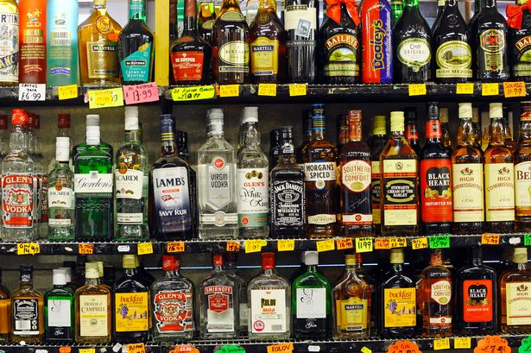
alcohol

Slide 10
Prevalent world wide
Efforts have been made to totally prohibit alcohol consumption in different countries & in Gujarat in India without much success. Such attempts usually lead to consumption with even more serious consequences.!
All over India(except Gujarat), the mere consumption of alcohol not constitute any offence. Only when the drunken person behaves in such a manner as to become a public nuisance, or poses a threat, or actually commits an act endangering the life or property of another person(or even his own!) will the law take cognizance of the fact.

Slide 11
TOBACCO
Commonest source is in form of smoking.
When a cigarette is inhaled, the smoker is exposed to both gaseous(smoke) & particulate matter(Nicotine & Tar).
Usual nicotine content of a regular cigarette is 13 to 20 mg. Certain European or Turkish cigarettes contains higher amount. ‘Low Nicotine Cigarette’ contains 7 to 10 mg of alkaloid. Cigars contain 15 to 40 mg of nicotine. When a cigarette is smoked usually 0.5 to 2 mg of nicotine is delivered to smoker. Non filtered cigarettes delivers slightly higher amount. It also depends on smoking technique of smoker.

Slide 12
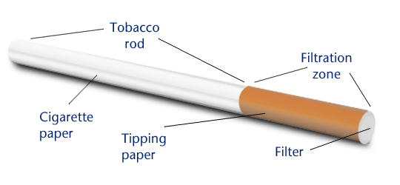
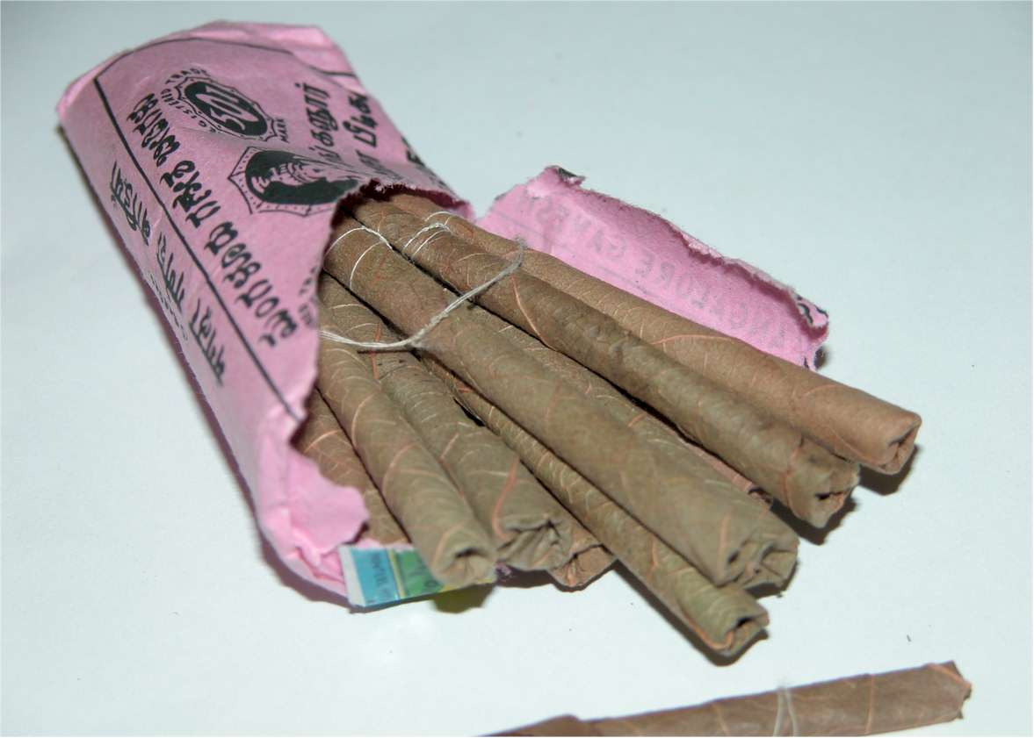
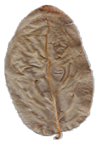
In India ‘Bidis” are very popular in lower economical population. Bidis are cheaper, smaller, brown, hand-rolled cigarettes consisting tobacco wrapped in a tendu or temburni leaf. They are more harmful than cigarette & produce higher levels of carbon monoxide, nicotine & tar. Low combustibility of tendu leads smokers to smoke more deeply & more often, delivering more toxins than cigarettes.

Slide 13
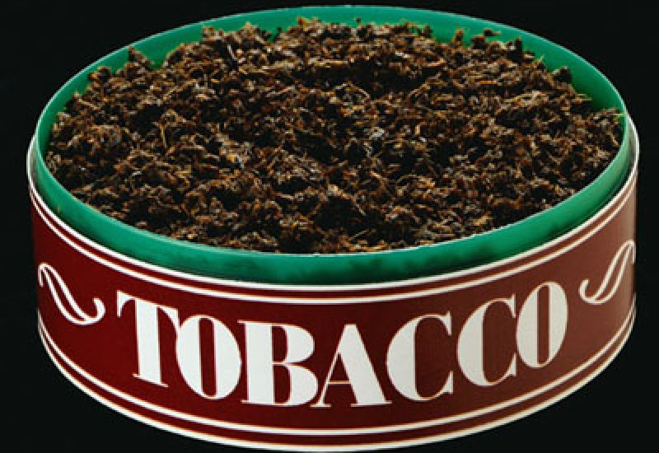
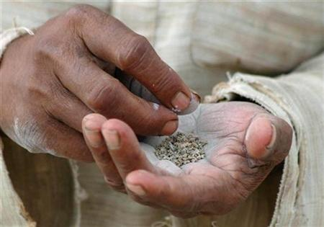
Next common source of nicotine toxicity is from smokeless tobacco, which is of two kinds – snuff and chewing tobacco

Slide 14
There has been resurgence of popularity in use of snuff recently, paralleling the decline in cigarette smoking because of general belief that smoking is not involved, socially snuff is more acceptable & less harmful. But, it is not true…
Snuff is available as finely cut tobacco powder which is packaged dry or moist. It contains approx 14 mg of nicotine per gm of tobacco.
Chewing tobacco is generally packed as “twists” (leaf tobacco twisted into rope like portions) or “plugs”(shredded tobacco pressed into cakes). These are chewed or simply placed between cheek & gums. The nicotine dissolves in the saliva & is absorbed through mucosa of mouth & gut.

Slide 15
A portion of tobacco that is placed in mouth each time is called “quid”. A typical quid contains 1.5 to 2.5 gm of tobacco & delivering approx same or little more dose of nicotine than tobacco snuffer. Person taking 8 to 10 quids/day gets nicotine equivalent of 30 to 40 cigarettes/day.
Tobacco abuse is the most widespread cause of death & disability worldwide than any single disease entity.
Environmental Tobacco Smoke(ETS) consists of mainstream smoke, sidestream smoke, and vapor phase components that diffuse through cigarette paper into the environment. ETS exposure occurs frequently in the home, in the workplace, & in other public areas.
Government of India is making attempts at prohibiting tobacco smoking in public places with varying success rates.

Slide 16
BARBITURATES
As Benzodiazepines have replaced Barbiturates almost for treatment of insomnia and other psycho-neurotic disorders , Barbiturates addiction has been declined dramatically.
It was rampant in the 1960s when barbiturates were widely prescribed and consequently abused.

Slide 17
BENZODIAZEPINES
Ever since their introduction, Benzodiazepines have become more & more popular as anxiolytic & sedatives and replaced Barbiturates for same.
Long term use of Benzodiazepines is believed to cause behavioral disinhibition which may induce a person to hostile acts, aggressive behavior and verbal indecency.
Some benzodiazepines induce amnesia in order to accomplish immoral acts. Particularly Flunitrazepam causes anterograde amnesia – used for Date Rape.
Addiction of benzodiazepines is frequent in long term users , but abuse potential is much less compared to barbiturates.
Withdrawal reactions are also less severe & easily manageable.

Slide 18
OPIATES
Commonest among the drug users in India currently.
Heroin(Brown sugar) is popular among all classes of addicts in metro-cities.
Therapeutically used opiates – Morphine, Pethidine, Pentazocine are more commonly abused be medical & paramedical persons.
Codeine which is easily available over the counter as antitussives is popular in youngsters.
Buprenorpine is also a important drug abused in India.
Accidental deaths by overdose are not uncommon among intravenous drug users(Death on Needle). Suicidal deaths are also reported frequently since opiates are reputed to cause a painless death. Homicides are rare.

Slide 19
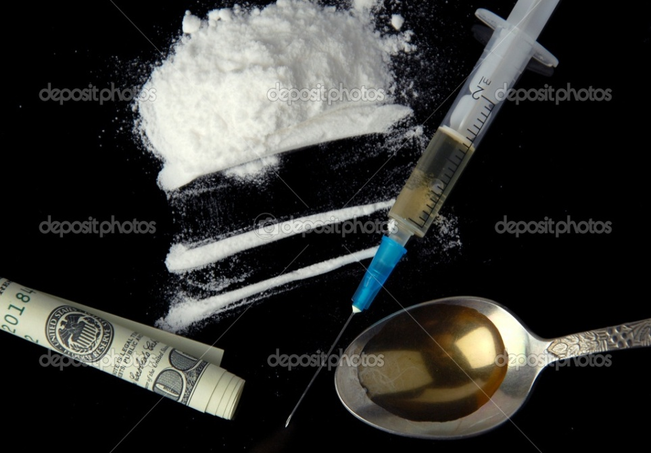
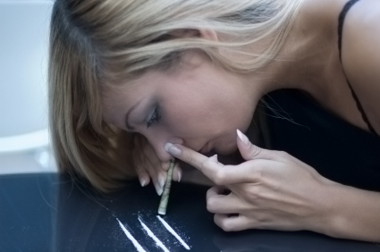
COCAINE
Have been abused for centuries.
“champagne drug” or “rich man's drug” – costly & relatively scarily available
“Page 3 drug” - Popular in high socioeconomical class people, film actors, musicians & artistes.

Slide 20
As it is reputed for enhance sexual pleasure, abuse also leads to spread AIDS because of high risk sexual practices.
Cocaine abuse by pregnant mothers causes teratogenicity & congenital malformations in fetus.
“Bodypacker syndrome” – the practice of swallowing balloons, condoms or plastic packets filled with illegal drugs for the purpose of smuggling. The person is called “mule”.
“Body stuffing” – an individual who is on verge of being arrested for possession of illegal drugs, swallows it to conceal the evidence.
Sudden death due to massive overdose can occur if the package burst inside body.

Slide 21
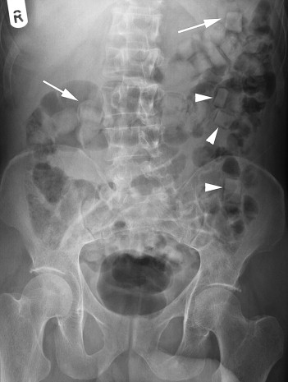
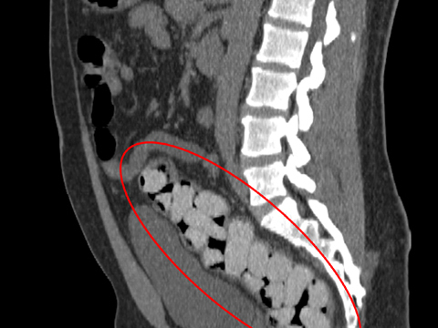

Slide 22
CANNABIS
Used since ancient times.
Most commonly used illicit substance in USA currently.
Always been popular in India in form of its various forms. Actually an integral part of Hindu culture. Sanyasis-Sadhu & temple pujaris use it to induce a trance like status for religious meditation. Widely consumed on festivals like Holi & Shiv-ratri by Hindu people.
Long term use can cause motor & cognition impairment.

Slide 23
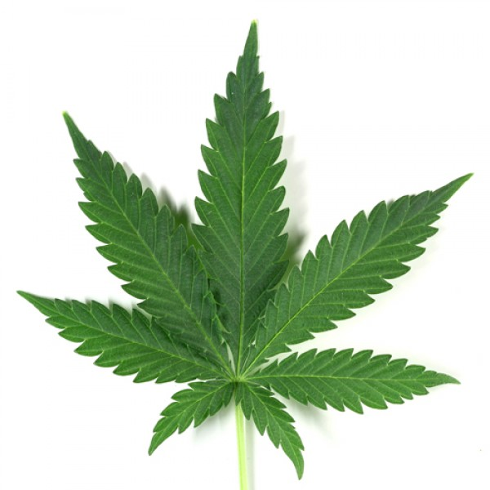
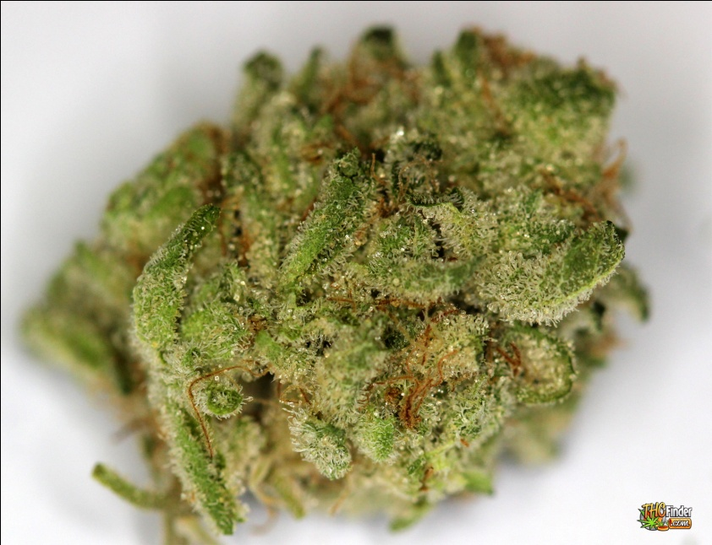
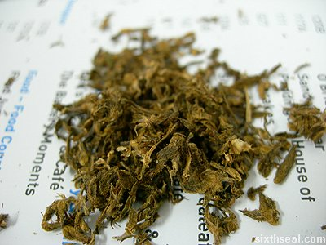

Slide 24
AMPHETAMINE & ‘Designer drugs’
2nd Most widely used drug(next to cannabis) in UK & Europe, Australia.
It is prescribed for obesity, narcolepsy, attention deficit disorder, psychotherapy under restriction. Virtually banned in India.
Crystalline methamphetamine(“ice”) introduced in Hawaii in 1980 & quickly became popular worldwide.
Currently designer amphetamines are very frequently by adolescents in rave parties. Because unlike other drugs like heroin & cannabis, designer drugs are considered ‘’cool” & “hep”. Tablets of Ecstacy are freely available for a few hundred rupees which are consumed easily without messiness of nasal insufflations, smoking or injections.

Slide 25
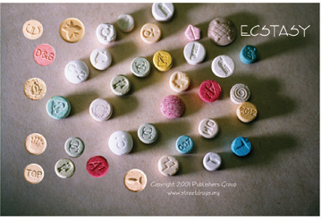

Slide 26
HALLUCINOGENS
Traditionally abused in Western countries. LSD & Phencyclidine are popular in USA, Europe & Australia.
Popularity gains by their glamorous representation in films & show business & rock music.
Causes long term psychological damage, violent assaultive behavior, homicides & suicides.

Slide 27
INHALANT substances
Inhalant(volatile) substances are widely available & frequently abused by adolescents from poor socioeconomic class.
Mostly volatile Hydrocarbons which are normally used as solvents, propellants, thinners & fuels. e.g. toluene from paints, glues, petrol, butane from cigarette lighter fluids, butyl & isobutyl nitrite, halogenated hydrocarbons from typewriter correction fluids, propellants & dry cleaning fluids.
Abusers often begin with “sniffing”(lower concentration), and progress subsequently to “huffing” and “bagging”(higher concentration).

Slide 28
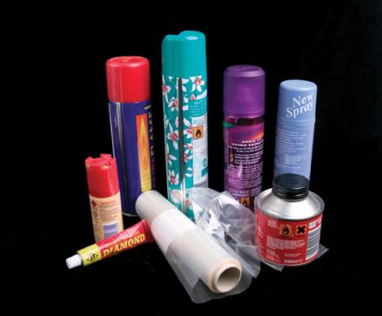
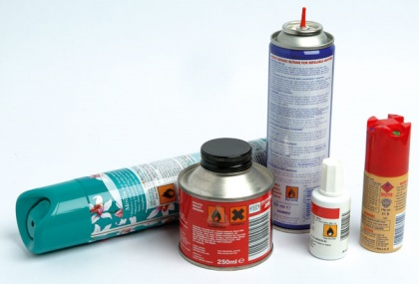

Slide 29
These substances produces intoxicating effects rapidly & lasting longer. They are well absorbed through the lungs & distributed quickly to CNS. Chronic users can maintain prolonged high with periodic inhalations every few hours.
Volatile substance abuse(VSA) is uniquely a adolescent phenomenon & particularly among lower socioeconomical classes because these substances are cheap, easily available, legal to possess & mode of intake is simple.
VSA is very common among street urchins of major cities of India.
Persons with adolescent conduct disorder and adult antisocial personality disorder are especially prone to VSA.

Slide 30
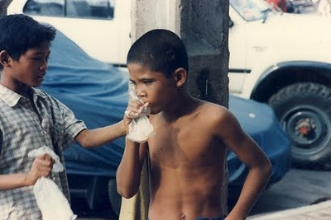
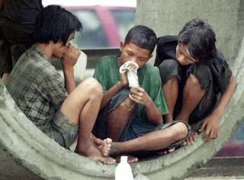

Slide 31
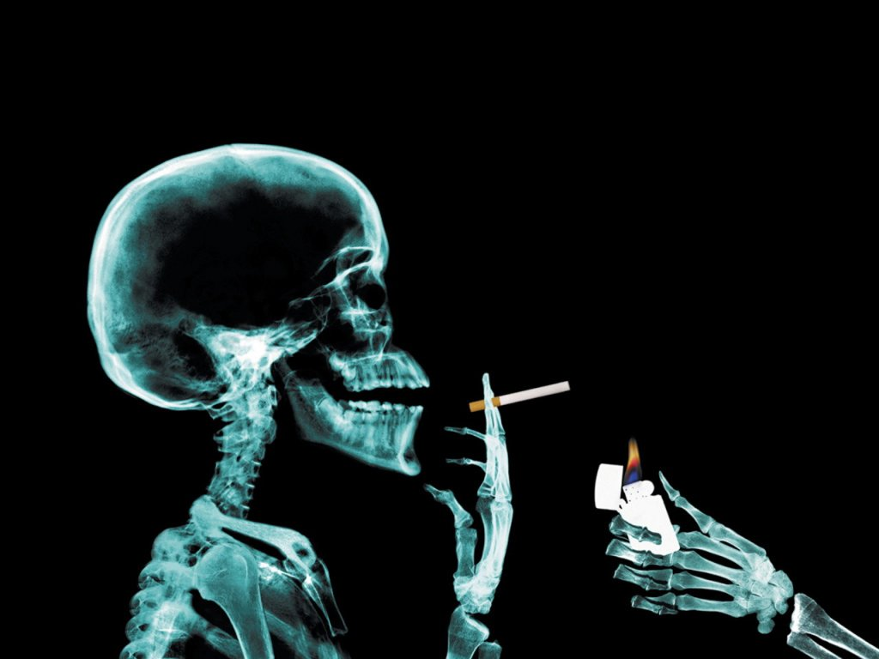
THANK YOU

