Slide 1
Rabies
Prepared by:
Dr. Divyang Patel
AP
Community medicine

Slide 2

What is Rabies?
Rabies is a disease caused by a single stranded RNAvirus
Belongs to the Lyssavirus genus and Rhabdoviridae family
Rabies is a deadly disease and almost all who get the disease die. There is NO CURE for the disease even today.

Slide 3







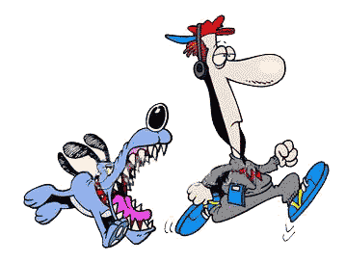
?????
Rabies can affect any mammal.
Rabies affected animals spread the virus to other animals through their saliva (mainly).
Transmission of disease through bites, scratches or licks by an infected animal.

Slide 4

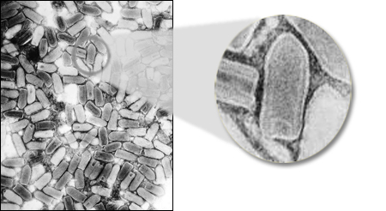
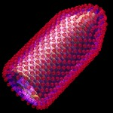
Rabies Virus

Slide 5












Vector of rabies in India
Dogs
Cats
Monkeys
Wolves
Cattle
Sheep / Goats
Mongoose
Pigs
Donkeys
Horses
Foxes / Jackals
Elephants

Slide 6

After a bite, WHAT TO DO?
Three simple steps
THAT CAN SAVE LIFE
Prevention of rabies

Slide 7
STEP - 1
Wash the wound immediately with water and soap for at least 10-15 minutes or over running water. Apply antiseptics like povidone iodine or absolute alcohol/ethanol.
STEP – 2
A full course of rabies vaccine should be taken as indicated.
STEP - 3
In severe bite cases, rabies immunoglobulin should be administered into the wounds.

Slide 8
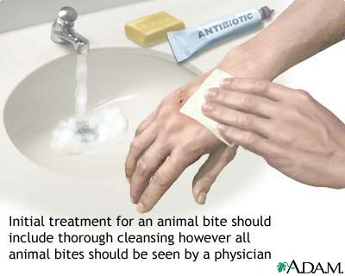
WOUND TOILETING

Slide 9
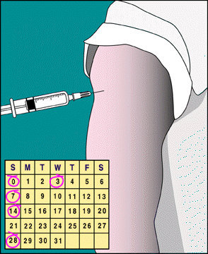
POSTEXPOSURE PROPHYLAXIS

Slide 10
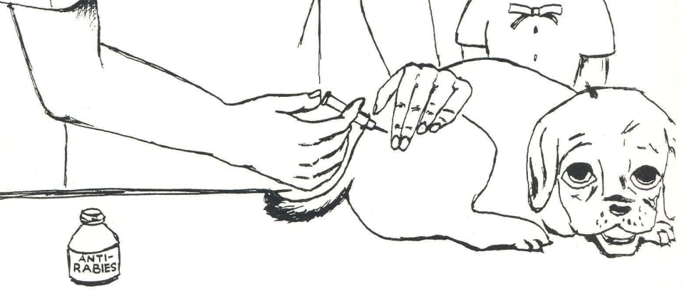
RESPONSIBILITIES OF A
PET OWNER
Vaccinate pets regularly

Slide 11
Evidence

Slide 12
National Institute of Communicable Diseases Directorate General of Health Services Ministry of Health & Family Welfare Government of India New Delhi | National Guidelines for Rabies Prophylaxis and Intra-dermal Administration of Cell Culture Rabies Vaccines (High level of evidence) | Since the rabies virus enters the human body through a bite or scratch, it is imperative to remove as much saliva, and thereby the virus, from the wound as is possible by an efficient wound toilet that should not involve additional trauma. Since the rabies virus can persist and even multiply at the site of bite for a long time, wound toilet must be performed even if the patient reports late. This can be done by prompt and gentle thorough washing with soap or detergent and flushing the wound with running water for 10 minutes. If soap and detergent are not immediately available wash with running water for at least 10 minutes. Avoid direct touching of wounds with bare hands. After thorough washing and drying the wound, any one of the available chemical agents should be applied viz Povidone iodine (Betadine), Alcohol, Chloroxylenol (Dettol), Chlorhexidine Gluconate and Cetrimide solution (Savlon - in appropriate recommended dilution), etc.

Slide 13
Department of Communicable diseases, Surveillance and response World Health Organization November 2002 | Current WHO GUIDE for Rabies Pre and Post-exposure Treatment in Humans | Wound treatment should be immediate. It is essential even if the person presents long after exposure. It should consist of immediate washing and flushing with soap and water or water alone and disinfecting with ethanol or iodine.

Slide 14
CONCLUSION
Proper wound toileting with the adequate measures can help in reducing/preventing rabies in humans after exposure
Mainstay

Slide 15
References
National Institute for Communicable Diseases, Government of India. National guidelines for Rabies prophylaxis and administration of intra-dermal cell culture rabies vaccine. Available at http://www.ncdc.gov.in/Rabies_Guidelines.pdf
Accessed 19th February 2014
WHO. Department of Communicable diseases, surveillance and response. Current WHO guide for rabies pre and post exposure treatment in humans. 2002. Available at http://www.who.int/rabies/en/WHO_guide_rabies_pre_post_exp_treat_humans.pdf Accessed 19th February 2014.

Slide 16
Questions
Q 1: In India, ‘’Rabies free’’ zone is
  Goa
  Lakshadeep
  Sikkim
  Nagaland

Slide 17
Questions
Q 2: Rabies can be transmitted by all the following routes except
  Aerosol
  Bites
  Ingestation
  Licks

Slide 18
Questions
Q 3: All of the following vaccines are commercially avaiable except
  Killed sheep brain vaccine
  Human diploid cell vaccine
  Vero continous cell vaccine
  Recombinant glycoprotein

Slide 19
Questions
Q 4: Active immunization following exposure is given most commonly for
  Rabies
  Polio
  Plague
  Measles

Slide 20
Questions
Q 5: The schedule of HDCV in rabies is
  0, 3, 7, 10, 14, 28
  0, 3, 10, 30
  3, 7, 14, 16, 18
  0, 7, 14, 16, 18

