Slide 1
DENGUE FEVER
Dr.Divyang Patel
Assistant Professor
Dept of community medicine

Slide 2
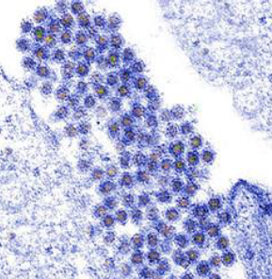
What is Dengue fever?
Dengue fever is an illness caused by infection with a virus transmitted by the Aedes mosquito
Dengue virus

Slide 3
History
In India first outbreak of dengue was recorded in 1963 in Kolkata
The next major outbreak of dengue/dengue hemorrhagic fever was reported in Delhi and neighbouring states in 1996
Most affected states are Delhi, West Bengal, Kerala, Tamilnadu, Karnataka, Maharashtra, Rajasthan, Gujarat and Haryana

Slide 4
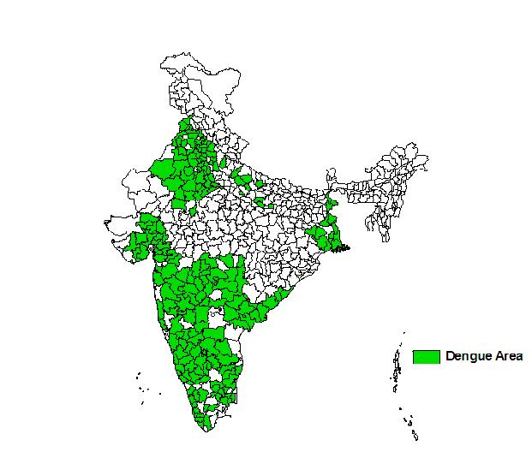
Distribution of dengue in India
Dengue endemic areas

Slide 5
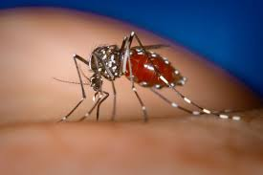
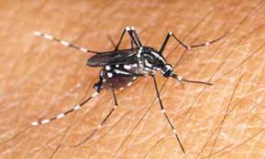
Causative agent
Dengue fever is caused by virus belong to genus Flavivirus
Most common mosquito vector is Aedes aegypti
Secondary vector is Aedes albopictus
Aedes aegypti
Aedes albopictus

Slide 6
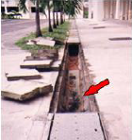
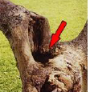
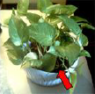

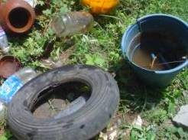
Favoured breeding places
Pots, buckets, flower vases, tins, tyres, tanks, coconut shells, tree holes and many more places where rainwater collects or is stored
Roadside drain
Tree hole
Flower pot
Flower pot plate
Tyre and bucket

Slide 7
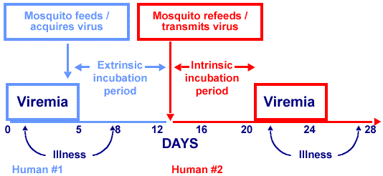
Transmission of dengue virus

Slide 8
Clinical Symptoms
Syndrome | Common findings
Dengue fever | Fever Headache Retro-orbital pain Bone pain Nausea, vomiting, weakness With or without rash
Dengue hemorrhagic fever (DHF) | Fever Thrombocytopenia(platelets ≤1,00,000/mm3) Petechiae
Dengue shock syndrome (DSS) | Most severe form of disease Restlessness, irritability Cold clammy extremities Rapid respiration, rapid/weak pulse

Slide 9
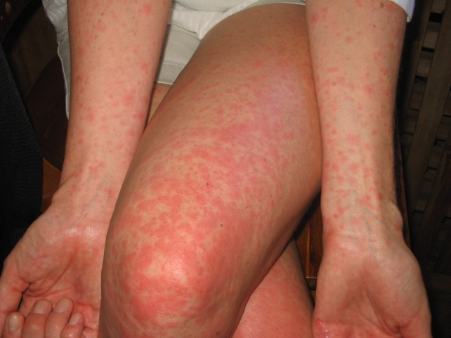
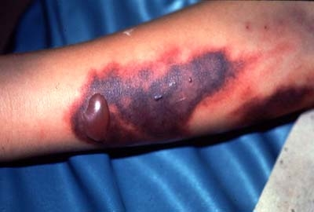
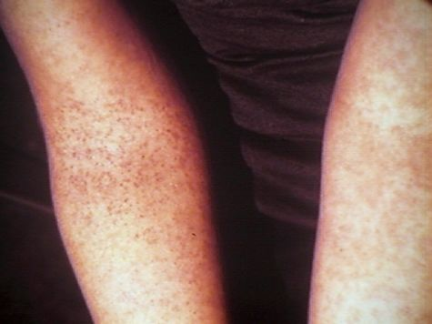
Rashes in dengue
Haemorrhage in dengue
Petechiae in dengue

Slide 10
Laboratory Criteria
Isolation of dengue virus
Increased IgM level in serum
Dengue antigen detection by immunohistochemistry, Immunofluorescence, ELISA, PCR
Leucopenia, Thrombocytopenia (platelets ≤1,00,000)

Slide 11
Treatment
Control of Aedes aegypti mosquito is the only method of choice
With early detection and proper symptomatic treatment, mortality can be reduced.
In dengue shock syndrome, following treatment is recommended:
Replacement of plasma losses
Correction of electrolyte and metabolic disturbances.
Blood transfusion

Slide 12
Vector control measures
Personal measures
Use of mosquito repellent cream, liquid, coils, mats, bed net, etc
Wearing of full sleeves shirts and full pants with socks
Chemical control
Use of chemical larvicides like abate in big breeding containers
Aerosol space spray during day time
Environmental management
Detection and elimination of mosquito breeding sources
Proper covering of stored water
Community participation
To aware and involve the community for detection of Aedes breeding places and their elimination

Slide 13
Do’s and Don’ts
Remove water from coolers and other small containers at least once in a week
Use aerosol during day time to prevent bite of mosquitoes
Do not wear clothes that exposes arms and legs
Children should not be allowed to play in shorts and half sleeved clothes
Use mosquito nets or mosquito repellents while sleeping during day time

Slide 14
Ashwini Kumar, Chythra R Rao, Vinay Pandit, Seema Shetty, Chanaveerappa Bammigatti, Charmaine Minoli Samarasinghe | Record-based study( low level of evidence) | A record-based descriptive study was undertaken to determine the clinical profile and outcome of all patients admitted to a tertiary care teaching hospital at Manipal, Karnataka (Kasturba Hospital) with a diagnosis of dengue, DHF and DSS according to WHO protocol, from January 2002 to December 2008 | clinical Study included 466 patients. Majority were males, 301(64.6%) and in the and in the age group of 15-44 years, 267 (57.5%). Maximum number of cases were seen in 2007, 219 (47%) and in the month of September, 89 (19.1%). The most common presentation was fever 462 (99.1%), followed by myalgia 301 (64.6%), vomiting 222 (47.6%), headache 222 (47.6%) and abdominal pain 175 (37.6%). The most common hemorrhagic manifestation was petechiae 84 (67.2%). 391 (83.9%) cases presented with dengue fever, 41 (8.8%) dengue hemorrhagic fever, and 34 (7.3%) with dengue shock syndrome. Out of 66 (14.1%) patients who developed complications, 22 (3had ARDS and 20 (30.3%) had pleural effusion. Deaths reported were 11(2.4%)3.3%

Slide 15
Questions
Q 1: Dengue virus is cause and transmitted by:
  Caused by _________
  Transmitted by _______

Slide 16
Questions
Q 2: Name favored bleeding places for vector of Dengue fever.

Slide 17
Questions
Q 3: Give Incubation period for Dengue and explain Intrinsic and extrinsic incubation period in case of dengue.

Slide 18
Questions
Q 4: Diagnosis of Dengue is conformed by:
  Isolation of dengue virus
  Increased IgM level in serum
  Dengue antigen detection by immunohistochemistry, Immunofluorescence, ELISA, PCR
  Complete blood count

Slide 19
Questions
Q 5: Describe shortly vector control in case of Dengue epidemic.

Slide 20
Thank you

