Slide 1
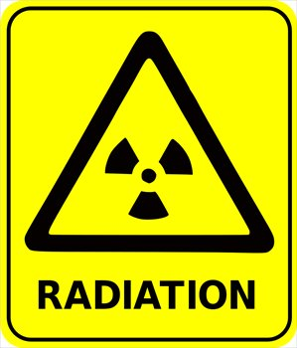
RADIATION- SOURCE, EFFECT & PROTECTION
Dr Jatin Chhaya
Department of Community Medicine
SBKS MI & RC

Slide 2
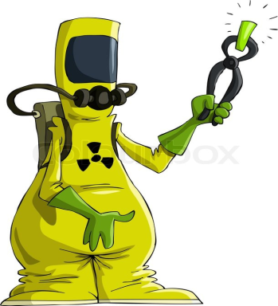
INTRODUCTION..
Radiation is defined as a form of energy, emitted from a matter, in all directions, in the form of waves, each wave carrying a quantum of energy or emitted in the form of fast moving subatomic particles or nucleotides.
The energy that is emitted depends upon the wave-lengths. Shorter the wave-length, greater is its energy value and vice versa.
Radiations are grouped into two groups—namely ionizing and nonionizing radiations, depending upon the ability to penetrate the tissue, deposit its energy and cause destruction of the tissue or not, respectively.

Slide 3
RADIATION UNIT
Radioactivity unit: Curie(Ci) & Becquerel (Bq)
1 Bq = 27 picocurie (1 disintegration per second)
Potency of radiation is measured by:
Roentgen: amount of radiation absorbed in air at a given point, i.e., number of ions produced in 1 ml of air.
Rad : Rad is the unit of absorbed dose. It is the amount of radioactive energy absorbed per gram of tissue or any material. 1 mrad = 0.001 rad
Rem : Rem is the product of the absorbed dose and the modifying factors. The rem indicates the degree of potential danger to health.
Some new units: Coulomb per kilogram (C/Kg), Gray (Gy), Sievert (Sv).

Slide 4
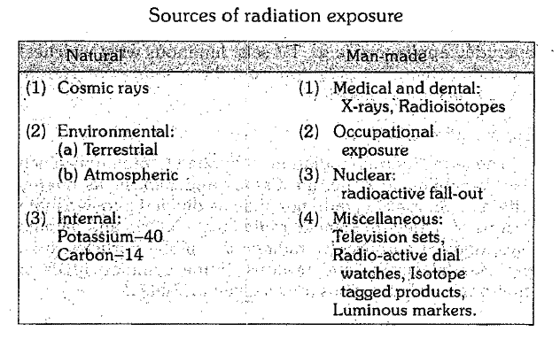
SOURCES OF RADIATION

Slide 5
NATURAL SOURCES
Cosmic rays:
The cosmic rays which originate in outer space are weakened as they pass through the atmosphere.
At ordinary living altitudes, their impact is about 35 mrad a year. At altitudes above 20 km cosmic radiation becomes important.
It has been calculated that a commercial jet pilot receives about 300 mrad per year from cosmic radiation.

Slide 6
NATURAL SOURCES.. Cont..
Environmental :
Terrestrial radiation :
Radioactive elements such as thorium, uranium, radium and an isotope of potassium (K40) are present in man's environment, e.g., soil, rocks, buildings.
It is estimated that man derives about 50 mrad per year from terrestrial radiation. Areas exist (e.g., Kerala in India) where there are rock formations containing uranium, it can be as high as 2000 mrad a year.
(ii) Atmospheric radiation :
The external radiation dose from the radioactive gases radon and thoron in the atmosphere is rather small : about 2 mrad per year.

Slide 7
NATURAL SOURCES.. Cont..
Internal radiation :
These radioactive materials, stored in the body tissues in minute quantities, of uranium, thorium, and related substances, and isotopes of potassium (K40), strontium (Sr90), and carbon (C14).
Internal radiation is thought to inflict about 25 mrad a year on the body as a whole, but may be as high as 70 or 80.
All in all, it is estimated that the total natural radiation to which the average person is subjected comes to approximately 0.1 rad a year.

Slide 8
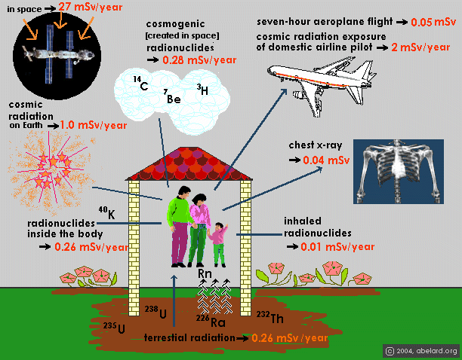

Slide 9
MAN-MADE SOURCES
X-rays :
The greatest man-made source of radiation exposure to the general population at the present time is medical and dental X-rays. Two distinct groups are involved : (i) patients and (ii) radiologists and medical technicians.
The skin dose to the patient from a single X-ray film varies roughly from 0.02 to 3.0 rad.
(b) Radioactive fallout :
Nuclear explosions: Code name: Smiling Budhha, Pokharan
the important being the isotopes of carbon (C14), iodine (I 131), cesium (Cs137) and strontium (Sr90). Cs137 and Sr90 are considered most important because they are liberated in large amounts and remain radioactive for many years.
(c) Miscellaneous: Too small.TV set, Luminous wrist watch, Mobiles.

Slide 10
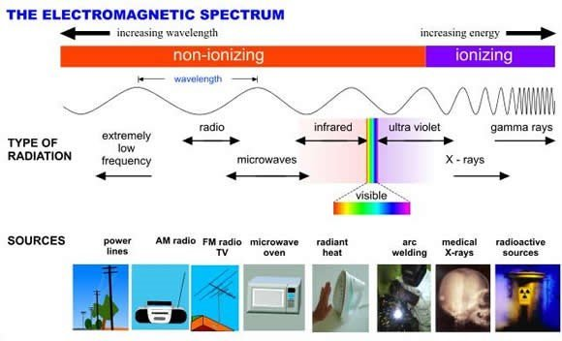
TYPE OF RADIATION

Slide 11
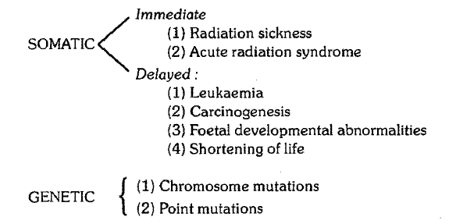
Biological Effect of Radiation
Acute or short term effects: exposure to high doses of radiation over a short period of time.
Chronic or long-term effect: exposure to low doses of radiation over an extended period of time.
Acute Radiation Syndrome: High doses tend to kill cells, causing organ damage.

Slide 12
The biological response of high dose of radiation is as follows:
  < 5 rad : No immediate observable effects
  5 rad to 50 rad : Slight blood changes may be detected by medical evaluations
  50 rad to 150 rad : Slight blood changes will be noted and symptoms of nausea, fatigue, vomiting etc. likely.
  150 rad to 1100 rad : Severe blood changes will be noted and symptoms appear immediately. Approximately 2 weeks later, some of those exposed may die. At about 300-500 rad : up to one half of the people exposed will die within 60 days without intensive medical attention.
  1, 100 rad to 2,000 rad : The probability of death increases to 100% within one to two weeks. The initial symptoms appear immediately. A few days later, things get very bad, very quickly since the gastrointestinal system is destroyed. Once the GI system ceases to function, nothing can be done, and medical care is for comfort only.

Slide 13
>2,000 rad : Death is a certainty.
At doses above 5,000 rad, the central nervous system (brain and muscles) can no longer control the body functions, including breathing and blood circulation. Everything happens very quickly. Nothing can be done, and medical care is for comfort only.

Slide 14
Radiation Protection
The amount of radiation received from outer space and background radiation has been estimated to be 0.1 rad a year. Apparently, this does not at present constitute a hazard. The additional permissible dose from man-made sources should not exceed 5 rad a year.
Of the man-made sources, the X-rays constitute the greatest hazard. In routine fluoroscopy, a dose of 4 rad is delivered to a part of the body in about one minute. This implies that unnecessary X-ray examinations should be avoided, especially in the case of children and pregnant women.

Slide 15
Effective protective measures include proper use of lead shields and lead rubber aprons. Lead aprons (0.5 mm of lead) will reduce the intensity of scattered X-rays over 90 per cent
Dosimeter: Workers must wear a film badge or dosimeter which shows accumulated exposure to radiation.
Periodic medical examinations, regular working hours, recreation, and holidays must be ensured to workers to maintain their state of health
It has been recommended that the genetic dose to the whole population from all sources additional to the natural background radiation, should not exceed 5 rems over a period of 30 years.

Slide 16
Knowledge of Radiation Hazards, Radiation Protection Practices and Clinical Profile of Health Workers in a Teaching Hospital in Northern Nigeria
KJ Awosan, MTO Ibrahim, SA Saidu, SM Ma’aji, M Danfulani
J Clin Diagn Res. 2016 Aug; 10(8): LC07–LC12.
Published online 2016 Aug 1. doi: 10.7860/JCDR/2016/20398.8394
PMCID: PMC5028529
Introduction
Use of ionizing radiation in medical imaging for diagnostic and interventional purposes has risen dramatically in recent years with a concomitant increase in exposure of patients and health workers to radiation hazards.
Aim
To assess the knowledge of radiation hazards, radiation protection practices and clinical profile of health workers in UDUTH, Sokoto, Nigeria.

Slide 17
Materials and Methods
A cross-sectional study was conducted among 110 Radiology, Radiotherapy and Dentistry staff selected by universal sampling technique. The study comprised of administration of standardized semi-structured pre-tested questionnaire (to obtain information on socio-demographic characteristics, knowledge of radiation hazards, and radiation protection practices of participants), clinical assessment (comprising of chest X-ray, abdominal ultrasound and laboratory investigation on haematological parameters), and evaluation of radiation exposure of participants (extracted from existing hospital records on their radiation exposure status).
Results
The participants were aged 20 to 65 years (mean = 34.04 ± 8.83), most of them were males (67.3%) and married (65.7%). Sixty five (59.1%) had good knowledge of radiation hazards, 58 (52.7%) had good knowledge of Personal Protective Devices (PPDs), less than a third, 30 (27.3%) consistently wore dosimeter, and very few (10.9% and below) consistently wore the various PPDs at work.

Slide 18
The average annual radiation exposure over a 4 year period ranged from 0.0475mSv to 1.8725mSv. Only 1 (1.2%) of 86 participants had abnormal chest X-ray findings, 8 (9.4%) of 85 participants had abnormal abdominal ultrasound findings; while 17 (15.5%) and 11 (10.0%) of 110 participants had anemia and leucopenia respectively.
Conclusion
This study demonstrated poor radiation protection practices despite good knowledge of radiation hazards among the participants, but radiation exposure and prevalence of abnormal clinical conditions were found to be low. Periodic in-service training and monitoring on radiation safety was suggested.

Slide 19
Thank you..

Slide 20
1.
Cosmic rays
Terrestrial radiation
Atmospheric radiation
X-ray radiation

Slide 21
2.Characteristic of Ionizing radiation
Ability to penetrate tissue
Short wavelength
Can destruct tissue
All of above

Slide 22
3. Unit of radioactivity
Curie (Ci)
Roentgen
Rad
Rem

Slide 23
4.Somatic effect of ionizing radiation is all except?
Radiation sickness
Acute radiation syndrome
Point mutation
leukaemia

Slide 24
5. Radiation protection include all except?
Periodic medical examination of workers
X-ray examination should be avoided
Use of Lead apron
Natural radiation should not exceed 5 rem over a period of 30 years.

