Slide 1
Note down some important questions for Exam from Last Lecture
IDD
What is IDD, Cause of IDD
What is Spectrum of IDD
Endemic goiter
Diagnosis of Goiter
Management

Slide 2
Fluorosis
Dr. Nilesh G. Patel
Assistant Professor
S.B.K.S.M.I. & R.C

Slide 3
What is Fluorosis
Fluorosis is a disease caused by deposition of fluorides in the hard and soft tissues of the body.
It is not merely caused by excess intake of fluoride but there are many other attributes and variables which determine the onset of fluorosis in human population.
It is usually characterized by discoloration of teeth and crippling disorders.

Slide 4
Magnitude of Fluorosis
Worldwide in distribution.
Endemic in 22 countries.
Asia and in Asia, India and China are worst affected.
Mexico in North and Argentina in Latin America.
East and North Africa are also endemic.

Slide 5
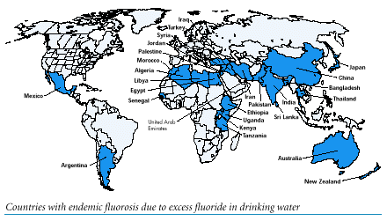
UNICEF Map of Fluorosis

Slide 6
Fluorosis in India
Rajasthan and Gujarat in North India and Andhra in South India are worst affected.
Punjab, Haryana, M.P. and Maharashtra are moderately affected.
T.N.,W.B.,U.P.,Bihar and Assam are mildly affected.
Throughout India fluorosis is essentially Hydrofluorosis except in parts of Gujarat and U.P. where industrial fluorosis is also seen.
In worst affected states, maps have been prepared of geographic pathology on the basis of fluoride distribution in the drinking water.

Slide 7
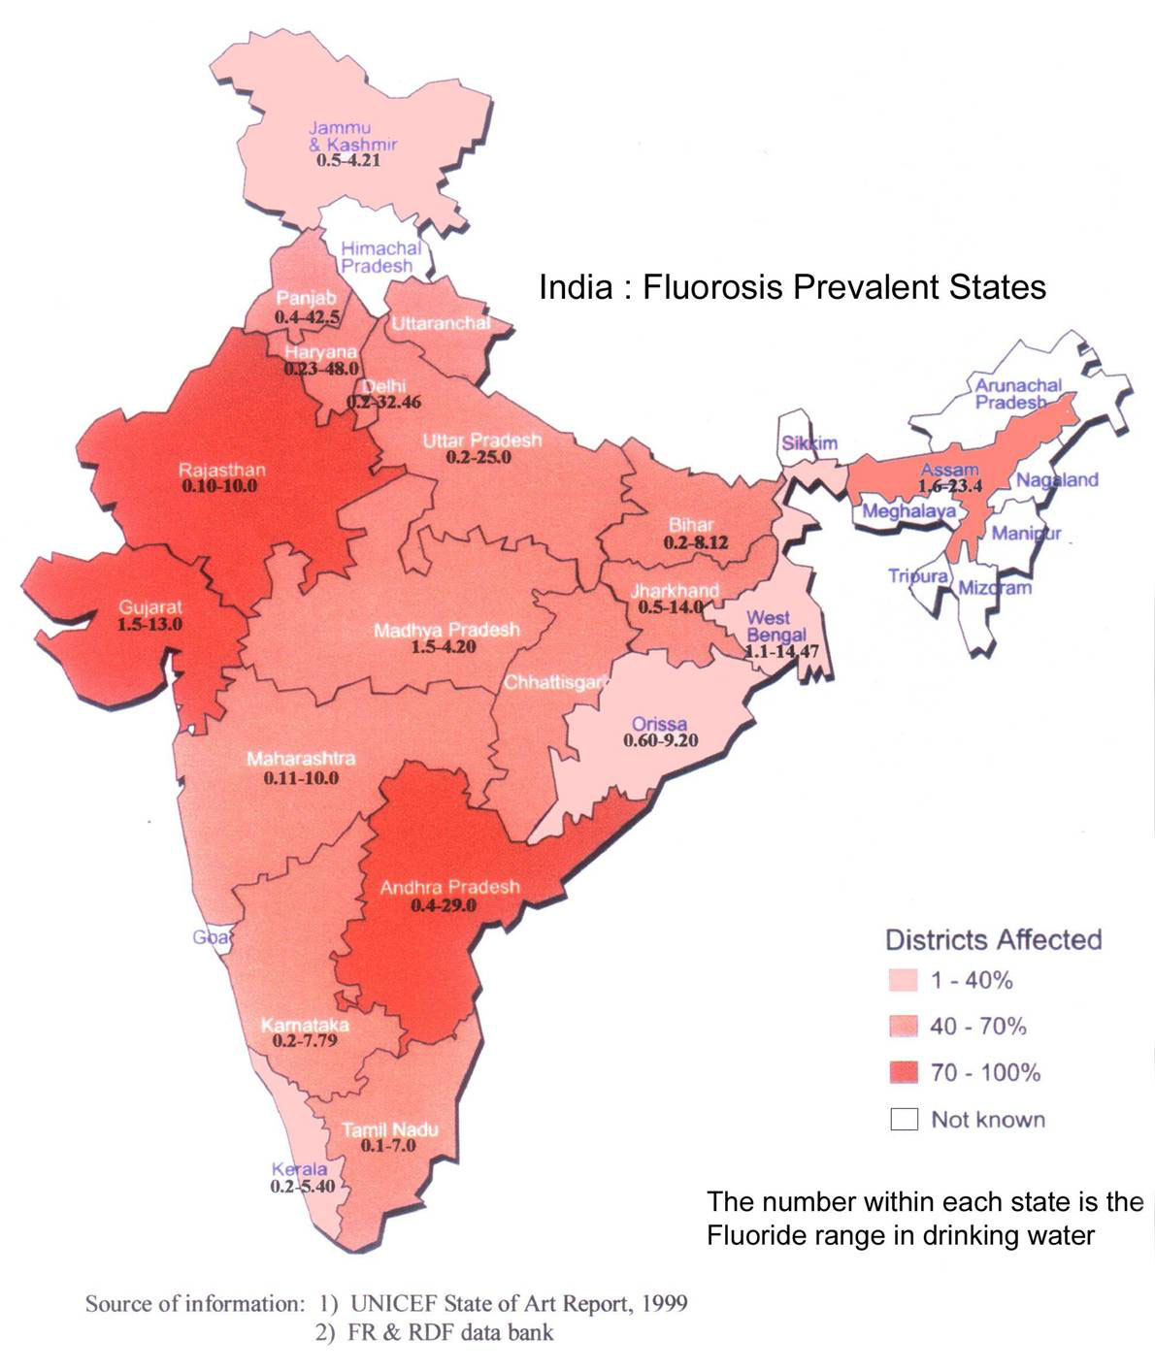
Fluorosis in India

Slide 8
epidemiology
Agent Factors
Primarily it is Fluoride which is present in drinking water
when F in water is more than 1.5 mg per liter, it is toxic to health.
pH in terms of alkalinity of water promotes the absorption of F.
calcium in the diet reduces the absorption of F.
Hard water rich in Calcium reduces the F toxicity.
Fresh Fruits and Vit.C reduces the effect of F.
Trace elements enhances the effect of F.

Slide 9
epidemiology
Host Factors
In School going children seen as dental fluorosis.
In third and fourth decade of life seen as Skeletal Fluorosis.
Males suffer more than females.
Illiterates suffer more frequently in the fluorotic belts.
Where aluminium ores are mined, it is seen as occupational health hazard.

Slide 10
epidemiology
Environmental Factors
High Annual Mean Temperature
Low Rainfall
Low humidity
F rich Natural subsoil rocks
Vegetables from high F belts
Fluoridated tooth paste particularly when used by children
Tropical climate
Developing Countries

Slide 11
TYPES OF FLUOROSIS
Dental Fluorosis in Children
Skeletal Fluorosis in Adults
Non Skeletal Fluorosis

Slide 12
Dental Fluorosis
Children living in high fluoride zone are bound to get dental discoloration which may be seen even in deciduous teeth.
Initially glistening white teeth become dull and yellow-white spots appear on the surface of teeth.
Gradually these spots turn brown and presents itself in brown streaks which are closer to the tip of the teeth.
In late stages the whole teeth become black. Teeth may be pitted or perforated and may even get chipped off.
In endemic zones people lose their teeth at an early age

Slide 13
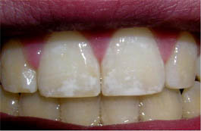
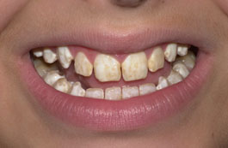
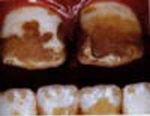
Degrees of dental fluorosis
Mild
(slight mottling of teeth)
Moderate
(obvious mottling of teeth)
Severe
(severe mottling of teeth)

Slide 14
Skeletal Fluorosis
It affects young as well as old. The symptoms include severe pain and stiffness in the backbone, joints and/or rigidity in hip bones.
X-ray examinations of the bones reveals thickening and high density of bones. In some patients with calcium deficiency osteomalacia type changes are seen.
Constriction of vertebral canal and intervertebral foramen - pressure on nerves leads to paralysis.

Slide 15

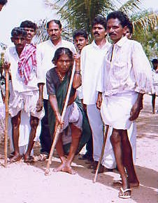
Skeletal Fluorosis

Slide 16
Non-Skeletal Fluorosis
There are convincing evidence of involvement of skeletal muscles, erythrocytes, G-I mucosa, ligaments and spermatozoa on consuming more than optimal intake of fluorides. Detection of Fluorosis at early stage is possible by understanding the soft tissue manifestation.
In the fluorosed muscles, actin and myosin filaments are destroyed and mitochondria lose their structural integrity thereby providing evidence of depletion of muscle energy.
The erythrocyte membrane loses its calcium content in presence of high fluoride.
Non-ulcer dyspeptic complaints are manifested by consuming high F in water and food.

Slide 17
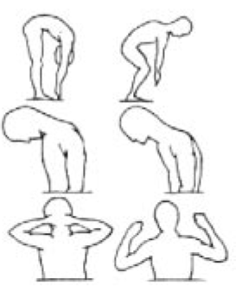
UNICEF’s Clinical Test
DIAGNOSIS
  Three simple clinical tests
    Forward flexion of spine
    Chin to Chest test
    Hands on the occiput test
  Normal person can do
  Person with skeletal fluorosis can not.
Left figures Normal, Right Abnormal

Slide 18
Tests for Skeletal Fluorosis
COIN TEST: The subject is asked to lift a coin from the floor without bending the knee. A fluorotic subject would not be able to lift the coin without flexing the large joints of lower extremity.
CHIN TEST: The subject is asked to touch the anterior wall of the chest with the chin. If there is pain or stiffness in the neck, it indicates the presence of fluorosis.
STRETCH TEST: The individual is made to stretch the arm sideways, fold at elbow and touch the back of the head. When there is pain and stiffness, it would not be possible to reach to the occiput indicating presence of Fluorosis.

Slide 19
How does fluoride treatment prevent tooth
decay ?
Human teeth (and bones) are primarily composed of the mineral calcium hydroxyapatite.
Calcium hydroxyapatite has the chemical formula: Ca₅[(PO₄)₃OH]. One of the main components of this mineral is the hydroxyl ion.
Fluoride substitutes for the hydroxyl ion, producing calcium fluoroapatite, with the chemical formula: Ca₅[(PO₄)₃F]
Calcium fluoroapatite is chemically stable than calcium hydroxyapatite in acid environment of the mouth.
This means that a higher concentration of calcium fluoroapatite in tooth enamel decreases tooth dissolution, and therefore can decrease the incidence of tooth decay.

Slide 20
PREVENTION
Since the major source of fluoride is drinking water, de-fluoridation is the best preventive measure which can be carried out at domestic as well as community level
Nutritional interventions like high intake of vitamin C and Calcium also helps reduce the problem

Slide 21
De-fluorideation
Precipitation methods are commonly used for de-fluoridation.
Lime treatment routinely used for hardness removal can remove F particularly when water is having high Mg hardness.
Alum is used at domestic level in high doses to remove the F.
In India scientists have developed a method known as “Nalgonda technique” in which based on the amount of F in drinking water and alkalinity of the Water (expressed as mgCaCO3), amount of Alum to be mixed with water is calculated.
Resins and other filter beds are also available filtering through which reduces the amount of F in water.

Slide 22
Indian J Med Res. 2012 Jun; 135(6): 873–877. PMCID: PMC3410214 Prevalence of dental fluorosis & dental caries in association with high levels of drinking water fluoride content in a district of Gujarat, India P.V. Kotecha,1 S.V. Patel,2 K.D. Bhalani,2 D. Shah,3 V.S. Shah,4 and K.G. Mehta2 | Endemic fluorosis resulting from high fluoride concentration in groundwater is a major public health problem in India. This study was carried out to measure and compare the prevalence of dental fluorosis and dental caries in the population residing in high and normal level of fluoride in their drinking water in Vadodara district, Gujarat, India. | Methods: A cross-sectional study was conducted in Vadodara district, six of the 261 villages with high fluoride level and five of 1490 with normal fluoride level in drinking water were selected. The data collection was made by house-to-house visits twice during the study period. | Results: The dental fluorosis prevalence in high fluoride area was 59.31 per cent while in normal fluoride area it was 39.21 per cent. The prevalence of dental caries in high fluoride area was 39.53 per cent and in normal fluoride area was 48.21 per cent with CI 6.16 to 11.18. Dental fluorosis prevalence was more among males as compared to females. Highest prevalence of dental fluorosis was seen in 12-24 yr age group. | Interpretation & conclusions: The risk of dental fluorosis was higher in the areas showing more fluoride content in drinking water and to a lesser degree of dental caries in the same area. High fluoride content is a risk factor for dental fluorosis and problem of dental fluorosis increased with passage of time suggesting that the fluoride content in the water has perhaps increased over time.

Slide 23
References
W.H.O. Monograph on Fluoride and Human Health, W.H.O., Geneva,1970.
ShivChandra et al:Determination of Optimal Fluoride Intake,Comm Dent. & Oral Epidemiol,8:35-40,1980.
Susheela A.K.: A Treatise on Fluorosis; Fluorosis Research and Rural Development Foundation,New Delhi, 2001.

Slide 24
1. Fluoride content in drinking H2O normally safe is:
(a) 0.5-0.8 mg/l
(b) 0.8-1.0 mg/l
(c) 0.2-0.8 mg/l
(d) 0.2-0.5 mg/l

Slide 25
2. Dental fluorosis is best seen in:
(a) Central & Lateral Incisors
(b) Central Incisors & 1st Molars
(c) 1st & 2nd Molars
(d) Canines

Slide 26
3. Twin fortified salt’ contains:
(a) Iodine + Fluorine
(b) Iodine + Calcium
(c) Iodine + Iron
(d) Iodine + Chlorine

Slide 27
4. Types of fluorosis except
Dental fluorosis
Skeleton fluorosis
Non-Skeleton fluorosis
HypoThyroid fluorosis

Slide 28
5. 1 gram of ‘Twin fortified salt’ provides:
(a) 1 mcg Iodine + 40 mg Iron
(b) 40 mcg Iodine + 40 mg Iron
(c) 1 mcg Iodine + 1 mg Iron
(d) 40 mcg Iodine + 1 mg Iron

Slide 29
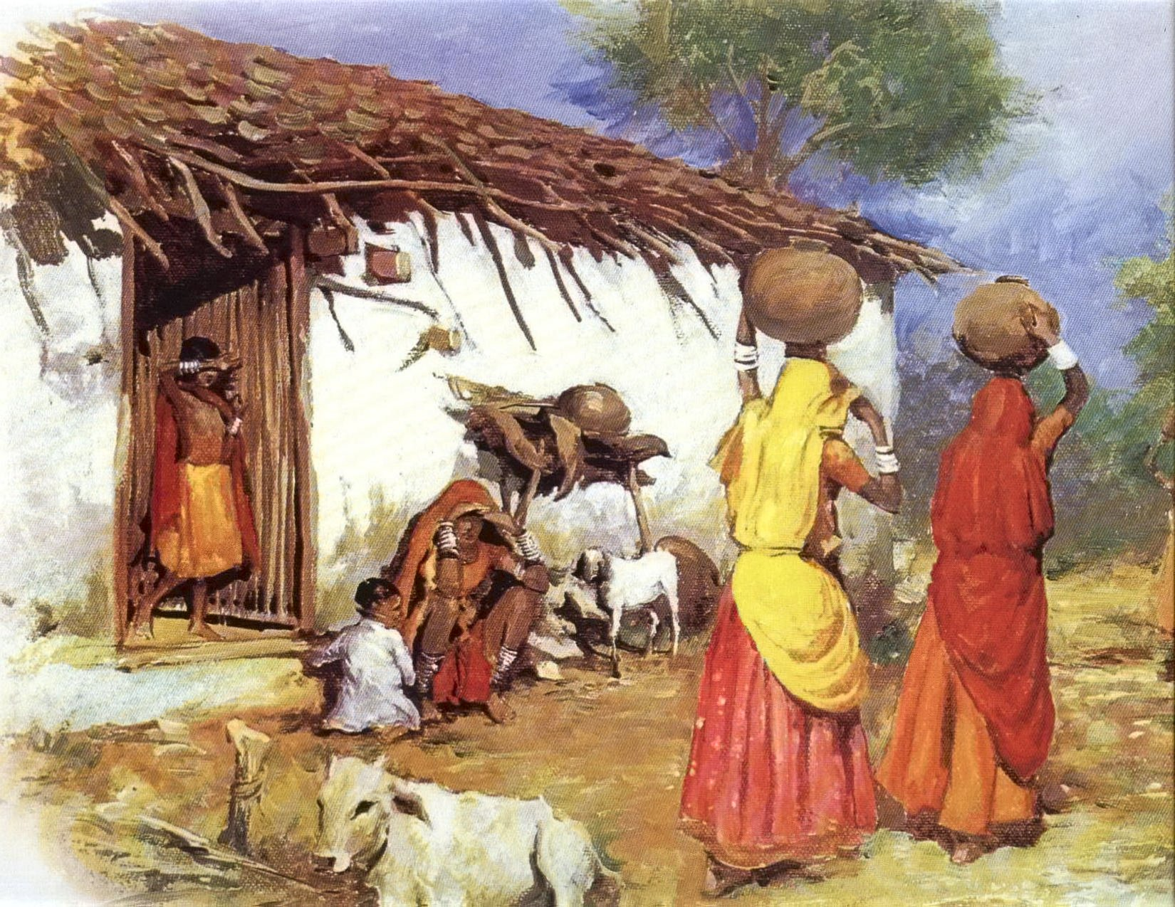
Thank You One and
All

