Slide 1


Slide 2
THE GALLBLADDER
Dr. Ketul Shah

Slide 3
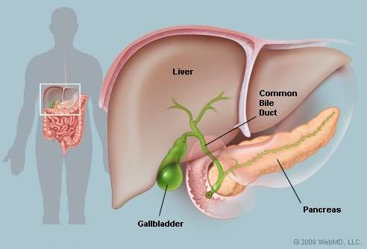

Slide 4
Introduction
In vertebrates the gallbladder (cholecyst, gall bladder or biliary vesicle) is a small organ where bile is stored, before it is released into the small intestine. Humans can live without a gallbladder. The gallbladder is a hollow organ that sits just beneath the right lobe of the liver.

Slide 5
GALL BLADDER- definition
Gall bladder is a pear shaped reservoir of bile situated in a fossa on the inferior surface of the right lobe of the liver.
The fossa for the gall bladder extends from the right end of the porta hepatis to the inferior border of the liver

Slide 6
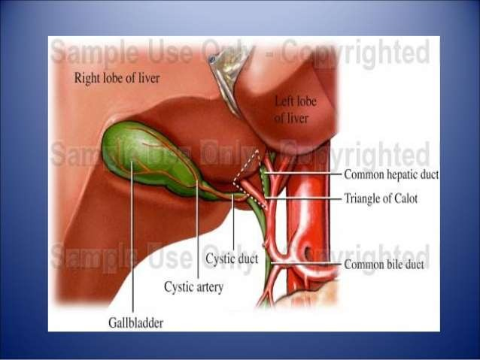

Slide 7
LOCATION:
–
–
–
–
Epigastric region
Right hypochondriac region
On inferior surface of liver
Between quadrate and right lobes

Slide 8
DIMENSIONS AND CAPACITY
The gall bladder is 7 to 10 cm long, 3 cm broad at its widest part, and about 30 to 50 ml in capacity.

Slide 9
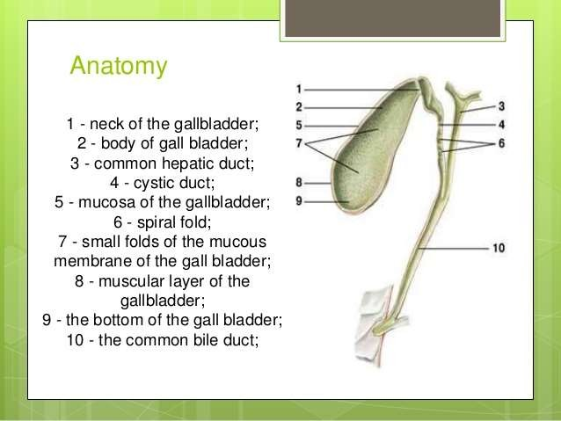

Slide 10
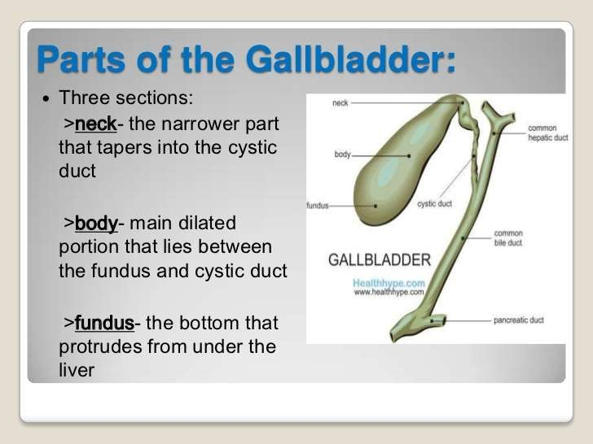

Slide 11
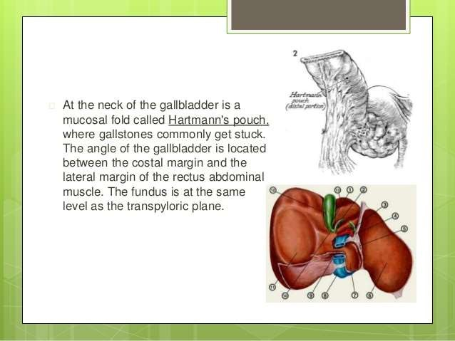

Slide 12
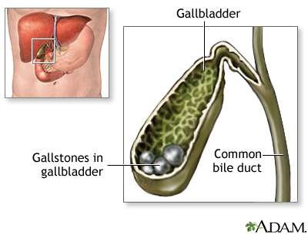

Slide 13
BILIARY APPARATUS
The biliary apparatus collects bile from the liver, stores it in the gall bladder, and transmits it to the second part of duodenum.
The apparatus consists of
1. the right and left hepatic ducts,
2.the common hepatic duct,
3. the gall bladder
4. the cystic duct
5.the bile duct.

Slide 14
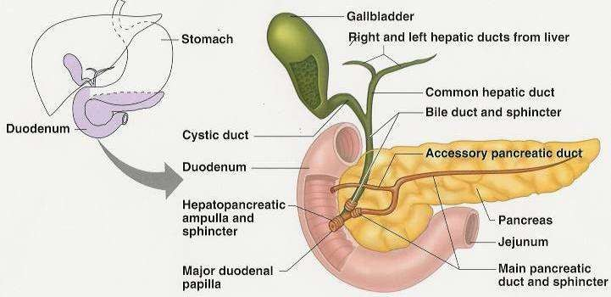
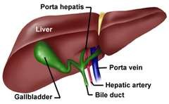
1. Hepatic ducts
The right and left hepatic ducts emerge at the porta hepatis from the right and left lobes of the liver.
The arrangement of structures at the porta hepatis from behind forwards is
-the branches of the portal vein
-hepatic artery
-hepatic ducts.

Slide 15
2.Common hepatic duct
It is formed by the union of the right and left hepatic ducts near the right end of the porta hepatis.
It runs downwards for about 3 cm and is joined on its right side at an acute angle by the cystic duct to form the bile duct.

Slide 16
4..CYSTIC DUCT

Slide 17
CYSTIC DUCT
Cystic duct is about 3 to 4 cm long.
It begins at the neck of the gall bladder, runs downwards, backwards and to the left, and ends by joining the common hepatic duct at an acute angle to form the bile duct

Slide 18
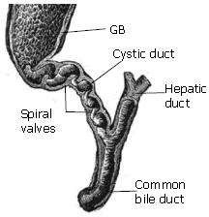
CYSTIC DUCT
The mucous membrane of the cystic duct forms a series of 5 to 12 crescentic folds, arranged spirally to form the so-called “spiral valve”of heister. This is not a true valve.

Slide 19
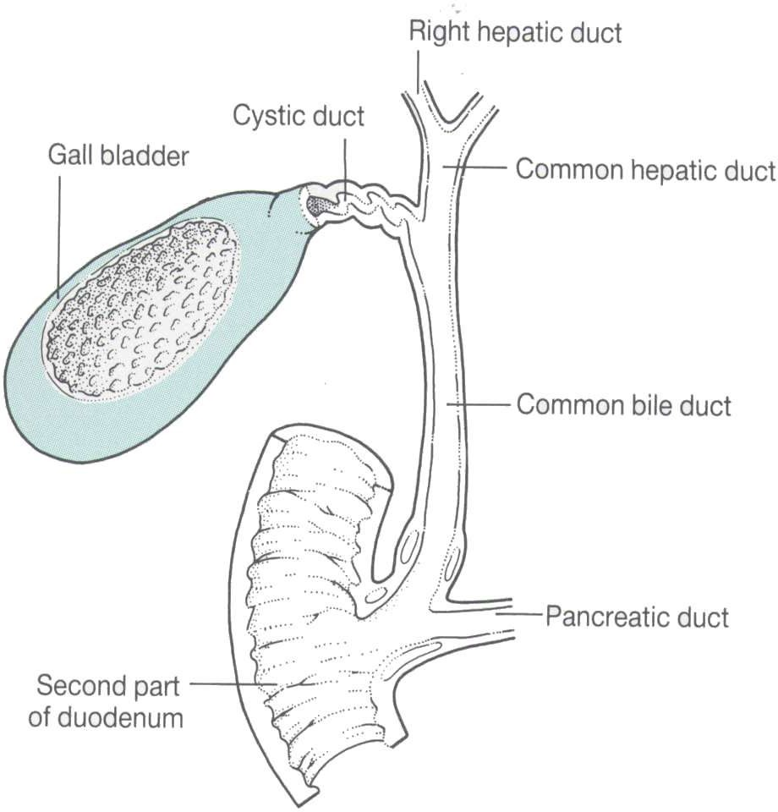

Slide 20
5.BILE DUCT
Bile duct is formed by the union of the cystic and common hepatic ducts near the porta hepatis.
It is 8cm long and has a diameter of about 6mm.
The bile duct runs downwards and backwards, first in the free margin of the lesser omentum, supra duodenal part , then behind the first part of the duodenum the retroduodenal part, and lastly behind, or embedded in , the head of the pancreas infraduodenal part.

Slide 21
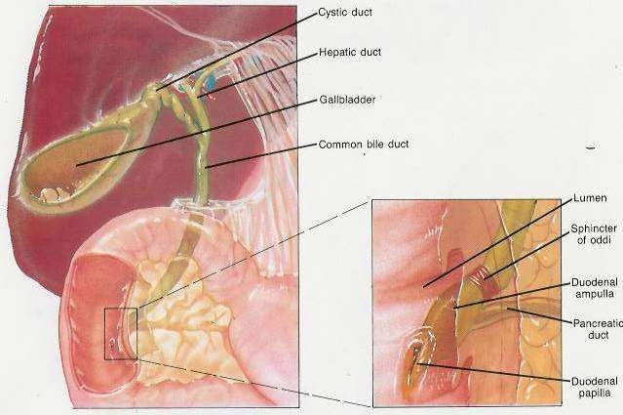

Slide 22
BILE DUCT
Near the middle of the left side of the second part of the duodenum it comes in contact with the pancreatic duct and accompanies it through the wall of the duodenum,the intraduodenal part.
The course of the duct through the duodenal wall is very oblique.
Within the wall the two ducts usually unite to form the hepatopancreatic ampulla, or ampulla of vater.

Slide 23
Sphincters related to the bile and
pancreatic ducts
Sphincter choledochus
Sphincter pancreaticus
Sphincter ampullae

Slide 24
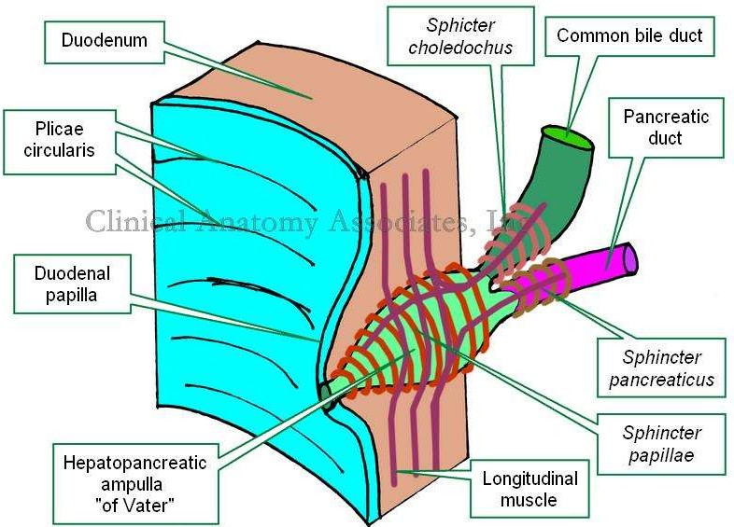

Slide 25
Sphincter choledochus
The terminal part of the bile duct is surrounded just above its junction with the pancreatic duct by a ring of smooth muscle that forms the sphincter choledochus( choledochus= bile duct).
This sphincter is always present.
As a result , bile formed in the liver keeps accumulating in the gall bladder and also undergoes considerable concentration.
When food enters the duodenum, specially a fatty meal, the sphincter opens and bile stored in the gall bladder is poured into the duodenum.

Slide 26
Sphincter pancreaticus and
Sphincter ampullae
Another less developed sphincter ,which is usually but not always present around the terminal part of the pancreatic duct is the sphincter pancreaticus.
A third sphincter surrounds the hepatopancreatic ampulla and is called the sphincter ampullae.or sphincter of Oddi.

Slide 27
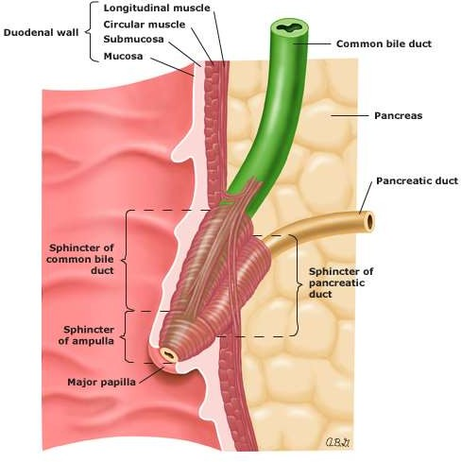

Slide 28
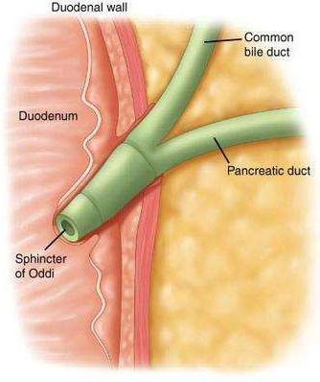

Slide 29
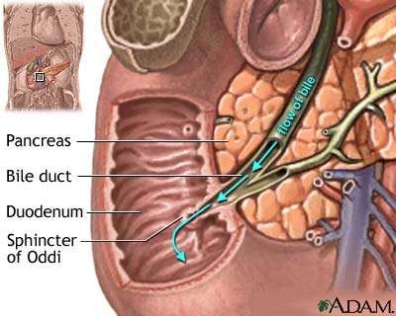

Slide 30
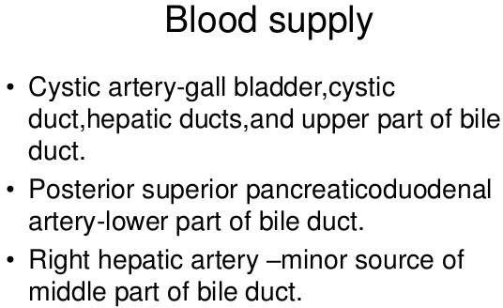
Cystic artery
Right hepatic artery Proper hepatic artery Common hepatic artery

Slide 31
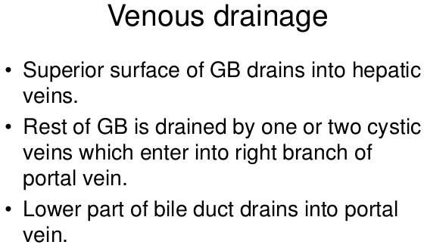

Slide 32
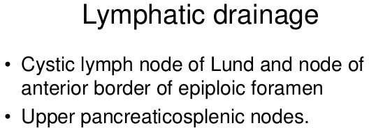

Slide 33
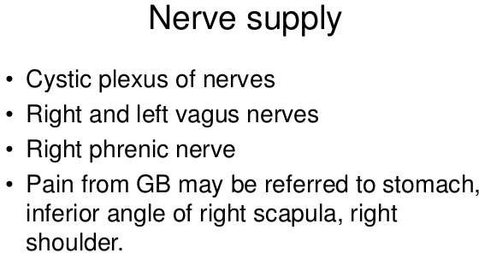

Slide 34


Slide 35
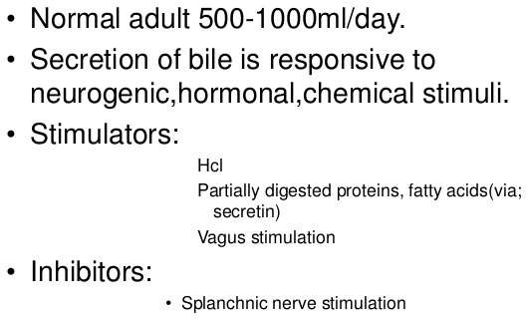

Slide 36
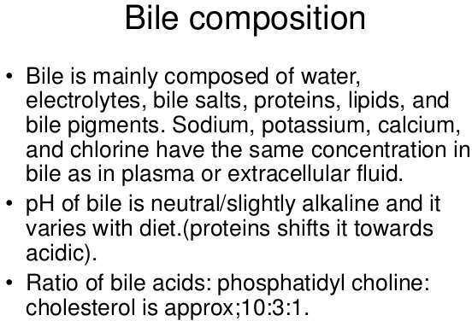

Slide 37
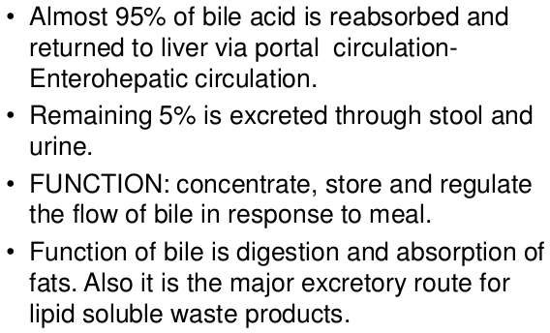

Slide 38
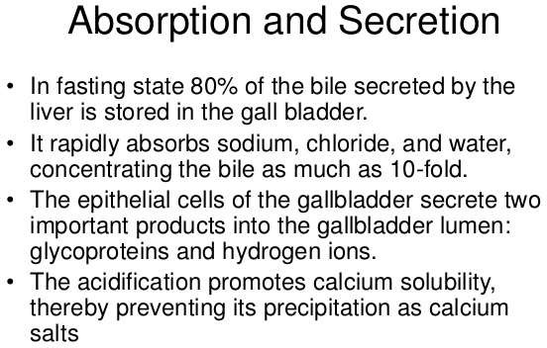

Slide 39
FUNCTIONS OF THE GALL BLADDER
1.Storage of bile, and its release into the duodenum when required.
2. Absorption of water, and concentration of bile. Bile may be concentrated as much as ten times.
3. The normal gall bladder also absorbes small amounts of a loose bile salt cholesterol compound.
4. It regulates pressure in the biliary system by appropriate dilatation or contraction. Thus the normal choledochoduodenal mechanism is maintained.

Slide 40


