Slide 1
Anaesthesia and surgery
Perioperative physician

Slide 2
Responsibilities of anesthetist safety and welfare
Make pre-op condition of patient optimal
Patient education
Coordination of surgical team
Prevent harm to patient as a part of collective team like injury to nerves ,eye ,cutaneous burns
Safe recovery of patient from anaesthesia in OT and in recovery room until clearly delegated to another person on surgical ward or ICU

Slide 3
Preparation for anaesthesia
Recognition of general medicine and specific anaesthetic risk factors
Early assessment and proper investigations
Post operative pain relief, nutrition and rehabilitation discussed with patient preoperatively

Slide 4
General anaesthesia
TRIAD OF UNCONSICOUSNESS , PAIN RELIEF AND MUSCULAR RELAXATION
UNCONSCIOUSNESS
induction – i.v.
maintainance – inhaled vapour
Induction by inhalation , non-pungent sevoflurane ,especially for children or needle-phobic adults
IV maintainance- (during airway laser surgery, endoscopy or cardiopulmonary bypass), comprise of propofol ,

Slide 5
2.ANALGESIA-short acting opioid angalgesic like alfentanil or ultra short acting like remifentanil , neruromuscular blockage and pulmonary ventilation through a mixture of air and oxygen
4.Analgesics reduce cardiovascular response to tracheal intubation, reduce pain at time of incision
5.Nitrous oxide – used as analgesic and weak anesthetic,
6.ether- replaced by sevo - and desflurane

Slide 6
3.Neuromuscular blockade
PROVIDES RELAXATION OF MUSCLES TO FACILITATE SURGERY AND MECHANICAL POSITIVE PRESSURE VENTILATION
TWO TYPES OF AGENTS
1.DEPOLARISING( works by blocking action of acetylcholine on skeletal muscle)- suxamethonium- causes postoperative diffuse muscle pains, occasionally prolonged muscular block if patient is deficient in plasma pseudocholinesterase
2.COMPETITIVE- curare, atracurium, cisatracurim,
Vecuronium and rocuronium

Slide 7
Advantages- More predictable activity profile
Less dependent on hepato-renal function for termination of action
Disadvantage- produce blockage of longer duration , so timing of doses should be carefully adjusted to restore muscle power at end of surgery
A peripheral nerve stimulator- to check adequate depth of blockage, to confirm satisfactory recovery before resumption of spontaneous respiration and extubation of trachea

Slide 8
Management of airway anesthetic tube
LOSS OF MUSCLE TONE AS A RESULT OF G.A. JEOPRDIZES AIRWAY
METHODS
POSITIONING OF TONGUE AND JAW- lifting the tongue of post. Pharyngeal wall , oropharyngeal airway(Guedel airway)
LARYNGEAL MASK AIRWAY- mask covers the laryngeal inlet ,inflatable cuff
ADVANTAGES -less irritation to patient airway, easier to learn;

Slide 9
3. ENDOTRACHEAL TUBE- prevents lung from aspiration by cuff – if fluid or debris is likely to collect in the mouth from above ,as in nasal surgery, an absorbant throat pack is placed in oropharynx
COMPLICATIONS-
1. oesophageal intubation
2. Not able to intubate
3.Intubation of main brnochus

Slide 10
4. Trauma to larynx ,trachea ,teeth
5.Aspiration of vomitus
6.Disconnection or blockage of tube
7.Delayed tracheal stenosis
DIFFERENT TYPES OF TUBES
-armoured tube to avoid kinking
-made of noncombustible material for laser surgery in airway to avoid fire

Slide 11
4. TRACHEOSTOMY TUBE-
5.ENDOBRONCHIAL TUBE- open thoracic procedures (one lung ventilation), broncho -pleural fistula
6. VENTILATION THROUGH A BRONCHOSCOPE OR ENDOTRACHEAL CATHETER- during laryngotracheal surgery or bronchoscopy by intermittent jet of oxygen

Slide 12
Hemostasis and blood pressure control
A 20-30% reduction of mean blood pressure( SBP+2{DBP}/3 , MAP should be maintained >= 65 mm hg) from the awake preoperative level in fit patients acceptable
TO RECUCE BLOOD LOSS- REDUCTION OF BLOOD PRESSURE BY CORRECT POSITIONING- AVOID VENOUS OBSTRUCTION- KEEP PATIENT in DEEP ANAESTHESIA- REDUCE ARTERIAL CO2 TENSION SOMEWHAT
CONTROLLED HYPOTENSION-

Slide 13
TEMPERATURE CONTROL
Vasodilatation, cold infusions, radiation and fluid evaporation from open body cavities cause hypothermia
Children and elderly more prone, children have high ratio of body surface area/body mass, hypothermia and shivering increase o2 consumption and vascular resistance and may cause MI
Use warm air blowers, warm blankets, warm fluid for i.v and irrigation

Slide 14
Monitoring
Mandatory presence of a trained anaesthetist and equipment
Inspiratory O2 conc., O2 by pulse oximetry, expiratory CO2 conc., B.P., ECG
In major surgery- hourly urine output, invasive monitoring
Ventilators must have airway pressure monitor, disconnection alarm, continuous analysis of O2 content with O2 failure alarm and conc. Of anaesthetic drug in inspirtory gas mixture

Slide 15
recovery
Should be closely supervised by, trained nursing staff skilled in airway management , in area equipped with means of resuscitation and adequate monitoring devices
Inadequate breathing may be
obstruction of airway
Central sedation from opioid drugs or anaesthetic agents
Hypoxia or hypercarbia
Hypocarbia from mechanical overventilation
Persistent neuromuscular blockage

Slide 16
Local anaesthesia
Two groups. Esters - tetracaine,procaine, cocaine, and chloroprocaine. Amides - lidocaine, mepivacaine, bupivacaine, and etidocaine
Mechanism of action- work by diffusing through the nerve plasma membrane and causing blockade of sodium channels. The nerve cell is unable to depolarize, and axonic conduction is inhibited.
Local tissue acidosis (e.g., from infection) slows the onset and decreases the intensity of analgesia by causing local anesthetic molecules to become positively charged and less able to diffuse into the neuron

Slide 17
 | Maximum dose | Mg/kg | Duration of action | hr
Agent | plain | With epinephrine | plain | With epinephrine
Procaine |  | 8 | 0.25-1 | 0.5-1.5
Lidocaine | 5 | 7 | 0.5-1 | 2-6
mepivacaine | 5 | 7 | 0.75-1.5 | 2-6
bupivacaine | 2.5 | 3 | 2-4 | 3-7
tetracaine | 1.5 |  | 24

Slide 18
NOT INFALLIBLE
CONTRAINDICATED IN ALLERGY AND LOCAL INFECTION
COMPLICATIONS- local- infection, hematoma systemic- depressed conscious level, convulsions, cardiac arrest( particularly bupivacaine ) may be heralded as circumoral parasthesia and lightheadedness, prilocaine may cause methaemoglobinemia( Fe2+ converted to Fe3+) Ropivacaine and levobupivacaine more safer.

Slide 19
Central nervous system (CNS) toxicity
Signs and symptoms include mental status changes, dizziness, perioral numbness, a metallic taste, tinnitus, visual disturbances, and seizures. Seizures resulting from inadvertent intravascular injection usually last only minutes. Continuous infusion of local anesthetics may result in high plasma levels and prolonged seizures.
Treatment involves airway support and ventilation with 100% oxygen, which should always be available. Prolonged seizures may require administration of benzodiazepines (midazolam, 1 to 5 mg intravenously; diazepam, 5 to 15 mg intravenously; or lorazepam, 1 to 4 mg intravenously). Intubation may be required to ensure adequate ventilation.
Cardiovascular toxicity
Signs and symptoms range from decreased cardiac output to hypotension and cardiovascular collapse. Most local anesthetics cause CNS toxicity before cardiovascular toxicity. Bupivacaine is an exception, and its intravascular injection can result in severe cardiac compromise.
Treatment includes fluid resuscitation, administration of vasopressors, and cardiopulmonary resuscitation, if necessary

Slide 20
Hypersensitivity reactions, although rare, have been described with ester-based local anesthetics and are attributed to the metabolite p-aminobenzoic acid. True amide-based local anesthetic anaphylactic reactions are questionable.
Signs and symptoms can range from mild to life-threatening. These include urticaria, bronchospasm, hypotension, and anaphylactic shock.
Treatment is similar to that for hypersensitivity reactions from other etiologies. Urticaria responds to diphenhydramine, 25 to 50 mg intravenously. Bronchospasm is treated with inhaled bronchodilators (e.g., albuterol) and oxygen. Hypotension is treated with fluid resuscitation and vasopressors [e.g., phenylephrine hydrochloride (Neo-Synephrine)] as required. Anaphylactic cardiovascular collapse can be treated with epinephrine, 0.5 to 1.0 mg administered as an intravenous bolus.

Slide 21
Addition of adrenaline
1:2,00,000
Hastens onset, prolongs duration and permits higher dose
Contraindicated in cardiovascular diseases, tricyclic antidepressants and MAO inhibitors and end-arterial locations where arterial spasm would lead to tissue necrosis (e.g., nose, ears, fingers, toes, penis).
Appropiate skilled perssonel, resuscitation equipment and oxygen should be available

Slide 22
Regional anaesthesia
Indicated in patients with debilitated cardiovascular and respiratory diseases, in obstetric cases
Use nerve stimulators to reduce chances of nerve damage and intravascular injection
Ultasound guided regional anaesthesia safe

Slide 23
The importance of preoperative communication between anesthesiologist and surgeon cannot be overemphasized.
extent and duration of the procedure must be appreciated by the anesthesiologist so that the appropriate area and duration of analgesia can be achieved.
If the possibility of a prolonged or complex operative procedure is likely, a general anesthetic may be more appropriate.
Certain surgical positions are poorly tolerated by awake patients (e.g., steep Trendelenburg may cause respiratory compromise); in these instances, a general anesthetic is appropriate.
Supplements to regional anesthesia.
No regional anesthetic technique is foolproof, and various degrees of failure may occur because of inexperience or adverse anatomy.
Local infiltration by the surgeon may be required if there is an incomplete block or one that is slow to set up fully.
Intravenous sedation using short-acting benzodiazepines, narcotics, barbiturates, or propofol can also be helpful.
General anesthesia may be required when a regional technique provides inadequate analgesia.
n.p.o. status. Because any regional anesthetic may progress to a general anesthetic, n.p.o. requirements for regional and general anesthetics are identical.
Monitoring requirements are same as for G.A.

Slide 24
Types of regional anaesthesia
Topical anaestheisa 1. EMLA- mixture of lignocaine and prilocaine for small children for venepuncture 2.COCAINE( Maffat’s solution )- used in nasal surgery for anaesthesia and vasoconstriction 3.LIGNOCAINE 4% SPRAY- for airway for awake fibreoptic intubation
Nerve blocks 1. INTERSCALANE BLOCK- for shoulder surgery. Complications include Horner’s syndrome, phrenic nerve block, accidental spinal or intravascular injection 2. AXILLARY BRACHIAL PLEXUS BLOCK- for upper limb surgery 3. FERMORAL OR SCIATIC NERVE BLOCK FOR lower limb surgery

Slide 25
Transverse abdominis plane block- T6 to L1 nerves enter triangle of petit just medial to anterior axillary line, where it can be blocked in fascial plane between internal oblique and transverse abdominis
Bier’s block- Esmarch’s bandage, double torniqute- inflate proximal – give i.v. prilocaine- inflate distal torniquate
Spinal anaestheisa- injection of small volumes of local anesthetic solution into the subarachnoid space at the level of the lumbar spine.
Epidural anaesthesia

Slide 26
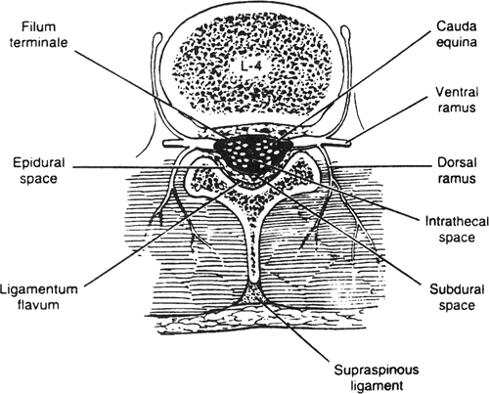
Anatomy and placement

Slide 27
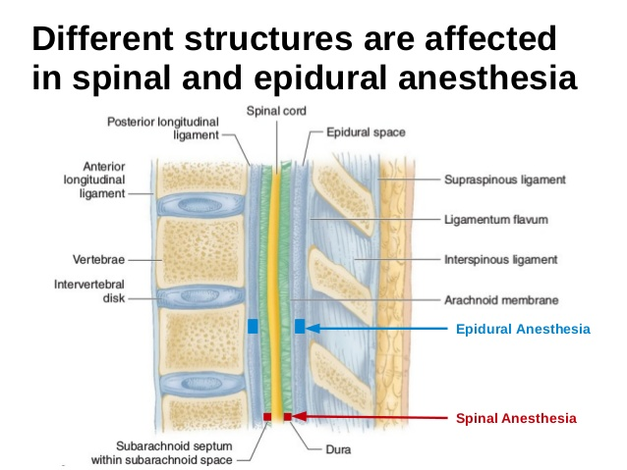

Slide 28
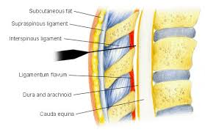

Slide 29
With the use of sterile technique and after local anesthetic infiltration of the skin and subcutaneous tissues, a small (22- to 27-gauge) spinal needle is passed between two adjacent lumbar spinous processes. The needle is passed through the following structures: supraspinous ligament, interspinous ligament, ligamentum flavum, dura mater, and arachnoid mater. Cerebrospinal fluid (CSF) is aspirated, and the appropriate local anesthetic solution is injected.
The needle can be removed (single-shot method) or a catheter can be placed to allow repeated dosing for potentially longer procedures (continuous spinal).

Slide 30
Level of analgesia
Multiple variables affect the spread of analgesia. The baricity of the agent (solution density compared to that of CSF) and the position of the patient immediately after injection are major determinants of level. The total dose injected (increased dose results in higher spread) and the total volume injected (increased volume results in higher spread) are also important determinants of anesthetic level.
Older patients tend to have greater spread of anesthesia by a few dermatomes, but this difference may or may not be clinically significant.
Onset and duration of analgesia
The specific characteristics of the local anesthetic used and the total dose injected are the primary determinants of onset and duration of action. Epinephrine added to the solution increases the duration of analgesia.
The variability in length of analgesia is significant, ranging from as little as 30 minutes (lidocaine) to up to 6 hours (tetracaine with epinephrine).

Slide 31
complications
Hypotension may occur as a result of sympatholytic-induced vasodilation and bradycardia. It may be more severe in hypovolemic patients or in those with preexisting cardiac dysfunction. Treatment includes volume resuscitation (crystalloid, 500 to 1,000 mL), vasopressors (epinephrine, 5 to 10 µg intravenously for adults; phenylephrine hydrochloride, 50 to 100 µg intravenously), and positive chronotropic drugs. It is advisable to administer 500 to 1,000 mL of crystalloid prior to spinal block to avoid hypotension due to spinal anesthesia.
High spinal blockade. Inadvertently high levels of spinal blockade may result in hypotension, dyspnea (loss of chest proprioception or intercostal muscle function), or apnea (decreased medullary perfusion secondary to hypotension). Respiratory dysfunction may necessitate intubation and ventilatory support

Slide 32
Headache - encountered with higher frequency in young or female patients. symptoms worsened by sitting up or standing
result of leakage of CSF from the puncture site.
use smaller-gauge spinal needles
Treatment- oral or intravenous fluids, oral analgesics, and caffeinated beverages. Severe refractory headache may require placement of an epidural blood patch to prevent ongoing leakage of CSF.
CNS infection - extremely rare, may result in meningitis, epidural abscess, or arachnoiditis.
Permanent nerve injury - exceedingly rare
Urinary retention with bladder distention occurs in patients with spinal anesthesia whose bladders are not drained by urethral catheters. Catheters should remain in place until after the spinal anesthesia has been stopped and full sensation has returned

Slide 33
Contraindications
Absolute contraindications- localized infection at the planned puncture site, increased intracranial pressure, generalized sepsis, coagulopathy, and lack of consent.
Relative contraindications- hypovolemia, preexisting CNS disease, chronic low back pain, platelet dysfunction, and aortic stenosis

Slide 34
Epidural anaesthesia
Anatomy and placement
similar to placing a spinal needle except that the epidural needle is not advanced through the dura. No CSF is obtained. The tip of the epidural needle lies in the epidural space between the ligamentum flavum posteriorly and the dura mater anteriorly. Local anesthetic solution can then be injected.
Either the needle is removed (single-shot method) or, more commonly, a flexible catheter is passed through the needle into the space and the needle is withdrawn over the catheter
(continuous catheter technique). Local anesthetics or opiates can be dosed intermittently or infused as needed.
Level of analgesia
Once injected into the epidural space, the local anesthetic solution diffuses through the dura and into the spinal nerve roots, resulting in a bilateral dermatomal distribution of analgesia.

Slide 35
The spread of nerve root blockade is primarily determined by the volume of injection and, to a lesser degree, by patient position and age and by area of placement.
Onset and duration of analgesia
Epidural anesthesia develops more slowly than does spinal anesthesia, because the local anesthetic solution must diffuse farther. The rate of onset of sympathetic blockade and hypotension also is slowed, enabling more precise titration of hemodynamic therapy compared with spinal anesthesia.
The dosing interval depends on the agent used.
Complications are similar to those encountered with spinal anesthesia.
Spinal headache may result from inadvertent perforation of the dura.
Epidural hematoma is rare and usually occurs with coexisting coagulopathy. Emergent laminectomy may be required to decompress the spinal cord and avoid permanent neurologic injury.

