Slide 1
HYDRONEPHROSIS
DR.OHANG CHAUDHARI

Slide 2
Course of urine…..
Formation of urine in kidney
Transport in ureter
Temporary storage in urinary bladder
Excrete from body via urethra after having micturition reflex

Slide 3
Obstruction of pathway
When any obstruction in the pathway of urine
Obstruction of Urine output from the kidney
Kidney will make urine regardless of such obstruction in the pathway
Kidney & renal pelvis will become DILATED

Slide 4
What is it???
It is an aseptic dilatation of PELVICALYCEAL SYSTEM
Due to PARTIAL or INTERMITTENT OBSTRUCTION
To the OUTFLOW of urine

Slide 5
WHY??
UNILATERAL
BILATERAL

Slide 6
UNILATERAL
INTRA-LUMINAL -stone in ureter or renal pelvis -papillary necrosis ( sloughed out papilla)
INTRA – MURAL -narrow ureter -ureterocele -PUJ obstruction ( congenital) -malignancy in ureter -stricture of ureter ( iatrogenic) or TB

Slide 7
UNILATERAL
EXTRA- MURAL -aberrant renal vessels (m.c. on LEFT side) -compression by malignant growth ( cervix, rectum) -retroperitoneal fibrosis - retrocaval ureter

Slide 8
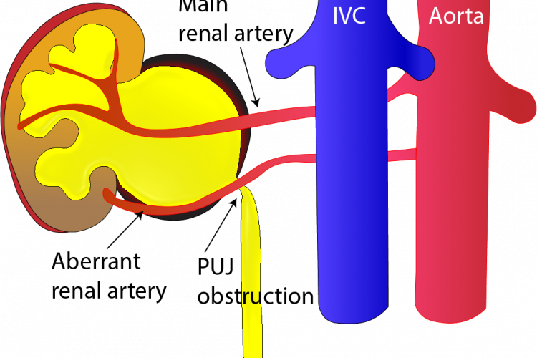
.

Slide 9
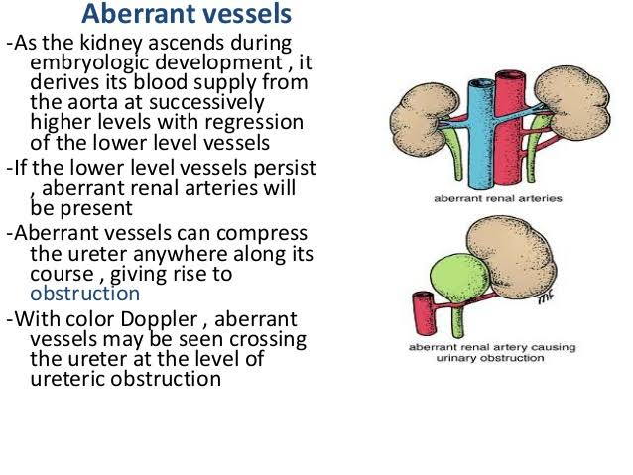
.

Slide 10
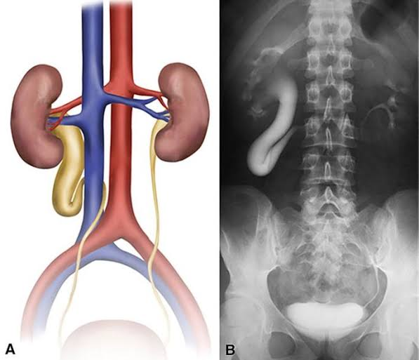
RETROCAVAL URETER

Slide 11
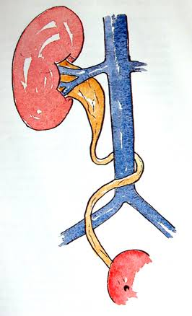
.

Slide 12
BILATERAL
CONGENITAL - stricture of external urethral meatus -posterior urethral valve
ACQUIRED
-BPH -malignancy in prostate -stricture urethra ( trauma, inflammatory) -post operative bladder neck scarring -phimosis -carcinoma cervix & bladder -bilateral stag horn calculi

Slide 13
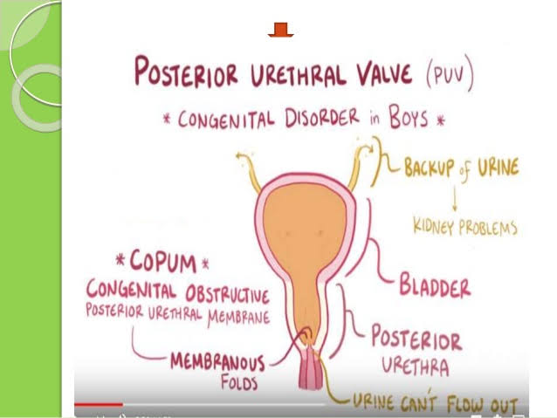
.

Slide 14
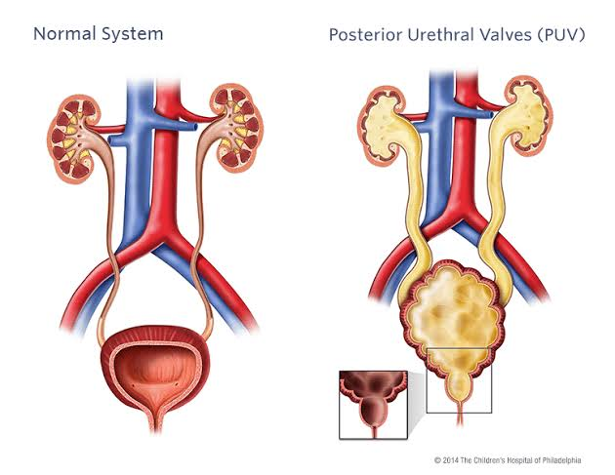
.

Slide 15
pregnancy
Due to effect of excessive progesterone -dilatation of ureter and renal pelvis -due to decreased muscle tone - starts early in few weeks of pregnancy & involutes 2-12v weeks post partum
CONGENITAL PUJ OBSTRUCTION is most common cause, so often BILATERAL,,, but presentation on one side is earlier

Slide 16
pathology
Initially pressure effect is limited to RENAL PELVIS
Then if obstruction is still present - pressure effects start to appear in CALYCES & renal parenchyma
Parenchyma become thinner gradually & got dilated
Kidney will become full of urine

Slide 17
Later stage
Secretory function got compromised
If parenchyma thickness less than 2 mm -kidney become non functioning
If bilateral– then patient will go in RENAL FAILURE

Slide 18
DILATATION OF RENAL PELVIS
INTRA-RENAL DILATATION
EXTRA – RENAL DILATATION

Slide 19
CLASSIFICATION--I
UNILATERAL HN
BILATERAL HN without renal failure
BILATERAL HN with renal failure

Slide 20
CLASSIFICATION--II
INTERMITTENT HN - obstruction occurs-swelling & pain in loin -after some time patient passes LARGE amount of urine -swelling & pain disappear DIETL”S CRISIS
PERSISTENT HN -due to persistent partial obstruction

Slide 21
CLASSIFICATION--III
HN ONLY
HN with hydroureter

Slide 22
CLASSIFICATION-- IV
Extra renal pelvic HN ( most common type)
Intra renal pelvic HN -destruction of renal parenchyma is more faster and more severe

Slide 23
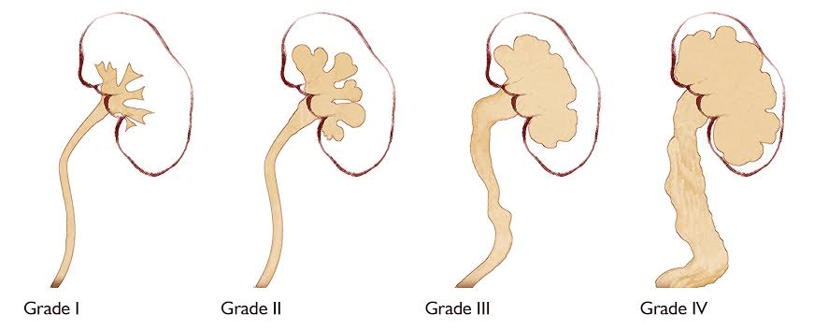
GRADE

Slide 24
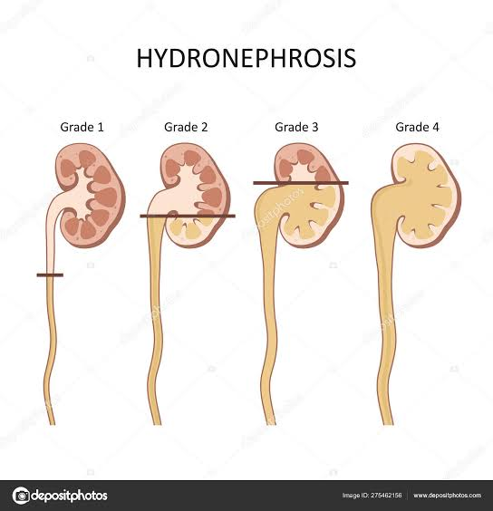
Stages of HN

Slide 25
C/f in UNILATERAL HN
Congenital PUJ obstruction & stone are most common causes
More common in male
Right side kidney more affected
Dull aching pain in lumbar region
Attacks of acute renal colic
Dragging sensation & heaviness in lumbar region
Burning micturiton, haematuria , fever

Slide 26
On examination
Pain on renal angle
Palpable mass in loin - smooth, mobile, ballotable - moves with respiration -dullness in renal angle
Can observe DIETL’S CRISIS

Slide 27
c/f in BILATERAL HN
Lower urinary tract obstruction
-Loin pain -Frequency, hesitancy, poor urinary stream ( BOO) -if renal failure develops early then no palpable mass in loin

Slide 28
B/L HN
Bilateral upper urinary tract obstruction -loin pain - mass in loin -attack of renal colic
Renal failure - oliguria -edema

Slide 29
COMPLICATIONS
PYONEPHROSIS
PERINEPHRIC ABSCESS
RENAL FAILURE in B/L HN

Slide 30
INVESTIGATIONS
Blood urea & serum creatinine
Urine for microscopy
USG ABDOMEN- investigation of choice
IVP- function of both kidney -shape of calyx
CECT UROGRPHY- DIAGNOSTIC
ISOTOPE RENOGRAPHY-before and after surgery for comparison( DTPA SCAN)

Slide 31
Whitaker test
A fine needle pass in renal pelvis through loin
Perfuse saline at rate 10ml/min
Normally , initially pressure increase & later it will remain constant
Persistent increase in pressure suggestive of HN

Slide 32
TREATMENT
Always try to conserve the kidney and try conservative surgeries first
NEPHRECTOMY – last option

Slide 33
Treat the cause
Stone in kidney or renal pelvis
Congenital anomaly
Aberrant renal vessels
Stricture urethra- dilatation, -urethrotomy , urethroplasty
Phimosis- circumcision
BPH- TURP
PUV- cystoscopic fulgration of valve

Slide 34
Surgery options
Andrson-hyne’s pyeloplasty
Davis – T –tube ureterostomy
Non dismembered pyeloplasty
Laparoscopic pyeloplasty
Endoscopic pyeloplasty
NEPHRECTOMY F/B RENAL TRANSPLANTATION --last option

Slide 35
Anderson hyne’s pyeloplasty
Dismembered pyeloplasty
Congenital PUJ obstruction
Excision of Spasmodic segment of renal pelvis
A new pelvis is created
Cut end of pelvis anastomos with ureter

Slide 36
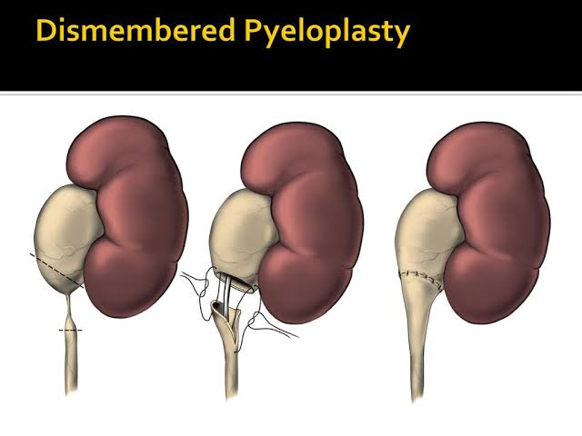
Anderson hyne’s pyeloplasty

Slide 37
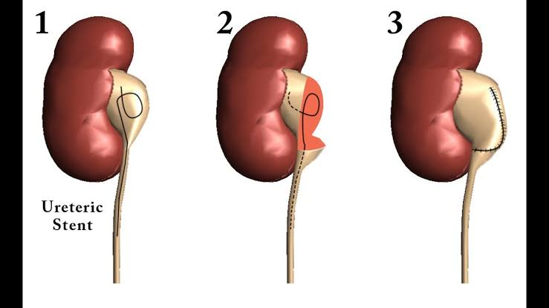
.

Slide 38
Davis –T- tube ureterostomy
Placement of T- tube
Longitudinal incision

Slide 39
Non dismembered pyeloplasty
PUJ is not transected
Reconstruction done without transection - foley’s Y-V plasty

Slide 40
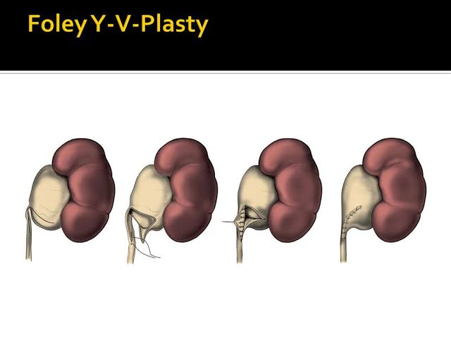
.

Slide 41
Laparoscopic pyeloplasty
Becoming popular day by day
Expensive & time consuming procedure
Gives good results
Retroperitoneal scopy can also be used

Slide 42
Endoscopic pyeloplasty
Technically easier
BUT…………..Results are not satisfactory

Slide 43
B/L HN without renal failure
Kidney which is functioning well should be operated first
Opposite kidney can be operated -after 3 MONTHS

Slide 44
B/L HN with renal failure
BILATERAL NEPHROSTOMY -followed by HAEMODIALYSIS
After 3-6 weeks - renal function checked by IVP
IF they are functioning - we can choose any surgical procedure
IF not functioning still on DTPA scan -Nephrectomy followed by TRANSPLANTATION

Slide 45
MCQ 1
Which of the following is not a cause for unilateral HN? 1.retrocaval ureter 2. BPH 3. PUJ obstruction 4.ureteric stricture

Slide 46
MCQ 2
Most common cause for HN is… 1. BPH 2. congenital PUJ obstruction 3.bladder neck stricture 4. renal stone

Slide 47
MCQ 3
At how much thickness of renal parenchyma..kidney function lost?? 1. less than 10mm 2. less than 6mm 3. less than 4 mm 4. less than 2mm

Slide 48
MCQ 4
In a patient of HN which of the following is not a clinical finding of a palpable lump?? 1. smooth 2.ballotable. 3 . Mobile 4. not moving with respiration

Slide 49
MCQ 5
In whitaker test normal saline perfusion done at which rate?? 1. 30 ml / min 2. 20ml/min 3. 10ml/min 4. 5ml/min

