Slide 1
Round worm & its surgical complications
Dr. Ohang Chaudhari

Slide 2
Round worm
Ascaris lumbricoids-parasite
LIFE CYCLE eggs-faecooral route-larvae-portal circulation-liver-hepatic veins- IVC, heart, pulmonary arteries-lung-mature-alveoli-coughed-swallowed to intestine-adult worm-male female union-release of eggs in stool

Slide 3
presentation
Colic pain
Fever ,tachycardia
Sub acute intestinal obstruction
Acute intestinal obstruction with palpable round worm bolus per abdomen
Perforation---ileum

Slide 4
investigations
Barium meal
USG
Peripheral smear – eosinophilia
Chest x ray – bronchitis
Stool examination – eggs
CT /MRI---obstruction, worm in CBD
gastroduodenoscopy

Slide 5
MANAGEMENT
based on presentation
Antihelminthic drugs
( piperazine,albendazole,mabendazole)
Ryle's tube
Iv fluids
If sub acute obstruction---child may pass stool with adult worms

Slide 6
Acute obstruction
Exploratory laparotomy
Milking worm in caecum then colon
Once they are in colon hypertonic saline per anus ------passed in stool
Removal of worms by ENTEROTOMY rarely done ………it can lead to worm toxin peritonitis

Slide 7
perforation
Common in ileum
Remove all worms by ENTEROTOMY
Give saline wash
Ileostomy
After 6-12 week closure of ileostomy

Slide 8
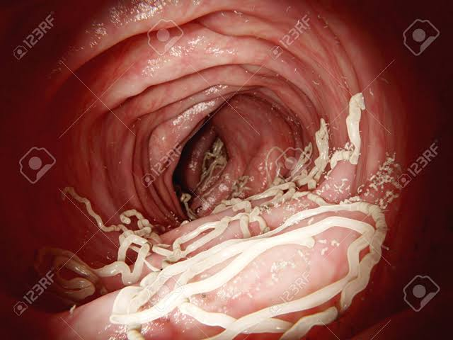
gastroduodenoscopy

Slide 9
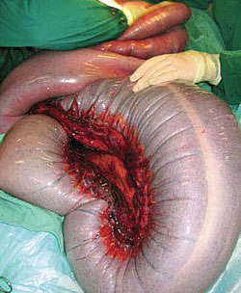
On table obstruction

Slide 10
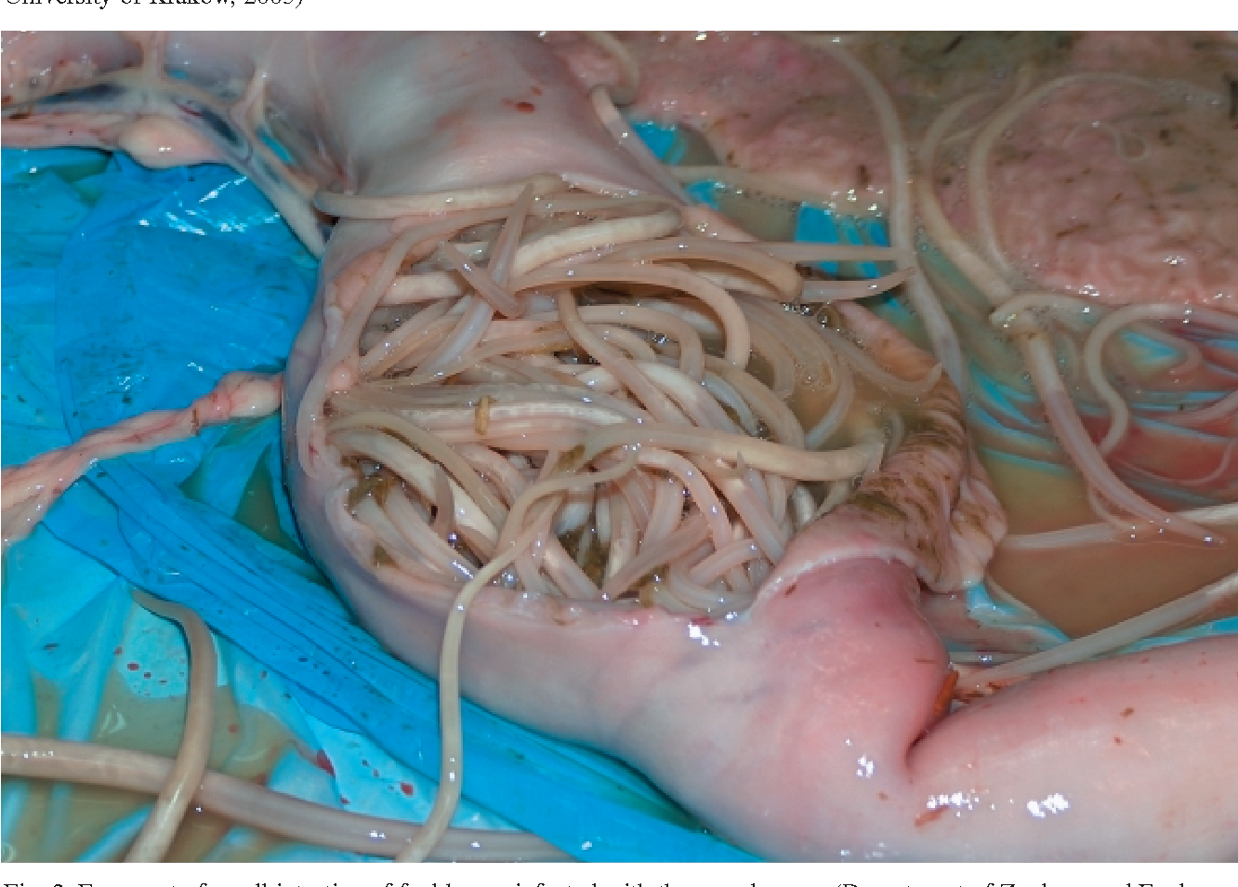
perforation

Slide 11
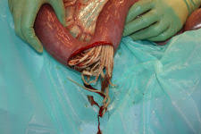
.

Slide 12
ERCP
Endoscopic retrograde cholangiopancratography
for removing worms from CBD/pancreatic duct

Slide 13
MCQ 1
Route of transmission of round worm 1. droplet 2 feco oral 3 blood 4 local spread

Slide 14
MCQ 2
Common site for bowel perforation in round worm infestation 1. caecum 2. rectum 3. ileum 4. ascending colon

Slide 15
MCQ 3
All can be used to investigate round worm infection EXCEPT…. 1. USG ABDOMEN 2. STOOL EXAMINATION 3.BAREUM MEAL 4.URINE MICROSCOPY

Slide 16
MCQ 4
Which one is not antihelminthic drug 1.mebendazole 2.piperazine 3.albendazole 4.miconazole

Slide 17
MCQ 5
Worm in common bile duct can be investigate by 1. USG ABDOMEN 2. CECT ABDOMEN` 3. BAREUM MEAL 4. X RAY ABDOMEN

Slide 18
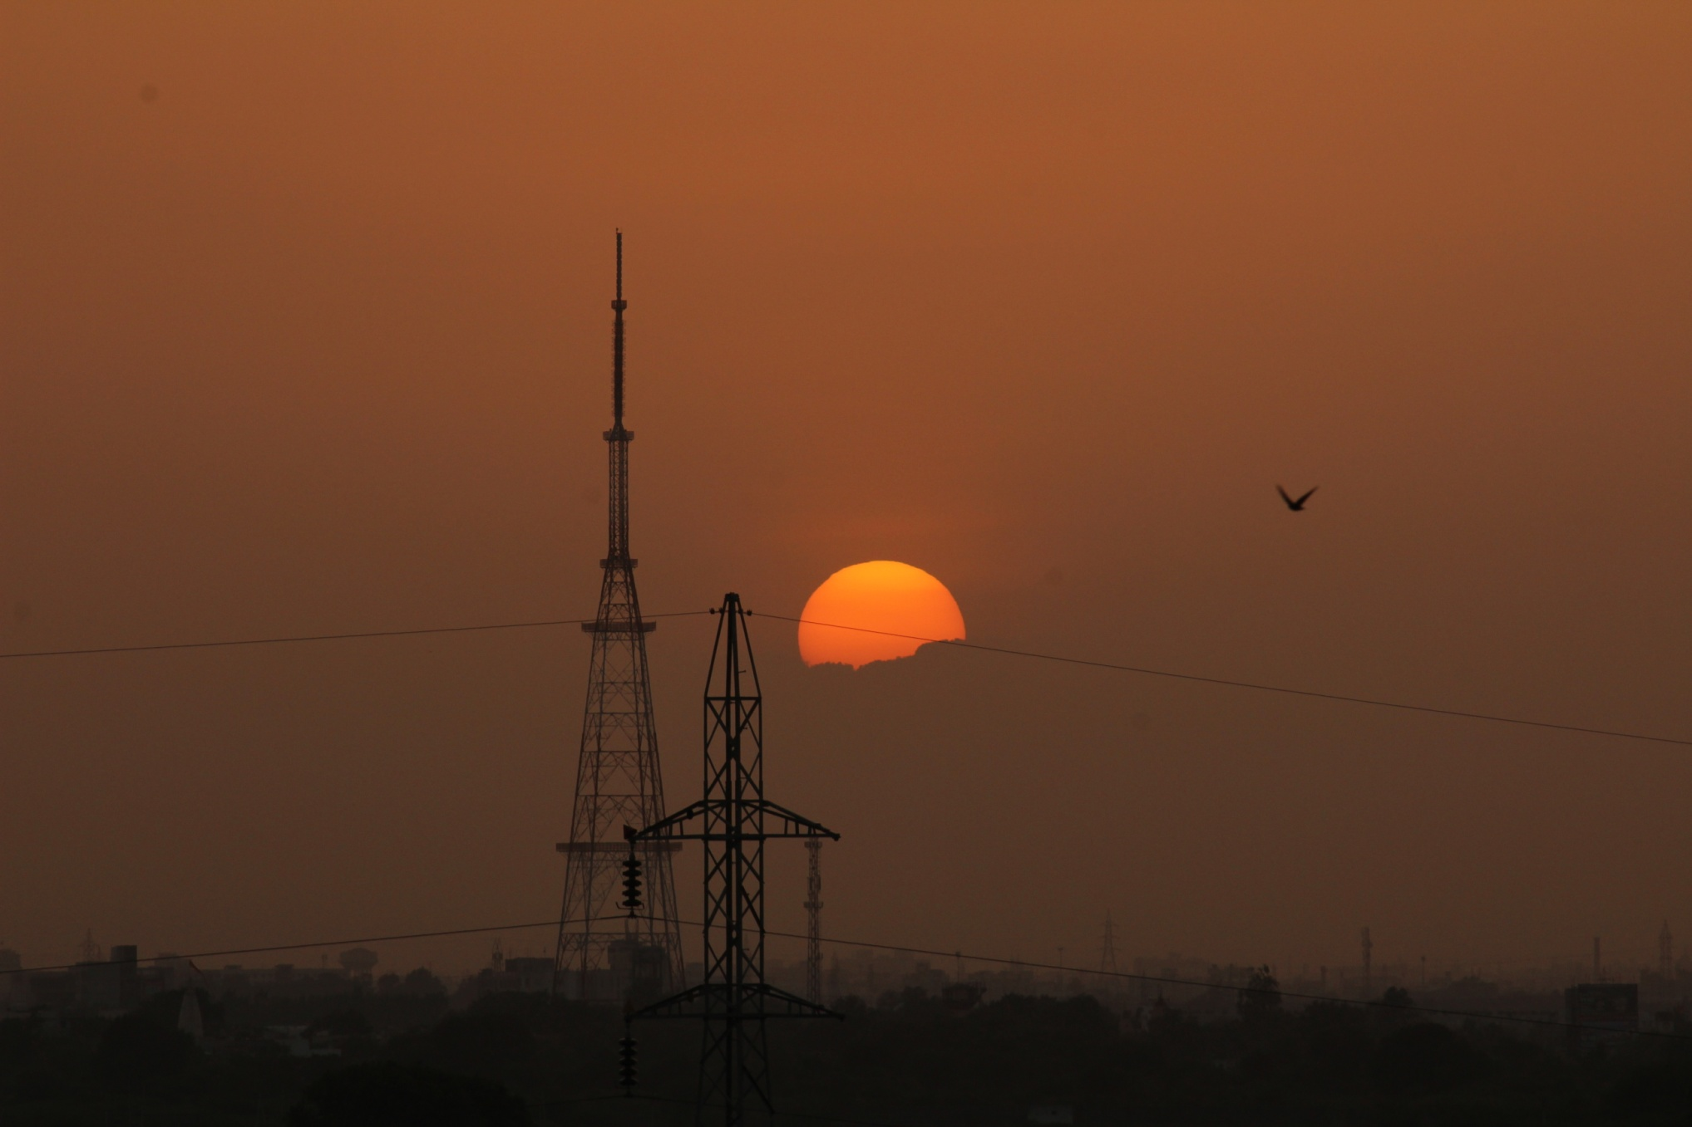
THANK YOU

