Slide 1
EMBRYOLOGY OF EYE
Dr. Aaditya

Slide 2
INTRODUCTION
The development of eyeball begins at day 22 when the embryo has 8 pairs of somites and is around 2mm in length.
The various components of the eyeball are derived from the following primordia:
Neuroectodermal outgrowth of the prosencephalon called the optic vesicle that forms retina, iris, and optic nerve.
Specialized area of surface ectoderm (called the lens placode) that gives rise to the lens and corneal epithelium.
Mesoderm surrounding the optic vesicle that forms fibrous and vascular coats of eye.
Migrating neural crest cells that contribute for choroid, sclera and corneal epithelium.

Slide 3
FORMATION OF THE OPTIC VESICLE
The region of the neural plate destined to form the diencephalic part of prosencephalon shows a linear thickened area on either side around 22nd day of development (8th somite stage).
This area soon becomes depressed to form the
optic sulcus
Meanwhile, the neural plate becomes converted into the prosencephalic vesicle. As the optic sulcus deepens, the wall of the prosencephalon overlying the sulcus bulges outwards to form the optic vesicle.

Slide 4
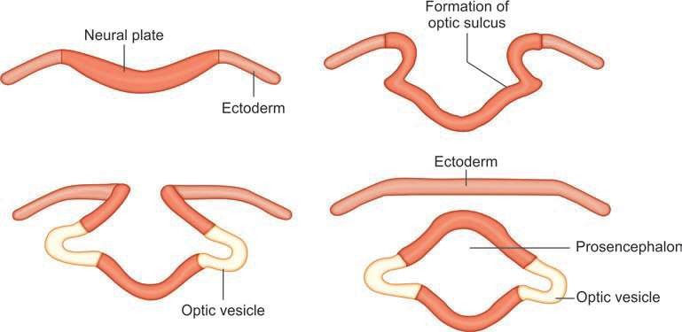
Fig.: Formation of the optic vesicle

Slide 5
FORMATION OF LENS VESICLE
As the optic vesicle grows laterally, it comes into relation with the surface ectoderm. An area of this surface ectoderm, overlying the optic vesicle, becomes thickened to form the lens placode.
The lens placode soon sinks below the surface to form lens pit. The ends of lens pit come closer and form lens vesicle.
The lens vesicle becomes completely separated from the surface ectoderm by 33rd day of development.
The proximal part of the optic vesicle becomes constricted, and elongated, to form the optic stalk.

Slide 6
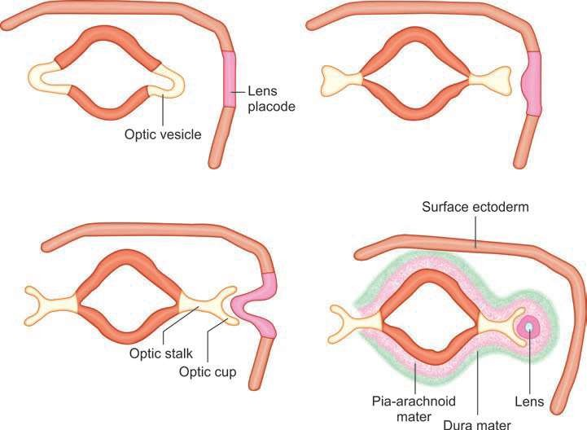
(A) Formation of lens placode; (B) Deepening of lens placode and optic cup; (C) Formation of the optic stalk and its invagination into the optic cup; (D) Lens vesicle and optic cup, meningeal coverings for developing optic cup and lens vesicle

Slide 7
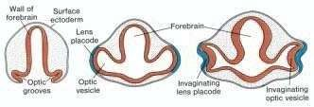
A. Transverse section through the forebrain of a 22-day embryo showing the optic grooves
B. Transverse section through the forebrain of a 27 day embryo showing the optic vesicles in contact with the surface ectoderm. Note the slight thickening of the ectoderm (lens placode).
C. Transverse section through the forebrain of an embryo showing invagination of the optic vesicle and the lens placode

Slide 8
FORMATION OF THE OPTIC CUP
During the 4th week of gestation, while the lens vesicle is forming, the optic vesicle becomes converted into a double-layered optic cup. The conversion of the optic vesicle, to the optic cup, is a result of differential growth of the wall of the vesicle.
The margins of the cup grow over the upper and lateral sides of the lens to enclose it. However, such overgrowth does not take place on the inferior aspect of the lens, as a result of which the wall of the cup shows a deficiency along the inferior surface of the optic stalk and is called the choroidal or fetal fissure. This fissure closes by 6th week of gestation.
The vascular mesoderm in choroidal fissure forms the hyaloid vessels that supply optic cup and lens vesicle.
The distal part of hyaloid vessels degenerate whereas the proximal parts persists as central artery and
vein of retina.
The developing neural tube is surrounded by mesoderm, which subsequently condenses to form the meninges. An extension of this mesoderm covers the optic vesicle.
Later, this mesoderm differentiates to form a superficial fibrous layer corresponding to the dura mater, and a deeper vascular layer corresponding to the piaarachnoid.
With the formation of the optic cup, part of the inner vascular layer is carried into the cup through the choroidal fissure. With the closure of fissure, the mesenchyme that is inside the optic cup gives rise to hyaloid system of vessels.
The outer fibrous layer surrounding anterior part of optic cup forms cornea. The corresponding vascular layer forms the iridopupillary membrane which attaches to anterior part of optic cup and forms iris.

Slide 9
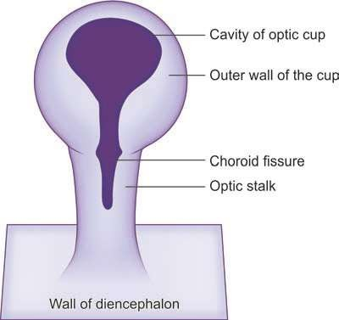
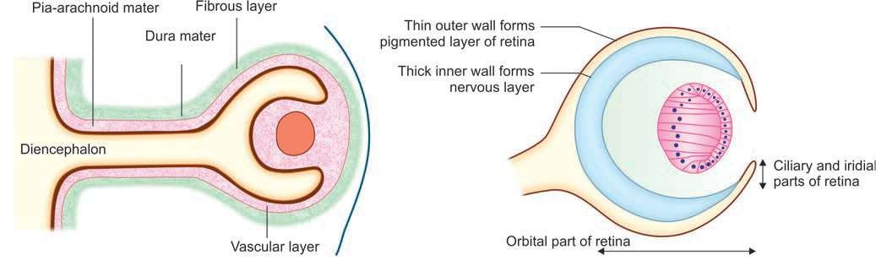
Fig. Optic cup and stalk seen from below to show the choroidal fissure.
Developing optic cup surrounded by extensions of pia-arachnoid and dura mater;
Subdivisions of the optic cup

Slide 10
Lens
The lens is formed from the lens vesicle. The lens vesicle is at first lined by a single layer of cuboidal cells.
The cells in the anterior wall of the vesicle remain cuboidal. Those in the posterior wall gradually become elongated and become columnar. As they do so, the cavity of the vesicle is encroached upon and is eventually obliterated by the end of the 7th week.
The elongated cells of the posterior wall lose their nuclei and are converted into the primary fibers of the lens. The primary lens fibres are formed upto 3rd month of gestation and are called the Embryonic nucleus.
The cells at the equatorial region of lens form the secondary lens fibers that continue to form from the anterior epithelium throughout life.
Fetal nucleus – secondary lens fibres formed from 3rd to 8th month of gestation.
Infantile nucleus - secondary lens fibres formed during last weeks of gestation to puberty.
Adult nucleus -- secondary lens fibres formed after puberty.
While the secondary lens fibers are forming, the primary lens fibers become harder.
In the beginning, the lens is supplied by hyaloid artery.
Later with the degeneration of distal part of artery, the lens is deprived of its blood supply and becomes an avascular structure.

Slide 11
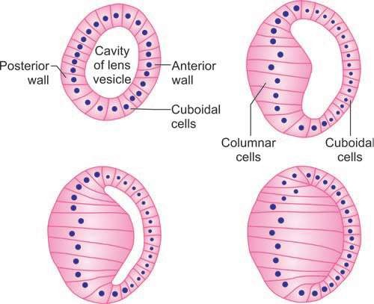
Fig. Stages in the formation of lens of the eye

Slide 12
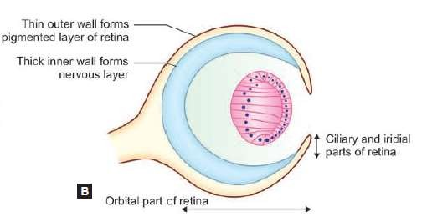
Retina
The retina is derived from the layers of the optic cup. The optic cup is divisible into anterior and posterior parts.
–– The larger posterior part becomes thick and forms the retina proper (optical part of retina).
–– The anterior part remains thin and forms an epithelial covering for the ciliary body and iris (ciliary and iridial parts of retina).
There are two layers in the retina.
–– The outer wall of the posterior part of the optic cup remains thin. Its cells form the pigmented layer of the retina .
–– The inner wall of the cup is called the nervous layer that differentiates into matrix, mantle and marginal layers as in the neural tube. The cells of the matrix layer form the rods and cones. The cells of the mantle layer form the bipolar cells, the ganglion cells, other neurons of the retina, and also the supporting elements. The axons of the ganglion cells grow into the marginal layer to form the layer of nerve fibers. These fibers grow into the optic stalk by passing through the choroidal fissure. The optic stalk is, thus, converted into the optic nerve.
The space between the pigmented and nervous layers is called intraretinal space that represents the original cavity of optic cup. With the proliferation of cells of inner layer, this space gets obliterated before birth, and the rod and cone cells come in contact with pigment epithelium.
Differentiation of retinal layers starts during the 6th week of gestation and by five and half months gestation, all the layers of the adult retina are recognizable.

Slide 13
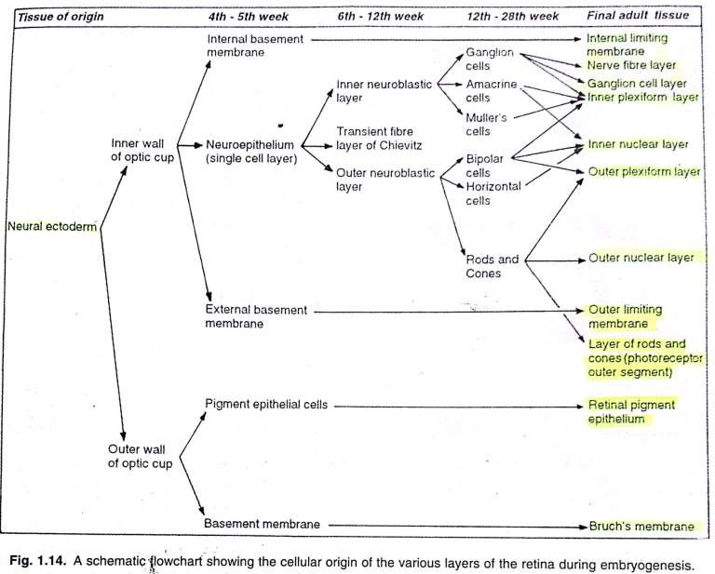

Slide 14
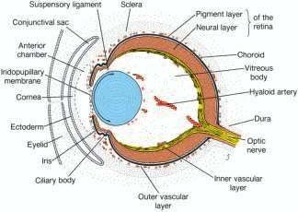
Vitreous
The vitreous is believed to be derived partly from ectoderm and partly from mesoderm.
The ectodermal component is derived mainly from the optic cup but the lens vesicle may also contribute to it.
The mesodermal component comes into the optic cup through the choroidal fissure.
Choroid
The choroid is formed from the inner vascular layer of mesoderm that surrounds the optic cup. According to some authorities, this mesoderm contains cells derived from the neural crest.
Anteriorly, the choroid is continuous with ciliary body and posteriorly it is continuous with pia-arachnoid around optic nerve.
Section through the eye of a 15-week fetus showing the anteriorchamber, iridopupillary membrane, inner and outer vascular layers, choroid, and sclera

Slide 15
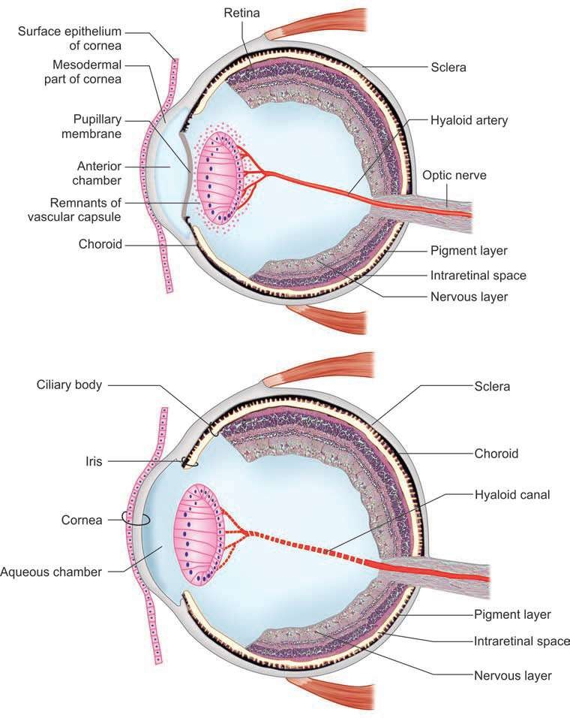
Derivation of coats of the eyeball. Note pupillary membrane and hyaloid artery. See the layers of retina, remnants of vascular capsule;
The hyaloid artery and pupillary membrane have disappeared. Position of artery can be seen
as the hyaloid canal

Slide 16
Ciliary Body and Iris
The mesodermal basis of the ciliary body and iris is derived from a
forward prolongation of the mesoderm forming the choroid.
The inner surface of this mesoderm comes to be lined by two layers of epithelium (pigment and nervous layers) derived from the ciliary and iridial parts of the retina. The two layers of epithelium correspond to the two layers of the optic cup.
The ciliary muscle has been generally regarded as mesodermal but the present view is that they are of neural crest origin.
The connective tissue of ciliary body is derived from mesoderm.
The musculature of the iris (sphincter and dilator pupillae) is of ectodermal origin (neuroectodermal cells of optic cup).
The extension of iris does not extend up to the center leaving a gap known as the pupil. The color of the iris depends on the concentration of pigments in pigment containing cells (chromatophores) in the iris.

Slide 17
Cornea
The Bowman’s layer, substantia propria, Descemet’s membrane and inner endothelium of the cornea are derived from the neural crest.
The superficial surface epithelium of the cornea is derived from the surface ectoderm
At about 40 days of gestation, corneal epithelium consists of a superficial squamous cell layer and a basal cuboidal epithelial cell layer. By the time eyelids open at 5-6 months of gestation, corneal epithelium attains an almost adult appearance.

Slide 18
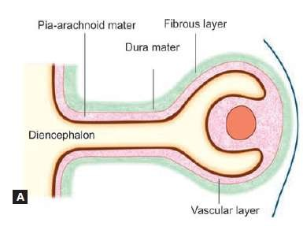
Sclera
The sclera is formed from the posterior part of the outer fibrous layer of mesoderm surrounding the optic cup, and corresponds to the dura.
Some authorities believe that (like the choroid) the mesoderm forming the sclera is infiltrated by cells from the neural crest.
The process starts at the limbal-equatorial region around 7th week of gestation and is completed by 5th month.

Slide 19
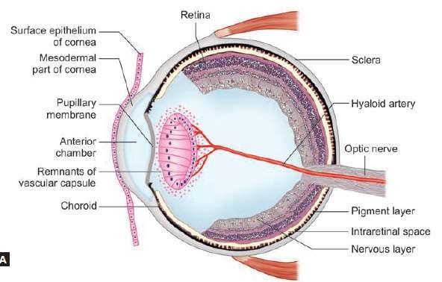
Anterior and Posterior Chambers of Eye
The anterior and posterior chambers of the eye (aqueous chamber) are formed by a splitting of the mesoderm in the region, and correspond to the subarachnoid space of the brain.
The cavity of the anterior chamber is formed by vacuolization of mesoderm present anterior to the lens.
Vacuolization splits the mesenchyme into outer (anterior) and inner (posterior) layers.
The outer layer becomes continuous with the sclera and with the substantia propria of the cornea.
The inner layer lies in front of lens and iris and is termed the pupillary membrane

Slide 20
Blood Vessels
The blood vessels of the eyeball are formed in the mesodermal layer that is a continuation of the piaarachnoid.
Part of this mesoderm that gets invaginated into the optic cup, forms the retinal vessels. The central artery and vein of the retina at first lie in the choroidal fissure, but come to be buried in the fibers of the developing optic nerve. As the choroidal fissure extends for some distance along the optic stalk, the central artery of the retina runs through the substance of the distal part of the optic nerve.
Initially, the lens is completely surrounded by a vascular capsule. The posterior part of the capsule is supplied by the hyaloid artery. This artery is a continuation of the central artery of the retina and passes through the vitreous. Later in fetal life, the vascular capsule and the hyaloid artery disappear, but the hyaloid canal in the vitreous (through which the artery passes) persists.
The anterior part of the vascular capsule of the lens, comes to be lined posteriorly by the iridial part of the retina, and forms the iris. The pupil is for some time closed by a part of this vascular tissue, which is termed the iridopupillary membrane. This membrane normally disappears before birth.

Slide 21
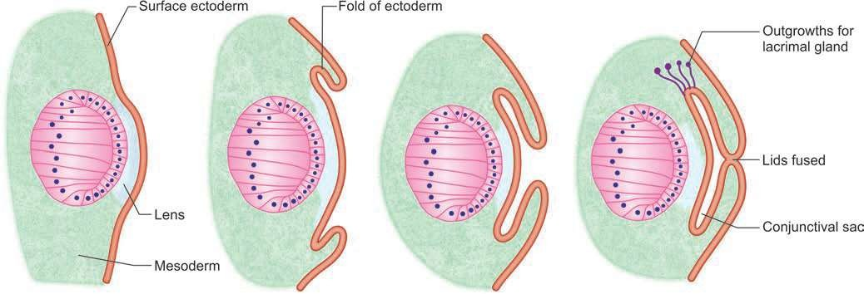
Eyelids
The eyelids are formed by reduplication of the surface ectoderm above and below the cornea
3rd month→ they become united
5th month→start to separate
7th month→complete separation
The ectodermal folds formed contain some mesoderm that gives rise to muscle and to the tarsal plates.
The conjunctiva is of ectodermal origin.
The eyelashes and glands in the eyelids develop from surface ectoderm.
Formation of eyelids, conjunctival sac and lacrimal gland

Slide 22
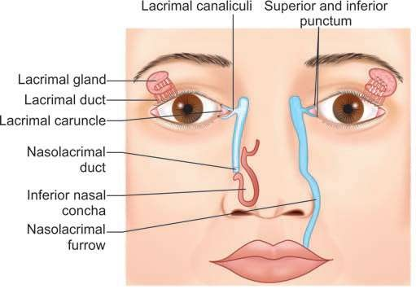
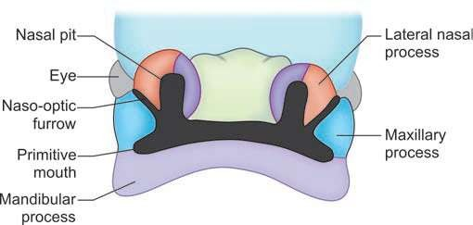
Lacrimal Apparatus
The lacrimal gland is formed from a number of buds that arise from the upper angle of the conjunctival sac
The lacrimal sac and nasolacrimal duct are derived from the ectoderm of the naso-optic (or nasolacrimal) furrow. This furrow lies along the line of junction of the maxillary process and the lateral nasal process, and extends from the medial angle of the eye to the region of the developing mouth.
The ectoderm of the furrow becomes buried to form a solid cord that is subsequently canalized. The upper part of this cord forms the lacrimal sac. The lower part, acquires a secondary connection to the nasal cavity, and forms the nasolacrimal duct.
The lacrimal canaliculi are formed by canalization of ectodermal buds that arise from the margin of
each eyelid near its medial end and grow to the lacrimal sac.
Position of nasolacrimal furrow and of nasolacrimal duct
Nasolacrimal (naso-optic) furrow

Slide 23
Extraocular Muscles of Eyeball
They are derived from preoccipital myotomes that are supplied by 3rd, 4th and 6th cranial nerves.
The extraocular muscles appear in the following sequence: LR->SR->LPS(week 5)->SO and MR(week 6)->IO and IR

Slide 24
Orbit
Orbital bones→From mesenchyme that encircles optic vesicle.
Medial wall→from lateral nasal process
Lateral + inferior wall→from maxillary process
Superior wall→mesenchymal capsule of forebrain
Posterior orbit→from bones of base of the skull
Bones of orbit form in membrane expect those from base of the skull which develop from cartilage
By 6th month of gestation, anterior half eyeball projects beyond orbital opening

Slide 25
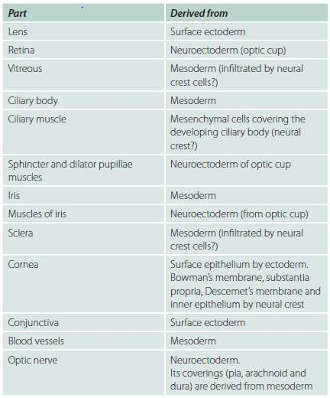
Summary of derivation of various parts of the eyeball

Slide 26
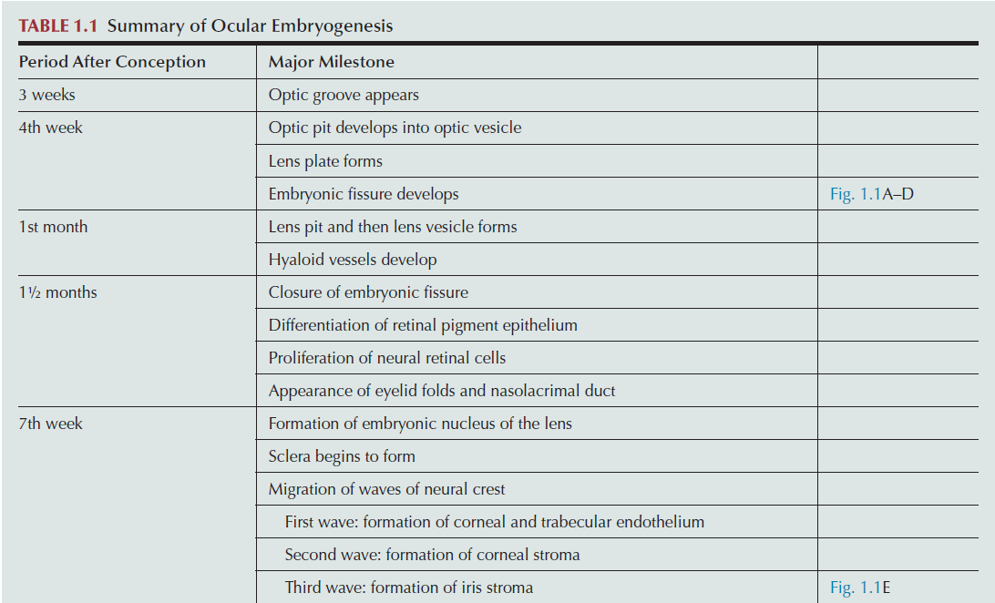

Slide 27
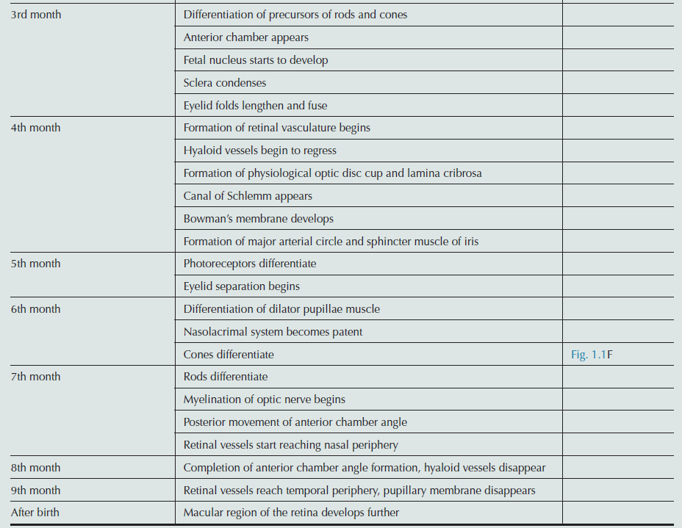

Slide 28
Primordial Tissue and its Derivatives
Neural ectoderm
Smooth muscle of the iris
Optic vesicle and cup
Iris epithelium
Ciliary epithelium
Part of the vitreous
Retina
Retinal pigment epithelium
Fibres of the optic nerve
Surface ectoderm
Conjunctival epithelium
Corneal epithelium
Lacrimal glands
Tarsal glands
Lens
Mesoderm
Extraocular muscles
Corneal stroma
Sclera
Iris
Vascular endothelium of eye and orbit
Choroid
Part of the vitreous

Slide 29
Neural crest
Corneal stroma, keratocytes and endothelium
Sclera
Trabecular meshwork endothelium
Iris stroma
Ciliary muscles
Choroidal stroma
Part of the vitreous
Uveal and conjunctival melanocytes
Meningeal sheaths of the optic nerve
Ciliary ganglion
Schwann cells of the nerve sheaths
Orbital bones
Orbital connective tissue
Connective tissue sheath and muscular layer of the ocular and orbital blood vessels

Slide 30
THANK YOU

