Slide 1
ANATOMY AND PHYSIOLOGY OF PARATHYROID GLAND

Slide 2
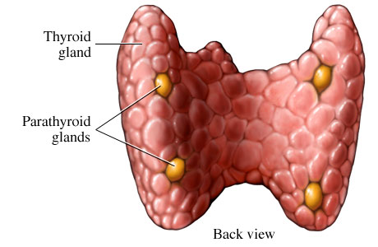
DEVELOPMENT
The parathyroid glands develop from the endoderm of the third and fourth pharyngeal pouches.
The inferior parathyroid glands are derived from the dorsal part of the third pharyngeal pouch.
The superior parathyroid glands are derived from the fourth pharyngeal pouch and migrate together with the ultimobranchial bodies.

Slide 3
NUMBER AND SIZE
Typically they are 4 in number.
Size-5 mm in length ,3mm in width and 1-2 mm in depth.
Lower glands are heavier than the upper glands.
Maximum weight of normal gland vary within 8.2 to 78 mg.

Slide 4
SHAPE
The inelasticity of the parathyroid gland accounts for its variation in shape and contour.
Subcapsular glands located at the upper pole of the thyroid gland have a tendency to be flattened,whereas glands in the cricothyroidal region and intrathymic region appear more oval and spherical in shape.
Occasionally a gland is bean ,sausage or rod shaped.

Slide 5
Macroscopic appearance and consistency
Varies from light yellow to reddish brown .
In children it appears as salmon pink because of the lower fat content.
They are ususally soft,pliable and with a smooth surface.

Slide 6
Microscopic appearance
Gland has a thin connective tissue capsule and septae which divide it into lobules.
Cells-chief cells,oxyphil cells.
Chief cells-synthesize PTH.
Chief cell are arranged into columns surrounded by sinusoidal capillaries responsible for transporting PTH from the gland.

Slide 7
Anatomical location
Great variation exists in the final anatomical location of the gland.
Attributed to the comlex migratory pathway and embryological development with other glands.

Slide 8
ARTERIAL SUPPLY
The inferior parathyroid gland is supplied by the inferior thyroid artery from the thyrocervical trunk.
The superior parathyroid gland is also usually supplied by the inferior thyroid artery or by an anastomotic branch between the inferior thyroid and the superior thyroid artery.
Venous drainage –via thyroid venous plexus.
INERVATION-nerve supply is adrenergic from the sympathetic system.

Slide 9
PHYSIOLOGY
Main function of parathyriod gland is calcium homeostasis.
Secretes PTH.
Low calcium levels stimulate parathyroid gland to secrete PTH.
PTH causes bone resorption and 1,25-dihydroxy vitamin D3 synthesis in the proximal convoluted tubules of the kidney.

Slide 10
CALCIUM HOMEOSTASIS
The parathyroid cells rely on a G-protein-coupled membrane receptor designated the calcium-sensing receptor (CASR), to regulate PTH secretion by sensing extracellular calcium levels
PTH secretion also is stimulated by low levels of 1,25-dihydroxy vitamin D.

Slide 11
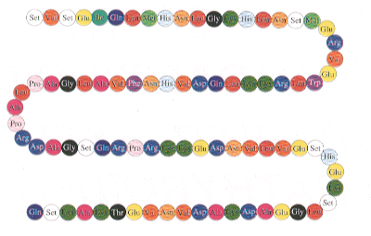
CALCIUM HOMEOSTASIS
PTH is synthesized in the parathyroid gland as a precursor hormone,preproparathyroid hormone, which is cleaved first to proparathyroid hormone and then to the final 84-amino-acid PTH.
Secreted PTH has a half-life of 2 to 4 minutes. In the liver, PTH is metabolized into the active N-terminal component and the relatively inactive C-terminal fraction

Slide 12
CALCIUM HOMEOSTASI
The calcium-sensing receptor (CASR) is expressed on the surface of the parathyroid cell and senses fluctuations in the concentration of extracellular calcium.
Increased PTH secretion leads to an increase in serum calcium levels by increasing bone resorption and enhancing renal calcium reabsorption.
PTH also stimulates renal 1-α Hydroxylase activity, leading to an increase in 1,25-dihydroxy vitamin D, which also exerts a negative feedback on PTH secretion

Slide 13
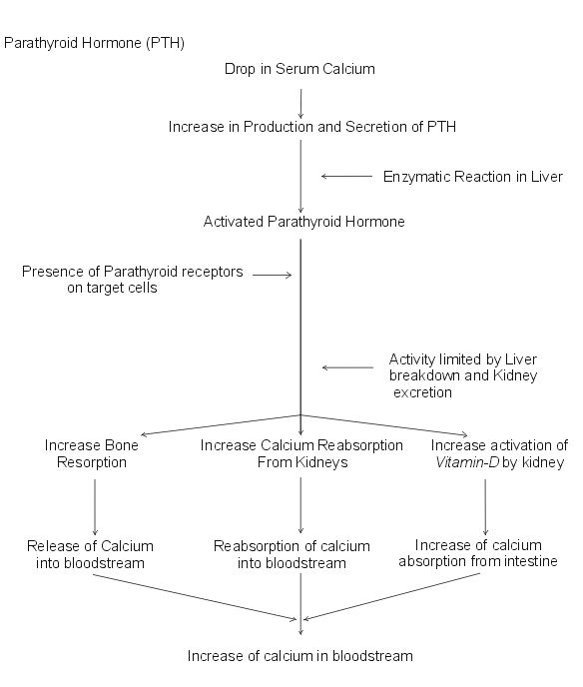
PTH functions to regulate calcium levels via its actions on three target organs, the bone, kidney, and gut.
PTH increases the resorption of bone by stimulating osteoclasts and promotes the release of calcium and phosphate into the circulation.

Slide 14
CALCIUM HOMEOSTASIS
At the kidney, PTH acts to limit calcium excretion at the distal convoluted tubule via an active transport mechanism.
PTH also inhibits phosphate reabsorption (at the Proximal convoluted tubule) and bicarbonate reabsorption.
PTH and hypophosphatemia also enhance 1-hydroxylation of 25-Hydroxyvitamin D, which is responsible for its indirect effect of increasing intestinal calcium absorption.

Slide 15
HYPERPARATHYROIDISM
Primary hyperparathyroidism is characterized by increased parathyroid cell proliferation and PTH secretion which is independent of calcium levels.
Etiology unknown, but radiation exposure, and lithium implicated, associated with MEN1, and MEN 2A

Slide 16
HYPERPARATHYROIDISM
Kidney stones, painful bones, abdominal groans, and fatigue
Kidney stones- calcium phosphate and oxalate
Osteopenia, osteoporosis, and osteitis fibrosa cystica. Increased bone turnover can usually be determined by documenting an elevated blood alkaline phosphatase level.
Peptic ulcer disease, pancreatitis
Psychiatric manifestations such as depression, anxiety.

Slide 17
SECONDARY HYPERPARATHYROIDISM
In pts with chronic renal failure
Deficiency of 1,25-dihydroxy vitamin D as a result of loss of renal tissue, low calcium intake, decreased calcium absorption, and abnormal parathyroid cell response
Normally treated medically

Slide 18
TERTIARY HYPERPARATHYROIDISM
Long standing renal failure s/p renal transplant
autonomous parathyroid gland function.
Can cause problems similar to primary hyperparathyroidism
Operative intervention
  symptomatic disease
  autonomous PTH secretion persists for more than 1 year after a successful transplant
  subtotal or total parathyroidectomy with autotransplantation

Slide 19
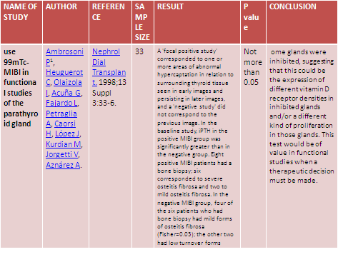

Slide 20
1. Parathyroid glands develop from
Ectoderm of third and fourth pharyngeal pouches
Mesoderm of third and fourth pharyngeal pouches
Endoderm of third and fourth pharyngeal pouches
none

Slide 21
2. Typically parathyroid glands how many in number
6
4
8
10

Slide 22
3. Microscopically which cells mostly found in the parathyroid glands
Chief cells
Oxyphil cells
Both
None

Slide 23
4. PTH secretion is stimulated by
Low calcium levels in blood
High calcium levels in blood
Low levels of 1,25 dihydroxy vit D
High levels of 1,25 dihydroxy vit D

Slide 24
5. Inferior thyroid artery is a branch of
Internal carotid
External carotid
Thyrocervical trunk
none

Slide 25
Thank you

