Slide 1
Anatomy of larynx
Dr. Jinesh Shah

Slide 2
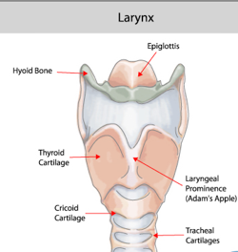
Framework of larynx

Slide 3
cartilages
Unpaired
Paired
Epiglottis
Thyroid
Cricoid
Arytenoids
Corniculate
Cuneiform

Slide 4
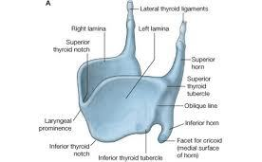
Thyroid cartilage
Oblique line
Thyrohyoid
Sternothyroid
Inferior constrictor

Slide 5
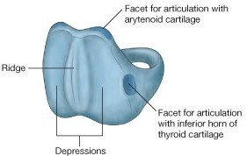
Cricoid cartilage
Only complete cartilaginous ring
Entire inner surface lined by mucous membrane

Slide 6
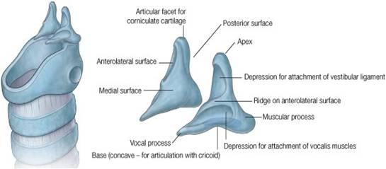
Arytenoid cartilages
Irregular
Three sided pyramids
Vocal process
Muscular process

Slide 7
Corniculate cartilages (of Santorini).
Cuneiform cartilages (of Wrisburg).

Slide 8
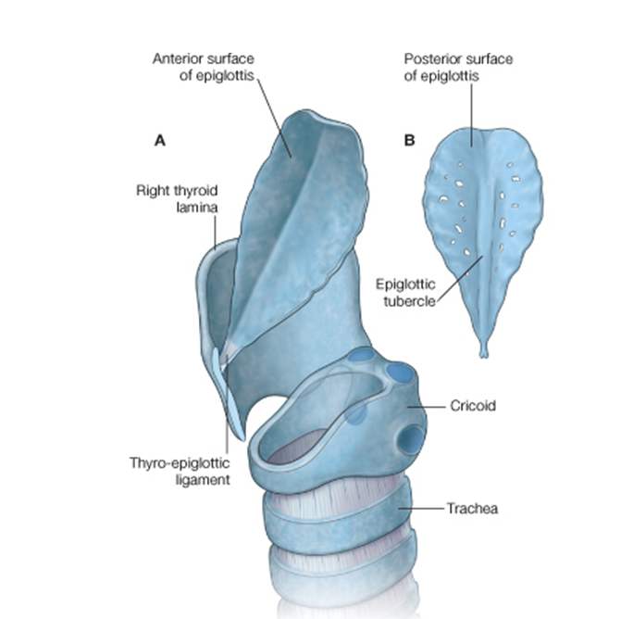
epiglottis
Thin
Leaf like
Elastic fibrocartilage

Slide 9
cartilages
Hyaline
Elastic fibrous
Thyroid
Cricoid
Arytenoid
Corniculate
Cuneiform
Epiglottis
Apices of arytenoid

Slide 10
ligaments
Extrinsic
Intrinsic
Thyrohyoid membrane
Cricotracheal ligament
Quadrilateral membrane
Cricovocal membrane

Slide 11
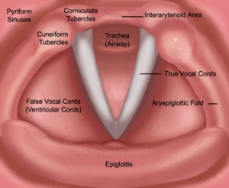
Vestibular fold (false cord)
Vocal fold (true cord)

Slide 12
Extrinsic Muscles
Suprahyoid
Infrahyoid
Mylohyoid
Geniohyoid
Stylohyoid
Digastric
Stylopharyngeus
Palatopharyngeus
Salpingopharyngeus
Thyrohyoid
Sternothyroid
Sternohyoid
Omohyoid

Slide 13
Intrinsic muscles
Posterior cricoarytenoid
Lateral cricoarytenoid
Transverse arytenoids
Oblique arytenoids
Thyroarytenoid (vocalis)
Cricothyroid

Slide 14
Nerve supply

Slide 15
Laryngeal vasculature
Arterial
Venous
Lymphatic drainage

Slide 16
NAME OF STUDY | NAME OF AUTHOR | REFERENCE DETAILS | SAMPLE SIZE | RESULT | P VALUE | CONCLUSION
Distant metastases and their significant indicators in laryngeal cancer | Liu WW, Zeng ZY, Guo ZM, Xu GP, Yang AK, Zhang Q. | Zhonghua Er Bi Yan Hou Ke Za Zhi. 2003 Jun;38(3):221-4. | 277 | The overall incidence of DM in laryngeal cancer was 6.5% (18/277). The target site of DM was mainly in lung 83.3% (15/18), liver 16.7% (3/18). | 0.005 | Cox model analysis showed that only N stage was the significant prognostic factor for DM in laryngeal cancer

Slide 17
Q-1 larynx has :
2 paired and 2 unpaired cartilages
3 paired and 2 unpaired cartilages
2 paired and 3 unpaired cartilages
3 paired and 3 unpaired cartilages

Slide 18
Q-2 crico-thyroid and crico-arytenoid joints are type of :
Synovial ; synovial
Synovial ; hinge
Hinge ; synovial
None of above

Slide 19
Q-3 sensory nerve supply of larynx below the level of vocal cord is :
External branch of superior laryngeal nerve
Internal branch of superior laryngeal nerve
Recurrent laryngeal nerve
Inferior laryngeal nerve

Slide 20
Q-4 supraglottis includes all except
Aryepiglottic fold
False cord
Lingual surface of epiglottis
Laryngeal surface of epiglottis

Slide 21
Q-5 narrowest part of infantile larynx is
Supraglottic
Subglottic
Glottic
None of the above

Slide 22
Thank you

