Slide 1
ANATOMY OF THE NASAL SEPTUM

Slide 2
Levels of Evidence
Grade A – Systemic reviews, Meta analyses, RCT
Grade B – Non-randomised studies
Grade C – Observational studies
Grade D – Case Series, Expert opinion

Slide 3
Levels of Evidence
**** ~ Systematic reviews, meta analysis of randomized control studies
*** ~ Non randomised studies
** ~ Observational or non experimental studies
* ~ Expert opinion

Slide 4
INTRODUCTION
Helps to preserve the geometry of the nose
Contributes to cosmesis

Slide 5
parts
Collumelar:
Membranous:
Septum proper:
- Cartilges – Quadrilateral cartilage
- Upper and lower alar cartilages
- Bones – perpendicular plate of ethmoid
- vomer
- crest of maxilla
- palatine bone

Slide 6
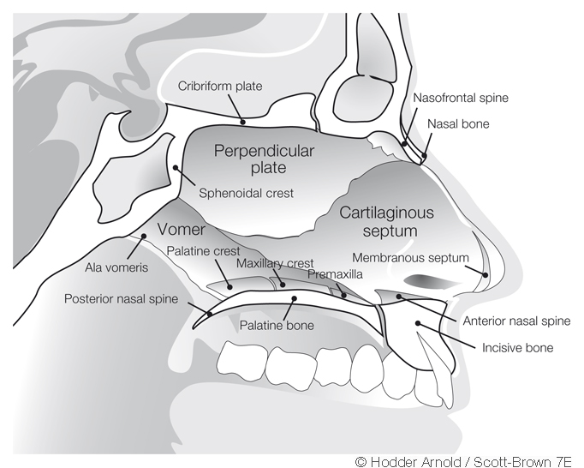

Slide 7
histology
The mucous membrane is predominantly respiratory with a small area of olfactory epithelium superiorly, just adjacent to cribriform plate.
Septal mucosal surface area
in newborn- 450 mm²
in adults – 1700 mm²
Respiratory epithelium is composed of ciliated and non-ciliated pseudostratified columnar cells, basal pleuripotent stem cells and goblet cells.

Slide 8
histology
Each columnar cell bears 300-400 microvilli. Their function is to increase surface area and prevent drying.
Seromucinous glands are found in submucosa and helps in mucus production.

Slide 9
BLOOD SUPPLY
Anterior ethmoidal artery
Posterior ethmoidal artery
Sphenopalatine artery
Greater palatine artery
Superior Labial artery
Kiesselbach’s plexus

Slide 10
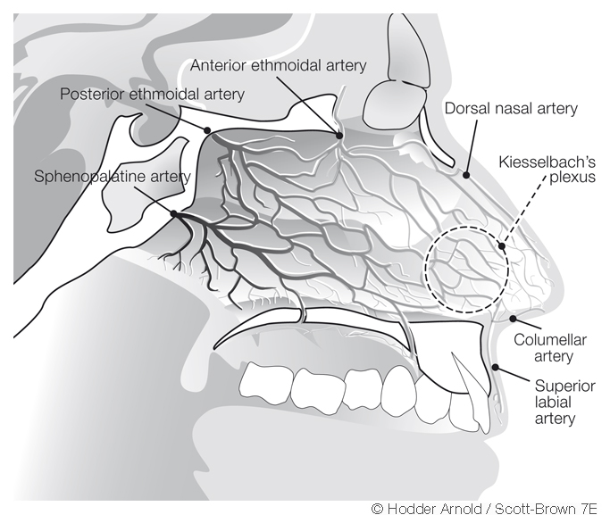

Slide 11
Nerve supply
Maxillary division of trigeminal nerve.
Anterior ethmoidal branch of nasociliary nerve.
Anterior superior alveolar nerve.
Nerve to pterygoid canal.
Posterior inferior nasal branch of anterior palatine nerve.

Slide 12
Lymphatic drainage
Anterior part of septum:
- submandibular lymph nodes
Posterior part of septum:
- retropharyngeal lymph nodes
- anterior deep cervical lymph nodes

Slide 13
Diseases of the nasal septum
Deviated nasal septum.
Septal haematoma.
Septal abscess.
Septal perforation.

Slide 14
Applied
Little’s area
Woodruff’s area

Slide 15
NAME OF STUDY | NAME OF AUTHOR | REFERENCE DETAILS | SAMPLE SIZE | RESULT | P VALUE | CONCLUSION
The effect of nasal septal deviation on maxillary sinus volumes and development of maxillary sinusitis | Kapusuz Gencer Z¹, Ozkırış M, Okur A, Karaçavuş S, Saydam L | Eur Arch Otorhinolaryngol. 2013 Nov;270(12):3069-73. | 825 | They could not demonstrate a statistically significant difference between the right maxillary sinus volumes of Groups I and II in left sided deviation cases | 0.77 | maxillary sinus volumes tend to be higher at the contralateral side of the severe septum deviations

Slide 16
Q-1Bony part of nasal septum is made up of following bones.
Perpendicular plate of etmoid
Vomer
Palatine and maxillary crest
All of the above

Slide 17
Q-2 which of the following is not a type of deviated nasal septum?
Anterior dislocation
C-shaped deformity
S-shaped deformity
Z-shaped deformity

Slide 18
Q-3 which of the following is an aetiology of deviated nasal septum
Trauma
Hereditary
Racial factors
All of the above

Slide 19
Q-4 which of the following does not take part in kiesslbach plexus formation?
Anterior ethmoidal artery
Posterior ethmoidal artery
Sphenopalatine artery
Greater palatine artery

Slide 20
Q-5 ‘JARJAWAY’ fracture results from blow from:
Below
Above
Sideways
None of above

Slide 21
THANK YOU…

