Slide 1
TUMOURS OF NASOPHARYNX
Dr. Nirali Chauhan

Slide 2
Levels of Evidence
Grade A – Systemic reviews, Meta analyses, RCT
Grade B – Non-randomized studies
Grade C – Observational studies
Grade D – Case Series, Expert opinion

Slide 3
Levels of Evidence
**** ~ Systematic reviews, meta analysis of randomized control studies
*** ~ Non randomised studies
** ~ Observational or non experimental studies
* ~ Expert opinion

Slide 4
Pharynx:-
It is a conical fibromuscular tube forming upper part of food and air passage.
12 -14 cm long.
Extent:-
Width 3.5 cm at base and narrow 1.5 cm at G.O. junction.

Slide 5
Division of pharynx:-
Nasopharynx
Oropharynx
Hypo or laryngopharynx

Slide 6
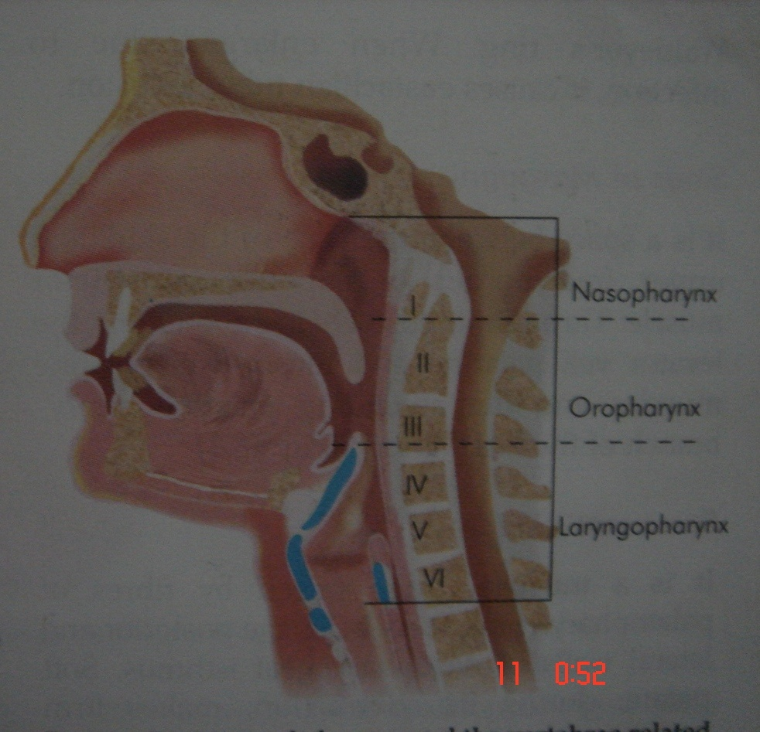

Slide 7
Nasopharynx:-
It is upper most part of the pharynx.
It lies behind nasal cavity.
Extent:-
Roof:-
Floor:-
Ant. Wall:-
Post wall:-
Lateral wall:-

Slide 8
Blood Supply:
•External carotid artery
•Ascending pharyngeal
•Facial arteries
•Venous drainage
•The pterygoidvenous plexus (superiorly)
•The pharyngeal plexus (inferiorly)

Slide 9
•Lymphatic drainage
Retropharynggeal & deep cervical group of lymphnode
Nerve supply
•The trigeminal nerve
–The pharyngeal branch of the sphenopalatine ganglion
•Below passavant's ridge the nerve supply is the same as for the rest of the pharynx by the glossopharyngeal and vagus nerves.

Slide 10
Functions of nasopharynx:
Airflow
–Like the nose, it is a noncollapsible structure.
–Usually nasopharyngeal obstruction results in reflex use of the oral airway.
–The exception is in neonates, who are regarded as obligate nasal breathers.
•Eustachian tube function
•Speech and swallowing
•Bacterial colonization

Slide 11
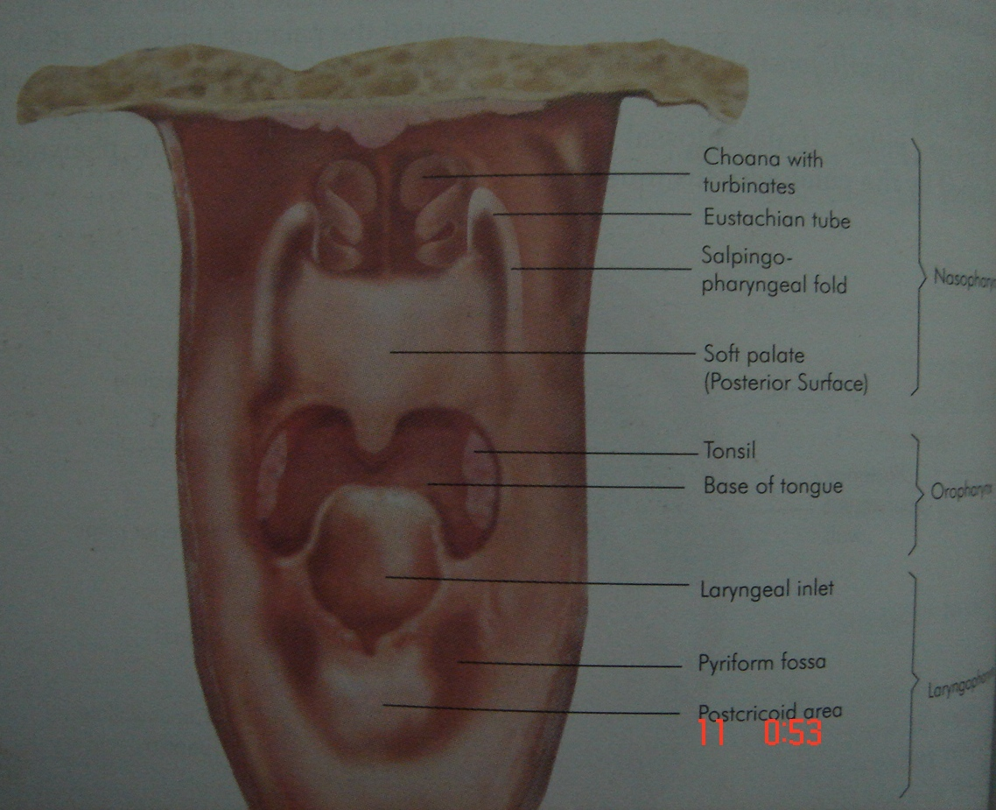

Slide 12
Benign tumours of nasopharynx:-
1) Juvenile nasopharyngeal angiofibroma
2) Teratoma
3) Pleomorphic adenoma
4) Chordoma
5) Hamartoma
6) Choristoma

Slide 13
Symptoms:
•Nasal obstruction:
–Severe nasal obstruction at birth suggests Bilateral Choanal Atresia
–Onset at age 2 to 3 years is suggestive of:
•Adenoidal hypertrophy
•Rhinitis
•Mouth breathing and snoring
•Posterior epistaxis
•Conductive hearing loss
•Hyper nasal speech or regurgitation

Slide 14
Physical Examination:
•Adenoid facies: (nonspecific)
–Open mouth, Flat midface
– High arched palate, pinched nose, crowded upper teeth
–A dull appearance
•Posterior rhinoscopic mirror examination
•Fiberoptic flexible endoscopy
–During speech and swallowing maneuvers gives functional information about velopharyngeal closure
•Rigid endoscope

Slide 15
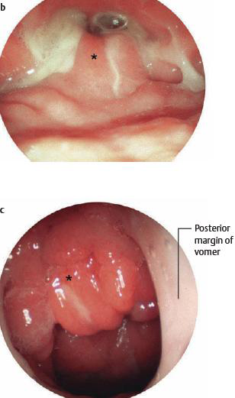

Slide 16
Radiology
•Plain radiographs
•Computed tomography(CT)
•MRI

Slide 17
Juvenile nasopharyngeal angiofibroma:-
The term nasopharyngeal fibroma by Chauveau in 1906 & the name angiofibroma by Freidberg in 1940 [**]
Incidennce - < 0.5% of head & neck tumours

Slide 18
Aetiology:-
exact Cause is unknown
Mostly seen in adolescent males in 2nd decade of life
Thought to be testosterone dependent
Presence of activated transforming growth factor B1 in the fibroblast & endothelial cells[**]
Such patients usually have a hamartomatous nidus of vascular tissue in nasopharynx, and this is activated to forem angiofibroma when male sex hormone appears.

Slide 19
origin
Site of origin of tumour is still a matter of dispute.
But now it is believed to arise from the posterior part of nasal cavity close to the superior margin of sphenopalatine foramen.
From here the tumor grows in other surroundings

Slide 20
Pathology:-
Angiofibroma made up of vascular & fibrous tissues .
The ratio of two components may vary.
The vessels are endothelium lined spaces with no muscle coat
This leads to excessive bleeding and cannot be controlled by application of ADRENALINE

Slide 21
Extersions of nasopharyngeal fibroma
It is a benign tumour but locally invasive and destroys the adjoining structure
It may extend into
Nasal cavity :-
Paranasal sinuses:-
Pterygomaxillary fossa:-
Orbits:-
Cranial cavity:-

Slide 22
Clinical features:-
Age and sex:-
Profuse and recurrent epistaxis:-
Progressive nasal obstruction and hyponasal speech:-
Conductive hearing loss and serous otitis media:-
Mass in nasopharynx:-
Other clinical features:-

Slide 23
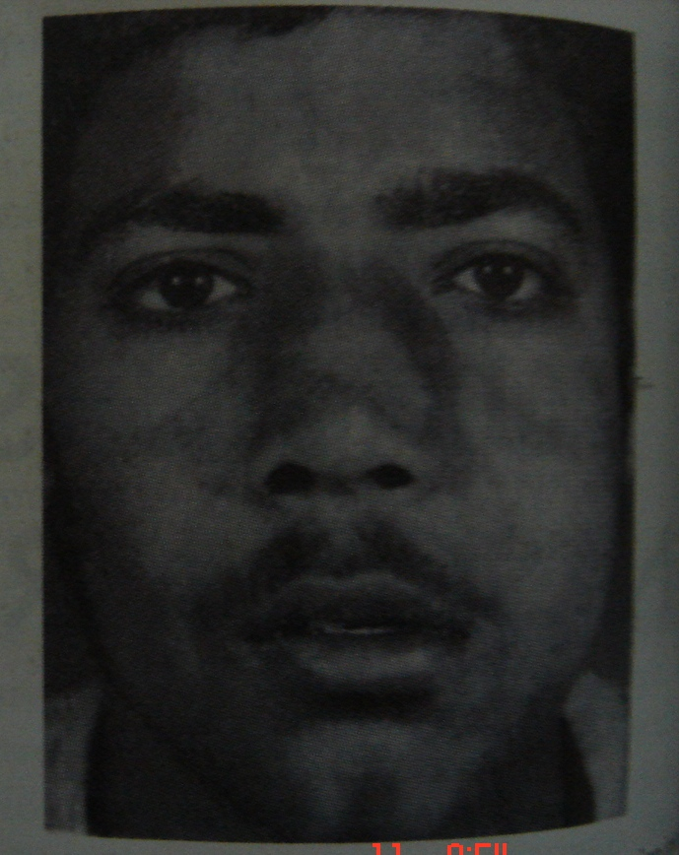

Slide 24
Investigations:-
Soft tissues lateral film of nasopharynx:-
X rays of paranasal sinuses and base of skull :-
(antral sign)
CT scan of the head with contrast enhancement:-
MRI:-when soft tissue extension are present intra cranially, in the infratemporal fossa and into the orbit.
Cartoid angiography:-

Slide 25
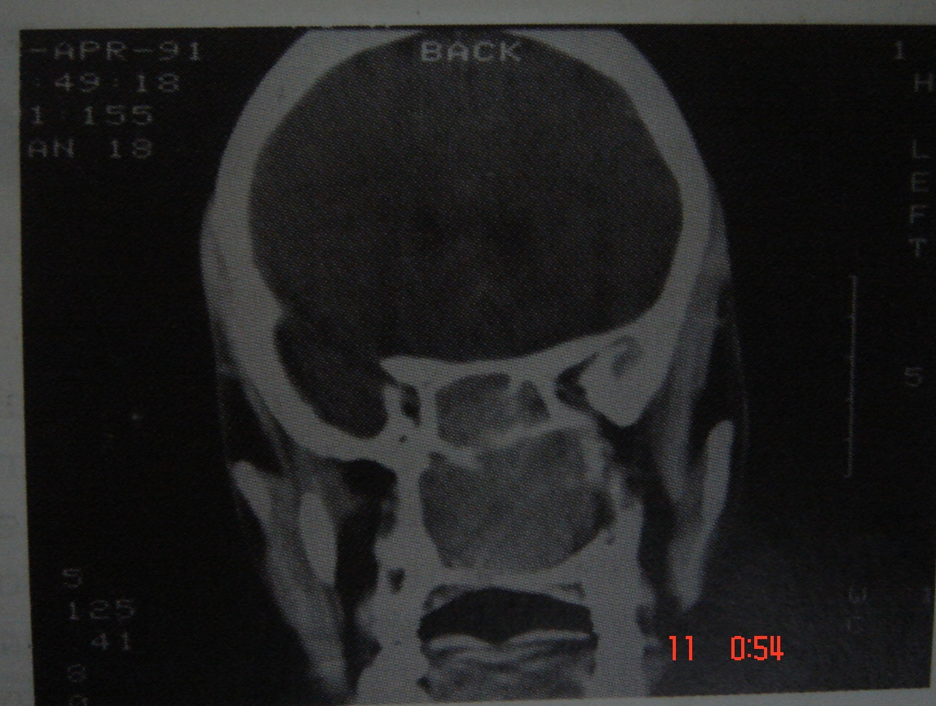

Slide 26
Diagnosis
Based mostly upon on clinical picture
Biopsy of the tumour is attended with bleeding
Biopsy can be done if it is essential to differentiate from other tumours

Slide 27
Treatment:-
Various surgical approach:-
1) Trans palatine:-
2) Transpalatine +sublabial
3) Lateral rhinotomy
4) Extended denker s approach
5) By endoscopic removal after embolisation of vessels.

Slide 28
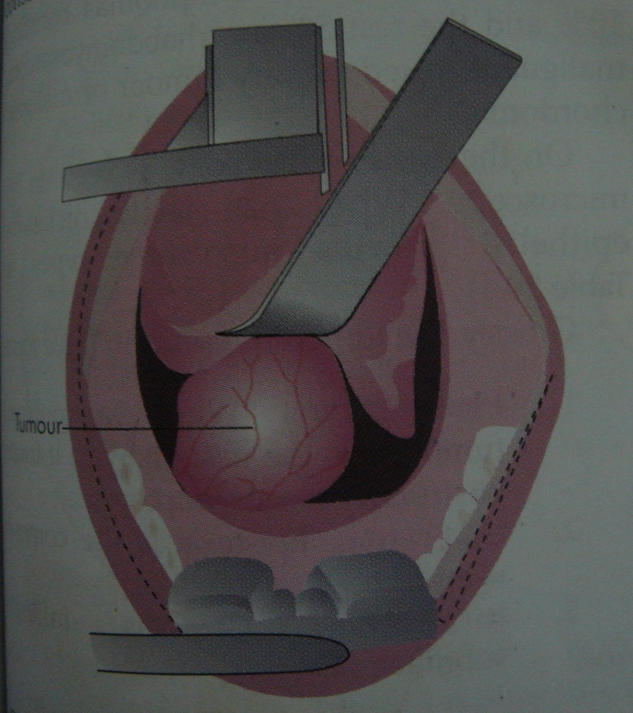

Slide 29
NAME OF STUDY | NAME OF AUTHOR | REFERENCE DETAILS | SAMPLE SIZE | RESULT | CONCLUSION
Management of Juvenile Nasopharyngeal Angiofibroma: A Five Year Retrospective Study | P. N. S. Moorthy,^{1,2} B. Ranganatha Reddy,³ Hamid Abdul Qaiyum,¹ Srivalli Madhira,¹ and Srikanth Kolloju¹ | Indian J Otolaryngol Head Neck Surg. Oct 2010; 62(4): 390–394. Published online Jan 11, 2011. doi: 10.1007/s12070-010-0097-2 | 13 | Juvenile nasopharyngeal angiofibroma is a pathologically benign yet locally aggressive and destructive vascular lesion of head and neck region typically affecting adolescent boys. The present article is a retrospective study of surgically treated patients of juvenile nasopharyngeal angiofibroma over a period of 5 years. The study discusses about most common presenting complaints, correlation of preoperative radiological and intraoperative staging and factors affecting recurrence of juvenile nasopharyngeal angiofibroma. | Juvenile nasopharyngeal angiofibroma or nasopharyngeal angiofibroma is an uncommon disease of male adolescents. It presents most commonly with nasal obstruction and intermittent moderate to severe nasal bleeding. This benign hamartomatous lesion has great potential for growth in all directions, eroding bony confines. The planning of surgical approach for excision of JNA is based on extent of the lesion or stage. Radiological investigations, like contrast enhanced CT or MRI, are helpful in staging the JNA provided they are done as close to surgery date as possible. Age of the patient and stage of the JNA at presentation are the two most important factors in predicting the recurrence of JNA. As younger the age of the patient and later the stage of JNA, are the higher the chances of recurrence. Hence early diagnosis not only helps in better management but also prevents recurrence of JNA.

Slide 30
Other benign tumours of nasopharynx:-
Teratoma:-
Congenital tumour.
Six time more common in females.
Various type include dermoid with skin appendages, also called a hairy polyp.

Slide 31
Swhwanoma:-
may arise in nasopharynx
slow growing & can spread locally by bony erosion
Pleomorpic adenoma:-
may arise from minor salivary gland

Slide 32
Chordoma:-derived from notochord.
Hamartoma:-malformed normal tissue.
E.g. haemingioma.
Choriostoma:-mass of normal tissue at an abnormal site.

Slide 33
Nasopharyngeal Carcinoma
Symptoms:
–Patients may present with significant nasal symptoms including nasal obstruction, epistaxis, a sensation of sinus fullness, and headache.
–Some patients present with minimal nasal symptoms, but complain of otalgia or decreased hearing due to eustachian tube obstruction from the mass.
–A majority of the patients present with a mass in the neck, and in some patients this is the only complaint.

Slide 34
•Physical findings:
–Nasopharyngeal carcinomas are typically erythematousand friable. The tumor arises most frequently near the fossaof Rosenmuller.
–Orbital invasion can produce significant proptosisor hypertelorism.
–Cranial nerves may be involved at the skull base. In particular the 5th & 6th nerve are at risk and their function should be examined.
are present in over 70% of patients. The nodes are usually involving the nodes at the mandibular angle.

Slide 35
Any persistent middle ear effusion of long duration in an adult patient with no prior history of middle ear disease is suspicious for a tumor and should be investigated accordingly.
•EBV antibody titer should be determined (this shows an elevated IgA, contrasting with the elevated IgM/ IgG that is found in infectious mononucleosis).

Slide 36
Pathology
WHO I tumors are keratinizing squamous cell carcinomas. In the
United States these tumors account for approximately 25% of nasopharyngeal carcinomas. In areas of the world where nasopharyngeal carcinoma is common, such as Southern China, these tumors account for less than 5% of nasopharyngeal carcinomas. These tumors are not related to EBV infection.
WHO II tumors are nonkeratinizingsquamous cell carcinomas. These tumors histologicallyresemble transitional cell bladder cancer, and are also called transitional cell carcinoma. These tumors are related to EBV infection.
WHO III tumors are undifferentiated carcinomas and include lymphoepithelioma. They account for the majority of nasopharyngeal carcinomas in the United States and worldwide. These tumors are related to EBV infection.

Slide 37
Diagnosis
History
Examination
Biopsy
CT/MRI

Slide 38
Treatment
Radiotheray
Chemotherapy
Surgery
Photodynamic therapy
Immunotherapy

Slide 39
References
Gullane PJ, Davidson J. Juvenile angiofibroma: Areview of leterature & case series report. Laryngoscope. 1992; 102: 928-33.
Harma RA. Nasopharyngeal angiofibroma. A clinical & histopathological study. Acta Oto-laryngolica. 1959; 146: 1-74.

Slide 40
MCQ

Slide 41
1. Which are the following are functions of nasopharynx except ?
Airflow
Speech and swallowing
Bacterial colonization
Hearing

Slide 42
2. Which are the following are features of adenoid facies except?
Open mouth
Flat midface
A dull appearance
Low arched palate

Slide 43
3. What is antral sign?
Bowing of posterior maxillary wall on x-ray
Bowing of anterior maxillary wall on x-ray
Bowing of posterior maxillary wall on MRI
Bowing of anterior maxillary wall on MRI

Slide 44
4. Which of the following investigation is not required for nasopharyngeal juvenile angiofibroma ?
Ct scan head with contrast
Biopsy
MRI Brain
Angiography

Slide 45
5. Which are the following approaches are used for angiofibroma?
Transpalatine /+sublabial
Lateral rhinotomy
Endoscopic removal after embolisation of vessels
All of the above

Slide 46
Thank you.....

Slide 47
D
D
A
B
D

