Slide 1
Complications of Sinusitis
Dr Nirali Chauhan

Slide 2
Levels of Evidence
Grade A – Systemic reviews, Meta analyses, RCT
Grade B – Non-randomized studies
Grade C – Observational studies
Grade D – Case Series, Expert opinion

Slide 3
Levels of Evidence
**** ~ Systematic reviews, meta analysis of randomized control studies
*** ~ Non randomised studies
** ~ Observational or non experimental studies
* ~ Expert opinion

Slide 4
Definition
Adverse progression of infection beyond
muco-periosteal lining of para nasal sinuses
to involve bone & neighboring structures
(orbit, intra-cranial cavity, dentition)
Compromise in function of any part of body
due to sinusitis

Slide 5
Etiology
1. Weak immune response of host: young
children & immuno-compromised adults
2. Inadequate or inefficient treatment
3. Infection by high virulence organisms
4. Abnormalities of muco-cilliary clearance
5. Persistent allergy & blockade of sinus ostia

Slide 6
Routes of infection
1. Via thin bones: lamina papyracea
2. Through natural suture lines
3. Through natural canal: infra-orbital canal
4. Retrograde thrombophlebitis: diploic vein of
Breschet
5. Closely related roots of upper 2nd premolar &
1st molar teeth
6. Peri-arteriolar space of Virchow Robin

Slide 7
Common pathogens
Staphylococcus aureus
Streptococcus pnemoniae
Haemophilus influenzae
Moraxella catarrhalis
Anaerobes: Bacteroides
Aspergillus
Rhizopus

Slide 8
Classification
A. Acute B. Chronic
1. Local • Mucocele (?)
• Orbital • Pyocele (?)
• Intra-cranial C. Associated diseases
• Bony • Otitis media
• Dental • Adeno-tonsillitis
2. Distant • Bronchiectasis
• Toxic shock • Atrophic rhinitis
syndrome • Nasal polyp

Slide 9
Orbital Complications[**]
    1. Pre-septal cellulitis
    2. Orbital cellulitis without abscess
    3. Orbital cellulitis with extra-periosteal abscess
    4. Orbital cellulitis with intra-periosteal abscess
    5. Cavernous sinus thrombosis ?: intracranial
    6. Orbital apex syndrome

Slide 10
Intracranial Complications[**]
    1. Meningitis
    2. Encephalitis
    3. Extra-dural abscess
    4. Sub-dural abscess
    5. Intra-cerebral abscess
    6. Cavernous sinus thrombosis
    7. Sagittal sinus thrombosis

Slide 11
Other local complications[**]
    Bony
    1. Osteitis
    2. Osteomyelitis (Pott’s puffy tumour)
    Chronic
    1. Mucocele/ pyocele
    Dental
    1. Dental abscess
    2. Oro-antral fistula

Slide 12
Orbital complications

Slide 13
Introduction
Commonest complication of sinusitis
Young people at high risk: 85% < 20 yrs age
Ethmoid sinus most commonly implicated → → Frontal → Sphenoid → Maxillary
Left orbit more commonly involved

Slide 14
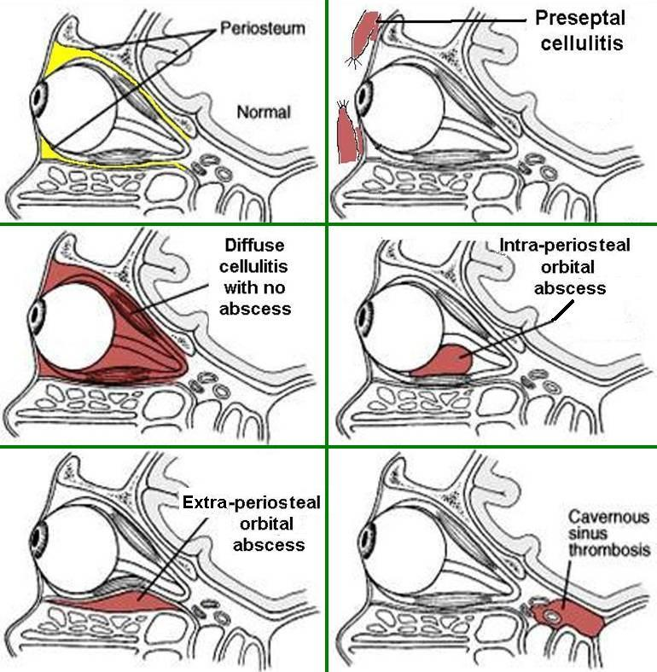

Slide 15
Pre-septal cellulitis

Slide 16
Pre-septal cellulitis
Infection external to peri-orbital septum
Edema of eyelid: upper lid = frontal sinusitis
lower lid = maxillary sinusitis
both lids = ethmoid sinusitis
No erythema / tenderness / proptosis / extra-ocular movement restriction / vision change

Slide 17
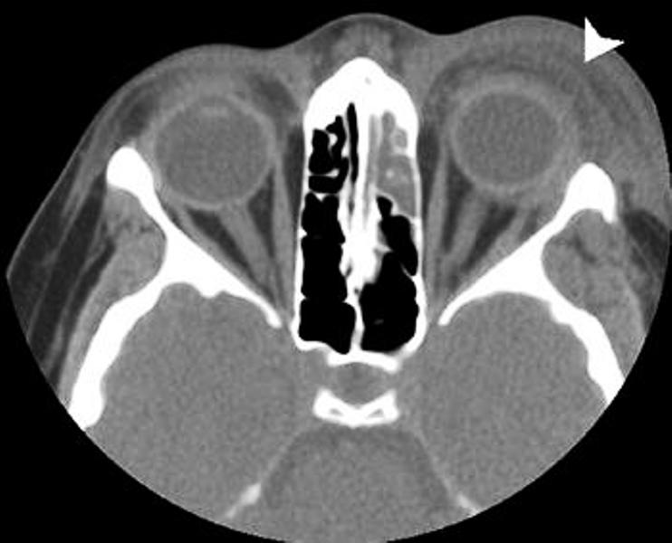
Pre-septal cellulitis

Slide 18
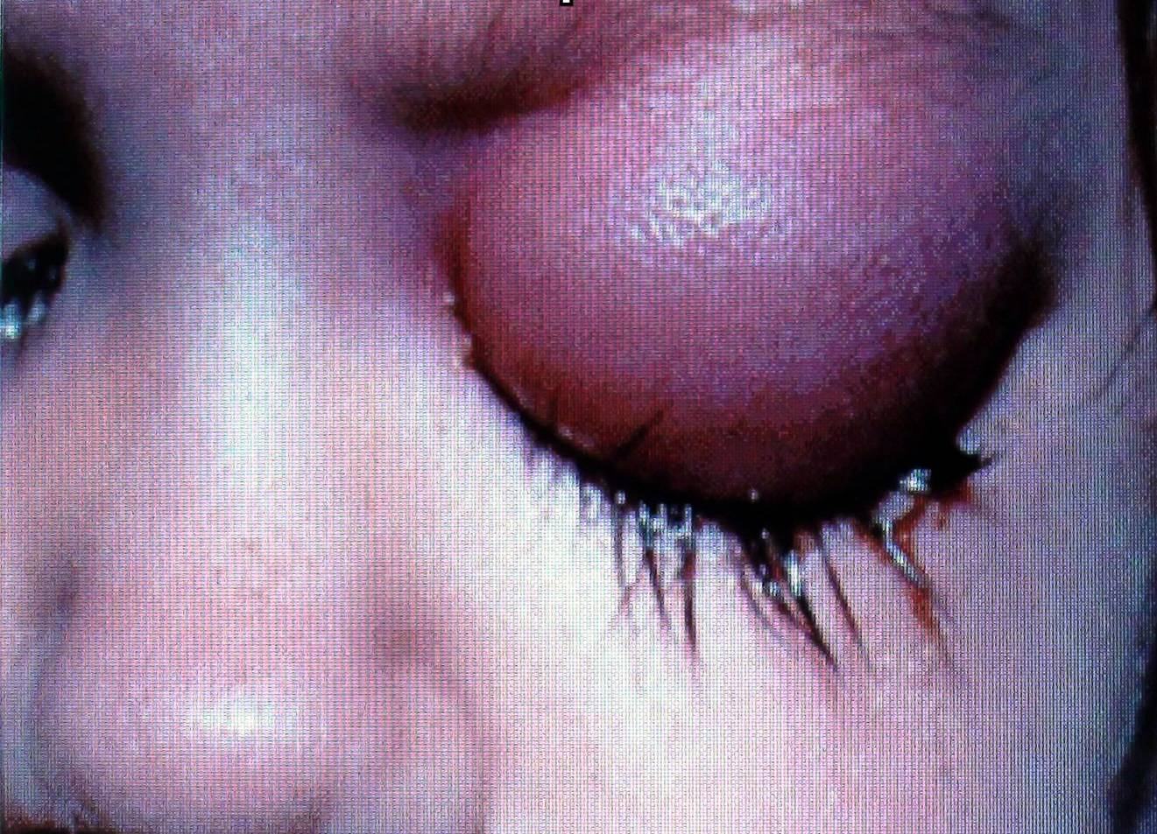
Pre-septal abscess

Slide 19
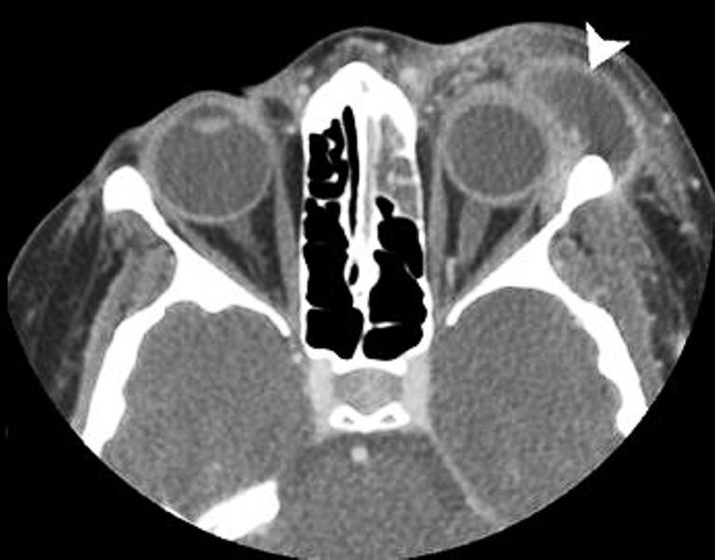
Pre-septal abscess

Slide 20
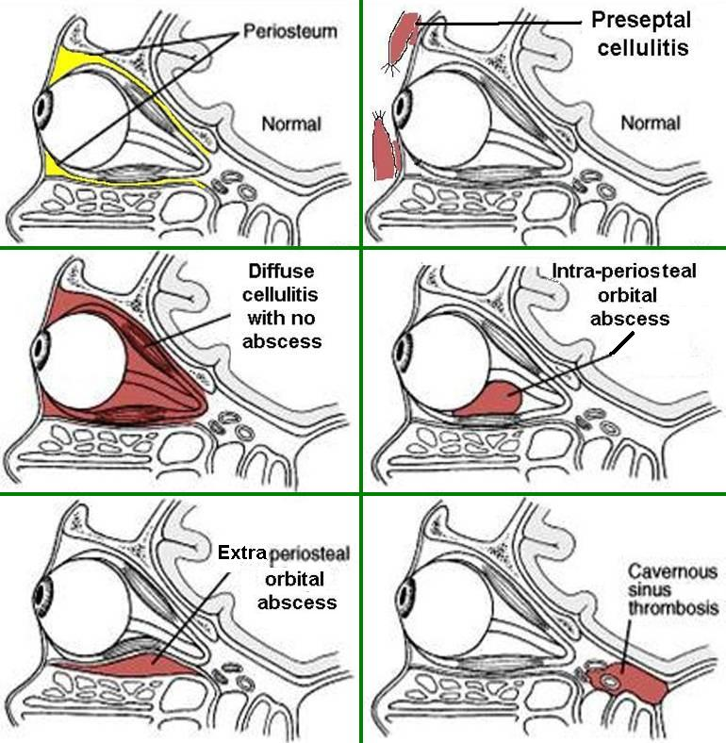
Orbital Cellulitis

Slide 21
Orbital Cellulitis
Infection inside peri-orbital septum
Diffuse peri-orbital edema
Mild proptosis present
Minimal or no restriction of extra-ocular movement
No change in vision

Slide 22
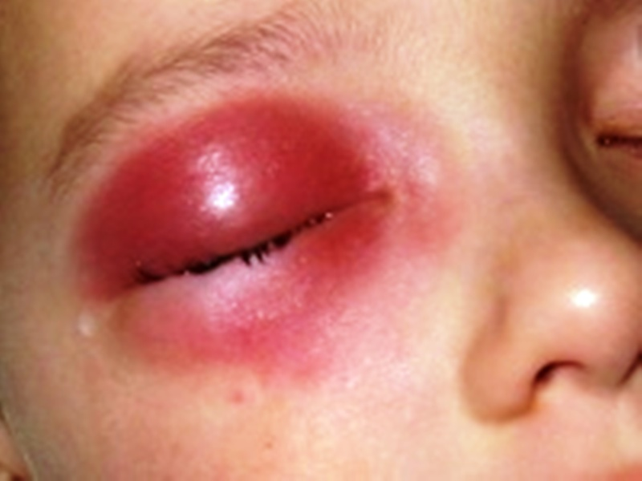
Orbital cellulitis

Slide 23
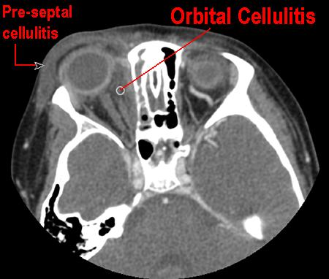

Slide 24
Extra-periosteal abscess

Slide 25
Extra-periosteal abscess
Localized extra-periosteal pus collection
Mild proptosis present
Mild restriction of extra-ocular movement
Mild vision loss
Color vision affected first: Red = brown
Blue = black

Slide 26
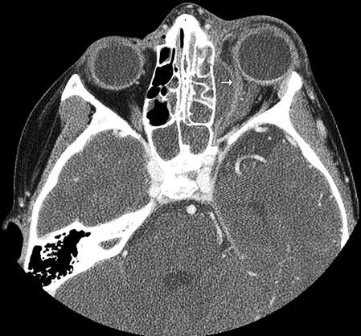
Extra-periosteal abscess

Slide 27
Intra-periosteal abscess

Slide 28
Intra-periosteal orbital abscess
Mild chemosis
Proptosis: severe, asymmetric, quadrantic
Frontal sinusitis = down + forward + lateral
Ethmoid sinusitis = forward + lateral
Maxillary sinusitis = up + forward
Concurrent, complete, ophthalmoplegia
Severe vision loss

Slide 29
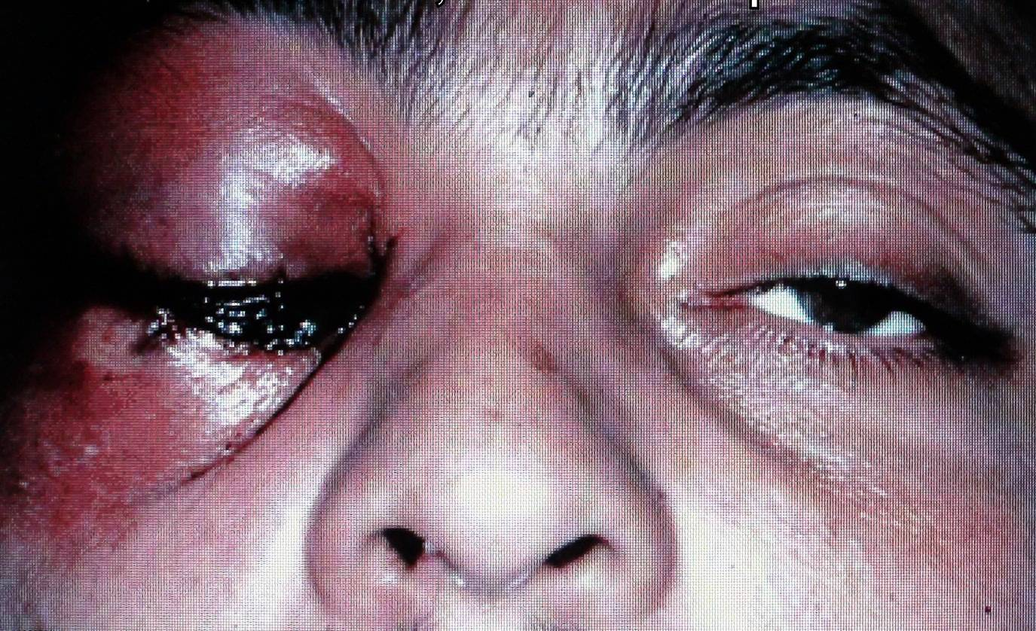
Proptosis

Slide 30
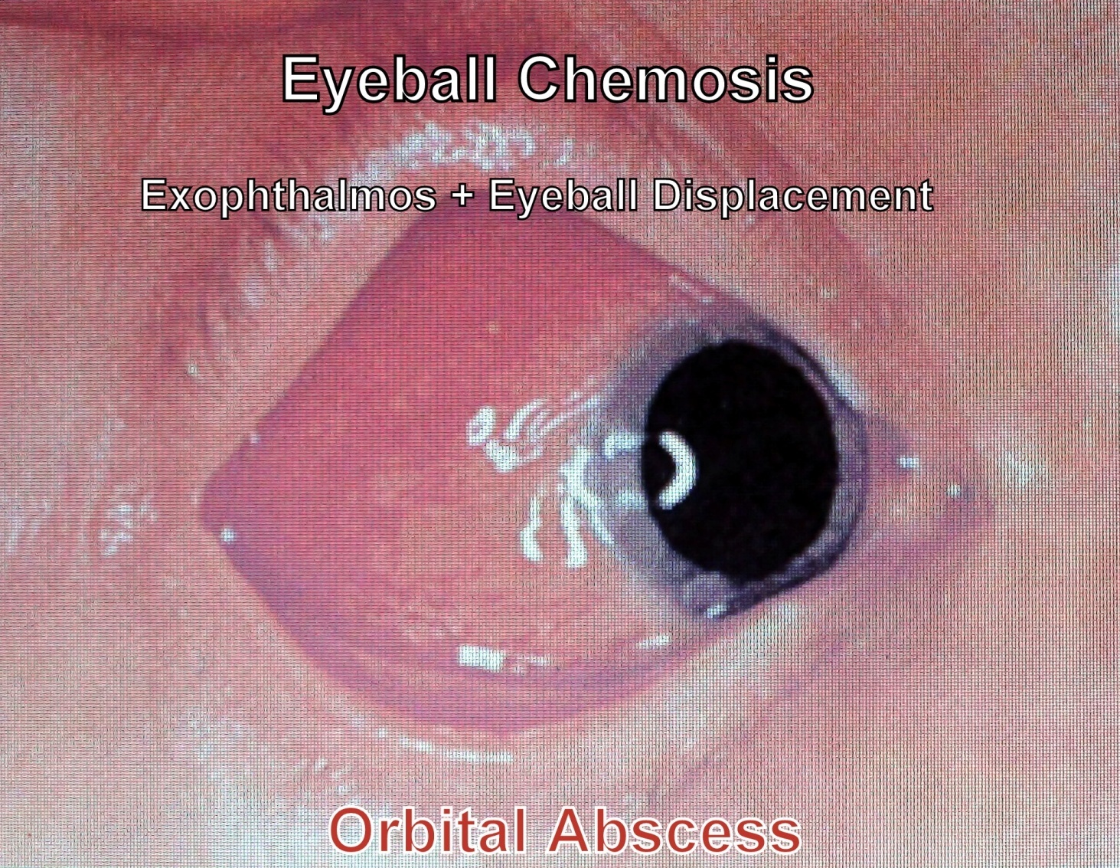
Chemosis

Slide 31
Cavernous Sinus Thrombosis

Slide 32
Cavernous Sinus Thrombosis
Rapid onset, hectic fever
Bilateral orbital pain + severe chemosis
Bilateral absent pupillary reflex
Bilateral symmetrical axial proptosis
Sequential ophthalmoplegia (VI → III → IV)
Papilloedema + loss of vision
Painful paraesthesia of V1, V2

Slide 33
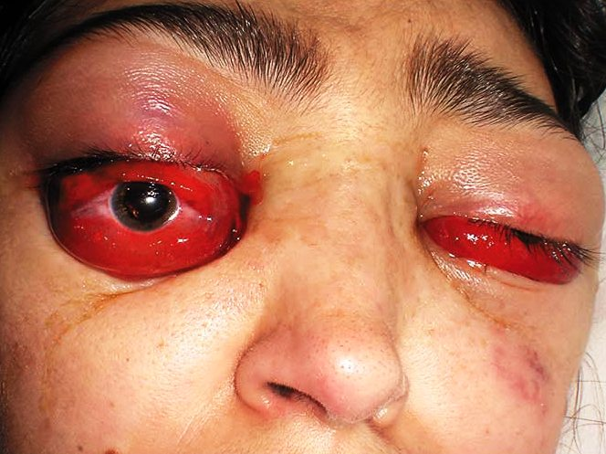
Cavernous sinus thrombosis

Slide 34
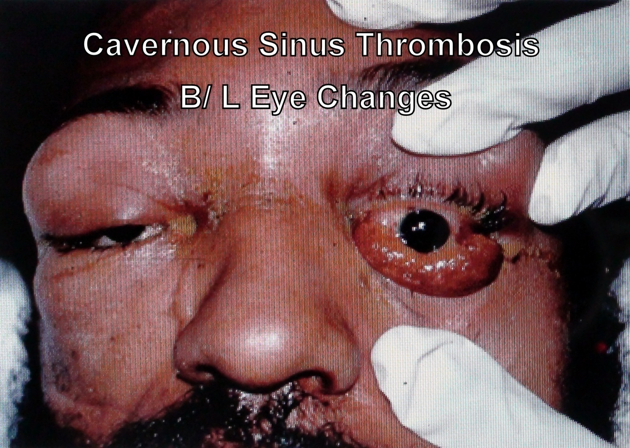
Cavernous sinus thrombosis

Slide 35
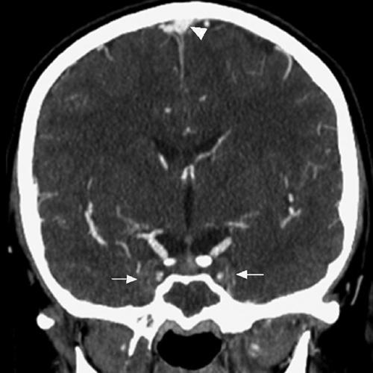
C.T. with venogram
Absence of
contrast in
cavernous
sinuses

Slide 36
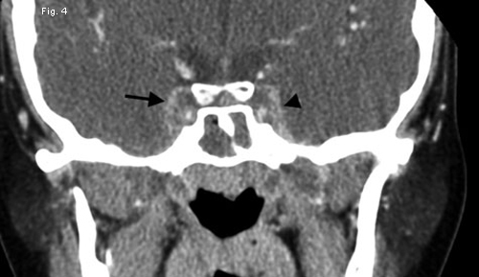
C.T. scan with contrast

Slide 37
C.S.T. | Orbital abscess
Bilateral | Unilateral
Rapidly progressive | Slowly progressive
Hectic fever | Low grade fever
Severe chemosis | Mild chemosis
Paraesthesia of V1, V2 | No paraesthesia
Sequential ophthalmoplegia | Concurrent pan-ophthalmoplegia
Symmetric axial proptosis | Asymmetric quadrantic proptosis

Slide 38
Orbital apex syndrome
Frontal headache + deep orbital pain
Optic nerve involvement (vision loss)
Paralysis of abducens nerve
Paralysis of oculomotor nerve
Paralysis of trochlear nerve
Painful paraesthesia of V1, V2

Slide 39
Evaluation of orbital complication
1. Eye examination: Ophthalmology consultation
Edema of eyelids
Displacement of eyeball
Ocular movement
Visual acuity
Fundoscopy for papilledema
2. CT scan PNS (including orbit): coronal & axial

Slide 40
Medical Treatment
    1. Broad spectrum, high dose IV antibiotics
    (Ceftriaxone + Metronidazole)
    2. NSAIDs
    3. Topical / oral decongestants
    4. Mucolytics: Bromhexine, Ambroxol
    5. Nasal saline irrigation

Slide 41
Surgical Treatment
For sinusitis:
1. Frontal trephination
2. External fronto-ethmoidectomy (Lynch Howarth)
3. Functional Endoscopic Sinus Surgery
For orbital complication:
1. Sub-periosteal abscess drainage
2. Orbital decompression

Slide 42
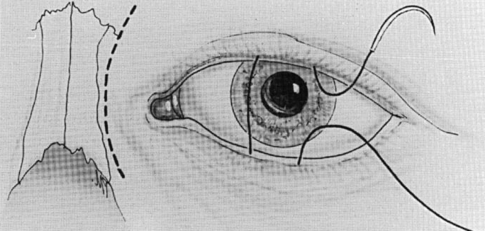
Lynch – Howarth incision

Slide 43
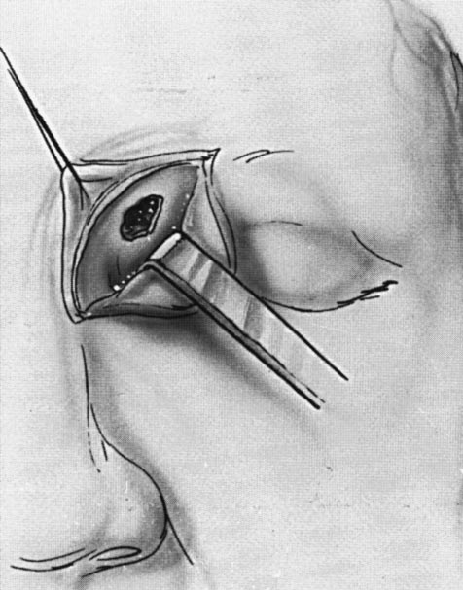
Frontal sinus trephination

Slide 44
Sub-periosteal abscess drainage
Incision made b/w caruncle (C) & semilunar fold (S)
Tissue b/w caruncle & semilunar fold incised with tenotomy scissors
Periosteum (P) incised & elevated with Freer elevator until abscess (A) is found & drained

Slide 45
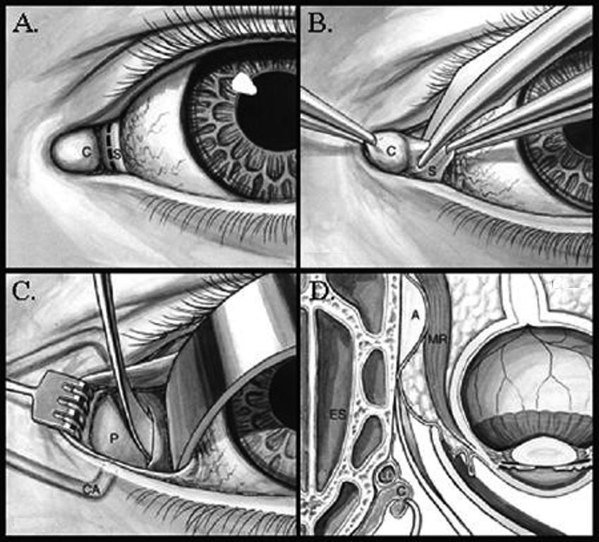
Sub-periosteal abscess drainage

Slide 46
Indications for orbital decompression
    No improvement in orbital symptoms in 24- 48 hours of treatment
    CT scan evidence of orbital abscess
    Visual acuity of 20 / 60 or worse

Slide 47
Techniques of decompression
1. Patterson’s trans-orbital approach
2. Endoscopic intra-nasal approach
3. Trans-antral approach
4. Combined intra-nasal & trans-antral approach
Medial wall + floor of orbit removed
Removal of 1 wall = 2 - 3 mm decompression
Removal of 2 walls = 4 - 7 mm decompression

Slide 48
Result of orbital complications
Exposure keratitis
Uveitis
Choroiditis
Ophthalmoplegia
Glaucoma
Permanent vision loss

Slide 49
Intra-cranial complications

Slide 50
Introduction
2nd commonest complication of sinusitis
Most common in adolescents & young adults (diploic venous system at peak vascularity)
Frontal sinus most commonly implicated → Ethmoid → Sphenoid → Maxillary
Base skull fracture through sphenoid can leads [**]
Commonest route of spread = retrograde thrombophlibitis via Diploic vein of Breschet
Early recognition & sebsequent treatment is essential to optimal outcome. [**]

Slide 51
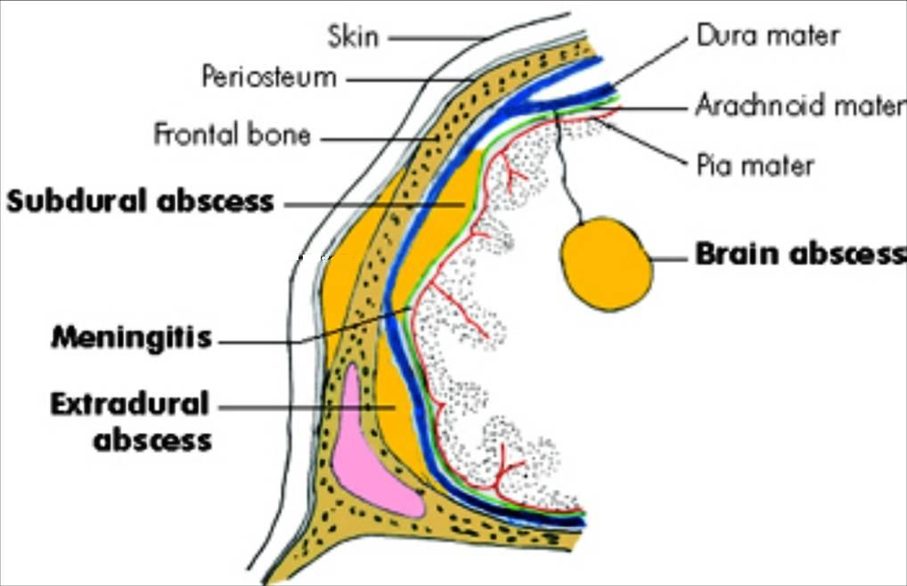
Intra-cranial complications

Slide 52
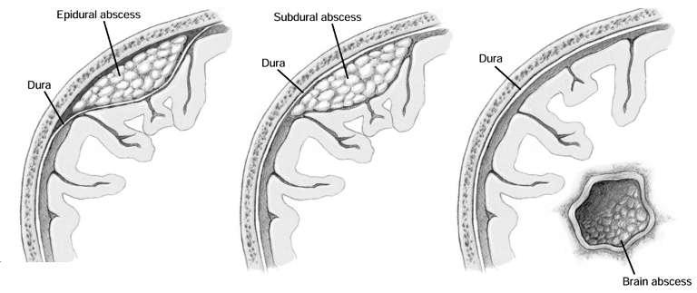

Slide 53
Clinical Features
Fever
Deep-seated headache
Nausea & projectile vomiting
Neck stiffness
Seizures
Altered sensorium & mood changes
Late: bradycardia / hypotension / stupor

Slide 54
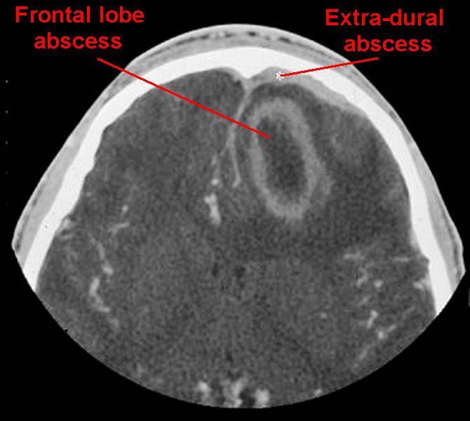
C.T.: Frontal lobe abscess

Slide 55
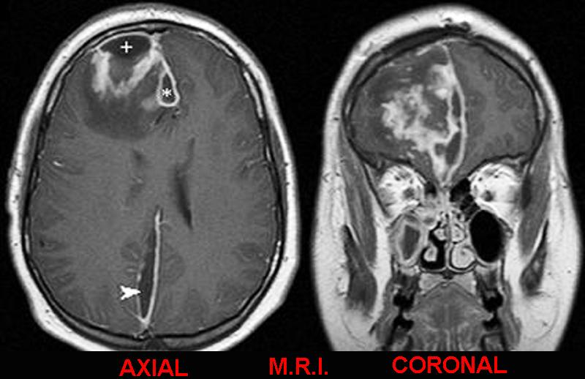
Frontal lobe abscess

Slide 56
Investigations & Medical Tx
Neurosurgery consultation
CT scan PNS + brain with contrast
MRI with contrast: investigation of choice
High dose IV broad spectrum antibiotics: Ceftriaxone & Metronidazole for 4-6 week
Steroids: controversial

Slide 57
Surgical Treatment
For sinusitis:
Frontal trephination ( placement of external drain – best immediate result) [**]
Prolong course (6weeks) of culture –directed antibiotics therapy should be given.[**]
2. External fronto-ethmoidectomy (Lynch Howarth)
3. Functional Endoscopic Sinus Surgery
For intra-cranial complication: by Neurosurgeon
1. Burr hole drainage: for small abscess
2. Craniotomy: for large brain abscess

Slide 58
Sequelae
Seizures: 7.5%
Hemiparesis: 2 - 17 %
Hemiplegia
Death: 15 - 43 %

Slide 59
Mucocoele of P.N.S.

Slide 60
Introduction
Definition: epithelium lined, mucus filled sac
completely filling paranasal sinus
& capable of expansion
Incidence:
Frontal = 65 % Ethmoid = 25 %
Maxillary = 10 % Sphenoid = rare

Slide 61
Etiology
  1. Chronic obstruction of sinus ostium with retention of normal sinus mucus within sinus cavity
  2. Mucous retention cyst: develops from obstruction of ducts of sero-mucinous glands within sinus mucosa

Slide 62
Clinical Features
  Cystic, non-tender swelling above inner canthus with egg-shell crackling sensation on palpation
  Proptosis: Frontal = down + forward + lateral
Ethmoid = forward + lateral
Maxillary = up + forward
  Diplopia & restricted eyeball movement
  Frontal headache, retro-orbital or facial pain

Slide 63
Differential diagnosis
Acute / chronic sinusitis
Retention cyst
Dermoid cyst
Cholesterol granuloma
Paranasal sinus tumours
Antro-choanal polyp

Slide 64
Investigations
  X-ray PNS: expanded frontal sinus, loss of scalloped margins, translucency, depression or erosion of supra-orbital ridge
  CT scan: homogenous smooth walled mass expanding sinus, with thinning of bone
  Ring enhancement on contrast = pyocoele

Slide 65
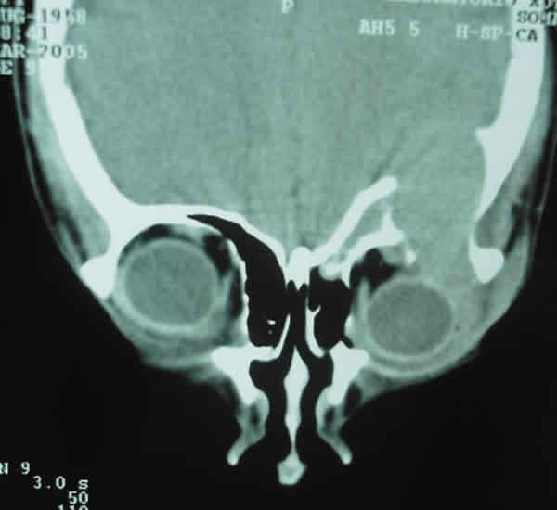
Frontal mucocoele

Slide 66
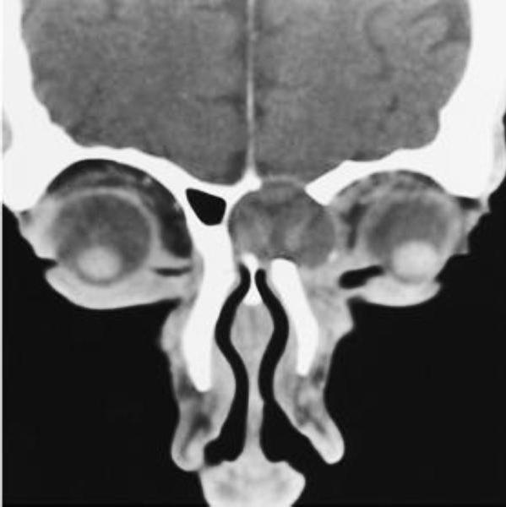
Fronto-ethmoid mucocele

Slide 67
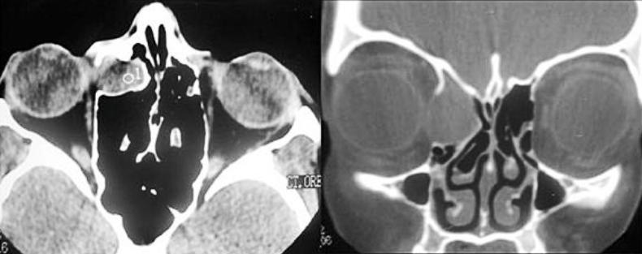
Fronto-ethmoid mucocoele

Slide 68
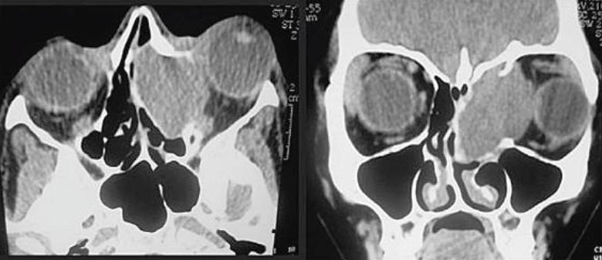
Fronto-ethmoid mucocoele with proptosis

Slide 69
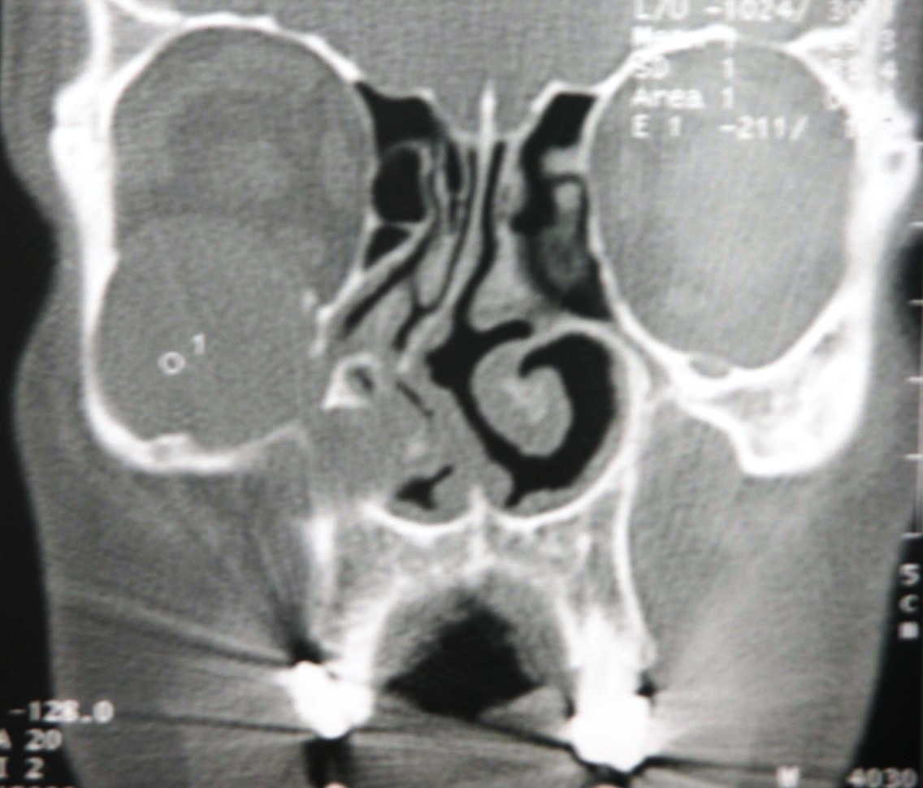
Maxillary mucocoele

Slide 70
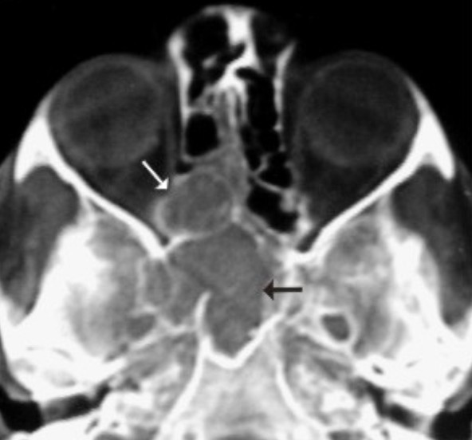
Ethmoid + sphenoid mucocoele

Slide 71
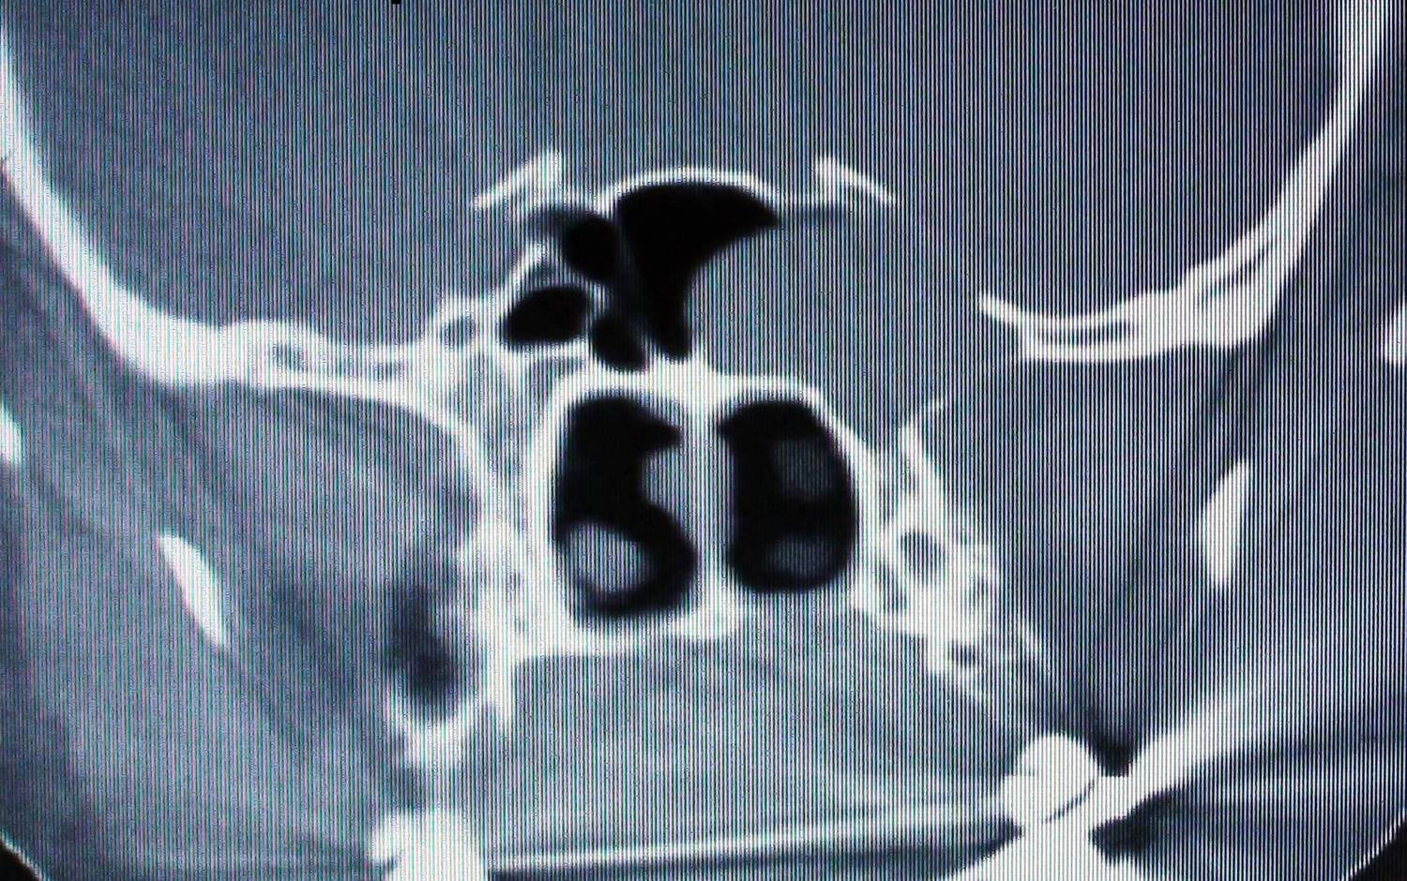
Sphenoid mucocoele

Slide 72
Treatment
  1. Antibiotics + nasal decongestants
  2. External fronto-ethmoidectomy:
  by Lynch – Howarth’s approach
  3. Endoscopic fronto-ethmoidectomy
  4. Endoscopic decompression (marsupialization)
  5. Osteoplastic flap repair

Slide 73
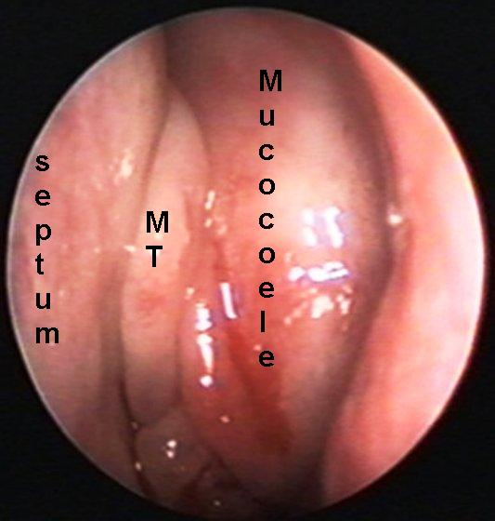
Lt ethmoid mucocoele

Slide 74
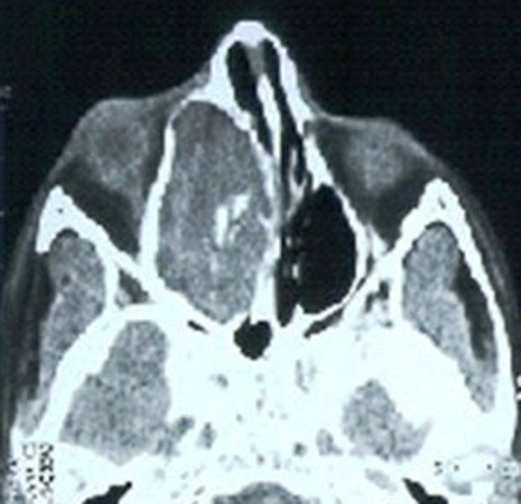
Pre-op CT scan (axial)

Slide 75
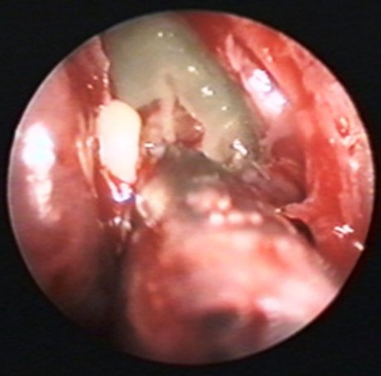
Drainage + Marsupialization

Slide 76
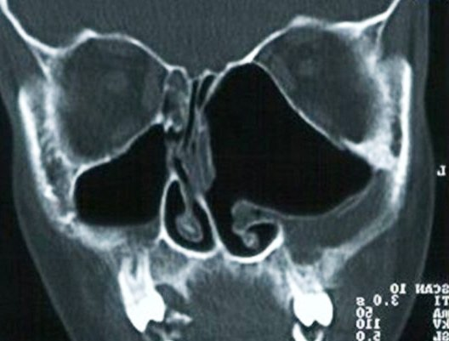
Post-op CT scan (coronal)

Slide 77
Osteoplastic flap procedure

Slide 78
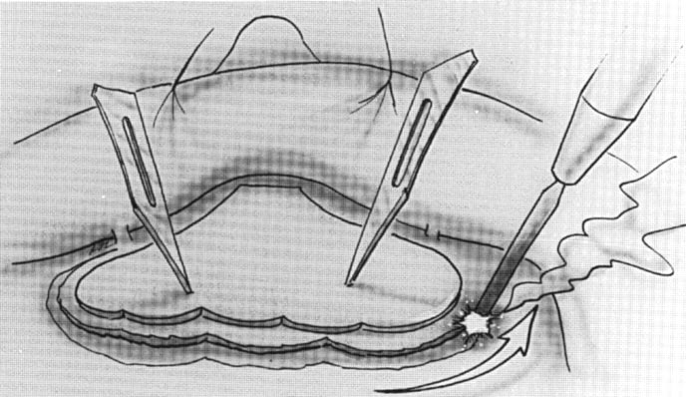
Osteoplastic flap procedure

Slide 79
Osteoplastic flap procedure

Slide 80
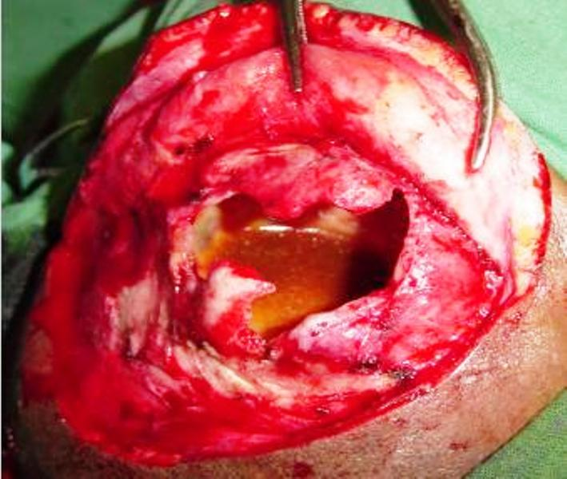
Frontal sinus mucocoele

Slide 81
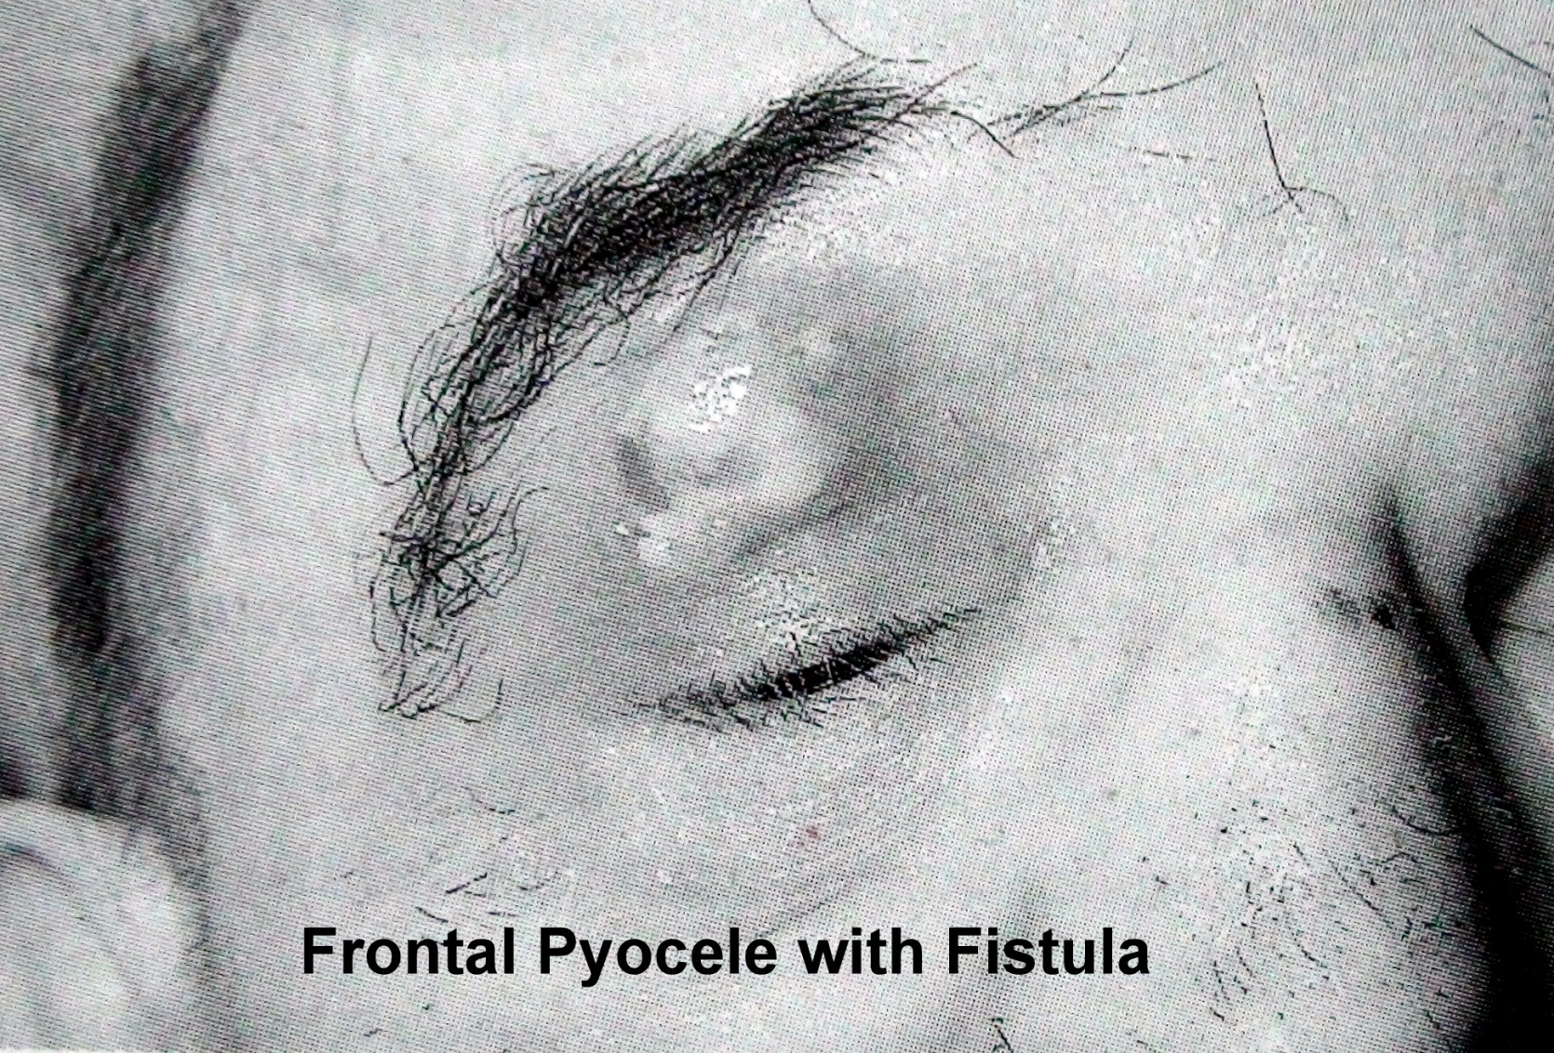
Frontal pyocoele + fistula

Slide 82
Pott’s puffy tumour
Frontal sinus osteomyelitis (Percival Pott, 1760)
Fluctuant swelling over forehead anteriorly
May spread posteriorly → subdural abscess
Tx: 6 week antibiotics + drainage of pus & debridement of bone + obliteration of frontal sinus by osteoplastic flap technique

Slide 83
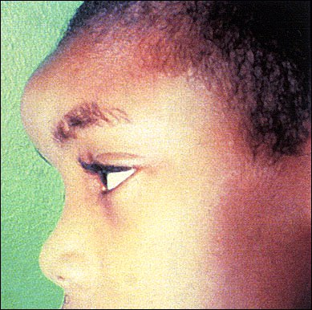
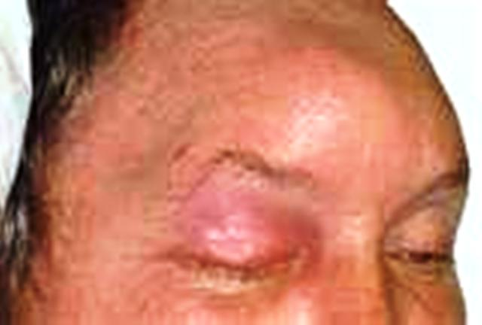
Pott’s puffy tumour

Slide 84
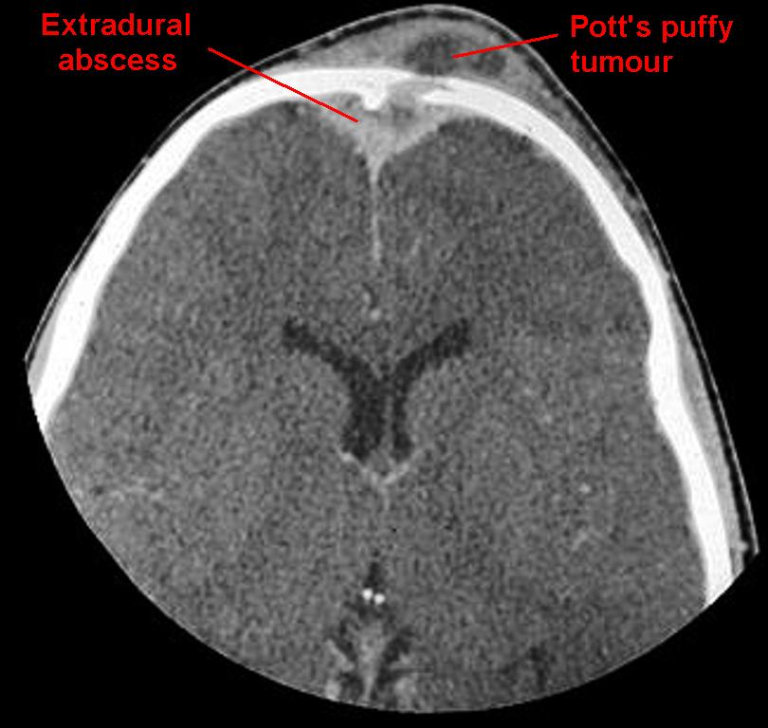

Slide 85
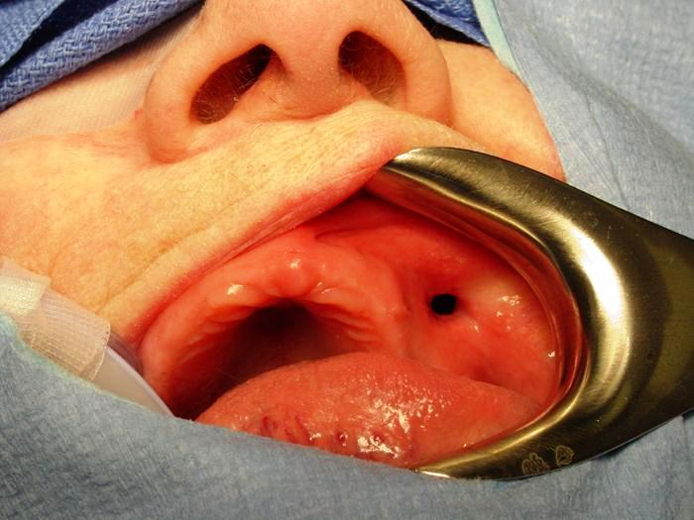
Oro-antral fistula
Communication b/w
oral cavity & maxillary
antrum
Tx: closure by
a. Buccal mucosal advancement flap
b. Palatal flap
c. Buccal fat pad flap

Slide 86
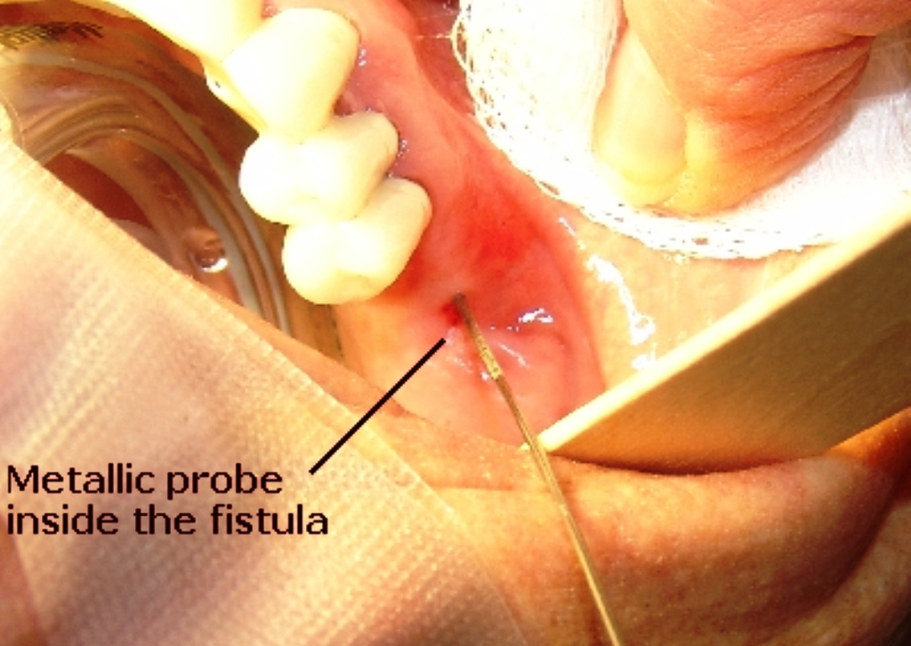
Oro-antral fistula

Slide 87
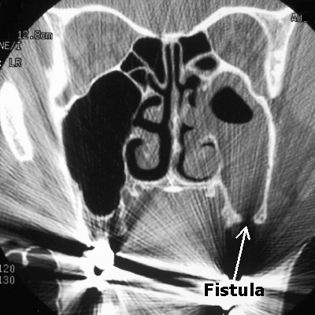
Maxillary sinusitis + fistula

Slide 88
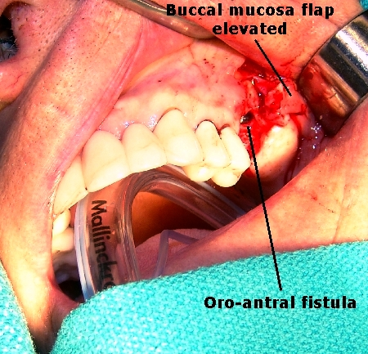
Buccal mucosal advancement flap

Slide 89
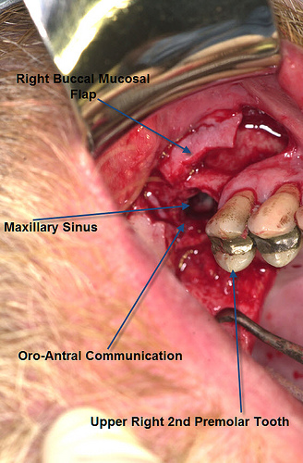
Buccal mucosal advancement flap

Slide 90
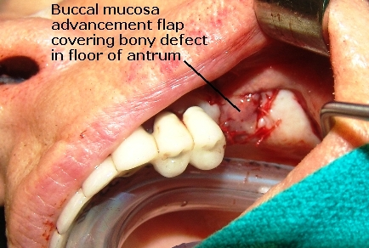
Fistula closed

Slide 91
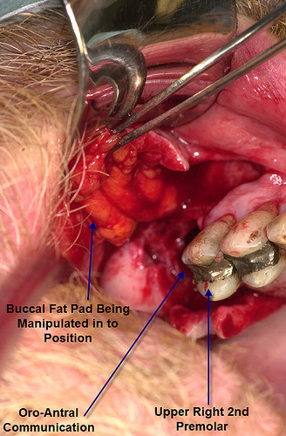
Buccal fat pad

Slide 92
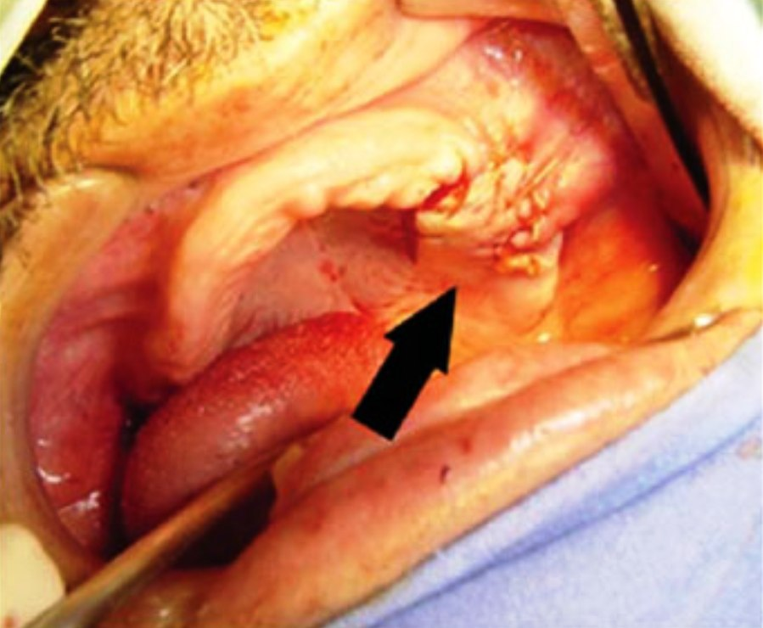
Palatal flap closure

Slide 93
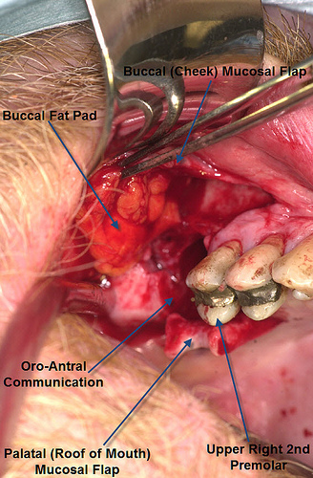
Combination of all 3 flaps

Slide 94
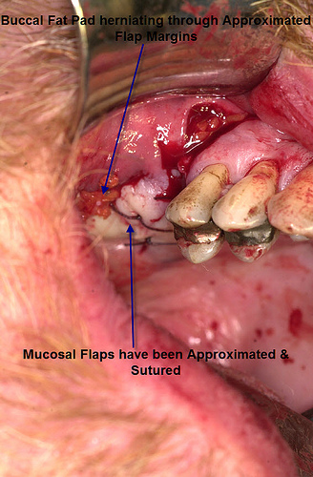
Combined flap closure

Slide 95
Toxic shock syndrome
Rare, potentially fatal complication
Septicaemia due to Staphylococcus aureus or Streptococcus infection
C/F: fever, hypotension, skin rashes with
desquamation, multi-system failure
Tx: 1. IV Ceftriaxone 1g
2. Drainage of sinus pus

Slide 96
References
Singh B. The management of sinogenic orbital complications. Journal of Laryngology & Otology. 1995; 109: 300-3
Bradly PJ, Manning KP. Brain abscess secondary to PNS rhinosinusitis. Journal of laryngology & otology. 1984; 86: 719-25.
Junes NS, Bassi S. the intracranial complications of rhinosinusitis. Larymgoscope. 1991; 101: 234-9.

Slide 97

Thank You

