Slide 1
Diseases of the Nasal Septum
Dr Nirali Chauhan

Slide 2
Levels of Evidence
Grade A – Systemic reviews, Meta analyses, RCT
Grade B – Non-randomized studies
Grade C – Observational studies
Grade D – Case Series, Expert opinion

Slide 3
Levels of Evidence
**** ~Systematic reviews, meta analysis of randomized control studies
*** ~ Non randomised studies
** ~ Observational or non experimental studies
* ~ Expert opinion

Slide 4
Anatomy of nasal septum
Three parts :
Collumellar septum
Membranous septum
Septum proper

Slide 5
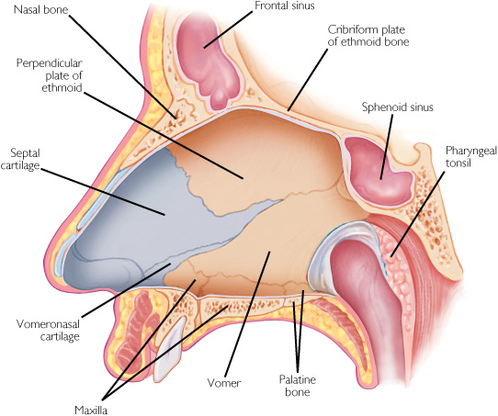

Slide 6
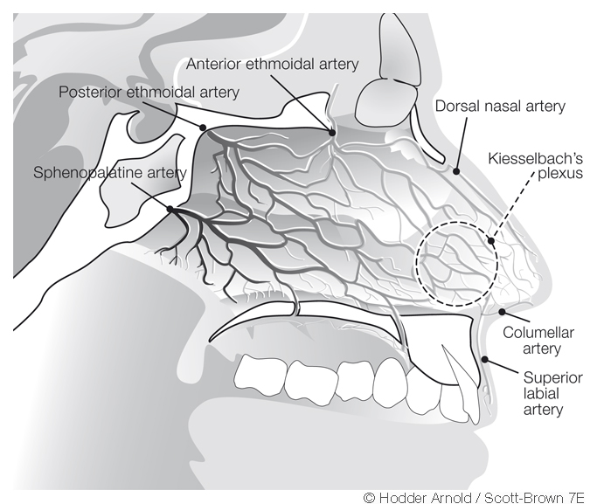

Slide 7
Diseases of the nasal septum
Septal fractures
Deviated nasal septum
Septal haematoma
Septal abscess
Septal perforation
Synechia

Slide 8
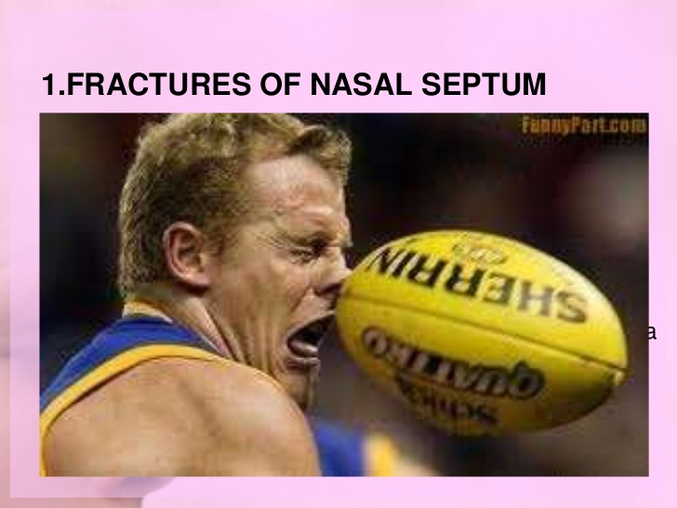

Slide 9
Jarjway :
front blow, runs horizonatlly
from ant. Nasal spine to junction of septal cartilage with vomer
Chellvet:
blows from below, runs vertically
ant nasal to junction of bony & cartilaginous dorsum of septum

Slide 10
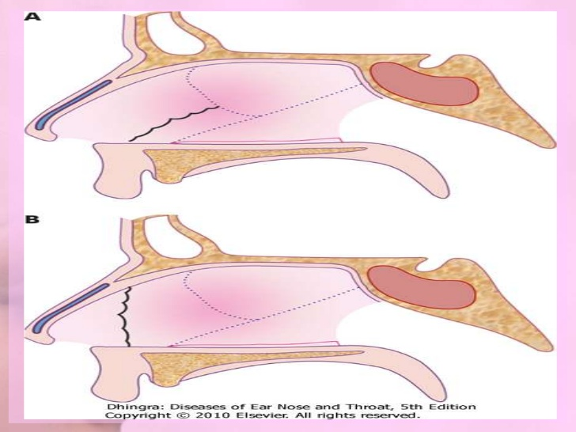

Slide 11
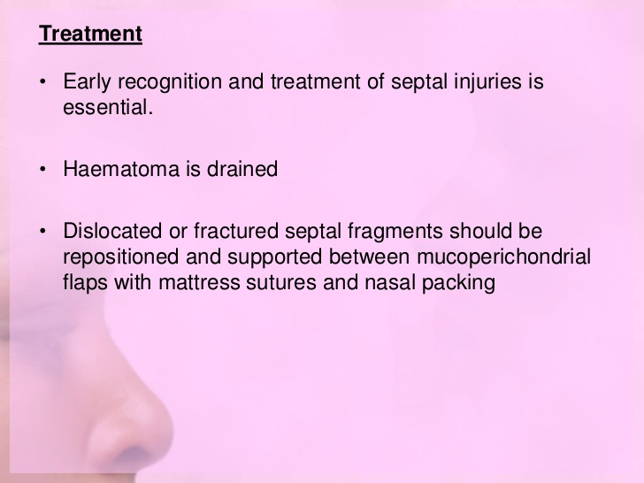

Slide 12
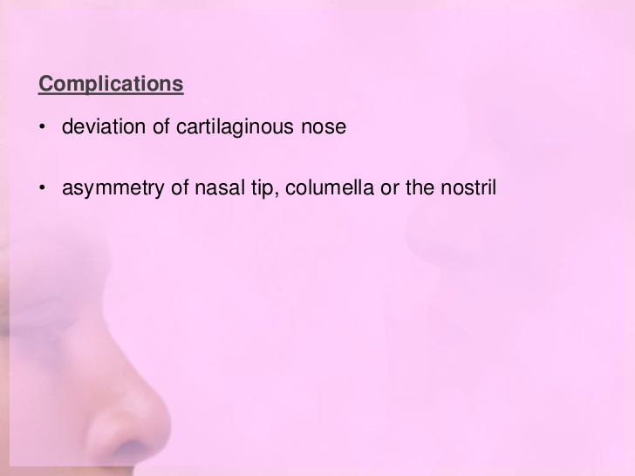

Slide 13
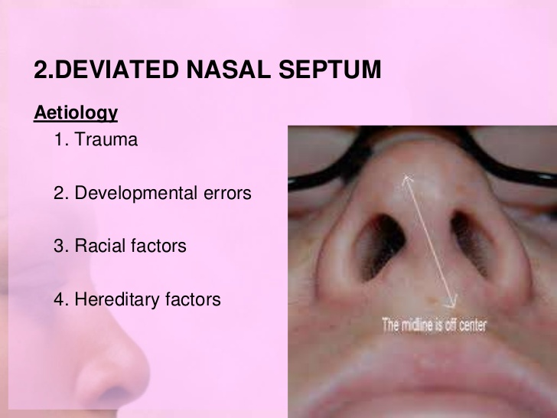

Slide 14
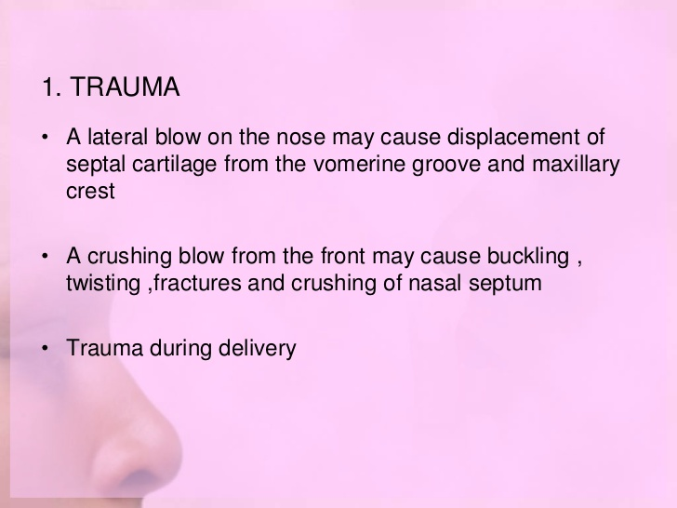

Slide 15
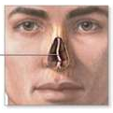

Slide 16
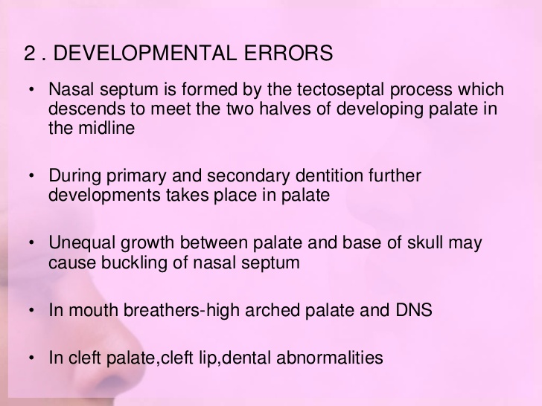

Slide 17
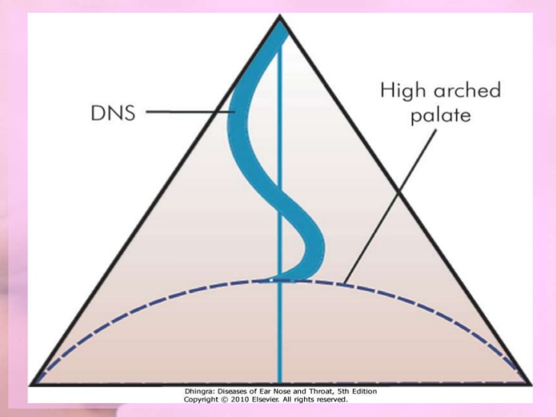

Slide 18
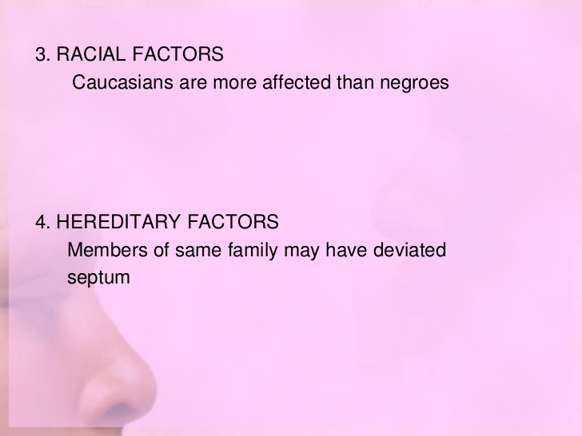

Slide 19
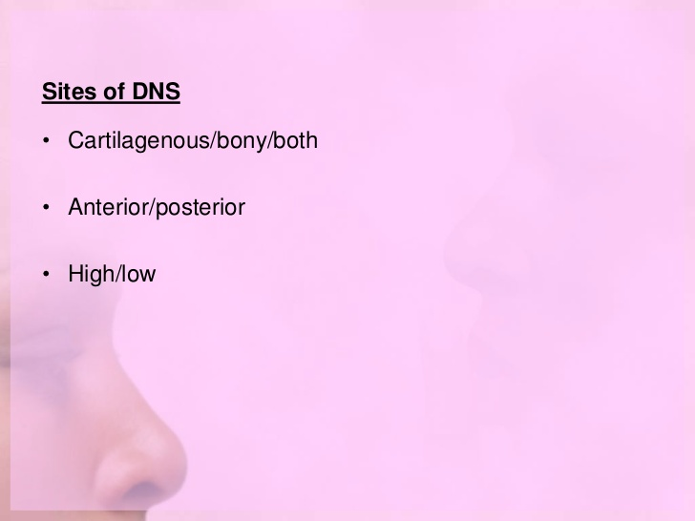

Slide 20
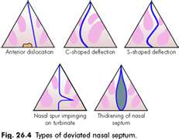

Slide 21
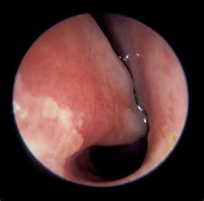

Slide 22
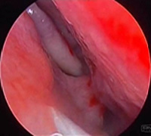

Slide 23
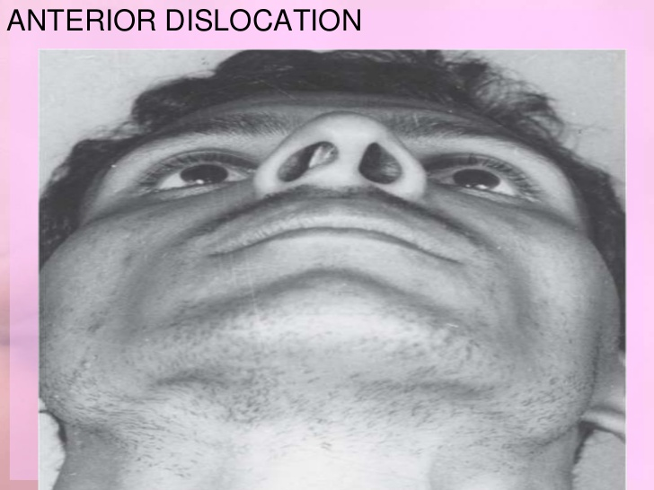

Slide 24
Problems caused by a deviated septum:
Nasal obstruction.
Nasal deformity.
Obstructive sleep apnea syndrome.
Sinusitis.
Headache.
Epistaxis.
Secondary atrophic rhinitis.
Anosmia (conductive type)[**/*]
Ear problems.

Slide 25
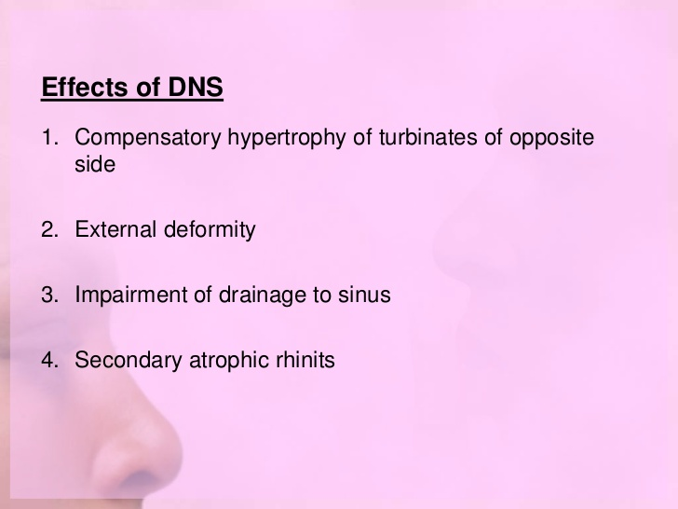

Slide 26
NAME OF STUDY | NAME OF AUTHOR | REFERENCE DETAILS | SAMPLE SIZE | RESULT | P VALUE | CONCLUSION
The effect of nasal septal deviation on maxillary sinus volumes and development of maxillary sinusitis | Kapusuz Gencer Z¹, Ozkırış M, Okur A, Karaçavuş S, Saydam L | Eur Arch Otorhinolaryngol. 2013 Nov;270(12):3069-73. | 825 | They could not demonstrate a statistically significant difference between the right maxillary sinus volumes of Groups I and II in left sided deviation cases | 0.77 | maxillary sinus volumes tend to be higher at the contralateral side of the severe septum deviations

Slide 27
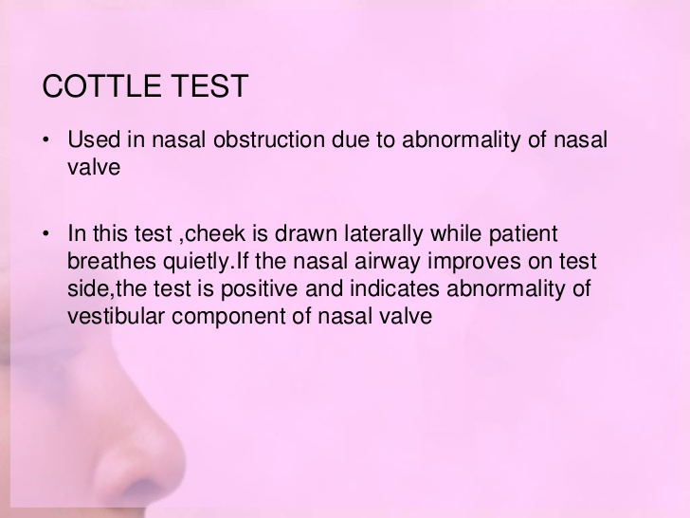

Slide 28
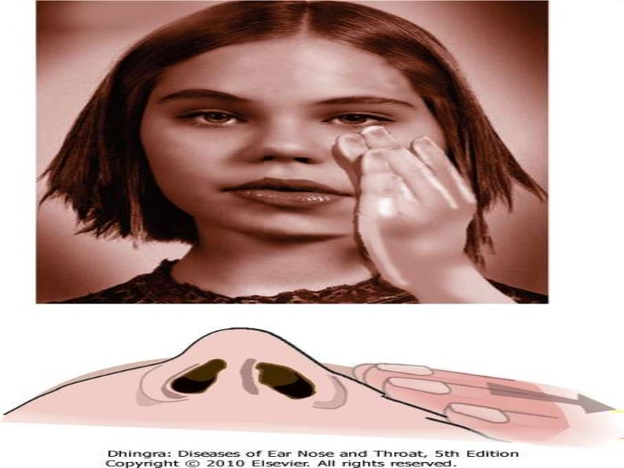

Slide 29
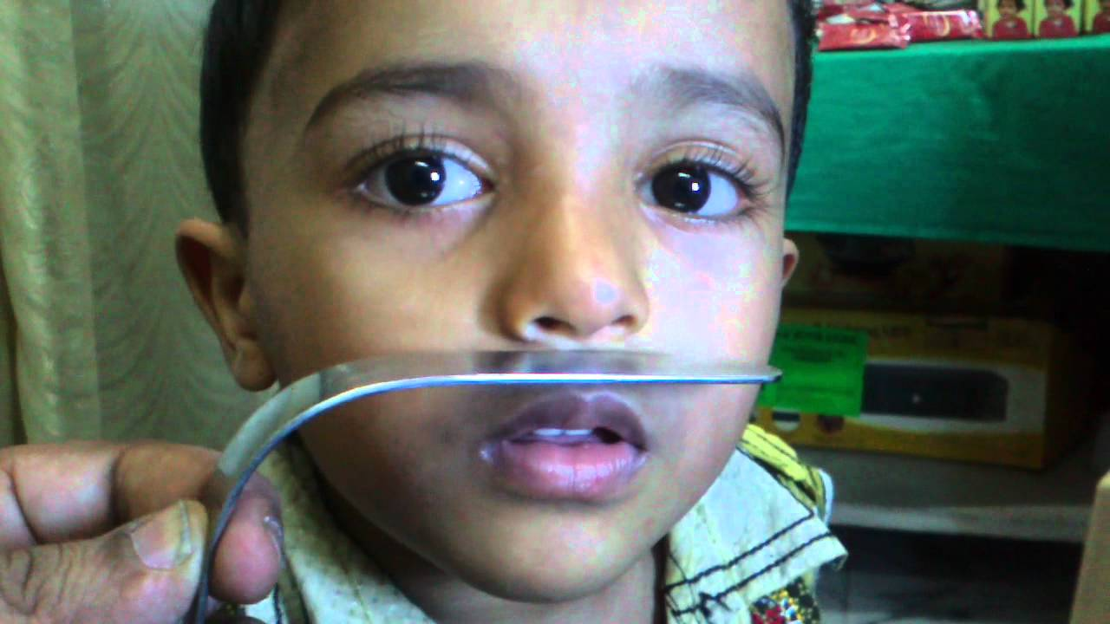
Cold spatula test

Slide 30
SEPTOPLASTY / SMR

Slide 31
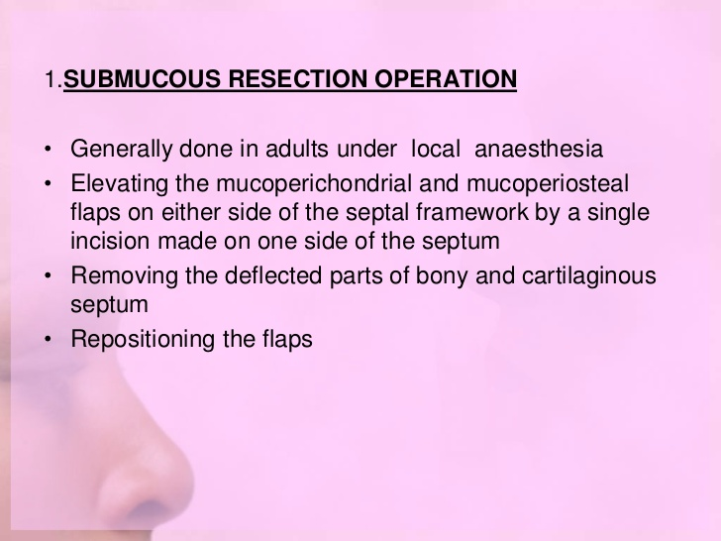

Slide 32
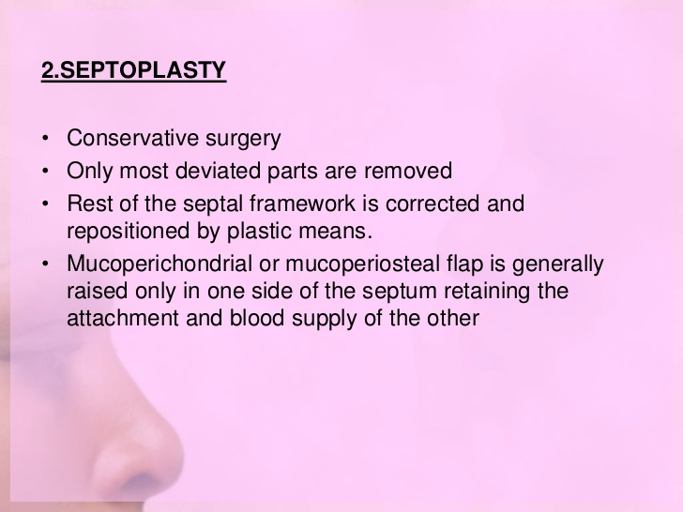

Slide 33
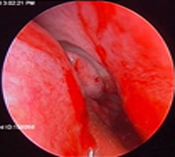

Slide 34
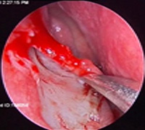

Slide 35
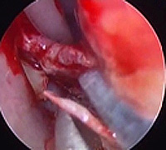

Slide 36
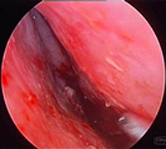

Slide 37
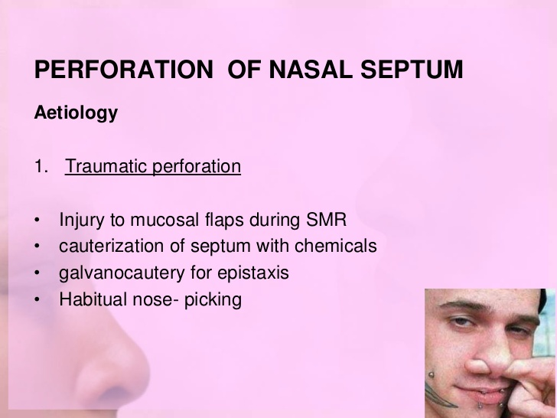

Slide 38
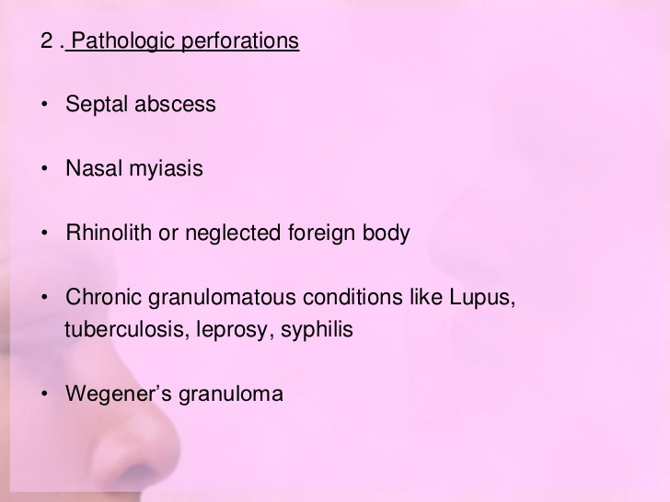

Slide 39
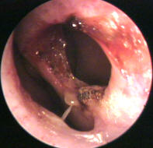

Slide 40
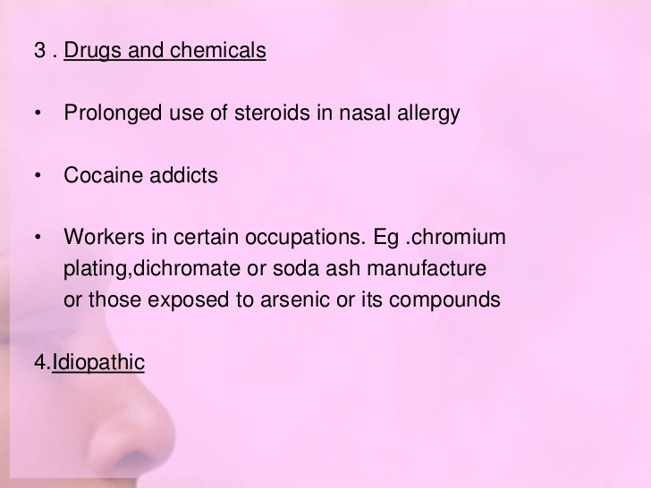

Slide 41
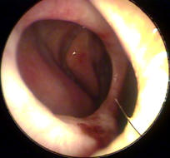

Slide 42
Dryness & crusting [***]
- low humidity
-slow mucocilliary clearance
-loss of mucosa
Rhinolalia [*]
Inability to clear secretions [*]
Pick- ulcer

Slide 43
Treatment of Septal Perforation
Observation. [Grade C]
Prosthesis.
Surgery.

Slide 44
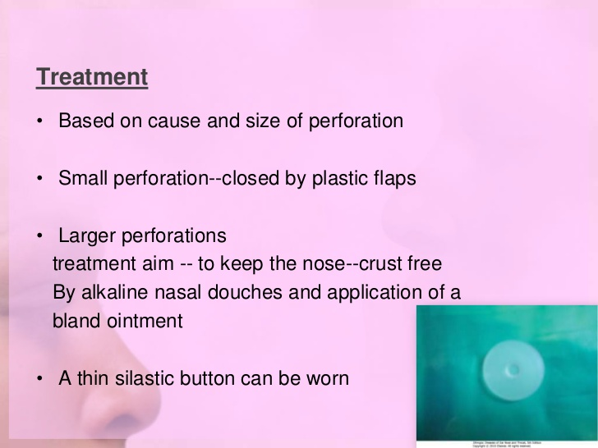

Slide 45
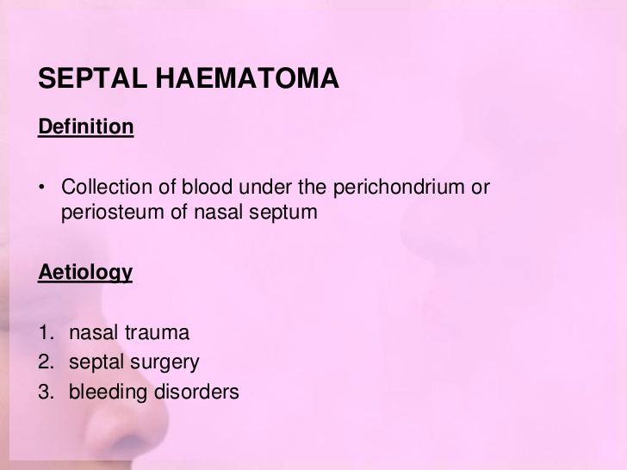

Slide 46
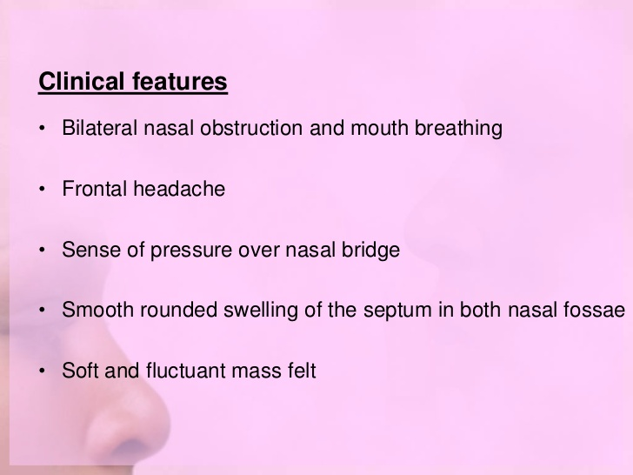

Slide 47
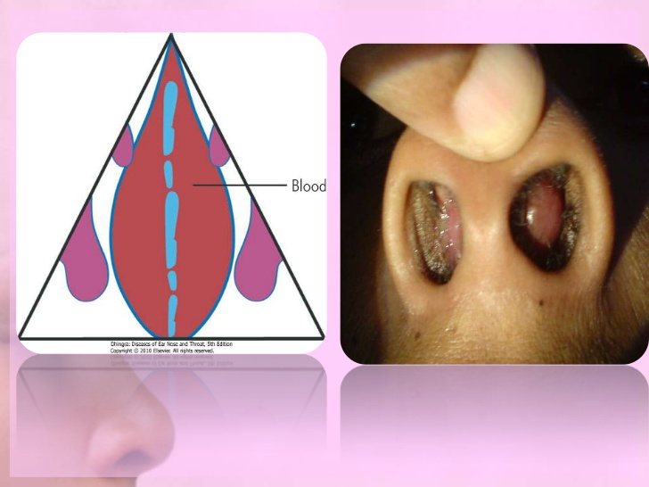

Slide 48
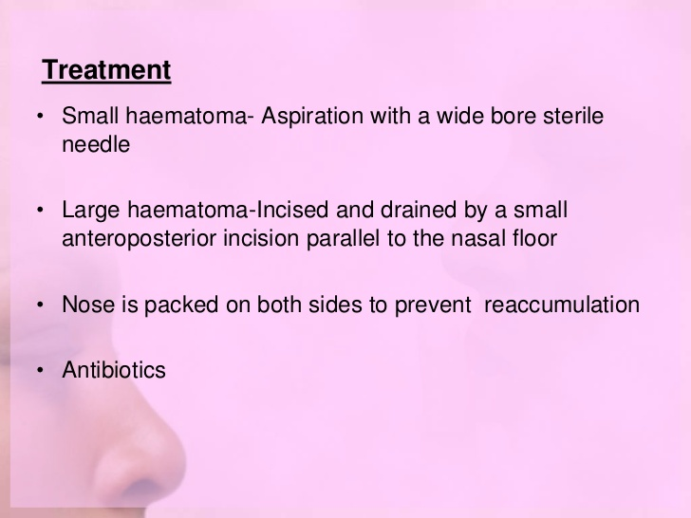

Slide 49
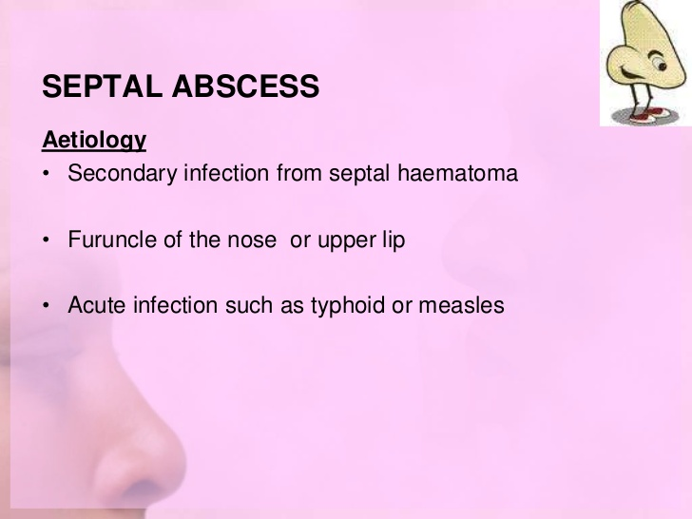

Slide 50
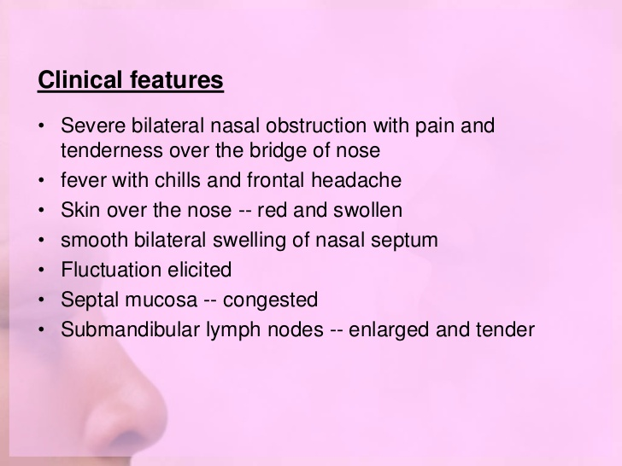

Slide 51
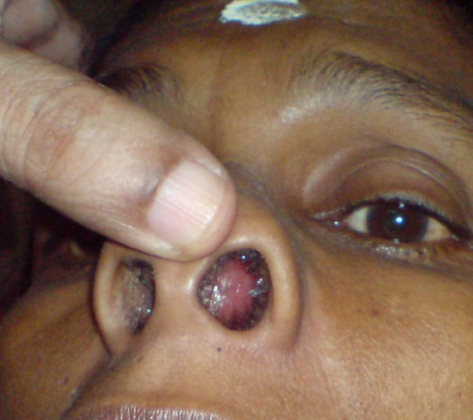

Slide 52
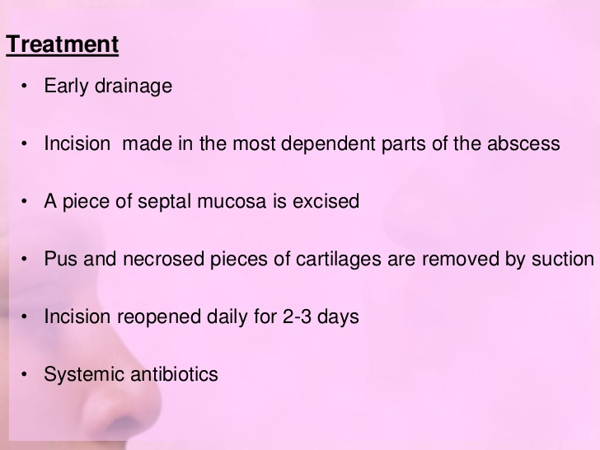

Slide 53
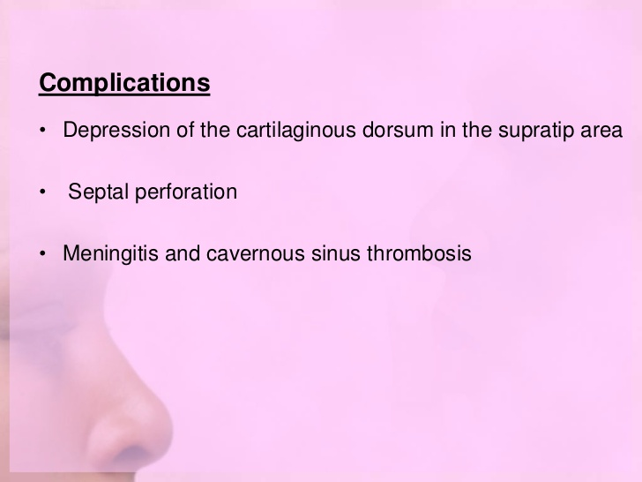

Slide 54
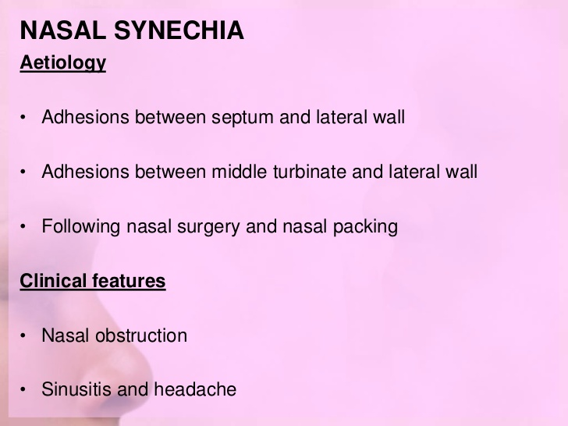

Slide 55
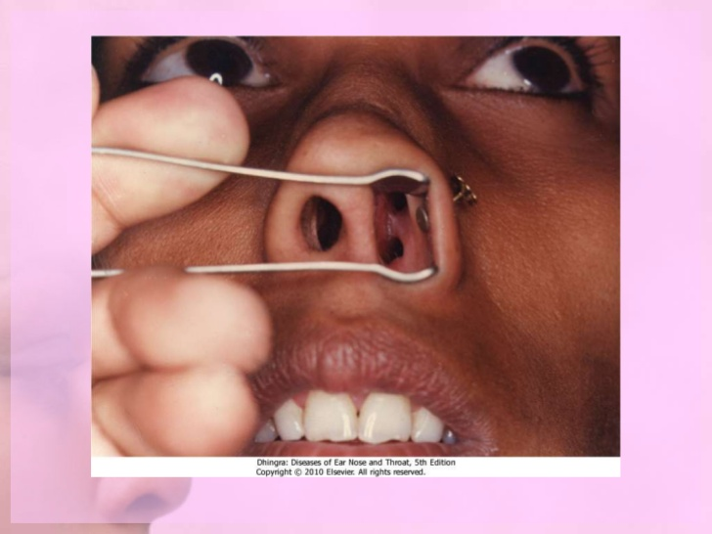

Slide 56
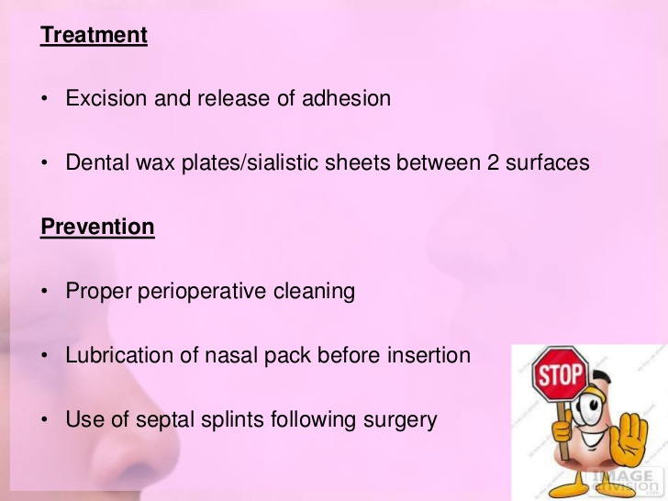

Slide 57
REFERANCES
Murry JAM. Management of septal deviation with nasal fractures. Facial plastic surgery. 1989; 62: 88-93.
Younger R, Blokmanis A. Nasal septal perforation. Journal of otolaryngology. 1985; 14: 125-31.
Pirsing W. Surgery of nose in childhood. Growth & late results. Laryngologie, Rhinologie, otologie. 1984; 63: 170-80.

Slide 58
MCQ

Slide 59
Which are the following are etiology for DNS except?
Trauma
Developmental & hereditary
Racial
Idiopathic

Slide 60
2. Which is the following disease in which Cottle's test is used?
Septal fractures
Deviated nasal septum
Septal hematoma & Septal abscess
Septal perforation

Slide 61
3. Which is the best surgery for DNS?
Septoplasty
Sub mucosal section
SMR
Septectomy

Slide 62
4. What is septal hematoma?
Collection of blood under mucoperichondrium of nasal septum
Collection of blood under mucoperiosteum of nasal septum
Collection of blood under mucoperichondrium & mucoperiosteam of nasal septum
Collection of blood between the layers of nasal septum

Slide 63
5. Which is the following chemical leads to septal perforation?
Cocaine
Steroids
Chromium
All of the above

Slide 64


Slide 65
-d
-b
A
C
C

