Slide 1
Retina
By-Dr. R.N KOTHARI

Slide 2
The retina is a thin, semitransparent, multilayered sheet of neural tissue that lines the inner aspect of the posterior two- thirds of the wall of the globe.
Thin delicate layer of nervous tissue
Surface area of 266 mm²
Extends from optic disc to ora serrata

Slide 3
Embryology
•
The outer layer of the optic cup is known as the
pigmented layer of the retina.
Development of the inner (neural) layer of the optic cup is more complicated.
The posterior four-fifths, the pars optica retinae, contains cells bordering the intraretinal space that differentiate into light-receptive elements, rods and cones.
Adjacent to this photoreceptive layer is the mantle layer, which, as in the brain, gives rise to neurons and supporting cells, including the outer nuclear layer, inner nuclear layer, and ganglion cell layer.
•
•
•

Slide 4
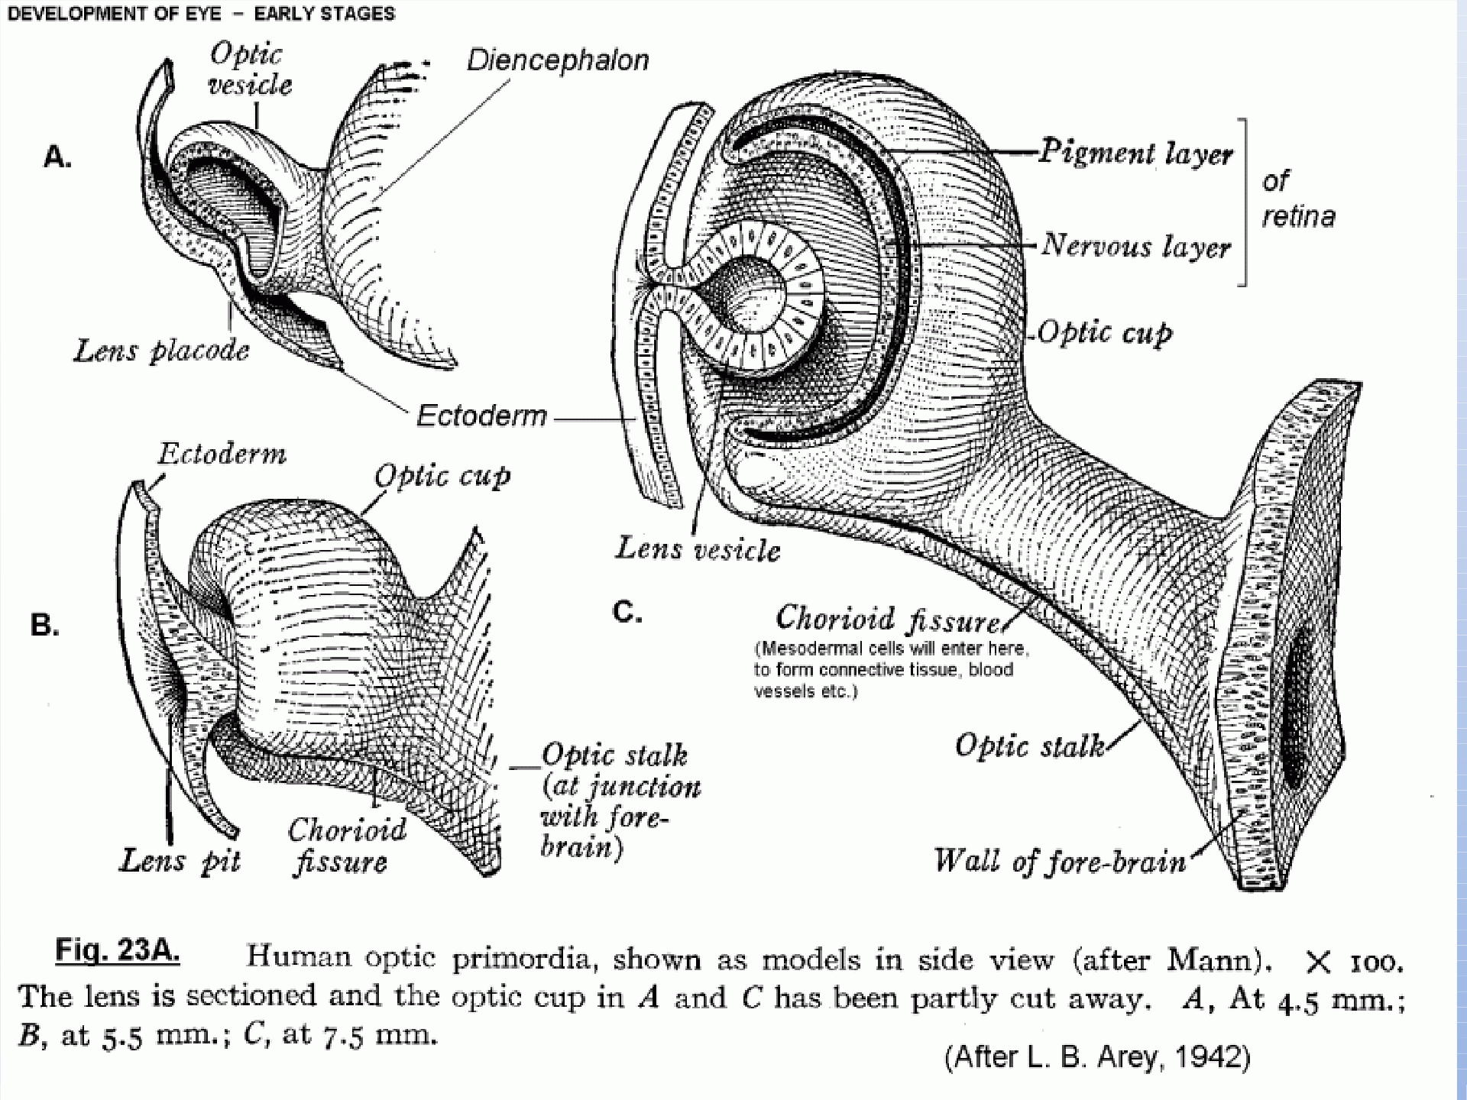

Slide 5
Visible LAND MARKS of Human Retina
Optic Disc
Retinal Blood Vessels
Area centralis with fovea and foveola Peripheral retina and ora serrata Thickest near the optic disc
Thin towards the peripheral

Slide 6
OPTIC DISC:
Circular or slightly oval app. 1.5mn
In the central contains a depression known as Physiological Cup
AREA CENTRALIS:
It is demarcated app. by upper and lower arcuate and temporal retinal vessels.
Corresponds to app. 15⁰ of the visual field and adopted for accurate diurnal vision and colour discrimination.
It is divisible into fovea and foveola
FOVEA:
Center of area centralis 4mm temporal to the center of the optic disc.

Slide 7
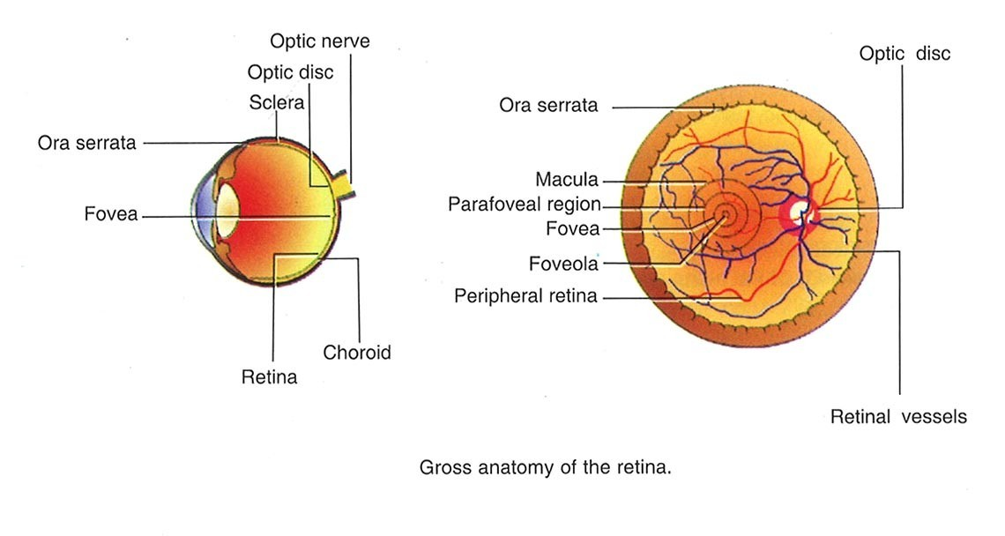

Slide 8
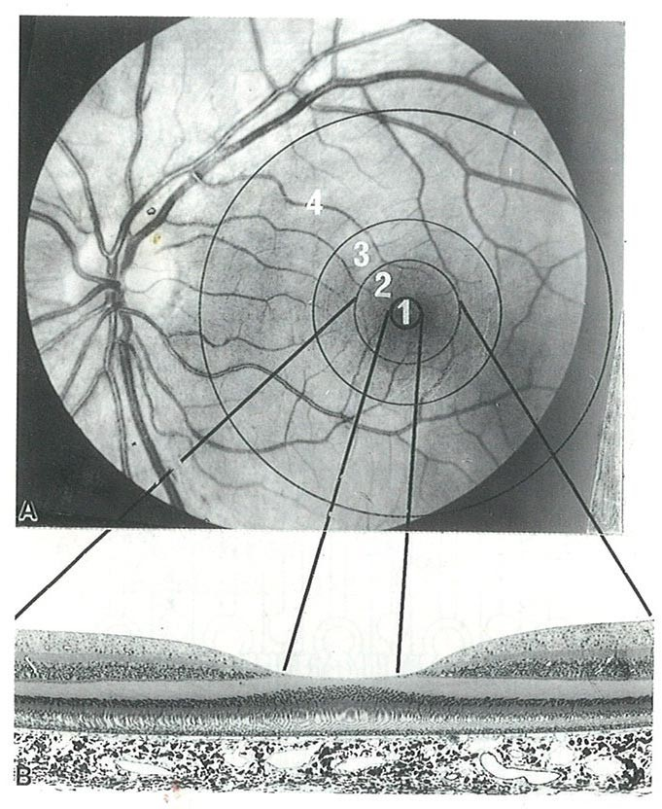

Slide 9
In this layer has there are no rods.
Cones are larger and abundant its central part consist of cones and there nuclei covered by a thin internal limiting membrane. All other layers are absent in this region.
In the center of the foveola there is tiny depression known as umbo. It corresponds to foveolar reflex.
PERIPHERAL RETINA:
4 Regions
Near periphery: Circumscribed region of about 1.5mm around the area centralis.
Mid periphery: Occupies 3mm wide zone around the near periphery.
Far periphery: Extends from the optic disc 9-10mm on the temporal side and 16mm on the nasal side in the horizontal meridian.

Slide 10
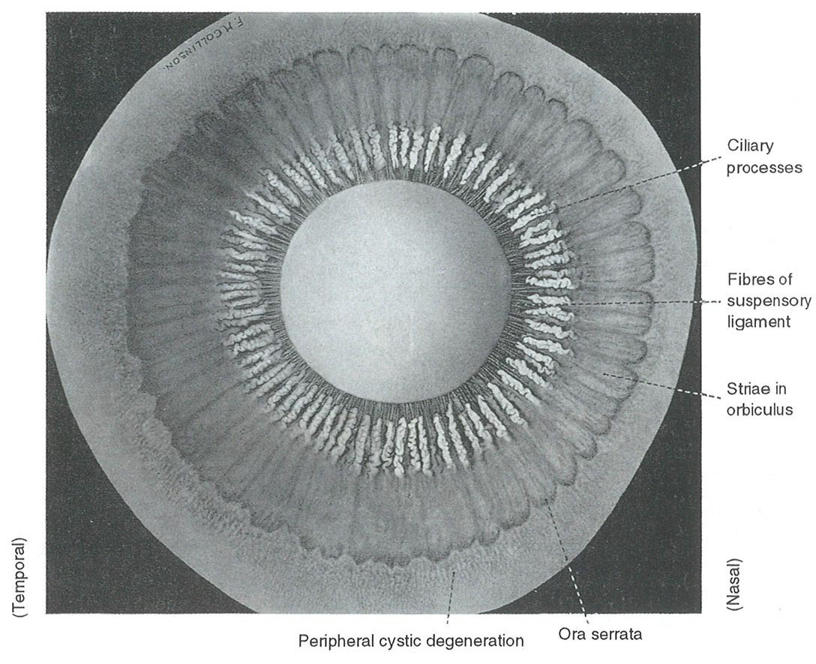
4. Ora serrata: Peripheral margin of the retina which consists of dentate fringe. The retina ends here and ciliary body stars.
Here sensory retina is firmly attached to vitreous and RPE
Servations are less developed temporally where cystic degeneration is most common.

Slide 11
•
Ora serrata marks the transition between the attenuated Retina and Inner Columnar Non- Pigment cells of Pars ciliariinues as retinae.
The RPE continues anteriorly as the outer cuboidal cell layer of the ciliary body.
Beginning at a younger age the cystoid degeneration starts at the outer plexiform layer , more marked on the nasal side.
They extend between the inner and the outer limiting membrane in elders and communicate with the vitreous leading to Retinal Detachment.
•
•
•

Slide 12
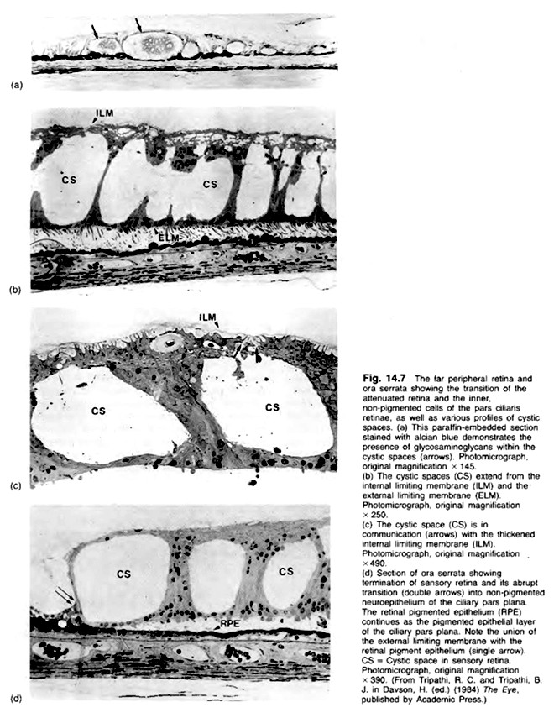

Slide 13
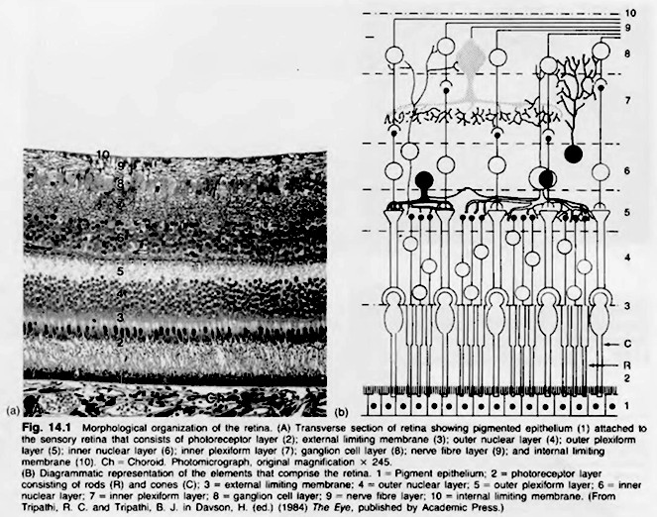

Slide 14
MICROSCOPIC STRUCTURE OF RETINA
It has 10 layers:
Retinal pigment epithelium
Layer of rods and cones
External limiting membrane
Outer nuclear layer
Outer molecular (plexiform) layer
Inner nuclear layer
Inner molecular (plexiform) layer
Ganglion cell layer
Nerve fibre layer
Internal limiting membrane

Slide 15
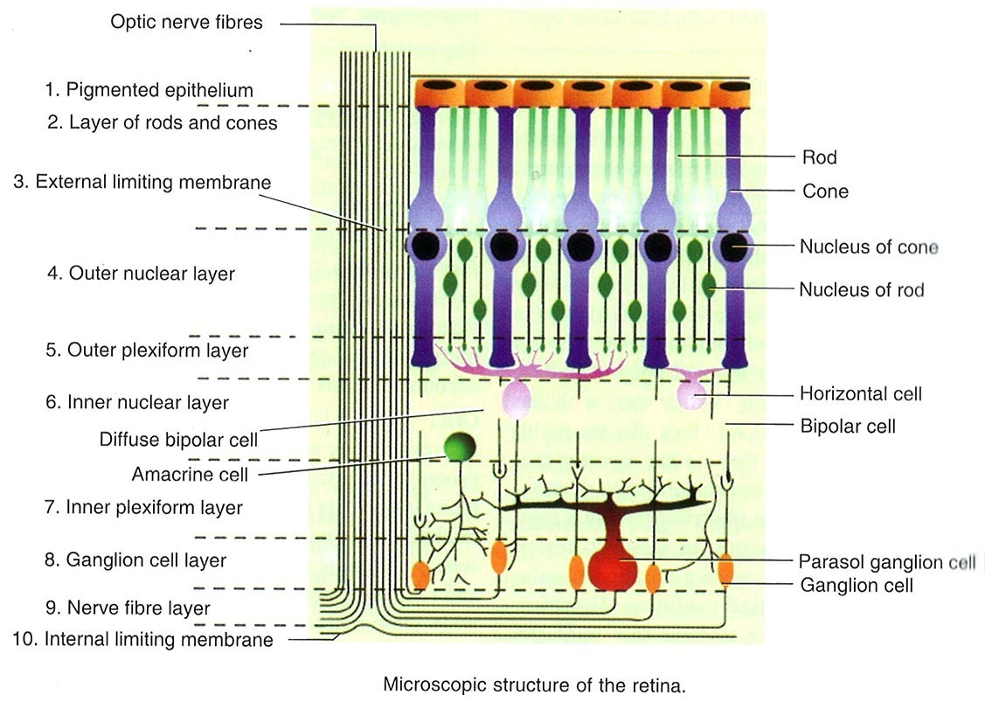

Slide 16
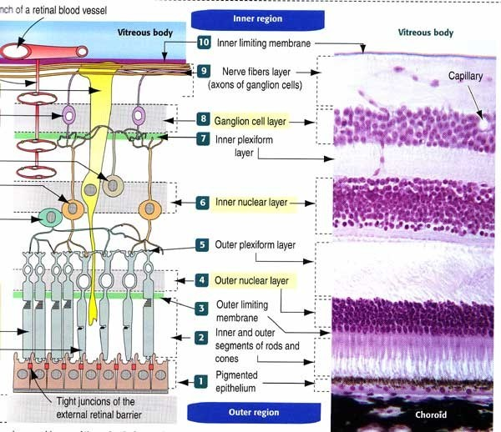

Slide 17
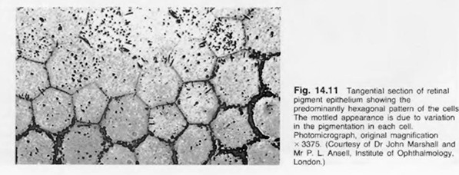
RPE:
Outer most layer consists of single layer of hexagonal shape cells which contain pigment.
It is firmly attached to underlying Bruch’s membrane and loosely attached to layer of rods and cones.
Space bet. RPE and sensory retina is called sub retinal space. Separation of RPE from sensory retina is called retinal detachment.
On electron microscopy the adjacent RPE cells are connected with each other by tight junctions and constitute the outer blood retinal barrier. –Terminal bars.
Terminaln bars- ( Gap junctons , zonula ocludens and zonula adherens.
Zonula ocludens forms the external component of the Blood retinal Barrier.
Rest of intercellular space is filled by Extra cellular matrix-VERHOEFF’S MEMBRANE in light microscope

Slide 18
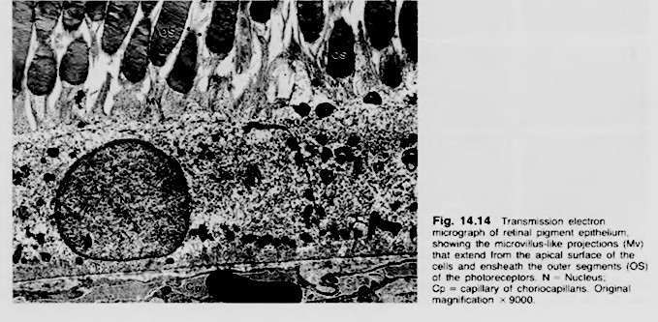

Slide 19
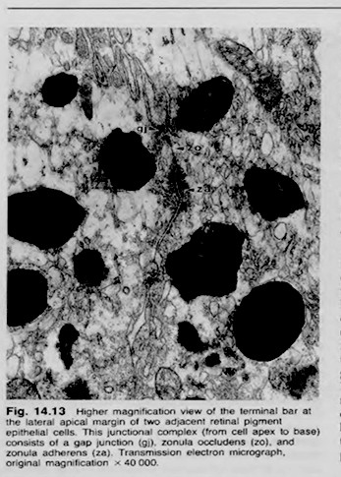

Slide 20
FUNCTIONS:
•
•
•
Imp. role in photo receptor renewal and recycling of Vit.A. Absorption of scattered light by Melanin Granules.
Transport of nutrients and metabolites through extra retinal blood barrier.
Inter photo receptor matrix participates in retinal attachment of the retina to RPE and facilitates Phagocytosis of the shed discs of the outer cone segments.
On the basal surface RPE cells produce type 4 collagen, heparin sulphate and laminin which become incorporated in lamina vitrea of Bruch’s membrane.
•
•

Slide 21
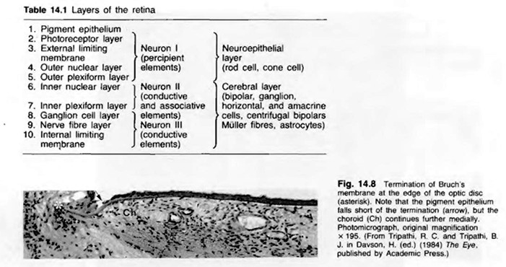

Slide 22
LAYER OF PHOTO RECEPTORS:
There are about 120 million rods and 6.5mm cones.
End organs of vision which transform light energy to visual impulse.
Rods contain photo sensitive substance rhodopsin which is responsible for peripheral vision and vision of low illumination.
Cones also contain a photo sensitive substain responsible for central vision and colour vision.
Highest density of cones is at fovea.
Rods are absent at fovea and maximum below the optic disc.

Slide 23
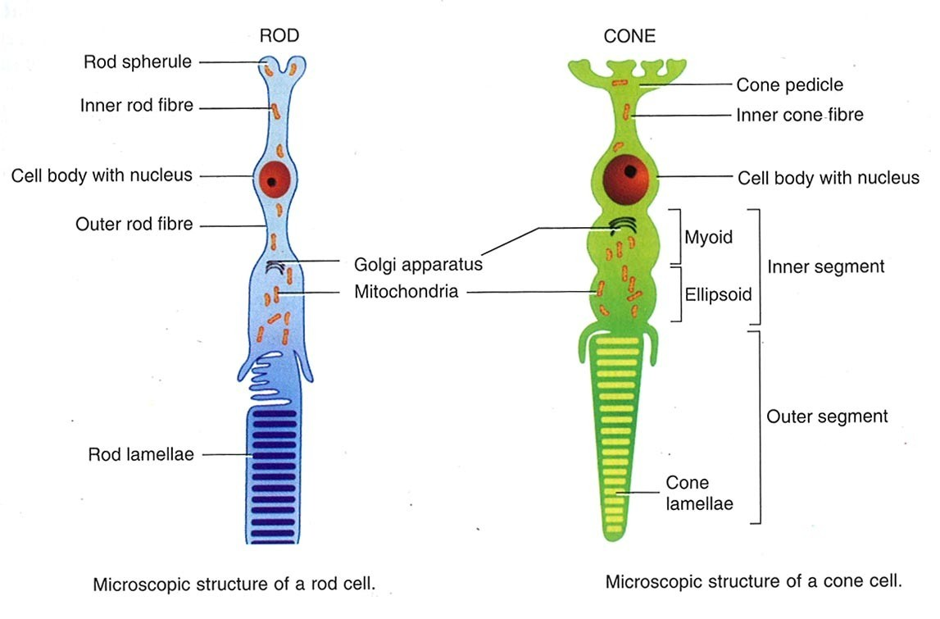

Slide 24
STRUCTURE OF ROD CELL:
1. 40-60 µm long.
Outer segment is cylindrical. It contains flattened double lamellae in the form of discs.
Discs various between 600 to 1000/rod cell. There are no special attachments bet. discs or bet. discs and plasma membrane.
Discs contain 90% of the visual pigment remaining is scattered on plasma membrane.
Inner segment of the rod is thicker than the outer. It has two regions.
  Outer eosinophilic ellipsoid which contains more mitocondria.
  Myoid which contains glycogen as well as usual organelles

Slide 25
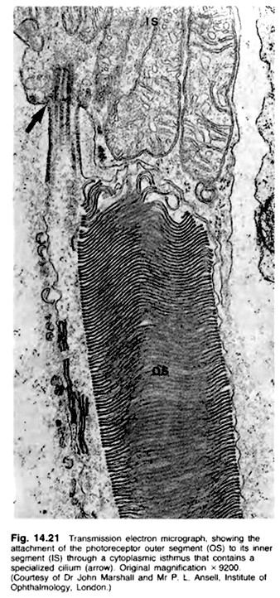
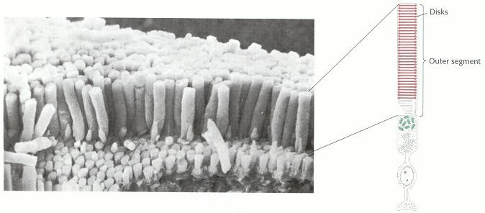
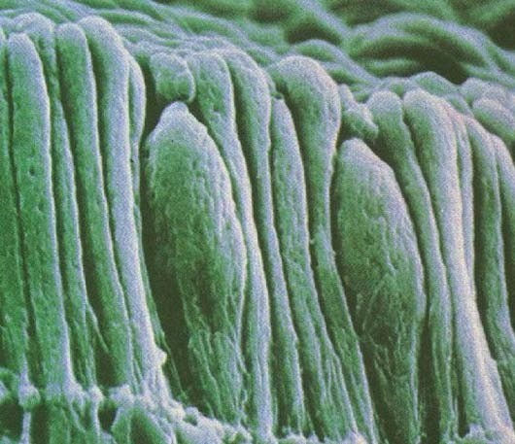

Slide 26
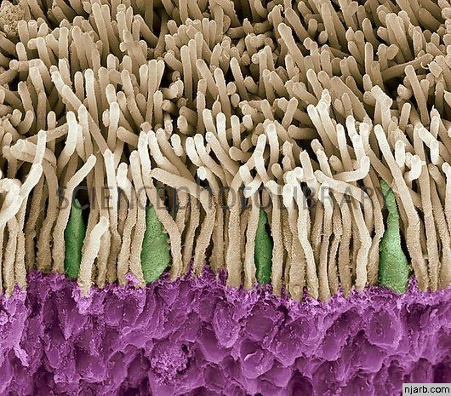

Slide 27
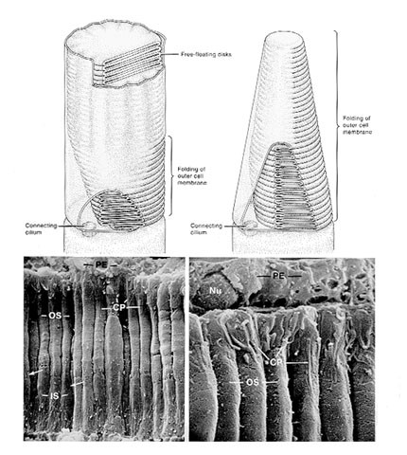
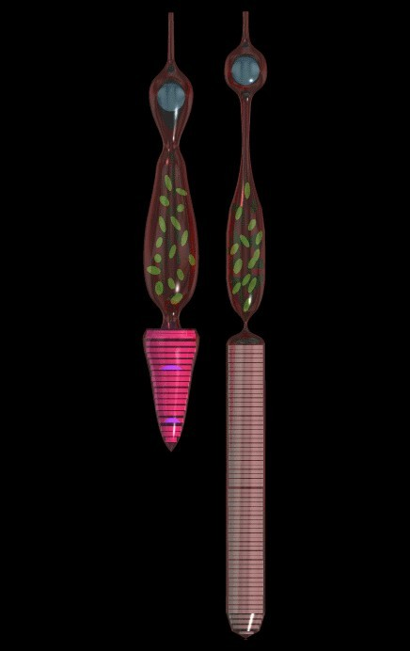

Slide 28
A modified cilium connects the outer segment to inner segment with 9+0 configuration i.e. 9 doublets around the periphery with no central micortubule.
Outer rod fibre arises from the inner end of the rod which passes through the external limiting memb. And swells into a densely staining nucleus the rod granule which at its end has an end buld called the rod spherule i.e. in contact with cone foot.
CONE CELL:
40 TO 80 µm largest at fovea shortest at periphery.
Outer segment of cone is conical and contains iodopsin.
Inner segment is similar to rod structures. Ellipsoid of cone is very plump and contains a large number of mitochondria.

Slide 29
EXTERNAL LIMITING MEMBRANE:
Fenestrated memb. which extents from the ora serrata to the edge of optic disc. Process of cones and rods pass through this.
OUTER NUCLEI LAYER formed by nuclei of rods and cones.
Rod nuclei form the bulk of this layer. Number of rows of nuclei and thickness of this layer where is from region to region.
OUTER PLEXIFORM LAYER:
This layer contains the synapses bet. rod spherules and cone pedicles with the dendrites of the bipolar cells and processes of the horizontal cells. It marks the junction of the end organs of vision and first order neurons in retina.

Slide 30
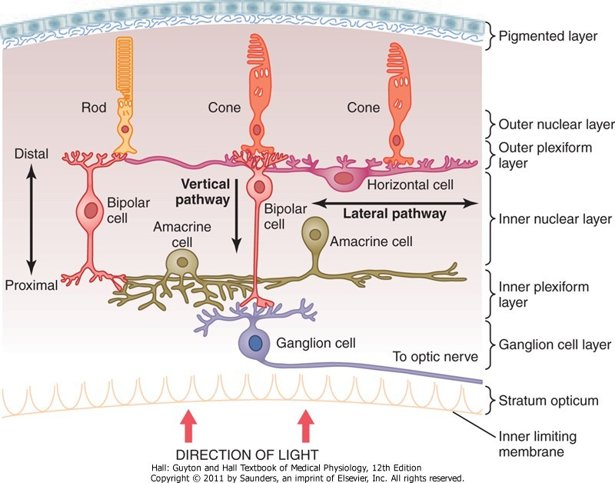

Slide 31
INNER NUCLEI LAYER:
Consists of following cells:
•
•
•
•
•
Bipolar cells Horizontal Amacrine
The soma of the Muller’s
Capillaries of the central retinal vessels
BIPOLAR CELLS:
•
•
Neurons of first order of vision.
Body of the bipolar cells consists entirely of nucleus, which lies in the inner nuclear layers. There dendrites arborize with the rod spherules and cone pedicles in outer plexiform layer.

Slide 32
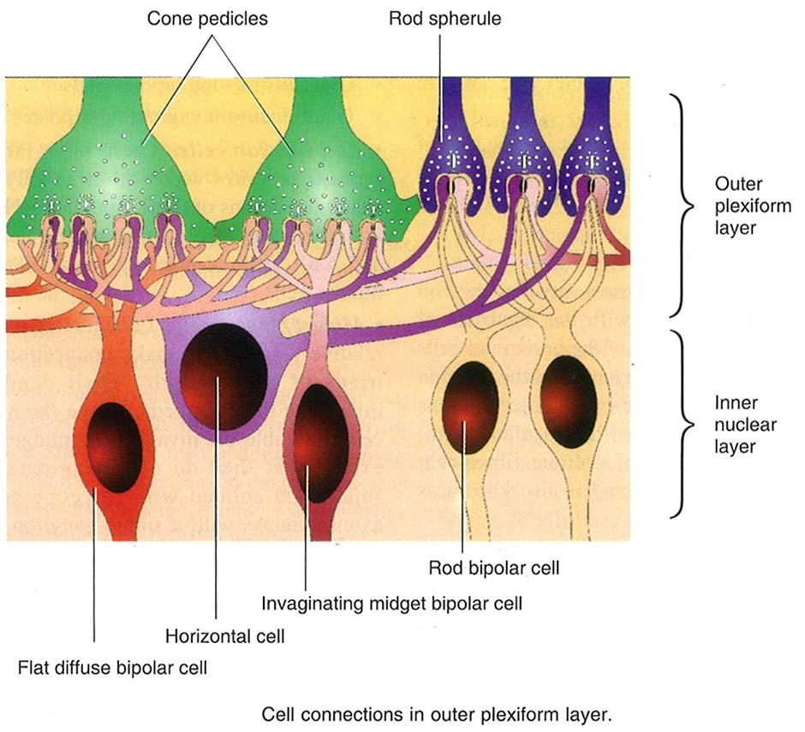

Slide 33
Under light microscopy nine types
  Rod bipolar cells
  Invaginating midget bipolar
  Flat midget bipolar
  Invaginating diffuse bipolar
  Flat diffuse bipolar
  On-centre blue cone bipolar
  Off-centre blue cone bipolar
  Giant bistratified bipolar
  Giatn diffuse invaginating bipolar

Slide 34
HORIZONTAL NEURONS:
Consists of following cells:
Flat cells having neumerous
horizontal associative and
and
neuronal interconnections between photo receptor
bipolar cells in the outer plexiform layer. Divided into 3 types- HI, HII and HIII.
AMACRINE CELLS:
Present in the inner most of this layer. They have a piriform body and single process.
Forms connections with the axons of the ganglion cells.

Slide 35
MULLERS CELLS:
Nucleus and cell bodies are with in the inner nuclear layer.
They provide structural support and contribute to
metabolism of sensory retina.
Retina contains other glial cells like astrocytes, microglial and oligodendrocytes.
INNER PLEXIFORM LAYER:
Consists of synapses bet. dendrites of ganglion cells.
Axons of bipolar cells and

Slide 36
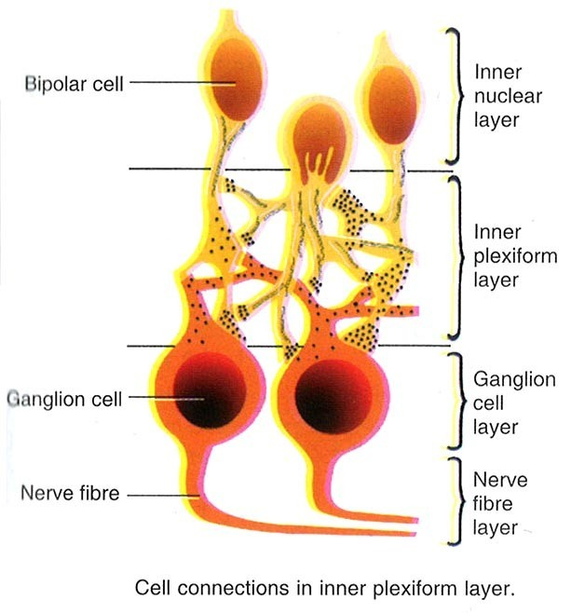

Slide 37
GANGLION CELL LAYER:
Cell bodies and nuclei of ganglion cells lie in this layer.
This layer is composed of single row of cells except in macula where it is multi layer and on temporal side of disc it has two layers.
It is absent in foveola Classification of ganglion cells:
w, x, y ganglion cells
P & M ganglion cells
Off centre & on centre
Mono & Polysynaptic

Slide 38
NERVE FIBRE LAYER:
Consists of unmyelinated axons of the ganglion cells which converge at the optic nerve head. Pass through the lamina cribrosa and become ensheathed by myelin posterior to the laminar.
Thickness where is from 0.5 to 2µm.

Slide 39
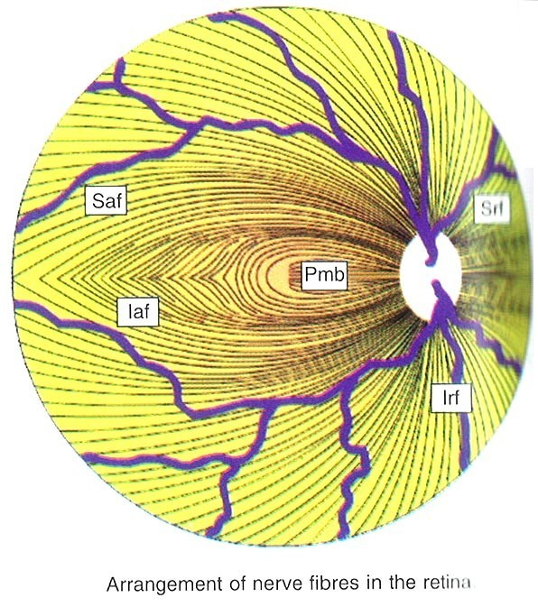
ARRANGEMENT OF NERVE FIBRES IN THE RETINA:
Fibres from the nasal half of the retina come directly to the optic disc as superior and inferior radiating fibres (srf and irf).
Fibres from the macular region pass straight in the temporal part of the disck as papillomacular bundle (pmb).
Fibres from the temporal retina arch above and below the
macular and papillomacular bundle as superior and inferior arcuate fibres (saf and iaf) with
a horizontal raphe in between.

Slide 40
ARRANGEMENT OF NERVE FIBRES OF THE OPTIC NERVE HEAD:
Fibres form the peripheral part of the retina lie deep in the retina but occupy the most peripheral (superficial) part of the optic disc. While the fibres originating closer to the optic nerve head lie superficially in the retina and occupy a more central (deep) portion of the disc.
THICKENSS OF NERVE FIBRE LAYER AT THE DISC:
Thickness of the nerve fibre layer around the different quadrants of the optic disc margin progressively increases in the following order:
Most lateral quadrant (thinnest)
Upper temporal and lower temporal quadrant Most medial quadrant
Upper nasal and lower nasal quadrant (thickest)

Slide 41
CLINICAL SIGNIFICANCE OF DISTRIBUTION AND THICKNESS OF NERVE FIBRES AT THE OPTIC DISC MARGIN:
Papilloedema appears first of all in the thickest quadrant (upper nasal and lower nasal) and last of all in the thinnest quadrant (most lateral).
Arcuate nerve fibres which occupy the superior temporal and inferior temporal quadrants of optic nerve head are most sensitive to glaucomatous damage, accounting for an early loss in corresponding regions of visual field.
Macular fibres occupying the lateral quadrant are most resistant to glaucomatous damage and explain the retention of the central vision till end.

Slide 42
INTERNAL LIMITING MEMBRANE:
Consists of PAS positive true basement membrane that forms the interface between retina and vitreous. The fibrils of the vitreous merge with the internal lamellae of this membrane. It consists of Collagen fibrils, Proteoglycans, Basement Membrane, Plasma Membrane of the Muller cells and possibly other glial cells of the retina.

Slide 43
BLOOD SUPPLY OF THE RETINA:
Outer 4 layers of retina is supplied by (till outer nuclear layer) choriocapillaries.
The inner six layers gets its supply from central retinal artery which is a branch of ophthalmic artery.
The outer plexiform layer gets partly by both the above arteries.
The fovea is avascular and is mainly supplied by choriocapillaries.
The inner portion of the retina is perfused by branches of the central retinal artery.
In 30% of eyes ,a cilioretinal artery,branching from the ciliary circulation ,supplies part of inner retina mainly The Macula Region.
The retinal blood vessels maintain the inner blood-retinal barrier.This
physiological barrier is endothelial cells,whose
due to single layer of non-fenestrated tight junctions are
impervious to tracer
substances such as fluorescein.

Slide 44
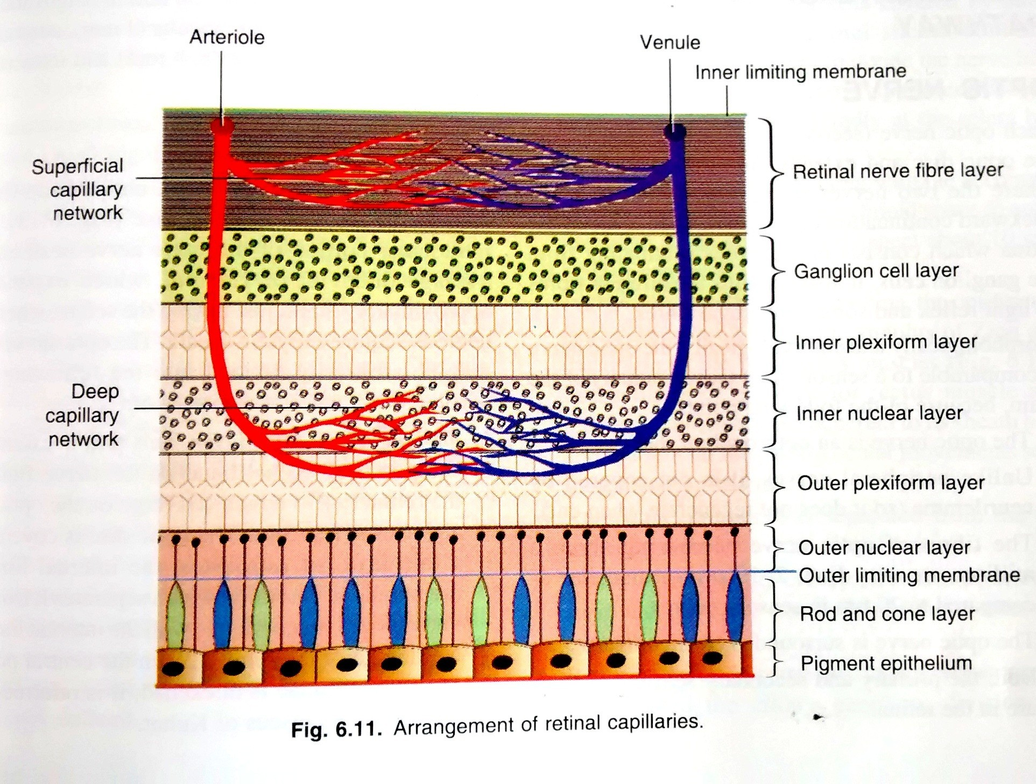

Slide 45
Retinal blood vessels lack an internal elastic lamina & a continuous layer of smooth muscle cells.
The retinal arteries are end arteries & have no
place where the retinal system
anastomoses.The only
anastomoses is in the neighbourhood of lamina cribrosa.
The veins of the retina unite to form Central retinal vein at the disc, which follows the corresponding artery.
The terminal fundus arterioles bend sharply and dip almost vertically into the retina.
In most of the Extramacular fundus- two retianal capillary networks- a superficial and a deep.
In parafoveal zone it is well developed and in 3 layers.
A capillary free zone of 500miceo metre diameter in foveal zone- FAZ.

Slide 46
Blood Retinal Barrier.
Formed by the endothelial cells that are closely bound together about the lumen by intercellular junctions of zonula occludens type.
These junctions normally prevent the free flow of fluids and solutes.
The endothelial cells are encircled by basement membrane and which is surrounded by layer of pericytes- which is further surrounded by basement membrane.
1:1 ratio of pericytes and basement membrane cells is normal.

Slide 47
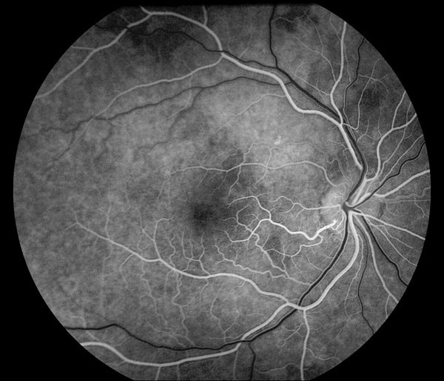

Slide 48
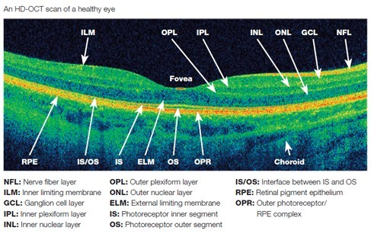

Slide 49


