Slide 1



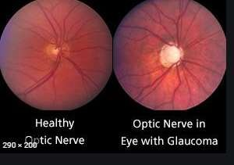
By- Dr.Punit Singh

Slide 2


















CONTENTS
Introduction
Definition
Causes and risk factor
Pathophysiology
Types
Clinical manifestation
Diagnostic evaluation
Nurses responsibility
Management
Prevention
Diet planning
Nursing diagnosis
New research done on it
References
Bibliography

Slide 3




INTRODUCTION
Glaucoma is a group of eye conditions that damage the optic nerve, the health of which is vital for good vision. This damage is often caused by an abnormally high pressure in eye.
Glaucoma is one of the leading causes of blindness for people over the age of 60. It can occur at any age but is more common in older adults.
Many forms of glaucoma have no warning signs. The effect is so gradual that you may not notice a change in vision until the condition is at an advanced stage.

Slide 4

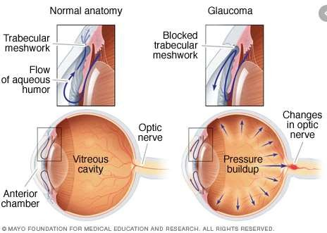

Slide 5
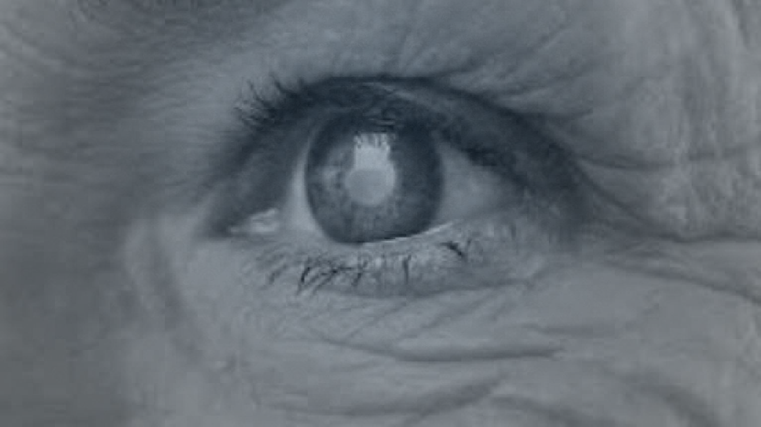




DEFINITION
Glaucoma is a group of eye diseases characterized by damage to the optic nerve usually due to excessively high intraocular pressure (IOP).This increased pressure within the eye, if untreated can lead to optic nerve damage resulting in progressive, permanent vision loss, starting with unnoticeable blind spots at the edges of the field of vision, progressing to tunnel vision, and then to blindness.

Slide 6
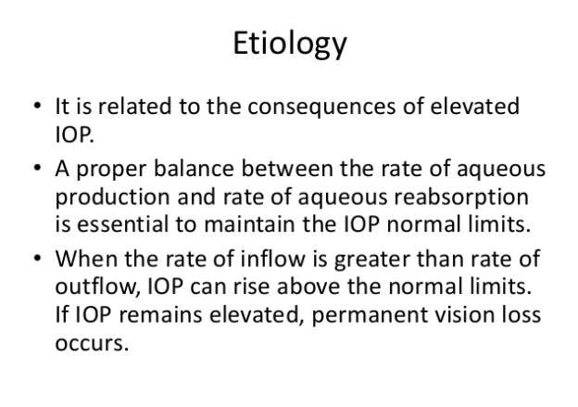

ETIOLOGY

Slide 7

ETIOLOGY
Congenital genetic malformation
Diabetic retinopathy
Occular trauma Corticosteroids

Slide 8
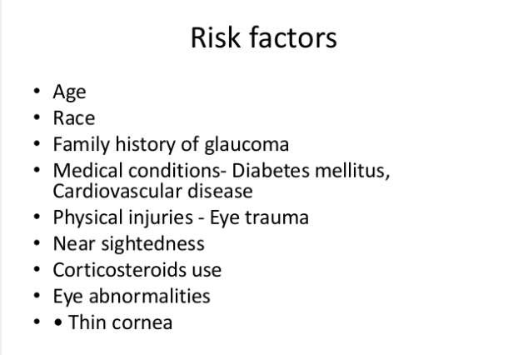

RISK FACTORS

Slide 9















NORMAL PHYSIOLOGY
90% of fluid flows out of the anterior chamber draining through the spongy trabecular meshwork.
10% of the fluid exist through the ciliary body into the suprachoroidal space.
Canal of schelm and the episcleral
veins.
Venous circulation of ciliary body, choroid and sclera.

Slide 10

STAGES
Initiating event
Structural alteration in aqueous outflow system
Functional alteration (increased IOP and impaired blood flow )
Optic nerve damage
Visual loss

Slide 11
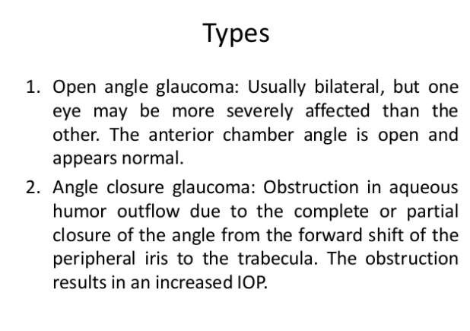

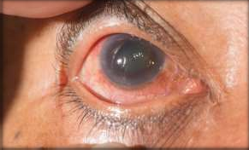
TYPES

Slide 12



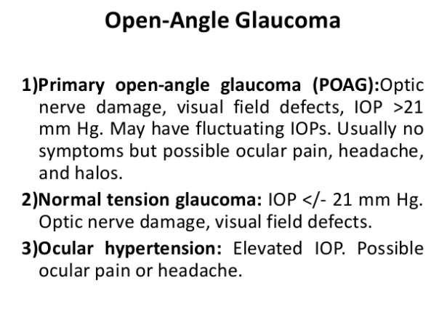
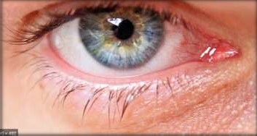
OPEN ANGLE GLAUCOMA

Slide 13

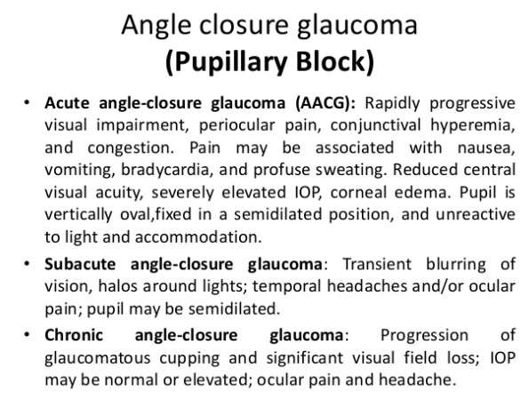


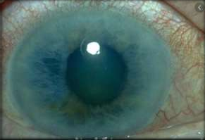
ANGLE CLOSURE GLAUCOMA

Slide 14
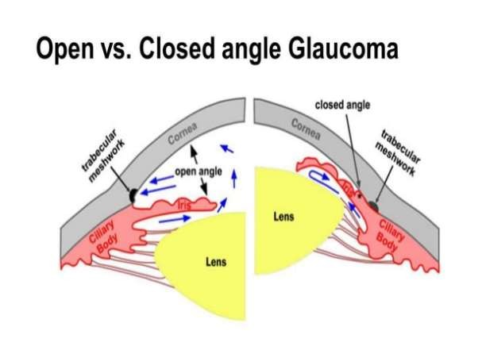

Slide 15
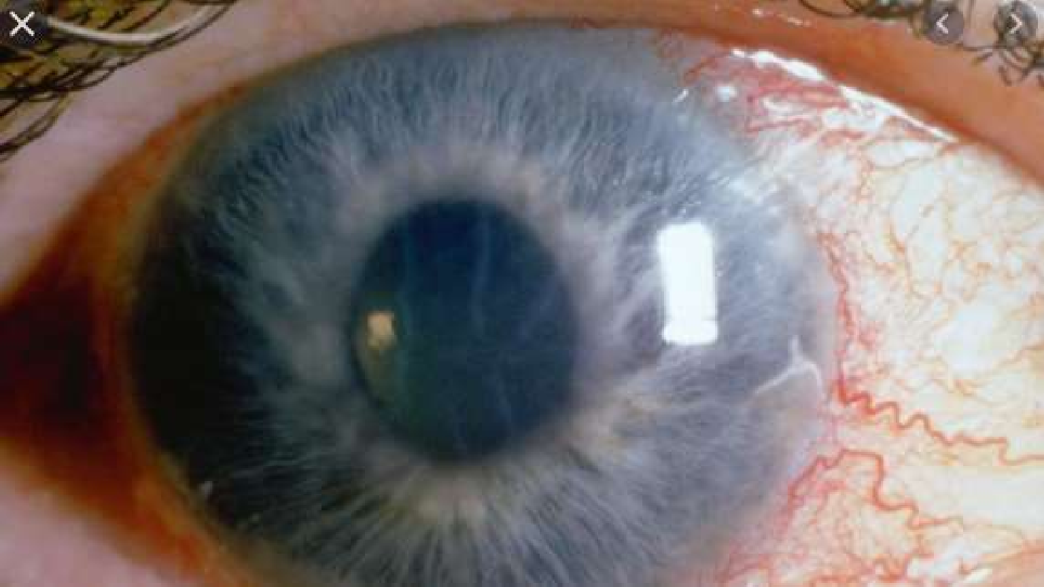



CLINICAL MANIFESTATION

Slide 16



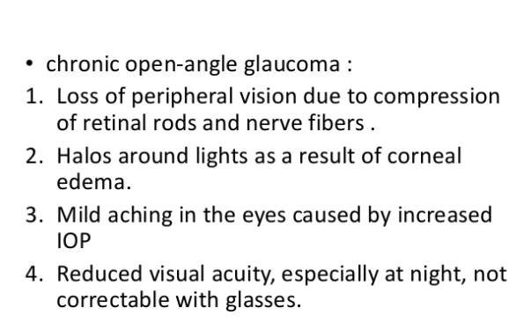
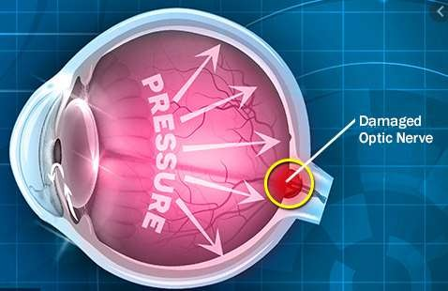
CLINICAL MANIFESTATION

Slide 17
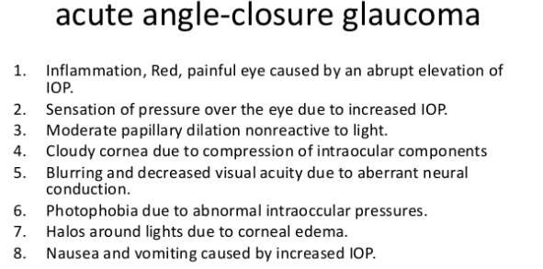

Slide 18




CLINICAL MANIFESTATION
Gradual peripheral visual loss
Sudden excruciating pain around eye
Corneal edema due to rise in IOP
Nausea and vomiting

Slide 19









SIGNS
SYMPTOMS
Red, teary eye
Mid-dilated , fixed pupil
Iris atrophy
1.Severe eye/headache 2.Blurred vision
Red eye
Nausea and vomiting 5.Halos around lights 6.Intermittent eye ache
at night.

Slide 20

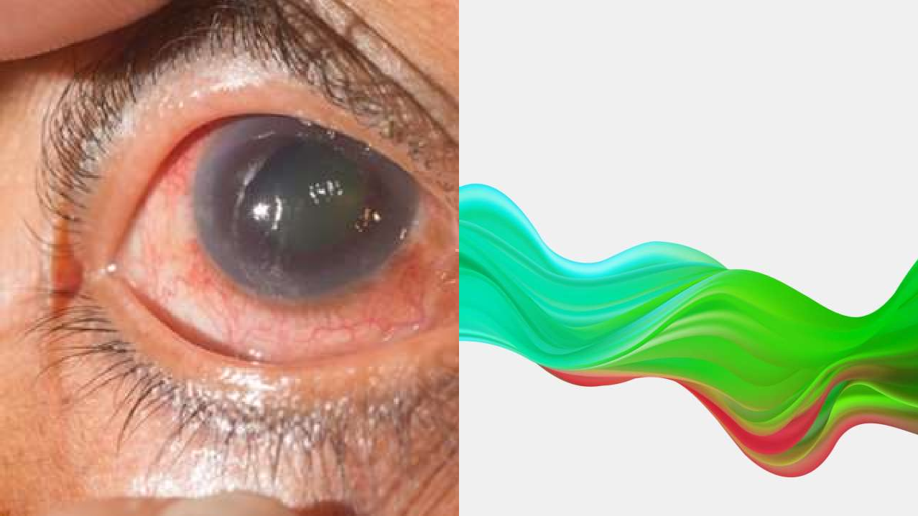


DIAGNOSTIC EVALUATION

Slide 21
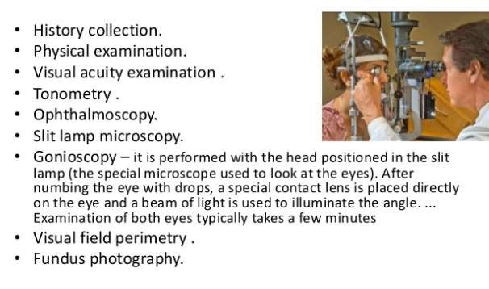

Slide 22

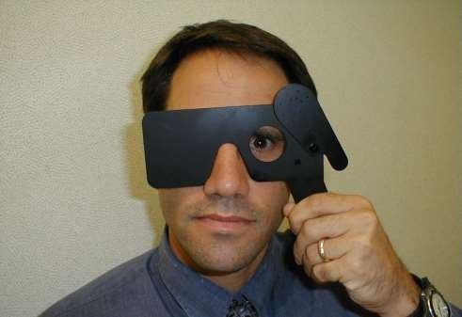
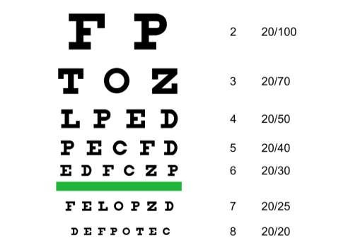

This Photo by Unknown Author is licensed under CC BY-SA
This Photo by Unknown Author is licensed under CC BY-SA
VISUAL ACUITY TEST

Slide 23
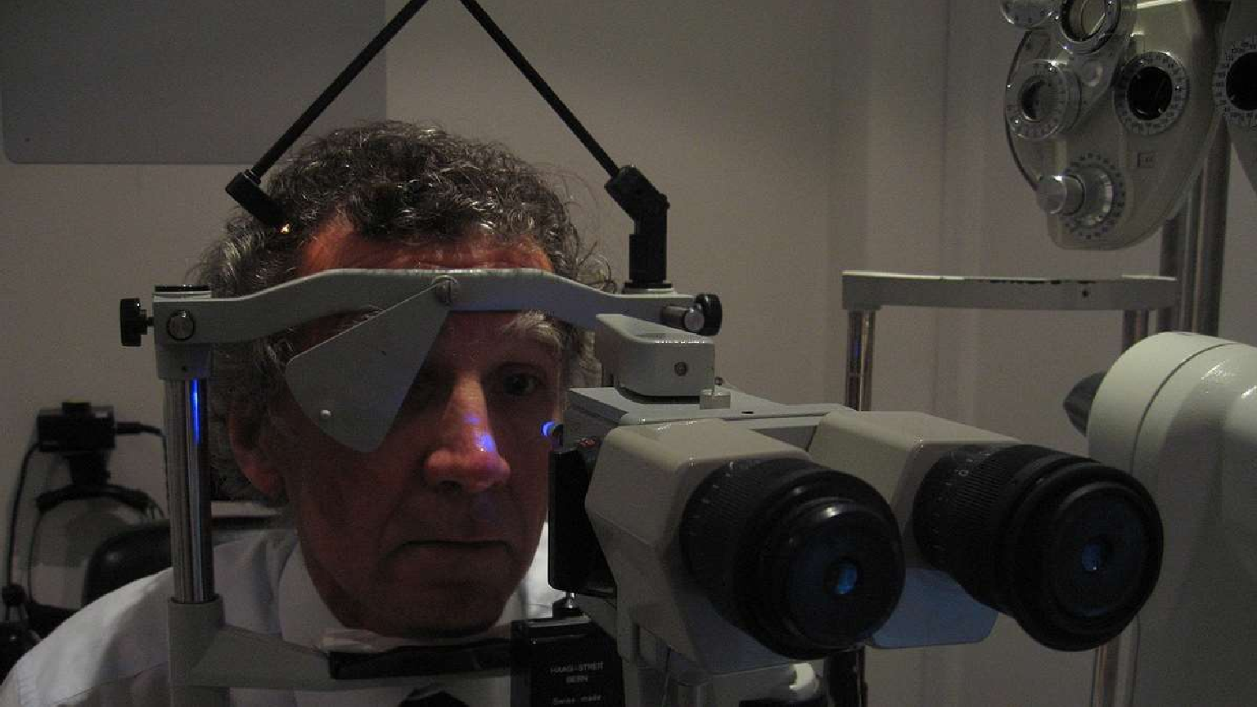
Tonometry test
This Photo by Unknown Author is licensed under CC BY-SA

Slide 24
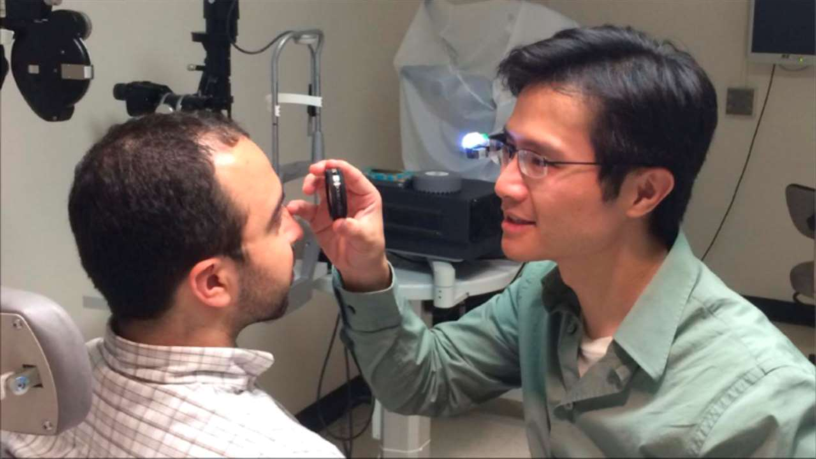

OPTHALMOSCOPY
This Photo by Unknown Author is licensed under CC BY-NC-ND

Slide 25
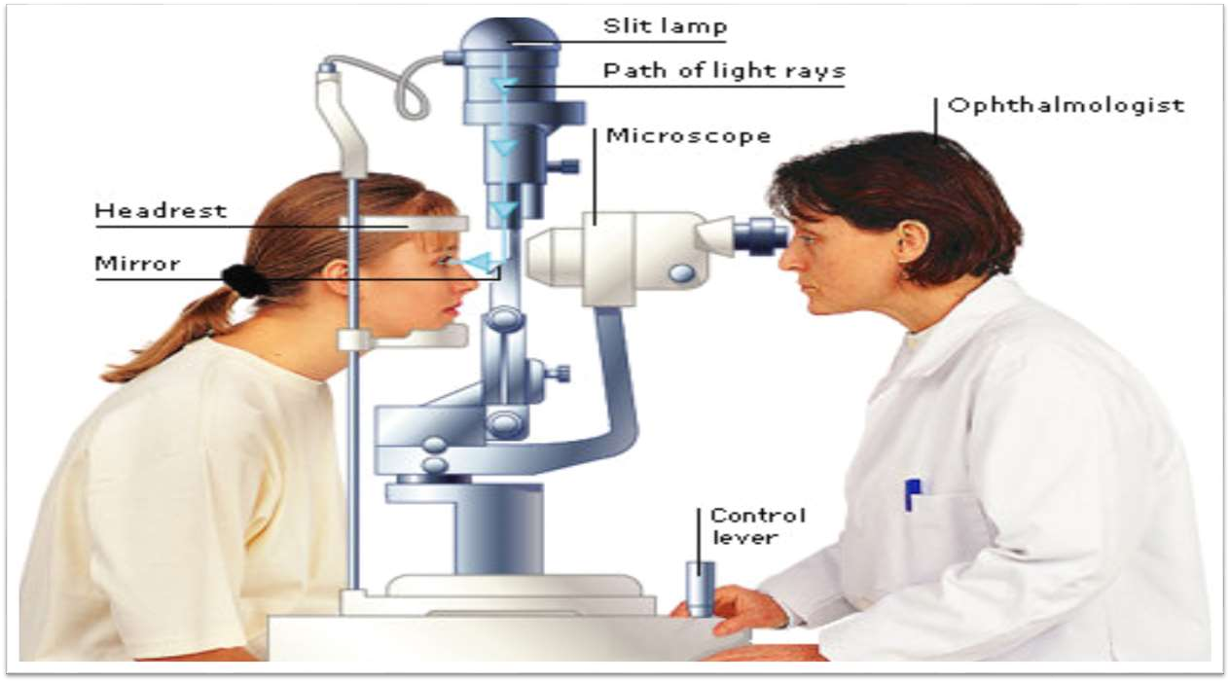

Slide 26
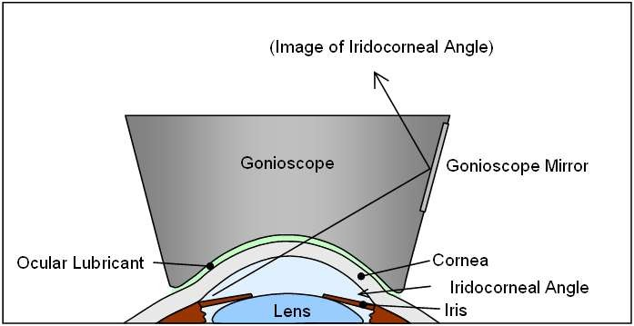
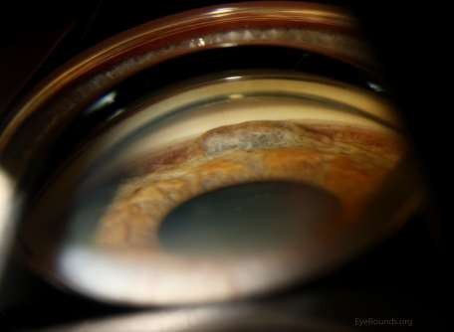

This Photo by Unknown Author is licensed under CC BY-
NC-ND
This Photo by Unknown Author is licensed under CC
BY-SA
GONIOSCOPY

Slide 27
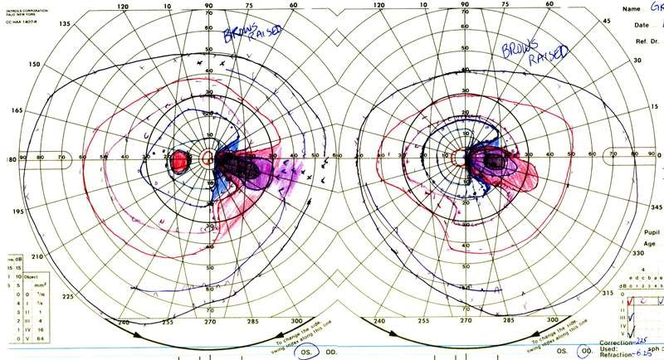

This Photo by Unknown Author is licensed under CC BY-NC-ND
VISUAL FIELD PERIMETRY

Slide 28
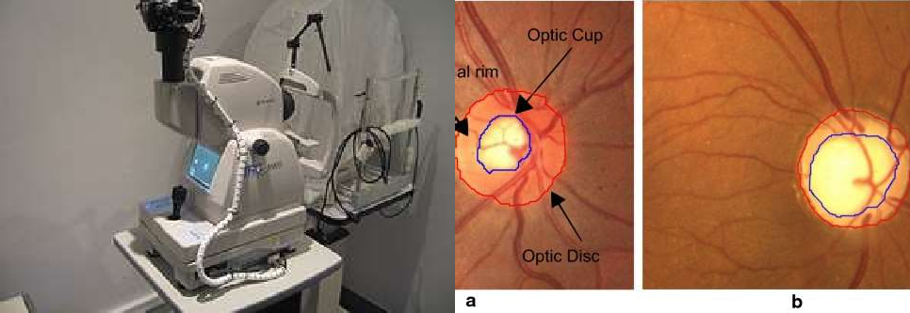

This Photo by Unknown Author is licensed under CC BY-SA
This Photo by Unknown Author is licensed under CC BY
FUNDUS PHOTOGRAPHY

Slide 29


MEDICAL MANAGEMENT

Slide 30
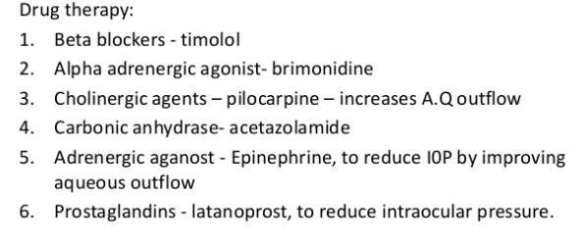

Slide 31
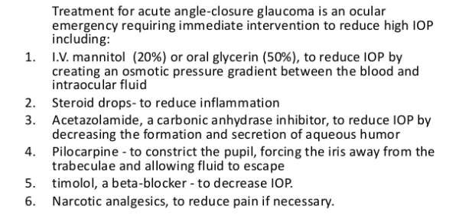

Slide 32


SURGICAL MANAGEMENT

Slide 33
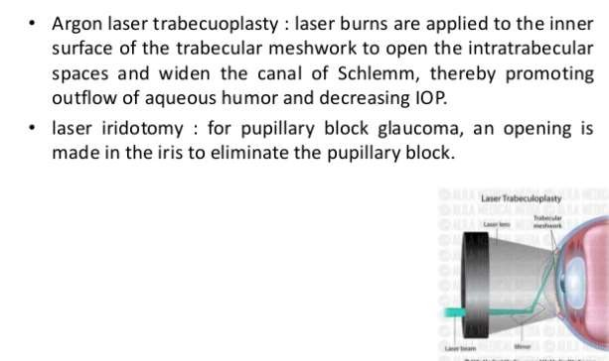

Slide 34
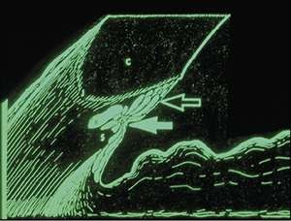


ARGON LASER TRABECUOPLASTY
This Photo by Unknown Author is licensed under CC BY-NC

Slide 35
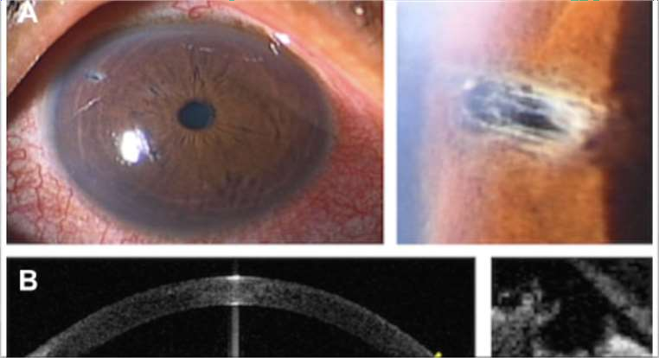

This Photo by Unknown Author is licensed under CC BY-NC
LASER IRIDOTOMY

Slide 36
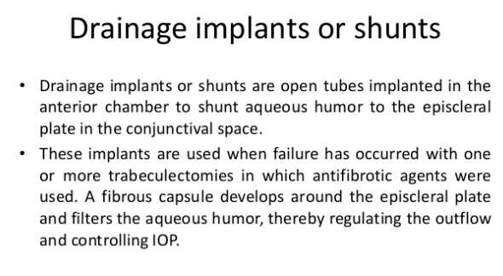

Slide 37
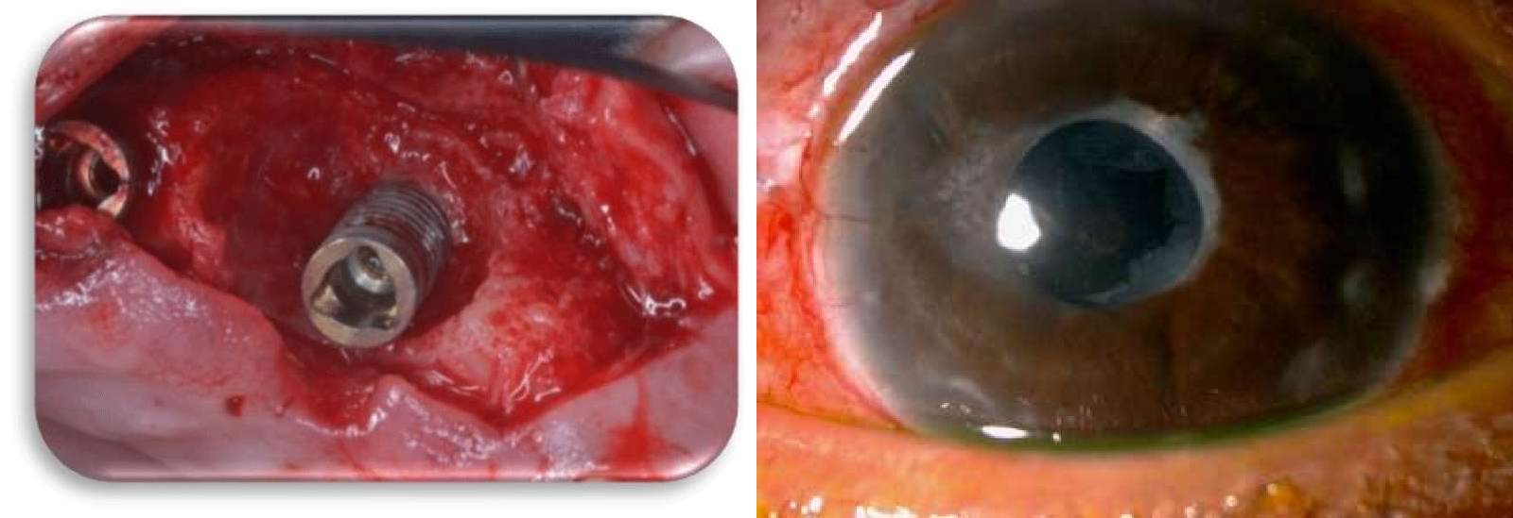

This Photo by Unknown Author is licensed under CC BY
This Photo by Unknown Author is licensed under CC BY-NC
DRAINAGE IMPLANT AND SHUNT

Slide 38
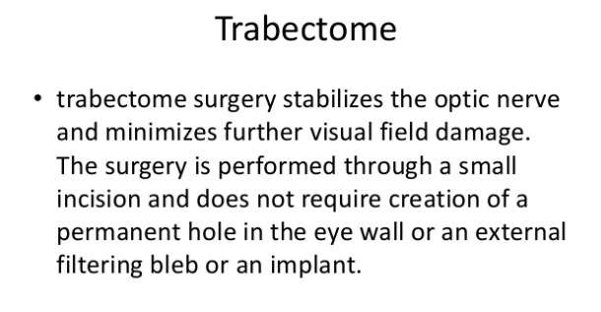

Slide 39
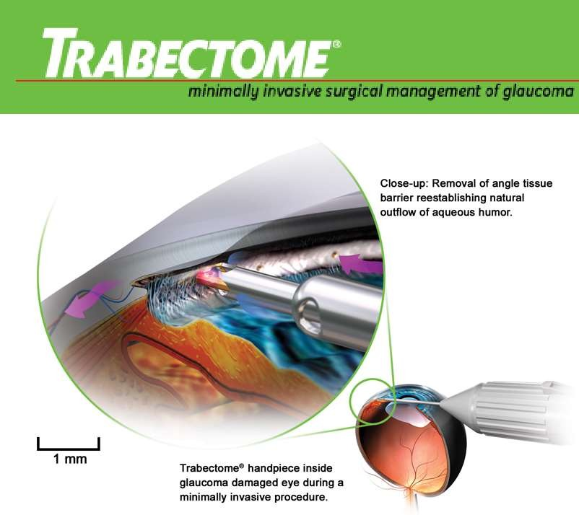
This Photo by Unknown Author is licensed under CC BY-SA

Slide 40
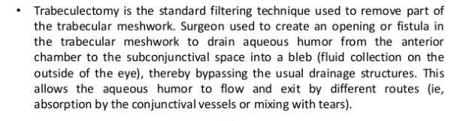

Slide 41
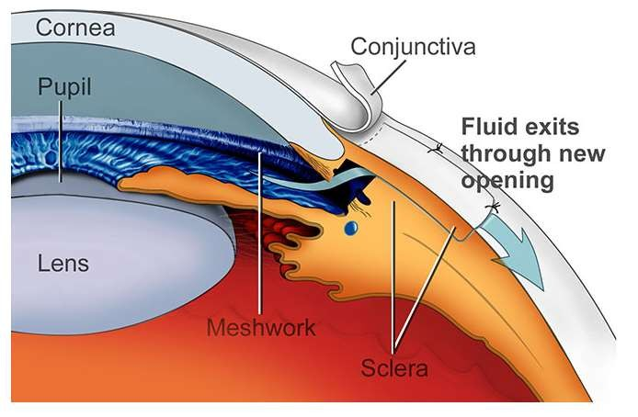

Slide 42
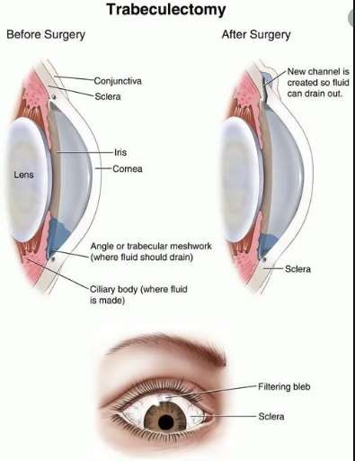

TRABECULECTOMY

Slide 43




NURSES RESPONSIBILITY
Provide information regarding management of glaucoma
Discuss preoperative and postoperative teaching for immediate surgical opening of the eye chamber.
Prepare to administer carbonic anhydrase inhibitors IV or IM, to restrict production of aqueous humor.
Prepare to administer osmotic agents.
Discuss and prepare the client for surgical or laser peripheral iridectomy after the acute episode is relieved.

Slide 44







NURSES RESPONSIBILTY
Provide information about laser trabeculoplasty, if medication therapy proves ineffective.
Teach the client about specific safety precautions.
Instruct the client to avoid mydriatics such as atropine, which may precipitate acute glaucoma in a client with closed-angle glaucoma.
Instruct the client to carry prescribed medications at all times.
Instruct the client to carry a medical identification card or wear a bracelet stating his type of glaucoma and need for medication.
Instruct the client to take extra precautions at night (e.g. use of handrails, provide extra lighting to compensate for impaired pupil dilation from miotic use).

Slide 45





PREVENTION
Get regular dilated eye examinations. Regular comprehensive eye exams can help
detect glaucoma in its early stages, before significant damage occurs.
Know your family's eye health history. Glaucoma tends to run in families.
Exercise safely. Regular, moderate exercise may help prevent glaucoma by
reducing eye pressure.
Take prescribed eyedrops regularly. Glaucoma eyedrops can significantly reduce the risk that high eye pressure will progress to glaucoma.
Wear eye protection. Serious eye injuries can lead to glaucoma. Wear eye protection when using power tools or playing high-speed racket sports in enclosed courts.

Slide 46









DIET PLANNING
Sea Food
Leafy Greens
Eggplant
Goji Berries
Blackcurrant
Peaches and Oranges
Drinkable

Slide 47


NURSING PROCESS

Slide 48
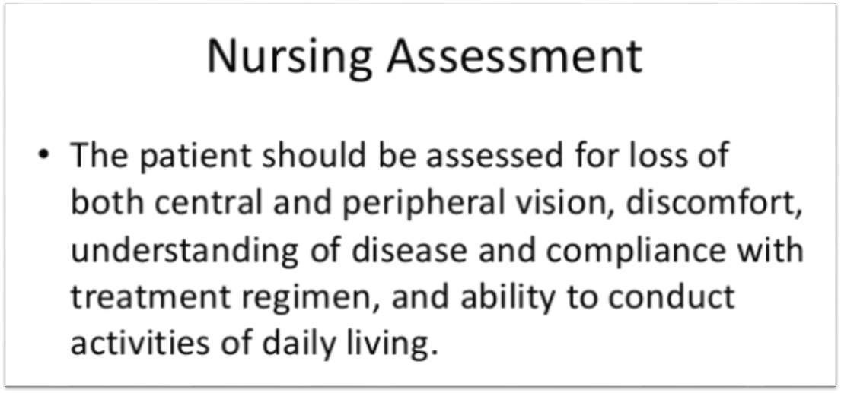

Slide 49
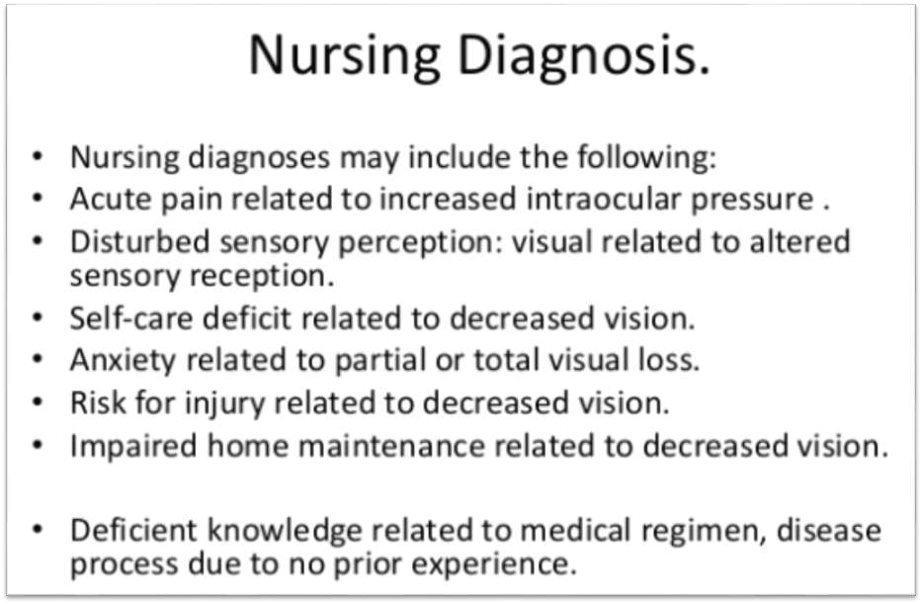

Slide 50
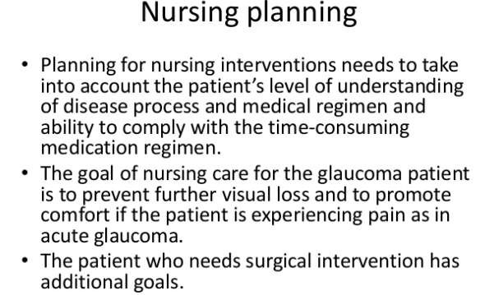

Slide 51
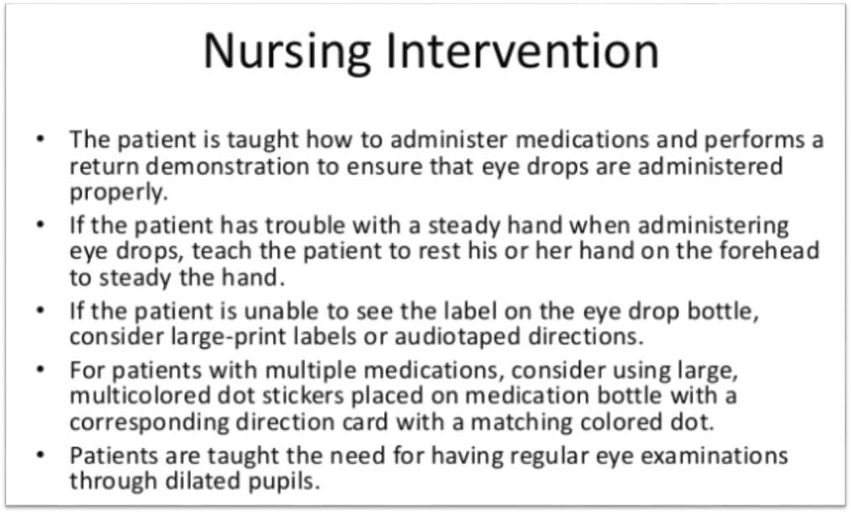

Slide 52
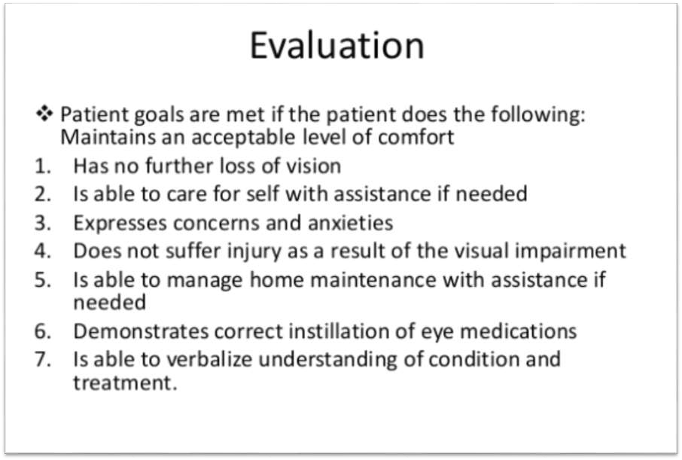

Slide 53

RESEARCH

Slide 54
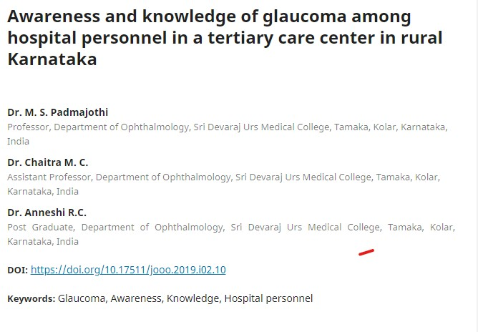

Slide 55
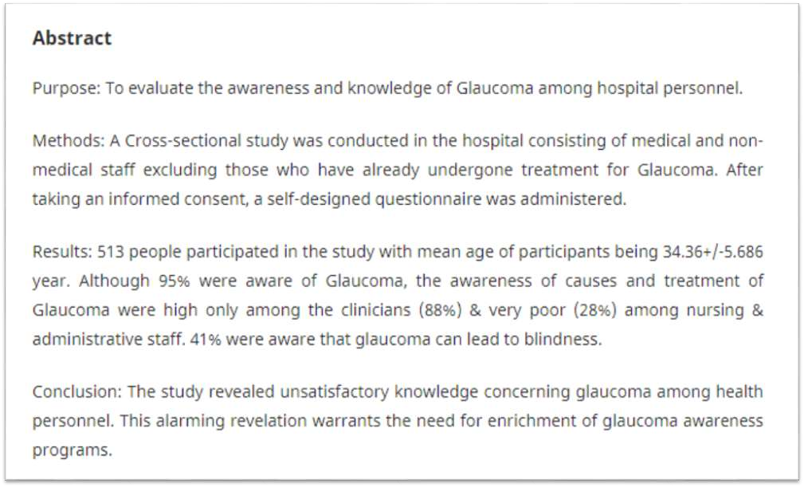

Slide 56
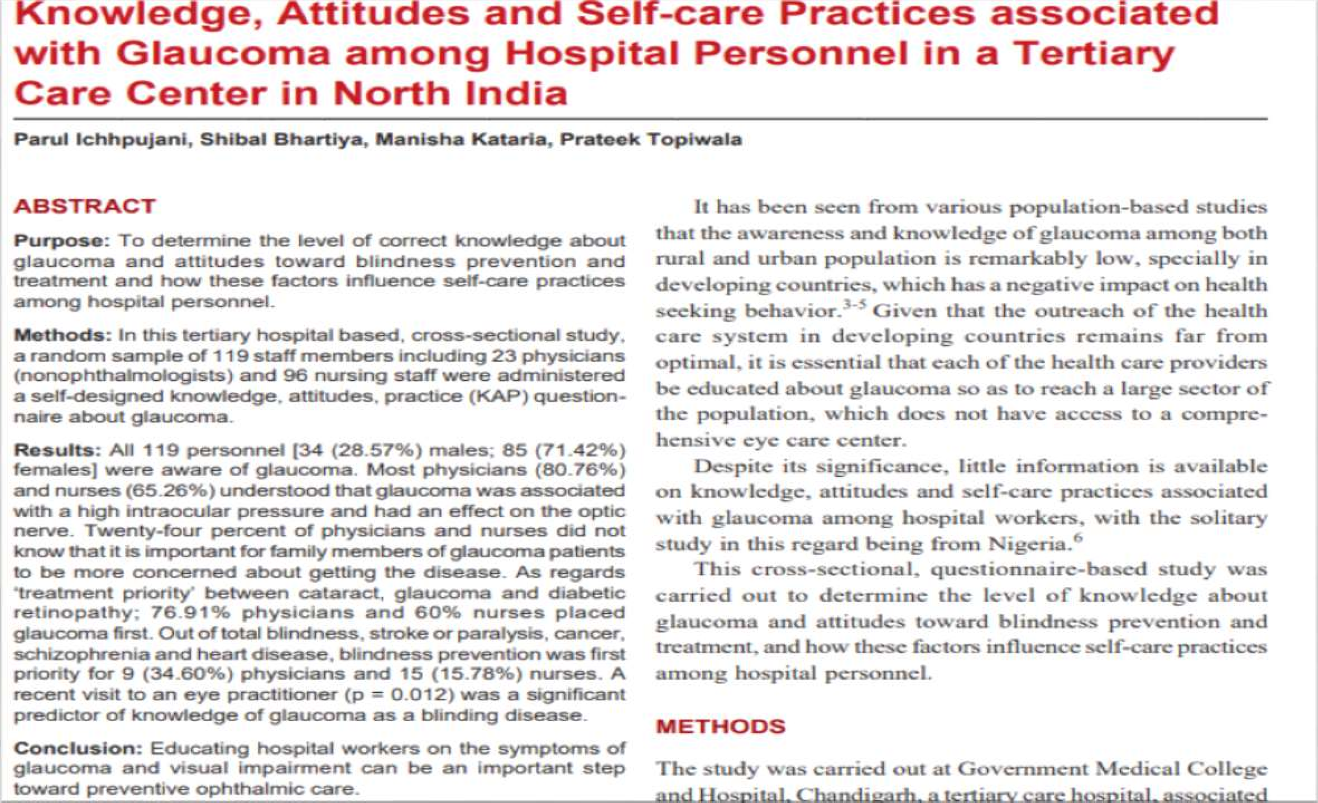

Slide 57
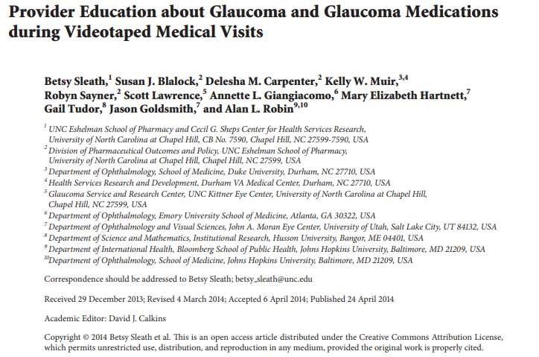

Slide 58
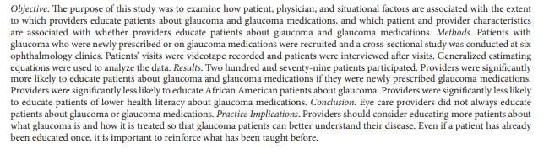

Slide 59













EVALUATION
Define glaucoma ?
Explain Stages of glaucoma?
What are the etiological causes of glaucoma?
What are the risk factor?
Enlist types of glaucoma ?
What are the clinical manifestation ?
What are the sign and symptoms ?
Enlist 4 diagnostic evaluations techniques ?
What are the surgical management for glaucoma ?
What are the preventive measues for glaucoma ?

Slide 60




REFRENCES
BOOKS
INTERNET
TEACHERS

Slide 61




















Kochuthresiamma Thomas, Medical surgical nursing volume 2
The Advanced Glaucoma Intervention Study (AGIS): 11. Risk factors for failure of trabeculectomy and argon laser trabeculoplasty. American Journal of Ophthalmology. 2002; 134(4):481–498
Advanced Glaucoma Intervention Study. 2. Visual field test scoring and reliability. Ophthalmology. 1994; 101(8):1445– 1455
Ahmed S, Khan Z, Si F, Mao A, Pan I, Yazdi F et al. Summary of glaucoma diagnostic testing accuracy: an evidence-based meta-analysis. Journal of Clinical Medicine Research. 2016; 8(9):641–649
www.slideshare.com
www.nurseslab.com
www.medsurg.com
BIBLIOGRAPHY

Slide 62



This Photo by Unknown Author is licensed under CC BY-SA-NC
This Photo by Unknown Author is licensed under CC
BY-ND

