Slide 1
AMNIOTIC CAVITY AND AMNION
STRUCTURE:
Fully formed amnion is 0.02-0.5 mm in thickness.
From within outwards 5 layers
  Cuboidal epithelium –single layer
  Basement membrane
  Compact layer of reticular tissue
  Fibroblastic layer and
  Spongy layer.

Slide 2
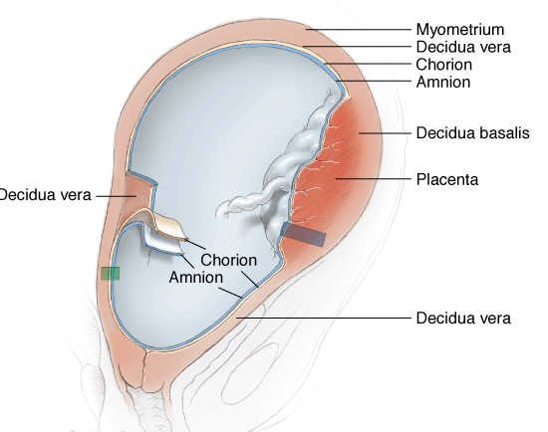
Photomicrograph of a histologic section through amnion, chorion, and decidua vera

Slide 3
  Amnion has got neither blood nor nerve supply nor any lymphatic system .
  Fluid accumulates slowly at first than obliterates the chorionic cavity.
  Initially cavity is located on the dorsal surface of embryonic disc .
  liquor amnii then surrounds the fetus everywhere except its attachment with the body stalk .

Slide 4
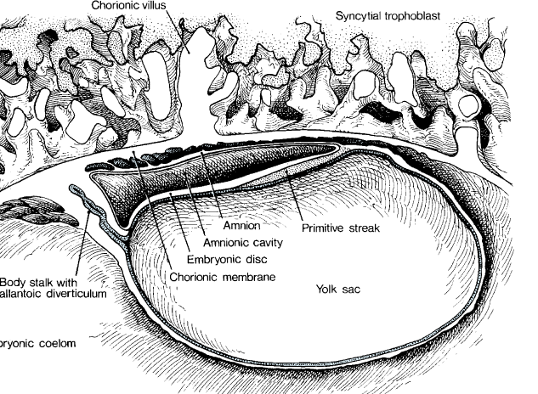
Streeter embryo shows the amnionic cavity and its relations to chorionic membrane and yolk sac

Slide 5
AMNIOTIC FLUID
Secreted from either:
        Tracheobronchial tree
        From fetal urine-400-1200ml/day
        Transduation from umbilical cord
        Transduation from maternal serum.
  Water in it is changed and replaced 3 hourly

Slide 6
Volume
The volume of amnionic fluid at each week is quite variable. In general, the volume increases by 10 mL per week at 8 weeks and increases up to 60 mL per week at 21 weeks, then declines gradually back to a steady state by 33 weeks (Brace and Wolf, 1989).
12 wks-50 ml
  20 wks-400 ml
  36-38 wks-1000 ml
  40 wks-800 ml
  43 wks -200ml

Slide 7
Typical Amnionic Fluid Volume
Weeks' Gestation | Fetus (g) | Placenta (g) | Amnionic Fluid (mL) | Percent Fluid
16 | 100 | 100 | 200 | 50
28 | 1000 | 200 | 1000 | 45
36 | 2500 | 400 | 900 | 24
40 | 3300 | 500 | 800 | 17

Slide 8
Measurement of Amnionic Fluid
Over the past decades, a number of sonographic methods have been used to measure the amount of amnionic fluid.
Phelan and colleagues (1987) described quantification using the amnionic fluid index—AFI. This is calculated by adding the vertical depths of the largest pocket in each of four equal uterine quadrants.
According to their calculations, significant hydramnios is defined by an index greater than 24 cm.
Magann and colleagues (2000) performed a cross-sectional study of longitudinal changes in the amnionic fluid index in normal pregnancies. Their curve and the ones of Hinh and Ladinsky (2005) and Machado and colleagues (2007) show a peak AFI at approximately 32 weeks followed by a steady decline until 42 weeks.

Slide 9
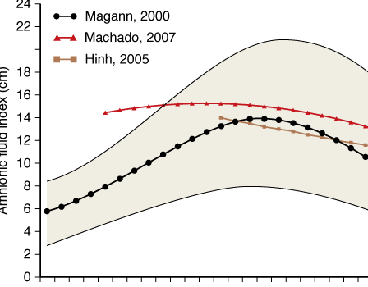
Amniotic fluid and gestestional age relations.

Slide 10
Fluid restriction or dehydration may lower the AFI.
In postterm pregnancy, Oz and colleagues (2002) investigated the etiology of oligohydramnios.
They found a reduction in renal artery end-diastolic velocity, suggesting that increased arterial impedance is an important etiological factor.
Ross and colleagues (1996) administered 1-deamino-[8-D-arginine] vasopressin (DDAVP) to women with oligohydramnios. This resulted in maternal serum hypoosmolality—285 to 265 mOsm/kg—that was associated with an increase in the AFI from 4 to 8 cm within 8 hours.

Slide 11
Composition
In early pregnancy, amnionic fluid is an ultrafiltrate of maternal plasma.
By the beginning of the second trimester, it consists largely of extracellular fluid that diffuses through the fetal skin and thus reflects the composition of fetal plasma (Gilbert and Brace, 1993).
After 20 weeks, the cornification of fetal skin prevents this diffusion, and amnionic fluid is composed largely of fetal urine.
Fetal kidneys start producing urine at 12 weeks, and by 18 weeks, they are producing 7 to 14 mL per day. Fetal urine contains more urea, creatinine, and uric acid than fetal plasma.

Slide 12
Composition
Amnionic fluid also contains desquamated fetal cells, vernix, lanugo, and various secretions. Because these are hypotonic, the net effect is that amnionic fluid osmolality decreases with advancing gestation.
Pulmonary fluid contributes a small proportion of the amnionic volume, and fluid filtering through the placenta accounts for the rest.

Slide 13
Composition
Early pregnancy = transudate of plasma
Later
Water-99%
Solids
Organic Inorganic Suspended Particles
Protein-0.3gm% NA 135mg/l Lanugo
        K 3.5 MG/L
        Exfoliated squam. cells,vernix
Glucose- 20mg%
Urea- 30mg%
NPN- 30mg%
Uric acid -4mg%
Creatinine- 2mg%
Lipid - 50 mg%
Hormones → prolactin , insulin , and renin

Slide 14
FUNCTIONS
MAINLY PROTECTIVE TO FETUS.
During pregnancy :
  Shock absorber
  Temprature maintanance
  Allows growth and free movements
  Prevents adhesions between fetal parts and amniotic sac
  Nutritive –provides salts and protein
  Water supply to fetus
  Immunologic properties
  Biochemical and hormonal function
  It creates a physical space for the fetal skeleton to shape normally,
  promotes normal fetal lung development, and
  helps to avert compression of the umbilical cord.

Slide 15
Epidermal growth factor (EGF) and EGF-like growth factors, such as transforming growth factor-, are present in amnionic fluid.
Ingestion of fluid into the gastrointestinal tract and inhalation into the lung may promote growth and differentiation of these tissues.
The formation of intrapulmonary fluid and, at least as important, the alternating egress and retention of fluid in the lungs by breathing movements are essential to normal pulmonary development.

Slide 16
FUNCTIONS
During labour :
  Hydrostatic wedge → helps dilatation of cervix
  During uterine contraction →prevents interference with fetal circulation
  Flushes birth canal before labour → aseptic and bactericidal action
  Prevents ascending infection in uterus.

Slide 17
FUNCTIONS
CLINCAL IMPORTANCE:
Study of am. fluid→ health status of fetus ,maturity of fetus by L/S ratio
Intra amniotic instilation →induction of abortion
Excess A.F. →POLYHYDRAMNIOS
Less A.F. →OLIGOHYDRAMNIOS
Rupture of am. memb. →induction of labour and augmentation of labour.
Fetal disease→ RH incompatibility →excess bilirubin in fluid
Alfa- feto- protein increased→ O N T Defects
Malformations of fetus

Slide 18
Colour-colourless in early pregnancy but turbid &pale straw coloured at term
Green- Meconium staining
Golden- RH incompatibility
Saffron- Postmaturity
Tobbaco juice- Intrauterine death
Dark- Accidental haemorhage.

Slide 19
Amnionic fluid volume for fetal well being
Amnionic fluid volume is commonly evaluated in women with complaints of decreased fetal movement (Frøen and colleagues, 2008).
Amnionic fluid has become an integral component in the antepartum assessment of pregnancies at risk for fetal death.
This is based on the rationale that decreased uteroplacental perfusion may lead to diminished fetal renal blood flow, decreased urine production, and ultimately, oligohydramnios.
The amnionic fluid index, the deepest vertical pocket, and the 2 x 2-cm pocket used in the biophysical profile are some sonographic-techniques used to estimate amnionic fluid volume .

Slide 20
Assessment of fetal pulmonary maturity
1.Estimation of pulmonary surfactant by lecithin/ sphingomyelin (L/S) ratio .
amniotic fluid L/S ratio at 31-32 weeks is 1,
at 35 weeks L/S ratio is 2.
L/S ratio >= 2 indicates pulmonary maturity .
2. Clement’s shake test or bubble test.
useful bed side test – increasing dilutions of amniotic fluid are mixed with 96 % ethanol ,alcohol shaken for 15 seconds and inspected after 15 minutes for the presence of a complete ring of bubbles at the meniscus, if it is present, the test is positive and indicates maturity of the fetal lungs.

Slide 21
Assessment of fetal pulmonary maturity
Foam stability index - FSI is calculated
FSI> 47 virtually excludes the risk of RDS.
Presence of phosphotydyl glycerol in amniotic fluid indicates lung maturation.
Saturated phosphatidyl choline >= 500 ng/ml indicates pulmonary maturity.
Amniotic fluid optical density at 650 m u greater than0.15 indicates lung maturity.
Lamellar body Is the storage form of surfactant in the amniotic fluid . Size= platelets .count >30000 /myl indicates lung maturity.

Slide 22
Assessment of fetal pulmonary maturity
Orange coloured cells- desquamated fetal cells obtained from the centrifuged amniotic fluid are stained with 0.1 % Nileblue sulphate. presence of orange coloured cells > 50% suggests pulmonary maturity.
Amniotic fluid is turbid at term due to vernix.
Yellow and clear during first and second trimester.

