Slide 1
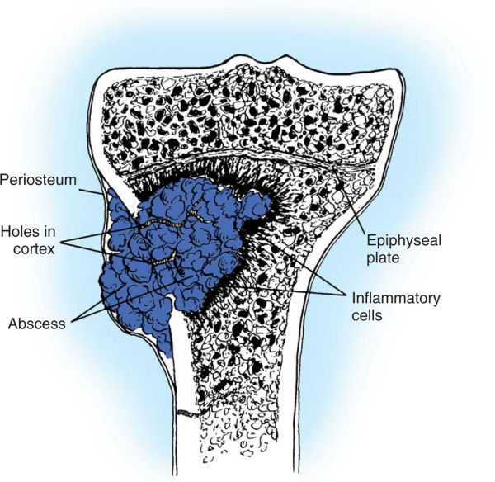
LECTURE 64
CHRONIC OSTEOMYELITIS
Dr Malkesh Shah
Assistant Professor
Dept of Orthopaedics
Dhiraj Hospital, SBKS MIRC
Sumandeep Vidyapeeth
Vadodara

Slide 2
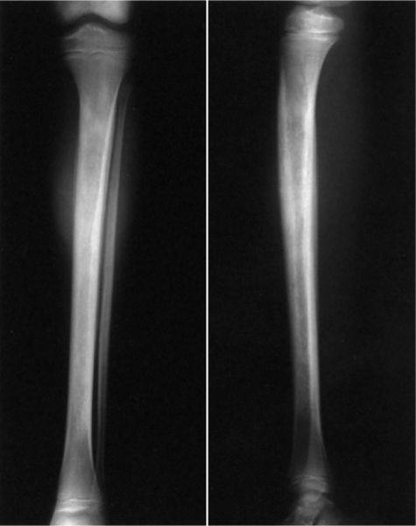
Osteomyelitis
Nelaton coined the term osteomyelitis in 1854.
Infection affecting
1)Bone
2)Medullary Cavity

Slide 3
Depending on Severity, Onset and Duration
Can be divided into :-
Acute osteomyelitis
2) Sub acute osteomyelitis
3) Chronic osteomyelitis

Slide 4
Acute osteomyelitis
Acute onset
Symptoms and signs are severe
Child is toxic
Subacute osteomyelitis
Onset is indolent
Symptoms and signs are mild
Complaints for more than 2 weeks
Chronic osteomyelitis
Onset insidious
Long history of symptoms
H/O acute exerbations in chronic course

Slide 5
Usually affects
Children – Bimodal age distribution
Below 2 years
Between 8 – 12 years
Involves metaphyses of rapidly growing long bones.
In neonates the periosteum is loosely applied to the cortical surface, which can allow pus to track upwards between these surfaces and extend over the entire length of the bone or rupture into the soft tissues

Slide 6
Why Metaphysis?
Hair pin bend arrangement of arterioles.
Less phagocytic activity at this site.
Sluggish flow.
Tortous blood vessels and skimming of bacteria.
Dead and degenerating cartilage cells from physeal plate serve as medium for growth.
Microfractures and local hematoma common in young active children.

Slide 7
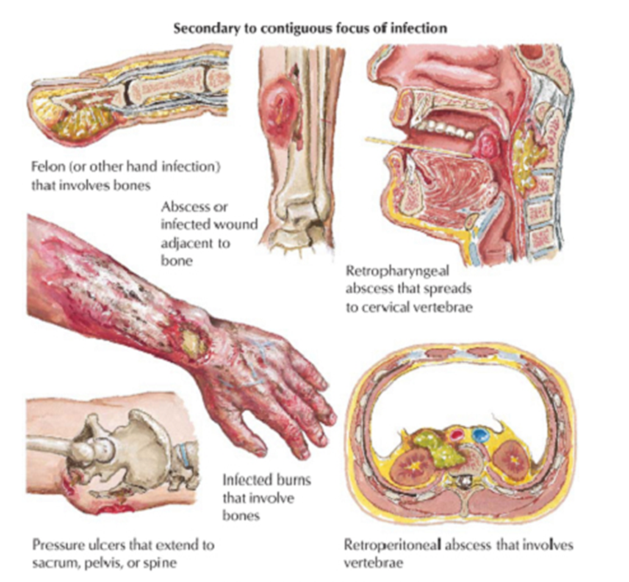
Infection may enter bones in the following ways:
1) By hematogenous spread.
2) By extension from an adjacent structure that is infected.

Slide 8
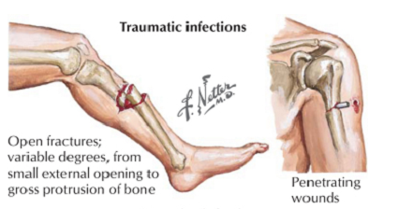
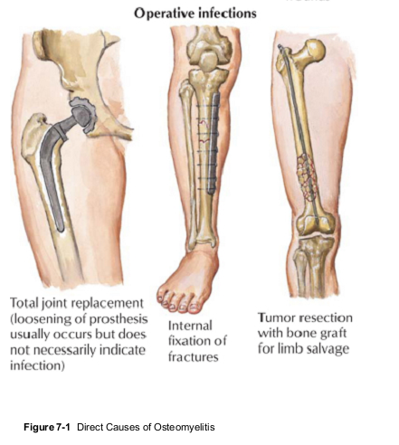
2)Through external inoculation from an open fracture or following surgery.
The route of entry is an important factor in the patient's presentation and treatment.

Slide 9
Organisms Involved
Staphylococcus Aureus
Group B streptococcus
Gram Negative organisms
Salmonella
Fungal osteomyelitis
Viral osteomyelitis
Anaerobic osteomyelitis
Staphylococcus aureus - Most common organism.
Pseudomonas - Most common in intravenous drug abusers.

Slide 10
Fungal Osteomyelitis - Chronically ill patients.
Salmonella Osteomyelitis – Sickle cell Anaemia.
In infants - S. aureus is a frequent isolate.
Group B streptococcus - Infects healthy infants 2 to 4 weeks old.
Haemophilus influenzae infections - In children 6 months to 4 years old.

Slide 11
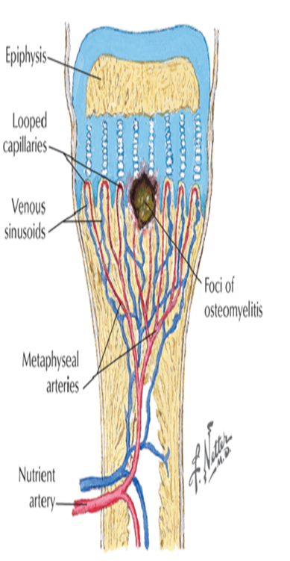

Pathophysiology
Growth plate (physis) is a barrier to metaphyseal arteries
Vessels make a U-turn at the physis.
Resultant sluggish circulation + Transient bacteremia
Setup for bacteria to gain a foothold in the metaphysis

Slide 12
Infection now can spreads in two directions:
  (Along the path of least resistance)
  (1) Down the medullary cavity
(2) Through the relatively thin metaphyseal cortex

Slide 13
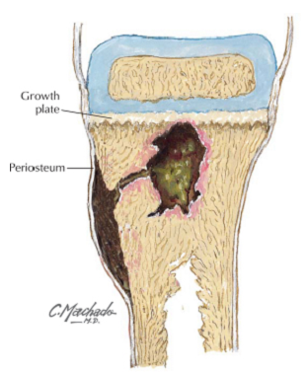
Epiphysis and Joint spared
Growth plate is a barrier
Infectious process
penetrates metaphyseal cortex
pus elevates the loosely adherent periosteum
Subperiosteal abscess may form

Slide 14
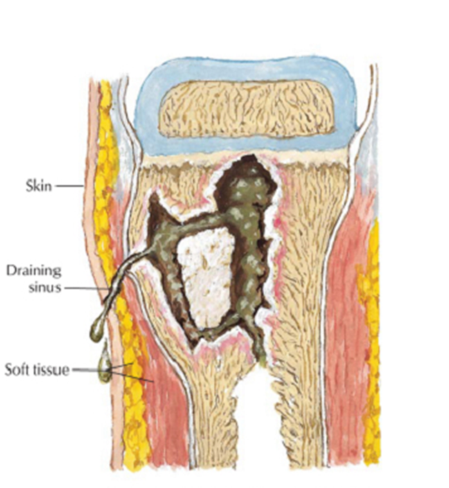
Down the medullary cavity
Infection erodes periosteum and forms sinus through soft tissue and skin to drain externally
Periosteum attempts to limit infection by laying down new bone – periosteal new bone formation

Slide 15
Bacterial antigens and toxins
Striking inflammatory response
Neutrophils and lymphocytes migrate to the metaphysis
Release interleukins and cytokines.
Enzymes + thrombosis of terminal vessels
Dramatic necrosis and osteolysis

Slide 16
In children younger than 2 years
Common blood supply of metaphysis and epiphysis crosses the physis spread of a metaphyseal abscess into the epiphysis and eventually into the joint.
Septic Arthritis
Hip
Radial Neck
Shoulder
Distal lateral fibula

Slide 17
Ultimate Fate
Cloaca – Holes made in the periosteum by pus.
Involucrum – Periosteal new bone formation in an attempt to contain infection.
Sequestrum – Dead piece of bone warded off from parent bone

Slide 18
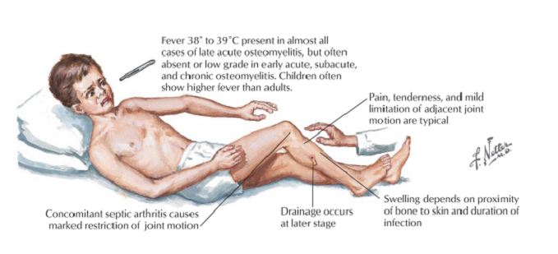
Clinical Features
Symptoms
1)Fever sometimes with chills
2) Pain
3)Swelling of affected part
4)Limitation of motion
Signs
1)Pt is Febrile
2)Warm
3)Swollen & Tender
4)Movements of part is painful

Slide 19
Diagnosis
Exams and Tests
A physical exam shows bone tenderness and possibly swelling and redness.
Tests may include:
Blood cultures
Bone biopsy (which is then cultured)- (Most Diagnostic)
Bone scan
Bone x-ray
Complete blood count (CBC)
C-reactive protein (CRP)
Erythrocyte sedimentation rate (ESR)
MRI of the bone and other scans
Needle aspiration of the area around affected bones

Slide 20
Diagnosis
In infants, elderly , or immunocompromised pts Clinical findings may be minimal
History and physical examination
Laboratory tests:
1)TLC, DLC
2)ESR
3)CRP
Raised
Plain radiographs
Technetium-99m bone scan ± MRI
Aspiration for suspected abscess
Culture & Sensitivity

Slide 21
Peltola & Vahvanen’s Criteria
Purulent material on aspiration of the affected bone.
Positive findings of bone tissue or blood culture.
Localised classic physical findings :- Bony Tenderness
Overlying soft tissue oedema, erythema
4. Positive radiological imaging.
Two of the four criteria required to diagnose acute osteomyelitis.

Slide 22
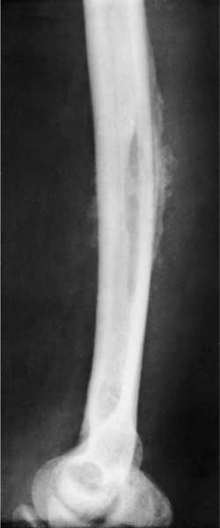
Plain Radiographs
Generally are negative, but may show soft-tissue swelling.
Skeletal changes periosteal reaction or bony destruction seen 10 to 12 days after infection.
Bone resorption seen as mottled areas of decreased density in metaphyseal area.
Later, a thin line of newly formed bone parallel to the shaft appears in the periosteal region of metaphysis due to infection progressing into the subperiosteal region.

Slide 23
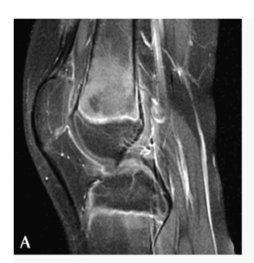
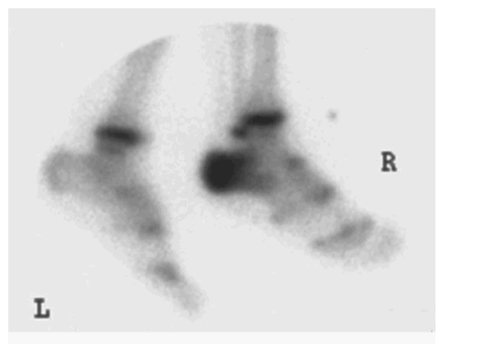
Technetium-99m bone scan ± MRI
MRI can show early inflammatory changes in bone marrow and soft tissue.
Technetium Tc 99m bone scan is a very sensitive and specific test for acute osteomyelitis.
Bone scan will show increased uptake

Slide 24
Technetium-99 pyrophosphate injected intravenously
Infection will absorb show an increased concentration
Seen with a special camera that produces the images on a computer screen
Abnormalities detected in early stages even when X-ray show normal findings.

Slide 25
Other Scan Modalities
Technetium-99m (^{99m}Tc) bone scan
Gallium-67 (⁶⁷Ga) scan
Indium-111–labeled leukocyte (¹¹¹In WBC) scan

Slide 26
Gallium Scan
Has been suggested to be more accurate than technetium scanning in detecting bone and joint infections in children.
Gallium works by localizing bacteria and inflammatory proteins in PMNs.
BUT
Any reactive bone process may also cause increased uptake.

Slide 27
Three-phase bone scan is the procedure of choice if the suspected osteomyelitis is not superimposed on another disease that cause increased bone remodeling.
If the suspected osteomyelitis is superimposed on a disease that causes increased bone remodeling, the combined Indium-111-labeled leukocyte-Technetium-99m bone scan is the procedure of choice.

Slide 28
Aspiration for suspected abscess
Performed with 16-gauge or 18-gauge needle in region of maximal swelling and tenderness.
Subperiosteal space should be aspirated first by inserting the needle to the level of the outer cortex.
If no aspirate
Needle is placed through the cortex to obtain a marrow aspirate.
Culture & Sensitivity
Gram Staining

Slide 29
TREATMENT
Nade 5 principles for treatment of acute osteomyelitis
(1) Antibiotic is effective before pus formation
(2) Antibiotics do not sterilize avascular tissues or abscesses which requires surgical removal
(3) If such removal is effective, antibiotics prevent their reformation, and primary wound closure is be safe.
(4) Surgery should not damage further already ischemic bone and soft tissue.
(5) Antibiotics should be continued after surgery.

Slide 30
Antibiotic alone
Antibiotic with surgery
OR
Intravenous fluids
2) Appropriate antibiotics
3) Appropriate analgesics
4) Comfortable positioning of the affected limb.
5) Frequent serial examinations should be done.
6) CRP checked every 2-3 days after starting antibiotic theray.

Slide 31
Main indications for surgery
Presence of an abscess requiring drainage.
Failure of the patient to improve despite appropriate intravenous antibiotic treatment.

Slide 32
Drainage of Acute Osteomyelitis
Golden rule for abcess anywhere in the body
Drainage
Drain any abscess cavity and remove all nonviable or necrotic tissue.
Objective

Slide 33
When a subperiosteal abscess is found in an infant, several small holes should be drilled through the cortex into the medullary canal.
If intramedullary pus is found, a small window of bone is removed. Skin is closed over drains, and the limb is splinted. The limb is protected for several weeks to prevent pathological fracture. Intravenous antibiotics should be continued postoperatively

Slide 34
AFTER TREATMENT
Plaster splint is applied.
Antibiotics based on culture sensitivities. Generally, a 6-week course of intravenous antibiotics is given.
Follow-up is continued for at least 1 year.

Slide 35
Differential Diagnosis
Cellulitis
2) Septic arthritis
3) Fracture
4) Neoplasm – Leukemia and Ewing Sarcoma
5) Bone infarction.

Slide 36
Complications
Recurrent osteomyelitis
2) Distant seeding
Concomitant septic arthritis and physeal separation
Pathologic fracture
5) Growth arrest – Limb length discrepancy developes uncommonly but angular deformity is more common.

Slide 37
Chronic osteomyelitis

Slide 38
Chronic osteomyelitis
A sequelea of AHO that is difficult to eradicate completely.
In any infection of bone there is an attempt to repair that, if incomplete, leads tochronic osteomyelitis characterised by persistence of low grade infections, subject to recurrent recrudescenceof acute process over many months.
The hallmark of chronic osteomyelitis is infected dead bone within a compromised soft tissue envelope.
The infected foci within the bone are surrounded by sclerotic, relatively avascular bone; the haversian canals become sealed off by scar tissue and proteinaceous material, and this is covered by scarred, thickened periosteum and scarred muscle and subcutaneous tissue. Thus the infected focus becomes relatively avascular. In this situation, systemic antibiotics that require tissue perfusion to be effective have limited value.

Slide 39

PERIOSTEAL NEW BONE
FORMATION
INVOLUCRUM
SEQUESTRUM

Slide 40
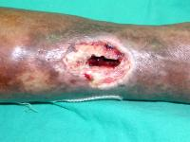
PUS DISCHARGING SINUS WITH
BONE EXPOSED
HALLMARK OF CHRONIC
OSTEOMYELITIS

Slide 41
TYPES OF SEQUESTRUM
RING SEUESTRUM in amputated stumps
MIRROR EN GRAFFE soft fluffy sequestrum found in tubercular osteomyelitis
BOMBAY SEQUESTRUM
COLOURED SEQUESTRUM in fungal infection
PORK SEQUESTRUM in diaphyseal involvement in tuberculosis
SAND SEQUESTRUM In metaphyseal involvement in tuberculosis

Slide 42
Cierny and Mader Classification
Based on physiological and anatomical criteria, to determine the clinical stage of infection.
This classification is helpful in treatment planning and in determining if treatment will be simple or complex, curative or palliative, or ablative or limb sparing
PHYSIOLOGICAL CRITERIA:-
Divided into three classes based on three types of hosts.
Class A Hosts have a normal response to infection and surgery.
Class B Hosts are compromised patients with local, systemic, or combined deficiencies in wound healing.
Class C Host When the results of treatment are potentially more damaging than the presenting condition.

Slide 43
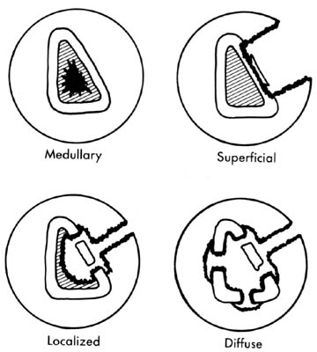
Cierny and Mader Classification
ANATOMICAL CRITERIA
TYPE I an endosteal or medullary lesion;
TYPE II superficial osteomyelitis, limited to the surface of bone;
TYPE III a localized infection involving a stable, well-demarcated lesion characterized by full-thickness cortical sequestration and cavitation (in this
type, complete debridement of the area will not lead to instability); and
TYPE IV, diffuse osteomyelitic lesions that are mechanically unstable, either at
presentation or after appropriate treatment

Slide 44
Treatment
Surgery for chronic osteomyelitis consists of sequestrectomy and resection of scarred and infected bone and soft tissue. The goal of surgery is eradication of the infection by achieving a viable and vascular environment. Radical debridement may be required to achieve this goal. Adequate debridement often leaves a large dead space that must be managed to prevent recurrence and significant bone loss that may result in loss of stability

Slide 45
Treatment
Sequestrectomy and curettage for chronic osteomyelitis-
Sequestrectomy and curettage require more time to perform and result in considerably greater blood loss than the inexperienced surgeon would anticipate.
TECHNIQUE
Sinus tracts may be injected with methylene blue 24 hours before surgery to make them easier to locate and excise. Remove all sequestra, purulent material, and scarred and necrotic tissue. If sclerotic bone seals off a cavity within the medullary canal, open it into the canal in both directions to allow blood vessels to grow into the cavity. After removing all suspicious matter, carefully excise the overhanging edges of bone and avoid leaving a cavity or dead space. If a cavity cannot be filled by the surrounding soft tissues, a local muscle flap or a free tissue transfer may be used to obliterate dead space. If possible, close the skin loosely over drains but be sure that no excessive tension is present. If closure is not possible, pack the wound open loosely and plan for delayed closure or skin grafting at a later time .Appropriate antibiotics should be used before, during, and after the operation.

Slide 46
When sequestectomy should be done??
ONLY WHEN THE INVOLUCRUM IS FORMED AND ENCOMPASS TWO THIRD OF THE CIRCUMFERENCE OF BONE DIAMETER
After treatment:-. The limb is splinted until the wound has healed, and it is then protected to prevent pathological fracture. Antibiotics usually are continued for a prolonged period.(6 weeks)

Slide 47
Two problems will face the surgeon after radical debridement ????
Instability of the remaining bone segments.
The limb is splinted until the wound has healed, and it is then protected to prevent pathological fracture
Reconstruction of the bone.
Bony and soft tissue defects must be filled to reduce the chance of continued infection and loss of function. The methods described to eliminate this dead space are bone grafting with primary or secondary closure; use of gentamicin polymethylmethacrylate (PMMA) beads as a temporary filler of the dead space before reconstruction or as a permanent filler; skin grafting and local muscle flaps with or without bone grafting; microvascular transfer of muscle, myocutaneous, osseous, and osteocutaneous flaps; and the use of bone transport (Ilizarov technique).

Slide 48
Open bone grafting (Papineau et al)
. Papineau et al. described an open bone grafting technique for the treatment of chronic osteomyelitis.
This procedure is based on the following principles:
granulation tissue markedly resists infection;
autogenous cancellous bone grafts are rapidly revascularized and are resistant to infection;
the infected area is completely excised
adequate drainage is provided
adequate immobilization is provided
antibiotics are used for prolonged periods.
The operation is divided into three stages
excision of infected tissue with or without stabilization using an external fixator or a medullary rod,
Cancellous autogenous bone grafting
skin closure

Slide 49
Polymethylmethacrylate (PMMA) antibiotic bead chains
The rationale for this treatment is to deliver levels of antibiotics locally in concentrations that exceed the minimal inhibitory concentrations. Pharmacokinetic studies have shown that the local concentrations of antibiotic achieved are 200 times higher than levels achieved with systemic antibiotic administration
This has the advantage of obtaining very high local antibiotic concentrations while maintaining low serum levels and low systemic toxicity. The antibiotic is leached from the PMMA beads into the postoperative wound hematoma and secretion, which acts as a transport medium. High concentrations of the antibiotic can be achieved only with primary wound closure; if such closure cannot be performed, the wound can be closed with a water-impermeable dressing.

Slide 50
Various biodegradable antibiotic delivery systems are now being evaluated that may replace the use of PMMA antibiotic beads.
Short-term, long-term, or permanent implantation of PMMA antibiotic beads is possible. In short-term implantations, the beads are removed within 10 days, and in long-term implantation they may be left in for up to 80 days.

Slide 51
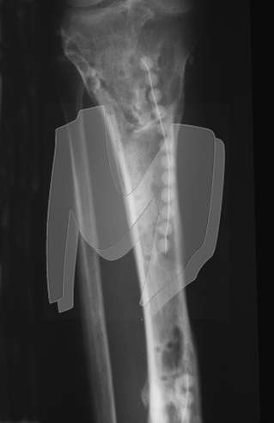

Slide 52
Closed suction drains
Closed suction antibiotic ingress and egress high-volume irrigation systems may be used over a period of 3 to 21 days; however, secondary contamination and infection with new organisms, usually hydrophilic gram-negative organisms, may occur. Because of this complication most surgeons have abandoned this treatment method.

Slide 53
Soft tissue transfer
Soft tissue transfers to fill dead space left behind after extensive debridement may range from a localized muscle flap on a vascular pedicle to microvascular free tissue transfer. The transfer of vascularized muscle tissue improves the local biological environment by bringing in a blood supply that is important in the host’s defense mechanisms, antibiotic delivery, and osseous and soft tissue healing.
Most commonly a local muscle flap is used in the treatment of chronic osteomyelitis of the tibia. The gastrocnemius muscle is used for defects about the proximal third of the tibia, and the soleus muscle is used for defects about the middle third of the tibia. A microvascular free muscle transfer is required for defects about the distal third of the tibia.
When a microvascular free muscle flap is used and segmental bone loss has occurred, autogenous cancellous bone grafting can be done for defects up to 6 cm long. If a delayed bone graft is required, this usually can be done about 6 weeks after the initial free flap transfer. A free fibular graft can be used for segmental bone loss of the tibia

Slide 54
Ilizarov technique
The Ilizarov technique has been helpful in the treatment of chronic osteomyelitis and infected nonunions. This technique allows radical resection or en bloc resection of the infected bone. A corticotomy is performed through normal bone either proximal or distal to the area of infection. The bone is transported until union is achieved. One of the disadvantages of this technique is the time needed to achieve a solid union and the high incidence of associated complications. Dendrinos et al. reported an average of 6 months to union with 2.5 complications per patient. However, even with these problems the Ilizarov procedure is of benefit in patients who require extensive resection of bone and reconstruction to achieve stability

Slide 55
Hyperbaric oxygen therapy
Hyperbaric oxygen therapy is another reported method for treating chronic osteomyelitis, but this has not proved to be reliably effective. The use of hyperbaric oxygen can be recommended only as an adjuvant to more traditional methods of treatment.

Slide 56
Complication of chronic osteomyelitis
Pathological fracture
Frequent acute exacerbation of infection
Growth abnormalities
Sinus tract malignancy due to squamous metaplasia
Amyloidosis late complication

Slide 57
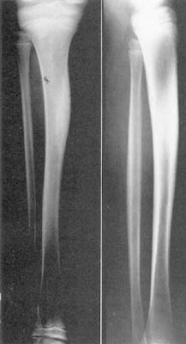
SCLEROSING OSTEOMYELITIS OF GARRÉ
Sclerosing osteomyelitis is a chronic form of disease in which the bone is thickened and distended but abscesses and sequestra are absent. The disease affects children and young adults. Its cause is unknown, but it is thought to be an infection caused by a low-grade, possibly
anaerobic bacteria.
Patients complain of intermittent pain of moderate intensity, usually of long duration. Swelling and tenderness over the affected bone may be found.
Roentgenograms show an expanded bone with generalized sclerosis. The ESR usually is slightly elevated. Biopsy shows only chronic, low-grade, nonspecific osteomyelitis, and cultures usually are negative. A secondary lesion at a distant site may occur years after onset. No treatment has been
predictably helpful, but fenestration of the sclerotic bone and antibiotics are advisable. The condition must be distinguished from osteoid osteoma and Paget disease.

Slide 58
OSTEOMYELITIS OF SPECIFIC REGIONS
Calcaneum
Destruction of the cortex usually is not extensive.
Formation of an involucrum is minimal.
Periosteum is firmly attached to bone
Periosteum is usually perforated
Rather than elevated by purulent material

Slide 59
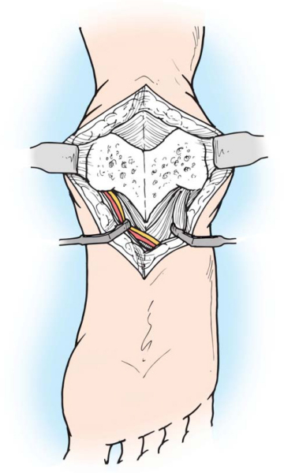
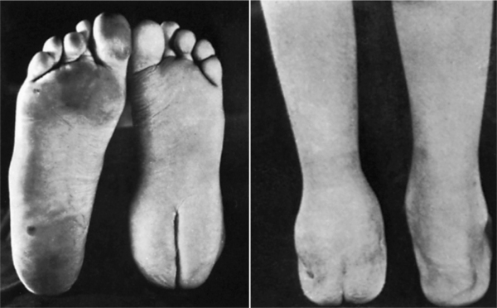
Drainage of Abcess
Medial and lateral approaches to the calcaneus I & D of abscesses
Gaenslen's approach through the plantar surface of the heel is indicated for resecting the diseased bone.
Tissues on either side curl inward and form thick cushions

Slide 60
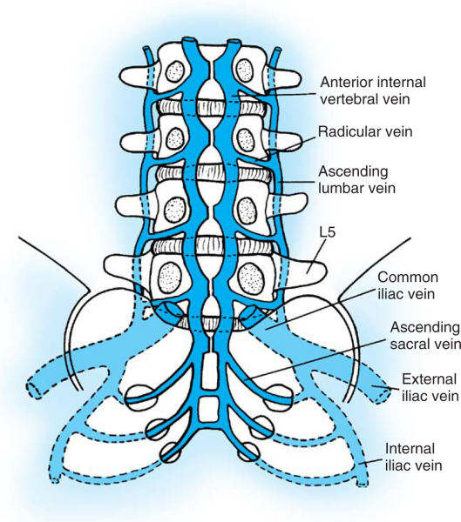
Vertebral Osteomyelitis
Infections may reach vertebrae
Urinary tract infections
Respiratory system
Batson's venous plexus
Blood borne infection
Blood Borne from any other system
More often in child than adult

Slide 61
  Risk factors
  Diabetes
  Older debilitated patients
  IV drug addicts
  UTI
  Skin infection
  Immuno-compromised patient
  Site of infection
  Lumbar spine is the area most often affected.
  Causative organism
  Staph aureus is most common but MRSA is also common.

Slide 62
Clinical Findings
Spine pain at involved level is characteristic, & tenderness, spasm, and loss of motion are seen.
Pain restricts ROM of spine, & percussion over spinous process is tender.
Neurological weakness.

Slide 63
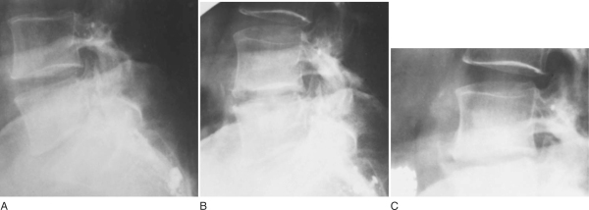
Radiographic Features
Osteolysis occurs
Rarefaction of adjacent vertebral bodies
Trabecular collapse and new bone formation
Disc space narrowing.
Other scanning modalities are useful

Slide 64
Treatment
Conservative
Operative

Slide 65
Author/year | Study design | Level | Results | Outcome
Aloui N, Nessib N, Jalel C, Ellouze S, Ben Chehida F, Sayed M, Bellagha I, Ghachem M, Hammou A. 2004 Apr | prospective study | III | MRI was normal in 7 children (26%). Bone marrow signal abnormality was noted in 19 cases (74%) consistent with acute osteomyelitis in 18 cases and metastatic neuroblastoma in 1 case | MRI is useful for evaluation of children presenting with sepsis and acute musculoskeletal pain, early diagnosis of osteomyelitis and to prevent unnecessary hospital admission and work-up

Slide 66
Thank you

Slide 67
MCQ 1
Osteomyelitis affects:
Long Bones only
Medullary cavity only
All bones and medullary cavity
Short bones only
None of the above

Slide 68
MCQ 2
Most common organism isolated in osteomyelitis is:
Staphylococcous Aureus
Salmonella Typhi
Haemophilus Influenzae
Streptococcous epidermidis
Pseudomonas

Slide 69
MCQ 3
Most common organism isolated in iv drug abusers is:
Pseudomonas
Staphylococcus
Streptococcus
H Influenzae

Slide 70
MCQ 4
Osteomyelitis affects the metaphysis of long bone due to:
Hair bend arrangement of blood vessels
Z shape arrangement of blood vessels
Y shape arrangement of blood vessels
X shape arrangement of blood vessels
A shape arrangement of blood vessels

Slide 71
MCQ 5
Which is a very sensitive and specific test for acute osteomyelitis
MRI
Technetium Tc 99m bone scan
CT scan
X ray
All of the above

