Slide 1
KOCH’S SPINE MANAGEMENT
DR . Rishit Soni
ASSISTANT PROFESSOR
DEPT OF ORTHOPAEDICS, DHIRAJ HOSPITAL
SBKS MIRC, SUMANDEEP VIDYAPEETH
VADODARA

Slide 2
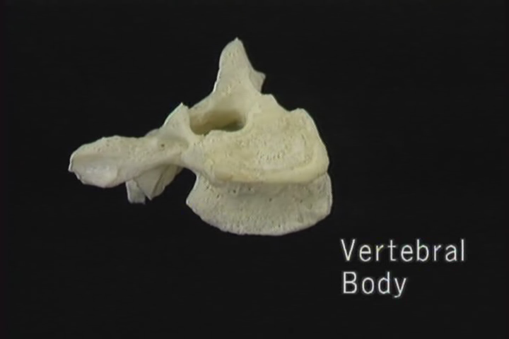
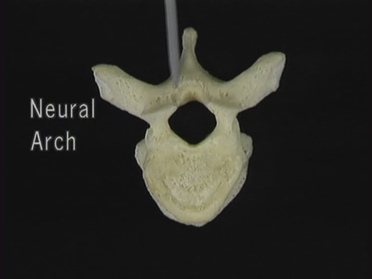
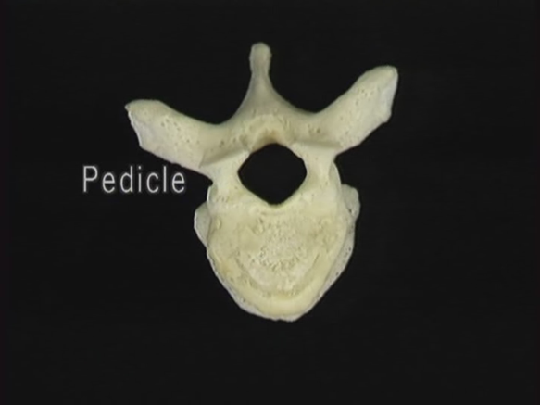
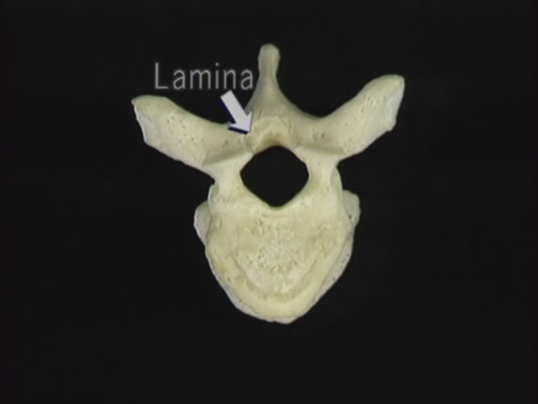
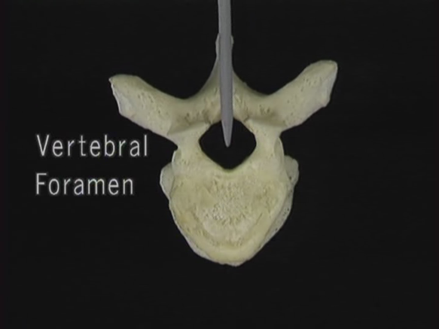
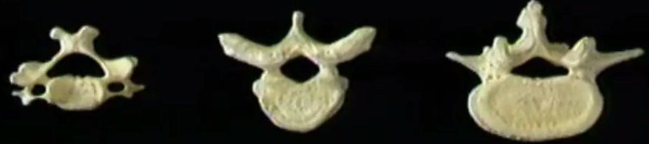
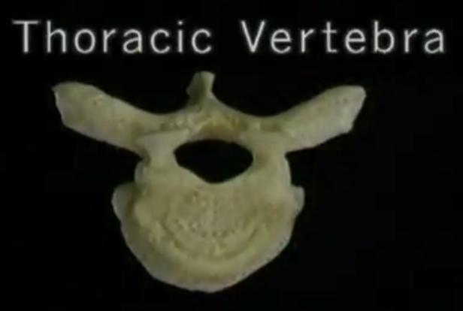
.
MANAGEMENT

Slide 3
NATURAL COURSE WITHOUT CHEMOTHERAPY
STAGE OF ONSET
Lasts 1 month to 1 year
Localised disease --- warm, tender swelling --- Localised osteoporosis with minimised destruction
STAGE OF DESTRUCTION
Lasts 1 to 3 years
Gross destruction of bones and joints with deformity, subluxation, contractures and abscess formation
Abscess gets ruptured, sinuses and secondary pyogenic infections occur
LOWERED Defence mechanism
Severe cachexia
Miliary tuberculosis and/or meningitis
1/3rd of patients die

Slide 4
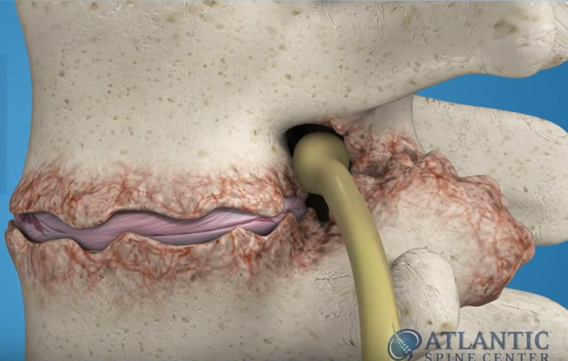
STAGE OF REPAIR AND ANKYLOSIS
Occurs 3 years after onset
Improved general condition
Resorption of abscesses
Healed sinuses
Destroyed bones remineralised
Fusion in deformed position(kyphosis)
Unsound ankylosis-unsatisfactory
(pain on movement and weight bearing)

Slide 5
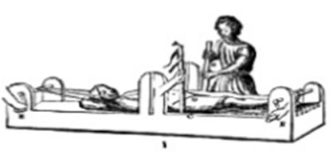

Basic principles of management
Early diagnosis
Expeditious medical treatment
Aggressive surgical approach
Prevention of deformity
Expect good functional outcome

Slide 6
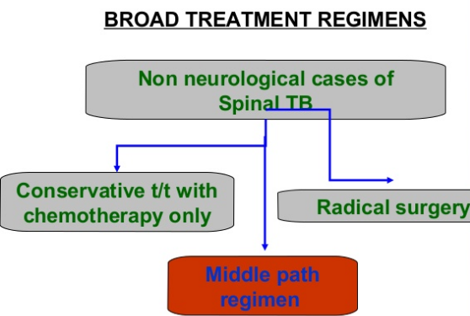

Slide 7
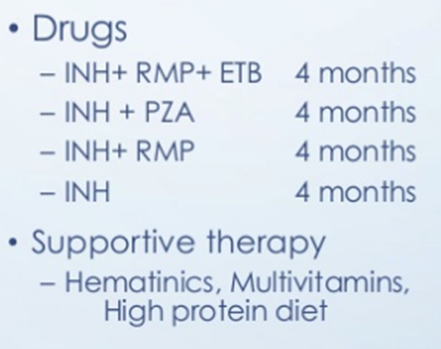
MIDDLE PATH REGIME
Dr SM TULI: “ All spine TB cases do not require surgery and only those who do not respond to conservative measures should be operated
Rest in hard bed
Drugs (DOTS)
X ray and ESR once in 3 months
MRI once in 6 months for 2 years
Gradual mobilization with Taylor’s brace at 3-9 weeks
Aspirate abscesses and instill 1 gm streptomycin or isoniazide

Slide 8
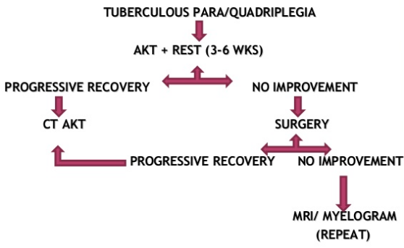
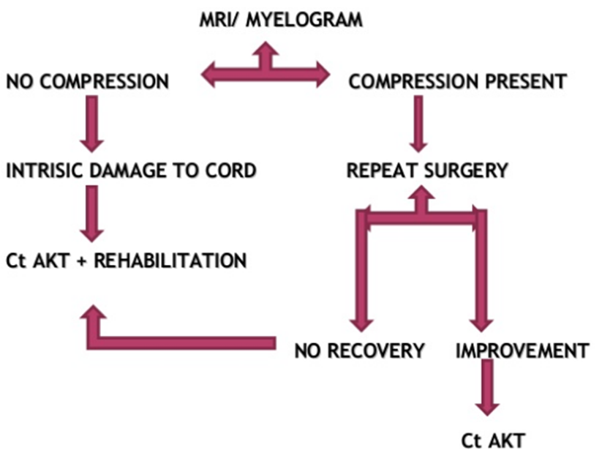

Slide 9
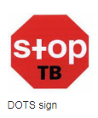
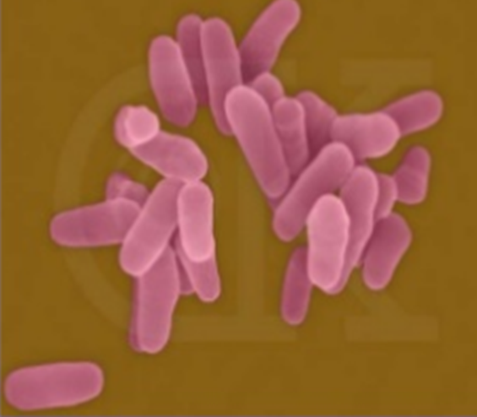
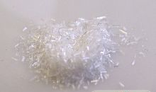
pharmacotherapy
Ethambutol

Slide 10
1st line chemotherapy
Sr No. | Bactericidal drugs | Dose
1 | Isoniazide | 5 mg/kg
2 | Rifampicin | 10-15 mg/kg
3 | Streptomycin | 20 mg/kg
4 | Pyrazinamide | 20-25 mg/kg
 | Bacteriostatic drugs | Dose
1 | Ethambutol (S/E: optic neuritis, red green colour blindness) | 25mg/kg for 2 months, then 15mg/kg

Slide 11
2nd line chemotherapy
Amikacin, Kanamycin, Capriomycin
Ciprofloxacin, Ofloxacin, Levofloxacin
Rifabutin
Clarithromycin
PAS (Para amino salicylic acid)
Bedaquiline
Delamanid
Clofazimine
Imipenam – Cilastin
Thioacetazone
Amoxicillin – Clavulinic acid

Slide 12
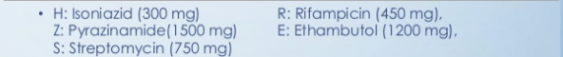
Dots (direct observation treatment strategy) – given daily (Recent Guidelines)
Category 1
Category II
New Sputum smear positive
New extra pulmonary Tuberculosis
Relapse
Failure
Default
2 HRZE + 4 HR 2 HRZES + 1 HRZE + 5 HRE

Slide 13
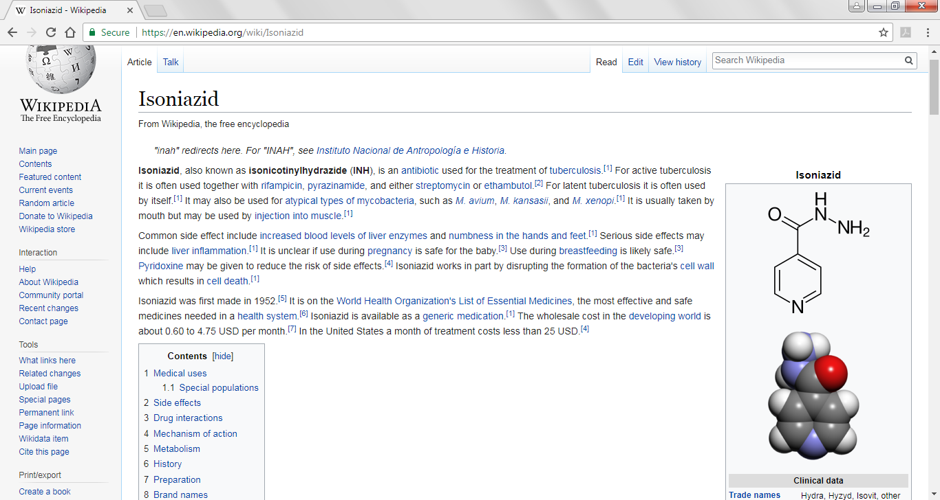
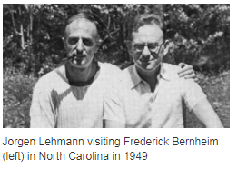
Isoniazide PAS
1951 – Isonicotinic hydrazide
Bayer – Germany
Squibb – USA
Hoffmann – LaRouche – USA
Disrupts cell wall
↑ Liver enzymes, numbness
Pyridoxine
1940
Para amino salicylic acid
Frederick Bernhiem & Lehmann
Duke University, North Carolina, USA

Slide 14
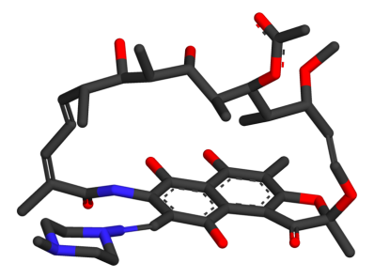
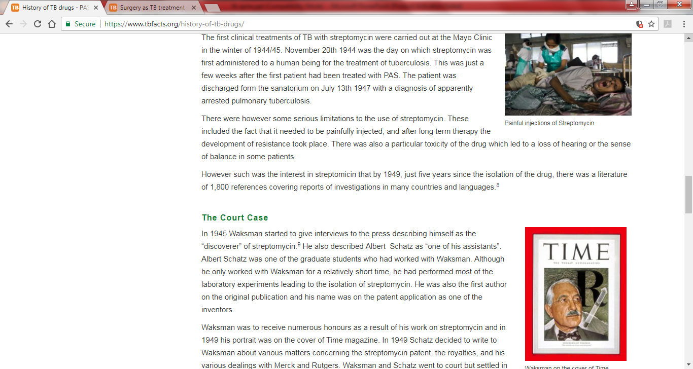
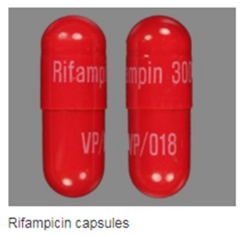
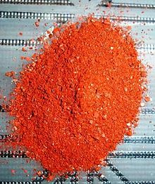
Rifampicin STREPTOMYCIN
1959 – Lepetit Pharmaceuticals, Italy
Pine forests of French Riveria
Professor Piero Sensi & Dr Maria Teresa Timbal
Action: Stops RNA production
S/E: orange urine
1945 – Waksman & Schatz
Painful injections
S/E: Hearing loss

Slide 15
Bedaquiline & Delamanid
2012
MDR TB
XDR TB
RR TB
S/E: Joint pains, QT prolongation
}
2012
MDR TB
XDR TB
RR TB
S/E: Nausea, Vomitting, Diarrhoea, QT prolong
}
Blocks ATP synthase
Blocks Mycolic acid in cell wall

Slide 16
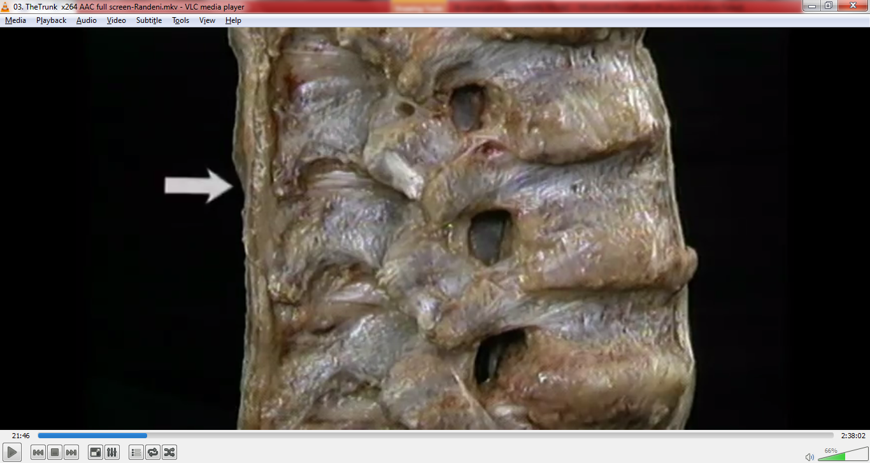
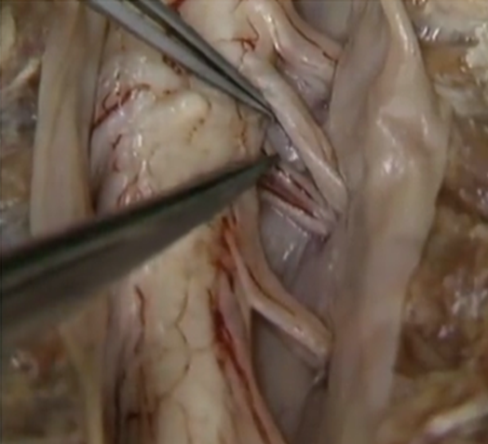
Surgical approaches

Slide 17
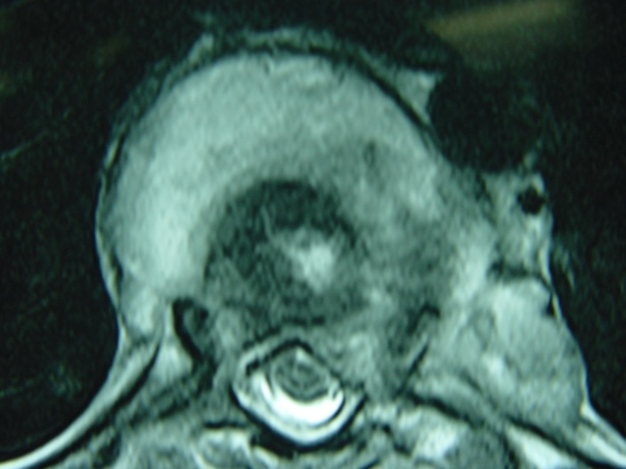
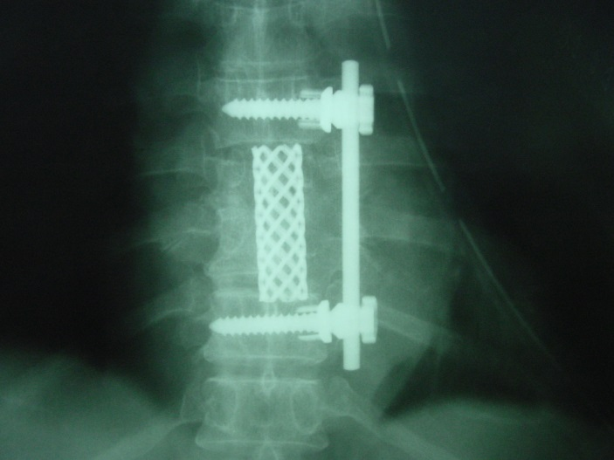
ROLE OF SURGERY
DRAINAGE OF ABSCESS
SCRAPPING LESION
PROGRESSIVE PARAPLEGIA
PULMONARY INSUFFICIENCY
STABILISATION
CONFIRMATION OF HISTO-PATH

Slide 18
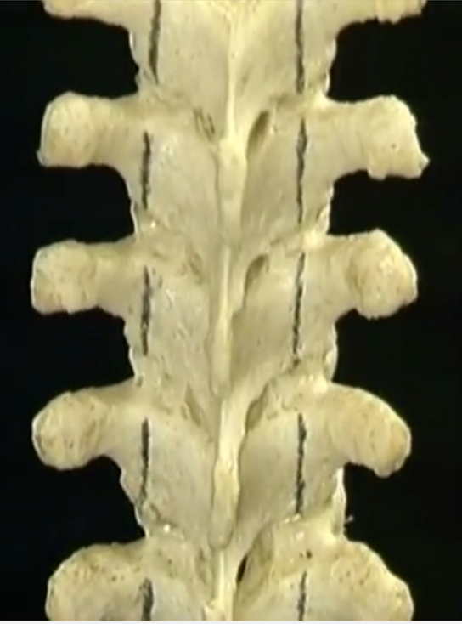
Indications of surgery
No neurological recovery
Neurological complication during conservative treatment
Worsening of neurology
Recurrence , relapse
Pressure effects on deglutition & respiration
Sphincter disturbances, flaccid paralysis, severe flexor spasms

Slide 19
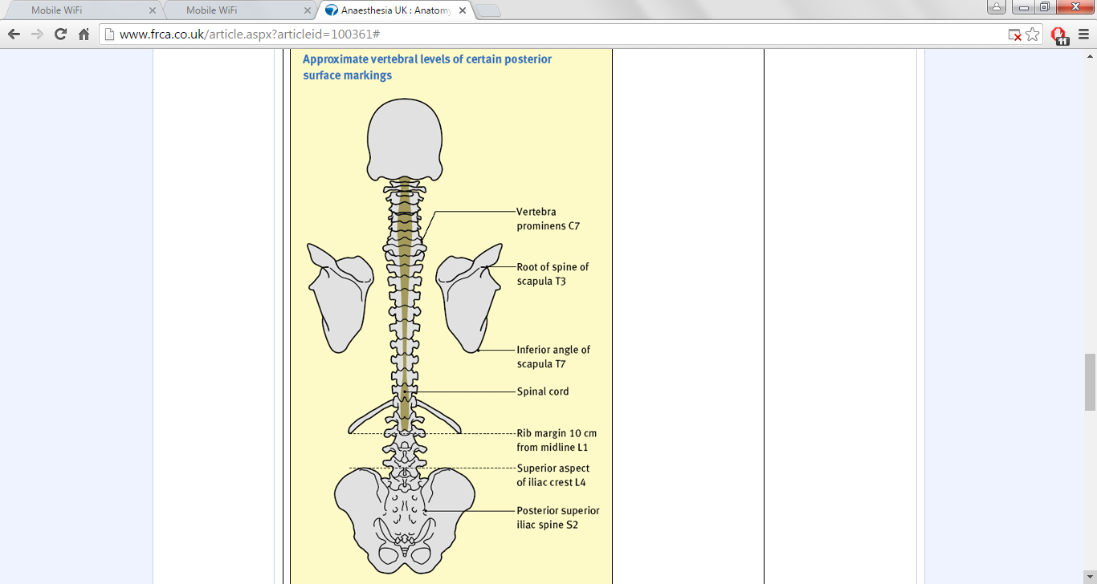
PREFERRED APPROACHES
Cervical Spine --- Anterior
Cervico Dorsal --- Thoracotomy Through Second Rib
Dorsal --- Thoracotomy
Dorsolumbar Junction --- Thoraco Abdominal Approach
Lumbar --- Retroperitoneal
Lumbosacral --- Anterior Laparotomy

Slide 20
TULI ‘S RECOMMENDED APPROACH
CERVICAL SPINE - Anterior approach
DORSAL SPINE – Anterolateral approach
LUMBAR SPINE & LUMBOSACRAL JUNCTION - Extraperitoneal Transverse Vertebrotomy

Slide 21
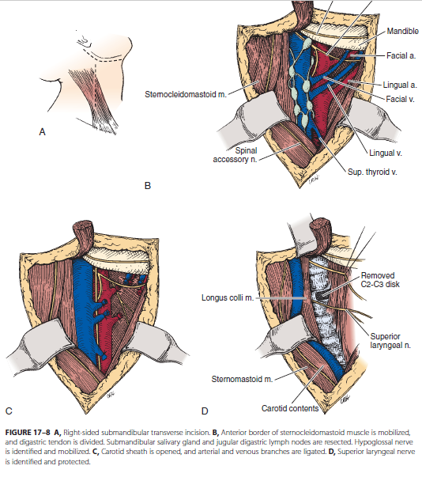
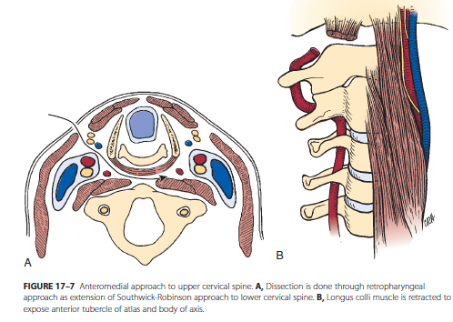
Approaches to Cervical spine
Abscess drainage –
retropharyngeal, posterior triangle and supraclavicular region

Slide 22
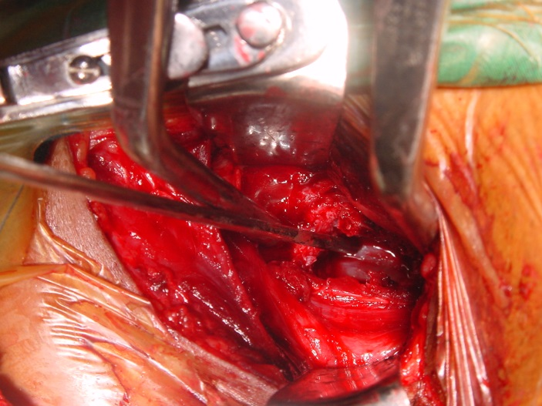
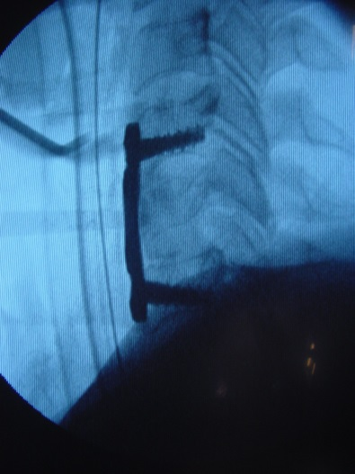
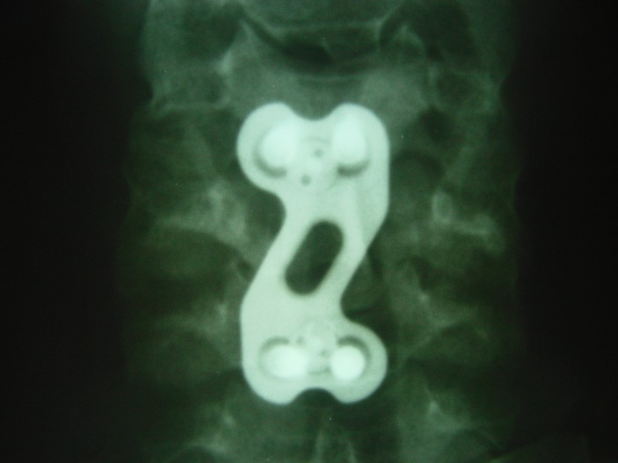
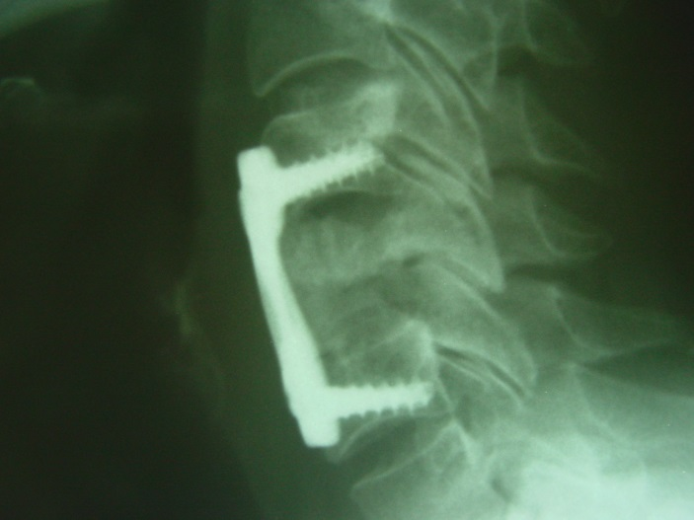
PARALYSIS – PREVENTION OF PROGRESSION
DECOMPRESSION & STABILISATION

Slide 23
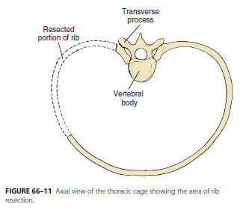
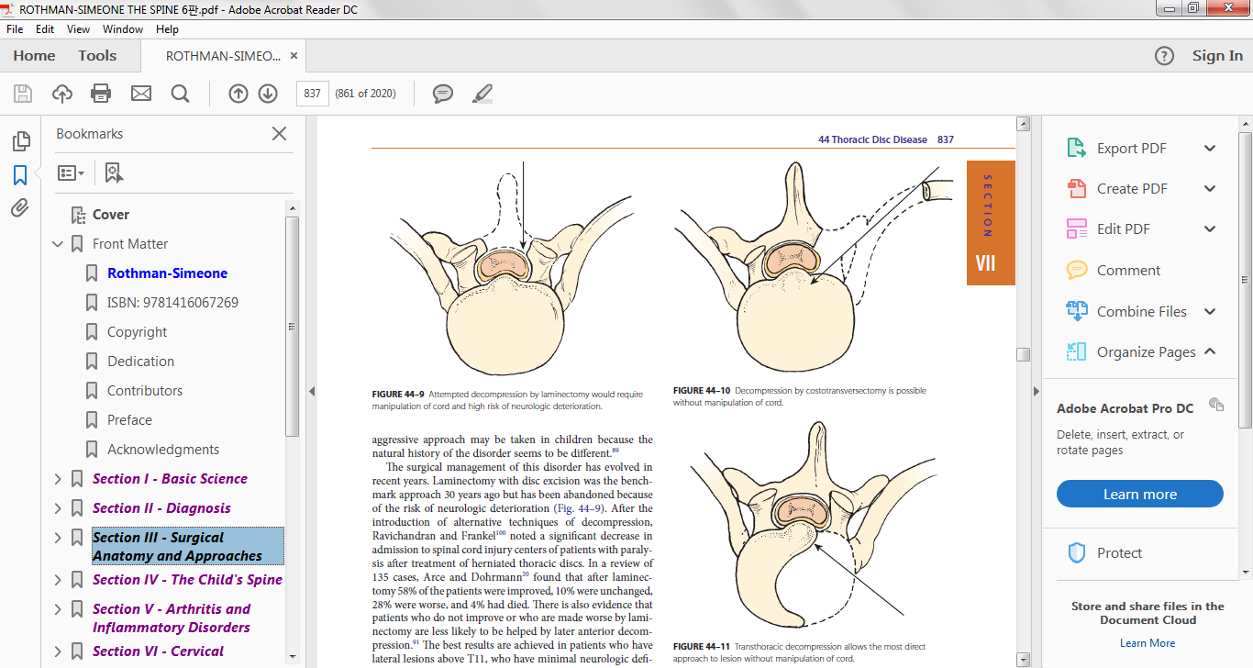
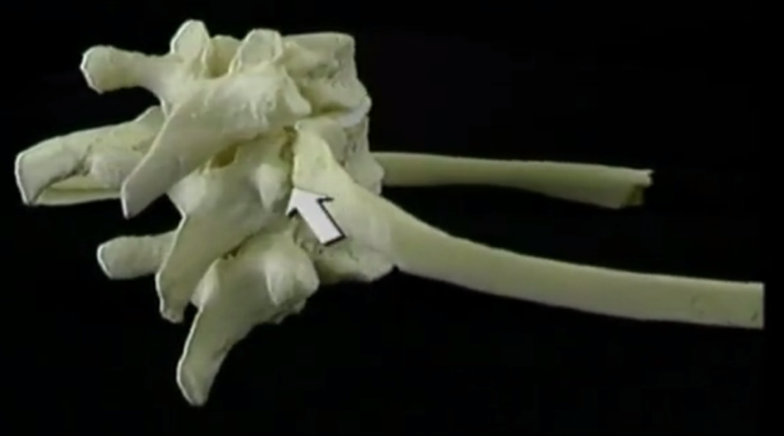
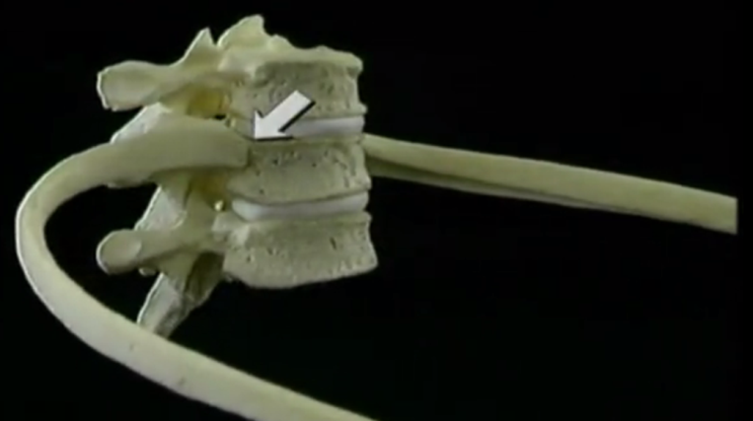
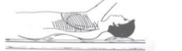
Approaches to dorsal spine
Costotransversectomy - MENARD

Slide 24
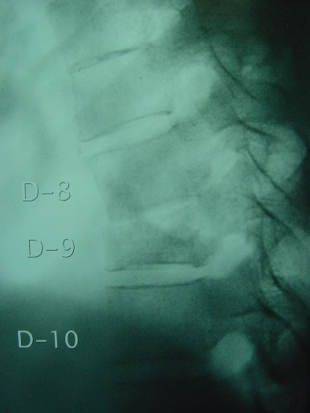
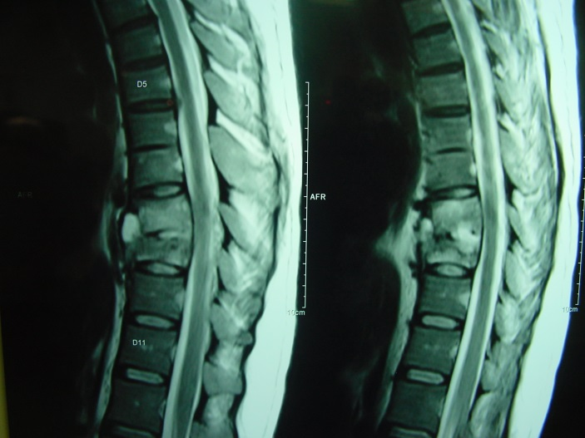
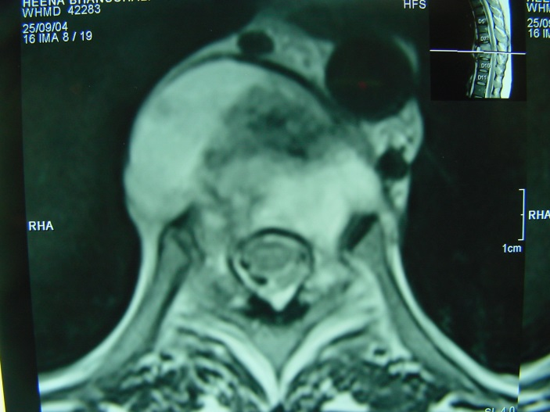
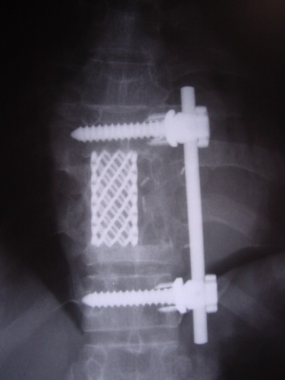
PARALYSIS – PREVENTION OF PROGRESSION
DECOMPRESSION & STABILISATION

Slide 25
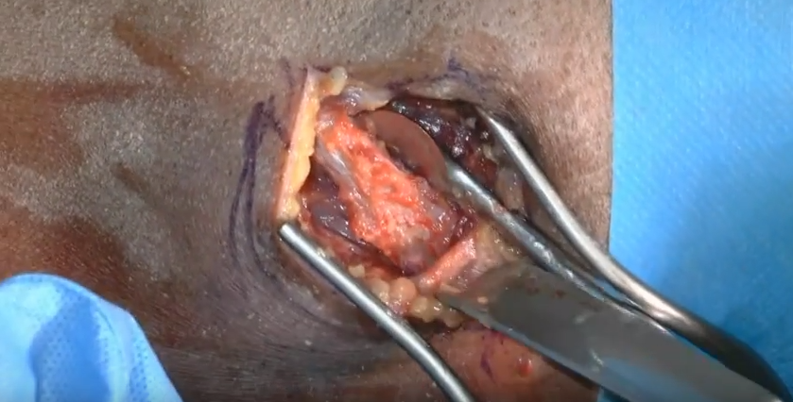
ALD – ANTERO LATERAL DECOMPRESSION PARAPLEGIC / NEUROLOGICAL DEFICIT
Rib
Transverse process
Pedicle
Curette vertebrae anteriorly
Leaves big void anteriorly --- instability --- kyphosis --- later internal Gibbus

Slide 26
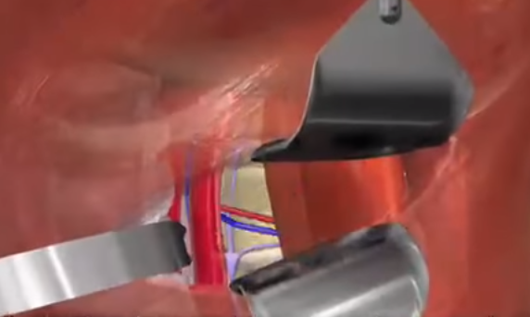
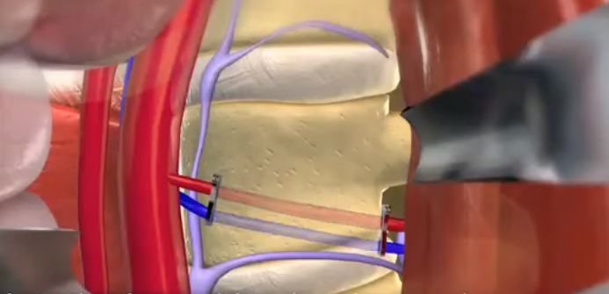
lumbar spine: ANTERIOR SURGERY
Radical surgery
Deals with the precise pathology
Stabilizes vertebrae
Decompresses thoroughly
Beware of aorta and its bifurcations

Slide 27
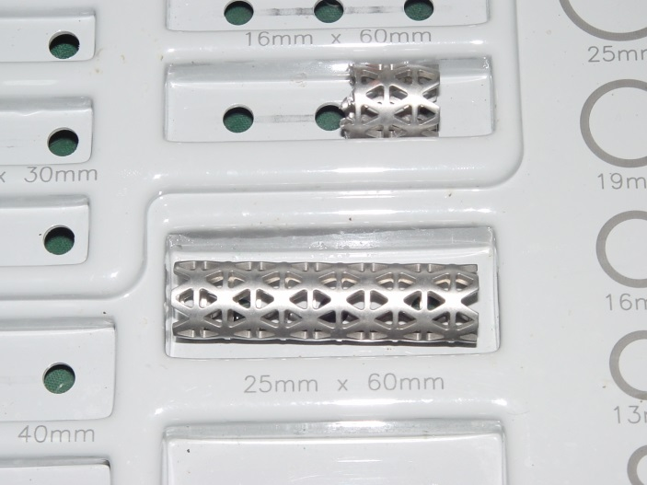
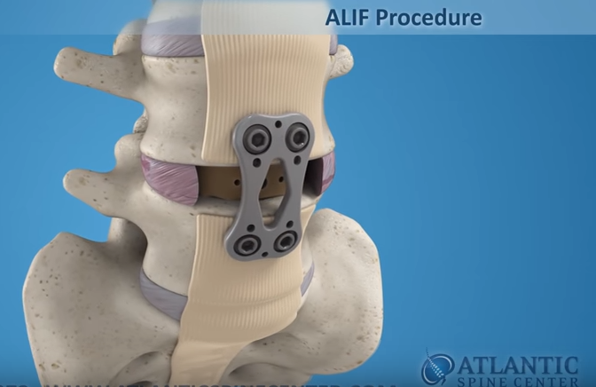
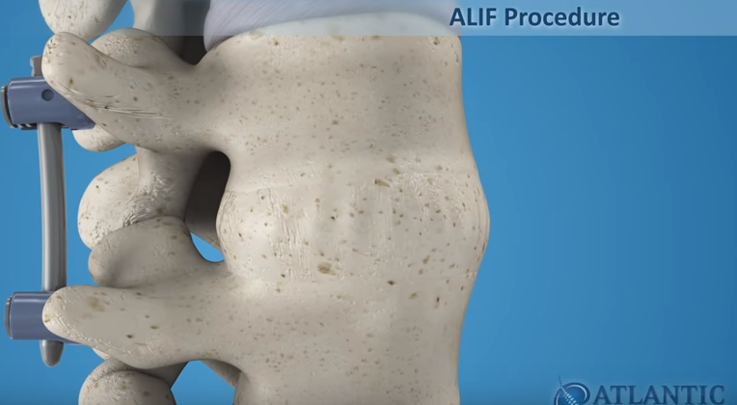
HARDWARE
Anterior plating or screw and rod fixation
OR
Post segmental pedicle screw fixation

Slide 28
ANTERIOR DECOMPRESSION WITH POSTERIOR INSTRUMENTATION with or without bone grafting
Recently, Anil Jain et.al. reported decompression by ALD with posterior instrumentation and bone grafting.
Probably less invasive and cheaper alternative.
Have shown good results.
Golwala et al hypothesised that after curettage, void created is filled up by haematoma which gets organized and forms new bone
Implants maintain the distraction till consolidation occurs in vertebra. So no need for bone grafting.
This method is more useful when there is multiple level involvement eg. skip lesions

Slide 29


Posterior spinal arthrodesis
ALBEE – tibial graft inserted longitudinally in to the split spinous processes across the diseased site
HIBBS – overlapping numerous small osseous flaps from contiguous laminae, spinous processes and articular facets
Indications:
1. Mechanical instability of spine in otherwise healed disease
2. To stabilize the craniovertebral region
3. As a part of panvertebral operation

Slide 30


BONE GRAFTING
Tricortical iliac crest : good , preferred
Rib graft : good osteo-induction
likely to fracture or
collapse
Fibular good strength
femoral : and
tibial poor osteo induction

Slide 31

Surgical correction of severe kyphotic deformity
To perform an osteotomy on the concave side of the curve and wedge it open (secured with strong autogenous iliac grafts).
To remove a wedge on the convex side and close this wedge (Harrington compression rods and hooks)

Slide 32




PREVENTION OF DEFORMITY
POST,
+
PL
TITANIUM
CAGE
RECONSTITUTE POSTERIOR CONSTRUCT

Slide 33




CORRECTION OF DEFORMITY
PRE-OP
KOCHS
DL JN
AKT
9 MTHS
EARLY NEURO
GLOBAL SURGERY
POST.+ ANT.

Slide 34
Post operative protocol
NEUROLOGICALLY INTACT
NEURODEFICIT
Taylor’s brace applied after 48 hours
Patient is kept ambulatory
Regular neurocharting
Taylor’s brace applied when patient sit for support
Ambulatory after 3 months
Variable to clinical and radiological outcome

Slide 35


RAJNIBEN PATIDAR, 25/F FRANKEL’S GR- D
PREOP: L3-4 KOCH’S WITH PSOAS ABSCESS
Courtesy: Prof Dr Golwala

Slide 36




Slide 37


RAJNIBEN : IMMEDIATE POST OP
Courtesy: Prof Dr Golwala

Slide 38


RAJNIBEN : 3 MONTHS POST OP
Courtesy: Prof Dr Golwala

Slide 39


YOGESH PATEL, 18/M, KOCH’S C 3, FRANKEL’S GR- D
PREOP
Courtesy: Prof Dr Golwala

Slide 40




Slide 41


YOGESH : IMMEDIATE POST OP
Courtesy: Prof Dr Golwala

Slide 42



YOGESH : 3 MONTHS POST OP
Courtesy: Prof Dr Golwala

Slide 43


KANTIBHAI, M/60Y
Courtesy: Prof Dr Golwala

Slide 44


Courtesy: Prof Dr Golwala

Slide 45
COMPLICATIONS
Paraplegia
  Difficult to rehabilitate
  Bed sores
  UTI
Unyielding TB infection associated with HIV may lead to death.

Slide 46
AUTONOMIC DYSFUNCTION
SPINAL CORD LESION WITH NEUROLOGICAL DEFICIT IS ASSOCIATED WITH SIGNIFICANT DYSFUNCTION OF SYMPATHETIC NERVOUS SYSTEM
LOSS OF SUPRA-SPINAL CONTROL OF SYMPATHETIC NERVOUS SYSTEM
ASSOCIATED WITH CERVICAL AND DORSAL SPINE TUBERCULOSIS

Slide 47
AUTONOMIC DYSFUNCTION CONT…
COMPLICATED BY 3 PHENOMENON BELOW THE LEVEL OF LESION:
1) REDUCED SYMPATHETIC ACTIVITY LEADS TO ORTHOSTATIC HYPOTENSION
2) LOW RESTING BLOOD PRESSURE
3) REFLEX BRADYCARDIA
4) CARDIAC ARREST

Slide 48
FOLLOW UP (MONTHS – 3,6,9,12,15,18)
CLINICAL
RADIOLOGICAL
Weight gain
Pain relief
Free Range of motion
Resolution of abscesses
Neurological recovery
Decreased soft tissue shadow
Disappearance of erosion
Return of mineralization
Graft incorporation
Bony ankylosis

Slide 49


Recurrence / relapse
Extra dural granuloma
Severe kyphosis
Reactivation of lesion due to
malnourishment
RR / MDR / XDR TB
HIV

Slide 50




Prevention national strategic plan (2017-2025)
Detect
Treat
Prevent
Build
TB harega, Bharath desh jitega

Slide 51
Take home message
Prolonged, continuous, uninterrupted antitubercular chemotherapy is the main stay of treatment
Surgery is indicated for refractory disease, neurological deficits and kyphotic deformity
Objectives are surgical decompression with stabilization and deformity correction
Surgical approach depends on the level of lesion, extent of disease, age of the patient and expertise of the surgeon
PREVENTION IS BETTER THAN CURE
LIFE IS MOVEMENT AND MOVEMENT IS LIFE

Slide 52

REFERENCES
PROF DR SM TULI BOOK ON TB
ACLANDS VIDEO
PROF DR RAJSHEKARAN
NETTER’S ATLAS ON HUMAN
ANATOMY
ROTHMAN-SIMEONE SPINE 6TH EDITION
PROF DR PARESH GOLWALA (HOD ORTHOPAEDICS, Addl. DEAN, SBKS MIRC)
PROF DR SARVANG DESAI (HOU II ORTHOPAEDICS)
PROF DR BHAGWATI SALGOTRA (HOD NEUROSURGERY)
PROF DR RAM CHADDA
ORGANISING SECRETARY PGLC 2018 DR RISHIT SONI

