Slide 1
ACUTE RESPIRATORY FAILURE

Slide 2
CASE STUDY
A 75 year old man with a long history of smoking, choric lung disease, and treatment non compliance is brought to the emergency department with c/o progressive dyspnea. The patient is awake, alert, and in moderate respiratory distress, with evident use of accessory muscles during inspiration and expiration and rr of 30 breathes per min. There are expiratory wheezes.

Slide 3
DEFINITION
Inability of the respiratory system to meet the oxygenation, ventilation, or metabolic requirements of the patient. ( given by society of critical care medicine)
Respiratory failure has been rather arbitrarily defined by cambell as a pao2, measured at rest at sea level, of less than 8kPa (60mmhg) or a Paco2 above 6.5kPa (49mmhg)

Slide 4
CLASSIFICATION
Hypoxemic | Hypercapnic | Mixed
Room air Pao2 of<=60 mmhg (6.7-8 kPa) | Room air Paco2 >= 50 mmhg(6.7 kPa) | Features of both
In absence of intracardiac right to left shunting | Not due to respiratory compensation for metabolic alkalosis.

Slide 5
CLASSIFICATION
ACUTE | CHRONIC | ACUTE ON CHRONIC
D/O OF RECENT ONSET (hours to days). This means respiratory failure has developed too rapidly for renal compensation to occur. (pH< 7.3) | OVER MONTHS TO YEARS Renal compensation occurs by retaining the bicarbonate.

Slide 6
CASE STUDY
A 67 year old women with severe copd came with c/o cough and sob for 2 days. Her vitals are as follow
Bp- 140/90
Hr- 122/min
T-99
Her ABG analysis shows
PH- 7.25
Pco2-62 mmhg
Po2-59mmhg

Slide 7
ACUTE RESPIRATORY DISTRESS SYNDROME
Berlin definition of acute respiratory distress syndrome.⁽¹⁾
Variable | ARDS
Timing | Within one week of a known clinical insult or new or worsening respiratory symptoms
Chest imaging | B/l opacities- not fully explained by effusions, lobar/lung collapse, or nodules
Origin of edema | Respiratory failure not fully explained by cardiac failure or fluid overload. Need objective assessment (2D echo) to exclude hydrostatic edema if no risk factor present.
Oxygenation
Mild | 200mmhg<PaO2/FIO2<=300mmhg with PEEP or CPAP>=5 cmH2o
Moderate | 100mmhg<PaO2/FIO2<=200mmhg with PEEP or CPAP>=5 cmH2o
Severe | PaO2/FIO2<=100mmhg with PEEP or CPAP>=5 cmH2o

Slide 8
CAUSES OF ACUTE RESPIRATORY FALIURE TYPE 1
RESPIRATORY SYSTEM
Airway disease
Chronic bronchitis and emphysema
Asthma
Parenchymal
Pneumonia
Bronchiectasis
Pulmonary fibrosis
Pneumoconiosis
ARDS
Granulomatous lung disease
Lymphatic carcinomatosis
Pulmonary embolism
Thromboembolic pulmonary hypertension
Pneumothorax
Fail chest
CARDIOVASCULAR SYSTEM
Killips class 3 or more heart failure
Cyanotic congenital heart disease
OTHERS
Fat embolism
Obesity
Kyphoscoliosis

Slide 9
CAUSES OF ACUTE RESPIRATORY FALIURE TYPE 2
BRAIN
Drugs
Opiods
Benzodiazepines
Propofol
Barbiturates
Poisons
Metabolic
Hyponatremia
Hypocalcemia
Alkalosis
Myxedema
Infection
Meningitis
Encephalitis
Abcess
Polio
West nile myelitis
Increased ICT
Central alveolar hypoventilation
Obstructive sleep apnoea

Slide 10
CAUSES OF ACUTE RESPIRATORY FALIURE TYPE 2
NERVES AND MUSCLES
Spinal chord injury
Diaphragmatic injury
Neuro muscular blocking agents
Aminoglycoside ab
Arsenic
Strychine
Botulism
Hypokalemia
Hyperkalemia
Hypophosphatemia
Hypomagnesemia
Tetnus
West nile myelitis
Motor neuron disease
Myasthenia gravis
Multiple sclerosis
Muscular dystrophy
GBS
Critical illness neuropathy

Slide 11
CAUSES OF ACUTE RESPIRATORY FALIURE TYPE 2
UPPER AIRWAY
Tonsil and adenoid hyperplasia
Malignant neoplasm
Goiter
Epiglottitis
Laryngotracheitis
Bilateral vocal chord palsy
Laryngeal oedema
Tracheomalacia
Cricoarytenoid arthritis
CHEST BELLOWS
Fail chest
Rib fracture

Slide 12
IMPORTANT CAUSES OF ACRF IN MICU IN INDIA⁽²⁾
Infections | Pneumonia, malaria, leptospirosis, tuberculosis, enteric fever, dengue hemorrhagic fever, scrub thyphus.
Poisoning | Organophosphorus and paraquat poisoning
Scorpion sting
Inhalation of toxic fumes | Chloride, methyl isocynate, nitrogen dioxide, paraffin fumes.
Neuromuscular disease | GBS and myasthenia gravis
Heat stroke
Others | Aspiration, drowning, fat embolism, acute pancreatitis.

Slide 13
MANIFESTATIONS OF ACUTE RESPIRATORY FAILURE
Clinical evidence of hypoxeia
Central cyanosis
Dyspnea
Hypoxeamia may effect ghe CNS at a very early stage presenting as irritability, imparied intellectual functions and clouding of consciousness.
Cardiac dsyrhythmias most common being ventricular extrasystole.
Pulmonary hypertension leading to cor pulmonale.
Persistent hypoxeamia leads to 2 polycythemia.

Slide 14
MANIFESTATIONS OF ACUTE RESPIRATORY FAILURE
Clinical evidence of hypercapnia
CNS- The effect is variable from patient to patient. The signs include irritability, confusion, somnolence and coma (very rare in copd ).it can also produce tremors, myoclonic jerks, asterixis, seizures, raised ICT and papilloedema.
Warm flushed skin and bounding pulse.
Tachycardia and sweating
Gastric dilatation and paralytic ileus.

Slide 15
MANAGEMENT STRATEGY OF ARF
ECALATION THERAPEUTIC STRATEGY^{{4}}

Slide 16
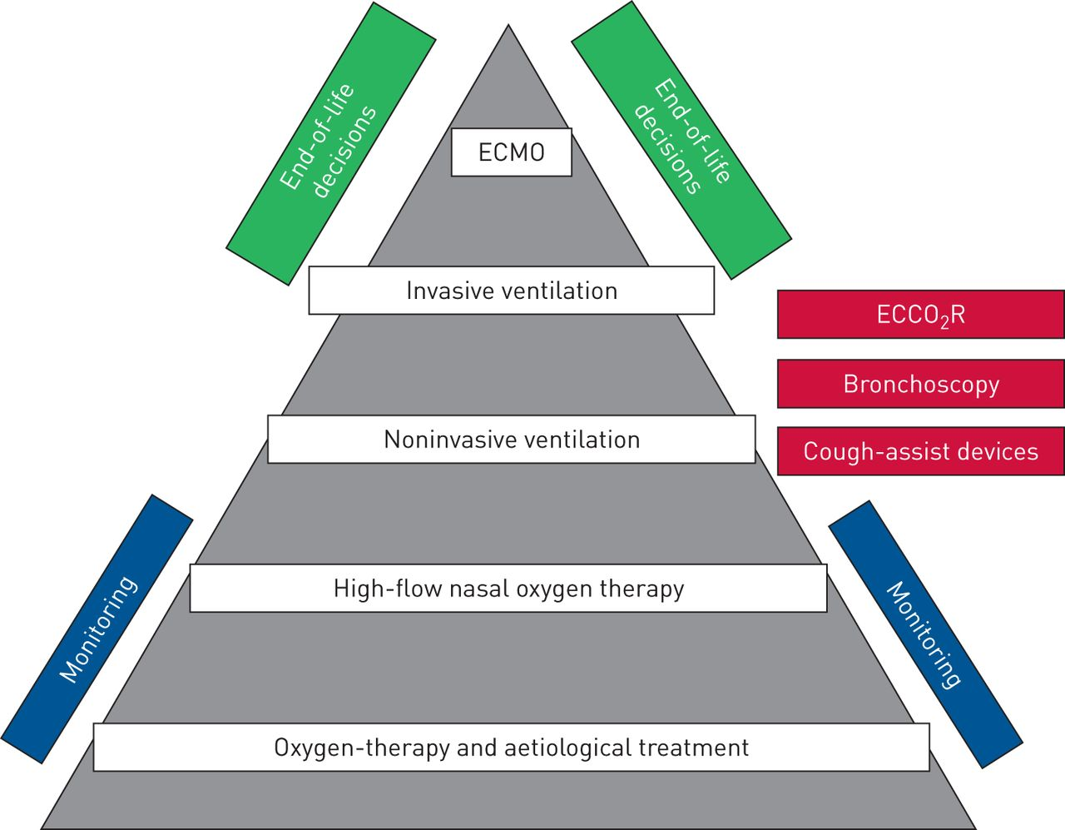

Slide 17
INITIAL EVALUATION AND DIAGNOSTIC APPROACH
Assess and stabilize the airway, breathing, and circulation
Perform a brief clinical bedside assessment with telemetry and oxygen monitoring
Draw an arterial blood gas (ABG)
Administer initial therapies

Slide 18
INITIAL THERAPIES
Administration of oxygen:
hypoxemic or hypercapnic respiratory failure who are not already on oxygen, we initiate oxygen therapy with a fraction of inspired oxygen (FiO2) to reach a target SpO2 of 90 to 93 percent or a PaO2 of 60 to 70 mmHg (8 to 9.3 kPa).

Slide 19
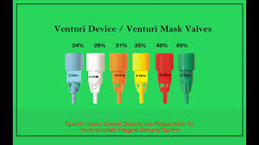
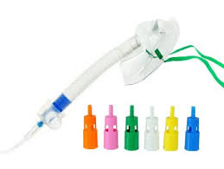
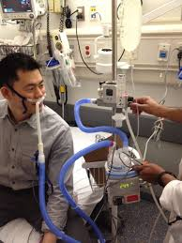
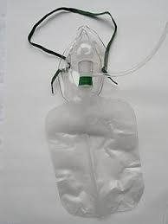
100% oxygen source
Flow rate <60L/min
Fio2-60 to 100%
Flow rate adjustable

Slide 20
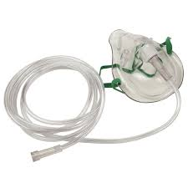
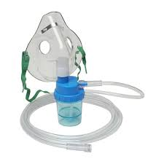
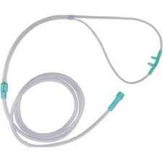
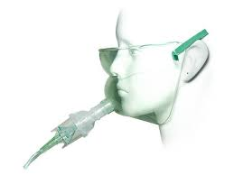
Flow rate- 6l/min minimum
Fio2-40%
Maximum fi02-40-60%
Minimum flowrate-8l/min
Maximum fi02-44%
Minimum flow rate1l/min
Maximum fi02-40-50%
Minimum flow rate-8l/min

Slide 21
INITIAL THERAPIES
Non invasive ventilation :

Slide 22
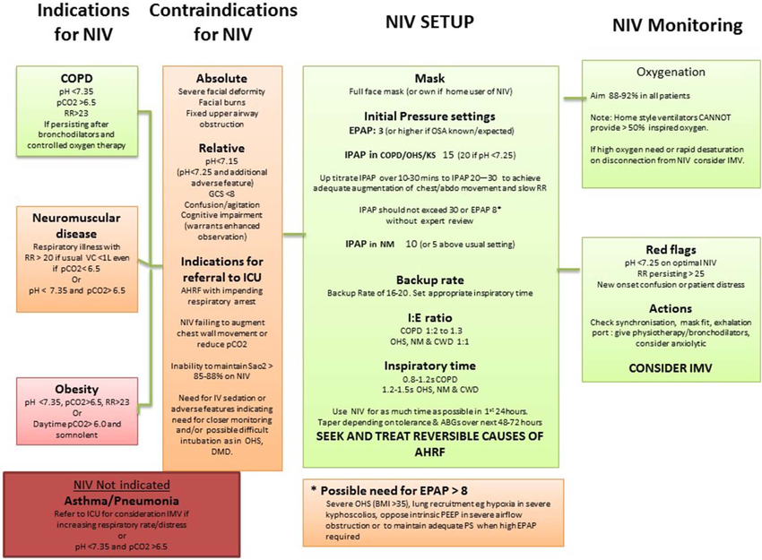

Slide 23
MONITORING IN NIV
Clinical parameters | Comfort Tolerance to interface Respiratory rate Dyspnoea and use of accessory muscles Consciousness-sensorium (GCS, Kelly–Matthay score) Ability to protect the upper airways and presence of an effective cough reflex Gastric distention Disease severity scores (APACHE II) Sedation-delirium scores Monitoring of side-effects
Physiological parameters | Oxygen saturation Arterial blood gas analysis (pH, PaCO2, PaO2) Transcutaneous CO2 End-tidal CO2

Slide 24
Ventilatory parameters | Respiratory frequency VTE, V′E Leaks Waveforms (flow–time, pressure–time, capnography) PEEPi Patient–ventilator interaction
Cardiac parameters | Blood pressure ECG Echocardiography#
Others | Radiological evaluation (chest radiography, computed tomography#) Lung and diaphragm ultrasonography

Slide 25
Levels of monitoring
 | General ward | hdu | icu
Degree of severity of respiratory failure pH Respiratory rate breaths·min-1 Restrictive disorders Obstructive disorders Level of consciousness GCS Failure of other organs Oxygenation PaO2/FIO2 ratio | Mild 7.35-7.30 <30 <25 15 No Corrected with low-flow oxygen (nasal prongs) >150 | Moderate 7.30-7.20 30-35 25-35 10-14 Debatable Corrected with high-flow oxygen (Venturi mask or nonrebreathing mask) <150 | Severe <7.20 >35 >35 <10 Yes Not corrected with high-flow oxygen <100

Slide 26
Gas exchange SpO2 ABG PtcCO2 | Every2-4 hours Every 8 hours Not indicated | Continuous Every 2-4 hours Indicated | Continuous Frequent by arterial line Indicated
Ventilatory parameters Leak, VTE, I:E, V′E Patient–ventilator asynchrony Flow traces Compliance and resistance | Every 2-4 hours Occasional Not necessary Not necessary | Every hour Frequent Indicated Indicated | Continuous Frequent Obligatory Obligatory

Slide 27
INITIAL THERAPIES
Reversal and avoidance of sedatives
Antidotes that are available for common agents that induce hypercapnia are naloxone for opiate overdoses and flumazenil for benzodiazepine (BDZ) overdose.
When spontaneous ventilations are present, an initial dose of 0.05 mg intravenously (IV) is an appropriate starting point, and the dose should be titrated upward every few minutes until the respiratory rate is 12 or greater.
Apneic patients should receive higher initial doses of naloxone (0.2 to 1 mg). Patients in cardiorespiratory arrest following possible opioid overdose should be given a minimum of 2 mg of naloxone.

Slide 28
INITIAL THERAPIES
The recommended initial dose of flumazenil is 0.2 mg given IV over 30 seconds. Repeated doses of 0.2 mg, to a maximum dose of 1 mg, can be given until the desired effect is achieved.

Slide 29
INITIAL THERAPIES
Empiric therapies for underlying etiology :
reversing the effects of sedatives when indicated,
treating a COPD exacerbation with bronchodilators and corticosteroids,
treating a pneumonia and dehydration with antibiotics and fluids.
In patients with hypercapnic respiratory failure suspected to be due to angioedema, intramuscular epinephrine can be administered at the bedside.
dose is 0.3 mg of 1:1000 epinephrine injected into the mid-outer thigh and repeated every 5 to 15 minutes as needed

Slide 30
INITIAL THERAPIES
In those with mild to moderate distress with a known treatable cause for the upper airway obstruction, eg, laryngeal edema, initiation of supplemental oxygen via a mixture of helium and oxygen (heliox) may reduce turbulent flow and the work of breathing while treatment for the underlying problem is started.

Slide 31
INVASIVE VENTILATION
Guidelines for the initiation of invasive ventilation
Chose the ventilator mode with which you are familiar with.
The initial fi02 should be 1.0, and therafter can be titrated downward to maintain spo2 @ 92-94%. In sever ARDS spo2 >=88 is acceptable to minimize the complications of mechanical ventilation.
Initial Vt=8-10ml/kg in patients with relatively normal lung compliance. In poor lung compliance target is 6ml/kg, to avoid over distention and maintain inspiratory plateau pressure <=30 cmh2o.

Slide 32
Choose a RR and minute ventilation according to clinical requirement (target pH and not Paco2).
Use PEEP in diffuse lung injury to maintain an open alveoli at end expiration.
Set trigger sensitivity to allow minimal patient effort to initiate inspiration. Be aware of autocycling if trigger is too sensitive.
In patients with obstructive airway disease, avoid choosing ventilator setting that limit expiratory time and cause auto PEEP.

Slide 33
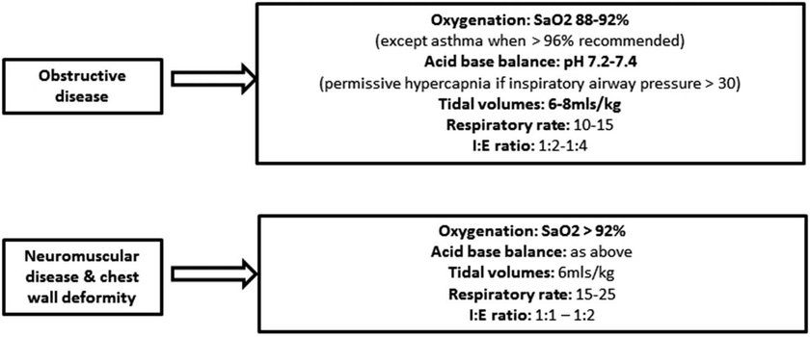
Recommendations of invasive ventilation in the guidelines
Invasive ventilation strategy

Slide 34
In obstructive causes of AHRF, PEEP may increase tidal volume, improve compliance and reduce airflow obstruction.
Setting PEEP greater than iPEEP can be harmful.
In restrictive causes of AHRF, PEEP may assist in lung recruitment, improve compliance and correct hypoxaemia.
Applied ePEEP should not normally exceed 12cm.

Slide 35
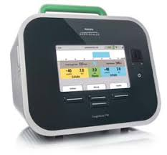
New therapeutic options
Noninvasive and invasive cough assist strategies
CoughAssist T70 MI-E

Slide 36
COUGHASSIST T70 MI-E
Patients with neuromuscular diseases and spinal injuries
Muscular dystrophy (Duchenne)
Myasthenia gravis
Poliomyelitis
Spinal cord injury
Amyotrophic lateral sclerosis (ALS)
Bronchiectasis
Spinal muscular atrophy (SMA)
Bullous emphysema
Pneumothorax or pneumomediastinum
Recent barotrauma

Slide 37
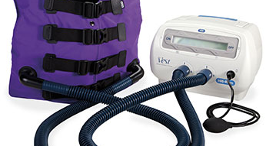
2. High-frequency chest wall oscillation

Slide 38
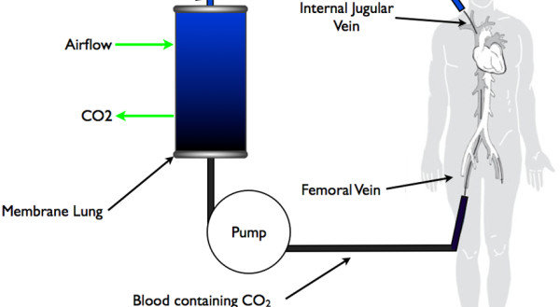
3. Extracorporeal CO2 removal

Slide 39
4. PRONE VENTILATION IN ARDS

Slide 40
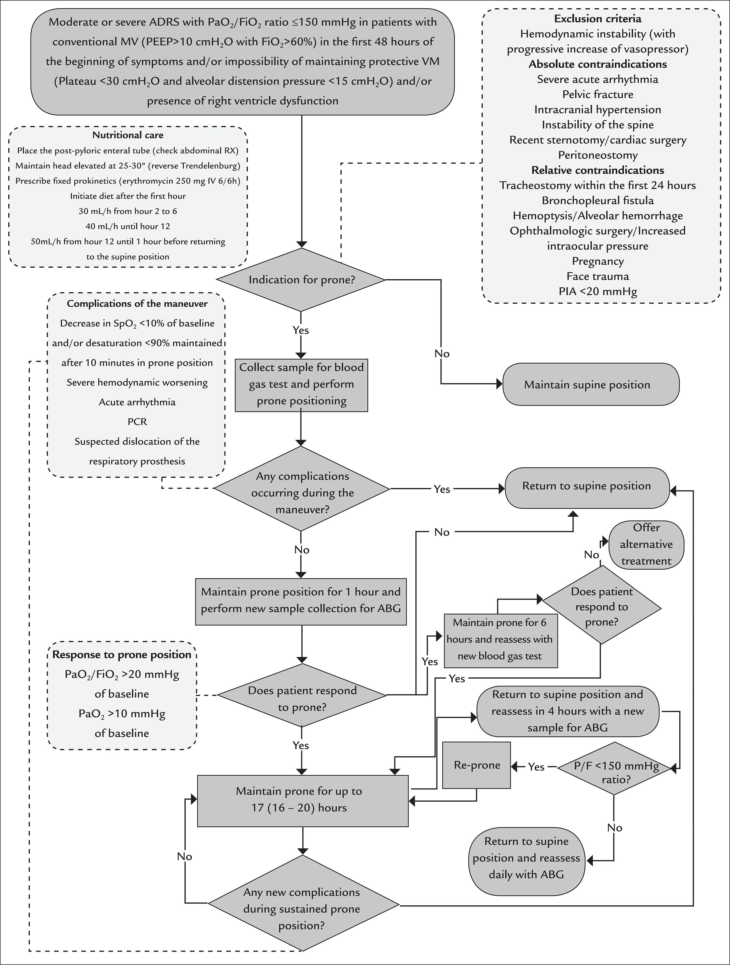
{5}

Slide 41
INVESTIGATIONS

Slide 42
Name of test | Important findings
Chest xray | diffuse or patchy infiltrates; pneumothorax; pulmonary effusion; hyperinflation; asymmetric opacification of lung fields; asymmetric lucency of lung fields
Pulmonary function test | PEFR <35% to 50% of predicted; FEV <35% to 50% of predicted; FVC <50% to 70% of predicted; FEV1 <50% of predicted; NIF above -25 cm H2O
Urine and serum toxicology | identification of select drugs of abuse
Chest CT | pulmonary embolism (involving large- and medium-sized pulmonary arteries); chronic lung disease; pulmonary consolidation and effusion; parenchymal disease; bronchiectasis
CT pulmonary angiography | pulmonary embolism (involving large- and medium-sized pulmonary arteries); chronic lung disease; pulmonary consolidation and effusion; parenchymal disease; bronchiectasis

Slide 43
Name of test | Important findings
Ventilation/perfusion lung scan | pulmonary embolism
Capnometry | abnormally low or high expired CO2
Cardiothoracic ultrasound | evidence of effusion, pneumothorax, consolidation, or abscess; abnormal right ventricular filling or distension
Transcutaneous co2 monitoring | reduced PaCO2

Slide 44
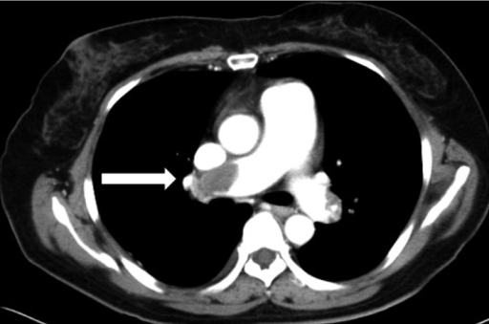
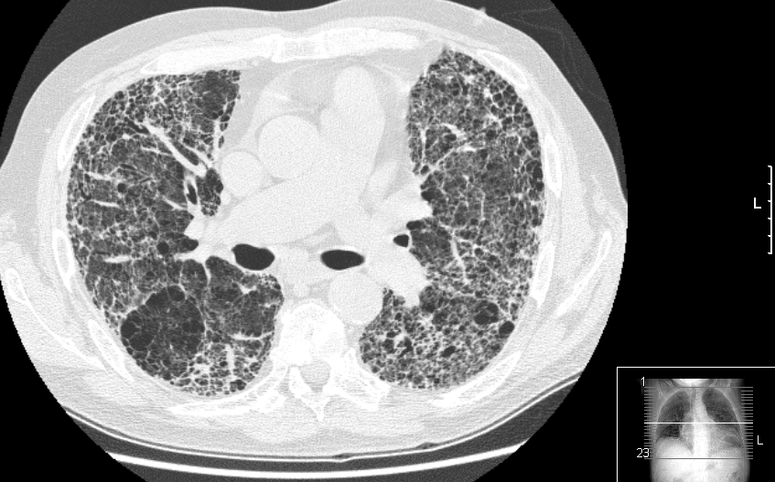
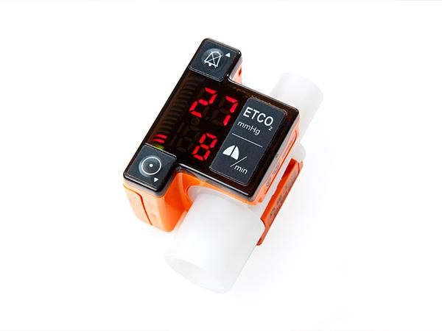
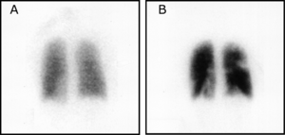
PULMONARY EMBOLISM
PULMONARY FIBROSIS
V/Q SCAN SHOWING PULMONARY EMBOLISM

Slide 45
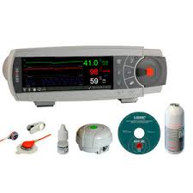

Slide 46
COMPLICATIONS
Pulmonary: pulmonary embolism, barotrauma, pulmonary fibrosis.
Cardiovascular: hypotension, acute MI, arrhythmias and pericarditis.
Gastrointestinal : stress ulcer, gastric distension, ileus, diarrhoea, pnuemo-peritonium.
Nosocomial infection

Slide 47
COMPLICATIONS
Barotrauma: Due to mechanical ventilation in patients with ARF incidence of pulmonary barotrauma is 1-8% of patients.
Frequency increases with ARDS patients.
Factors associated with an increased incidence of barotrauma are
High peak airway pressures
High level of intrinsic and external PEEP
High tidal volume

Slide 48
COMPLICATIONS
Gastrointestinal bleeding: gastric erosion or ulceration producing gastrointestinal bleeding in patients with ARF , has incidence of 20%
Incidence is lower (9%) in acute exacerbation of copd.
Risk of bleeding is reduced by continuous entral feeding, ulcer prophylaxis and maintaining gastric pH above 4.

Slide 49
COMPLICATIONS
Nosocomial pneumonia: caused by gram negative bacilli which may be resistant to common antibiotics.
Most common source of organism appears to be aspiration of microorganism that colonize the pharynx.

Slide 50
PROGNOSIS
In studies from india, mortality in patients with ARF especially ARDS is high (upto 44%).^{{3}}
The reasons for higher mortality include delays in transfer of critically ill patients from the emergency department to the ICU, selection bias of most sick patients, critically ill patients with multiple organ failure.
Several studies suggest the best predictor of mortality in patients with ARF is degree of acidaemia.
pH of less than 7.26 is associated with increased mortality.
Interestingly mechanical ventilation in ARF is not itself associated with increased mortality.

Slide 51
References
Ards definition task force, Ranieri VM, Rubenfeld G, Thompson BT, Ferguson ND, Caldwell E et al. the berlin definition. JAMA.2012;307(23):2526-33.
Sharma S, Gupta R, Aggrawal AN, et al. aetiology, outcome and predictors of mortality in acute respiratory faliure from a tetiary care centre in north india. Indian J med Res 2016:143(6):782-92.
Magazine R, Rao S, Chogtu B, Venkateswaran R, Shahul HA. Epidemiological profile of acute respiratory distress syndrome: a tertiary care experience, Lung india. 2017;34(1):38-42.
Scala R, Heunks L. Highlights in acute respiratory failure. Eur Respir Rev 2018; 27
American Journal of Respiratory and Critical Care Medicine 197:8, 991-993.

Slide 52
THANK YOU

Slide 53
BTS/ICS GUIDELINES FOR VENTILATORY MANAGEMENT OF ACUTE HYPERCAPNIC RESPIRATORY FALIURE

Slide 54
Recommendations in the guidelines
Bronchodilator therapy with NIV
▸ Nebulised drugs should normally be administered during breaks from NIV.
▸ If the patient is dependent on NIV, bronchodilator drugs can be given via a nebuliser inserted into the ventilator tubing.
Sedation with NIV
Patient distress is common in AHRF and often made initially worse by applying NIV .

Slide 55
Recommendations in the guidelines
Sedation should only be used with close monitoring .
Infused sedative/anxiolytic drugs should only be used in an HDU or ICU setting .
If intubation is not intended should NIV fail, then sedation/ anxiolysis is indicated for symptom control in the distressed or agitated patient
In the agitated/distressed and/or tachypnoeic individual on NIV, intravenous morphine 2.5–5 mg (± benzodiazepine) may provide symptom relief and may improve tolerance of NIV.

Slide 56
Recommendations in the guidelines
Sputum retention.
Sputum retention can be a precipitant for AHRF, can cause NIV to fail and is a common reason for respiratory distress post- extubation in patients initially managed by IMV. Excessive sputum production characterises bronchiectasis and CF, and complicates some patients with AECOPD

Slide 57
Recommendations in the guidelines
Manual-assisted cough and MI-E are safe methods for aiding secretion clearance.
MI-E is more effective than manual-assisted cough in patients with stable NMD .
Mini-tracheostomy is a useful bedside procedure that can markedly improve secretion clearance, but requires patient cooperation and a skilled operator to be performed safely .
In patients with NMD, mechanical insufflation and exsufflation should be used, in addition to standard physiotherapy techniques, when cough is ineffective and there is sputum retention.
Mini-tracheostomy may have a role in aiding secretion clearance in cases of weak cough (NMD/CWD) or excessive amounts (COPD, CF)

Slide 58
SPECIFIC TYPES OF RESPIRATORY FAILURES
Neurological disorders
Can result in respiratory morbidity and mortality due to depression of ventilation (central or respiratory muscle weakness ) or pulmonary edema.
Due to acute cerebral insult ( encephalitis, stroke, tumors, raised ICT) and in recurrent aspiration , due to primary muscle disease or lesion of brainstem.

Slide 59
SPECIFIC TYPES OF RESPIRATORY FAILURES
Neurogenic pulmonary edema syndrome
Due to trauma, SAH, severe convulsions.
Associated with raised ICT, cerebral edema.
massive adrenergic discharge by hypothalamus will cause sudden rise In systemic and pulmonary vasculature.

Slide 60
RESPIRATORY MUSCLE DYSFUNCTION
Three patterns
Generalized weakness: as in diffuse neuropathies and myopathies.
Condition in which diaphragm is spared but other muscles of respiration are involved as in lower cervical quadriplegia.
Unilateral and bilateral diaphragm weakness or paralysis resulting from disorder of phrenic nerve.

