Slide 1
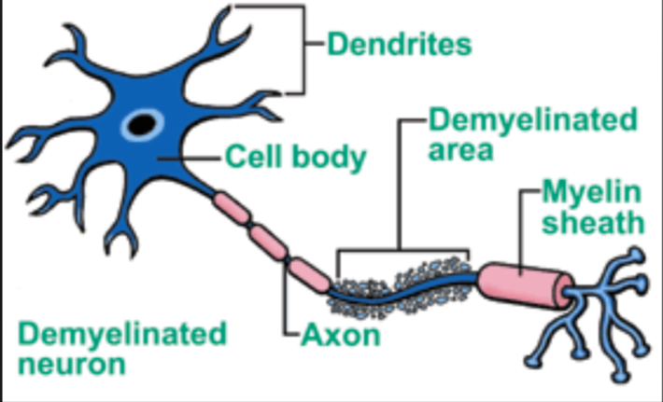
DEMYELINATING DISORDERS

Slide 2
Case:-
A 35 year old white female came to Neurology Clinic for evaluation of her long-term neurologic complaints.
The patient relates that for many years she had noticed some significant changes in neurologic functions, particularly heat intolerance precipitating a stumbling gait and a tendency to fall.
Her visual acuity also seemed to change periodically during several years.
Two months ago the patient was working very hard and was under a lot of stress. She got sick with a flu and her neurologic condition worsened.
At that time, she could not hold objects in her hands, had significant tremors and severe exhaustion.
She also had multiple history of fall. Since that time she had noticed arthralgia on the right and subsequently on the left side of her body.
Then, the patient abruptly developed a right hemi sensory deficit after several days of work.

Slide 3
NEUROLOGIC EXAMINATION:-
Cranial Nerve II - disks are sharp and of normal color. Funduscopic examination is normal.
Cranial Nerves III, IV, VI - No extraocular motor palsy.
Remainder of the cranial nerve exam is normal except for decreased hearing on the left, and numbness in the right face, which extends down into the entire right side.
Motor examination reveals relatively normal strength in the upper extremities throughout.
However, rapid alternating movements are decreased in both upper extremities and the patient has dysdiadochokinesia in the left hand.
Mild paraparesis is noted in both legs without severe spasticity.

Slide 4
Deep tendon reflexes are +2 and symmetrical in the arms, +3 at the ankles and at the knees. Bilateral extensor toe sign are present.
Sensory exam reveals paresthesia on the right to touch and decreased pin sensation on the right diffusely.
The patient has mild vibratory sense loss in the distal lower extremities.
Romberg's is negative.

Slide 5
Diagnosis: Multiple Sclerosis

Slide 6
CASE:-
A 37-year-old male presented to neurology complaining about recent onset of tingling and numbness in both lower limbs.
He also complained about his feet which he described as "feeling sleepy."
Pt also complained of weakness in bilateral lower limb , after 12hrs pt also noticed weakness in bilateral upper limb.
His symptoms began slowly following an upper respiratory tract infection that he had about 14 days prior.
No history suggestive of bowel and bladder involvement.
No history of trauma was present nor had he ever complained of the current symptoms.

Slide 7
He had a past history of mechanical back pain and received treatment including spinal manipulative therapy which gave complete relief.
Examination of this man revealed a healthy person in otherwise good condition.
Sensory loss was variable in both his upper and lower limbs .
Areflexia of all 4 limbs.
A general physical examination gave no other orthopedic , neurological or organic findings.
Respiratory and cardiac function was within normal limits.

Slide 8
Diagnosis:-Guillain-Barre syndrome (GBS)

Slide 9
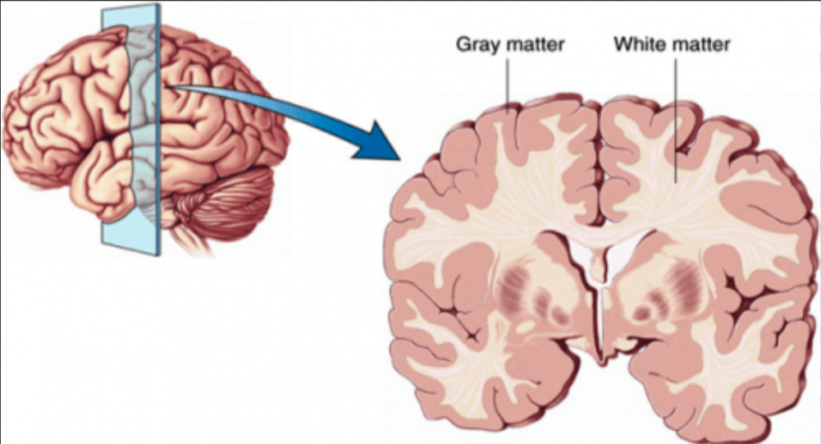
The nervous systems of vertebrates are often divided into grey and white matter .
The grey matter consists largely of cell bodies and dendrites, white matter contains mostly axons and gets its name from the lipid membrane sheets called myelin that are wound tightly around those axons .
Myelin originates from different classes of glial cells referred to as oligodendrocytes in the central nervous system (CNS) and Schwann cells in the peripheral nervous system (PNS).

Slide 10
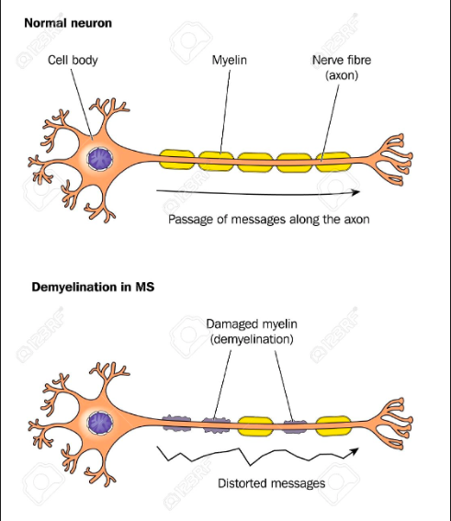
DEFINITION
A demyelinating disorder is any condition that results in damage to the protective covering
(myelin sheath) that surrounds nerve fibers in brain, optic nerves and spinal cord.

Slide 11
CLASSIFICATIONs
-Demyelinating diseases can be divided into disorders that affect the CNS and disorders that affect the PNS.

Slide 12
-Depending on their origin , these diseases of CNS are divided into two categories.
-Demyelinating conditions :-
-Are acquired conditions characterized by preferential damage to previously normal myelin
- Commonly result from immune mediated injury
-Also due to inflammatory, toxic, or metabolic causes.
-Dysmyelinating conditions:-
-Are mostly of a genetic nature
-Myelin not formed properly or has abnormal turnover kinetics
-Associated with mutation affecting proteins required for formation of normal myelin or in mutation that affect synthesis or degradation of myelin lipids
-The other term for these disorder is Leukodystrophy.

Slide 13
Demyelinating disorders of central nervous system:-
1.INFLAMMATORY DEMYELINATING DISORDERS:-
A. Multiple sclerosis:-
1.Relapsing bouts of MS (RMS)
2. Secondary progressive MS (SPMS)
3. Primary progressive MS (PPMS)
4.Acute Multiple sclerosis (Tumefective &Marburg variant)
5.Diffuse cerebral ( concentric sclerosis of Balo and Schilder diseases)
B. Neuromyelitis optica (Devic’s disease) & Progressive necrotic myelopathy
C. Acute disseminated encephalomyelitis (ADEM) & Acute hemorrhagic leuko-encephalitis
D. Demyelination in association with autoimmune disease(SLE , Sjogren’s syndrome and related conditions)
E. Sarcoid related demyelination
F. Graft versus host disease

Slide 14
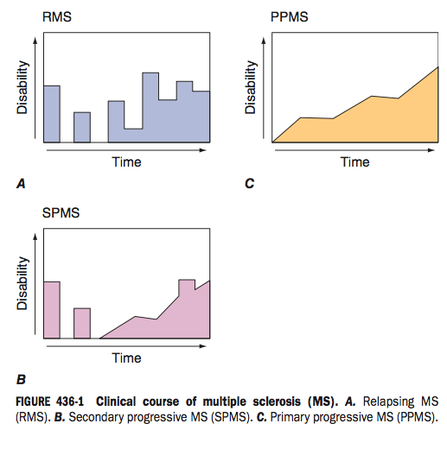

Slide 15
2.TOXIC/METABOLIC DEMYELINATING DISORDERS :-
-Carbon monoxide
-Vitamin B12 deficiency
-Mercury intoxication
-Alcohol/tobacco amblyopia
-Central pontine myelinosis
-Marchiafava-Bignami disorder
-Hypoxia and radiation
3.VASCULAR DEMYELINATING DISORDERS :-
-Binswanger disease:-Small vessel vascular dementia caused by irregular loss of myelin and axons.

Slide 16
HEREDITARORY LEUKODYSTROPHY:-
1) Adrenoleukodystrophy : disorder of perioxisomal beta fatty acid oxidation result in accumulation of very long chain fatty acids in tissues throughout the body.
Cause: mutation in ABCD1 gene located on X chromosome.
2) Metachromatic Leukodystrophy : lysosomal storage disorder , due to arylsulfatase A deficiency cause: mutation in gene located on long arm of chromosome 22 , autosomal recessive inheritance.
3) Krabbe’s disease : lysosomal storage disease , a/k/a globoid cell leukodystrophy, deficiency of enzyme –galactosylceramidase cause: mutation in GALC gene located on chromosome 14, autosomal recessive inheritance .
4)Alexender’s disease : mutation in gene for glial fibrillary acidic protien ( GFAP ) located on chromosome 17, autosomal dominant inheritance , characterized by formation of rosenthal fibers – fibrous eosoniphilic deposits due to white matter destruction.

Slide 17
5) Canavan disease : degenerative disorder caused by deficiency of aminoacylase 2 due to defective ASPA gene located on chromosome 17, characterized by accumulation of N-acetylaspartate interfering with the metabolism of myelin .
6) Phenylketonuria : an inborn error of metabolism causing decreased metabolism of phenylalanine due to decreased activity of phenylalanine hydroxylase enzyme leading to accumulation of phenylalanine that gets converted to phenylketone detected in urine.
Cause :mutation in PAH gene located on chromosome 12 , with autosomal recessive inheritance ,

Slide 18
Demyelinating diseases of the peripheral nervous system
The demyelinating diseases of the peripheral nervous system include:-
1.AUTOIMMMUNE :-
A. Guillain–Barré syndrome and its chronic counterpart, chronic inflammatory demyelinating polyneuropathy
B. Anti-MAG peripheral neuropathy
2.HEREDITARY:-
Charcot–Marie–Tooth disease and its counterpart Hereditary neuropathy with liability to pressure palsy

Slide 19
TOXIN/METABOLIC:-
1.Copper induced
DRUG INDUCED :-
1.Amiodarone
2.Tacrolimus

Slide 20
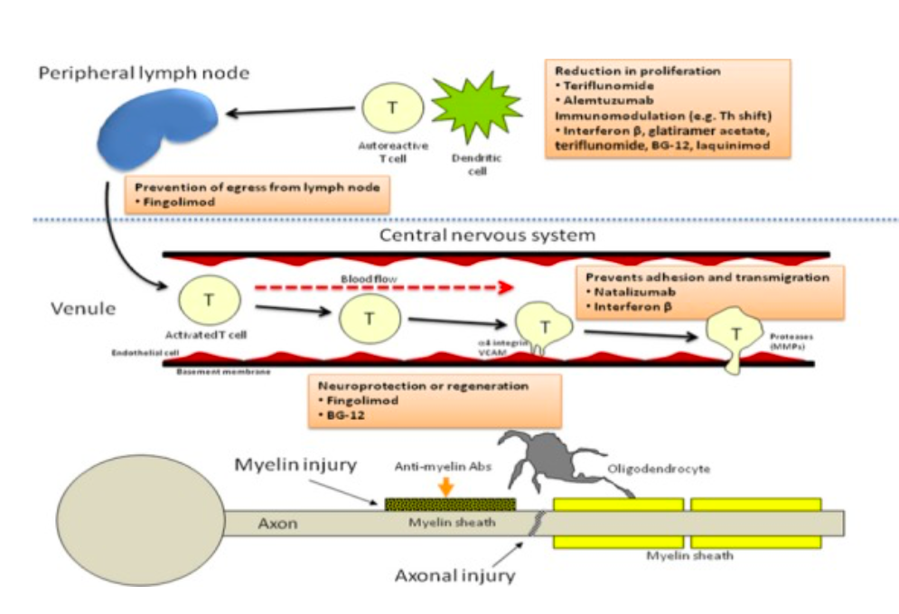
PATHOGENESIS OF INFLAMMATORY DEMYELINATING DISORDERS

Slide 21
Breach of self-tolerance triggered by environmental agents mostly infections toward myelin and other CNS antigens resulting in persistent peripheral activation of autoreactive T cells.
Result in release of autoantigens due to cellular damage, which can then lead to activation of T cells by cross reactivity between an endogenous protein (e.g., myelin basic protein) and the pathogenic exogenous protein (viral or bacterial antigen), by a process known as molecular mimicry.
once activated in the periphery, myelin-reactive T cells are able to migrate across the blood–brain barrier (BBB). The transmigration process involves interaction between very late antigen-4 (VLA-4) present on T lymphocytes and the vascular cell adhesion molecule-1 (VCAM-1) expressed on capillary endothelial cells
After entering the CNS, the autoreactive peripherally activated T cells can be reactivated upon encountering the autoantigenic peptides within the brain parenchyma
Triggering an inflammatory cascade leading to release of cytokines and chemokines, recruitment of additional inflammatory cells including T cells, monocytes, and B cells and persistent activation of microglia and macrophages resulting in myelin damage

Slide 22
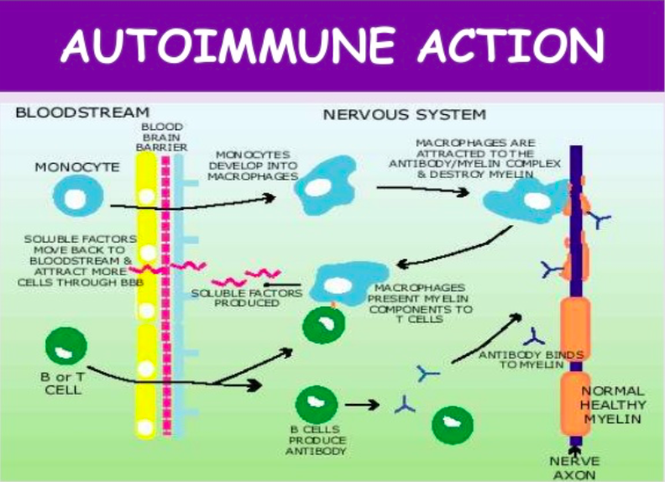

Slide 23
PATHOGENESIS OF VIT.B12 INDUCED DEMYELINATION
Met- B12 is needed as a cofactor by the methyltetrahydrofolate-homocysteine methyltransferase (MTR) enzyme to generate methionine from homocysteine and tetrahydrofolate from methyltetrahydrofolate
Methionine is the precursor of S-adenosylmethionine, a universal methyl donor which is important in the methylation of myelin basic protein and myelin lipids
Decreased methionine and S-adenosylmethionine lead to instability of the myelin sheath.

Slide 24
PHYSIOLOGICAL DYNAMICS AFFECTED DUE TO DEMYELINATION:-
Demyelination can result progressively in ionic disequilibrium, energy crisis, conduction block and eventually neurodegeneration.
(A) A normal node of Ranvier with juxtaparanodal, paranodal and nodal regions intact, depicting Na+, K+ and Ca2+ ions flowing through their respective channels with mitochondria supplying the ATP for energy-dependent Na+K+ ATPases that re-establish the ion gradients depleted by ion flux through channels.
(B) Partial demyelination results in dispersal of nodal ion channels, energy insufficiency and disequilibrium of ion gradients;
(C) Complete demyelination can result in conduction block and axonal degeneration due to the accumulation of intracelluar Ca2+ that results from energy crisis and disruption of ionic balances.

Slide 25
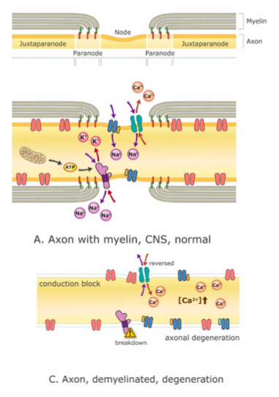
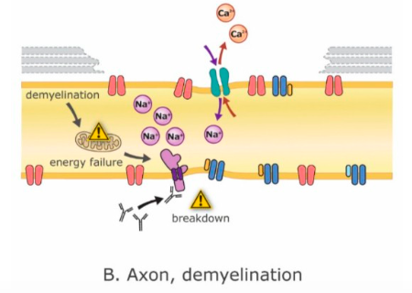
Mechanisms of demyelination-related Neurodegeneration

Slide 26
CLINICAL PRESENTATION:-
Demyelination should be considered in any patient with unexplained neurologic deficits.
Primary demyelinating disorders are suggested by the following:-
-Diffuse or multifocal deficits
-Sudden or subacute onset, particularly in young adults
-Onset within weeks of an infection or vaccination
-Deficits that wax and wane
-Symptoms suggesting a specific demyelinating disorder (eg, unexplained optic neuritis or internuclear ophthalmoplegia suggesting multiple sclerosis).

Slide 27
Epidemiology:-
Incidence of demyelinating diseases vary from disorder to disorder.
-Multiple sclerosis vary in prevalence depending on the country and population.
-Threefold more common in women than men.
-Age of onset is typically between 20 and 40 years (slightly later in men than in women), but the disease can present across the lifespan.
-Optic neuritis occurs preferentially in females typically between the ages of 30 and 35.
-GBS Males are at slightly higher risk for GBS than females, adults are more frequently affected than children.

Slide 28
Based on the duration of symptom development demyelinating peripheral neuropathy can be:-
-Acute (< 4 weeks),
-Subacute (1–3 months)
-Chronic (> 3 months).
-Vasculitic lesions are often hyperacute mononeuropathies, usually coming on over 24–72 hours.
-In some conditions, early assessment following symptom onset, it cannot be clarified at presentation but becomes evident later.
-Guillain-Barré syndrome (GBS), for example, by definition reaches its nadir within four weeks of onset, and any progression beyond this may suggest relapsing disease or evolution into chronic inflammatory demyelinating polyradiculoneuropathy (CIDP), both of which would require further treatment.

Slide 29
Demyelinating Peripheral neuropathies:-
Acute:-
– Guillain Barre syndrome (GBS)
Chronic:-
– chronic inflammatory demyelinating polyradiculoneuropathy (CIDP)
– paraproteinemia related
– amiodarone toxicity
– Charcot-Marie-Tooth (CMT) types 1, X and AR CMT 1
– metachromatic leucodystrophy
– statins

Slide 30
IS THE NEUROPATHY AXONAL OR DEMYELINATING ON CLINICAL GROUNDS?
Clinically it is difficult to diagnose each of this variety with any degree of accuracy and therefore a neurophysiological examination with measurement of conduction velocities in several nerves, measurement of sensory action potentials, and measurement of distal latencies and F wave latencies are required.
However some clinical clues like:-
-Loss of reflexes in muscles that are not particularly weak or wasted is a classic feature of demyelination.
- Selective loss of the ankle jerk reflex in the presence of wasting and weakness of the foot is more typical of an axonal damage.

Slide 31
CLINICAL MANIFESTATIONS OF MS:-
The onset of MS may be abrupt or insidious. Symptoms may be severe or seem so trivial that a patient may not seek medical attention for months or years .
Symptoms of extremely varied and depend on the location and severity of lesions within the CNS .
Sensory symptoms are varied and include –
-Paresthesias (e.g., tingling, prickling sensations, formications, “pins and needles,” or painful burning )
- Hypesthesia (e.g., reduced sensation, numbness, or a “dead” feeling).
-Unpleasant sensations (e.g., feelings that body parts are swollen, wet, raw, or tightly wrapped)
Sensory impairment of the trunk and legs below a horizontal line on the torso (a sensory level) indicates that the spinal cord is the origin of the sensory disturbance. It is often accompanied by a band-like sensation of tightness around the torso.

Slide 32
-Weakness of the limbs - the upper motor neuron type of weakness.
-Spasticity is associated with spontaneous and movement-induced muscle spasms.
-Especially in the legs.
-This spasticity provides support for the body weight during ambulation, thus treatment of spasticity may actually do more harm than good.
-Optic neuritis (ON) presents as diminished visual acuity, dimness, or decreased color perception (desaturation) in the central field of vision.
-Diplopia may result from internuclear ophthalmoplegia (INO) - consists of impaired adduction of one eye due to a lesion in the ipsilateral medial longitudinal fasciculus .
-Other common gaze disturbances in MS include
(1) a horizontal gaze palsy,
(2) a “one and a half” syndrome (horizontal gaze palsy plus an INO),
(3) acquired pendular nystagmus.

Slide 33
-Bladder dysfunction is present in >90% of MS patients.
Detrusor hyper reflexia, due to impairment of suprasegmental inhibition, causes urinary frequency, urgency, nocturia, and uncontrolled bladder emptying.
Detrusor sphincter dys-synergia, due to loss of synchronization between detrusor and sphincter muscles, causes difficulty in initiating and/or stopping the urinary stream, producing hesitancy, urinary retention, overflow incontinence, and recurrent infection.
-Constipation occurs in >30% of patients.
-Ataxia , vertigo , fatigue , facial weakness, Facial myokymia persistent rapid flickering con- tractions of the facial musculature (especially the lower portion of the orbicularis oculus) or a contraction that slowly spreads across the face) ,cognitive dysfunction, depression are other features that can be present.

Slide 34
-Lhermitte’s symptom is an electric shock–like sensation (typically induced by flexion or other movements of the neck) that radiates down the back into the legs. Rarely, it radiates into the arms.
-Heat sensitivity refers to neurologic symptoms produced by an elevation of the body’s core temperature. For example, unilateral visual blurring may occur during a hot shower or with physical exercise (Uhthoff’s symptom). It is also common for MS symptoms to worsen transiently, sometimes dramatically, during febrile illnesses Such heat-related symptoms probably result from transient conduction block .
-Sexual dysfunction may manifest as decreased libido, impaired genital sensation, impotence in men, and diminished vaginal lubrication or adductor spasms in women.

Slide 35
GUILLAIN-BARRÉ SYNDROME
Guillain-Barré syndrome (GBS) is an acute, frequently severe, and fulminant polyradiculo-neuropathy that is autoimmune in nature.
Clinical Manifestations GBS :-
-Rapidly evolving areflexic motor paralysis with or without sensory disturbance.
-Ascending paralysis first noticed as rubbery legs.
-The legs are usually more affected than the arms, and facial diparesis is present in 50% of affected individuals. The lower cranial nerves are also frequently involved, causing bulbar weakness with difficulty handling secretions and maintaining an airway.

Slide 36
-Cutaneous sensory deficits , superficial sensation (pain and temperature) are usually relatively mild, but functions subserved by large sensory fibers(Touch-pressure-vibration) are more severely affected.
-Bladder dysfunction may occur in severe cases but is usually transient. If bladder dysfunction is a prominent feature and comes early in the course or there is a sensory level on examination, diagnostic possibilities other than GBS should be considered, particularly spinal cord disease.
-Autonomic involvement is common and manifest as loss of vasomotor control with wide fluctuations in blood pressure, postural hypotension, loss of sweating,and cardiac dysrhythmias.

Slide 37
Diagnostic Algorithm of Demyelinating Diseases :-
According to different possible differential diagnoses, a broad spectrum of diagnostic procedures are often required.
We usually start with thorough history and physical examination. then the following studies are performed:-
1) NMR (Nuclear Magnetic Resonance) of the brain and spinal cord using T1, T2 and FLAIR sequence and gadolinium as a paramagnetic contrast medium, to asses the activity of demyelinating disorder.

Slide 38
MRI FINDINGS IN MULTIPLE SCLEROSIS:-
-T1 sequence
Lesions are typically iso- to hypointense (T1 black holes).
Callososeptal interface may have multiple small hypointense lesions (Venus necklace) or the corpus callosum may merely appear thinned .
-T2 sequence
Lesions are typically hyperintense & acute lesions often have surrounding edema.
-SWI (susceptibility weighted imaging)
It reveals venous connectivity of plaques and presence of iron in some lesions.

Slide 39
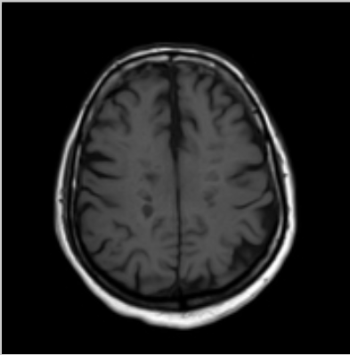
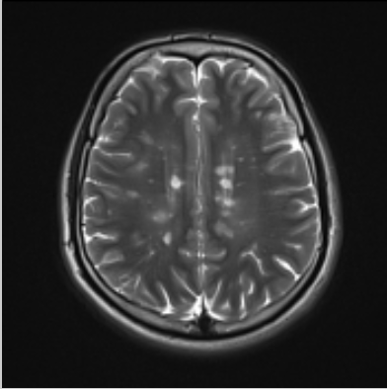
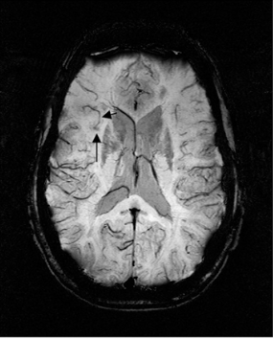
SWI showing Iron-containing lesion and a peripheral vein that curls up toward the lateral right side of the brain
T1 SEQUENCE SHOWING BLACK HOLES
T2 SEQUENCE SHOWING HYPERINTENSE LESIONS

Slide 40
FLAIR SEQUENCE :-
Lesions are typically hyperintense.
Earliest sign is called "ependymal dot-dash sign” i.e alternating small foci of hyperintensity along the callososeptal interface.
When these propagate centrifugally along the medullary venules and arranged perpendicular to the lateral ventricles in a triangular configuration (extending radially outward - best seen on parasagittal images), they are termed Dawson's fingers.
FLAIR is more sensitive than T2 in detection of juxtacortical and periventricular plaques, while T2 is more sensitive to infratentorial lesions.
T1 C+ (Gd) :-
Active lesions show enhancement & enhancement is often incomplete around the periphery (open ring sign).

Slide 41
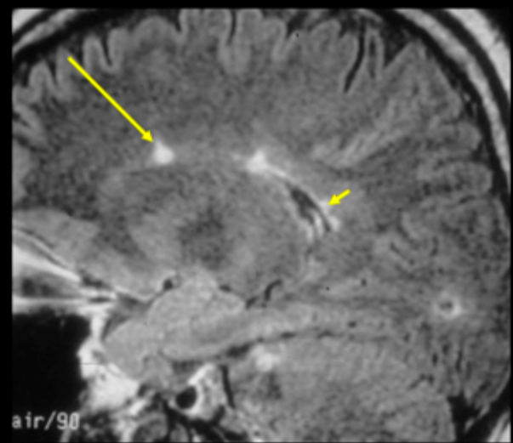
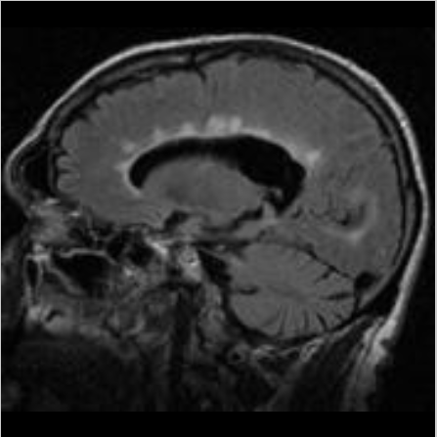
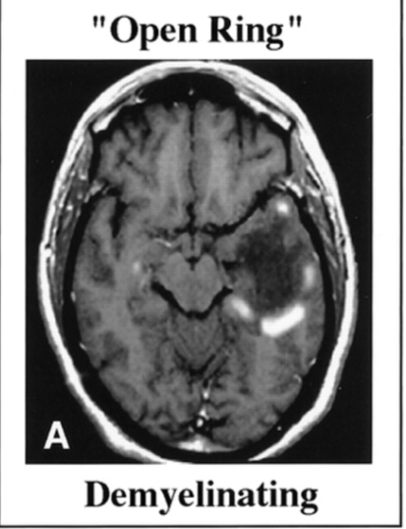
“Ependymal dot-dash sign”on FLAIR
Dawson's fingers on FLAIR
open ring sign on T1 POST CONTRAST

Slide 42
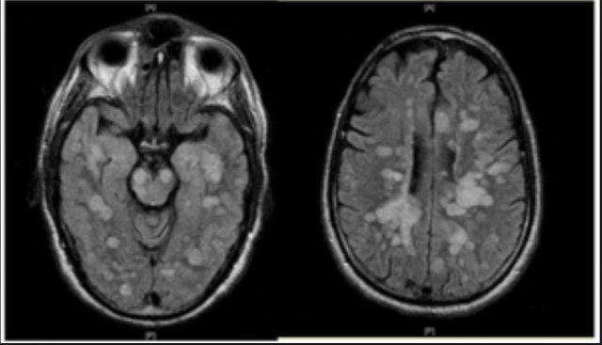
Diffuse , poorly demarcated Hyperintense lesion on T2 predominently involving white matter in NEUROMYELITIS OPTICA.

Slide 43
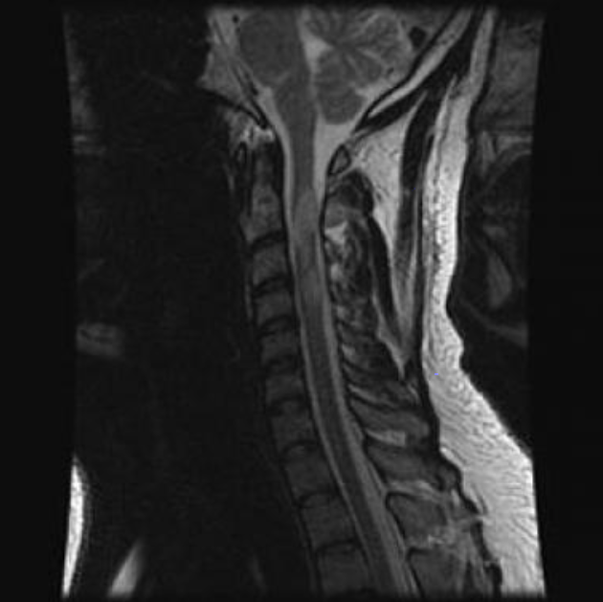
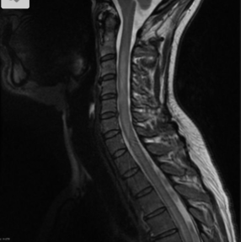
Sagittal, T2-weighted image showing areas of signal hyperintensity in the cervical spinal cord-Spinal MS
T2-weighted image showing hyperintense lesion in the cervical spine cord(often >3 vertebral body lengths) -Neuromyelitis optica

Slide 44
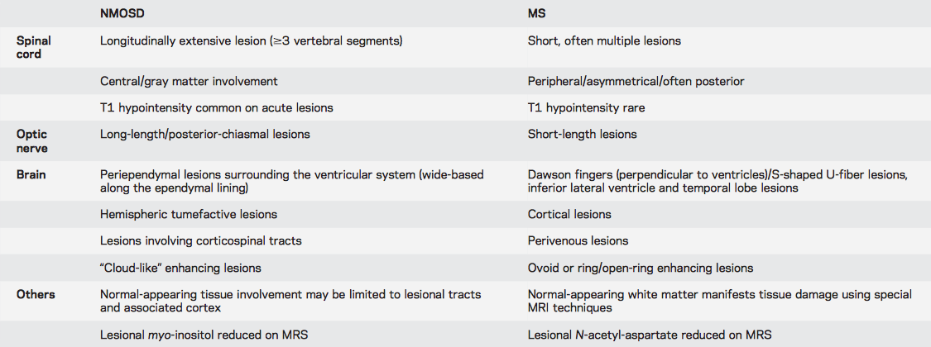
Comparison of characteristic MRI findings between NMOSD and MS

Slide 45
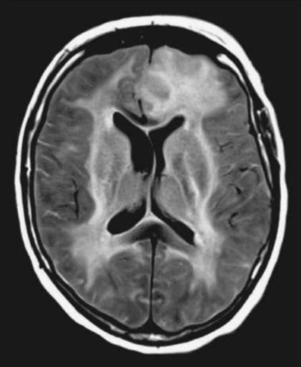
MRI Reveal bilateral but assymetrical large, confluent, edematous lesions in cerebral white matter with myriad of punctate haemorrhags in grey and white matter in Acute hemorrhagic leuko-encephalitis

Slide 46
2.Lumbar puncture/ CSF analysis :-
Multiple Sclerosis:-
-CSF Findings:- Mononuclear cell pleocytosis
-An increased level of intrathecally synthesized IgG.
-CSF IgG index( “Link Index”) elevated,
(expresses the ratio of IgG to albumin in the CSF divided by the same ratio in the serum)
-Presence of OCBs by agarose gel electrophoresis assesses intrathecal production of IgG.
-Two or more discrete OCBs, not present in a paired serum sample, are found in >75% of patients with MS.
-OCBs may be absent at the onset of MS, and in individual patients, the number of bands may increase with time.

Slide 47
Neuromyelitis Optica:-
CSF findings :- Pleocytosis greater than that observed in MS,
With neutrophils and eosinophils present in many acute cases; OCBs are uncommon, occurring in <20% of NMO patients.
Acute hemorrhagic leuko-encephalitis:-
CSF findings:- Few lymphocytes to PMN pleocytosis of up to 30,000 cells/mm³
-Presence of RBC’s in variable number
-Increased protein content
-Normal glucose content

Slide 48
Progressive multifocal leukoencephalopathy (PML):-
CSF Findings:- Mild elevation in protein and/or IgG
-Pleocytosis occurs in <25% of cases (predominantly mononuclear, rarely exceeds 25 cells/μL )
-Positive CSF PCR for JCV DNA
Guillain-Barré syndrome (GBS) /AIDP:-
CSF Findings :- Elevated CSF protein level without accompanying pleocytosis (Albumino-cytological Dissociation).
Chronic Inflammatory Demyelinating Polyneuropathy (CIDP):-
CSF Findings :- Protein typically elevated in range of 75-250mg/dl.
-Elevated CSF gamma globulin fraction with mild lymphocytic pleocytosis ( Typically in HIV - positive patients).

Slide 49
3) Evoked potentials:- visual, auditory and somatosensory:-
Evoked potentials (visual, brainstem auditory, and somatosensory) useful in demonstrating the presence of subclinical lesions in sensory pathways or in providing objective evidence of lesions suspected on the basis of subjective complaints.
Of the sensory evoked potential tests, the visual evoked potential is the most useful because it can provide objective evidence of an optic nerve lesion that may not be evident on an MRI scan.
For example, in a patient with a relapsing spinal cord syndrome with sensory deficits in the legs, an abnormal somatosensory EP following posterior tibial nerve stimulation provides little new information. But, an abnormal visual EP in this circumstance would permit a diagnosis of clinically definite MS.

Slide 50
4) Peripheral blood Analysis:- Complete blood count,
-Erythrocyte sedimentation rate (ESR),
-Coagulation profile
-C- reactive protein (CRP),
-Protein S, antithrombin III
-Serum immunoelectrophoresis
-Molecular analysis of prothrombotic factors factor V Leiden, MTHFR, PAI-1)
-Immunologic analysis (ANCA, ANA, ENA, antiDNA , C3, C4)
-Thyroid gland hormones
-Vitamin B12 and folic acid
-Serologic analysis for neurotropic viruses, and serologic analysis for HIV, hepatitis B &C -VDRL, TPHA

Slide 51
5.Nerve Conduction Studies:-
Guillain-Barré syndrome (GBS) /AIDP:-
NCV Findings:- Prolonged F-wave latencies,
-Prolonged distal latencies
-Reduced amplitudes of compound muscle action potentials (CMAPs)
(Due to involvement of nerve roots and distal motor nerve terminals early in the course)
-Later, slowing of conduction velocity, conduction block, and temporal dispersion occurs.

Slide 52
Charcot-Marie-Tooth disease :-
-Slow mean conduction velocity- Range(less than 38m/s)- CMT1
-Normal or near normal mean conduction velocity-Range(more than 38m/s)-CMT2
-Markedly Slowed conduction velocity ( 5-10m/s)-CMT3

Slide 53
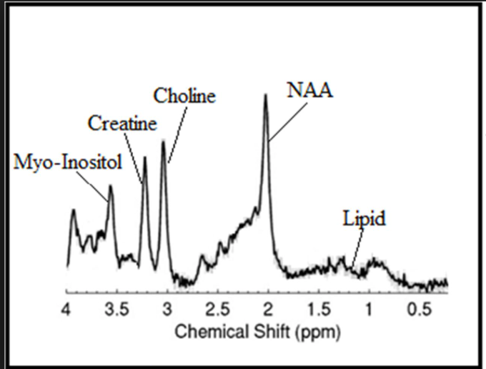
6.MR spectroscopy :-
-MS:-
NAA peaks may be reduced within plaques, the most common and remarkable finding. choline and lactate are found to be increased in the acute pathologic phase.
NMO:-
Myo-inositol peaks are reduced with in the lesion.

Slide 54
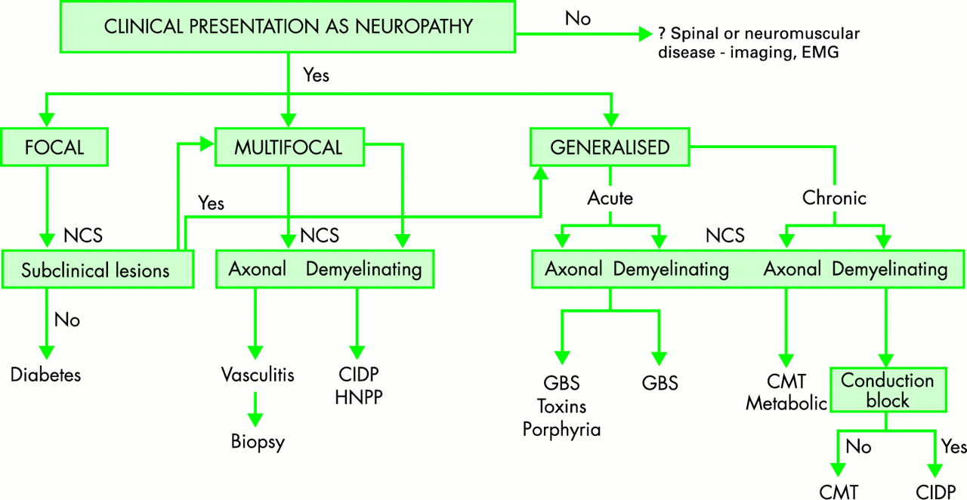

Slide 55
APPROACH TO MANAGEMENT OF DIFFERENT DEMYELINATING DISORDER

Slide 56
PRIMODIAL PREVENTION:-
Primordial prevention is defined as prevention of risk factors themselves, beginning with change in social and environmental conditions in which these factors are observed to develop , and continuing for high risk development of disease.
Risk factors for MS and its prevention:-
-Genetic predisposition(HLA-DRB1)-Early identification for existence of this gene in family members
-EBV exposure during childhood- Prevent
-Vit.D deficiency-Treatment
-Cigarette smoking- Cessations

Slide 57
SPECIFIC MEDICAL THERAPY:-
ACUTE ATTACKS OR INITIAL DEMYELINATING EPISODES TREATMENT OF MS:-
-Glucocorticoids are used to manage either first attacks or acute exacerbation.
- Intravenous methylprednisolone, (500–1000 mg/d ) for 3–5 days, either without a taper or followed by a course of oral prednisone beginning at a dose of (60–80 mg/d) and gradually tapered over 2 weeks.
-Lithium carbonate (300 mg orally bid) may help manage emotional lability and insomnia associated with glucocorticoid therapy.
-Plasma exchange (five to seven exchanges: 40–60 mL/kg per exchange, every other day for 14 days) benefit patients with fulminant attacks of demyelination that are unresponsive to glucocorticoids.

Slide 58
DISEASE-MODIFYING THERAPIES FOR RELAPSING FORMS OF MS (RMS, SPMS WITH EXACERBATIONS)
These agents has been divided into those used more and less frequently; and also by an estimate of their relative (modest, moderate or high) perceived level of efficacy.
MODESTLY EFFECTIVE | MODERATELY EFECTIVE | HIGHLY EFFECTIVE
Interferon | Fingolimod | Natalizumab
Glatiramer Acetate | Dimethyl Fumarate | Ocrelizumab
Teriflunomide |  | Mitoxantrone Hydrochloride
 |  | Alemtuzumab

Slide 59
MORE FREQUENTLY USED DRUGS | LESS FREQUENTLY USED DRUGS
Interferon 30 IM once a week | Teriflunomide 7-14 mg orally every day
Glatiramer Acetate 20 mg every day or 40 mg thrice weekly SC | Alemtuzumab
Fingolimod 0.5 mg orally every day | Mitoxantrone Hydrochloride 12mg/m² every 3 months
Dimethyl Fumarate 240 mg 0rally twice a day
Natalizumab 300 mg IV Infusion each month
Ocrelizumab 600 mg IV Infusion every 24 weeks

Slide 60
TREATMENT OF GBS:-
In patients with GBS, treatment should be initiated as soon after diagnosis is made.
-Either high-dose intravenous immune globulin (IVIg) or plasma-pheresis can be initiated, as they are equally effective for typical GBS.
-IVIg is often the initial therapy chosen because of its ease of administration and good safety record . IVIg is administered as five daily infusions for a total dose of 2 g/kg body weight.
- Plasmapheresis usually consists of ~40–50 mL/kg PE 4–5 times over 7–10 days.
-If the patient has already reached the plateau stage, then treatment probably is no longer indicated, unless the patient has severe motor weakness and one cannot exclude the possibility that an immunologic attack is still ongoing.

Slide 61
TREATMENT IF CIDP:-
Initiate treatment for CIDP when progression is rapid or walking is compromised.
If the disorder is mild, management can be expectant, awaiting spontaneous remission.
Initial therapy :-
1. IVIg:- 2.0 g/kg body weight given in divided doses over 2–5 days; three monthly courses.
-If the patient responds, the infusion intervals can be gradually increased or the dosage decreased (e.g., starting at 1 g/kg every 3–4 weeks).
2.PE (Plasmapharesis):- 2-3 treatments per week for 6 weeks.
-Periodic retreatment required.
3. Glucocorticoids :- 60–80 mg prednisone PO daily for 1–2 months, followed by a gradual dose reduction of 10 mg per month as tolerated.

Slide 62
Rehabilitation:-
- Intensive rehabilitation with the help of a multidisciplinary team to focus on improving activities of daily living (ADLs).
- Intensive rehabilitation improves long-term symptoms.
-Teams may include physical therapists, occupational therapists, speech language pathologists, social workers, psychologists, other allied health professionals .
-Physiotherapy interventions include strength, endurance and gait training with graduated increases in mobility, maintenance of posture and alignment as well as joint function.
-Occupational therapy aims to improve everyday function with domestic and community tasks as well as driving and work.

Slide 63
-Home modifications, gait aids, orthotics and splints may be provided.
⁻Speech-language pathology input may be required in those with speech and swallowing problems, as well as to support communication in those who require ongoing breathing support .
-Nutritional support by dieticians.
-Psychologists may provide counseling and support. Psychological interventions may also be required for anxiety, fear and depression.

Slide 64
THANK YOU

