Slide 1
NEWER ADVANCES IN MANAGEMENT OF HEART FAILURE

Slide 2
CONTENT
Definition
Etiology
Classification
Presentation and assessment
Approach :
- diagnosis – investigations
- management –
> guidelines
> newer pharmacological therapy
> Cardiac resynchronization therapy
> mechanical support devices

Slide 3
CASE – 65 year old male patient, chronic tobacco chewer ,k/c/o HTN since 4 years , obese
p/w – breathlessness on mild exertion and easy fatiguability since 2 months.
O/E : EDEMA + - pedal edema , pitting type, upto knee joints, JVP raised, BMI – 36.5Kg/m2
T – Afebrile, P – 86/ min, regular, BP – 136/90 mmHg.
R/S – B/L AE + crepitations + B/L
CVS – apex impulse seen at 6th ICS, lateral to MCL , apex beat displaced lateral to MCL at 6th ICS, S1/ S2 + ( soft ) , systolic murmur present at MA heard in left lateral position, at height of expiration with diaphragm of stethoscope .
P/A – soft , tenderness in right upper quadrant, BS+
CNS – conscious /oriented
ECG – sinus rhythm, regular, LAD, T wave inversions in leads V1-V4
Chest radiogram – cardiomegaly, interstitial edema and B/L diffuse hazy opacities
BNP- 330pg/ml
Rest all blood reports within normal limits
2D echo – Dilated LA/LV , NO RWMA, global LV hypokinesia, EF -15 %, SEVERE MR.

Slide 4
Diagnosis : ADHF - HFrEF ,ACC/AHA STAGE C AND NYHA CLASS III
EF – 15% , Hypertensive cardiomyopathy with Severe MR ( functional ) in K/C/O HTN with obesity grade 2 .
Management :
ask 2 questions at bedside assessment
If there are signs of congestion? – YES
If perfusion is adequate? – YES
So in this case patient is “ WET and WARM “
Rx:
IV DIURETICS –LOOP
VASODILATORS – NTG
ACEI/ARB/MRA/ ARNIs
BETA BLOCKERS
.
5 “D” of HF: Diet DIURETICS DILATORS DOBUTAMINE DIGOXIN

Slide 5
Heart failure : Structural and functional impairment of LV –
filling or ejection of blood.
complex clinical syndrome of HF with symptoms -
dyspnea and fatigue and signs – edema and rales.
HF patients are broadly classified :
1) HFpEF : formerly called diastolic failure , EF > 40-50%
2) HFrEF – formerly as systolic failure, EF - < 40%

Slide 6
CAUSES OF HEART FAILURE
HFrEF ( EF< 40%)
HFpEF ( EF >40% - 50% )
Coronary artery disease
Chronic pressure overload – hypertension
Chronic volume overload - regurgitant valvular diseases
Chronic lung disease – Cor pulmonale
Non-ischemic DCMP
Toxic/drug induced
Chagas disease
Pathologic hypertrophy – primary (hypertrophic ), secondary ( HTN)
Aging
Restrictive cardiomyopathy – infilterative , storage diseases
Fibrosis

Slide 7
STAGING AND CLASSIFICTAION
AHA/ACA STAGING
STAGE A : At risk for HF but without structural heart disease or symptoms of HF
STAGE B : structural heart disease but without signs and symptoms of HF
STAGE C : structural heart disease with prior or current signs and symptoms of HF
STAGE D : refractory HF requiring specialized interventions

Slide 8
NYHA FUNCTIONAL CLASSIFICATION
CLASS I : No limitation to physical activity , ordinary physical activity does not cause any symptoms of HF
CLASS II : slight limitation of physical activity, comfortable at rest but ordinary physical activity results in symptoms of HF
CLASS III : marked limitation of physical activity , comfortable at rest, but less than ordinary physical activity produces symptoms of HF.
CLASS IV : unable to carry on any physical activity without symptoms of HF or symptoms of HF at rest .

Slide 9
When the diagnosis of heart failure is suspected , the goals of clinical assessment :
To determine whether HF is present ? Symptoms and signs of HF
To define underlying etiology – Inciting event ( ischemic or toxin induced etc.)
To define the type of HF – HFrEF Vs HFpEF
To assess the severity of HF – NYHA functional Class and AHA HF staging
To identify comorbidities that can influence the clinical course and response to the treatment. – DM type 2, CKD, Anemia etc.
The treatment strategies of HF are based on these two categories therefore it is critical to identify the type of HF

Slide 10
Symptoms of heart failure
Fatigue
Shortness of breath
Dyspnea / tachypnea /orthopnea/ PND
Cough
Nocturia
Weight loss/weight gain
Edema – dependant areas
Abdominal pain confined to right upper quadrant
Loss of appetite / early satiety
Somnolence

Slide 11
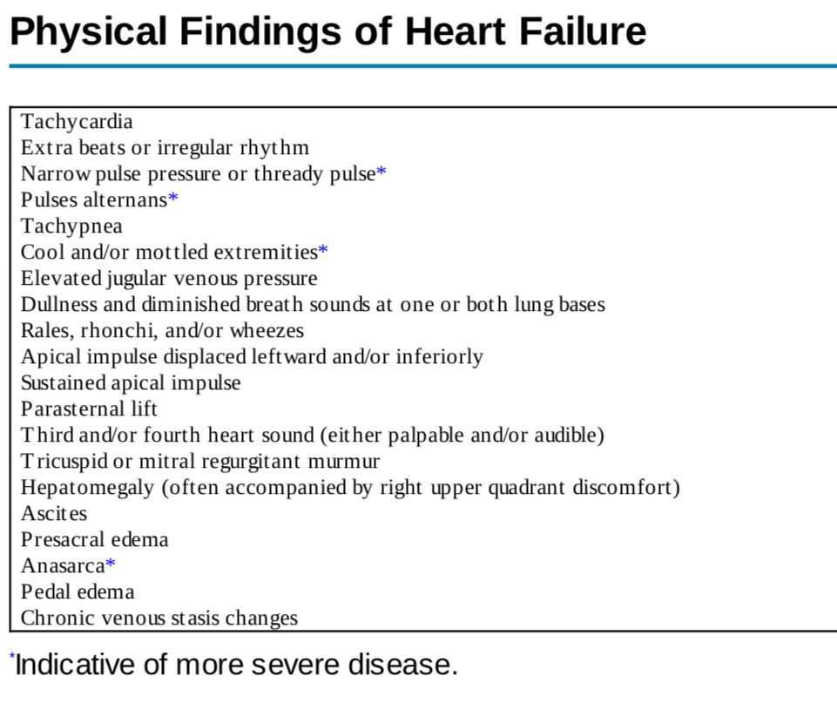

Slide 12
RISK SCORING FOR PROGNOSIS :
Seattle heart failure model : internet based application , well validated risk score
Parameters :
Age
Weight
NYHA class
EF
Systolic BP
Presence of LBBB or not
QRS > 150ms
Gives info regarding percentage 1 year survival
also includes use of medications, devices ,lab values
Compares baseline 1 year survival without any intervention with survival with interventions.

Slide 13
Important components of examination : reduced cardiac output systemic hypoperfusion and systemic congestion
categorize the patients into 4 categories
Prognostic and inform treatment decision making.
“Dry/warm” : uncongested with normal perfusion
“Wet/warm” : congested with normal perfusion- most commonly seen combination in decompensated HF.
“Dry/cold” : uncongested but hypoperfused
“Wet/cold” : cardiogenic shock.

Slide 14
PATIENT WITH ACUTE HEART FAILURE
BEDSIDE ASSESMENT TO IDENTIFY HEMODYNAMIC PROFILES
‘WET PATIENTS’
PRESENCE OF CONGESTION ?
‘DRY PATIENTS’
CONGESTION AT REST ?
Orthopnea
Elevated JVP
Pulmonary rales
S3 gallop
Edema
YES
(95% OF ALL AHF patients )
NO
( 5% of all AHF patients )

Slide 15
‘WARM PATIENTS’
‘COLD PATIENTS’
ADEQUATE PERIPHERAL PERFUSION ?
YES
NO
LOW PERFUSION AT REST ?
Narrow pulse pressure
Cool extremeties
hypotension

Slide 16
Hypertension
predominates
Congestion predominates
Wet and warm
(elevated JVP with normal SBP)
Vasodilator
diuretic
Diuretic
Vasodilator
ultrafilteration
Notes:
DIURETICS DONOT IMPROVE MORTALITY And morbidity

Slide 17
Wet and cold patients
Systolic BP < 90 mmHg
YES
NO
1).INOTROPIC AGENTS
2).CONSIDER VASOPRESSIN in refractory cases
3).DIURETIC ( when perfusion corrected )
4).Consider mechanical circulatory support if no response to drugs
1).VASODILATOR
2).DIURETIC
3).Consider inotropic agent in refractory cases

Slide 18
DRY AND COLD
(HYPOPERFUSED AND HYPOVOLEMIC )
CONSIDER FLUID CHALLENGE
CONSIDER INOTROPIC AGENT IF STILL HYPOPERFUSED

Slide 19
DRY AND WARM
(ADEQUATELY PERFUSED - COMPENSATED )
ADJUST ORAL THERAPY

Slide 20
MANAGEMENT OF HEART FAILURE
1) GUIDELINE DIRECTED MEDICAL THERAPY ( GDMT )
2) NEWER DRUGS
3) CRT AND MECHANICAL SUPPORT DEVICES

Slide 21
GUIDELINE DIRECTED MEDICAL THERAPY - GDMT
The guidelines are organized into recommendations for each stage .
Recommendations classify interventions into 3 classes of recommendations ( COR )
CLASS I : STRONG – recommended /indicated ( benefit > risk )
CLASS IIa : MODERATE – Reasonable / can be useful ( benefit > risk )
CLASS IIb : WEAK – might be reasonable/considered ( benefit > risk )
CLASS III : NO BENEFIT ( MODERATE ) : not recommended /indicated/useful ( benefit = risk )
CLASS III : HARM ( strong ) : potentially harmful / associated with excess morbidity and mortality ( risk > benefit )

Slide 22
Levels of evidence
LEVEL A : data from multiple populations with data from multiple RCTs or meta analysis
LEVEL B : data from limited populations with data from a single RCT or nonrandomized studies
B-R: moderate quality evidence from 1 or more RCT
B-NR: moderate quality evidence from 1 or more nonRCT
LEVEL C: based on very limited populations or consensus opinion of experts or case studies

Slide 23
GUIDELINES FOR USE OF BIOMARKERS
CLASS | BIOMARKERS FOR PREVENTION OF HF | LOE
IIa | At risk for HF – NP biomarkers based screening can be useful | B-R
 | BIOMARKERS FOR DIAGNOSIS
I | Patients p/w dyspnea measurement of NP biomarkers is useful to support diagnosis or exclude HF | A
 | BIOMARKERS FOR PROGNOSIS OR ADDED RISK STRATIFICATION
I | Measurement of BNP or NT pro BNP is useful for establishing prognosis or disease severity in chronic HF | A
I | Measurement of baseline levels of NP and/or cardiac troponin on admission to hospital is useful to establish a prognosis in ADHF | A
IIa | During hospitalization, predischarge NP level can be used to establish post discharge prognosis | B-NR
IIb | Chronic HF Patients , measurement of other clinically available tests – other markers may be considered | B - NR

Slide 24
BIOMARKERS USED IN HEART FAILURE
MARKERS OF MYOCYTE INJURY
Cardiac specific troponins I and T
Myosin light chain kinase 1
Heart type fatty acid protein
Creatinine kinase MB fraction
MARKERS OF MYOCYTE STRESS
B- type natriuretic peptide
N- terminal pro B Type natriuretic peptide
mid regional proadrenomedullin
ST2

Slide 25
NATRIURETIC PEPTIDES : estimates HF severity and prognosis.
Released from cardiomyocytes in response to stretch
Half lives : BNP : 20 mins differences in clearances
NT-pro BNP : 90 mins circulate at different concentrations
Their levels increase with worsening NYHA functional class and tend to be higher in HFrEF than HFpEF
Acute HF patients : higher levels of BNP and NT-proBNP as compared to chronic stable HF .
Also raised in valvular heart disease, pulmonary hypertension,ischemic heart disease, atrial arrythmias, pericardial diseases, renal failure , sepsis , right ventricular dysfunction due to pulmonary embolism .
patients taking neprilysin inhibitors will have elevated BNP but no effect on NT-proBNP
Also increase with age, but have been found lower than expected in obesity despite the fact that there is higher wall stress in obese patients.( supression of the NP gene)

Slide 26
PEPTIDE | CUTOFF VALUE | SENSITIVITY | SPECIFICITY | NPV | PPV
TO EXCLUDE ACUTE DECOMPENSATED HEART FAILURE
BNP | <30-50 pg/ml | 97 % | * | 96% | *
NT –PRO BNP | <300 pg/ml | 99% | * | 99% | *
TO IDENTIFY ACUTE DECOMPENSATED HEART FAILURE
BNP | >100 pg/ml | 90% | 76% | 89% | 79%
NT PRO BNP | >900 pg/ml | 90% | 85% | 94% | 76%

Slide 27
TROPONIN I AND T :
MARKERS OF MYOCYTE INJURY
May be elevated in HF in absence of acute coronary syndrome
AMI triggers acute HF so these can be found high, so should always be measured in acute HF patients but must be interpreted cautiously
`GALECTIN 3
Novel biomarker of tissue fibrosis
Produced by activated macrophages in response to tissue injury
Associated with myocardial collagen formation
Uses :
> predicts adverse outcomes in HF
>predicts onset of HF in normal patients

Slide 28
STAGE A :
Treating hypertension and lipid disorders
Optimal blood pressure should be less than 130/80 mmHg
Control other factors : obesity , Diabetes mellitus, tobacco use, known cardiotoxic agents
NP biomarker based screening followed by team based care.

Slide 29
STAGE B
Goal is to reduce risk of further damage to heart and to minimize rate of progression of LV dysfunction
B-blockers and ACEI , or ARBs recommended regardless of EF with history of MI and for all patients with diminished EF regardless of history of MI ( CLASS 1 level A-C)
Guidelines discourage use of CCBs with negative inotropic action
Support use of ICD in asymptomatic ischemic cardiomyopathy > 40 days of MI and EF – 30% or less on appropriate therapy with life expectancy longer than 1 year.

Slide 30
STAGE C
Same measures are applicable as for stage A and stage B
Physical activity and cardiac rehabilitation are recommended
Recent guidelines reflected result of HF- ACTION trial – exercise training did not have favorable impact
Diuretics are recommended who have evidence of fluid retention
B-Blockers + ACEIs - for all STAGE C patients if not C/I
ARBs for those intolerant to ACEI
ARNIs recommended to replace ACEI /ARBs to further reduce mortality and morbidity.

Slide 31
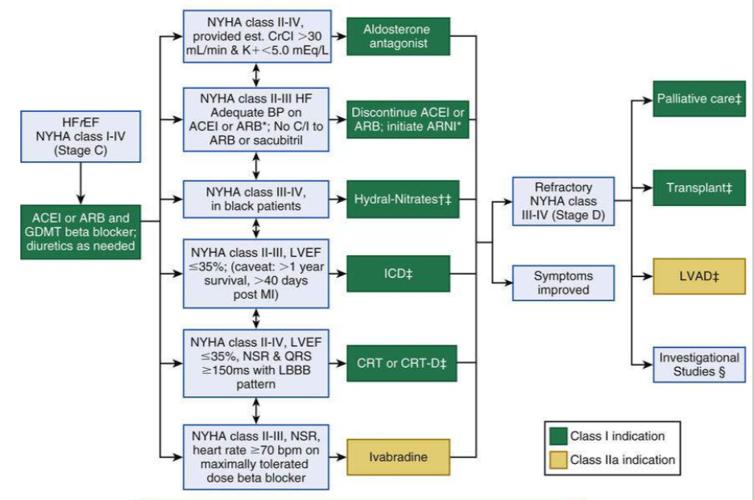

Slide 32
STAGE D – REFRACTORY END STAGE HEART FAILURE
Eligible for specialized advanced treatment strategies :
MCS devices , continous inotropic infusions or cardiac transplantations.
Until definitive therapy can be performed , continous I/V inotropic support is recommended
Fluid restriction <1.5 l/d

Slide 33
DIURETICS
To relieve congestion .
Donot improve mortality and morbidity.
Provides symptomatic relief .
Key principle – prescribe minimum dose to maintain edema free state ( dry weight ).Dose can be increased or decreased based on patient’s volume status.
Advanced stage HF patients need IV diuretics as bolus or infusion due to resistance to oral diuretic therapy probably because of poor absorption.
Loop diuretics and MRA ( spironolactone ) are given together to prevent risk of hypokalemia .

Slide 34
Role of ACEI:
ACEI : should be used in symptomatic and asymptomatic patients with HFrEF.
ACEI BENEFITS :
Stabilize LV remodelling
Improve patient symptoms
Prevent hospitalization
Prolong life
fluid retention can attenuate their effect so diuretic dose should be optimized first , but can lead to systemic hypotension !

Slide 35
ROLE OF ARBS :
For those intolerant to ACEIs - cough,rashes,angioedema
Blocks the effects of AgII on Ag type 1 receptor → thereby blocking all adverse effects of Ag II on cardiac remodelling
Should be initiated in doses of → valsartan 40 mg BD uptiterated every 3-5 days by doubling the dose.
BP, renal function and potassium levels reassessed within 1-2 weeks after starting.
ARBs are as effective as ACEIs in reducing morbidity and mortality in symptomatic HF patients.
But ACEIs remain the first line therapy whereas ARBs recommended to intolerant patients.

Slide 36
ROLE OF BETA BLOCKERS :
Blocks alpha 1, beta 1 and beta 2 receptors , but most of sympatholytic effect is mediated by beta 2 rec.
When given with ACEIs, reverse process of LV remodelling .
Indicated for patients with symptomatic or asymptomatic HF and reduced EF.
Should be initiated at lower doses and uptiterated rapidly
Dose should be decreased if HR < 50 / min or second or third degree AV Block or systemic hypotension
Dose : carvedilol : 3.125 mg twice, bisoprolol : 1.25 mg twice , metoprolol : 12.5 mg every day.

Slide 37
DIGOXIN
cardiac glycosides
Beneficial effects were secondary to its inotropic properties.
Most imp effect in HF – increase in vagal tone that counterbalances increased adrenergic activation .
Also inhibit Na-K ATPase activity in kidney and decreasing sodium reabsorption
Recommended dose – 0.125 to 0.25 mg daily

Slide 38
IVABRADINE
Heart rate lowering agent
Acts by selectively blocking cardiac pacemaker I_{f} (funny ) channels
Initially developed and approved as antianginal agent
The SHIFT trial of ivabradine suggested the use in symptomatic patients in sinus rhythm and a heart rate of 70/min or higher ( at rest )
Recommended dose : 5 mg twice daily upto 7.5 mg twice ( approved in european union but not FDA approved ).

Slide 39
NESIRITIDE : recombinant human BNP ,
potent vasodilator in venous and arterial vasculatures
reduces in venous and ventricular filling pressures
increases in cardiac output.
Limitations : high cost.
Evidence : The vasodilation in the management of acute CHF (VMAC) trial randomized 489 patients with decompensated CHF and dyspnea at rest to placebo, nesiritide and NTG. After 3 hours,patients receiving nesiritide had significant improvement in dyspnea and decrease in PCWP.

Slide 40
Recommended dose : 2mcg/kg as bolus followed by 0.01 mcg/kg/min infusion
May reduce diuretic requirements .

Slide 41
LEVOSIMENDAN :
a novel agent
increases myocardial contractility and produces peripheral vasodilation
clinical trials levosimendan - shown to reduce the risk of worsening CHF or death compared with dobutamine and placebo in patients with decompensated CHF.
The drug is well tolerated, does not appear to be proarrhythmic, has minimal potential for interactions with other drugs.
Dose : 12 – 24mcg/kg over 10 mins as bolus followed by 0.05 to 0.10 mcg/kg/min
Notes:
One strategy used in the management of congestive heart failure (CHF) is to increase myocardial contractility. Established positive inotropic agents achieve this by increasing intracellular concentrations of free calcium. However, this action markedly increases myocardial energy consumption, which may contribute to the risk of arrhythmias seen with some inotropic agents.

Slide 42
The drug acts by increasing the sensitivity of the cardiac myofilament to calcium, rather than increasing intracellular concentrations of free calcium.
By binding to cardiac troponin C in a calcium-dependent manner, levosimendan stabilises troponin C and the kinetics of actin-myosin cross-bridges without increasing myocardial consumption of adenosine triphosphate (ATP).
It also causes venous, arterial and coronary vasodilation, probably by opening ATP-sensitive potassium channels in smooth muscle.
Half life : 80 hours , after stopping infusion, effects stay for days.
Notes:
a dual mechanism of action which enhances cardiac contractility and vasodilatation without affecting intracellular free calcium, and so should have reduced proarrhythmic potential.

Slide 43
CLINICAL BENEFITS
Enhances cardiac contractility without increasing myocardial oxygen demand, and causes vasodilation
Significantly reduces the incidence of worsening CHF or death in patients with decompensated CHF
No evidence of arrhythmogenesis to date
POTENTIAL LIMITATIONS
Vasodilatory properties can cause adverse effects (headache, hypotension)
Must be administered intravenously
Limited clinical experience at present

Slide 44
SERELAXIN : recombinant human relaxin 2 ,
relaxin was first identified as major hormone of pregnancy with powerful systemic and renal vascular effects and benefecial effects on cardiac preconditioning and ischemia ,inflammation,fibrosis and apoptosis.
The phase III RELAX –AHF ( efficacy and safety of relaxin for treatment of AHF ) trial - enrolled 1161 patients within 16 hours of presentation who had dyspnea,congestion,mild to moderate renal insufficiency and SBP greater than 120 mmHg and randomized them to standard of care with a 48 hour infusion of serelaxin ( 30mcg/kg/day) and placebo.
The trial demonstrated efficacy of serelaxin in improving dyspnea and signs of congestion with no serious side effects ,and confirming the beneficial effects on hemodynamics.

Slide 45
ALISKIREN – direct renin inhibitor ,
blocking the first enzymatic step in the RAAS cascade leading to profound suppression of neurohormonal system
it is the first oral DRI currently approved for treatment of hypertension
ASTRONAUT trial enrolled 1639 hemodynamically stable patients within 5 days after admission for AHF with EF < 40% ,elevated NP and signs or symptoms of fluid overload randomized to daily oral aliskiren or placebo.
Result : found to be associated with higher rates of hyperkalemia,hypotension and renal failure.

Slide 46
ROLOFYLLINE –
adenosine A1 receptor antagonists ,
increases renal blood flow and enhance diuresis without activating tubuloglomerular feedback, can be used to treat AKI in setting of AHF.
But in one study it was found to be associated with sezuires and stroke events so its beneficial use is still under study.

Slide 47
FINERENONE –
novel, potent, selective third generation nonsteroidal mineralocorticoid receptor anatgonist
combine the potency and efficacy of spironolactone with the selectivity of eplerenone and with less hyperkalemia is in clinical trials.
Acts on distal nephron to inhibit Na/K exchange at site of aldosterone action.
Eplerenone – selective for MR than steroid receptor, shorter half life
Fineronone was compared with eplerenone in phase IIb ARTS-HF study, found to be well tolerated , less hospitalization and greater decrease in NTproBNP level.

Slide 48
CARDIAC MYOSIN ACTIVATORS : OMECAMTIV MECARBIL
Increase myocardial contractility – HOW?
Increase the transition rate from weakly bound to strongly bound state necessary for initiation of a force generating power stroke.
increases stroke volume , ejection time and cardiac output without increasing Ic Calcium
In PHASE IIb dose-finding study of 606 patients with AHF ( ATOMIC –AHF TRIAL ) , IV form did not meet the endpoint in improving dyspnea compared to placebo but at higher doses it improved dyspnea and was well tolerated so action is dose dependant.

Slide 49
SACUBITRIL / VALSARTAN [ VYMADA ]:
angiotensin receptor neprilysin inhibitor
consists of the neprilysin inhibitor sacubitril and the angiotensin receptor blocker valsartan, in a 1:1 mixture by molecule count.
recommended for use as a replacement for an ACE inhibitor or an angiotensin receptor blocker in people with heart failure with reduced ejection fraction.
The combination slows the degradation of natriuretic peptides thereby increasing natriuresis ,diuresis and myocardial relaxation,
also inhibits renin and aldosterone secretion while selectively blocking AT1 receptors – reduces Vc, sodium and water retention .

Slide 50
Should be given in low doses : sacubitril 49mg/valsartan 26 mg BD
Target dose in PARADIGM – HF TRIAL which compared ARNIs to ACEIs sacubitril 97 mg/valsartan 103 mg twice.
Guidelines donot recommend starting HFrEF patients on ARNIs who are tolerating ACEIs or ARBs , these are recommended as replacement to furthur reduce mortality
While switching , ACEI should be witheld for atleast 36 hrs to minimize risk of angioedema.

Slide 51
CARDIAC RESYNCHRONIZATION THERAPY
Several conduction abnormalities are commonly seen in association with chronic heart failure among these are ventricular conduction abnormalities such as BBB that alters the timing and pattern of ventricular contraction and place the already failing heart at a furthur mechanical disadvantage.
Consequences of ventricular conduction delays :
Suboptimal ventricular filling
Reduction in LV contractility
Prolonged duration of MR
Paradoxical septal wall motion

Slide 52
These mechanical manifestations of altered ventricular conduction is termed as VENTRICULAR DYSSYNCHRONY , defined by prolonged QRS duration greater than 120 ms. About 1/3 of patients with systolic HF have ventricular dyssynchrony . It reduces the ability of failing heart to eject blood and increases mortality in HF patients.
Ventricular dyssynchrony can be addressed with pacing therapy through implanatation of pacing leads to both right and left ventricles and this form of pacing therapy is known as CRT.

Slide 53
A CRT device has a left ventricular pacemaker lead, also known as a “coronary sinus” lead.
This lead is also implanted via the central veins of the chest. Under X-ray guidance, this specialized left ventricular pacing lead is placed into a structure known as the “coronary sinus“. This structure is located in the right atrium and drains the blood supply of the heart.
Consequently, the vein courses along the back side of the heart to the left ventricular wall. By accessing this vein, the left coronary sinus lead can be positioned along the left ventricular wall to provide selective pacing of the left ventricle that can be coordinated with the right ventricle via the right ventricular pacing lead .
This resultant coordinated biventricular pacing can reduce the right and left ventricular electrical delay and improve cardiac function and symptoms of heart failure.

Slide 54
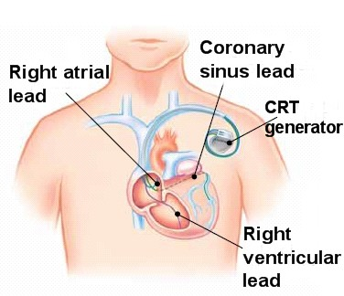
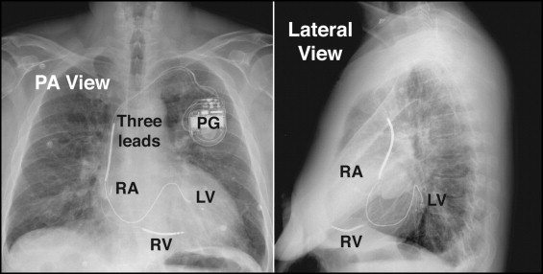

Slide 55
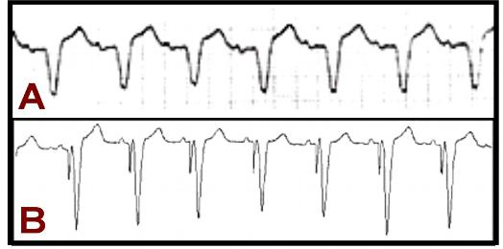
Patients who qualify for CRT implant are based on studies done in particular subgroups of patients. They typically must satisfy the following:
Depressed left ventricular ejection fraction < 35%
Evidence of asynchronous, uncoordinated left and right ventricular contraction with left bundle branch block (LBBB) on ECG.
Moderate to severe symptoms of heart failure, despite lifestyle changes and maximal medications
Panel A shows an ECG strip of LBBB in a patient with heart failure and dysynchronous ventricular contraction. With implantation of a CRT system, the patient’s biventricular-paced ECG in Panel B shows narrowing of the QRS-complex with synchronous ventricular contraction.

Slide 56
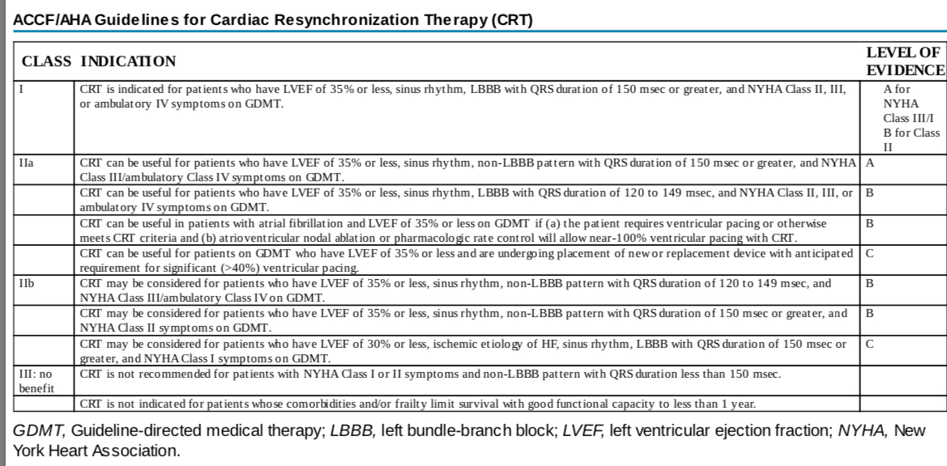

Slide 57
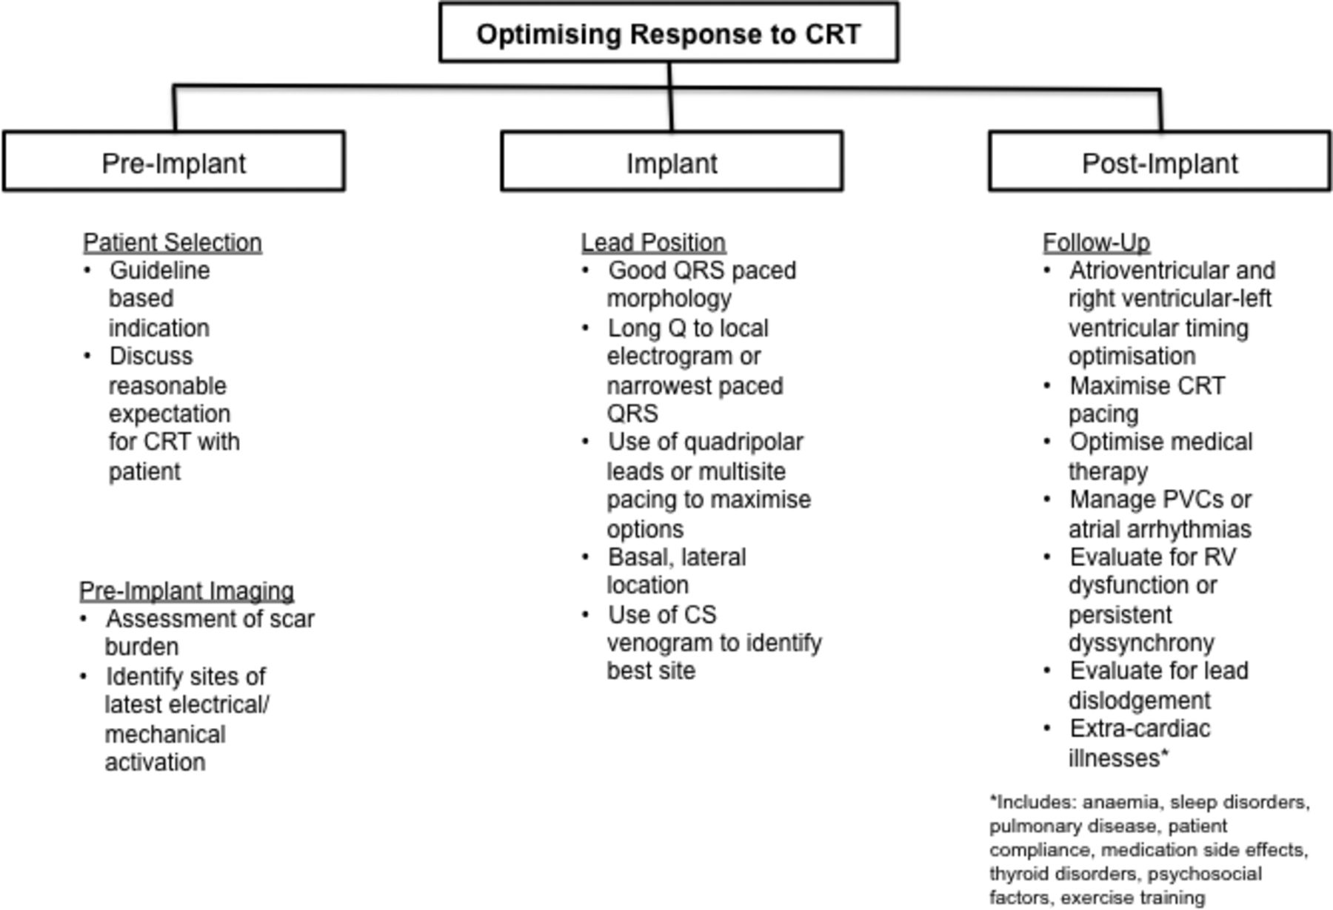

Slide 58
There are two types of CRT devices. One is a special kind of pacemaker. It’s called a cardiac resynchronization therapy pacemaker (CRT-P) or “biventricular pacemaker.”
The other is the same device, but it also includes a built-in implantable cardioverter defibrillator (ICD). This type is called a cardiac resynchronization therapy defibrillator (CRT-D).
How CRT-D Devices Work?
A CRT-D is a special device for heart failure patients who are also at high risk for sudden cardiac death. While functioning like a normal pacemaker to treat slow heart rhythms,
A CRT-D device can also treat dangerously fast heart rhythms (arrhythmias) that can lead to sudden cardiac arrest. If the device senses heartbeats that are dangerously fast, it delivers a shock to the heart. This shock (defibrillation) stops the abnormal rhythm.
How CRT-P Devices Work?
While functioning like a normal pacemaker to treat slow heart rhythms, a CRT-P device also delivers small electrical impulses to the left and right ventricles to help them contract at the same time so you heart pumps more efficiently.

Slide 59
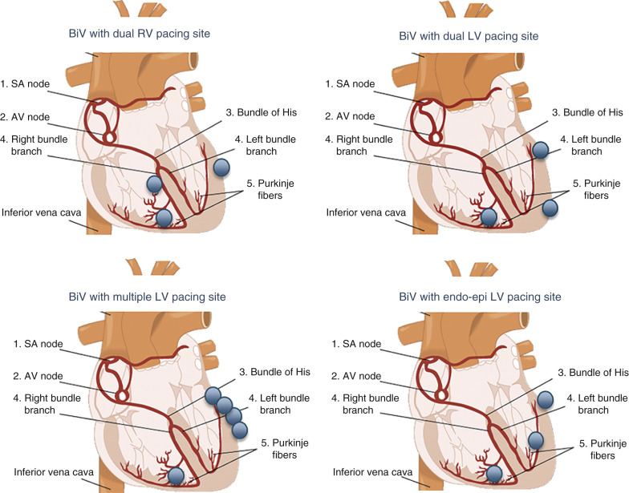

Slide 60
MECHANICAL CIRCULATORY SUPPORT DEVICES
Are mechanical pumps designed to assist or replace the function of either left or right ventricle or both ventricles.
Important characterstics of these devices :
Location of pumping chamber
Specific ventricle supported
Pumping mechanism
Indicated duration of support – temporary vs long term
extracorporeal or paracorporeal – pump located outside the body
Intracorporeal - implantable pump

Slide 61
INDICATIONS FOR MCS DEVICES
Three indications approved by FDA
Bridge to recovery : refers to use of MCS devices in patients with cardiogenic shock or acute decompensated heart failure refractory to optimal medical management , when it is expected that myocardial injury is reversible for ex: acute MI , acute myocarditis ,postcardiotomy cardiogenic shock
Bridge to transplantation : refers to use of MCS devices in patients with cardiogenic shock or ADHF refractory to OMM in whom myocardial function in unlikely to recover for ex: long standing ischemic ,valvular,or idiopathic cardiomyopathy and who are eligible for cardiac transplantation
Destination therapy : it is application of MCS devices in patients with chronic refractory symptoms of advanced HF that results from irreversible forms of either nonischemic or ischemic CMP who are ineligible for heart transplantation.

Slide 62
The intra-aortic balloon pump (IABP)
is a mechanical device that increases myocardial oxygen perfusion and indirectly increases cardiac outoup through afterload reduction.
It consists of a cylindrical polyurethane balloon that sits in the aorta, approximately 2 centimeters (0.79 in) from the left subclavian artery.
The balloon inflates and deflates via counter pulsation, meaning it actively deflates in systole and inflates in diastole.
Systolic deflation decreases afterload through a vacuum effect and indirectly increases forward flow from the heart.

Slide 63
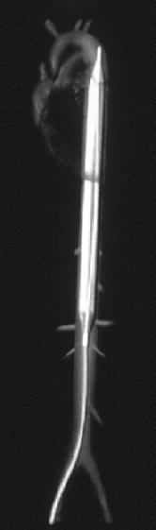
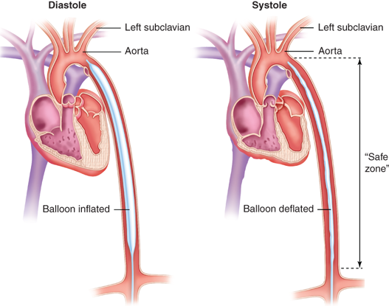

Slide 64
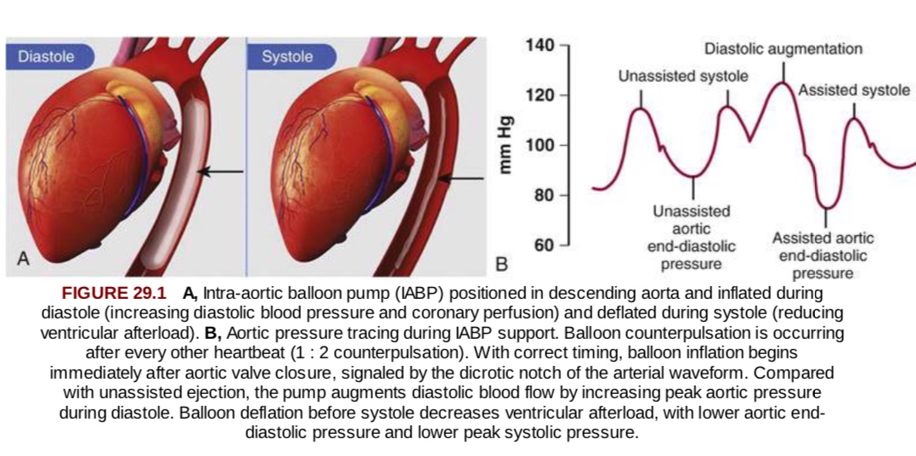

Slide 65
ECMO
extracorporeal technique of providing prolonged cardiac and respiratory support to persons whose heart and lungs are unable to provide an adequate amount of gas exchange or perfusion to sustain life.
It is used either post-cardiopulmonary bypass or in late stage treatment of a person with profound heart and/or lung failure

Slide 66
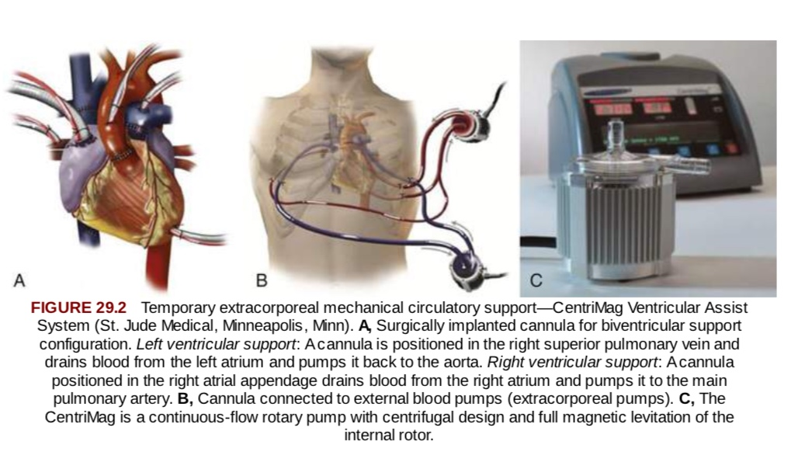

Slide 67
IMPELLA :
Impella is a percutaneously inserted ventricular assist device (VAD). It has been increasingly used in patients with severe heart failure, cardiogenic shock, and high-risk percutaneous intervention (PCI).
The device pumps blood from the left ventricle into the ascending aorta and systemic circulation at the upper rate of 2.5 L/min.
Impella supports led to a decrease in pulmonary capillary wedge pressure, increase in cardiac output, mean arterial blood pressure (MAP), and improved organ perfusion in patients with severe CS. Additionally, it was suggested that the device could be potentially useful in high-risk percutaneous coronary intervention.

Slide 68
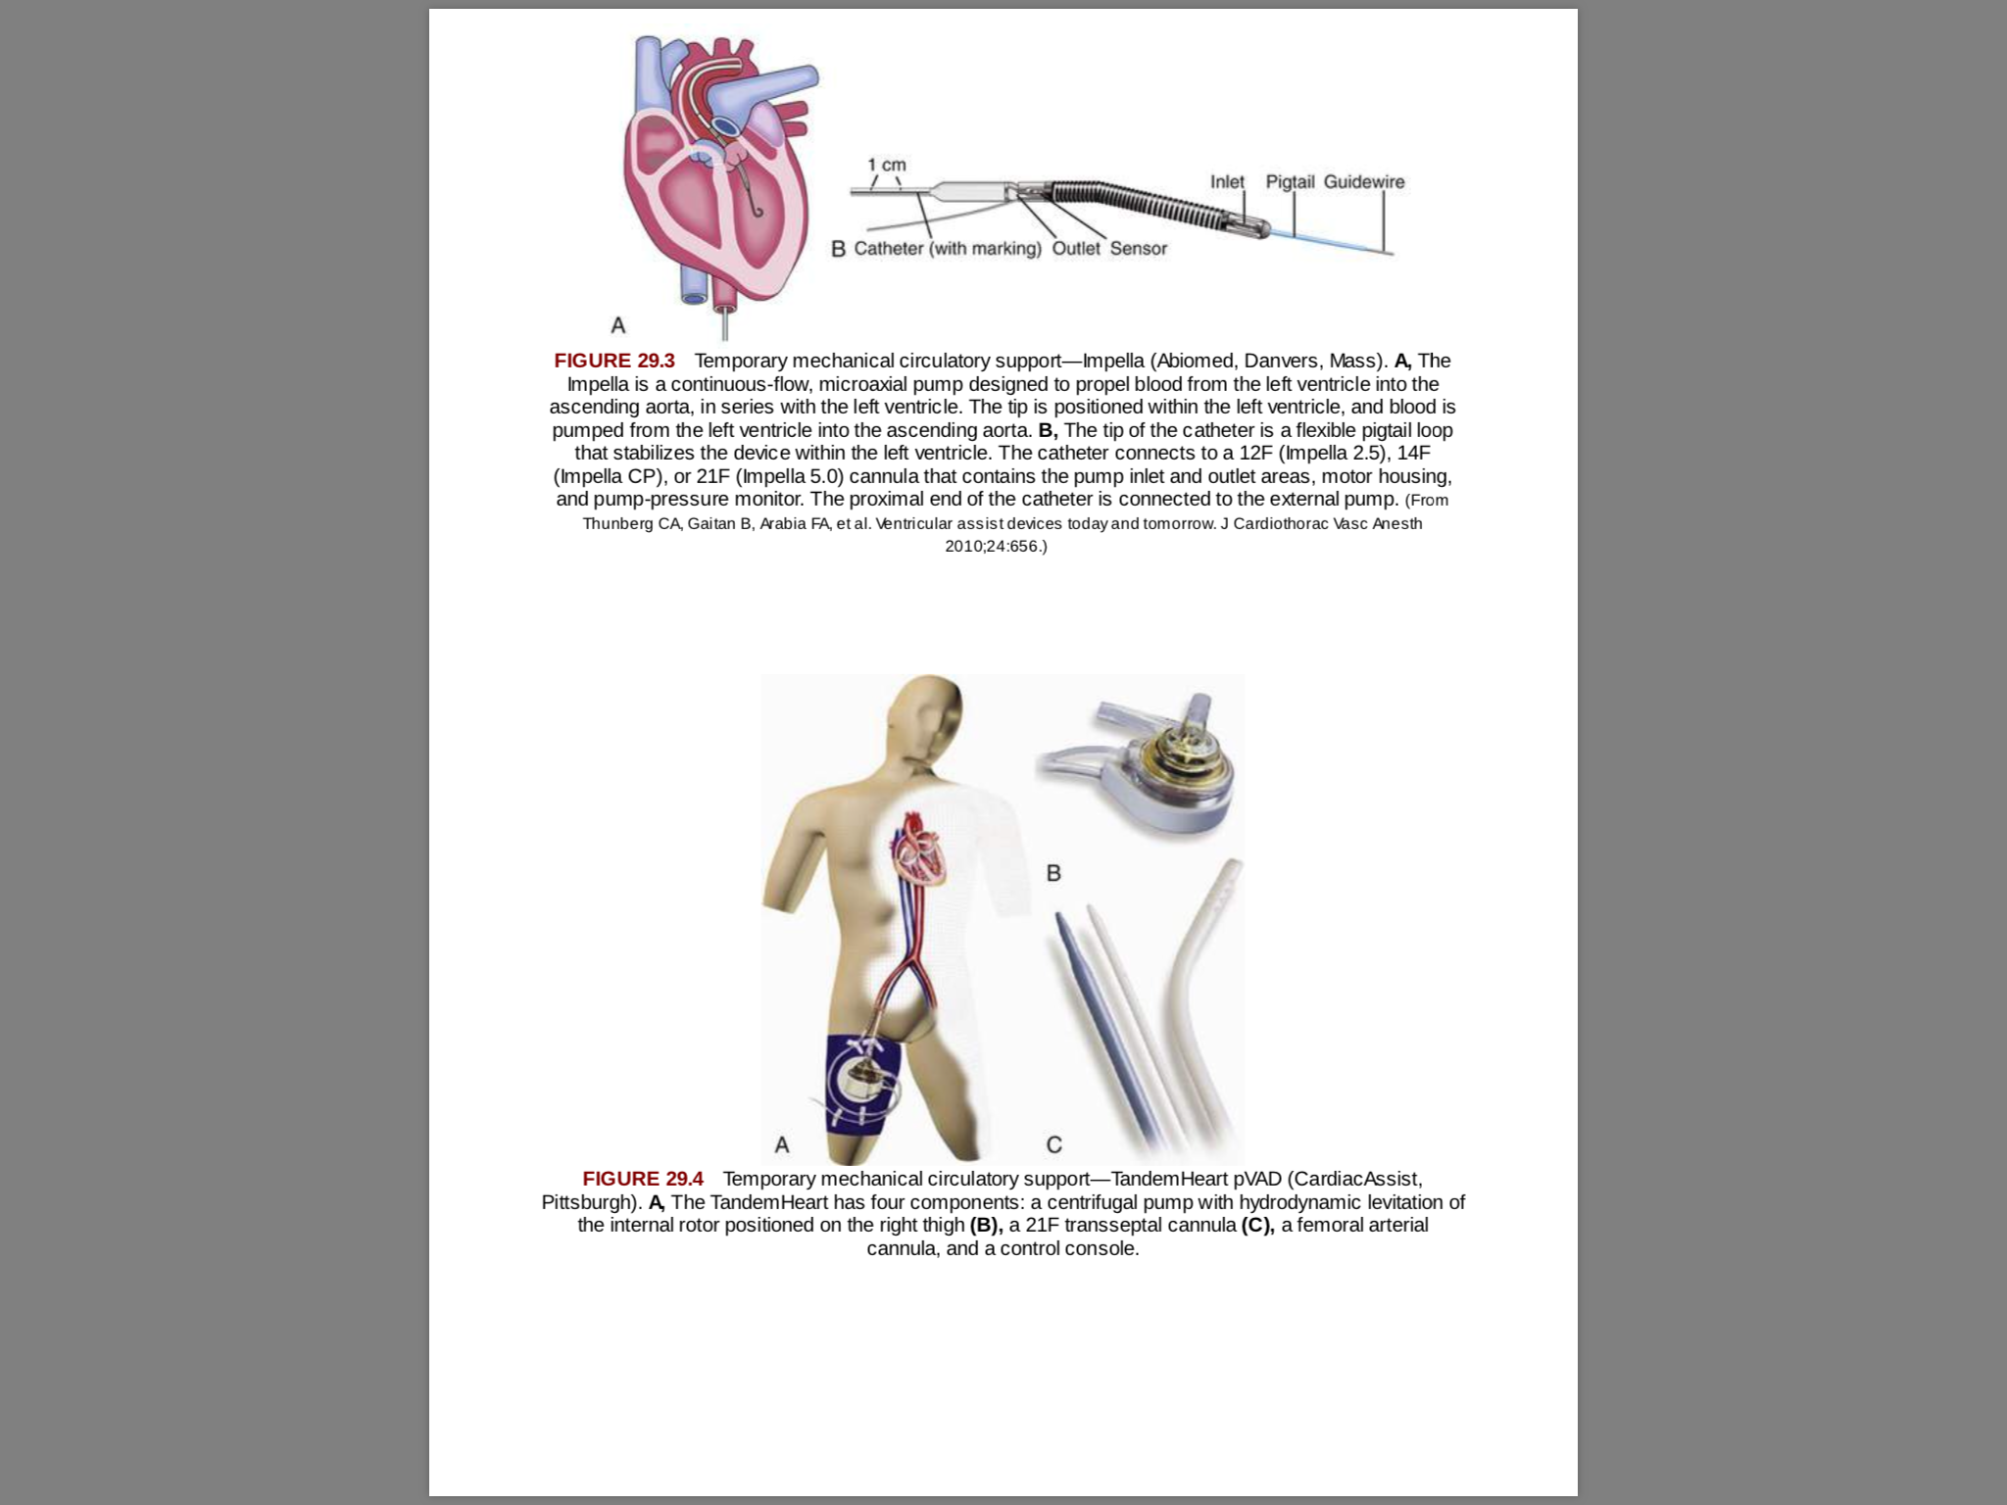

Slide 69
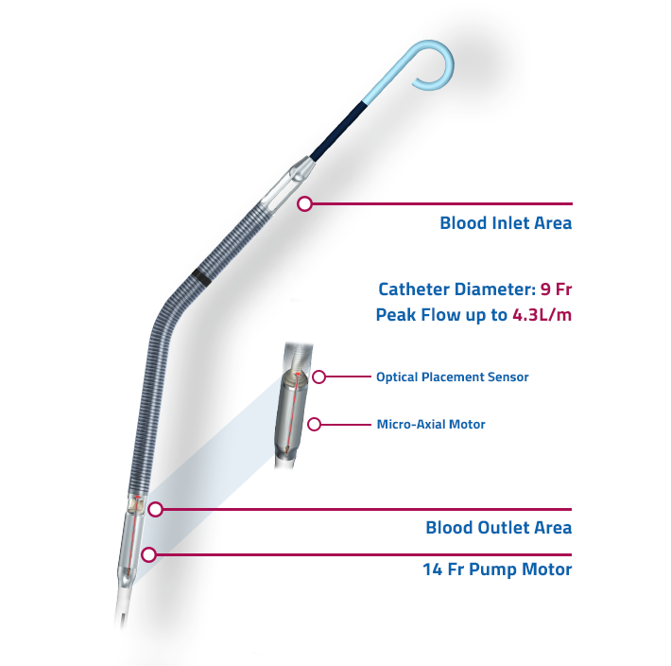

Slide 70
TANDEM HEART
The TandemHeart is a left atrial-to-femoral artery bypass system comprising a transseptal cannula, arterial cannulae, and a centrifugal blood pump. The pump can deliver flow rates up to 4.0 L/min at a maximum speed of 7500 rpm.
A 21F transseptal inflow cannula aspirates oxygenated blood from the left atrium. Blood is then pumped into the femoral artery through the 15F or 17F arterial cannulae.
The pump rotates on a lubricating fluid film and is driven by an electromagnetic motor. The continuous infusion of a heparin solution into the lower inner housing of the pump allows lubrication and cooling, which aids in the prevention of thrombosis in the pump chamber.

Slide 71
Using fluoroscopic guidance, a transseptal puncture is made between the right and left atria, via the femoral vein .
Iliac angiography before implantation is recommended to confirm that the femoral artery will accommodate the arterial return cannula.
A guidewire is inserted into the left atrium, and the interatrial septum is dilated using a 2-stage dilator (14F and 21F) .
Proper positioning of the cannula is confirmed by fluoroscopy. The guidewire and obturator are removed, and the transseptal cannula tip remains in the left atrium

Slide 72
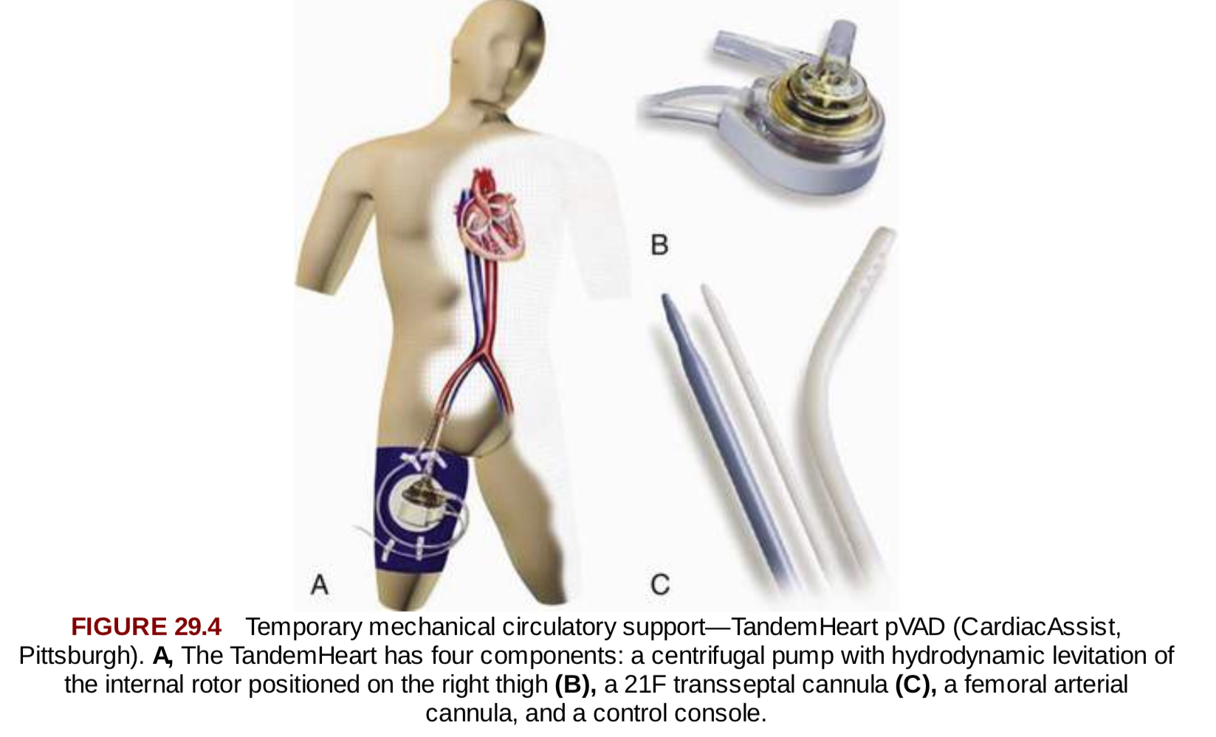

Slide 73

THANKYOU

