Slide 1
REFRACTORY ASCITES

Slide 2
Refractory ascites refers to the ascites that cannot be mobilized ( minimal/ no weight loss) by low sodium diet (88mEq/ 2000 mg/day) and maximal doses of diuretics( upto 400mg spironolactone and 160 mg furosemide per day) or the early recurrence of which ( i.e .., after therapeutic paracentesis) cannot be prevented by medical therapy.
Occurs in 5% of cirrhotic patients with ascites.

Slide 3
Mechanism of ascites formation :
In cirrhosis, the source of ascites is mainly the hepatic sinusoids . Sinusoidal hypertension is the initial mechanism that determines leakage if ascites into the peritoneal space . Sinusoidal hypertension results mainly from hepatic venous outflow block secondary to regenerative nodules and fibrosis.
The other essential factor in pathogenesis of cirrhotic ascites is sodium and water retention, resulting mainly from splanchnic and systemic vasodilatation, which allows for the replenishment of the intravascular volume and maintenance of ascites formation.

Slide 4
PATHOPHYSIOLOGY
Different theories have been proposed to explain the pathophysiology of ascites . The three main theories include the underfill, overfill and peripheral vasodilation theories .
The overfill theory propose that extracellular volume expands secondary to increased reabsorption of sodium at the proximal and distal tubules and the activation of the renin – angiotensin – aldosterone system (RAAS) and the symapathetic nervous system .

Slide 5
Overfill hypothesis
Hepatic signal
(baroreceptor and others)
↓
Renal sodium and water retention
↑plasma volume
↑cardiac output
↓systemic vascular resistance +portal hypertension
↓
Overflow into the peritoneal cavity

Slide 6
The underfill theory suggests that increased portal pressure, in the presence of portal hypertension , causes splanchnic vasodilatation . This results in increased portal venous blood flow and lymph formation by splanchnic circulation, eventually leaking into the peritoneal cavity.
Furthermore splanchnic vasodilation causes a decrease in arterial blood volume , activating central baroreceptors . As a result , SNS is activated causing arterial vasoconstriction . The RAAS is also activated promoting further sodium retention.

Slide 7
A commonly accepted theory of ascites formation is based upon the peripheral vasodilation theory , which states that ascites develops secondary to the continous retention of sodium . Splanchnic vasodilation causes arterial system undefilling, as a result , vasopressin and activity increases and causes hypovolemia .
Initially there is no sodium retention , however the body is eventually unable to maintain homeostasis , and fluid starts leaking into the peritoneal cavity.

Slide 8
Peripheral vasodilatation
↓
Diminished effective arterial blood volume
↓
Rise in renin, aldosterone , vasopressin,
Sympathetic system stimulated
↓
Sodium and water retention
Renal vasoconstriction
↓
Plasma volume expansion plus portal hypertension
↓
ASCITES

Slide 9
Sodium and water retention develop as the SNS and RAAS are activated to compensate for arterial underfilling . This theory is believed to explain the development of HRS and dilutional hyponatremia in pateints with refractory ascites
Splanchnic circulation remains patent in portal hypertension as result of its own production of vasodilators such as prostaglandin E, prostacyclin, nitric oxide.

Slide 10
The production of these vasodilators results in a hyperdynamic state of the splanchnic circulation, causing low vascular resistance , increased cardiac output , decreased blood pressure .
As a result of elevated sinusoidal pressure , there is an increase in venous blood and, therefore , increased lymph formation in the splanchnic circulation . The rate of lymph production exceeds the flow rate into the peritoneal cavity forming ascites.

Slide 11
The INTERNATIONAL ASCITES CLUB divided refractory ascites into two categories
Type I :– Diuretic resistant ascites
defined as the inability to mobilize ascites despite intensive medical therapy and salt restriction diet for atleast one week
B. Type II :- Diuretic intractable ascites
characterized by the recurrence of ascites secondary to the development of diuretic induce complications, which prevents the use of maximal dose of diuretics. Complications include hepatic encephalopathy ,

Slide 12
renal failure, and electrolyte disturbances such as hyponatremia and/ or hyper or hypokalemia .
The Diagnostic criteria of refractory ascites consists of
Ascites that cannot be mobilized with early recurrence within 4 weeks of abdominal paracentesis
Lack of response to maximal doses of diuretic(spironolactone 400mg/d and 160 mg/d) for atleast one week
Diuretic induced complications such as hyponatremia, hepatic encephalopathy, renal failure or hyper- -kalemia in the absence of other precipitating factor.

Slide 13
Further more Ring Larsen and Moore revised the diagnostic criteria of refractory ascites to include
d) persistent ascites despite sodium restriction
(50-90mmol/d)
e) Mean weight loss of less than 0.8kg over
four days
f) Urinary sodium excretion that is less than sodium intake (<50mmol/d)

Slide 14
Complications of refractory ascites :
Dilutional hyponatremia :
Develops in the presence of ascites when serum sodium levels are less than 130mmol/L. This occurs in 30% of patients with ascites and is associated with poor survival rate . Hyponatremia increases the risk of death in patients with cirrhosis and ascites, and serum levels less than 125mEq/L increase the risk of mortality by 48%.
Hyponatremia may be due to splanchnic vasodilatation and subsequent activation of SNS and RAAS cause sodium and water retention as well as expansion of extracellular volume .

Slide 15
Dilutional hyponatremia alone may not cause symptoms because it develops slowly, giving the brain time to adapt . The severity of symptoms is related to the degree and potential rate at which hyponatremia develops.
Patients with hyponatremia rarely have specific symptoms , if present patient present with fatigue and confusion. Therefore, when sodium levels are <120mEq daily patients may be treated with fluid restriction.
Hypertonic saline is not recommended as it can precipitate central pontine myelinolysis.

Slide 16
B. Hepatorenal syndrome :
Hepatorenal syndrome is the development of renal failure in patients with severe liver disease in the absence of any identifiable renal pathology. It is a functional rather than structural disturbance in renal function.
HRS results from continuous sodium and water retention caused by increased production of vasoactive substances activated by splanchnic vasodilation. About 10% of patients with advanced cirrhosis will present with HRS.
Type 2 HRS is often associated with refractory ascites.

Slide 17
CRITERIA FOR DIAGNOSIS OF HEPATORENAL SYNDROME
Low glomerular filteration rate( serum creatinine >1.5mg/dl)or creatinine clearance <40ml/min
Absence of shock, ongoing sepsis, fluid loss, nephrotoxic drugs
No sustained improvement in renal function( serum creatinine <1.5mg/dl or creatinine clearance >40ml/min) after diuretic therapy stopped and expansion of plasma volume with 1.5L of plasma expander
Proteinuria <500mg/day, no ultrasound evidence of renal tract obstruction or renal disease

Slide 18
Severe liver disease or cirrhosis + portal hypertension
↓
Splanchnic arterial vasodilatation
↓
Central arterial hypovolemia
↓
Activation of sympathetic, renin/angiotensin/aldosterone , anti diuretic harmone
↓
Renal vasoconstriction
↓
Intrarenal vasoconstriction ↑
intrarenal vasodilators↓
↓
Renal vasoconstriction↑↑
↓
Hepatorenal syndrome

Slide 19
The goal of therapy is to reverse splanchnic vasodilation and renal vasoconstriction . Initially, diuretics should be discontinued to prevent worsening of renal failure.
A combination of vasoconstricting agents in conjunction with albumin infusion has been shown to increase survival by reversing splanchnic arterial vasodilation. Vasoconstrictors such as a vasopressin agonists( terlipressin) or alpha adrenergic agonist (midodrine or noradrenaline ).

Slide 20
Midodrine in combination with octreotide improves renal perfusion and blocks splanchnic vasodilators, redistributing blood volume.
When albumin is used with these agents, it maintains systemic plasma volume expansion. It also improves renal function by increasing total blood volume . The infusion rate of albumin consists of 1.5g/kg, followed by 1g/kg after days

Slide 21
C. Spontaneous bacterial peritonitis:
SBP develops from translocation from gut flora. Portal hypertension, volume overload, reticuloendothelial system impairment, malnourishment in patients with refractory ascites increase intestinal wall permeability .
In addition, ascitic fluid has low complement levels and a decreased number of phagocytes contributing to bacterial translocation to the blood stream and ascitic fluid.
SBP manifests with abdominal pain, tense abdomen, fever, progressive encephalopathy

Slide 22
Occurs about 8% of cirrhotic patients with ascites
The diagnosis is often based upon the presence of hepatic encephalitis, leucocytosis and renal impairment but confirmed with abdominal paracentesis. The most common organism found in ascitic fluid are E.coli, Staphylococcus aureus, Streptococcus viridians and Enterococcus species .
SBP is treated with parenteral third generation cephalosporins.

Slide 23
D. Hepatic Hydrothorax:
The development of pleural effusion in the absence of cardiac or pulmonary disease with severe cirrhosis and ascites occurs in 6-10% of patients.
Hepatic hydrothorax is defined as the presence of pleural fluid greater than 500ml in a patient with cirrhosis . Ascitic fluid accumulation into pleural space is primarily believed to occur by diffusion of peritoneal fluid through diaphragmatic defects or transdiaphragmatic lymphatics .

Slide 24
As result patient develops severe dyspnoea, dry cough, pleuritic chest pain, cardiac tamponade.
Reversing ascites and preventing complications from hepatic hydrothorax are goals of management. The resolution and prevention of recurrence is accomplished by decreasing the pressure in abdominal cavity, adhering to a low salt diet and using therapeutic thoracocentesis .
Pateints requiring thoracocentesis more than every 2-3 weeks may require TIPS to help decrease portal pressure and therefore improve sinusoidal drainage of lymph into thoracic duct.

Slide 25
E. Spontaneous bacterial Empyema :
Is defined as an infection of a pre existing pleural effusion( hydrothorax) in a patient with cirrhosis . Patients with SBEM have a lower level of C3 and total protein. SBEM may occur in the absence of peritonitis considering phagocytosis may be more severely impaired in pleutal cavity
F. Umblical Hernia :
occurs in 20% of patients secondary to the increased intra-abdominal pressure contributing to omentum rupture at the umbilicus . In patients with refractory ascites, elective surgery is best avoided because of the risk of fluid leakage and infection.

Slide 26
MANAGEMENT OF REFRACTORY ASCITES
Refractory ascites is associated with multiple comorbidities characteristic of patients who have failed standard treatment of ascites . Multiple approaches have been developed to control portal hypertension thus decreasing ascites.
The survival rate of patients with refractory ascites is poor and the quality of life of these patients has little or no improvement with only diuretic management. Currently accepted nonmedical treatment are large volume paracentesis , TIPS and liver transplantation.

Slide 27
ABDOMINAL PARACENTESIS
Paracentesis is commonly the first therapeutic step in the setting of refractory ascites to achieve immediate relief of intra abdominal pressure . Paracentesis has shown to decrease the length of hospital stay and the number of complications when compared to medical therapy alone.
Patients presenting with ascites, volume greater than 10L paracentesis is performed atleast with 2 weeks of interim period .

Slide 28
The indications for large volume paracentesis are
Respiratory distress
Umblical hernia
Poor response to medical therapy
About 20% of patients following large volume paracentesis over 4-6L are associated with postparacentesis circulatory dysfunction when not followed by volume expansion.
Circulatory dysfunction involves worsening of hyponatremia and hyovolaemia. The decrease in vascular resistance after large volume paracentesis triggers the SNS and RAAS, increasing the risk of renal failure, worsening of hyponatremia and decreasing

Slide 29
survival. Therefore, intravenous infusion of albumin is given to prevent renal perfusion impairment causing blood volume expansion.
The main contraindications to paracentesis are fibrinolysis and DIC .
Complications associated with paracentesis include abdominal wall heamatoma , hemoperitoneum, infection and leakage of ascitic fluid .

Slide 30
TRANSJUGULAR INTRAHEPATIC PORTOSYTEMIC
SHUNTS (TIPS)
TIPS is a non invasive method used to treat refractory ascites.
TIPS decreases portosystemic pressure by creating a shunt between the heaptic vein and the portal vein, relieving intra abdominal pressure and improving renal function . Consequently RAAS activity decreases, improving urinary sodium excretion .
TIPS is usually indicated in patients with refractory ascites who require repeated paracentesis more than three times a month, presence of loculated ascites or have multiple abdominal adhesions .

Slide 31
Two types of stent can beused for TIPS:
Bare
covered.
Bare stents are associated with a high rate of dysfunction of shunts. Stenosis or obstruction of bare stents occurs in 70% of cases within 1 year.1
Covered stents, including polytetrafluoroethylene (PTFE)-covered stents, have a lower frequency of dysfunction than bare stents.2
The use of covered stents for TIPS in patients with refractory ascites increases the survival rate.3
1. Sanyal AJ, Genning C, Reddy KR, et al. The North American study for the treatment of refractory ascites. Gastroenterology 2003; 124: 634–641
2.Bureau C, Thabut D, Oberti F, et al. Transjugular Intrahepatic Portosystemic Shunts With Covered Stents Increase Transplant-Free Survival of Patients With Cirrhosis and Recurrent Ascites. Gastroenterology 2017; 152: 157–163
3.Gaba RC, Parvinian A, Casadaban LC, et al. Survival benefit of TIPS versus serial paracentesis in patients with refractory ascites: a single institution case-control propensity score analysis. Clin Radiol 2015; 70:e51–e57.

Slide 32
The volume of blood shunted through the liver is related to postTIPS HE ,So the stent diameter is important.4
A 10-mm PTFE stent is more effective in controlling refractory ascites than an 8-mm stent, and it does not increase the incidence of HE.5
4.Sarfeh IJ and Rypins EB. Partial versus total portacaval shunt in alcoholic cirrhosis. Results of a prospective, randomized clinical trial. Ann Surg 1994; 219: 353–361
5. Miraglia R, Maruzzelli L, Tuzzolino F, et al. Transjugular intrahepatic portosystemic shunts in patients with cirrhosis with refractory ascites: comparison of clinical outcomes by using 8- and 10-mm PTFE-covered stents. Radiology 2017; 284: 281–288.

Slide 33
The contraindications for TIPS include
Portal vein thrombosis
Hepatic encephalopathy
An INR greater than 2
Presence of SBP
Age older than 60years
Ejection fraction less than 55%
Child – Pugh score >12
The complications involving TIPS include
Intra abdominal bleeding,
hepatic encephalopathy(30%),
DIC,
Ascitic leak ,
pulmonary edema,
increase in liver enzymes secondary to decreased blood flow to hepatocytes
shunt stenosis(40%)

Slide 34
The high incidence of hepatic encephalopathy and shunt dysfunction after TIPS is the main disadvantange .
Recurrence of ascites is known to occur after TIPS , however TIPS patients have a lower recurrence rate than those undergoing paracentesis .
The rate of recurrence for TIPS is 42% compared to 89% for large volume paracentesis

Slide 35
ALFA pump
This device is subcutaneously implanted and battery-powered, and moves ascites from the peritoneal cavity to the urinary bladder to facilitate removal of fluid by urination.9
The design of the ALFApump enables it to function in the day time and stop when sleeping. Additionally, this device has internal sensors that monitor the pressure of the bladder and peritoneal cavity. When there is no ascites in the peritoneal cavity or the bladder is full, the ALFApump will stop working.
9. Bellot P, Welker MW, Soriano G, et al. Automated low flow pump system for the treatment of refractory ascites: a multicenter safety and efficacy study. J Hepatol 2013; 58: 922–927.

Slide 36
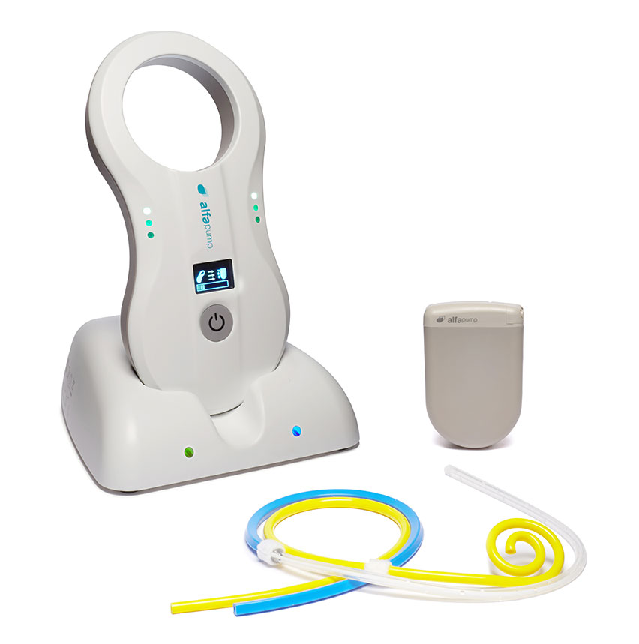
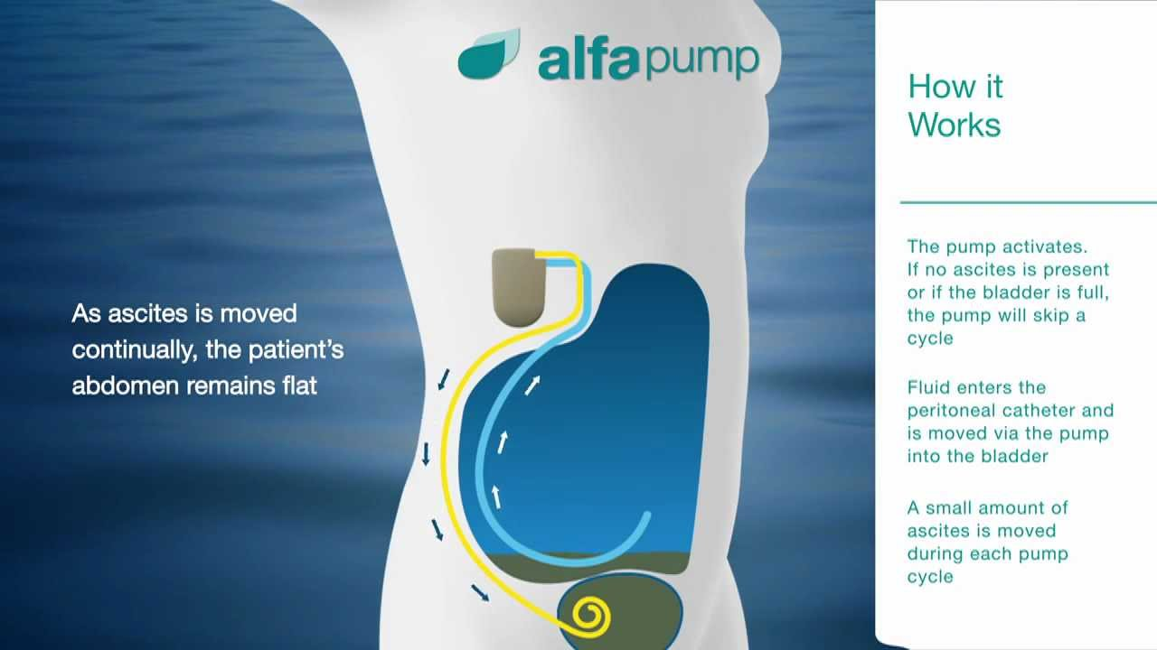

Slide 37
The ALFApump is mainly used in patients who are
unsuitable for TIPS,
previously failed TI.PS, or
patients with portal thrombosis.
A multicentre study of the ALFApump system showed a significant reduction in the frequency of LVP (median number per month, 3.4 vs 0.2, p < 0.01).10
Two multicentre, randomized, controlled studies by Devabhavi et al.49 and Bureau et al.50 showed that there was no difference in survival between patients who were treated with the ALFApump and LVP with a follow-up for 6 and 3 months, respectively.
The ALFApump can be a bridge for patients on the transplant list, but the ultimate solution is still liver transplantation.
10. Bellot P, Welker MW, Soriano G, et al. Automated low flow pump system for the treatment of refractory ascites: a multicenter safety and efficacy study. J Hepatol 2013; 58: 922–927.

Slide 38
LIVER TRANSPLANTATION
Liver transplant is the ultimate treatment for refractory ascites .
Because of large discrepancy between patients waiting for liver transplantation and those undergoing transplantation, many patients with refractory ascites succumb to their disease before receiving transplant. TIPS and recurrent paracentesis are used as bridges to liver transplantation to control ascites .
There is a remarkable improvement in the survival rate after liver transplantation. 11
11.Senousy BE and Draganov PV. Evaluation and management of patients with refractory ascites. World J Gastroenterol 2009; 15: 67–80.

Slide 39
THANK YOU

