Slide 1
ROLE OF UPPER GI ENDOSCOPY IN CLINICAL PRACTICE

Slide 2
ENDOSCOPY PROCEDURE
Upper endoscopy, also referred to as esophagogastroduodenoscopy (EGD), is performed by passing a flexible endoscope through the mouth into the esophagus, stomach, and duodenum.
Video Endoscopy is performed by attaching a microchip camera at the insertion tube, setup image is viewed on the monitor.

Slide 3
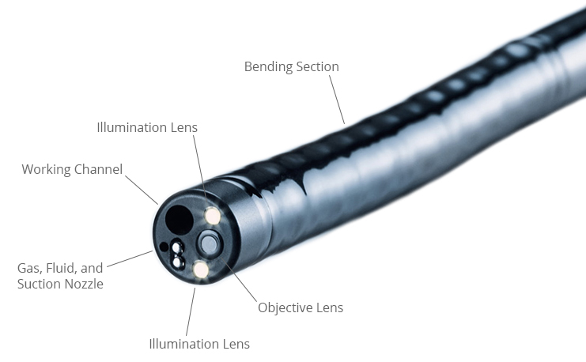
DISTAL TIP OF ENDOSCOPE

Slide 4
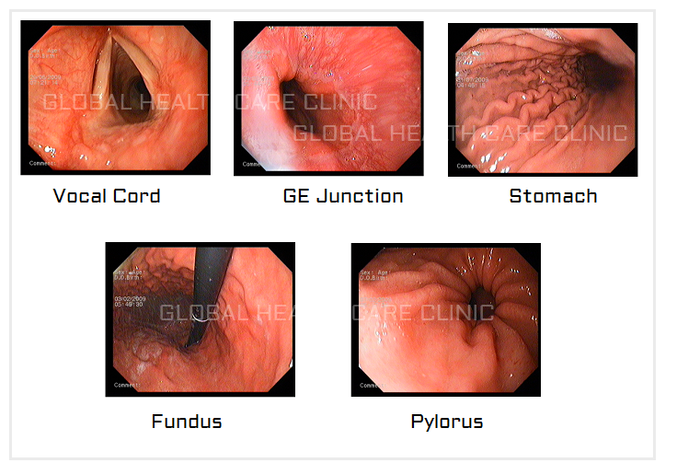

Slide 5
Preparation before endoscopy
A medical history with prior Consent should be obtained with thorough discussion regarding benefits and risks of the procedure.
Patient should be hemodynamically stable.Respiratory insufficiancy, altered mental status or ongoing hemetemesis indicates need for endotracheal intubation prior to endoscopy.
Lab tests : Complete blood counts, coagulation tests, bleeding time, electrocardiography, pregnancy testing, BGCM, renal function tests, Serology.
Patient suspected to have cirrhosis or AV fistula or who rebleed in hospital should undergo urgent endoscopy (<2hrs).
Patients should be kept empty stomach to allow gastric emptying at least 6 hours prior the elective procedure.

Slide 6
In patients with severe UGI bleed, gastric lavage should be performed to remove blood clots from stomach.
IV administration of gastric prokinetic medications 30-90 mins before procedure to induce gastric contractions and push blood from stomach to SmalI intestine helps better endoscopic visualization.
EGD is routinely performed with topical pharyngeal anesthesia only. Patient tolerance of unsedated EGD is improved by the use of an ultrathin, 5-mm diameter endoscope that can be passed transorally or transnasally.
Certain procedures like Cirrhosis with Acute GI bleeding, EUS guided FNAC or Percutaneous Endoscopic Gastrostomy (PEG) which increases the risk of infective endocarditis or peristomal cellulitis may require prophylactic Antibiotics.
High level disinfection with soaking in solutions like gluteraldehyde or Per acetic acid should be emphasized.

Slide 7
INDICATIONS OF URGENT UGI SCOPY
ACUTE GASTROINTESTINAL HEMORRHAGE.
PEPTIC ULCER.
VARICES.
MALLORY WEISS TEAR.
VASCULAR ECTASIAS.
GASTROINTESTINAL OBSTRUCTION AND PSEUDOOBSTRUCTION.
FORIEGN BODY IN GIT.

Slide 8
INDICATIONS OF ELECTIVE UGI SCOPY
DYSPEPSIA (Gastritis and Duodenitis)
GASTROESOPHAGEAL REFLUX DISEASE (GERD
BARRET’S ESOPHAGUS.
PEPTIC ULCER
NONULCER DYSPEPSIA
DYSPHAGIA
TREATMENT OF MALIGNANCIES
Endoscopic mucosal resection (EMR) or Endoscopic submucosal dissection (ESD)
Percutaneous gastrostomy tube placement during EGD
NEWER MODALITIES
Endoscopic Ultrasonography EUS and EUS guided procedures

Slide 9
COMPLICATIONS OF UPPER GI ENDOSCOPY
Unplanned cardiopulmonary events such as hypotention, hypoxemia, apnea, aspiration, myocardial infarction, pneumonia, resp arrest, and account for 30-60% patients undergoing sedation and anasthesia.
Ulceration can occur following sclerotherapy in about 78% patients.
Medications used during conscious sedation may cause respiratory depression or allergic reactions.
All endoscopic procedures carry some risk of bleeding and gastrointestinal perforation.
Some procedures carry a higher incidence of postprocedure bacteremia, and prophylactic antibiotics may be indicated.
Management of antithrombotic agents prior to endoscopic procedures should take into account the procedural risk of hemorrhage, the agent, and the patient condition, as summarized in Table

Slide 10
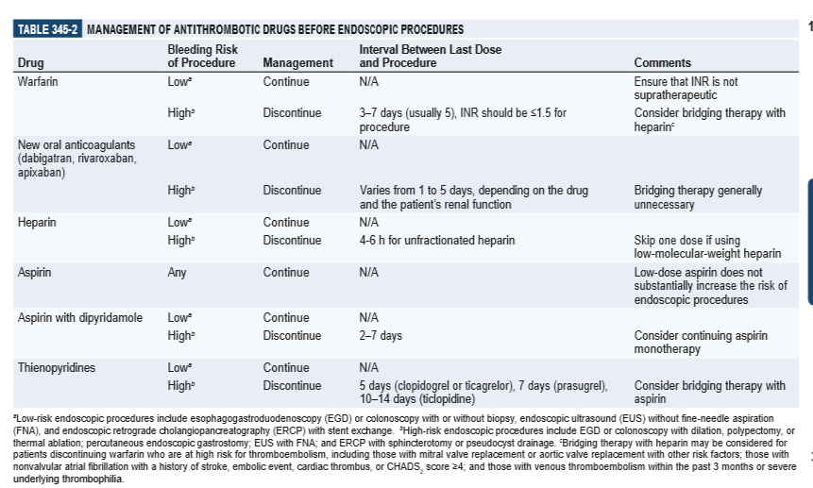

Slide 11
CONTRAINDICATIONS
SUSPECTED OR KNOWN PERFORATION.
KNOWN OR SUSPECTED COAGULOPATHY.
PATIENT IN SHOCK.
UNCOOPERATIVE PATIENT.
INADEQUATELY TRAINED PERSONNEL.

Slide 12
Causes of Upper GI Bleed diagnosed by UGIscopy
Non Variceal bleed (80%):
Peptic ulcer disease (30-50%)
Mallory weiss tear(15-20%)
Gastritis/ duodenitis (10-15%)
Esophagitis (5-10%)
AV malformations (5%)
Tumors (2%)
Variceal Bleed (20%)
Gastro esophagial varices (>90%)
PHTN gastropathy (5%)
Others
Dieulafoy lesion (<2%).
GAVE gastric antral vascular ectasias
No cause found (8%)

Slide 13
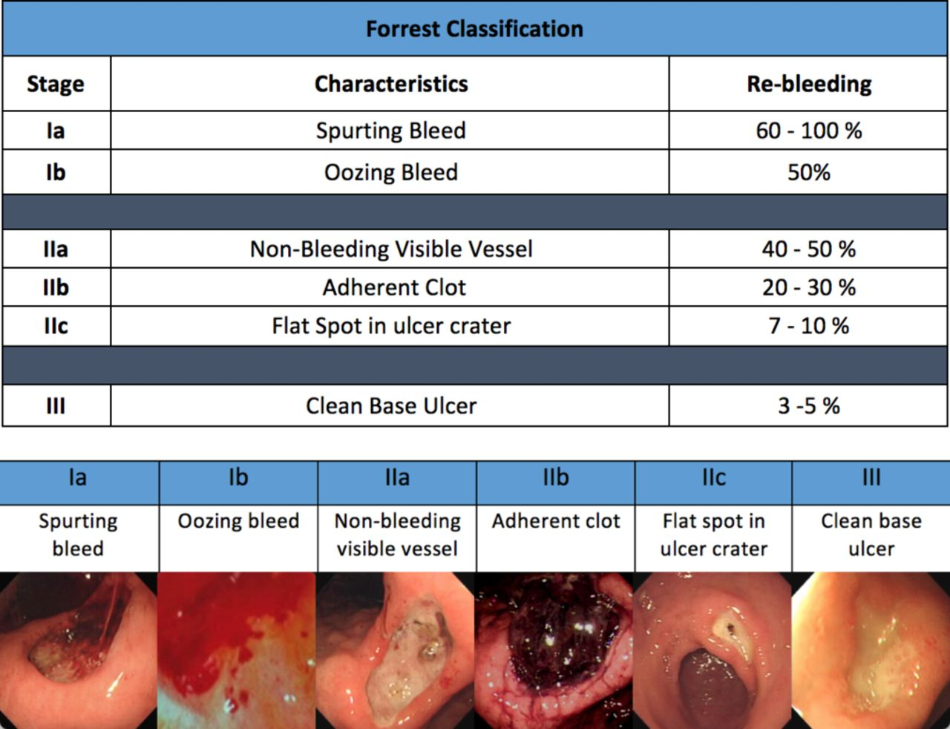
Forest Classification of duodenal ulcer

Slide 14
Treatment according to staging
Stage 1A: Inj 0.5- 1ml of epinephrine (1:20000) via sclerotherapy needle into four quadrant of ulcer within 1-2 mm bleeding site. Epinephrine with thermocoagulation(12-15watts for 10 sec).
Stage 1B: Inj epinephrine to be given.No role of high dose PPI infusion.
Stage 2A: Thermal coagulation or Thermal coagulation and inj epinephrine or hemoclipping.
Stage 2B: Inj epinephrine f/b rotatable cold smear to the clot piecemeal without pulling it off the base.
Stage 2C: Oral PPI.
Stage 3: Oral PPI. No endoscopic intervention.

Slide 15
Follow up endoscopy in peptic ulcer
Routine second loop endoscopy is not recommended for most patients with peptic ulcer bleeding except in those whom the initial endoscopic examination was suboptimal because excessive blood obscured the view,technical problems with hemostasis occurred,clinically significant bleeding recurred, or less effective endoscopic techniques such as epinephrine injection alone were used.

Slide 16
ESOPHAGIAL VARICES
Two complementary strategies guide therapy of bleeding varices: local treatment of the bleeding varices and treatment of the underlying portal hypertension.
Local therapies, including endoscopic variceal band ligation, endoscopic variceal sclerotherapy, and balloon tamponade with a Sengstaken-Blakemore tube, effectively control acute hemorrhage in most patients.

Slide 17
GRADING OF ESOPHAGIAL VARICES
(MODIFIED PAQUET CLASSIFICATION)
GRADE 1 :Varices extending just above mucosal level can be compressed with air insufflation.
Grade 2 :Varices projecting by 1/3rd of luminal diameter that cannot be compressed with air insufflation.
Grade3 :Varices projecting up to 50% of the luminal diameter.
NEWER CLASSIFICCATION based on size of varices
Small : <5mm
Large : >5mm
Follow up in case of EVL every 3 weeks until obliteration of varices occurs.

Slide 18
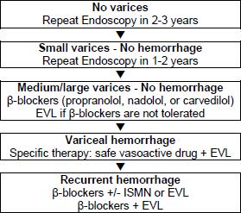
Newer Classification with treatment and follow up

Slide 19
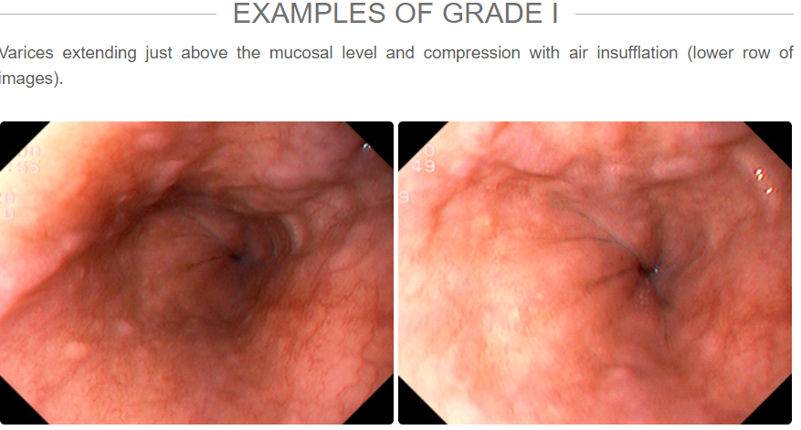

Slide 20
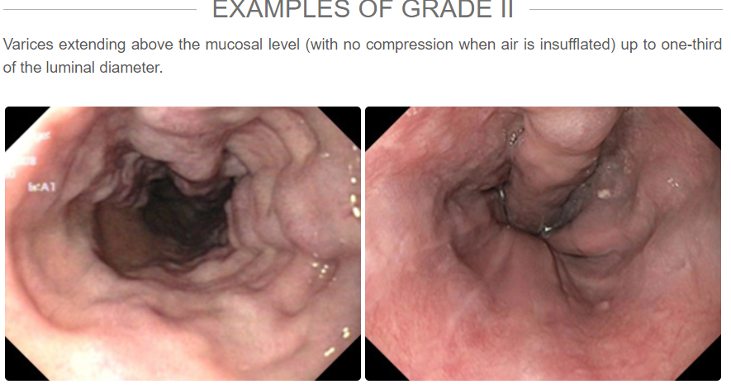
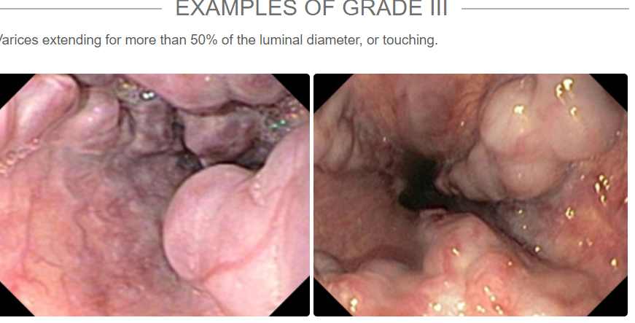

Slide 21
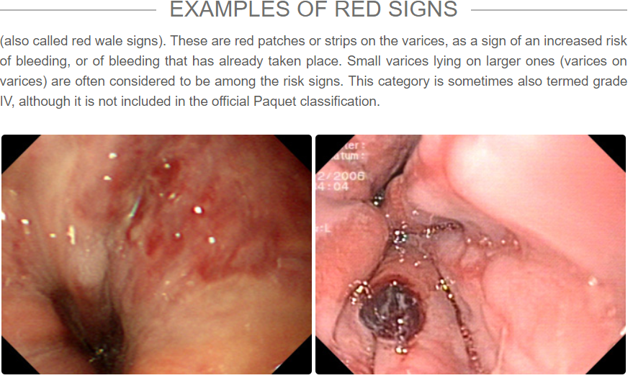

Slide 22
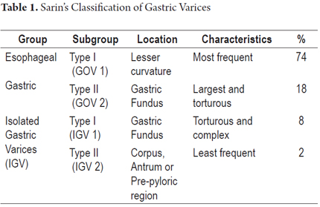

Slide 23
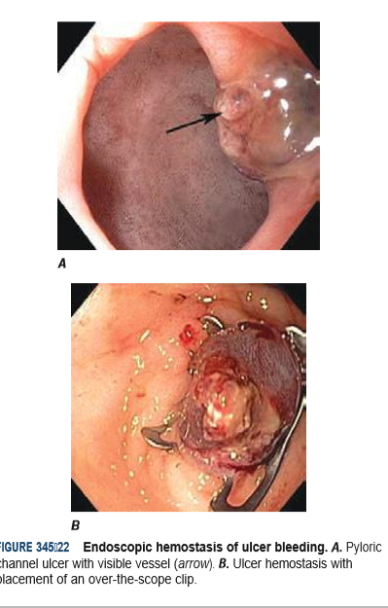
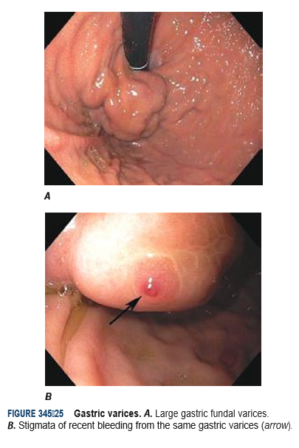

Slide 24
Treatment of gastric varices
GOV1: EVL or Glue injection plus EVL
GOV2: Glue injection or Glue inj plus EVL.
IGV1 or 2: Glue injection.

Slide 25
Portal Hypertensive Gastropathy
PHG is caused by increased portal venous pressure and severe mucosal hyperemia that results in ectatic blood vessels in the proximal gastric body and cardia and oozing of blood.
Severe PHG with diffuse bleeding is treated with B adrenergic blockers or TIPS placement or surgical portocaval shunt.
Endoscopic management has no role unless an obvious focal bleeding site is identified.

Slide 26
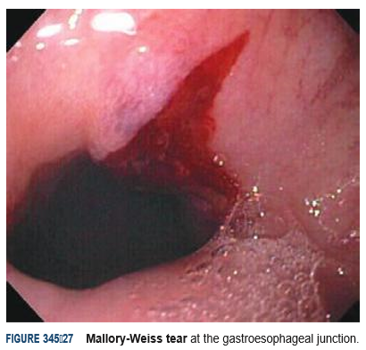
MALLORY WEISS TEAR
A Mallory-Weiss tear is a linear mucosal or submucosal laceration at the gastroesophageal junction that is often associated with retching or vomiting (Fig)
In 50% cases it is self limited.
Rebleeding rate is around 10%
An actively bleeding tear can be treated endoscopically with epinephrine injection, coaptive coagulation, band ligation, or hemoclips.

Slide 27
GERD & BARRET’S ESOPHAGUS
GERD is a physiological process by which gastric contents move retrograde from stomach to the esophagus.
Most patients have no mucosal damage on Endoscopy while others have Esophagitis, peptic strictures or Barrets esophagus.
The sensitivity of endoscopy for GERD is low but specificity is 90-95%.

Slide 28
LA CLASSIFICATION OF ESOPHAGITIS
Grade A:One or more mucosal breaks < 5 mm in maximal length.
Grade B: One or more mucosal breaks > 5mm, but without continuity across mucosal folds.
Grade C: Mucosal breaks continuous between > 2 mucosal folds, but involving less than 75% of the esophageal circumference.
Grade D: Mucosal breaks involving entire esophageal circumference.

Slide 29
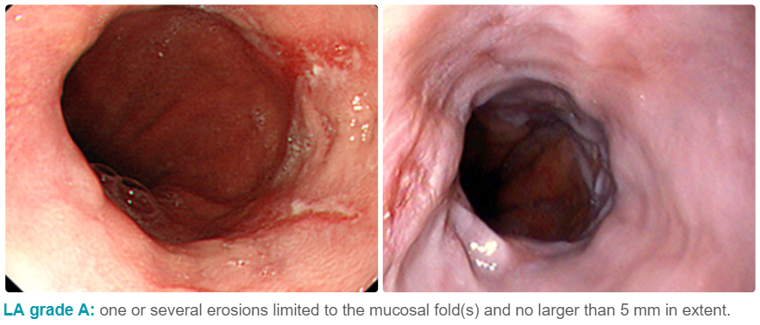
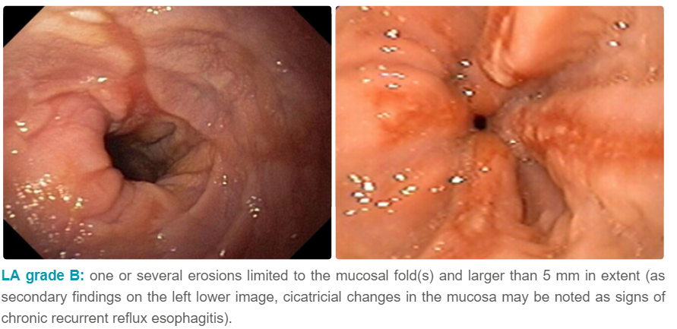
Grading of Esophagitis

Slide 30
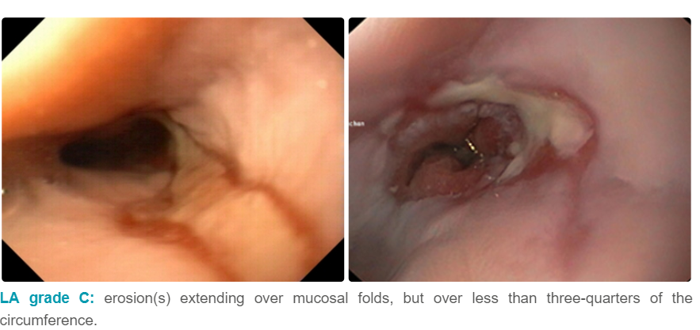
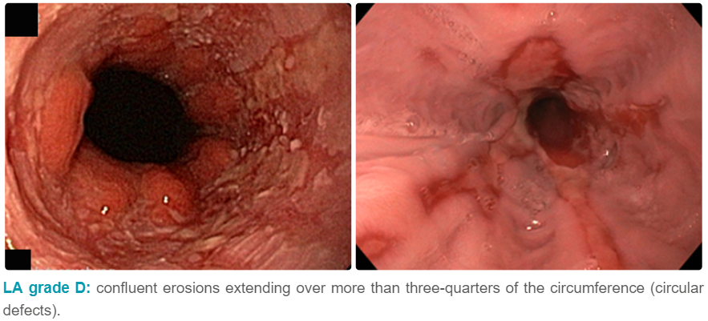

Slide 31
Endoscopic findings of different etiology of esophagitis
In terms of endoscopic appearance, infectious esophagitis is diffuse and tends to involve the proximal esophagus far more frequently than does reflux esophagitis.
The ulcerations seen in peptic esophagitis are usually solitary and distal, whereas infectious ulcerations are punctate and diffuse.
Eosinophilic esophagitis characteristically exhibits multiple esophageal rings, linear furrows, or white punctate exudate.
Esophageal ulcerations from pill esophagitis are usually singular and deep at points of luminal narrowing, especially near the carina, with sparing of the distal esophagus.

Slide 32
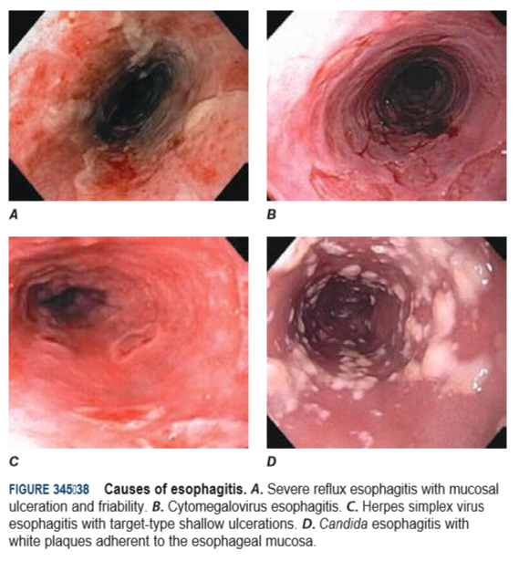

Slide 33
Barrets Esophagus
DEFINITION: A condition in which abnormal columnar epithelium replaces the stratified squamos epithelium that normally lines the distal esophagus.
Two types on the basis of endoscopic findings
Short segment : < 3cm of metaplastic epithelium.
Long segment: >3cm of metaplastic epithelium.
Endoscopic screening for barret’s esophagus only for patients who have multiple risk factors for esophagial adenocarcinoma include: chronic GERD, male, age >50 years or older,white race, hiatus hernia, elevated BMI, nocturnal reflux symtom and tobacco use.
Endoscopic biopsy is the gold standard for confirmation of Barrett’s esophagus and for dysplasia or cancer arising in Barrett’s mucosa.
Endoscopic treatment options:
Endoscopic ablative therapy.
Endoscopic mucosal resection (EMR).
Non Endoscopic treatment:
Esophagectomy.

Slide 34
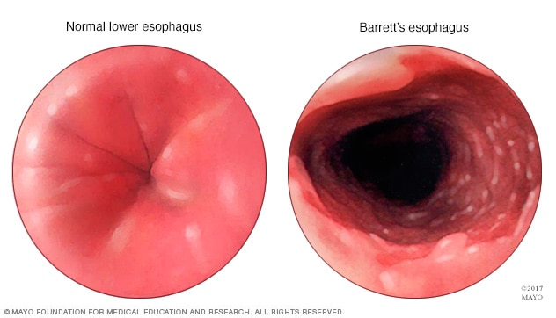

Slide 35
DIEULAFOY’S LESION
Dieulafoy’s lesion is a large 1-3mm submucosal artery that protrudes through the mucosa not associated with peptic ulcer and can cause massive bleeding
Seen most commonly in gastric fundus within 6 cm of GE junction
Endoscopic therapy, such as thermal coagulation or band ligation, or inj epinephrine therapy or hemoclips.

Slide 36
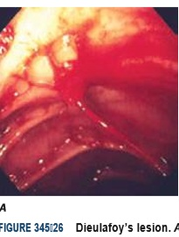

Slide 37
Vascular Ectasias
Vascular ectasias (gastric antral vascular ectasia [GAVE] or “watermelon stomach”) are charecterised by rows or stripes of ectatic mucosal blood vessels that emnates from the pylorus and extended proximally into the antrum.
Associated with cirrhosis and scleroderma .
Treatment is endoscopic therapy with argon plasma coagulation

Slide 38
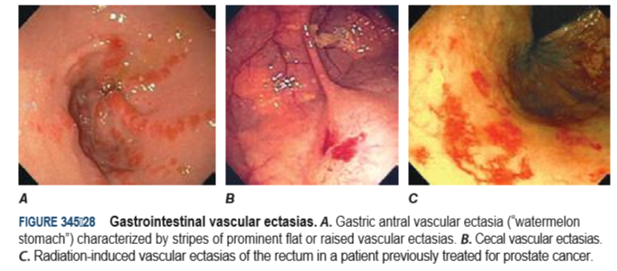

Slide 39
CAMERON’S LESION
Linear erosion or ulceraations in the proximal stomach at the end of large hiatal hernia, near the diaphragmatic pinch.
Treatment with iron supplementation with oral PPI therapy .

Slide 40
DYSPHAGIA
  MECHANICAL OBSTRUCTION (50%)
Esophageal tumors
Foreign bodies
Esophageal ring and web
2. MOTILITY DISORDERS
Achalasia:- Lower esophageal muscle (sphincter) doesn't relax properly to let food enter your stomach
Diffuse spasm:- Lower esophageal muscle (sphincter) doesn't relax properly to let food enter your stomach
Esophageal stricture:- A narrowed esophagus(Tumors or scar tissue), often caused by gastroesophageal reflux disease (GERD), can cause narrowing.
GERD
Scleroderma
Radiation therapy

Slide 41
Mechanical Trauma and Iatrogenic Injury
Instrument perforation from endoscopy or nasogastric tube placement typically occurs in the hypopharynx or at the gastroesophageal junction. Perforation may also occur at the site of a stricture in the setting of endoscopic food disimpaction or esophageal dilation.
Endoscopic clipping or stent placement may be indicated in nonoperated iatrogenic perforations or nonoperable cases such as perforated tumors.
Corrosive Esophagitis: Early endoscopic evaluation is recommended to assess and grade the injury to the esophageal mucosa. Severe corrosive injury may lead to esophageal perforation, bleeding, stricture, and death.

Slide 42
Esophagial Web and RING
A lower esophageal mucosal ring, also called a B ring, is a thin membranous narrowing at the squamocolumnar mucosal junction.
When the lumen diameter is less than 13 mm, distal rings are associated with episodic solid food dysphagia and are called Schatzki rings.
Schatzki ring is one of the most common causes of intermittent food impaction, also known as “steakhouse syndrome” because meat is a typical instigator. Symptomatic rings are easily treated by dilation.
Web-like constrictions higher along the anterior aspect of the esophagus can be of congenital or inflammatory origin.

Slide 43
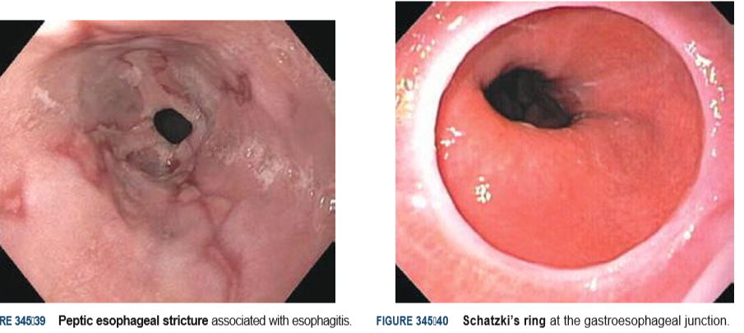

Slide 44
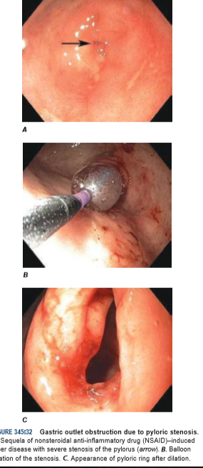
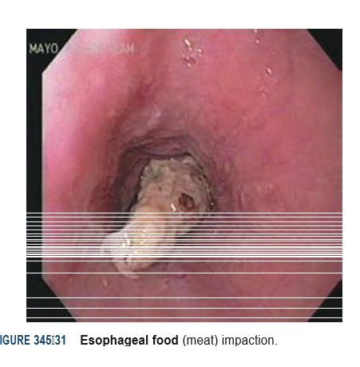

Slide 45
Achalasia Cardia
Definition: Achalasia is characterised by impaired LES relaxation with swallowing and aperistalsis in the smooth muscle esophagus due to loss of ganglion cells within the myenteric plexus.
Although endoscopy is not a diagnostic tool for achalasia cardia but it is a routine initial procedure to rule out other mechanical causes and finding includes dilatation of the esophagel lumen.
Therapies for achalasia are pneumatic dilatation and Heller myotomy. Pneumatic dilatation, with a reported efficacy ranging from 32–98%, is an endoscopic technique using a noncompliant, cylindrical balloon dilator positioned across the LES and inflated to a diameter of 3–4 cm. The major complication is perforation with a reported incidence of 0.5–5%.
An endoscopic approach to LES myotomy has been introduced, referred to as per oral esophageal myotomy (POEM). This technique involves the creation of a tunnel within the esophageal wall through which the circular muscle of the LES and distal esophagus are transected with electrocautery.

Slide 46
Gastric Outlet Obstruction
Obstruction of the gastric outlet is commonly caused by gastric, duodenal, or pancreatic malignancy or chronic peptic ulceration with stenosis of the pylorus.
Patients with benign pyloric stenosis may be treated with endoscopic balloon dilatation of the pylorus, and a course of endoscopic dilatation results in long-term relief of symptoms in about 50% of patients.
Malignant gastric outlet obstruction can be relieved with endoscopically placed expandable stents in patients with inoperable malignancy.

Slide 47
TREATMENT OF MALIGNANCIES
Early-stage malignancies limited to the superficial layers of the gastrointestinal mucosa may be resected using the techniques of endoscopic mucosal resection (EMR) or endoscopic submucosal dissection (ESD).
Ultrasound images are obtained of the gut wall and adjacent organs, vessels, and lymph nodes by ENDOSCOPIC ULTRASOUND (EUS).EUS provides the most accurate preoperative local staging of esophageal, pancreatic, and rectal malignancies
Photodynamic therapy (PDT) and radiofrequency ablation (RFA) are effective modalities for ablative treatment of high-grade dysplasia and intramucosal cancer in Barrett’s esophagus.

Slide 48
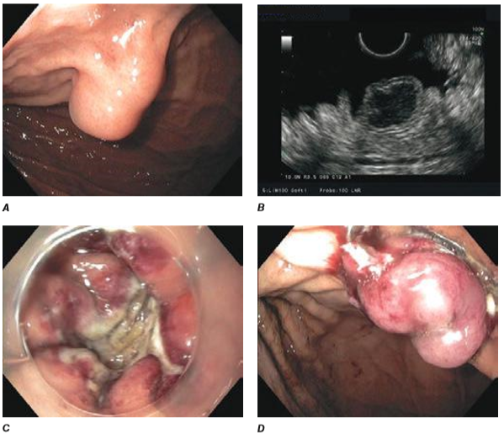
Endoscopic full-thickness resection of a gastrointestinal stromal tumor.
A. Subepithelial lesion in the proximal stomach. B. Hypoechoic lesion arising from the fourth layer (muscularis propria) at endoscopic ultrasound.
C. Full-thickness resection defect. D. Closure of defect using an over-the-scope clip.

Slide 49
NEWER MODALITIES : EUS
EUS provides the most accurate preoperative local staging of esophageal, pancreatic, and rectal malignancies.
Fine needle aspirates and core biopsies of masses and lymph nodes in the posterior mediastinum, abdomen, pancreas, retroperitoneum, and pelvis can be obtained under EUS guidance (Fig. 345-16).
EUS-guided therapeutic procedures are increasingly performed, including drainage of abscesses, pseudocysts, and treatment of gastrointestinal hemorrhage, and drainage of obstructed biliary and pancreatic ducts.

Slide 50
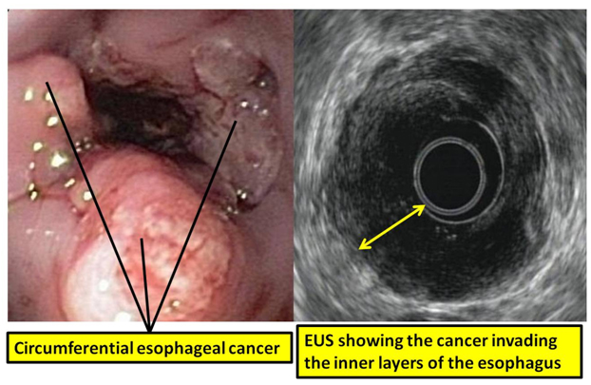

Slide 51
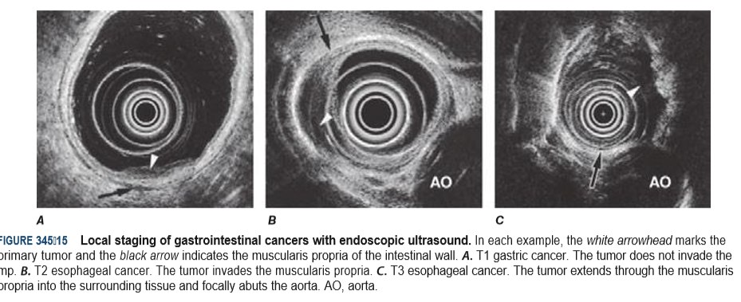

Slide 52
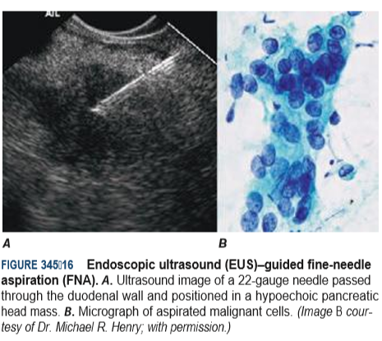

Slide 53
ENDOSCOPIC RESECTION AND CLOSURE TECHNIQUES
Some Natural Orifice Transluminal Endoscopic Surgery (NOTES) procedures, such as percutaneous endoscopic gastrostomy (PEG) or endoscopic necrosectomy of pancreatic necrosis,others, such as per-oral endoscopic myotomy (POEM) and endoscopic full-thickness resection of gastrointestinal mural lesions, are emerging as viable clinical therapeutic options.
The development of more robust over-the scope Endoscopic clips has facilitated endoscopic closure of gastrointestinal fistulas and perforations not previously amenable to endoscopic therapy.
Endoscopic suturing is also feasible, and the technique can be used to close perforations and large defects (Fig.), anastomotic leaks, and fistulas. Other potential indications for endoscopic suturing include stent fixation to prevent its migration (Fig.), and endoscopic bariatric procedures.

Slide 54
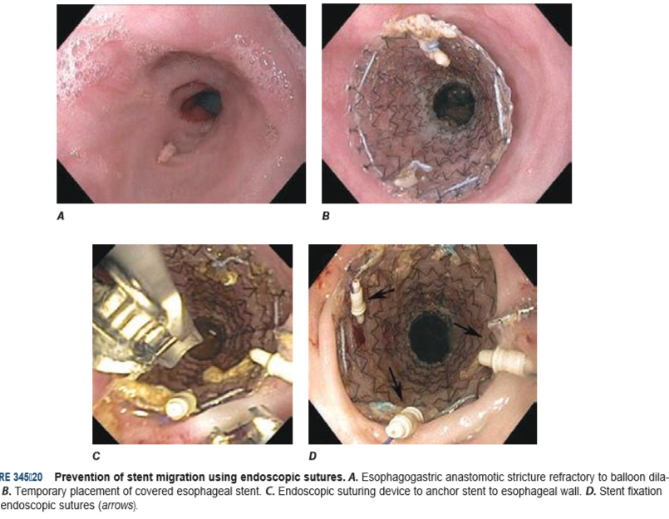

Slide 55
REFERENCES
Harrisson’s principles of internal medicine 19th edition.2015.
Sleisenger and Fordtran’s Gastro intestinal and Liver Disease 11th edition.2014.

Slide 56

TREATMENT FOR BLEEDING DUODENAL ULCER

