Slide 1
MONOCLONAL ANTIBODIES AND IT’S USES

Slide 2
History of mAb development
1964- Littlefield developed a way to isolate hybrid cells from 2 parent cell lines using the hypoxanthine-aminopterin-thymidine (HAT) selection media.
1975 -Kohler and Milstein provided the most outstanding proof of the clonal selection theory by fusion of normal and malignant cells
1990 -Milstein produced the first monoclonal antibodies logen
Paul Ehrlich at the beginning of the 20th century theorized that a cell under threat grew additional side-chains to bind the toxin, and that these additional side chains broke off to become the antibodies that are circulated through the body.

Slide 3
Beginning of Monoclonal Era
Georg Kohler and Cesar Milstein fused mice lymphocytes with neoplastic mouse plasma cells to yield hybridomas that produced specific antibodies. This offered a limitless supply of monoclonal antibodies.
They were awarded the Nobel Prize in 1984 (along with Jerne) for their work
Monoclonal antibodies permit diagnostic tests that are specific, and function as probes.

Slide 4
Monoclonal antibodies (mAb) are antibodies that are identical because they are produced by one type of immune cell, all clones of a single parent cell.
Polyclonal antibodies are antibodies that are derived from different cell lines which differ in amino acid sequence.

Slide 5
Characters of Monoclonal Antibodies
Monoclonal antibodies (mAb) are a single type of antibody that are identical and are directed against a specific epitope (antigen, antigenic determinant) and are produced by B-cell clones of a single parent or a single hybridoma cell line.
A hybridoma cell line is formed by the fusion of a one B-cell lymphocyte with a myeloma cell.

Slide 6
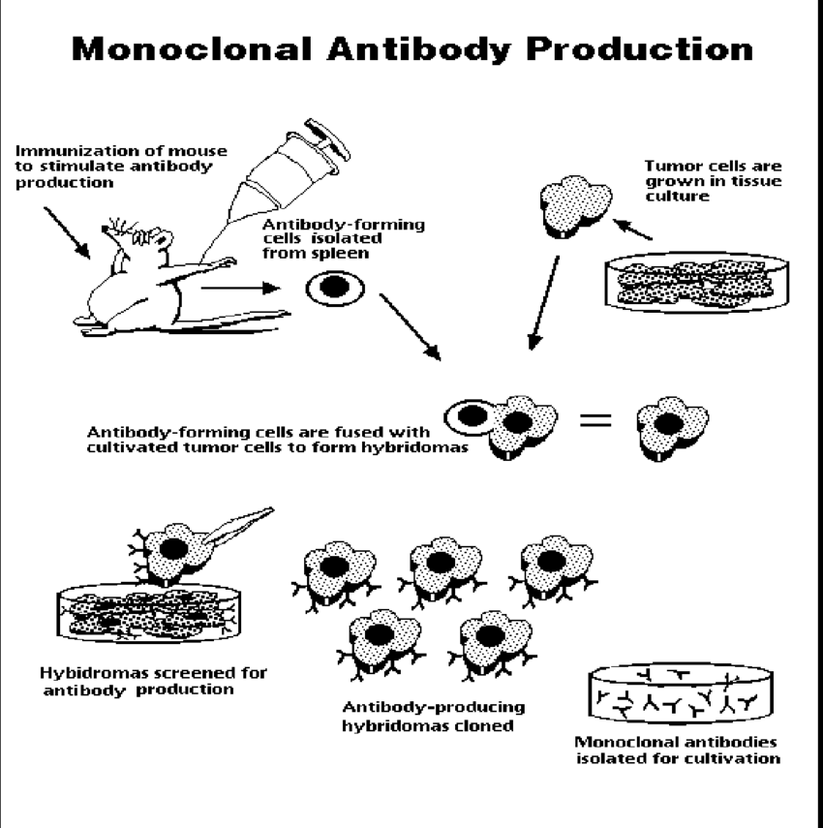
.

Slide 7
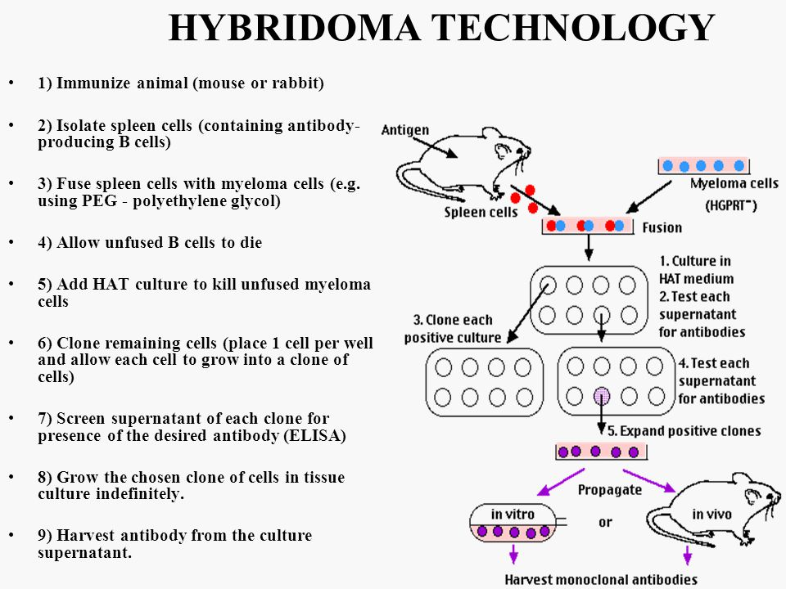
Principles in Hybridoma technology

Slide 8
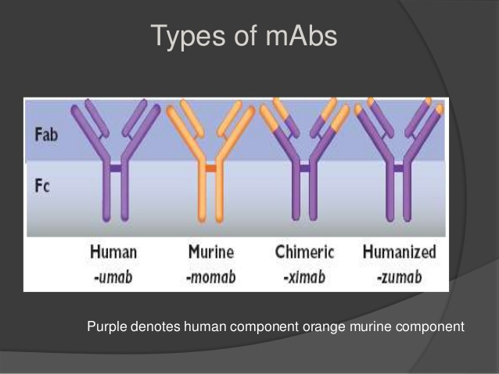
Types of mAbs-

Slide 9
Murine antibody
Whole of the antibody is of murine origin.
Major problems associated with murine antibodies include-
reduced stimulation of cytotoxicity .
Formation of complexes after repeated administration.
allergic reactions .
anaphylactic shock
Chimeric antibody
Chimeric antibodies are composed of murine variable regions fused onto human constant regions.
Antibodies are approximately 65% human.
This reduces immunogenicity and thus increases serum half-life.

Slide 10
Humanized Mab
Humanised antibodies are produced by grafting murine hypervariable amino acid domains into human antibodies.
This results in a molecule of approximately 95% human origin.
Human Monoclonal antibody
Human monoclonal antibodies are produced by transferring human immunoglobulin genes into the murine genome, after which the transgenic mouse is vaccinated against the desired antigen, leading to the production of monoclonal antibodies

Slide 11
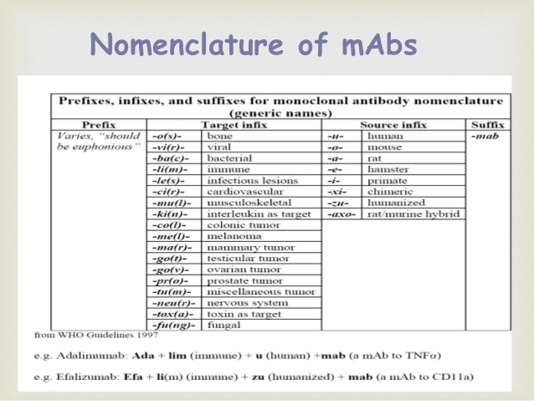

Slide 12
Applications of Monoclonal Antibodies
Diagnostic Applications –
Detects protein of interest either by blotting or immunofluorescence
Therapeutic Applications-
Transplant rejection
Cancer
Autoimmune disorders
Inflammatory disease

Slide 13
Monoclonal antibody are used to detect for the presence and quantity of a substance, for instance in a Western blot test (to detect a substance in a solution) or an immunofluorescence test
Monoclonal antibodies can also be used to purify a substance with techniques called immunoprecipitation and affinity chromatography.

Slide 14
Monoclonal antibodies for cancer treatment
Monoclonal antibodies that bind only to cancer cells specific antigen and induce immunological response on the target cancer cell (naked antibodies).
mAb can be modified for delivery of [toxin], radioisotope, cytokine-Toxins or radioactive isotopes are bound to the constant region of the mAbs. When the mAb binds to the surface cells of a tumor the toxin or radioactivity will kill the cancer cells and all cells within a certain radius (a killing zone). In this way tumor cells will be killed.

Slide 15
Side effects of mAbs-
Allergic reactions such as itching and skin rashes
Flu-like symptoms, including chills, fatigue, fever, and muscle aches and pains
Nausea
Diarrhea
Infusion reactions.
Pancytopenia
Cardiac complications -Certain monoclonal antibodies may cause heart failure and a small risk of MI
Bleeding- Some of the monoclonal antibody drugs are designed to stop cancer from forming new blood vessels. There have been reports that these medications can cause bleeding
Death

Slide 16
Arcitumomab
Arcitumomab is a murine Fab fragment from an anticarcinoembryonic antigen (CEA) antibody labeled with technetium 99m ( 99m Tc) that is used for imaging patients with metastatic colorectal carcinoma (immunoscintigraphy) to determine extent of disease.
CEA is often upregulated on tumor in patients with gastrointestinal carcinomas.
The use of the Fab fragment decreases the immunogenicity of the agent so that it can be given more than once.

Slide 17
Capromab pendetide
Capromab pendetide is a murine monoclonal antibody specific for prostate specific membrane antigen.
It is coupled to isotopic indium ( 111 In) and is used in immunoscintigraphy for patients with biopsy-confirmed prostate cancer and post-prostatectomy in patients with rising prostate specific antibody level to determine extent of disease.

Slide 18
Ibritumomab tiuxetan
Ibritumomab tiuxetan is an anti-CD20 murine monoclonal antibody labeled with isotopic yttrium ( 90 Y) or 111 In.
The radiation of the isotope coupled to the antibody provides the major antitumor activity.
Ibritumomab is approved for use in patients with relapsed or refractory low-grade, follicular, or B-cell non- Hodgkin’s lymphoma, including patients with rituximab-refractory follicular disease.
It is used in conjunction with rituximab in a two-step therapeutic regimen.

Slide 19
Tositumomab
Tositumomab is an anti-CD20 monoclonal antibody and is complexed with iodine 131 ( 131 I).
Tositumomab is used in two-step therapy in patients with CD20-positive, follicular non-Hodgkin’s lymphoma whose disease is refractory to rituximab and standard chemotherapy.
Toxicities are similar to those for ibritumomab and include severe cytopenias such as thrombocytopenia and neutropenia.
Tositumomab should not be administered to patients with greater than 25% bone marrow involvement.

Slide 20
Muromonab (OKT-3)
First FDA-approved therapeutic monoclonal antibody was a murine CD3 specific in 1986
Target CD3 and their blockade suppresses activity of T cells
Indicated in prevention of transplant rejection in patients receiving kidney, Heart, liver transplants
S/E – Cytokine release syndrome - Due to initial activation of T cells and release of cytokines before T cell clearance by macrophages - Fever, chills, nausea, vomiting, hypotension - As soon as T cells eliminated, symptoms improve - Pre-treatment with antihistamines and glucocorticoids reduces risk

Slide 21
Abciximab
Chimeric antibody binds to GP IIb/IIIa receptors on platelets and prevents their aggregation
Antiplatelet agent approved 2 mg IV - In patients undergoing PCI - In patients with unstable angina not responding to conventional medical therapy when PCI is planned within 24 hours

Slide 22
Rituximab
Binds to CD20 protein on normal and malignant B lymphocytes
The mechanism of action includes –
complement mediated lysis,
antibody-dependent cellular cytotoxicity,
induction of apoptosis in the malignant lymphoma cells.
Rituximab approved in dose of 375 mg/m2 IV weekly for 4 weeks for treatment of non hodgkins lymphoma, CLL
S/E – severe infusion reactions, steven johnson’s syndrome

Slide 23
Ofatumumab
Ofatumumab is a human IgG 1 monoclonal antibody directed against a different epitope on CD20 compared to rituximab.
It is approved for patients with chronic lymphocytic leukemia (CLL) who are refractory to fludarabine and alemtuzumab.
Ofatumumab binds to all B cells including B-CLL. It is thought to lyse B-CLL cells in the presence of complement and to mediate antibody-dependent cellular cytotoxicity.
There is a slight risk of hepatitis B virus reactivation in patients taking ofatumumab.

Slide 24
Basiliximab
Basiliximab is a chimeric mouse-human monoclonal antibody to the α chain (CD25) of the IL-2 receptor of T cells.
It is used to prevent rejection in organ transplantation, especially in kidney transplants.

Slide 25
Daclizumab
Daclizumab is a therapeutic humanized monoclonal antibody.
It is used to prevent rejection in organ transplantation,especially in kidney transplants.
Daclizumab works by binding to CD25, the alpha subunit of
the IL-2 receptor of T cells.

Slide 26
Palivizumab
Palivizumab is produced by recombinant DNA technology.
It is used in the prevention of respiratory syncytial virus (RSV) infections. It is recommended for infants that are high-risk because of prematurity or other medical problems such as congenital heart disease
Palivizumab is a humanized monoclonal antibody (IgG) directed against an epitope in the A antigenic site of the F protein of RSV.
Palivizumab is dosed once a month via intramuscular (IM) injection, to be administered throughout the duration of the RSV season.

Slide 27
Infliximab
Infliximab is a human-mouse chimeric IgG 1 monoclonal antibody possessing human constant (Fc) regions and murine variable regions.
It is administered intravenously but has the same anti-TNF-α activity as adalimumab and etanercept.
It is approved for use in Crohn’s disease, ulcerative colitis, rheumatoid arthritis, ankylosing spondylitis, plaque psoriasis, and psoriatic arthritis.

Slide 28
Trastuzumab
Humanized mab that binds to human epidermal growth factor receptor HER2/neu .
Prevents binding of natural ligand and down regulate the receptor
Approved for metastatic Ca breast with overexpressed HER2/neu
S/E - Cardiomyopathy

Slide 29
Gemtuzumab
Humanized MAB specific against CD33, protein found on leukemic blast cells in AML.
Gemtuzumab alone has some antiblast activity, clinical formulation has coupled to cytotoxic agent ozogamicin.
It binds to DNA leading to cell death. Approved for patients of AML not responding to cytotoxic agents in 2 doses of 9 mg/m2 IV separated by 2 weeks.
S/E – severe myelosupression, hepatotoxicity, hypersensitivity reactions

Slide 30
Alemtuzumab
Humanized anti CD52 antibody that binds to normal and malignant B and T cells, NK cells.
Approved 30 mg IV once weekly for treatment of B-cell CLL failed to respond to alkylating agents.
S/E – neutropenia, thrombocytopenia, patient should be closely monitored for opportunistic infections

Slide 31
Adalimumab
Adalimumab is a completely human IgG 1 approved for use in patients with rheumatoid arthritis, juvenile idiopathic arthritis,psoriatic arthritis, ankylosing spondylitis, Crohn’s disease, and plaque psoriasis.
Like the other anti-TNF-α biologicals, adalimumab blocks the interaction of TNF-α with TNF receptors on cell surfaces; it does not bind TNF-β.
Adalimumab lyses cells expressingTNF-α in the presence of complement.
Pharmacodynamic studies showed that administration of adalimumab reduced levels of C-reactive protein, erythrocyte sedimentation rate, serum IL-6, and matrix metalloproteinases MMP-1 and MMP-3

Slide 32
Cetuximab
MAB that targets epidermal growth factor receptor (EGFR).
Binding of cetuximab to EGFR inhibits tumor growth by variety of mechanisms, including decrease in kinase activity, growth factor production and increased apoptosis.
Approved for metastatic colorectal carcinoma whose tumor overexpresses EGFR.
Cetuximab 400 mg/kg loading followed by 200 mg/kg weekly IV alone or in combination with irinotecan

Slide 33
Omalizumab
Omalizumab is an anti-IgE recombinant humanized monoclonal antibody that is approved for the treatment of allergic asthma in adult and adolescent patients whose symptoms are refractory to inhaled corticosteroids.
The antibody blocks the binding of IgE to the high-affinity Fc receptor on basophils and mast cells, which suppresses IgEmediated release of type I allergy mediators such as histamine and leukotrienes.
Total serum IgE levels may remain elevated

Slide 34
Bevacizumab, Ranibizumab
Humanized antibody against VEGF, thus preventing angiogenesis.
Approved 5 mg/kg IV every 2 weekly till disease progression declines, for use in combination therapy with fluorouracil based regimens for metastatic carcinoma colon and non– small-cell lung cancer.
S/E – Since it is antiangiogenic, patient should be watched for hemorrhage, GI perforations and wound healing problems. Off label, it is used IV for neovascular macular degeneration

Slide 35
Natalizumab
Humanized IgG4 monoclonal antibody that binds to the α4- subunit of α4β1 and α4β7 integrins expressed on the surfaces of all leukocytes except neutrophils, and inhibits the α4-mediated adhesion of leukocytes to their cognate receptor.
The drug works by reducing the ability of inflammatory immune cells to attach to and pass through the cell layers lining the intestines and blood–brain barrier.
It has proven effective in treating the symptoms of both diseases, preventing relapse, vision loss, cognitive decline and significantly improving quality of life in people with multiple sclerosis, as well as increasing rates of remission and preventing relapse in Crohn's disease

Slide 36
Panitumumab
Panitumumab , is a fully human monoclonal antibody specific to the epidermal growth factor receptor, used in the treatment of refractory EGFR expressing metastatic colorectal cancer in patients with non-mutated (wild-type) KRAS

Slide 37
Eculizumab
Eculizumab is a humanized monoclonal antibody that is a first-in-class terminal complement inhibitor and the first therapy approved for the treatment of paroxysmal nocturnal hemoglobinuria (PNH),
Eculizumab also is the first agent approved for the treatment of atypical hemolytic uremic syndrome (aHUS), an ultra-rare genetic disease that causes abnormal blood clots to form in small blood vessels throughout the body, leading to kidney failure, damage to other vital organs and premature death.

Slide 38
Golimumab
Golimumab targets tumor necrosis factor alpha (TNF-alpha), a pro-inflammatory molecule and hence is a TNF inhibitor.
Subcutaneous treatment for adults with moderately to severely active rheumatoid arthritis, psoriatic arthritis, and ankylosing spondylitis.
Golimumab has been approved in 2013 for use in adults with moderately to severely active Ulcerative Colitis

Slide 39
Ustekinumab
Ustekinumab is a human IgG 1 monoclonal antibody that binds to the p40 subunit of IL-12 and IL-23 cytokines.
It blocks IL-12 and IL-23 from binding to their receptors, therefore inhibiting receptor- mediated signaling in lymphocytes. Ustekinumab is approved in Canada, Europe and the United States to treat moderate to severe plaque psoriasis.
It has been tested in Phase II studies for multiple sclerosis and sarcoidosis, the latter versus golimumab. On September 24, 2013, the FDA approved the use of ustekinumab for the treatment of psoriatic arthritis.

Slide 40
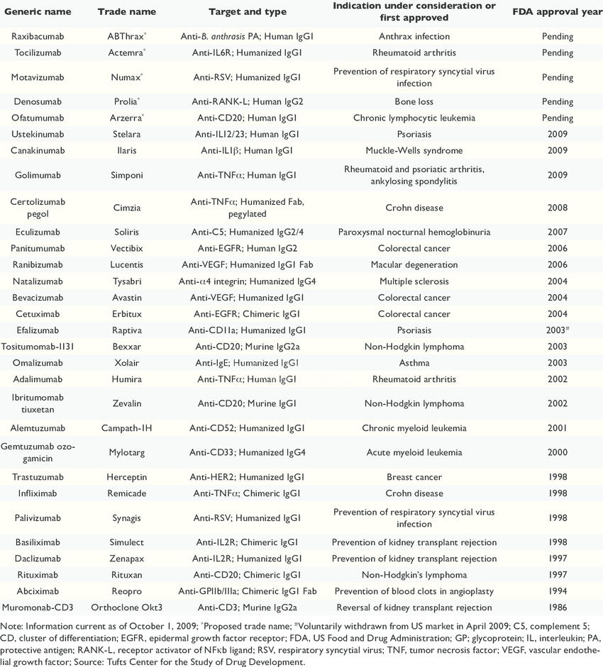

Slide 41
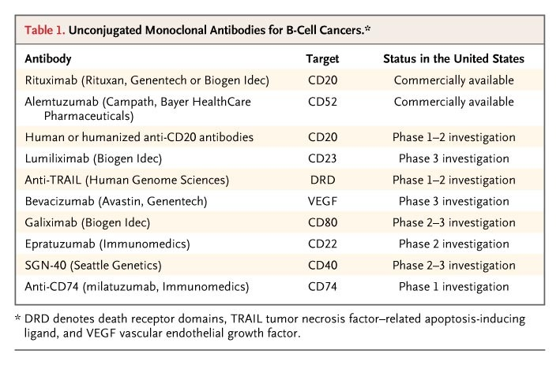

Slide 42
Thank you

