Slide 1
Weaning From Mechanical Ventilation

Slide 2
INTRODUCTION
In intubated patients, mechanical ventilation offers essential ventilatory support, while the respiratory system recovers from acute respiratory failure.
However, invasive ventilation is associated with a number of complications such as
    Pneumonia
    Tracheal stenosis
    Baro/volutrauma
    Oxygen toxicity
    Intrinsic PEEP
    Cardiovascular complications

Slide 3
Many of the complications increase in likelihood with duration of ventilation. It is therefore important to wean patients from mechanical ventilation as quickly as possible.
Weaning from mechanical ventilation is the process of reducing ventilatory support, ultimately resulting in a patient breathing spontaneously and being extubated.

Slide 4
Classification
Brochard’s classification: Based on the ability to wean
Simple weaning: Patient tolerates first spontaneous breathing trial (SBT) and is successfully extubated (70% of all patients).
Difficult weaning: Patient fails to tolerate initial SBT, successful weaning requiring up to three SBTs or up to 7 days from first SBT.
Prolonged weaning: Patient fails at least three SBTs or takes more than 7 days after the first SBT.

Slide 5
Objective
Identify patients who are ready to wean from mechanical ventilation
Understand weaning parameters
Identify when patients are ready for extubation

Slide 6
Discontinuing Mechanical Ventilation
Two step process:
  1. Readiness testing:
    Purpose is to identify patients who should start weaning
  2. Weaning:
    Process of decreasing the amount of support a patient receives from the ventilator with the patient assuming greater portion of their ventilation

Slide 7
Criteria for Weaning Trial^{[1,2]}
Subjective assessment:
  Adequate cough
  No neuromuscular blocking agents
  Absence of excessive trachea-bronchial secretion
  Reversal of the underlying cause for respiratory failure
  No continuous sedation infusion or adequate mentation on sedation.
  Ability to generate spontaneous repiratory effort.
Penuelas O, Thille AW, Esteban A. Discontinuation of ventilatory support: new solutions to old dilemmas. Current opinion in critical care. 2015;21(1):74-81.
Boles J-M, Bion J, Connors A,HerridgeM,Marsh B,Melot C, et al.Weaning from mechanical ventilation. European Respiratory Journal. 2007;29(5):1033-56.

Slide 8
Criteria for Weaning Trial
Objective measurements
  Stable cardiovascular status
  Heart rate - 140 beat/minute
  No active myocardial ischemia
  Adequate hemoglobin level ( >8 g/dl)
  Systolic blood pressure >90 and <160 mmHg
  Afebrile (temperature >36°C and<38±0.5°C)
  No or minimal vasopressor or inotrope

Slide 9
Criteria for Weaning Trial
Adequate oxygenation
  Tidal volume > 5 mL/kg
  Proper inspiratory effort
  Respiratory rate <35 and >16/minute
  PaO2 ≥ 60mmHg and PaCO2 ≤ 50mmHg
  Positive End Expiratory Pressure :5-8 cmH2O
  No significant respiratory acidosis (pH ≥ 7.30)
  Maximal inspiratory pressure (MIP) : -20 to -25 cmH2O
  O2 saturation > 90% on FIO2 40-50%

Slide 10
In order to understand methods of weaning, we first need to understand the different modes of mechanical ventilation:
  Assist-Control Ventilation (ACMV)
  Synchronised Intermittent Mandatory Ventilation (SIMV)
  Pressure-Support Ventilation (PSV)
  Pressure-Control Ventilation (PCV)
  Inverse-Ratio Ventilation (IRV)
  Continuous Positive Airway Pressure (CPAP)
  Non-Invasive Ventilation (NIV)

Slide 11
Assist Control Mechanical Ventilation
Patient has partial control over his respiration – Better Pt ventilator synchrony
Ventilator rate determined by patient or backup rate (whichever is higher) hence, risk of respiratory alkalosis is present if tachypnoea occurs.

Slide 12
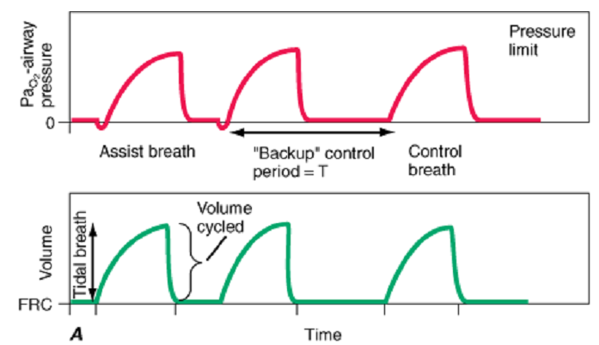
Assist Control Mechanical Ventilation

Slide 13
Synchronised Intermittent Mandatory Ventilation
Basically, ACMV with spontaneous breaths (which may be pressure supported) allowed in between.
Synchronisation window – Time interval from the previous mandatory breath to just prior to the next time triggering, during which ventilator is responsive to patients spontaneous inspiratory effort.
  Advantage - Allows patients to exercise their respiratory muscles in between – avoids atrophy.
  Hence, this mode is commonly used for weaning.

Slide 14
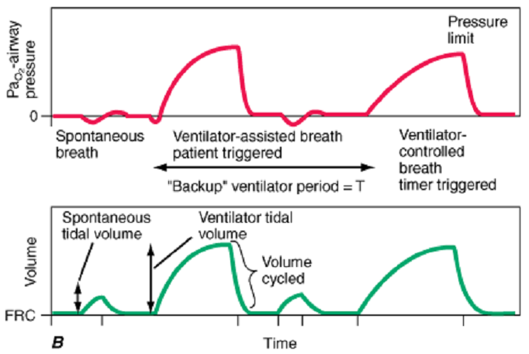
Synchronised Intermittent Mandatory Ventilation

Slide 15
Pressure Controlled Ventilation
This form of ventilation is timetriggered, time-cycled, and pressure-limited.
A specified pressure is imposed at the airway opening throughout inspiration.

Slide 16
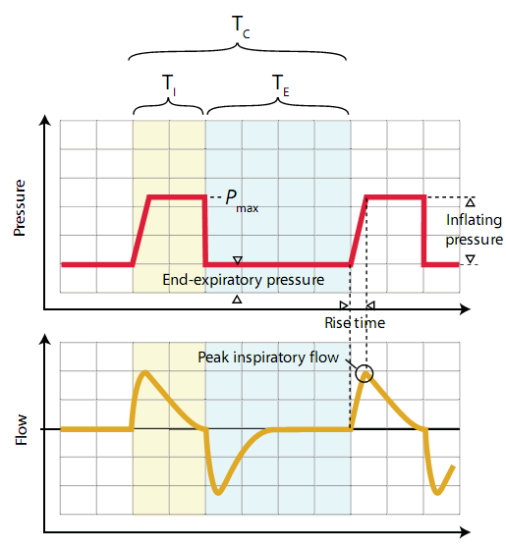
Pressure Controlled Ventilation

Slide 17
Inverse Ratio Ventilation
This mode is a variant of PCV that incorporates the use of a prolonged inspiratory time with the appropriate shortening of the expiratory time.
IRV has been used in patients with severe hypoxemic respiratory failure.
This approach increases mean distending pressures without increasing peak airway pressures.

Slide 18
Pressure Support Ventilation
Most common mode of ventilation for weaning of patient from the ventilator.
After the trigger (patient-generated spontaneous respiratory effort), ventilator generates a flow sufficient to raise and then maintain airway pressure at a preset level for the duration of the patient’s spontaneous respiratory effort.

Slide 19
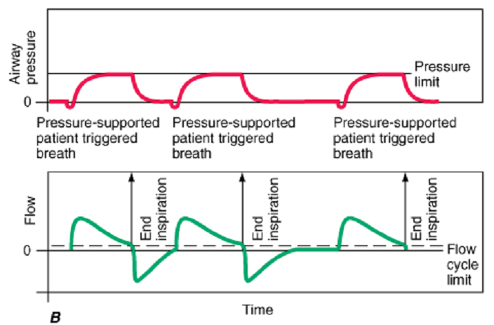
Pressure Support Ventilation

Slide 20
Continuous Positive Airway Pressure
CPAP is actually PEEP applied to a spontaneously breathing patient.
No inspiratory pressure is applied and the patient is allowed to generate their own inspiratory force.
Usually used in patients with COPD/ARDS in order to maintain alveolar patency.

Slide 21
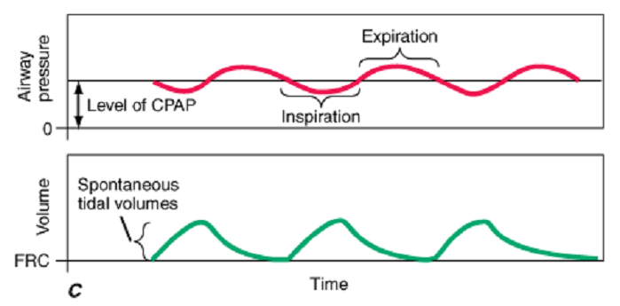
Continuous Positive Airway Pressure

Slide 22
Non Invasive Ventilation As
A Weaning Tool
In weaning, NIV has been studied for three different indications:
Stable COPD patients: As an alternative weaning modality for patients who are intolerant of the initial weaning trial
Rescue therapy: As a treatment option for patients who have been extubated but developed ARF within 48 hrs
COPD patients, Patients with CAD/CHF, Post-operative: As a prophylactic measure after extubation for patients who are at high risk for re intubation but who did not develop ARF

Slide 23
Non-Invasive Ventilation
ADVANTAGES:
Avoid intubation
Preserve natural airway defences
Comfort
Speech/ swallowing remains intact
Intermittent use
DISADVANTAGES:
Cooperation is poor
Mask discomfort
Air leaks
Facial ulcers, eye irritation, dry nose
Limited Pressure support
e.g. BiPAP, CPAP

Slide 24
Methods of Weaning
Spontaneous Breathing Trial (SBT):-
  When patient spontaneously breathes through ETT for a set period of time (30-120 min).
  Usually done using T-piece.
  If T-piece is not tolerated, minimal pressure support is given with ventilator set to PS 5-7 cmH2O and PEEP of 5 cmH2O
  Duration of SBT should be at least 30 minutes and not longer than 120 minutes.
  The initial few minutes of the SBT should be monitored closely before judgment is made to continue the SBT as there are chances of developing respiratory muscle fatigue.

Slide 25
Methods of Weaning
Pressure Support Ventilation (PSV):-
  Progressive decrease in pressure support (2 to 4 cmH2O daily)
  Alternative to patients who do not tolerate SBTs.
  Amount of pressure support is set to ensure adequate tidal volume then progressively decreases as patient tolerates.

Slide 26
Weaning Parameters
Predictors:
  Rapid Shallow Breathing Index (RSBI):
    Respiratory Rate/Tidal volume (in Litres)
    Most important of all the parameters.
    Value should be <105
    Higher number indicates rapid breaths of smaller volumes.
  Negative Inspiratory Force (NIF):
    ≤ -30mmHg H20
    It is a global assessment of strength of respiratory muscles.

Slide 27
Weaning Parameters
Predictors:
  Minute ventilation:
    Respiratory Rate x Tidal Volume <10 to 15L/min
    Estimates demand on the respiratory system
    Normal is 5-6L/min in healthy adults.
    Increased CO2 production from fever, hyper-metabolic state, hypoxemia etc will increase minute ventilation
  Spontaneous volume:
    ≥ 5 ml/kg

Slide 28
Weaning Parameters
Predictors:
  Carrico Index:
    Defined as partial pressure of O2 divided by FiO2.
    Used as a clinical indicator of hypoxaemia.
    It is also used in the Berlin definition of ARDS (value <300).

Slide 29
Weaning Trial Failure
Clinical assessment and subjective indices:^{[3,4,5]}
  Agitation and anxiety
  Depressed mental status
  Diaphoresis
  Cyanosis
  Evidence of increasing effort
  Increased accessory muscle activity
  Facial signs of distress
  Dyspnoea
3. Esteban A, Frutos F, Tobin MJ, et al. A comparison of four methods of weaning patients from mechanical ventilation. Spanish Lung Failure Collaborative Group. N Engl J Med 1995; 332: 345–350.
4. Brochard L, Rauss A, Benito S, et al. Comparison of three methods of gradual withdrawal from ventilatory support during weaning from mechanical ventilation. Am J Respir Crit Care Med 1994; 150: 896–903.
5. Jubran A, Tobin MJ. Pathophysiologic basis of acute respiratory distress in patients who fail a trial of weaning from mechanical ventilation. Am J Respir Crit Care Med 1997; 155: 906–915

Slide 30
Weaning Trial Failure
Objective measurements:
  PaO2 <50–60 mmHg on FIO2 50%
  PaCO2 >50 mmHg or an increase in PaCO2 of 8 mmHg
  pH -7.32 or a decrease in pH of 0.07
  RR of 35 breaths/min or increased by 50%
  HR of 140 beats/min or increased by 20%
  Systolic BP >180 mmHg or increased by 20%
  Systolic BP <90 mmHg
  Cardiac arrhythmias

Slide 31
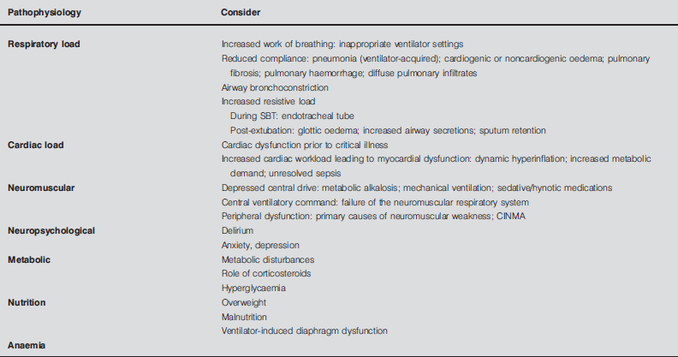
Causes of weaning trial failure^{[6]}
6. JM. Boles, J. Bion, A. Connors, M. Herridge, B. Marsh, C. Melot, R. Pearl, H. Silverman, M. Stanchina, A. Vieillard-Baron, T. Welte; European Respiratory Journal May 2007, 29 (5) 1033-1056

Slide 32
Extubation
Prior to extubation:
  Certain criteria have to be met in order to consider extubation of the patient.
  Have equipment ready
    Facemask/bipap
  Suction secretions
  Keep patient in sitting position

Slide 33
Neurological
  Awake, cooperative, alert and orientated.
  Able to lift his/her head off the pillow
  Able to move all limbs and obey simple verbal commands
  Pain controlled.
Respiratory
  Adequate and equal chest movement / breath sounds.
  Peak End Expiratory Pressure (PEEP)/Continuous Positive Airway Pressure (CPAP) 5 to 8mmHg
  Tidal volume 6-8 ml/kg
  Able to protect airway (cough, gag and swallow reflexes intact)
  Positive cuff leak test
  Minimal secretions
  A strong, effective cough

Slide 34
Blood Gas Parameters
  pH 7.35 ‑ 7.45
  PaCO₂<45mmHg
  Pa0₂> 70mgHg on 40-50% FIO₂
  HCO₃ 20 ‑ 30mmol/L
  O₂ sat> 95%
Cardiovascular
  Absent or only low dose inotrope/vasopressors
  A stable blood pressure in a sitting position
  A stable cardiac rhythm
  Adequate perfusion.
Metabolic
  The patient's temperature must be greater than 36° but less than 38.5°C.

Slide 35
Risk Factors for extubation failure
Failure of two or more consecutive spontaneous breathing trials
Chronic heart failure
Partial pressure of arterial CO2> 45 mmHg after extubation
More than one coexisting condition other than heart failure
Weak cough
Upper-airway stridor at extubation
Age > 65 years

Slide 36
Complications of Extubation
Laryngospasm – occurs in ~23% of patients^{[7]}
Macroglossia.
Laryngeal Injuries.
Vocal cord paralysis.
Pharyngeal, nasopharyngeal and esophageal injuries.
7.Rose DK, Cohen MM, Wigglesworth DF, DeBoer DP. Critical respiratory events in the postanesthesia care unit. Patient, surgical, and anesthetic factors. Anesthesiology 1994; 81: 410-418, 1994

Slide 37
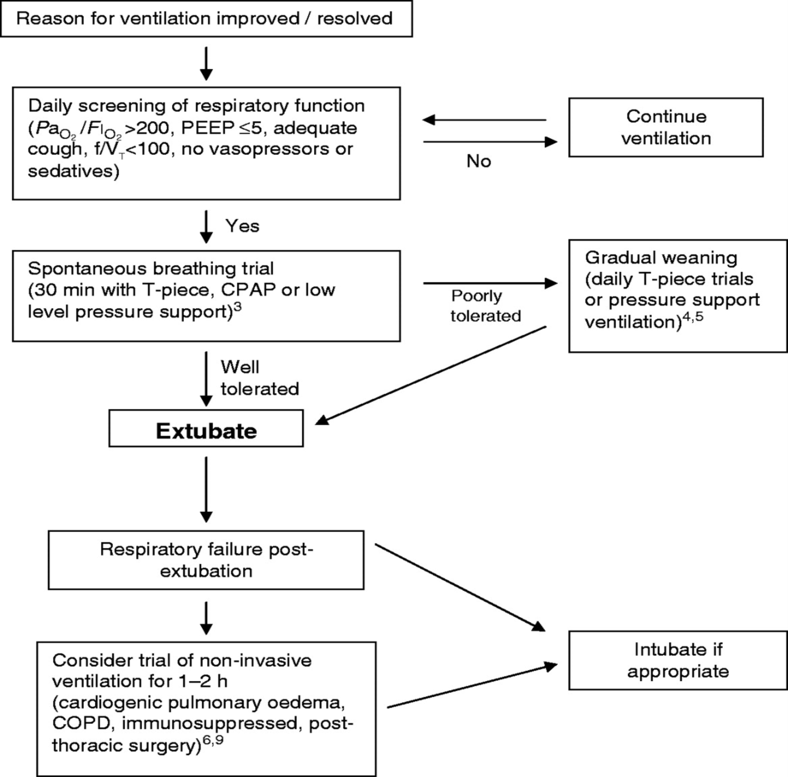

Slide 38
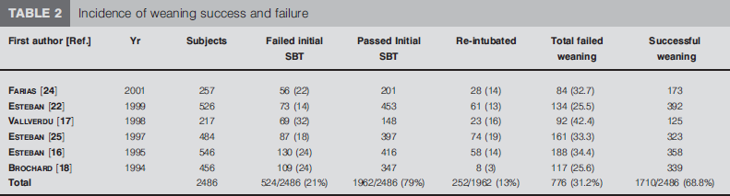

Slide 39
PSV vs SBT vs SIMV
The study by BROCHARD et al involving 456 randomised patients determined that the use of PSV compared with SIMV and intermittent T-piece trials resulted in shorter duration of weaning (5.7±3.7 days PSV versus 9.9±8.2 days SIMV).
In 130 patients who had failed the initial SBT, ESTEBAN et al reported that either one daily trial or multiple daily trials of unassisted, spontaneous breathing (T-piece) more substantially reduced the duration of weaning than either SIMV or PSV, the median duration of weaning with each technique being 3, 3, 5 and 4 days, respectively.

Slide 40
Summary
Patients must meet clinical criteria in order to start weaning
Know your weaning parameters
  RSBI, NIF, Minute Ventilation, Spontaneous Tidal Volume, Carrico Index.
Use self-judgment and ask yourself if the patient looks ready to be extubated.
Even in planned extubations, 12-14% of patients fail and require reintubation. Make sure to frequently reassess patients after extubation.

Slide 41
THANK YOU

