Slide 1
Electroconvulsive Therapy
By: Dr Lakhan Kataria
Department of Psychiatry

Slide 2


Slide 3
(Pre-)History of Convulsive Therapies
1933 – Manfred Sakel develops insulin coma therapy (Insulin-shock behandlung) – treated opioid dependent pt’s first, later schizophrenia.
Txs were occasionally, but not always, accompanied by seizures.
(Sakel later claimed to have invented convulsive therapy, but this is disputed)
Kaplan Sadocks Comprehensive Textbook of Psychiatry 2 Volume Set 7th Ed Lippincott Williams Wil

Slide 4

History of Convulsive Therapies
1934 – Ladislas Meduna induces seizures using SC camphor in oil initially and later, IV Metrazol (pentylenetetrazol, pentamethylenetetrazol):
Tx was based upon a theory of opposition beween epilepsy and schizophrenia.
Kaplan Sadocks Comprehensive Textbook of Psychiatry 2 Volume Set 7th Ed Lippincott Williams Wil
(Drawing by Renato Sabattini, PhD)

Slide 5
History of Convulsive Therapies
1938 – Ugo Cerletti and Lucio Bini induce seizures in Rome using electrical stimuli
1940 – Renato Almansi and David Impasto administer ECT at Columbus Hospital in NYC. Lothar Kalinowsky starts giving ECT at Psychiatric Institute
1940 - A.E. Bennett uses curare for muscle relaxation with Metrazol convulsive therapy
1952 – Holmberg uses succinylcholine as a muscle relaxant with ECT
Kaplan Sadocks Comprehensive Textbook of Psychiatry 2 Volume Set 7th Ed Lippincott Williams Wil

Slide 6
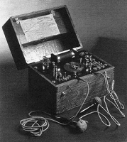
(Image provided courtesy of Renato Sabattini, PhD)

Slide 7
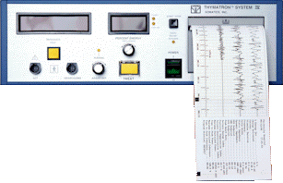
Thymatron™ System IV - Integrated ECT Instrument
(Reproduced with permission from: Somatics, LLC)

Slide 8
Electrical Stimulus
Brief-pulse square-wave AC
Voltage approx. 200V (based upon 220 Ω impedance)
Current 0.9A
Frequency 30 - 70Hz
Pulsewidth 0.5 - 2 msec
Duration 0.1 - 8 sec
Charge 25 - 504mC (5 - 99J)

Slide 9
How does it work?
Seizure - 15 to 180 sec (by EEG)
Low-dose RUL ECT - Less effective clinically despite adequate seizure duration
Down-regulation of beta receptors
Up-regulation of 5HT2 receptors
GABA (anti-convulsant theory of ECT)
BDNF (reversal of hippocampal atrophy)
Kaplan Sadocks Comprehensive Textbook of Psychiatry 2 Volume Set 7th Ed Lippincott Williams Wil

Slide 10
Anticonvulsant theory of ECT
Increasing seizure threshold during a course of ECT is associated with clinical response
Hypothesis: linked anticonvulsant and antidepressant response to ECT

Slide 11
ECT induced seizure
Discharge of neuronal population which is:
  Paroxysmal
  Synchronous
  Repetitive
Post-ictal suppression follows seizure
  Inhibitory interneurons
  GABA (as detected by MRS)
  Ect manual of NIMHANS

Slide 12
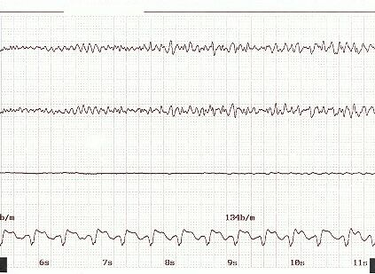
(Image provided courtesy of Conrad Swartz, MD)

Slide 13
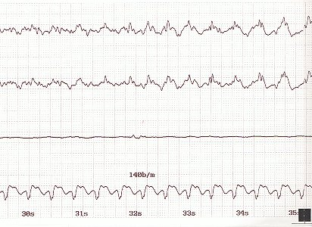
(Image provided courtesy of Conrad Swartz, MD)

Slide 14
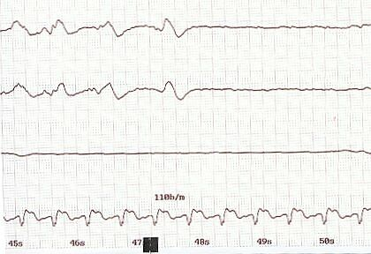
(Image provided courtesy of Conrad Swartz, MD)

Slide 15
ECS (ECT) induced depolarization
NE, 5HT
cAMP
PKA
CREB
BDNF
Duman RS and Vaidya VA. JECT, 14(3):181-193, 1998.

Slide 16
Modern (Modified) ECT
General anesthesia (propofol 1mg/kg, etomidate 0.15mg/kg, methohexital 1mg/kg))
Muscle relaxant (succinylcholine 1mg/kg, mivacurium 0.15mg/kg))
Anticholinergic (glycopyrrolate 0.2mg, atropine 0.4mg)
Oxygen/ventilation by mask
Continuous cardiac and EEG monitoring
(Other pre- and post-medications as indicated – NTG, Beta-blockers, promethazine, ketorolac, midazolam, sumatriptan, sodium amytal)

Slide 17
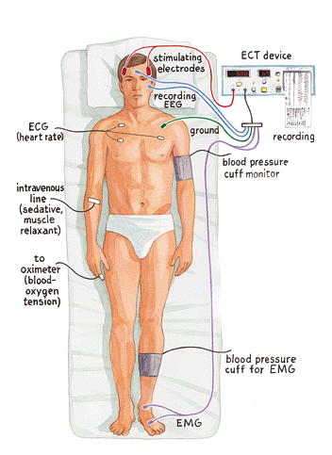
(Fink M. Electroshock revisited. American Scientist. March-April 2000.)

Slide 18
Indications for ECT
Treatment-refractory conditions
Severe or life-threatening psychiatric illness
Most often used for the treatment of medication-resistant depression (MDD)
Kaplan Sadocks Comprehensive Textbook of Psychiatry 2 Volume Set 7th Ed Lippincott Williams Wil

Slide 19
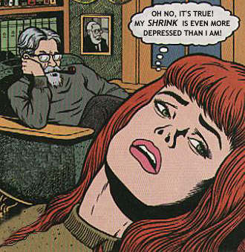

Slide 20
Diagnostic Indications
MDD
BPAD
Psychosis (Schizophrenia, SAFD)
Catatonia
NMS
PD
Delirium

Slide 21
Reasons to consider ECT first
Severe sucidality
Catatonia/NMS
Patient preference (usually previous ECT)
Pregnancy and severe psychiatric illness
Kaplan Sadocks Comprehensive Textbook of Psychiatry 2 Volume Set 7th Ed Lippincott Williams Wil

Slide 22
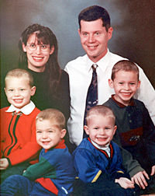
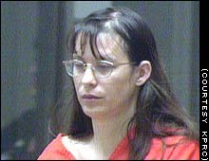

Slide 23
Patient categories:
Healthy young adults
Pregnant
Medical complicated - stable
Elderly
Adolescents
Children

Slide 24
Risks/Side Effects
Common: transient confusion, headache, nausea, myalgia, retrograde and anterograde amnesia
Uncommon: cardiac arrest, unstable arrhythmias, ischemia, severe hypertension or hypotension, stroke, prolonged apnea, aspiration, laryngospasm, prolonged seizures (status), fractures, malignant hyperthermia
Death: 1:80,000 Txs (1:10,000 patients)

Slide 25
Conditions of increased risk
Increased ICP (mass)
Unstable angina
Recent MI
Recent stroke
Pheochromocytoma
Retinal detachment

Slide 26
Medications and ECT
Anticonvulsants - taper and d/c or reduce (except in the case of seizure disorder)
Stimulants - taper and d/c
D/C Lithium 36-48 hrs prior to Tx
Trazodone -d/c
Others (SSRI’s, TCA’s, MAOI's, anti-PD ) - consider dose reduction or d/c
Neuroleptics - may be synergistic
Reserpine, chlopromazine - adverse effects

Slide 27
ECT and Medications, cont.
Beneficial medications (Give before Tx)
  Anti-HTN (other than diuretics)
  Anti-GERD/reflux (not Carafate, Mylanta, etc.)
  Pulmonary (brochodilators)
  Glaucoma meds
  Neuroleptics/Antipsychotics – Haldol, Clozapine, Risperdal – may be beneficial in combination with ECT

Slide 28
Consent
Informed consent - adequate mental capacity, understand procedure, risks, side effects, benefits, alternatives
Printed consent form
Surrogate consent – Guardian, POA, NOK if patient is incapacitated - two licensed physicians concur (SC Adult Health Care Consent Act – SC Code of Laws Title 44, Chapter 66)

Slide 29
Electrode Placement
Bilateral (BL) - most common, most effective, most cognitive dysfunction
Right unilateral (RUL) - less cognitive effect, may be less clinically effective
Bifrontal (BF) – may be as effective as BL with less cognitive effect

Slide 30
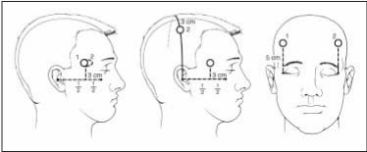
Bilateral RUL Bifrontal
Rasmussen KG et al. Mayo Clin Proc. 2002:77:552-556

Slide 31
Electrode Placement, BL vs. RUL
Response rates:
Low-dose RUL - 17%
High-dose RUL - 43%
Low-dose BL - 65%
High-dose BL - 63%
Systematic review and meta-analysis of bifrontal electroconvulsive therapy versus bilateral and unilateral electroconvulsive therapy in depression. World J Biol Psychiatry. 2012 Apr;13(4):248-58. doi: 10.3109/15622975.2011.615863. Epub 2011 Nov 18.
Sackheim HA et al. NEJM. 1993; 328:839-846.

Slide 32
Author/year | Study design | Level | Results | Outcome
Dunne RA,McLoughlin DM/World J Biol Psychiatry/ 2012 | Meta analysis of RCTs | l | Efficacy was equal between BF and BT ECT (Hedges's g=0.102, P=0.345, confidence interval (CI): -0.110, 0.313) and BF and RUL ECT (standardized mean difference=-0.12, P=0.365, CI: -0.378, 0.139) | Bifrontal ECT is not more effective than BT or RUL ECT but may have modest short-term benefits for specific memory domains. BF ECT has potential advantages, but given longer experience with BT and RUL, bifrontal ECT requires better characterization

Slide 33
Stimulus Dosing
Stimulus titration
Age-based
Fixed high dose (RUL)

Slide 34
Course of ECT
Index course 6 - 8 Txs
2 -5 Txs per week
Tx until improvement plateaus
Continuation/Maintenance ECT
Prophylactic medication

Slide 35
ECT Instructions/Orders
Void on call to ECT in AM
NPO after MN
Hold BZ after 9pm
Hold all current medications the morning of ECT except
  Anti-HTN (other than diuretics)
  Anti-GERD/reflux (not Carafate, Mylanta, etc.)
  Pulmonary (brochodilators)
  Glaucoma meds

Slide 36
Alternatives to ECT
Pharmacologic Tx - TCA, MAOI, SSRI, venlafaxine, Atypical Neuroleptic, Lamictal
Psychotherapy - CBT
VNS (FDA approved)
rTMS (experimental)
Neurosurgery – DBS (experimental)

Slide 37
1]Electroconvulsive therapy causes-
A)Retrograde amnesia of short duration
B)Antegrade amnesia of short duration
C)Psychogenic amnesia of short duration
D)Psychgenic amnesia of long duration

Slide 38
2] Which of the following is not a indication for ECT.
Suicidal ideation
Major depressive Disorder
Schizophrenia
Alcohol Use Diorder

Slide 39
3] Commonest complication of modified ECT is-
A)Fracture spine
B)Intracerebral bleeding
C)Amnesia
D)Generalized bodyaches and myopathy

Slide 40
4]True about ECT is -
A)Invented by cerliti and bini
B)Effective in delusional disorder
C)Contraindicated in pregnancy
D)Indicated in phobias

Slide 41
5]What is the usual course of ECT sessions?
1/week
2-3/week
1/day
2/day

Slide 42
Answer Key
1] – A
2] – D
3] – C
4] – A
5] - B

Slide 43
Thank you

