Slide 1
Basic lesions of skin

Slide 2
TYPE OF LESIONS
SHAPE OR CONFIGURATION
PATTERN OF LESIONS
DISTRIBUTION OF LESIONS

Slide 3
TYPES OF LESIONS

Slide 4
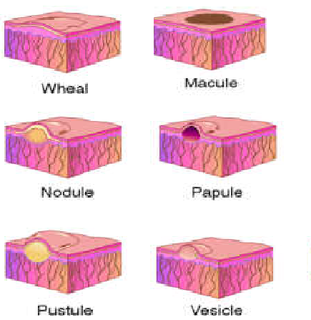
CLASSIFICATION
PRIMARY LESIONS
Initial lesions of a disease
Macule
Papule
Plaque
Nodule
Wheal
Vesicle
Bulla
Pustule

Slide 5
Secondary lesions
Lesions secondarily modified by external factors like infection or scratching
SCALE
CRUST
EROSION
ULCER
EXCORIATION
FISSURE
SCAR
ATROPHY

Slide 6
SPECIAL SKIN LESIONS
COMEDONE
MILIA
CYST, ABSCESS
PETECHIAE/ECCHYMOSIS
BURROW
LICHENIFICATION
TELANGIECTASIA

Slide 7
Primary lesions

Slide 8
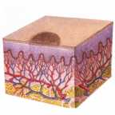
MACULE
  A circumscribed alteration in the colour of the skin without elevation or depression of the surface
  No change in texture
  Can not be palpated
  Types:
  Hyperpigmented
  Hypopigmented
  Erythematous
  Purpuric

Slide 9
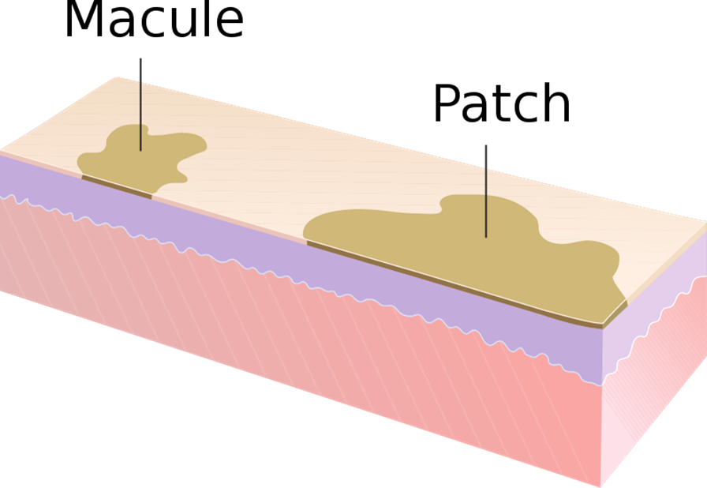
  PATCH→ Macule >1cm.

Slide 10
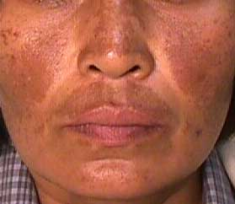
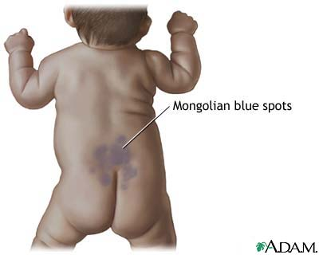
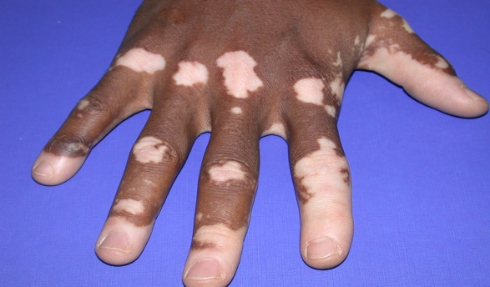
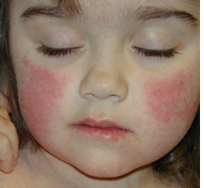
  Hyperpigmented macules-
  Brown colour- café au lait spots, melasma,
  Blue to black – mongolian spots
  Hypopigmented macules
  Ash leaf macules
  Tinea versicolor
  Depigmented macule- vitiligo
  Erythematous macules- drug eruptions
  - viral exanthems

Slide 11
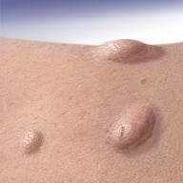
PAPULE
A circumscribed palpable elevation usually <0.5 cm in diameter
Due to –metabolic deposits
-hyperplasia of epidermis/ dermis/ both
- cellular infiltrates in dermis

Slide 12
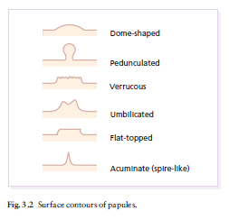
SURFACE CONTOUR OF PAPULES
Dome shaped - molluscum contagiosum, trichoepithelioma
Verrucous - verruca vulgaris
Umblicated- molluscum contagiosum
Flat topped - lichen planus
Acuminate/pointed- miliaria rubra, acne

Slide 13
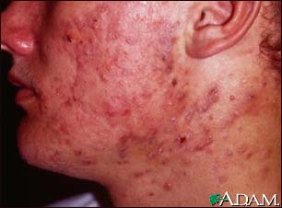
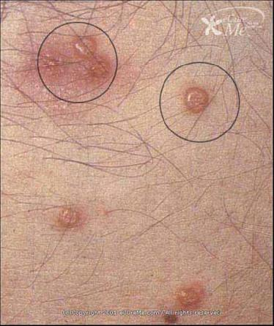
Acne vulgaris
Molluscum contagiosum

Slide 14
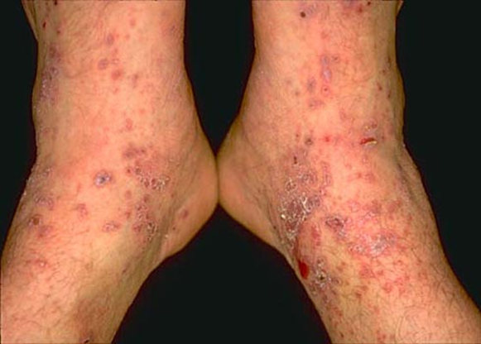
Lichen Planus

Slide 15
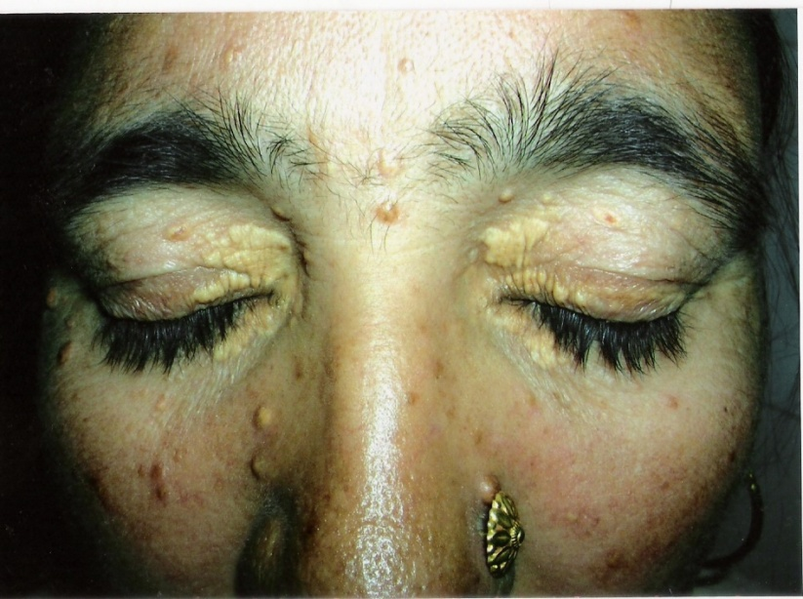
Colour :
Red -> psoriasis
Yellow -> xanthomatosis
Skin coloured -> adenoma sebacium, skin tags
violaceous -> lichen planus
Pearly White -> molluscum contagiosum

Slide 16
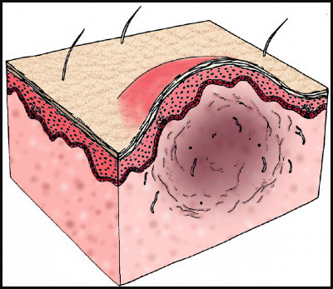
NODULE
A palpable, elevated, solid mass in the skin >0.5 cm in diameter
Depth of involvement and/or substantial palpability differentiate a nodule from a papule
5 types:
Epidermal: verruca vulgaris, keratoacanthoma, basal cell carcinoma
Epidermal-dermal: compound naevi, malignant melanoma, mycosis fungoides
Dermal: granuloma annulare, dermatofibroma
Dermal-subdermal: erythema nodosum, superficial thrombophlebitis
Subcutaneous: lipoma

Slide 17
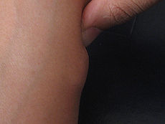
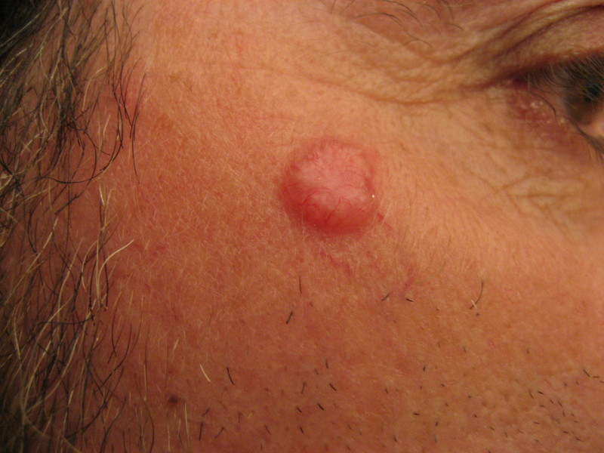
Lipoma BCC

Slide 18
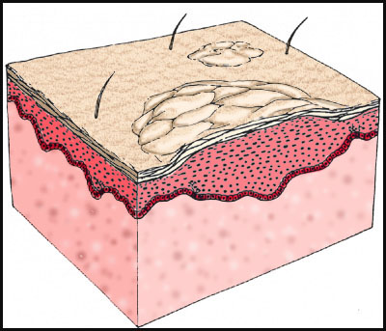
PLAQUE
An solid plateau like elevation of skin usually defined as 2cm or more in diameter
Associated with change in texture of skin
Formed by the coalescence of either papules or nodules.

Slide 19
Types of plaques
Lichenified plaques- atopic dermatitis,lichen simplex chronicus
Atrophic plaque- lichen sclerosus et atrophicus
Discoid plaque – DLE
Annular plaque –T.corporis
Scaly plaques-P.rosea

Slide 20
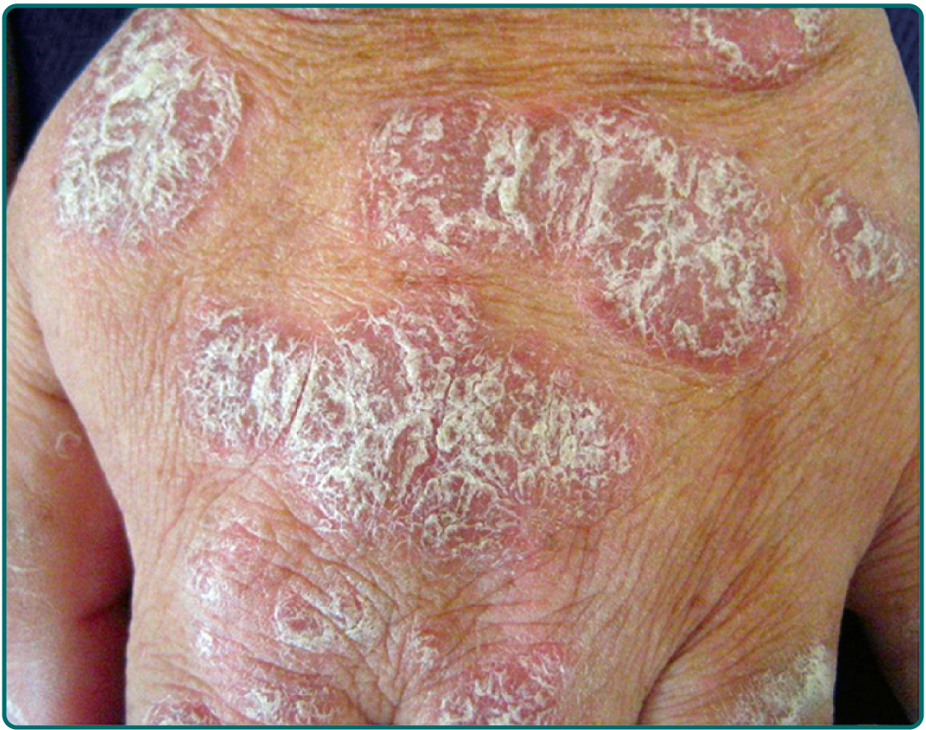
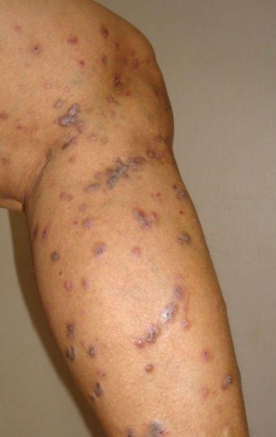
psoriasis
lichen planus

Slide 21
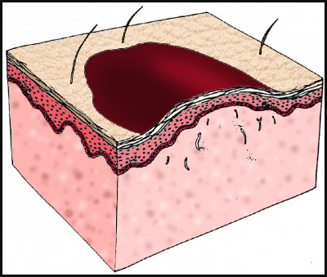
WHEAL
Erythematous , edematous, evanescent lesion often with central pallor
-characteristic lesion of urticaria
-borders- sharp but not stable
-May be round, oval, serpiginous, annular
-often surrounded by red, axon mediated flare

Slide 22
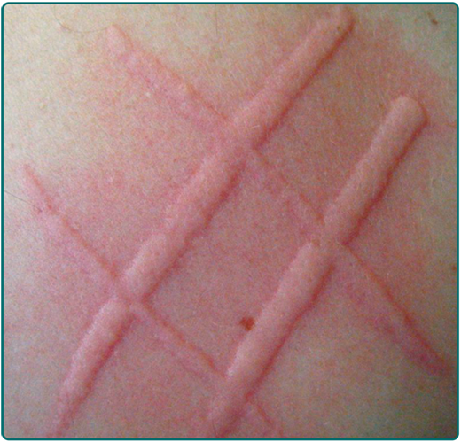
Dermographism- firm stroking of skin produces wheals (due to triple response) in a normal person but in 5% of people this response is exaggerated to produce dermographism
If associated with itching- symptomatic dermographism

Slide 23
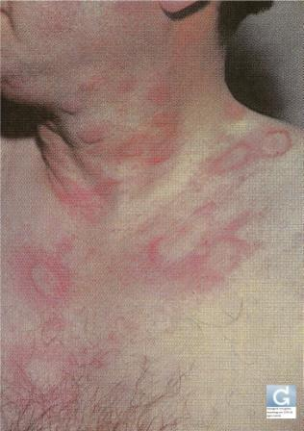
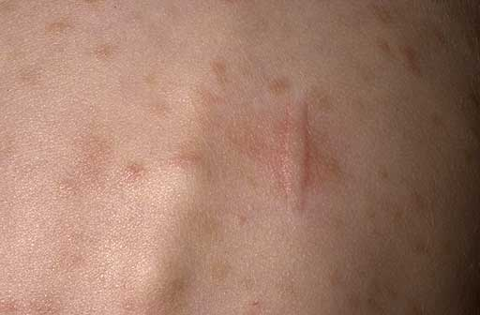
Urticaria
Darier’s sign

Slide 24
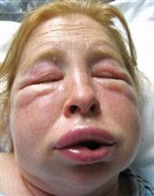
ANGIOEDEMA
Deep oedematous urticarial reaction that occurs in the areas with very loose dermis and subcutaneous tissue
Eg- lips, penis, hands, periorbital area

Slide 25
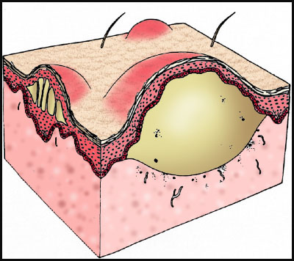
VESICLE & BULLAE
Vesicle - It is a circumscribed elevated visible accumulation of fluid <0.5cm in diameter.
Fluid- serum, lymph, blood or extracellular fluid
Bulla- Visible accumulation of fluid within or beneath the epidermis >0.5cm in diameter.

Slide 26
LEVELS OF CLEAVAGE
Subcorneal : impetigo, pemphigus foliaceous
Intraepidermal :
-spongiosis : contact eczematous dermatitis
dyshydrotic eczema
-acantholysis: pemphigus vulgaris
Subepidermal : Bullous Pemphigoid
Linear Ig A disease
Dermatitis Herpetiformis

Slide 27
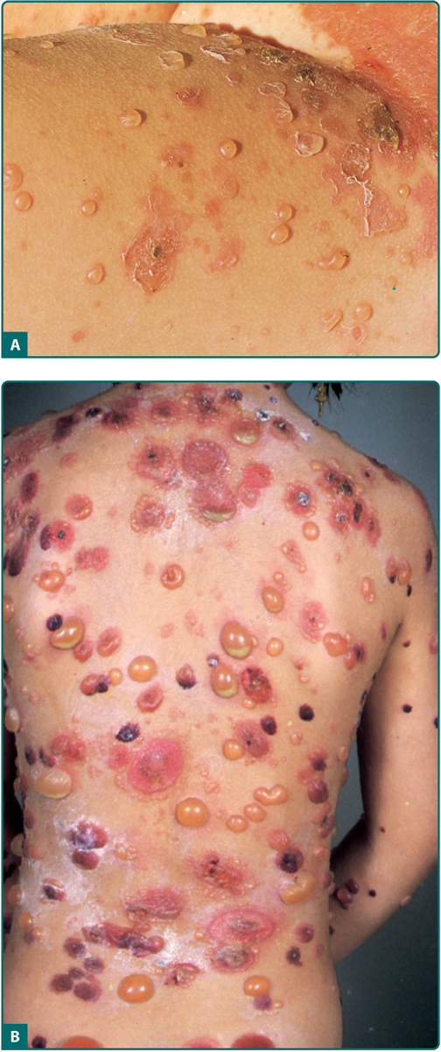
IMPETIGO
BULLOUS PEMPHIGOID

Slide 28
Tense : Bullous Pemphigoid
Flaccid : Pemphigus vulgaris
Umblicated : Viral vesicles
Grouped : Herpes Zoster
Single and diffusely scattered :Chicken pox

Slide 29
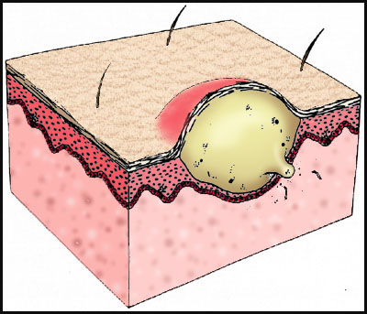
PUSTULE
A circumscribed elevation of the skin that contains a purulent exudate
May contain bacteria or may be sterile
Pustules are seen in:
Sub corneal pustular dermatosis
Pustular psoriasis
Acne
Drug eruptions- bromide, iodide
Viral exanthems

Slide 30
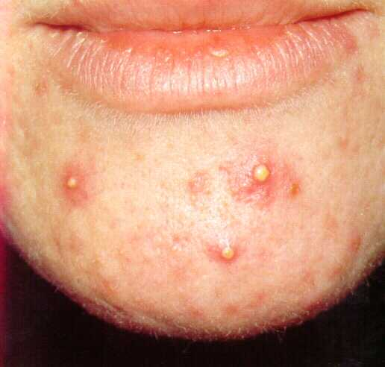
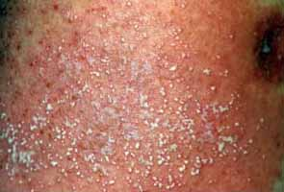
acne pustulosa
pustular psoriasis

Slide 31
SECONDARY LESIONS

Slide 32
SCALE
A flat plate or flake arising from the outermost layer of stratum corneum
Arises due to:
Increased shedding of stratum corneum due to decreased duration of cell turn over eg-psoriasis
Decreased shedding or accumulation of s.corneum eg- x linked recessive ichthyosis

Slide 33
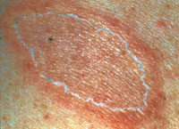
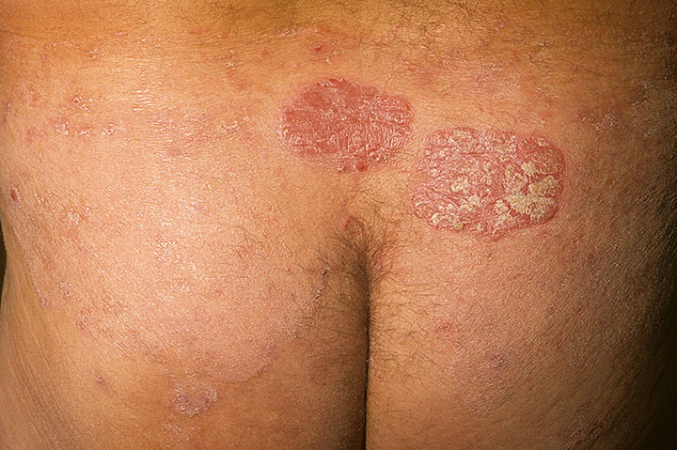
Types of scales
Collarette scales-Pityriasis rosea
Micaceous scales- Psoriasis

Slide 34
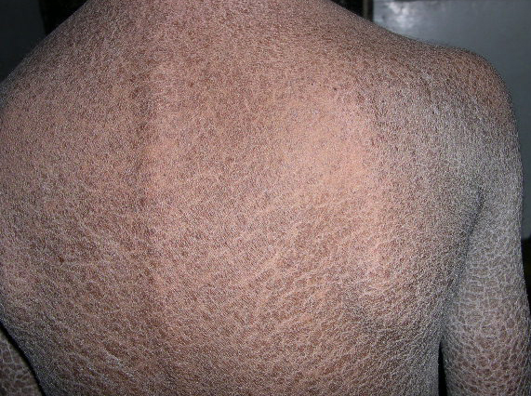
Fish like scales-Icthyosis vulgaris
Furfuraceous scales-Pityriasis versicolor

Slide 35
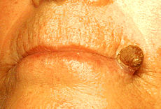
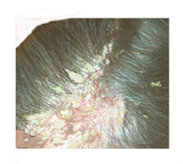
Gritty/ sandpaper like scales
Solar keratosis
Yellow and greasy scales Seborrhoea capitis

Slide 36
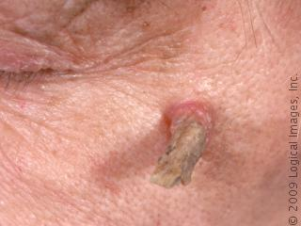
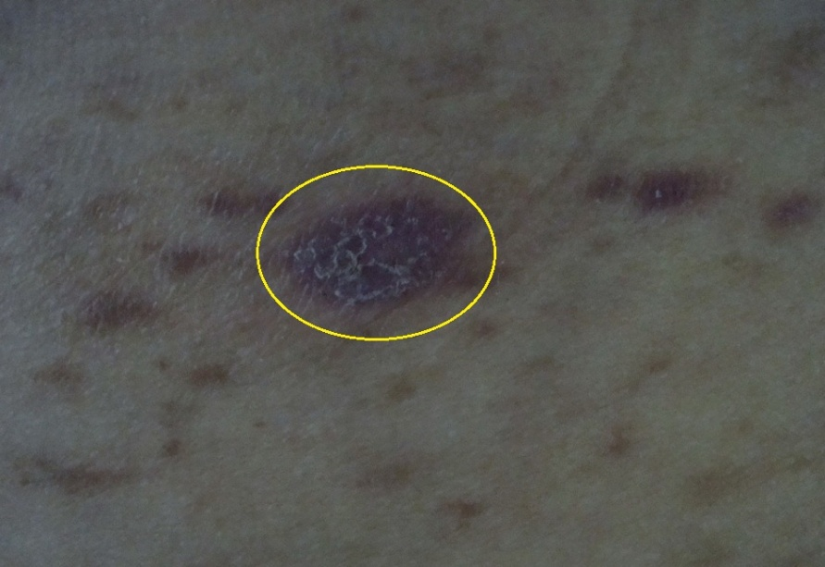
Keratotic scales
cutaneous horn
Wickham striae
lichen planus

Slide 37
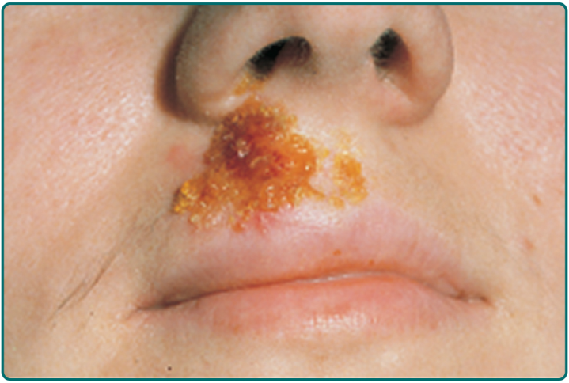
CRUSTS
Crusts consist of dried serum , other exudate or blood along with cellular debris
Yellow -formed from dried serum
Green or yellow green -purulent exudate
Brown or dark red -blood
Thin, delicate, friable crusts -Impetigo
Thick and adherent crusts -Ecthyma

Slide 38
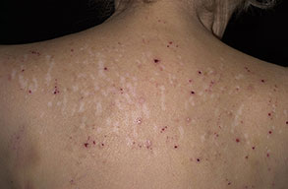
EXCORIATIONS
Loss of skin substance specifically produced by scratching
Usually long and parallel
Sometimes crossing or
punctate
Seen in –Atopic Eczema
Dermatitis Herpetiformis
Infestations

Slide 39
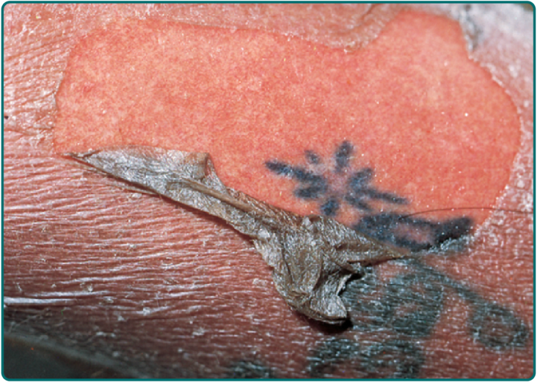
EROSION
Moist, circumscribed , usually depressed lesion that involves loss of all or portion of viable epidermis
Usually result of rupture of vesicles or bullae
Since, there is no loss of dermis they heal without scarring

Slide 40
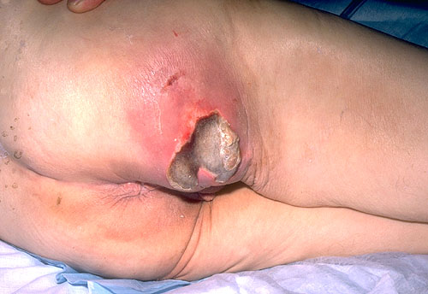
ULCER
A lesion in which there has been destruction of epidermis and atleast the papillary dermis.
Heals with scarring

Slide 41
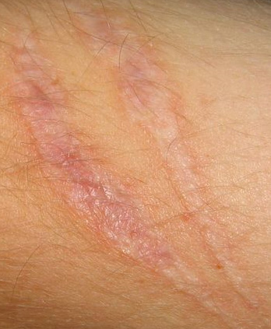
SCAR
Replacement by fibrous tissue of another tissue that has been destroyed by injury or disease
Atrophic scar -thin and wrinkled

Slide 42
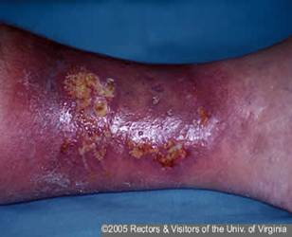
CRIBRIFORM SCARS
pyoderma gangrenosum

Slide 43
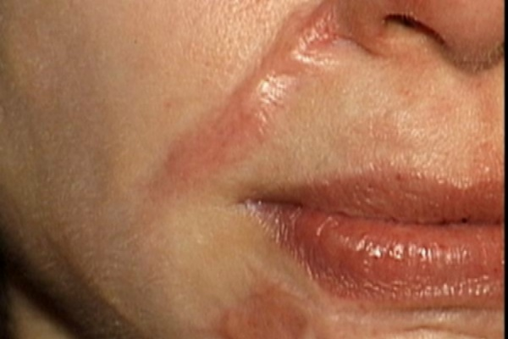
Hypertrophic scars

Slide 44
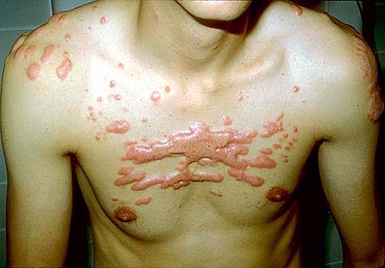
keloid
keloid with claw like extensions

Slide 45
ATROPHY
A loss of tissue from one or more of the epidermis, dermis, or subcutaneous tissue.
Epidermal -skin is thin or shiny with or without loss of normal skin lines along with fine wrinkling eg-Senile skin
Dermal + epidermal - Striae of pregnancy -Cushing’s disease
-Scleroderma
Dermal Decrease in papillary or reticular dermal connective tissue following trauma or inflammation
Manifest as depression in the skin
Subcutaneous tissue atrophy-panniculitis, progressive lipodystrophy

Slide 46
Special lesions

Slide 47
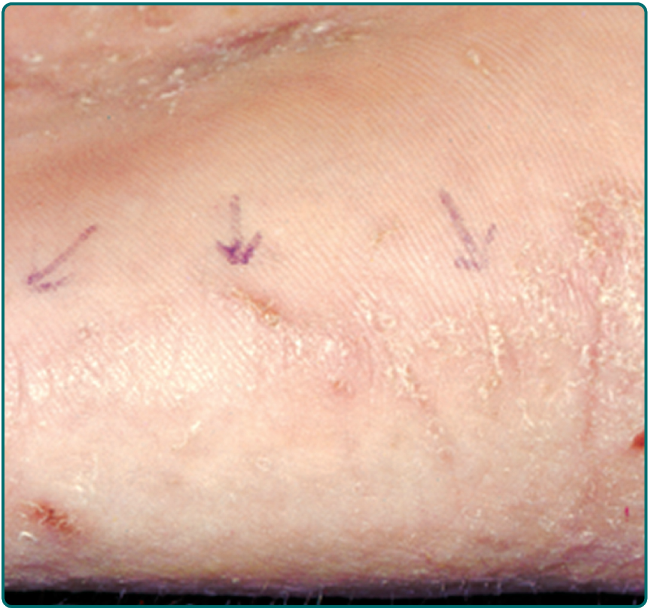
BURROW
Burrow: A serpiginous tunnel in the skin which houses a parasite

Slide 48
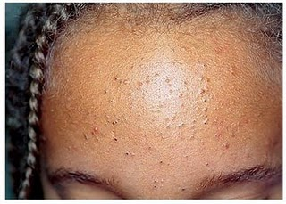
COMEDONE
Comedo: A plug of keratin and sebum in a dilated pilosebaceous orifice.
Non inflammatory lesion of acne.
OPEN- pilosebaceous unit is open to the surface of skin with visible keratin plug
CLOSED- Follicular opening is closed.

Slide 49
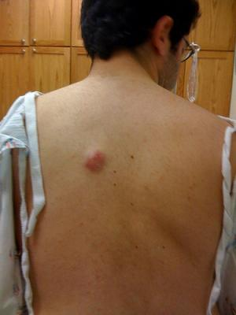
CYST/ ABSCESS
Cyst
Any closed cavity or sac(normal or abnormal) with an epithelial, endothelial or membranous lining and containing fluid or semisolid material
-resilient on palpation
Abscess:
A localized accumulation of purulent material so deep in the dermis or subcutaneous tissue that the pus is not visible on the surface of the skin

Slide 50
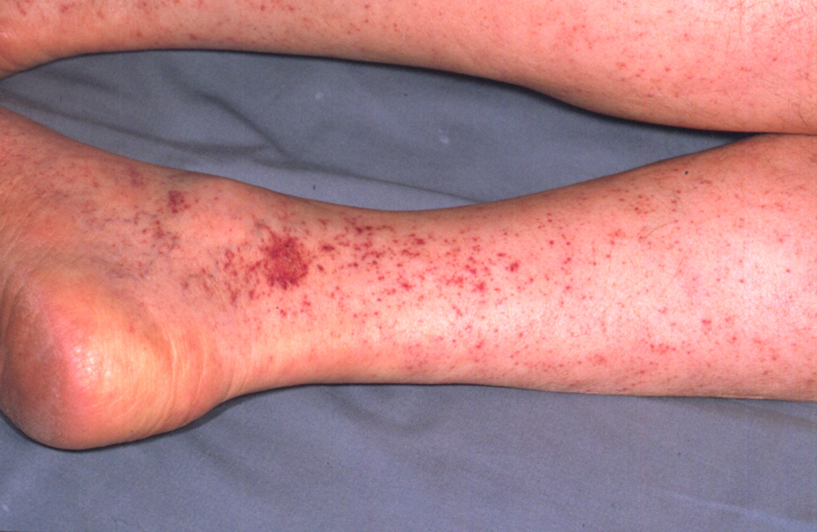
Petechiae/ ecchymosis
Purpura : caused by extravasated RBCs
Petechiae – small pinpoint purpuric spots (1-2mm)
Eccymosis – larger purpuric lesions (>2mm)

Slide 51
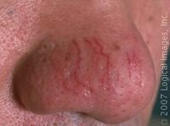
TELANGIECTASIA
Telangiectases : permanent dilatations of small capillaries in the superficial dermis
-non pulsatile
-fine bright red lines or net like pattern
Examples:
Lupus erythematosus, dermatomyositis- periungal
Rosacea –nose and central part of face
Hereditory haemorrhagic telangiectasia

Slide 52
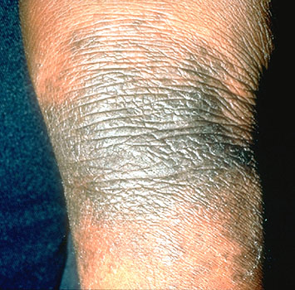
LICHENIFICATION
Changes induced in epidermis and dermis by repeated scratching which causes –
Thickening of skin
hyperpigmentation
Accentuation of Skin markings

Slide 53

SCLEROSIS
Circumscribed or diffuse hardening or induration of skin
Detected easily by palpation
morphea
Systemic sclerosis
Chronic stasis dermatitis
Lichen sclerosus et atrophicus

Slide 54

MILIA
Tiny white cyst containing lamellated keratin

Slide 55
Shapes of skin lesions

Slide 56
Annular
Nummular
Polycyclic
Arcuate
Linear
Reticular
Serpiginous
Target like
whorled

Slide 57

Annular lesions
Ring shaped
Edge of the lesion is different from the center either by being raised , scaly, or differing in colour
Eg.-
Granuloma annulare
Tinea corporis

Slide 58

Nummular or discoid
Coin shaped
Round to oval lesion with uniform morphology from periphery to the center
Eg-
Nummular eczema
Discoid lupus erythematosus

Slide 59

POLYCYCLIC
Formed from coalescing circles, rings or incomplete rings
Eg
Subacute cutaneous lupus erythematosus
urticaria

Slide 60

ARCUATE
Incomplete formation of an annular lesion
Eg
Urticaria
Sub acute lupus erythematosus

Slide 61

LINEAR
Arrangement resembling a straight line
Implies an external contactant or koebner’s phenomenon
Single lesion –scabies
- poison ivy
dermatits
Multiple lesions- sporotrichosis

Slide 62

RETICULAR
Net like or lacy pattern
Eg
oral lichen planus
Livedo reticularis

Slide 63

SERPIGINOUS
Serpentine or snake like lesions
Eg
Cutaneous larva migrans
Scabies (sometimes)

Slide 64

Target lesions/bull’s eye lesion
Characteristic lesion of erythema multiforme
3 zones of color change are seen
Central area of dusky erythema or purpura
Middle paler zone of oedema
Outer ring of erythema with a well defined edge

Slide 65

WHORLED
Swirling pattern
Two colours interspersed in a wavy pattern
Eg
Epidermal naevi
Incontinentia pigmentii

Slide 66
PATTERNS OF LESIONS

Slide 67


GROUPED/ CLUSTERED
Eg-herpetic vesicles
CONFLUENT
eg p.versicolar
herpetic vesicles

Slide 68


SCATTERED/ DISSEMINATED
Eg- viral exanthemata
drug eruptions
Spared
Eg- pityriasis rubra pilaris

Slide 69


Scarlitiniform
innumerable small red papules that are widely and diffusely distributed.
Morbiliform
like measles
red macular lesions usually 2-10 mm in diameter but may be confluent in places

Slide 70
Symmetrical- plaque type psoriasis
Asymmetrical- tinea
Localised - cellulitis
Generalised- drug eruptions
Universal- alopecia universalis

Slide 71
SIZE OF LESION
Punctate : dot or point size
Miliary : size of a millet
Guttate : size of a drop of water
Lenticular: size of a small pea or bean
Nummular: size of a small coin

Slide 72
Distribution of lesions

Slide 73



Distribution of lesions
Flexural areas sun exposed areas sun protected areas

Slide 74


Distribution of lesions
Acral areas p. rosea

Slide 75


Blaschkoid

Slide 76


Dermatomal

Slide 77
THANKS

