Slide 1
CLASSIFICATION OF
EPIDERMOLYSIS BULLOSA

Slide 2
EPIDERMOLYSIS BULLOSA
Epidermolysis bullosa (EB) is a group of genetically transmitted disorders characterized by skin fragility and blistering in response to seemingly mild mechanical trauma (“mechanobullous disorders”).

Slide 3
Mutations in any of 11 genes, each encoding for a structural protein within the epidermis or the basement membrane zone, are responsible for the at least 25 phenotypes that have been distinguished on the basis of clinical features, mode of inheritance, genes responsible, and ultrastructural findings.
The conditions vary widely in severity: some patients may be asymptomatic with occasional blistering while others may have deformities and may even die prematurely. They may present at birth or much later in life. The cutaneous features may include blisters, erosions, scarring, atrophy, nail dystrophy, exuberant granulation tissue, hypo- or hyperpigmentation, milia, and alopecia.

Slide 4
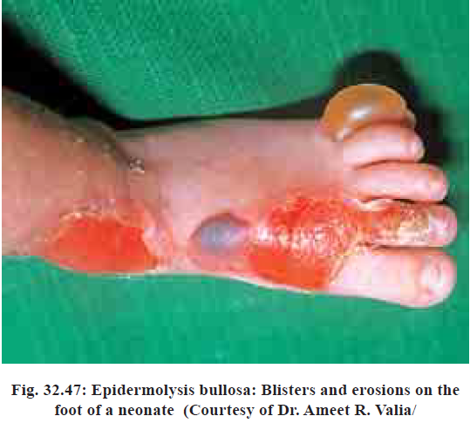
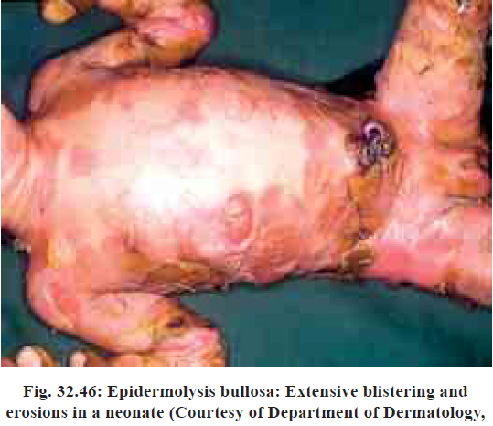

Slide 5
On the basis of the level of cleavage of the skin leading to blistering, EB has been divided into three broad categories:
Epidermolysis bullosa simplex (EBS), in which blisters develop intraepidermally at the level of the basal keratinocytes, above the basement membrane,
(b) Junctional epidermolysis bullosa (JEB), in which blisters form within the basement membrane, and
(c) Dystrophic epidermolysis bullosa (DEB), in which blisters form beneath the basement membrane

Slide 6
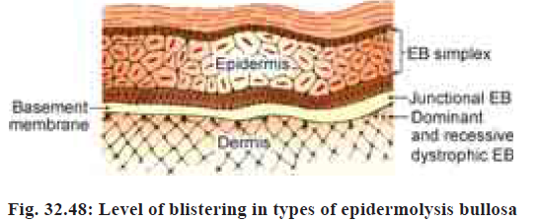

Slide 7
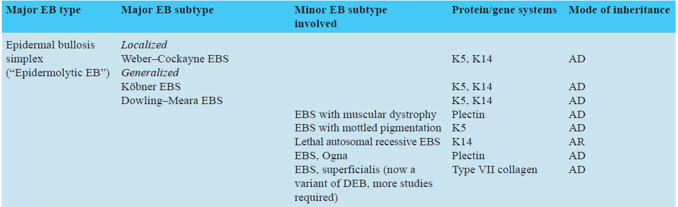
Classification of inherited epidermolysis bullosa

Slide 8
Epidermolysis Bullosa Simplex
Keratins are expressed in basal cells, they contain a central alpha-helical domain flanked by globular domains at either end.
Defects that produce the most severe phenotypes, like the Dowling–Meara subtype, cause alterations of the boundary region between the alpha-helical domain and the globular domains.
Mutations that involve other regions produce milder forms of the disease.
Thus, the location of the defect in the genes dictates the severity of disease.

Slide 9
The split in EBS occurs in basal cells, except in EBS superficialis where it occurs just beneath the stratum corneum. Has intraepidermal nature with vacuoles within basal keratinocytes adjacent to the blister.
A PAS-positive basement membrane zone is seen on the dermal side of the blister
Antigen mapping reveals BP antigen 1 and type IV collagen on the floor of the blister.

Slide 10
On electron microscopy, Dowling–Meara subtype shows characteristic intracytoplasmic clumping of tonofilaments in basal keratinocytes, differentiating it from the other forms of EBS.
Histopathologically seen as dyskeratosis in individual keratinocytes

Slide 11
In all types of EBS, excluding EBS superficialis, immunoperoxidase staining for collagen IV demonstrates linear deposition along the floor of the blister.
Immunoperoxidase staining for keratins reveals a segmented or continuous band of keratin along the BMZ, determinatining the intraepidermal position of the blister
Differentiation from junctional EB.

Slide 12
Weber–Cockayne Epidermolysis Bullosa Simplex
Commonest form of EB.
Early onset, infancy or early childhood. Females are less severely affected.
Thick-walled blisters are typically localized (90%) to palms and soles and worsen during warm weather.
Hyperhidrosis of palms and soles - common and exacerbates blistering. Healing occurs without scarring. Calluses on the hands and feet - common in adults.
The hair, teeth, nails and mucous membranes are usually spared.

Slide 13
Koebner Epidermolysis Bullosa Simplex
Onset is at birth or soon thereafter.
Bullae are tense, serous, heal with atrophic scarring.
In infancy, blisters appear on the occiput, back and legs, while in childhood the hands and feet are affected.
Palms and soles are not preferentially involved.
Blistering - worse in summer.

Slide 14
Mucosal erosions can occur. Oral ulcers may develop in the newborn due to vigorous sucking.
The hair and teeth are normal.
Nail involvement can occur but is minimal compared to JEB or DEB.

Slide 15
Dowling–Meara Epidermolysis Bullosa Simplex (Syn. Epidermolysis Bullosa Herpetiformis)
Onset of blistering is at birth or soon thereafter in a generalized distribution, blistering is rarely life threatening.
There may be mucosal involvement, shedding of nails and transient formation of milia.
After several months, blistering of palms and soles becomes more frequent.

Slide 16
Spontaneous grouped (‘herpetiform’) blisters on the trunk and proximal limbs - distinctive feature. Heal with mild hyperpigmentation, occasionally milia and atrophic scarring.
Focal callosities of the palms and soles - after the age of 6–7 years and become confluent.
The tendency for blistering diminishes significantly after the age of 6 or 7 years.

Slide 17
Epidermolysis Bullosa Simplex with Muscular Dystrophy
Autosomal recessive trait, result of consanguineous marriages.
Onset in early infancy, development of post-traumatic blisters and erosions initially on the hands and feet and later in a generalized distribution with atrophic scarring, milia and nail deformities.
Considerable muscle weakness & muscular dystrophy can cause immobility and, eventually, death later in life.

Slide 18
Epidermolysis Bullosa Simplex with Mottled Pigmentation
Hypopigmented and hyperpigmented macules 2 to 5 mm in diameter are present at birth or appear during infancy, giving a mottled appearance, especially over the neck, proximal extremities and upper trunk.
Blistering - localized to palms and soles, or more generalized.
As patient approaches adulthood, mottling becomes less apparent with appearance of atrophy.

Slide 19
The hair and teeth are normal.
Nails - longitudinally curved.
Punctate keratoses develop on the palms and soles.

Slide 20
Epidermolysis Bullosa Simplex, Ogna
Derives its name from the Norwegian village where the first family originated.
Patients have hemorrhagic blistering of acral areas (hands and feet), a bruising tendency and toenails with onychogryphosis.

Slide 21
Epidermolysis Bullosa Simplex Superficialis
Erosions, rather than blisters, begin at birth or in early infancy and may be generalized or acral.
Milia formation, atrophic scarring and nail dystrophy are common.
Mutations found in COL7A1, the type VII collagen gene, suggest that it is a dystrophic type of EB than EBS

Slide 22
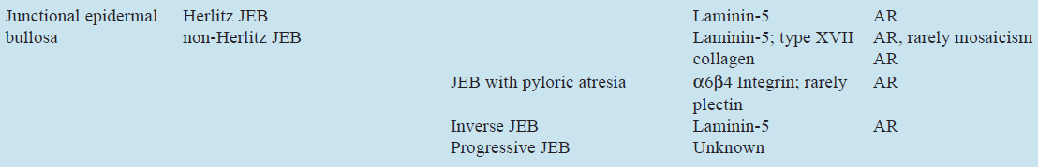
Classification of inherited epidermolysis bullosa

Slide 23
Junctional Epidermolysis Bullosa
Characterized by the presence of subepidermal separation with specific ultrastructural defects.
Its manifestations range from the severe Herlitz form, which is usually lethal in the first 2 years of life, to the milder non-Herlitz forms in which blistering may be mild.
The ultrastructural abnormalities are identical in all cases, with separation at the level of the lamina lucida, except in JEB with pyloric atresia, where it may be intraepidermal, just above the basal plasma membrane.

Slide 24
Subepidermal bulla formation - on light microscopy.
PAS staining - PAS-positive BMZ forming the floor of the blister.
Antigen mapping - antikeratin and BP antigen 1 antibodies localized to the roof while anti-type IV collagen stains the floor.
Electron microscopy - the split to be in the lamina lucida, with the hemidesmosomes on the roof and the lamina densa on the floor.

Slide 25
Herlitz Junctional Epidermolysis Bullosa (Syn. Epidermolysis Bullosa Letalis)
Severe generalized blistering with mucosal involvement is seen at or within several days of birth.
Entire skin is extremely fragile, lifting or turning the baby cause extensive blistering or peeling of epidermis.
Eroded areas heal with no or mild atrophic scarring, and milia not seen.

Slide 26
Oral and pharyngeal mucosal involvement - severe; hoarseness and stridor signify laryngeal supraglottic involvement.
Painful corneal erosions
Teeth - dysplastic, pitted, malformed and lost prematurely.
Characteristic perioral and perinasal non-healing erosions and hypertrophic granulation tissue appear at 6 to 12 months of age.
Following blistering and erosions, granulation tissue forms on nail folds and nail bed, leads to shedding of nails and bulbous changes of the fingertips

Slide 27
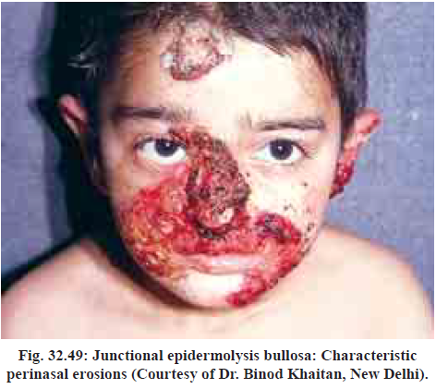
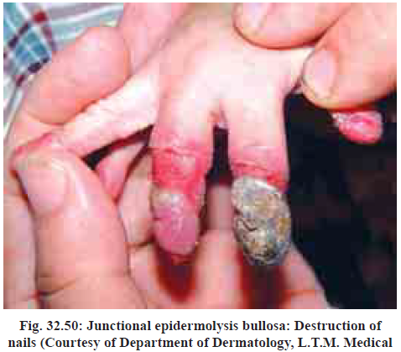

Slide 28
Absence of laminin V results in gastrointestinal, genitourinary and respiratory complications.
Oral lesions impair caloric intake. This, with chronic infection and loss of protein and iron from the skin, result in growth retardation and refractory anemia.
During the first year of life, 40% of patients die, and most patients succumb within the first 5 years, most commonly due to sepsis and multiorgan system dysfunction.
Those with less severe involvement survive to adulthood, 75% develop flexural contractures at the axillae, upper and lower limbs by the age of 20 years.

Slide 29
Generalized Non-Herlitz Junctional Epidermolysis Bullosa (Syn. Generalized Atrophic Benign Epidermolysis Bullosa)
Generalized fragility and blistering first appear at birth with significant nail, teeth and mucosal involvement.
Blisters over the scalp - atrophic hair loss and alopecia characteristic; also seen over the axillae and pubis.
Heal with atrophic scarring - resemble dystrophic EB.
Pigmented nevi or acquired macular hyperpigmentation with irregular borders are common.

Slide 30
Mucous membrane involvement - less severe than Herlitz JEB, but can lead to esophageal, tracheal and urethral strictures.
Teeth - severe enamel defects, may not erupt normally.
Nails – dystrophic, missing, especially on toes.
Corneal ulcers - severe eye involvement.
Blistering improves with age and significantly decreases in adolescence.

Slide 31
In contrast to the Herlitz variant, growth is normal and anemia is rare.
A variant of this form is cicatricial junctional epidermolysis bullosa, whose sequelae include severe scarring leading to syndactyly and contractures.

Slide 32
Junctional Epidermolysis Bullosa with Pyloric Atresia
Presents at birth, following a pregnancy complicated by polyhydramnios, as extensive skin and mucosal blistering
Heals with atrophic scarring and associated with pyloric and/or duodenal atresia.
Non-bilious vomiting on attempt to feed the newborn should arouse the presence of pyloric atresia.

Slide 33
Nails - dystrophic
Teeth - hypoplastic.
Repeated urinary tract infections, hydronephrosis and nephritis.
Death usually occurs within the first few months of life, unless the pyloric atresia is surgically corrected.

Slide 34
Inverse Junctional Epidermolysis Bullosa
Characterized by fragility and generalized blistering in the neonatal period that localizes to intertriginous areas (the neck, groin, perineum and axilla) within several months.

Slide 35
Progressive Junctional Epidermolysis Bullosa
Onset delayed until the age of 5 to 8 years. At this time, nail dystrophy and defective tooth enamel appear.
May be accompanied by blistering on the hands and feet, and later over the knees and elbows
Heals with variable atrophy. Progressive atrophic changes lead to early loss of fingerprint patterns and mild finger contractures.
Many have partial deafness.

Slide 36
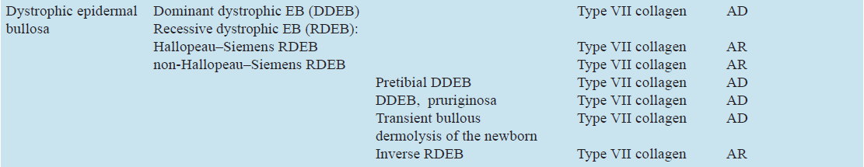
Classification of inherited epidermolysis bullosa

Slide 37
Dystrophic Epidermolysis Bullosa
Characterized by severe fragility of the skin blistering, scarring, nail changes and milia formation
All variants of dystrophic epidermolysis bullosa (DEB) are caused by mutations in the gene COL7A1, resulting in defective synthesis or assembly of type VII collagen.

Slide 38
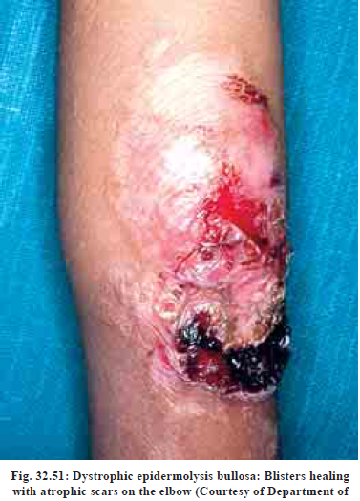
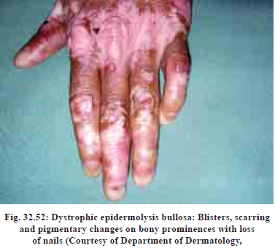

Slide 39
Blister is subepidermal, no characteristic findings except for prominent scarring in the underlying dermis.
PAS staining - not helpful in DEB as staining of BMZ is hazy and unrecognizable.
Antigen mapping - total absence of staining of type VII collagen, and BP antigen 1, keratin 14 and type IV collagen are found on the roof of the blister.
Electron microscopy shows blisters form below the lamina densa within the papillary dermis at the level of anchoring fibrils, and the fibrils may be absent, fewer or morphologically altered.

Slide 40
Dominant Dystrophic Epidermolysis Bullosa [Syn. Hyperplastic (Cockayne–Touraine), and Albopapuloid (Pasini) Variants]
Generalized blistering and erosions begin at birth.
Mechanical trauma associated with crawling or a baby’s first pair of shoes result in bullae and scarring over the elbows, knees and ankles.
Skin is less fragile & Blistering is difficult to provoke
Later in life blisters are localized to the dorsal aspects of the hands and feet, elbows and knees.

Slide 41
Localized scarring with milia formation and dystrophic or absent nails are the most consistent findings.
Nail dystrophy is the most important diagnostic feature, especially in adults
Mucosal involvement is mild and teeth are near normal.
The albopapuloid (Pasini) variant is characterized by the extensive development of white papules mainly on the back and the trunk.

Slide 42
Pretibial Dystrophic Epidermolysis Bullosa and Epidermolysis Bullosa Pruriginosa
Pretibial DEB is dominantly inherited, late-onset form of DEB with itching, bullae, atrophy and scarring on the shins.
Mucosal involvement is minimal or absent.
Intractable pruritus is a characteristic of EB pruriginosa.

Slide 43
Presents at birth, with mild blistering, or during infancy or childhood.
Violaceous lichenoid papules and plaques, often in linear arrangement, appear on shins, forearms and heal with scarring, atrophy and milia formation.
Toenail dystrophy is a common finding in adult patients.

Slide 44
Autosomal Recessive Dystrophic Epidermolysis Bullosa (Hallopeau–Siemens)
Onset at birth or early infancy, with both cutaneous and mucosal involvement.
There are large flaccid bullae, often yield a positive Nikolsky’s sign, rupture to leave ulcerations that heal slowly with atrophic scarring and milia formation.
The entire skin is fragile, but the sites most commonly affected are those subject to friction or trauma such as the elbows, knees, hands, feet, back of the neck, shoulders and over the spine.

Slide 45
Pruritus is common. The scars are like cigarette paper or slightly thicker.
Repeated blistering and subsequent scarring lead to partial or total syndactyly, hands and feet assuming a mitten like appearance.
Nearly all patients develop flexural contractures at the axillae, knees, elbows and wrists by the age of 20 years.
Nails become dystropic and are lost early in life.
Scarring alopecia may be seen.
Recurrent blistering and scarring lead to microstomia and ankyloglossia.

Slide 46
A constant feature is the patient’s inability to protrude the tongue or even to open the mouth normally.
Gums are fragile and toothbrushing may induce bleeding.
Tongue’s surface appears smooth, shiny and atrophic due to the loss of lingual papillae.
Teeth become carious - prolonged exposure to food, stemming from a reduced ability to chew food and diminished circulation of saliva.
Hoarseness and aphonia - laryngeal bullae; scarring in this area - stenosis.

Slide 47
Complain of dysphagia. The upper one-third of the esophagus is most often involved, with strictures or webs
Complications - obstruction, rupture, hemorrhage, carcinoma and aspiration pneumonia.
Perianal erosions and anal fissures add to the patient’s discomfort, and heal with scarring and anal stenosis.
The result is chronic constipation and fecal retention.

Slide 48
Ocular complications include symblepharon, limbal broadening and corneal opacities.
Genitourinary system - consequent urethral stenosis, leading to urinary retention, hypertrophy of the bladder and ureters, and finally hydronephrosis.
Renal failure - due to either poststreptococcal glomerulonephritis or secondary amyloidosis, and is cause of death in about 12%

Slide 49
Anemia, due to blood loss through skin, infection and undernourishment, and growth retardation are present.
Most devastating late complication - development of aggressive multiple squamous cell carcinomas in areas of repeated blistering and scarring, primarily on the extremities;
Morbidity and mortality are high. Patients die by the third or fourth decade either as a direct or indirect result of EB, repeated infection being the most frequent cause.

Slide 50
Non-Hallopeau–Siemens Recessive Dystrophic Epidermolysis Bullosa
All patients of RDEB who lack the characteristic cutaneous and extracutaneous features of the Hallopeau–Siemens subtype are included
Onset is at birth, manifestations are milder.
The skin and mucosae are very fragile, but lesions, including nail changes, milia and atrophic scarring, tend to be more localized and similar as seen in classical DDEB.

Slide 51
Pseudosyndactyly, ocular and gastrointestinal complications, anemia, growth retardation and the development of squamous cell carcinomas are much less common.

Slide 52
Transient Bullous Dermolysis of the Newborn
Presents as neonatal skin blistering, especially over the limbs, remarkably improves during childhood and remits completely.
Blisters heal without dystrophic scarring but often with mild hypopigmentation.
Nails are normal, mild involvement of the oral mucosa.
Appearance of new lesions spontaneously ceases in the first year of life.

Slide 53
Light microscopy shows a subepidermal blister beginning in the dermal papillae
Electron microscopy, a sublamina densa cleavage.
Ultrastructurally, basal keratinocytes contain stellate bodies that consist of type VII collagen.
These changes revert to normal, and type VII collagen may be present at the DEJ at about the time that blistering ceases, suggesting there is a transient secondary abnormality in packaging, transport or incorporation of mutated type VII collagen into the DEJ during infancy in these patients.

Slide 54
Inverse Recessive Dystrophic Epidermolysis Bullosa
Blisters and erosions are frequently present at birth, commonly in axillae, groin, neck, trunk, with relative sparing of the extremities.
The lesions heal with scarring, without significant milia formation.
Nail dystrophy, mucosal involvement and dental changes are similar to the generalized form.
Esophageal involvement may lead to a stricture.

Slide 55
EPIDERMOLYSIS
BULLOSA ACQUISITA

Slide 56
Epidermolysis bullosa acquisita (EBA) is an acquired mechanobullous disorder so named due to its clinical and molecular similarity with inherited dystrophic epidermolysis bullosa.
EBA is a rare, acquired, chronic, trauma-induced subepidermal blistering disease in which tissue bound and circulating antibodies to type VII collagen are found.

Slide 57
Etiology and Pathogenesis
Association with HLA-DR2 phenotype is common.
The EBA antigen is type VII collagen, a 290 kDa glycoprotein, specifically found in basement membranes of stratified squamous epithelia.
Type VII collagen is produced predominantly by epithelial keratinocytes. It forms the major structural component of anchoring fibrils, which are located below the lamina densa of the basement membrane

Slide 58
It plays a pivotal role in the adherence between the basement membrane and the papillary dermis.
EBA autoantibodies are IgG, directed at the NC-1 domain of collagen VII.
They are pathogenic, i.e. capable of inducing subepidermal blisters, and are found in bullous LE as well.

Slide 59
Possible mechanisms of blister formation in EBA include one or both of the following:
1. A direct effect of the antibodies on type VII collagen, interfering with its adhesive functions by disturbing the critical direct interactions between type VII collagen and other extracellular components within the DEJ such as type IV collagen, laminin-5, and fibronectin (noninflammatory cases of EBA)
2. An inflammatory reaction, triggered by a complement activating immune complex, that attracts neutrophils, which release proteolytic enzymes that degrade fibronectin, essential component of the basement membrane and upper papillary dermis, resulting in a split.

Slide 60
Clinical features
EBA typically presents in the fourth to sixth decades, but has been occasionally reported in children.
It varies in severity from mild and localized disease to a severe and widespread eruption with mucosal involvement.

Slide 61
The commonest presentation, the dermolytic or noninflammatory variant of EBA, is as a non-inflammatory mechanobullous disease suggestive of dystrophic epidermolysis bullosa or porphyria cutanea tarda.
The skin is markedly fragile. Flaccid blisters and erosions develop acrally, especially on the injury-prone areas (e.g. elbows, knees, and dorsal aspects of the hands and feet) and heal with atrophic scars, milia formation and hyperpigmentation
Acral involvement may be mutilating, with a ‘mitten’ deformity of the fingers, syndactyly, and nail dystrophy or loss.
Cicatricial alopecia may be noted.

Slide 62
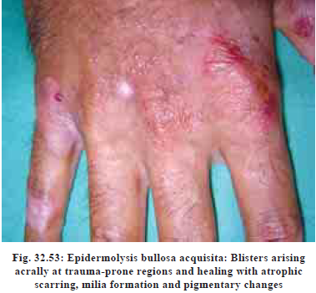

Slide 63
Mucosal lesions, particularly oral and conjunctival, with subsequent scarring are common. However, patients with predominant mucosal involvement should be regarded as having mucous membrane pemphigoid.
About 15% of patients initially present with a generalized bullous pemphigoid-like eruption of itchy papules, urticarial plaques, and large tense bullae on erythematous bases that heal without scarring.
The clinical picture may slowly change so that skin fragility, milia and scarring develop later.
EBA has been associated with other diseases, most commonly SLE and inflammatory bowel disease. The association of EBA with the HLA-DR2 haplotype, which is also associated with autoimmune disorders, may partially explain this.

Slide 64
Histopathology
Skin biopsy specimens reveal subepidermal blisters with an infiltrate that is minimal in the typical case and dense (usually lymphocytic) in those with inflammatory lesions.
In some neutrophils predominate and can form papillary dermal microabscesses that can be confused with dermatitis herpetiformis and linear IgA bullous dermatosis.
In others, eosinophils are prominent, resembling bullous pemphigoid.

Slide 65
Immunopathology
Direct immunofluorescence (DIF) of perilesional skin shows linear deposition of IgG and C3 at the BMZ as in BP, sometimes accompanied by IgM or IgA
DIF after incubating the biopsy specimen in 1 molar saline (thereby splitting the lamina lucida) shows antibodies on the dermal side, whereas in BP they are present on the epidermal side (85%) or on both sides (15%).
Salt-split skin technique is the most reliable test for differentiating these two disorders.

Slide 66
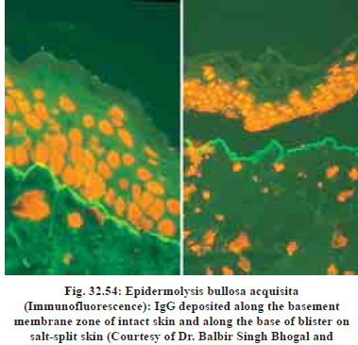

Slide 67
Salt-split skin technique
This technique was first introduced by Gammon et al. to distinguish between sAIBDs with similar DIF findings.
This technique involves artificially splitting the skin at the level of lamina lucida by incubating it in 1 M solution of sodium chloride for 24 h.
There are two types of salt-split technique (SST) - direct and indirect. Direct SST employs patient's skin biopsy specimen, either freshly obtained or the one which was initially used for routine DIF. Indirect SST uses NHS as a substrate and is usually preferred over direct SST.

Slide 68
BMZ staining in the split skin may take either a “roof” pattern (band is seen toward the epidermal side of the split) or “floor” pattern (band is seen on the dermal side of the split) or a “combined” pattern (BMZ deposits on either side of the split)
In BP, antibodies tend to bind to the “roof” in 70% of the cases and in the remaining 30% of cases it reveals “combined” pattern, whereas EBA (antibodies to type VII collagen) characteristically shows a “floor” pattern on indirect SST.
Other conditions that may also show “floor” pattern of staining of antibodies are antilaminin-332 subtype of MMP, anti-p200 pemphigoid, and bullous SLE.

Slide 69
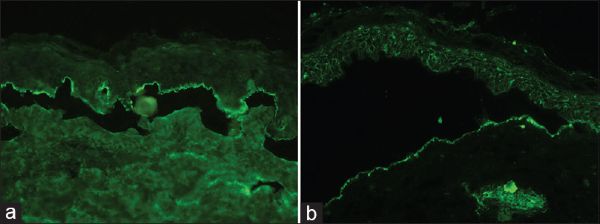
Salt-spit technique showing IgG staining on the epidermal side of the split skin in bullous pemphigoid (a) and staining with IgG on the dermal side in epidermolysis bullosa acquisita (b) (fluorescein isothiocyanate, ×200)

Slide 70
Indirect immunofluorescence (IIF) using stratified squamous epithelia reveals circulating IgG anti-BMZ antibodies in 30% to 50% of patients. Circulating IgA autoantibodies have also been reported.
However, salt-split skin is preferred as a substrate because the results are positive in 85% of patients. Fluorescence is on the blister floor, differentiating EBA from bullous pemphigoid.
IgM, IgA and complement are also sometimes found at the basement membrane zone, but only in modest amounts.

Slide 71
By immunoelectron microscopy, IgG deposits localize below the lamina densa of the basement membrane (in contrast, in BP, antibodies are found in the lamina lucida).
Electron microscopy shows that the cleavage is either within the lamina lucida (usually associated with a dense dermal inflammatory cell infiltrate) or below the lamina densa (usually correlating with minimal clinical or histological inflammation).

Slide 72
Diagnostic criteria include:
(a) cutaneous lesions consisting of blisters, erosions, milia and scars in trauma-prone sites,
(b) Onset in adult life,
(c) histology showing a subepidermal blister,
(d) absence of a family history of bullous disorders,
(e) Linear deposition of IgG and C3 at the dermoepidermal junction on DIF, and
(f) exclusion of all other blistering disorders.
Other criteria are binding of antibodies to the dermal side of salt-split skin on IIF or demonstration of antibodies to type VII collagen by Western blot, enzyme-linked immunosorbent assay, or immunoelectron microscopy.

Slide 73
Differential Diagnosis
Includes bullous pemphigoid, cicatricial pemphigoid, dystrophic epidermolysis bullosa (in children), linear IgA disease, dermatitis herpetiformis, porphyria cutanea tarda and bullous systemic lupus erythematous.

Slide 74
Course and Prognosis
EBA is usually a chronic protracted disease with periods of partial remissions and exacerbations. It rarely, if ever, spontaneously remits, but patients with a BP-like picture may go into remission.

Slide 75
Course and Prognosis
EBA is notoriously difficult to treat, but the inflammatory type is more amenable to treatment than the noninflammatory mechanobullous variety.
A combination of prednisolone (0.4–1.5 mg/kg per day) and dapsone is probably the best first line of treatment, particularly in children.
A prolonged clinical remission is unlikely and significant side effects are likely with a combination of high dose prednisolone and immuno-suppressives like azathioprine.
In patients with very limited or mild disease, a trial of colchicine (0.6–1.5 mg/d) for 4 to 6 months may be useful.

Slide 76
High-dose intravenous immunoglobulin therapy may be the agent of choice in patients with widespread disease, especially with mucosal involvement.
However, it is expensive and its potential to maintain remission is yet to be established.
Although some patients respond to cyclosporine and a remission may persist even after its discontinuation, the drug’s serious side effects and multiple drug interactions must be carefully weighed against any potential benefits.
There are also isolated reports on the benefit of mycophenolate mofetil, daclizumab, basiliximab, and rituximab.

Slide 77
1090

Slide 78
THANK YOU

