Slide 1
Haemothorax,
Empyema,
Hydropneumothorax
Dr Stani Ajay
Associate Professor
Dept of Respiratory Medicine

Slide 2
Hemothorax
“ the collection of blood between the visceral and parietal pleura…”

Slide 3
Hemothorax
Causes of a Spontaneous Hemothorax
  Pulmonary: bullous emphysema, PE, infarction, AVM’s
  Pleural: torn adhesions, endometriosis
  Neoplastic: primary, metastatic (melanoma)
  Blood Dyscrasias: thrombocytopenia, hemophilia, anticoagulation
  Thoracic Pathology: ruptured aorta, dissection
  Abdominal Pathology: pancreatic pseudocyst, hemoperitoneum

Slide 4
Hemothorax
The physiological Process
the accumulation of pleural blood forms a stable clot
overall ventilation & oxygenation becomes impaired
    mechanical compression of the lung parenchyma
    mediastinal shift
    flattening of the hemidiaphragm

Slide 5
Hemothorax
The Pathophysiologic Process
over time, the clot is partially-absorbed, leaving behind loculated fluid and fibrinous septations
macro-fibrin deposition begins to provide a structural framework
this “peel” slowly contracts to entrap the underlying lung

Slide 6
Hemothorax
Goal of Treatment
to remove the pleural blood
and allow for
complete lung re-expansion

Slide 7
General Management Options
  thoracentesis: bedside / ultrasound-guided / C.T.-guided
  thoracostomy drainage: with icd the mainstay
  thorascopic surgery: less than 2 wks.
  thoracotomy: massive hemothorax / instability / chronic hemothorax
  local fibrinolytic therapy: urokinase (1000 IU/ml) in 150cc solution

Slide 8
Hemothorax
Questions ?

Slide 9
What is an Empyema ?

Slide 10
Empyema Thoracis
An Accumulation of Pus in the Pleural Cavity

Slide 11
The Stages of Empyema
Stage I - “Exudative”
    sterile pleural fluid develops secondary to inflammation without fusion of the pleura
Stage II - “Fibrinopurulent”
    a fibrinous peel develops on both pleural surfaces limiting lung expansion
Stage III - “Organizing”
    in-growth of capillaries & fibroblasts into the fibrinous peel

Slide 12
Causes
in connection with pleural effussions,pneumonia, chest wounds, chest surgery, lung abscess, or a ruptured esophagus.
number of different organisms, including bacteria, fungi, and amebas
Streptococcus pneumoniae, Hemophilus influenzae, and Staphylococcus aureus
S. aureus is the most common cause in all age groups, accounting for 90% of cases

Slide 13
Bacteriological data.
Streptococcus pneumoniae: 15-20%
      Increased resistance
Staphylococcus:15-30%
Streptococcus spp
Gram Negative: 20-50%
      Klebsiella, Enterobacter, Pseudomonas, Hemophilus, E.Coli
Anaerobes:
      Fusobacterium, Bacteroides fragilis

Slide 14
Symptoms:
vary somewhat according to the location of the infection and its severity.
symptoms of pneumonia- including fever,
fatigue,
cough(+/- sputum),
shortness of breath and chest pain.
In severe cases - dehydrated,
cough up blood, greenish–brown sputum,
or run a fever as high as 105F,
or fall into a coma
Signs:
Decreased respiratory movements/breath sounds
Decreased TVF/VR
Tenderness
Dull note on percussion

Slide 15
Diagnosis
Clinical Examination
On an X-ray, empyema thoracis will appear as a cloudy or opaque area
Needle aspiration
USG guided
HRCT Thorax

Slide 16
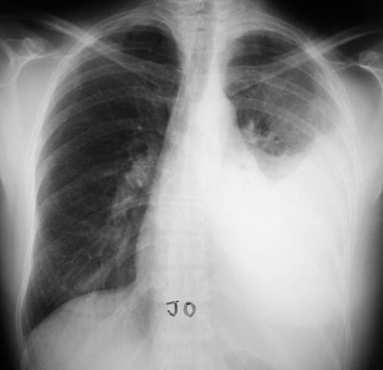
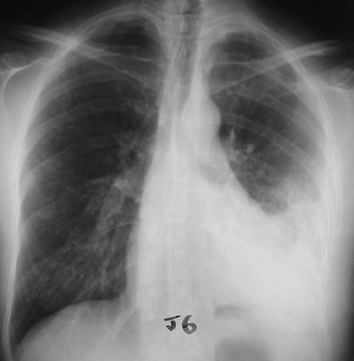

Slide 17
Primary treatment options
Antibiotics alone;
Recurrent thoracocentesis
Insertion of chest drain alone or in combination with fibrinolytics
VATS
Open decortication

Slide 18
Treatment
Combination of medications and surgical techniques
Medication involves intravenously administering a two-week course of antibiotics.
It is important to give antibiotics as soon as possible to prevent first-stage empyema from processing to its later stage.
The antibiotics most commonly used are penicillin and vancomycin.

Slide 19
Thoracocentesis
Big caliber and wide bore needle
Mostly diagnosis technique
Therapeutically used if the liquid remains fluid
Theoretically allows pleural lavage

Slide 20
Thoracentesis
Thoracentesis is a procedure that the patient is given a local anesthetic, a needle is inserted into the pleural cavity through the back between the ribs on the infected side, and a sample of fluid is withdrawn.
If the patient has empyema, there will be leukocytosis, a high level of protein, and a very low level of blood sugar.

Slide 21
Surgical Treatment
Surgical treatment of empyema has two goals: drainage of the infected fluid and closing up of the space left in the pleural cavity.
In second-stage empyema, insert a chest tube or remove part of a rib (rib resection).
In third-stage empyema, the surgeon may cut or peel away the thick fibrous layer coating the lung, a procedure which is called decortication.
The doctor may use video-assisted thoracic surgery (VATS) techniques to position the chest tube or to perform a limited decortication.

Slide 22
Thoracic Surgery
VATS is a minimally invasive surgical technique that uses a thoracoscope to allow the surgeon to view the chest cavity.
A lung is collapsed and 3-4 small or access ports, are made to facilitate insertion of the thoracoscope and surgical instruments.
When the surgical procedure is complete, the surgeon expands the lung and inserts a chest tube in one of the incision sites.

Slide 23
Chest Tube
As soon as the liquid is thick
Localization
    free: axillary
    loculated: Chest imaging using ultrasonography and/or computed tomography
Size: 20 à 24
Bedside

Slide 24
Intrapleural fibrinolytic therapy for treatment of adult para pneumonic effusions and empyemas: a systematic review and meta-analysis.
Chest. 2012 Aug;142(2):401-11.
.
Janda S, Swiston J. | Oxford Centre for Evidence-Based Medicine 2011 Levels of Evidence Level 1 Evidence | a systematic review and meta-analysis of all randomized controlled trials to date comparing fibrinolytics with placebo to clarify their current role in the management of parapneumonic effusions and empyemas | This meta-analysis does reveal that fibrinolytic therapy is potentially beneficial in the management of parapneumonic effusions and empyemas in the adult population.

Slide 25
Thoracocentesis
Clear liquid
Not clear or purulent effusion
pH>7.20
pH<7.20
Not loculated
Loculated
No intervention
Reccurent thoracocentesis
Drainage
Pleural lavage
Fibrinolytics 24-48h
Drainage
Fibrinolytics
Pleural lavage
VATS
Drainage
Pleural lavage
Failure
VATS
Surgery
Failure
Surgery

Slide 26

Questions?

Slide 27
MCQ
1.Exudative pleural effusion is characterized by:
Protein content > 3 g/100 ml
WBC > 5000/mm3
Pleural to serum LDH ratio > 0.6
LDH > 1/3 of serum LDH level
PH < 7.3
2.Abrams needle is used for.
A. Pleural biopsy
B. Renal biopsy
C. Liver biopsy
D. Peritonial biopsy
3. All of the following respiratory diseases can produce acute dyspnea at rest except
A. Acute sever asthma
B. Pneumonia
C. Lobar collapse
D. Mild pleural effusion
E. Pneumothorax

Slide 28
4) What is the most appropriate intial step in management of patient with empyema?
Clindamycin
Parentralpencillin
Surgical drainage
Surgical drainage and clindamycin
Surgical drainage and pencillin
5) Whichis most common organism causing empyema?
Fusobacterium nucleatum
Beta-hemolytic streptococci
Pseudomonas aeroginosa
Candida albicans

Slide 29
6) In patient with a persistent infected air spaces after empyema removal, the best treatment is?
Prolonged antibiotics
Muscles transposition
Thoracoplasty
Pneumonectomy
7) In a very ill patient who is not a surgical candidate, the best means of treating empyema is ?
Thoracostomy
VATs
Rib resection
Antibiotics

Slide 30
8) Which fibrinolytic agent used to treat empyema can sometime cause a allergic reaction?
Urokinase
Unfractionated heparin
Streptokinase
LMWH

Slide 31
HYDROPNEUMOTHORAX
9) All of the following finding is auscultated in hydropneumothorax except?
Succussion splash
Decreased breath sound
Crepitation
Wheeze
10) treatment of choice of hydropneumothorax?
Thoracocentesis
Tube thoracstomy
Antibiotics
Antibiotic and tube thoracostomy

Slide 32
11) Which type of breath sound is heard in hydropneumothorax?
a)Tubular bronchial breathing
b)Cavernous bronchial breathing
c)Amphoric breathing
d)Bronchovesicular breathing
12) Bronchopleural fistula is seen in which of the following condition?
a)Pleural effusion
b)Hydropneumothorax
c)Lung abscess
d)Bronchiectasis
1) a,c (2) a (3) c (4)d (5)a (6)b (7)c (8)c (9) d (10) b (11) c (12)b

